Slide 1

CSE 439 Machine Vision
Lecture 01
Introduction, Image Attributes &
Image Formation (Beginning)
Md. Jahin Alam [MJA]
Lecturer, CSE, BracU

Slide 2
Why Machine Vision?
Environmental Understanding:
Vision enables machines to perceive and comprehend their surroundings.
Essential for autonomous navigation and obstacle detection.
Object Recognition:
Machine vision allows for object identification and classification.
Examples include Detection, Tracking, and Segmentation.
Human-Computer Interaction:
Vision systems interpret gestures and body language.
Enhances natural and immersive user interfaces.
Data Acquisition & Analysis:
Vision gathers rich data for analysis.
Useful in healthcare, agriculture, and security applications.

Slide 3
Expectations: Math or Memorizing?
Obviously Math
Tons of Visualization
Real-world implications
Have to think like a camera/an imaging device
And, expect a surprise in this course!
It’s not going to be easy. Most of your reading material is being made from MIT and Stanford resources.

Slide 4
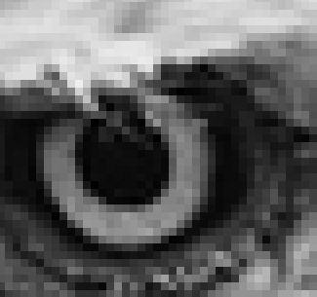
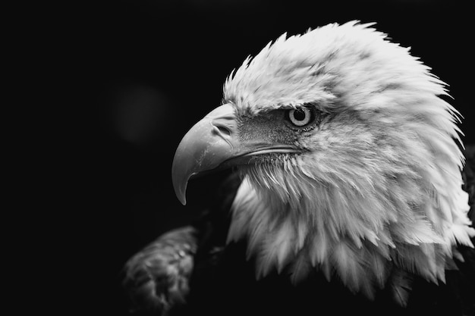
How to start?
(0,0)
X
(512, 0)
Image
A 2D Signal
Axes: X and Y
Origin Starts from Top-Left
We can see individual Pixels
(341 x 512)
Y
(0, 341)
(512, 341)

Slide 5
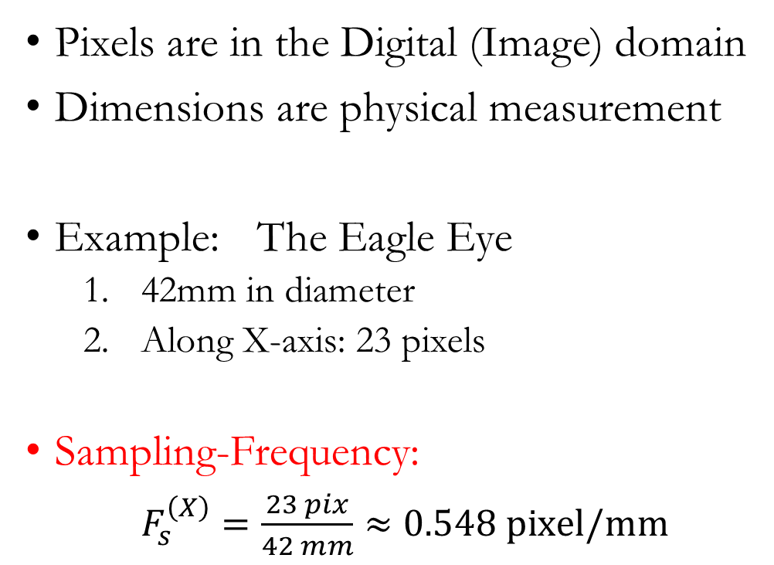
Pixels and Dimensions
Pixels are in the Digital (Image) domain
Dimensions are physical measurement
Example: The Eagle Eye
42mm in diameter
Along X-axis: 23 pixels
Sampling-Frequency:
$F_{s}^{\left(X\right)}=\frac{23 pix}{42 mm}≈0.548 pixel/mm$

Slide 6
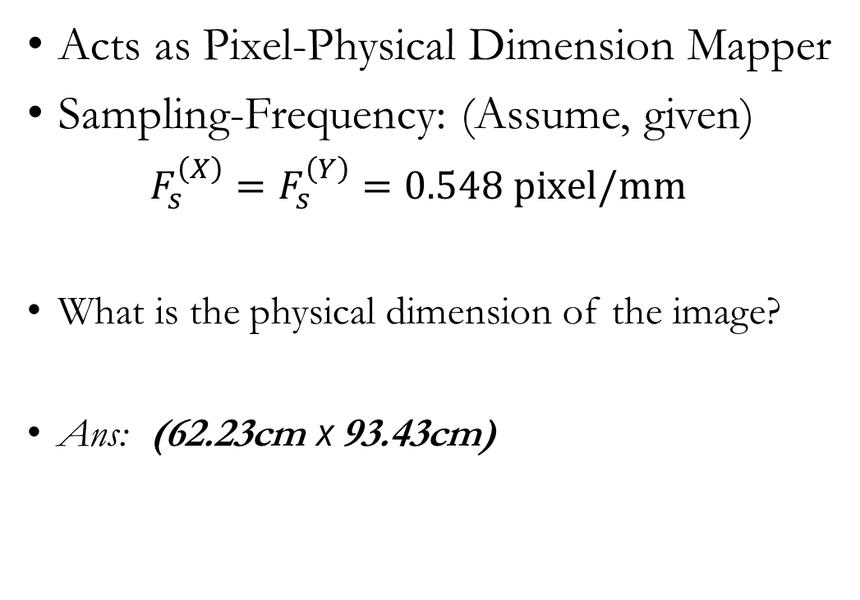
Spatial Sampling Frequency
Acts as Pixel-Physical Dimension Mapper
Sampling-Frequency: (Assume, given)
$F_{s}^{\left(X\right)}=F_{s}^{\left(Y\right)}=0.548 pixel/mm$
What is the physical dimension of the image?
Ans: (62.23cm x 93.43cm)
(341 x 512)
Y
axis
X
axis

Slide 7
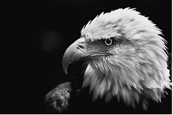


Down sample
Original vs 50% down-sampled image
(341 x 512)
(170 x 256)
$F_{s}^{\left(X\right)}=F_{s}^{\left(Y\right)}=0.548 pixel/mm$
$F_{s}^{\left(X\right)}=F_{s}^{\left(Y\right)}=0.548∗0.5=0.274 pixel/mm$

Slide 8
Inverse Graphics
Imaging
Device
Image
Content
Machine Vision
A World
Description
World
Machine Vision uses the following concepts:
Geometry
Vectors
Trigonometry
Calculus
Image Processing
Optimization
Graphics
Inverse
Graphics

Slide 9
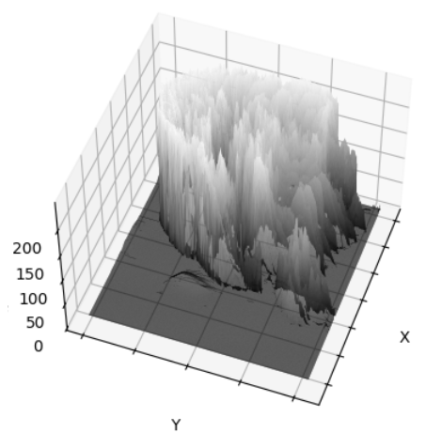
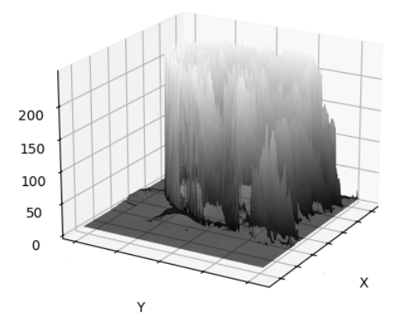
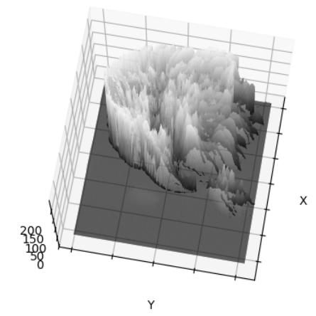
Image Processing: First and Foremost
: Intensity/Brightness
What do we ‘see’/‘perceive’?
X
Y

Slide 10
Image Processing: First and Foremost
Code for Intensity Map:
import cv2
import numpy as np
import matplotlib.pyplot as plt
image = cv2.imread('C:/Users/User/Desktop/1.png')[:,:,0:1]
x, y = np.meshgrid(np.arange(image.shape[1]), np.arange(image.shape[0]))
# Flatten the X, Y, and image arrays
x_flat = np.flip(x.flatten())
y_flat = y.flatten()
z_flat = image.flatten()
fig = plt.figure()
ax = fig.add_subplot(111, projection='3d')
# Plot the surface mesh
surf = ax.plot_trisurf(x_flat, y_flat, z_flat, cmap='gray')
# Customize the plot
ax.set_xlabel('X')
ax.set_ylabel('Y')
ax.set_zlabel('Intensity')
ax.view_init(elev=75, azim=10) #change as you like
# Display the plot interactively
plt.show()
# Keep the plot open (optional)
plt.show(block=True)
X
Y

Slide 11






Image Formation
Before moving to ‘Image Processing’, we need to ‘Form’ the image.
$$X$$
$$f$$
P
$$x$$
$$Z$$
P’
$$\frac{x}{f}=\frac{X}{Z}$$
$$\frac{y}{f}=\frac{Y}{Z}$$
Perspective Projection :
Pin-hole Model

Slide 12




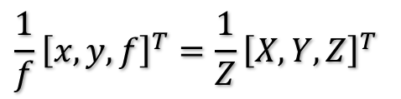









Image Formation
$\underline{z}$ (small z vector): unit vector along z-axis
Perspective Projection :
$$X$$
$$f$$
$$\frac{x}{f}=\frac{X}{Z}$$
$$\frac{y}{f}=\frac{Y}{Z}$$
$$x$$
$$Z$$
$$\frac{1}{f}{\left[x,y,f\right]}^{T}=\frac{1}{Z}{\left[X,Y,Z\right]}^{T}$$
$$X$$
$$x$$
$$⇒\frac{1}{f}\underline{r}=\frac{1}{Z}\underline{R}$$
$$f$$
$$\frac{1}{f}\underline{r}=\frac{1}{\underline{R}.\underline{z}}\underline{R}$$
$$⇒ \frac{1}{f}\underline{r}=\frac{1}{\underline{R}.\underline{z}}\underline{R}$$
$$Z$$

Slide 13
Expectations: Math or Memorizing? (Recap)
Obviously Math
Tons of Visualization
Real-world implications
Have to think like a camera/an imaging device
And, expect a surprise in this course!
It’s not going to be easy. Most of your reading material is being made from MIT and Stanford resources.
→ Machine Vision is purely Applicational
→ There will be a Project

Slide 14
Thank You

