Slide 1

CSE 439 Machine Vision
Lecture 02
Image Formation, Image Motion,
Brightness Changes
Md. Jahin Alam [MJA]
Lecturer, CSE, BracU

Slide 2







Previous Class
Object in
Environment
Perspective Projection :
Projection
Pin-Hole
$$\frac{x}{f}=\frac{X}{Z}$$
$$\frac{y}{f}=\frac{Y}{Z}$$
Scalar Form
$$X$$
$$x$$
$$f$$
$$\frac{1}{f}\underline{r}=\frac{1}{\underline{R}.\underline{z}}\underline{R}$$
Vector General Form
$$Z$$
$\underline{z}$ (small z vector): unit vector along z-axis

Slide 3





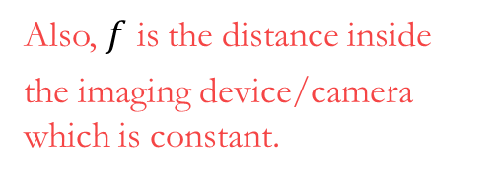











Motion in Image
Derivative, $\frac{d}{dt}\left(.\right)$
How to compute motion/velocity? :
First, we find motion in the Scalar Format
$$X$$
$$x$$
$$\frac{1}{f}.\frac{dx}{dt}=\frac{1}{Z}.\frac{dX}{dt}−\frac{X}{Z^{2}}.\frac{dZ}{dt}$$
$$f$$
$$⇒$$
$$\frac{x}{f}=\frac{X}{Z}$$
$$\frac{1}{f}.u=\frac{1}{Z}.U −\frac{X}{Z^{2}}.W$$
$$Z$$
$$⇒$$
In general:
$$\frac{d}{dt}\left(\frac{a}{b}\right)=\frac{1}{b}.\frac{da}{dt}−\frac{a}{b^{2}}.\frac{db}{dt}$$
$$\frac{1}{f}.\frac{dy}{dt}=\frac{1}{Z}.\frac{dY}{dt}−\frac{Y}{Z^{2}}.\frac{dZ}{dt}$$
$$⇒$$
$$\frac{y}{f}=\frac{Y}{Z}$$
Also, $f$ is the distance inside
the imaging device/camera which is constant.
$$\frac{1}{f}.v=\frac{1}{Z}.V −\frac{Y}{Z^{2}}.W$$
$$⇒$$

Slide 4










Motion in Image
$$=\frac{1}{Z}\left(U −\frac{X}{Z}.W\right)$$
$$\frac{1}{f}.u=\frac{1}{Z}.U −\frac{X}{Z^{2}}.W$$
$$⇒$$
$$\frac{x}{f}=\frac{X}{Z}$$
$$⇒ \frac{1}{f}.u=\frac{1}{Z}\left(U −\frac{x}{f}.W\right)$$
$$x$$
$$X$$
$$f$$
$$=\frac{1}{Z}\left(V −\frac{Y}{Z}.W\right)$$
$$Z$$
$$\frac{1}{f}.v=\frac{1}{Z}.V −\frac{Y}{Z^{2}}.W$$
$$\frac{y}{f}=\frac{Y}{Z}$$
$$⇒$$
$$⇒ \frac{1}{f}.v=\frac{1}{Z}\left(V −\frac{y}{f}.W\right)$$

Slide 5


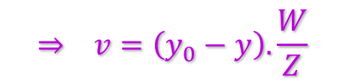

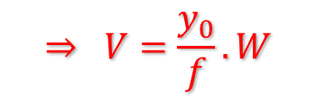

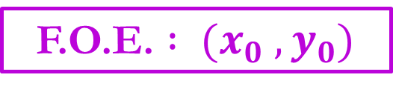


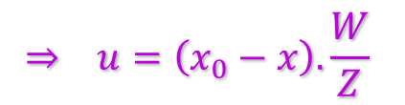

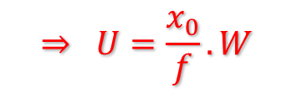
Focus of Expansion (F.O.E.)
$$⇒ \frac{1}{f}.u=\frac{1}{Z}\left(U −\frac{x}{f}.W\right)$$
$$⇒ u=\left(x_{0}−x\right).\frac{W}{Z}$$
$$\frac{x}{f}=\frac{X}{Z}$$
$$=0$$
$$x$$
$$X$$
$$⇒ \frac{x}{f}=\frac{U}{W}$$
$$⇒ \frac{x_{0}}{f}=\frac{U}{W}$$
$$⇒ U=\frac{x_{0}}{f}.W$$
$$f$$
$$Z$$
$$⇒ \frac{1}{f}.v=\frac{1}{Z}\left(V −\frac{y}{f}.W\right)$$
$$⇒ v=\left(y_{0}−y\right).\frac{W}{Z}$$
$$\frac{y}{f}=\frac{Y}{Z}$$
$$=0$$
$$⇒ \frac{y}{f}=\frac{V}{W}$$
$$⇒ \frac{y_{0}}{f}=\frac{V}{W}$$
$$⇒ V=\frac{y_{0}}{f}.W$$
F.O.E. $: (x_{0} , y_{0})$

Slide 6
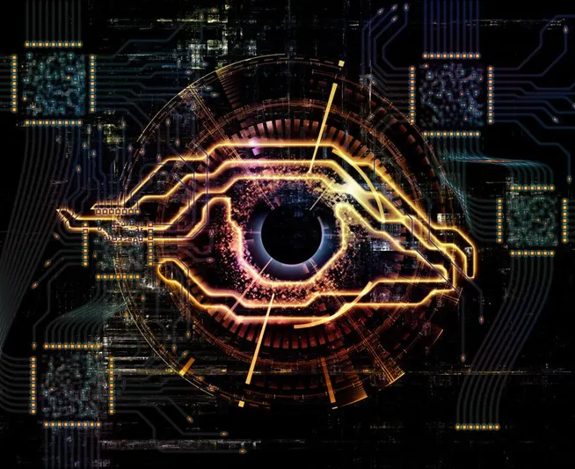











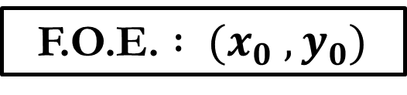


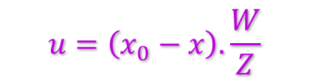


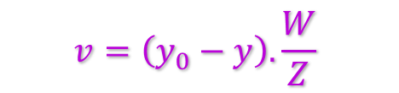

Focus of Expansion (F.O.E.)
$$x$$
$$X$$
$$f$$
$$u=\left(x_{0}−x\right).\frac{W}{Z}$$
F.O.E. $: (x_{0} , y_{0})$
$$Z$$
$$U=\frac{x_{0}}{f}.W$$
$Z=$ Object to Pin-hole
$f=$ Image to Pin-hole
$$y$$
$W=$ Camera/Object Velocity along z-axis
$$v=\left(y_{0}−y\right).\frac{W}{Z}$$
$U=$ Camera/Object Velocity along x-axis
$$V=\frac{y_{0}}{f}.W$$
$V=$ Camera/Object Velocity along y-axis
$u=$ Image Velocity along x-axis
$$x$$
$v=$ Image Velocity along y-axis
camera
$$z$$

Slide 7
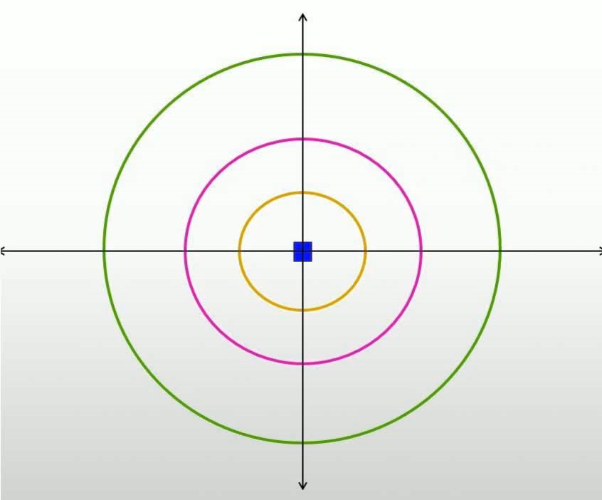
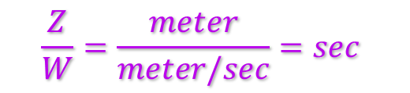
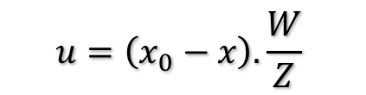
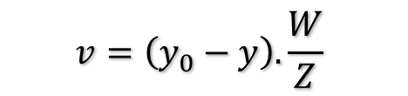
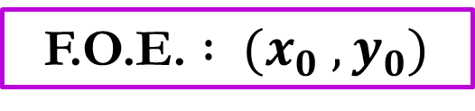
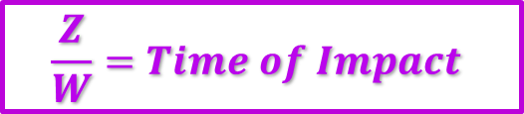
Focus of Expansion (F.O.E.)
F.O.E. $: (x_{0} , y_{0})$
$$u=\left(x_{0}−x\right).\frac{W}{Z}$$
$$v=\left(y_{0}−y\right).\frac{W}{Z}$$
$$\frac{Z}{W}=\frac{meter}{meter/sec}=sec$$
$$\frac{Z}{W}=Time of Impact$$

Slide 8


Focus of Expansion (F.O.E.)
image
image
$$\left(x_{0} , y_{0}\right)=\left(128,128\right)$$
$$\left(x_{0} , y_{0}\right)=\left(138,114\right)$$

Slide 9
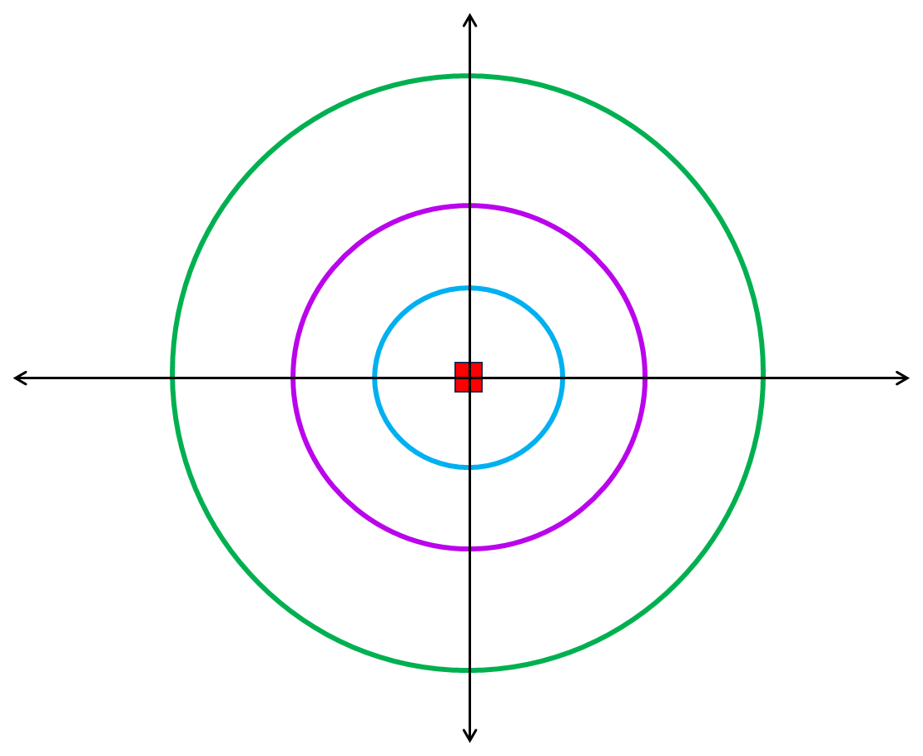
Code
import cv2
import numpy as np
import matplotlib.pyplot as plt
from skimage.transform import resize
delta = 2
video_frames = 100
image = cv2.imread('C:/Users/User/Desktop/Capture1.jpg')
image = cv2.cvtColor(image, cv2.COLOR_BGR2RGB)
video_ = np.zeros((image.shape[0],
image.shape[1],
image.shape[2],
video_frames))
plt.imshow(image)
for i in range(video_frames):
if delta*i*2>=image.shape[0] or delta*i*2>=image.shape[1]:
print(i)
break
im_temp = image[delta*i:-1-delta*i,delta*i:-1-delta*i,:]
im_temp = resize(im_temp, (image.shape[0], image.shape[1]))
video_[:,:,:,i] = im_temp
Next Save ‘video_’ as an mp4/avi

Slide 10
Thank You

