Slide 1

CSE 439 Machine Vision
Lecture 03
Mathematical Problems & Brightness Gradient (Beginning)
Md. Jahin Alam [MJA]
Lecturer, CSE, BracU

Slide 2







Recap: Perspective Projection
$$\frac{x}{f}=\frac{X}{Z}$$
$$\frac{y}{f}=\frac{Y}{Z}$$
Scalar Form
$$X$$
$$x$$
$$f$$
$$\frac{1}{f}\underline{r}=\frac{1}{\underline{R}.\underline{z}}\underline{R}$$
Vector General Form
$$Z$$
$\underline{z}$ (small z vector): unit vector along z-axis

Slide 3
Problems
Problem-1: The two diagonal corners of a square sheet are located at the coordinates (0, 0, 4) and (8, 8, 4). A pinhole camera captures the sheet and produces an image with the diagonals at (0, 0, 0.5) and (1, 1, 0.5). The camera has a spatial sampling freq. of 2 pixel/mm. [The coordinates are in ‘cm’]
(i) What is the camera size?
(ii) What percentage was the sheet shrunk to?
(iii) How many pixels will take to create the image?
(iv) Suppose, the camera is moved a bit. As a result, the new image has the diagonals at the points (0, 0, 0.8) and (1.3, 1.3, 0.8). Seeing this incident, explain which point on the object would be the F.O.E.?

Slide 4




















Recap: Image Motion and F.O.E.
$$x$$
$$X$$
$$f$$
$$u=\left(x_{0}−x\right).\frac{W}{Z}$$
F.O.E. $: (x_{0} , y_{0})$
$$Z$$
$$U=\frac{x_{0}}{f}.W$$
$Z=$ Object to Pin-hole
$f=$ Image to Pin-hole
$$y$$
$W=$ Camera/Object Velocity along z-axis
$$v=\left(y_{0}−y\right).\frac{W}{Z}$$
$U=$ Camera/Object Velocity along x-axis
$$V=\frac{y_{0}}{f}.W$$
$V=$ Camera/Object Velocity along y-axis
$u=$ Image Velocity along x-axis
$$x$$
$v=$ Image Velocity along y-axis
camera
$$z$$

Slide 5
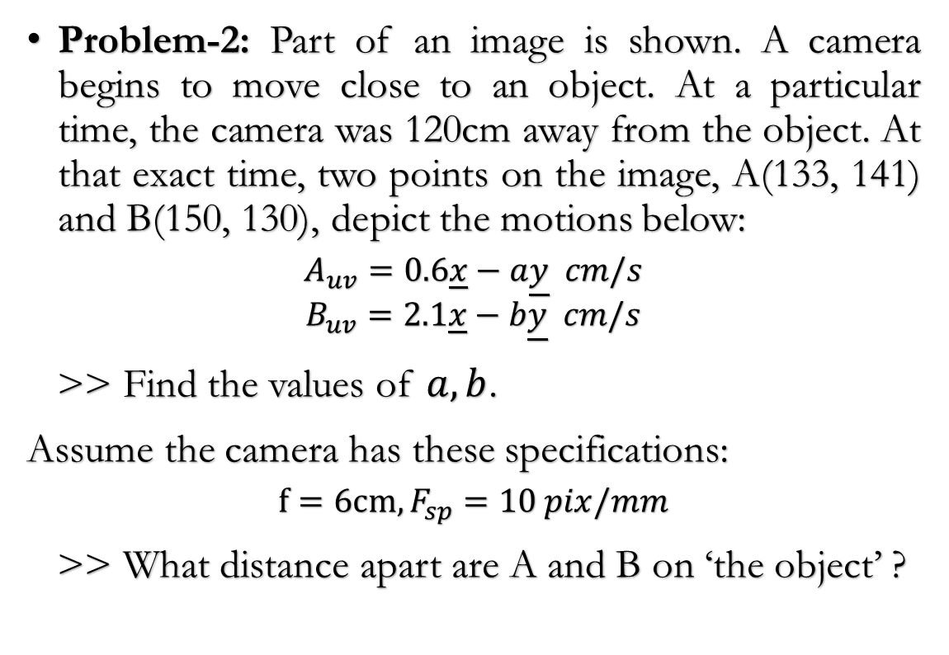

Focus of Expansion (F.O.E.)
image
Problem-2: Part of an image is shown. A camera begins to move close to an object. At a particular time, the camera was 120cm away from the object. At that exact time, two points on the image, A(133, 141) and B(150, 130), depict the motions below:
$$A_{uv}=0.6\underline{x}−a\underline{y} cm/s$$
$$B_{uv}=2.1\underline{x}−b\underline{y} cm/s$$
>> Find the values of $a, b$.
Assume the camera has these specifications:
$$f=6cm, F_{sp}=10 pix/mm$$
>> What distance apart are A and B on ‘the object’ ?
B
A
$$\left(x_{0} , y_{0}\right)=\left(130, 145\right)$$

Slide 6


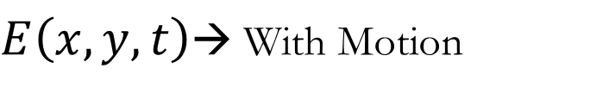



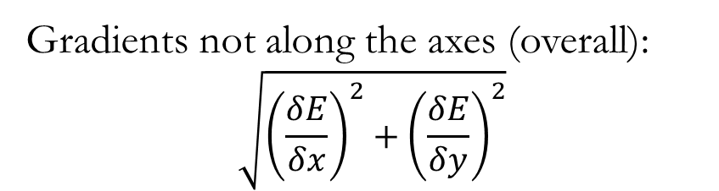

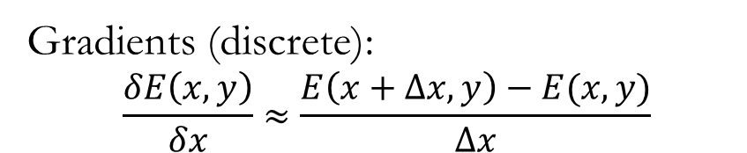







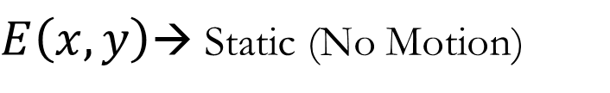
Brightness Gradient
image
$E\left(x,y,t\right)$→ With Motion
$E\left(x,y\right)$→ Static (No Motion)
$$E_{7}$$
$$E_{8}$$
$$E_{9}$$
Gradients: $\left(\frac{δE}{δx},\frac{δE}{δy}\right)$ → analogue
y
$$E_{5}$$
$$E_{6}$$
$$E_{1}$$
$$E_{2}$$
Gradients (discrete):
$$\frac{δE\left(x,y\right)}{δx}≈\frac{E\left(x+Δx,y\right)−E(x,y)}{Δx}$$
$$E_{3}$$
$$E_{4}$$
Gradients not along the axes (overall):
$$\sqrt{{\left(\frac{δE}{δx}\right)}^{2}+{\left(\frac{δE}{δy}\right)}^{2}}$$
$$E_{10}$$
$$E_{11}$$
$$E_{12}$$
x

Slide 7



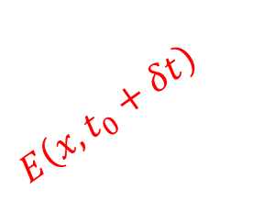
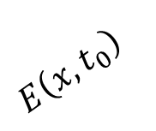
Brightness Gradient
image
$$E\left(x,t_{0}\right)$$
$$E_{7}$$
$$E_{8}$$
$$E_{9}$$
$$E\left(x,t_{0}+δt\right)$$
y
$$E_{5}$$
$$E_{6}$$
$$E_{1}$$
$$E_{2}$$
x
$$E_{3}$$
$$E_{4}$$
$$E_{10}$$
$$E_{11}$$
$$E_{12}$$
$$\frac{δE}{δx}=E_{x}$$
$$δE$$
x
$$δx$$

Slide 8


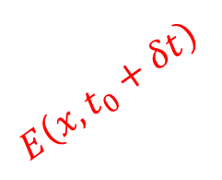


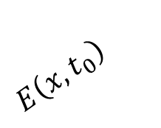

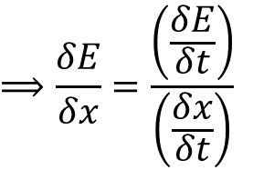





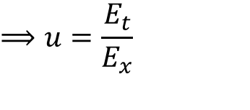

Brightness Gradient
$$\frac{δE}{δx}=E_{x}$$
$$δt$$
$$E\left(x,t_{0}\right)$$
$$E_{2}$$
$$⟹\frac{δE}{δx}=\frac{δt}{δx}.\frac{δE}{δt}$$
$$E_{1}$$
$$E\left(x,t_{0}+δt\right)$$
$$E_{3}$$
$$⟹\frac{δE}{δx}=\frac{\left(\frac{δE}{δt}\right)}{\left(\frac{δx}{δt}\right)}$$
$$⟹E_{x}=\frac{1}{u}\frac{δE}{δt}$$
x
$$δx$$
$$⟹E_{x}=\frac{1}{u}E_{t}$$
$$⟹u=\frac{E_{t}}{E_{x}}$$
$$≈\frac{\frac{1}{δt}\left(E_{3}−E_{1}\right)}{\frac{1}{δx}\left(E_{2}−E_{1}\right)}$$
$$⟹u=\frac{E_{t}}{E_{x}}$$

Slide 9
Thank You

