Slide 1

CSE 439 Machine Vision
Lecture 04
Brightness Gradient &
Edge Detection
Md. Jahin Alam [MJA]
Lecturer, CSE, BracU

Slide 2


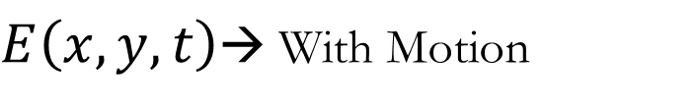



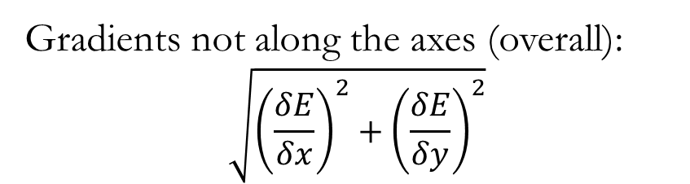

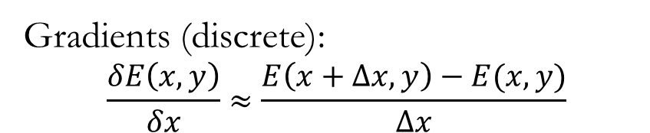



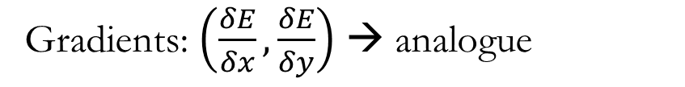



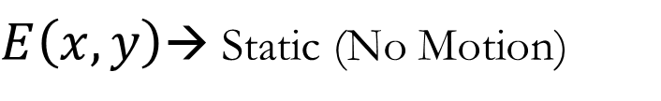
Brightness Gradient
image
$E\left(x,y,t\right)$→ With Motion
$E\left(x,y\right)$→ Static (No Motion)
$$E_{7}$$
$$E_{8}$$
$$E_{9}$$
Gradients: $\left(\frac{δE}{δx},\frac{δE}{δy}\right)$ → analogue
y
$$E_{5}$$
$$E_{6}$$
$$E_{1}$$
$$E_{2}$$
Gradients (discrete):
$$\frac{δE\left(x,y\right)}{δx}≈\frac{E\left(x+Δx,y\right)−E(x,y)}{Δx}$$
$$E_{3}$$
$$E_{4}$$
Gradients not along the axes (overall):
$$\sqrt{{\left(\frac{δE}{δx}\right)}^{2}+{\left(\frac{δE}{δy}\right)}^{2}}$$
$$E_{10}$$
$$E_{11}$$
$$E_{12}$$
x

Slide 3






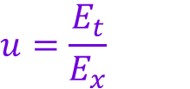




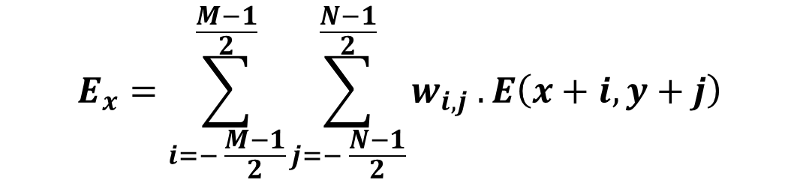
















Brightness Gradient
$$δx$$
$$Δx={δx\text{ . }F}_{sp}$$
$$u=\frac{E_{t}}{E_{x}}$$
$$E_{x}=\frac{F_{sp}}{Δx}\left(E_{4}−E_{5}\right);Δx=1 pix$$
$$w_{i,j}$$
y
What $E_{x}$is 0 or, close to 0?
$$0.1$$
$$0.05$$
$$0.1$$
$$E_{0}$$
$$E_{1}$$
$$E_{2}$$
$$E_{9}$$
Solution: An area based weighting
area-based
$$0.05$$
$$0.4$$
$$0.05$$
$$E_{3}$$
$$E_{4}$$
$$E_{5}$$
$$E_{10}$$
$$E_{6}$$
$$E_{7}$$
$$E_{8}$$
$$E_{11}$$
$$0.1$$
$$0.05$$
$$0.1$$
$$E_{x}=\sum_{i=− \frac{M−1}{2}}^{\frac{M−1}{2}}{\sum_{j=− \frac{N−1}{2}}^{\frac{N−1}{2}}{w_{i,j} .E\left(x+i, y+j\right)}}$$
x

Slide 4


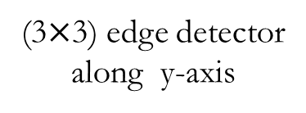

















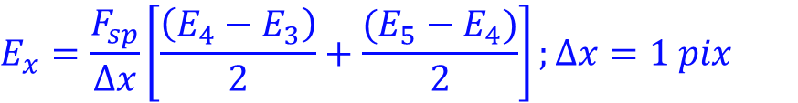



Edge Detection
$$δx$$
$$Δx={δx\text{ . }F}_{sp}$$
$$E_{x}=\frac{F_{sp}}{Δx}\left(E_{4}−E_{5}\right);Δx=1 pix$$
$$E_{x}=\frac{F_{sp}}{Δx}\left[\frac{\left(E_{4}−E_{3}\right)}{2}+\frac{(E_{5}−E_{4})}{2}\right];Δx=1 pix$$
y
$$E_{12}$$
$$E_{0}$$
$$E_{1}$$
$$E_{2}$$
$$E_{9}$$
$$E_{13}$$
$$E_{3}$$
$$E_{4}$$
$$E_{5}$$
$$E_{10}$$
$$−\frac{1}{2}$$
$$+\frac{1}{2}$$
$$−1$$
$$0$$
$$+1$$
$$0$$
$$E_{14}$$
$$E_{6}$$
$$E_{7}$$
$$E_{8}$$
$$E_{11}$$
$$.$$
$$−2$$
$$0$$
$$+2$$
$$−1$$
$$0$$
$$+1$$
$$E_{3}$$
$$E_{4}$$
$$E_{5}$$
(3$×$3) edge detector
along y-axis
x

Slide 5



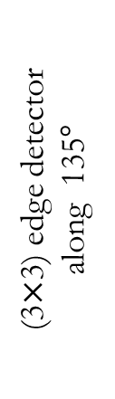
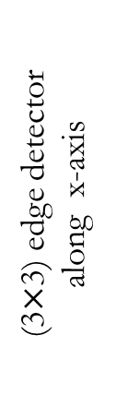


















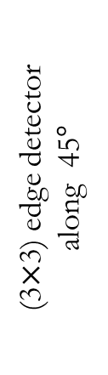





















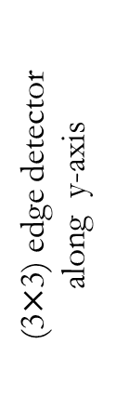


Edge Detection
$$−1$$
$$0$$
$$+1$$
$$+2$$
$$+1$$
$$0$$
$$+1$$
$$0$$
(3$×$3) edge detector
along y-axis
(3$×$3) edge detector
along 45$°$
$$+1$$
$$0$$
SOBEL Y
SOBEL 45
$$−2$$
$$0$$
$$+2$$
$$−1$$
$$0$$
$$−1$$
$$−1$$
$$0$$
$$+1$$
$$0$$
$$−1$$
$$−2$$
Roberts Cross Edge Filter
$$−1$$
$$−2$$
$$−1$$
$$0$$
$$+1$$
$$+2$$
$$0$$
$$+1$$
(3$×$3) edge detector
along x-axis
(3$×$3) edge detector
along 135$°$
$$0$$
$$0$$
$$0$$
$$−1$$
$$0$$
SOBEL 135
SOBEL X
$$+1$$
$$−1$$
$$0$$
$$+1$$
$$+2$$
$$+1$$
$$−2$$
$$−1$$
$$0$$

Slide 6








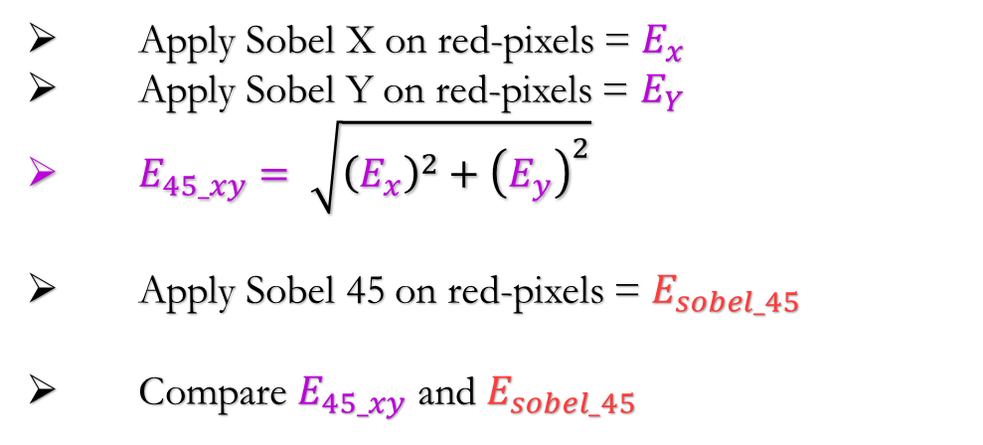















Edge Detection
Question: Compare Sobel X, Y with Sobel 45/135.
$$32$$
$$76$$
$$100$$
$$150$$
Apply Sobel X on red-pixels = $E_{x}$
Apply Sobel Y on red-pixels = $E_{Y}$
$E_{45_xy}= \sqrt{{\left(E_{x}\right)}^{2}+{\left(E_{y}\right)}^{2}}$
Apply Sobel 45 on red-pixels = $E_{sobel_45}$
Compare $E_{45_xy}$ and $E_{sobel_45}$
$$46$$
$$85$$
$$109$$
$$154$$
$$218$$
$$71$$
$$127$$
$$168$$
$$225$$
$$250$$
$$102$$
$$144$$
$$199$$
$$248$$
$$254$$
$$132$$
$$184$$
$$234$$
$$250$$
Normalize the Image first
(division by 255)

Slide 7
Thank You

