Slide 1

CSE 439 Machine Vision
Lecture 05
Morphological Image Processing: Erosion & Dilation
Md. Jahin Alam [MJA]
Lecturer, CSE, BracU

Slide 2
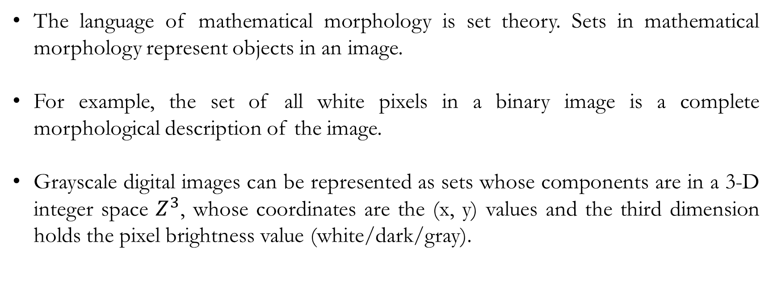
Morphological Image Processing
The language of mathematical morphology is set theory. Sets in mathematical morphology represent objects in an image.
For example, the set of all white pixels in a binary image is a complete morphological description of the image.
Grayscale digital images can be represented as sets whose components are in a 3-D integer space $Z^{3}$, whose coordinates are the (x, y) values and the third dimension holds the pixel brightness value (white/dark/gray).

Slide 3
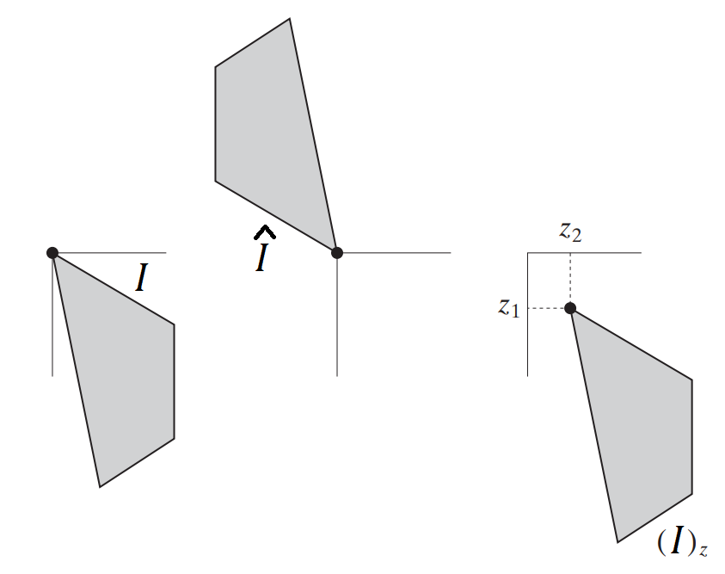
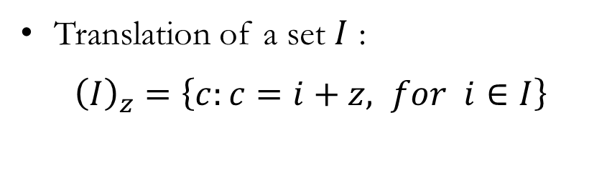
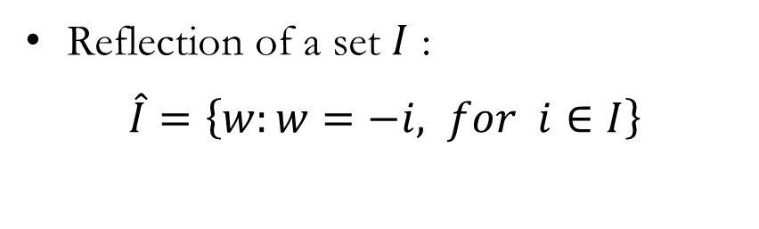
Morphological Image Processing
For example, the concepts of set reflection and translation are used extensively in morphology.
Reflection of a set $I$ :
$\hat{I}=\left\{w:w=−i, for i∈I\right\}$
Translation of a set $I$ :
${\left(I\right)}_{z}=\left\{c:c=i+z, for i∈I\right\}$

Slide 4
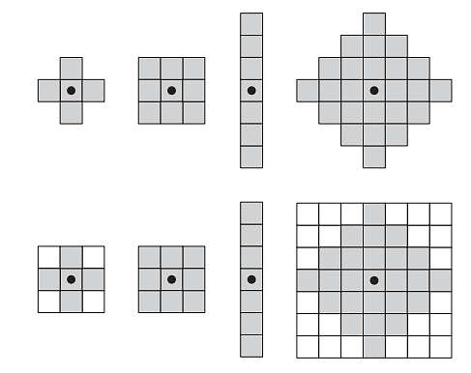
A Structuring Element
A small window (regular/irregular shape) that determines what operations we intend to do to an image set based on the center.
Some examples:

Slide 5
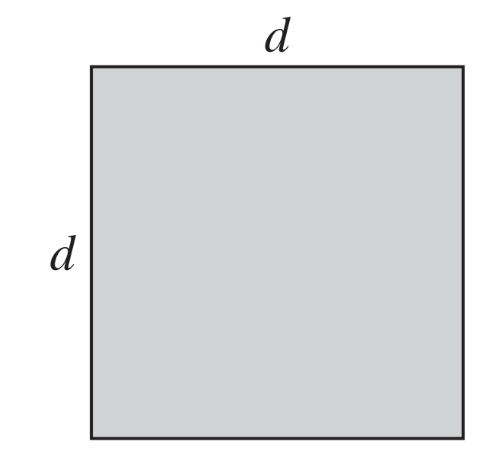
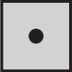
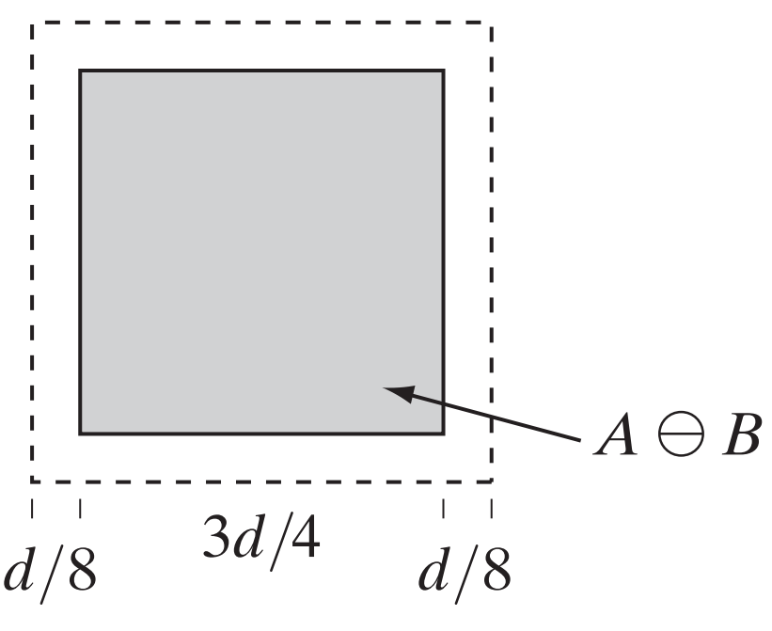

Erosion
We erode an image (remove the outside surface of an image) using the structuring element and replace with ‘0’ pixels. [A: image set, B: Structuring element]

Slide 6
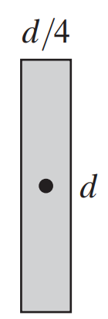
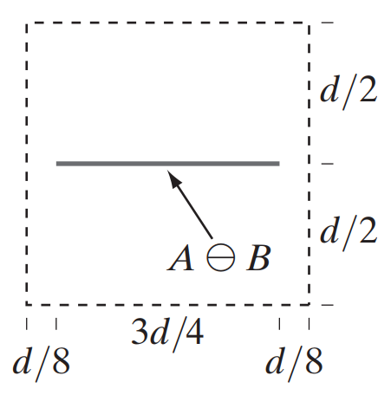
Erosion
We erode an image set (remove the outside surface of an image) using the structuring element and replace with ‘0’ pixels. [A: image set, B: Structuring element]

Slide 7
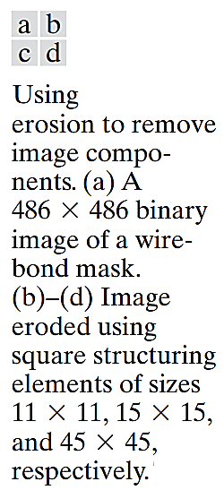
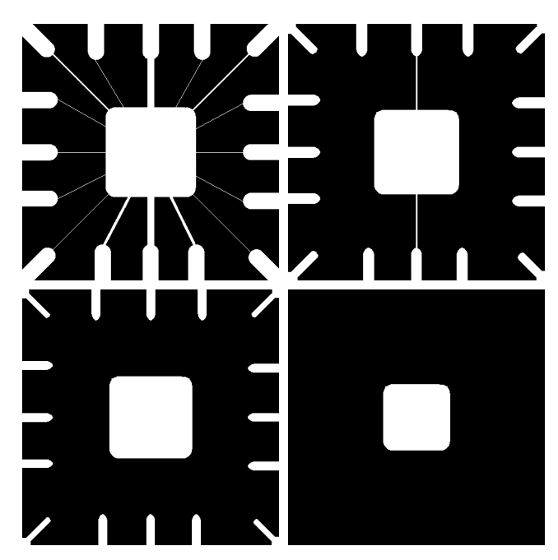
Erosion

Slide 8
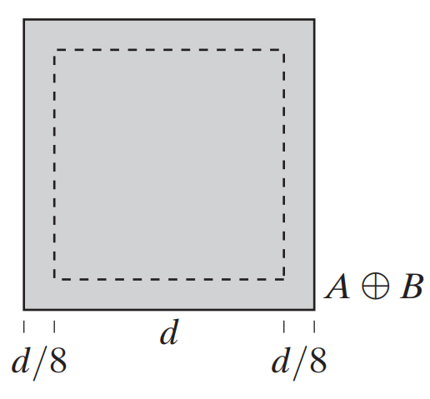
Dilation
We fill an image set (fill the outside surface of an image) using the structuring element with ‘255’ pixels. [A: image set, B: Structuring element]

Slide 9
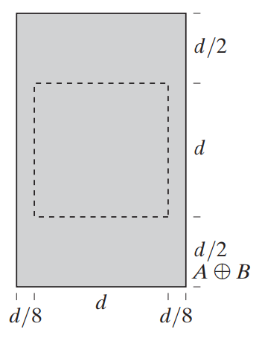

Dilation
We fill an image set (fill the outside surface of an image) using the structuring element with ‘255’ pixels. [A: image set, B: Structuring element]

Slide 10
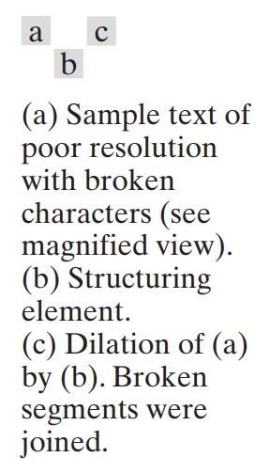
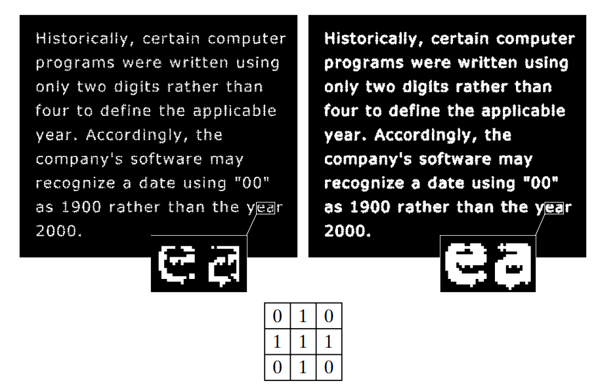
Dilation

Slide 11





Example 1: Erosion on Image
55
5
55-2*2=51
5
$$E$$
51
5
92
5
$$\frac{5−1}{2}$$
88
92-2*2=88
boundary
$$I⊖E$$
$$\frac{5−1}{2}$$
boundary
$$I$$

Slide 12


Example 2: Erosion on Image
55
55-2*4=47
47
9
92
5
92-2*2=88
88
$$E$$
$$I⊖E$$
$$I$$

Slide 13
Example 3: Erosion on Image
55
20
16
27
9
35
91
12
5
4
41
45
16
8
30
26

Slide 14


Example 4: Dilation on Image
55
$$I⊕E$$
20
24
27
9
19
92
12
5
20
41
37
16
$$E$$
24
30
34
$$I$$

Slide 15



Example 5: Dilation on Image
134
128
7
128
7
134
$$E$$
$$I$$
$$I⊕E$$

Slide 16
Code
import numpy as np
import cv2
import matplotlib.pyplot as plt
# Creating the 2D array with a checkerboard pattern
array = np.zeros((100, 64), dtype=np.uint8)
array[4:4+92, 5:5+55] = 255
array[4:4+92//2, 5:5+55//2] = 0
array[4+92//2:, 5+55//2:] = 0
# Defining the erosion and dilation kernels
# --> The kernels don't have to be filled with all 1s.
# --> The 1s can have a '+' or 'x' shape.
# --> Try to manually make the kernels.
erosion_kernel = np.ones((7, 7), dtype=np.uint8)
dilation_kernel = np.ones((7, 7), dtype=np.uint8)
# Performing erosion using OpenCV
eroded_array = cv2.erode(array, erosion_kernel)
# Performing dilation using OpenCV
dilated_array = cv2.dilate(array, dilation_kernel)
# Plotting the arrays
plt.figure(figsize=(10, 5))
plt.subplot(1, 3, 1)
plt.imshow(array, cmap='gray')
plt.title('Original Array')
plt.subplot(1, 3, 2)
plt.imshow(eroded_array, cmap='gray')
plt.title('Eroded Array')
plt.subplot(1, 3, 3)
plt.imshow(dilated_array, cmap='gray')
plt.title('Dilated Array’)
plt.show()

Slide 17
Thank You

