Slide 1


Kazi Mahathir Rahman
ID -23341066
CSE440 NATURAL LANGUAGE PROCESSING FINAL PROJECT
Pandemic Tweet Sentiment Prediction Challenge

Slide 2


ABOUT CHALLANGE
The Pandemic Tweet Challenge involves classifying tweets related to COVID-19 into five sentiment categories. Using the dataset, the task is to build an NLP model for the text classification of these tweets.
Data Explorer
Data preprocessing
Model Train
Model Evaluation

Slide 3



DATA EXPLORER
About Data
Contains 41,157 tweets
Columns: Username, ScreenName, Location, Tweet At (Date), Original Tweet, Sentiment
Feature: Original Tweets
Label: Sentiment class:
extremely positive
positive
neutral
negative
extremely negative
Data Visualization
Length distribution Histogram
WordCloud Visualization
Sentiment classes distribution

Slide 4
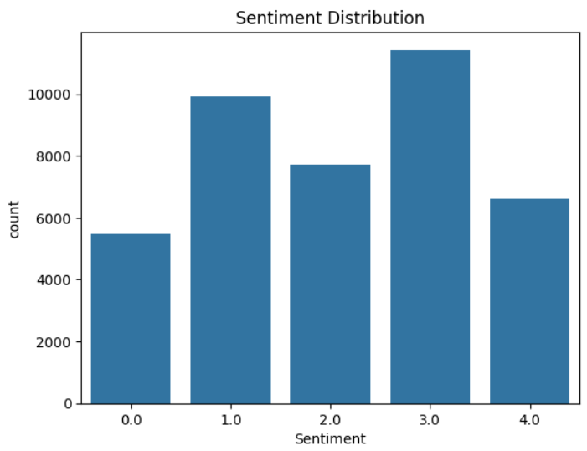
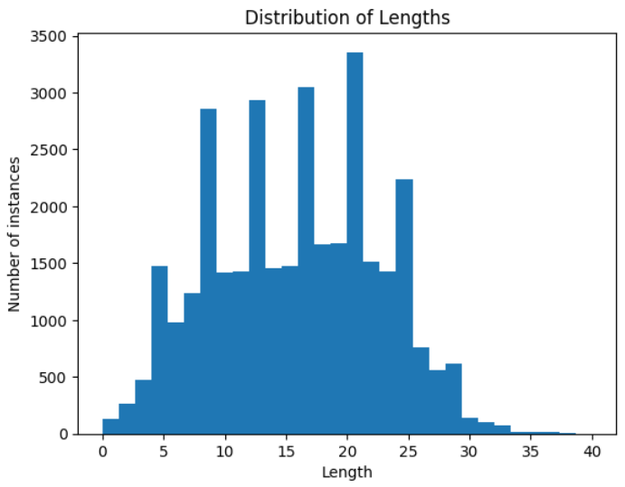

Class Distribution
Length Distribution
WordCloud graph for each class

Slide 5






DATA PREPROCESSING
Handling Missing Values
Data Cleaning
Stopword Removal
Tokenization
Word2Vec Vectorization and Padding
Data Splitting

Slide 6


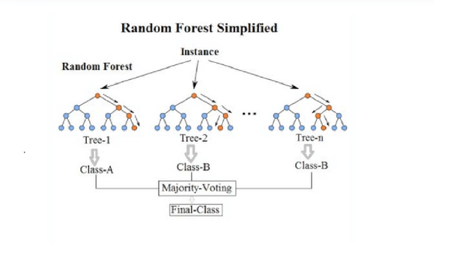
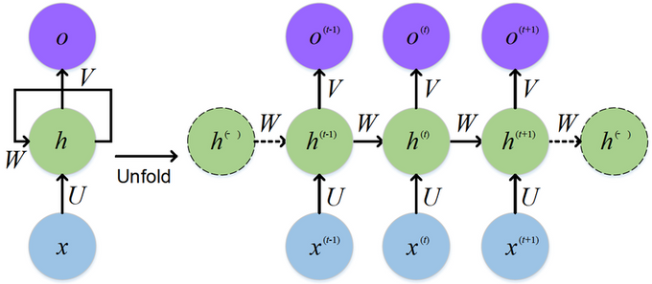
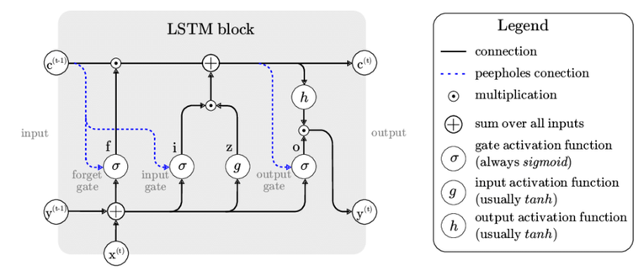
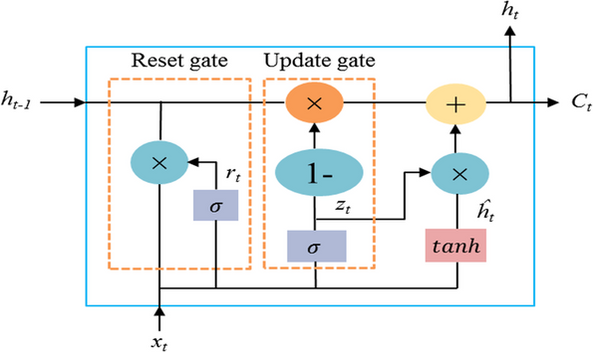
MODELTRAIN
Random Forest
RNN
LSTM
GRU

Slide 7


MODEL EVALUATION
LSTM
GRU
RF
RNN
Train loss
0.6699
0.7247
N/A
1.0199
Validation Loss
4.7586
4.2989
N/A
3.3955
Test Loss
4.7586
4.2989
N/A
3.3955
Train Accuracy
75.54%
17.63%
100%
58.15%
Validation Accuracy
16.66%
73.30%
34.66%
18.16%
Test Accuracy
16.66%
17.63%
37.61%
18.16%

Slide 8
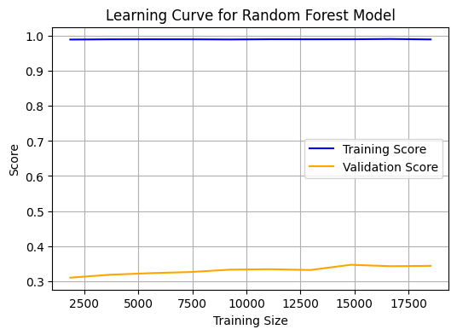
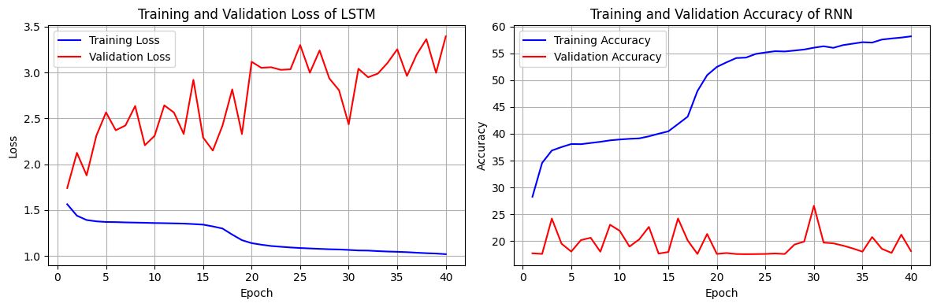
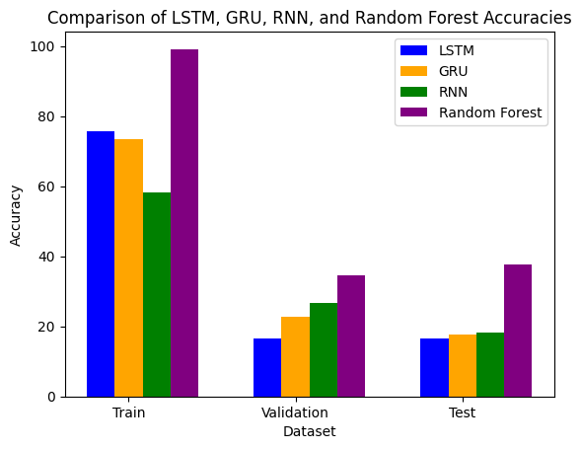
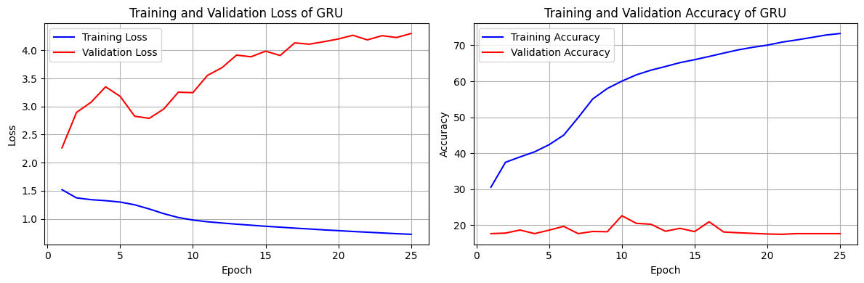
Train and validation loss of RF
Train and validation loss of RNN
Train and validation loss of LSTM
Train and validation loss of GRU
Comparison of all models

Slide 9
THANK YOU!
FOR YOUR ATTENTION

