Slide 1

Content recommendation system based on facial expression recognition using swin transformer model
Literature Review

Slide 2
Group Info-
Kazi Mahathir Rahman (23341066)
Md. Samin Rahman (21301349)
Abdullah All Jilan (24141272)
MD Farabi Tanim (21301513)

Slide 3
MAIN CONCEPTS
Why recommendation system based on facial expression?
Real-time
Fast
Less computation and preprocessing

Slide 4
Abstract Summary
Utilize Haar Cascade algorithm for real-time face detection in images or video streams, enabling efficient identification of faces
Employ Swin Transformer model for facial expression recognition, capturing global contextual information and subtle nuances in expressions
Utilize datasets such as RAF-DB or CK+ for training the Swin Transformer model on facial expression recognition tasks.
Integrate Haar Cascade algorithm for real-time face detection in the recommendation system pipeline

Slide 5
Literature Review
Some existing Techniques for FER-
ML based model
CNN/ RNN based
VGGNet based
ResNet based
Transformer based

Slide 6
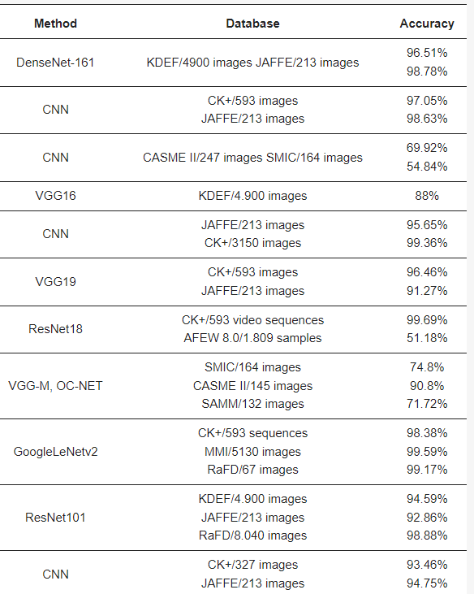
Literature Review
Some existing DL and ML model for FER and recommendation-

Slide 7
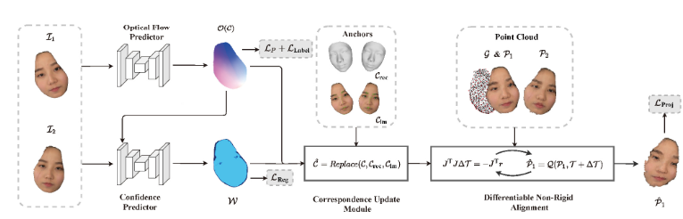
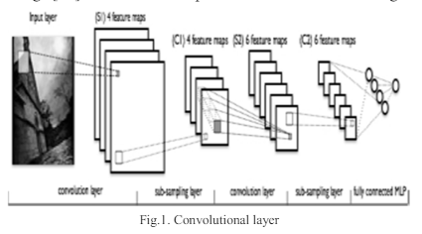
Model
Machine learning based model
Z. Peng, B. Jiang, H. Xu, W. Feng and J. Zhang, "Facial optical flow estimation via neural non-rigid registration", Computational Visual Media, vol. 9, no. 1, pp. 109-122, 2023.
S. Deebika and K.A Indira, "A machine learning based music player by detecting emotions", 2019 Fifth International Conference on Science Technology Engineering and Mathematics (ICONSTEM), vol. 1, pp. 196-200, 2019, March.
R. S. Deshmukh, V. Jagtap and S. Paygude, "Facial emotion recognition system through machine learning approach," 2017 International Conference on Intelligent Computing and Control Systems (ICICCS), Madurai, India, 2017, pp. 272-277, doi: 10.1109/ICCONS.2017.8250725.

Slide 8
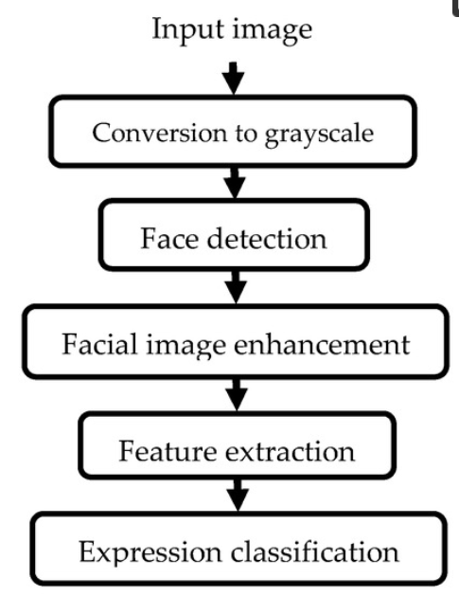
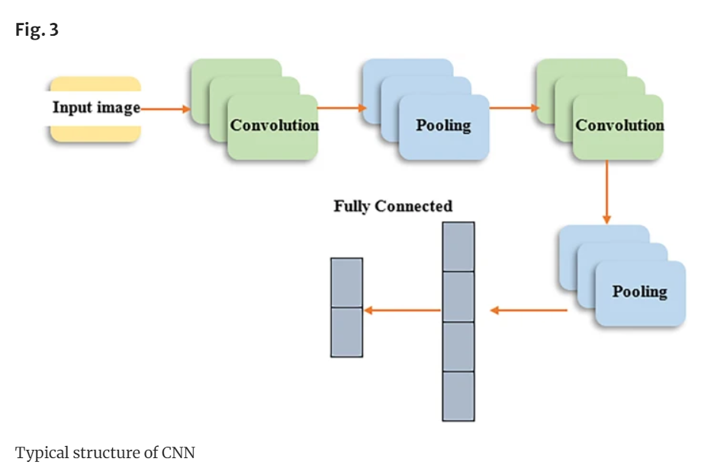
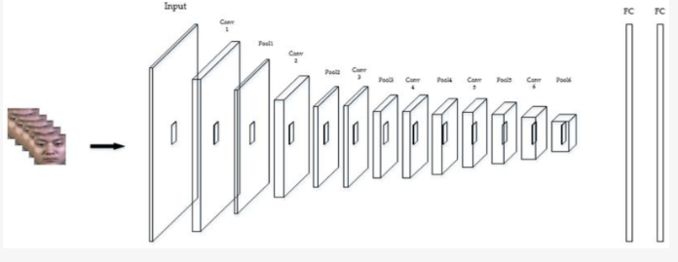
Model
CNN based FER-
Khattak, A., Asghar, M. Z., Ali, M., & Batool, U. (2022). An efficient deep learning technique for facial emotion recognition. Multimedia Tools and Applications, 81(2), 1649-1683.
Li, C. K., Lin, L., Xiong, S. L., Ge, M. Y., Li, X. B., Li, T. P., ... & Zhuang, R. L. (2021). HXMT identification of a non-thermal X-ray burst from SGR J1935+ 2154 and with FRB 200428. Nature Astronomy, 5(4), 378-384.
Bendjillali, R. I., Beladgham, M., Merit, K., & Taleb-Ahmed, A. (2019). Improved facial expression recognition based on DWT feature for deep CNN. Electronics, 8(3), 324.

Slide 9
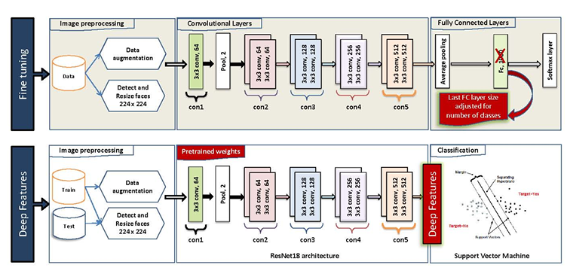
Model
ResNet based model
K. SLIMANI, Y. RUICHEK and R. MESSOUSSI, "Compound Facial Emotional Expression Recognition using CNN Deep Features", Engineering Letters, vol. 30, no. 4, 2022.

Slide 10
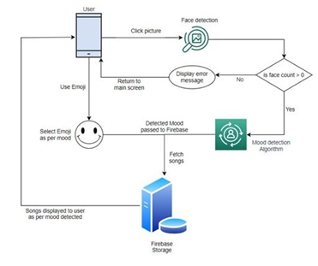
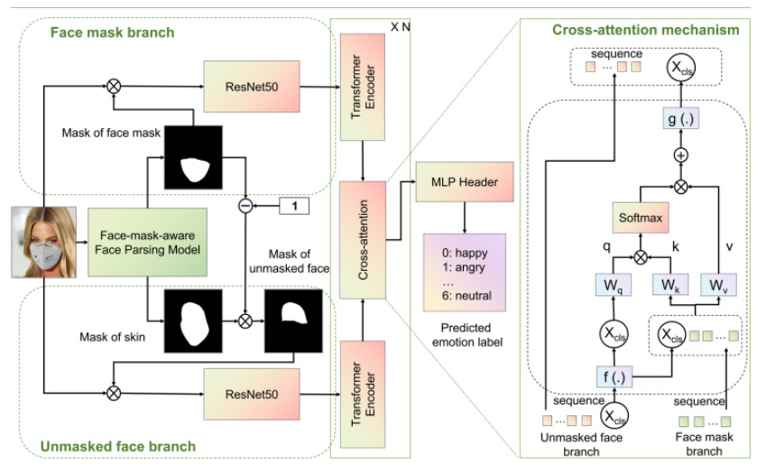
Model
Transformer based model-
A. Mahadik, S. Milgir, J. Patel, V.B. Jagan and V Kavathekar, "Mood based Music Recommendation System", INTERNATIONAL JOURNAL OF ENGINEERING RESEARCH & TECHNOLOGY (IJERT) Volume 10., 2021.
Yang, B., Wu, J., Ikeda, K., Hattori, G., Sugano, M., Iwasawa, Y., & Matsuo, Y. (2022). Face-mask-aware facial expression recognition based on face parsing and vision transformer. Pattern Recognition Letters, 164, 173-182.

Slide 11
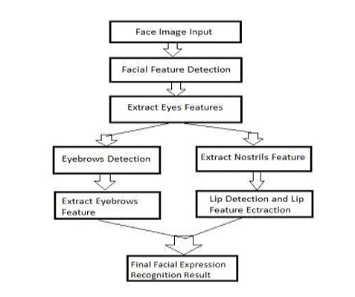
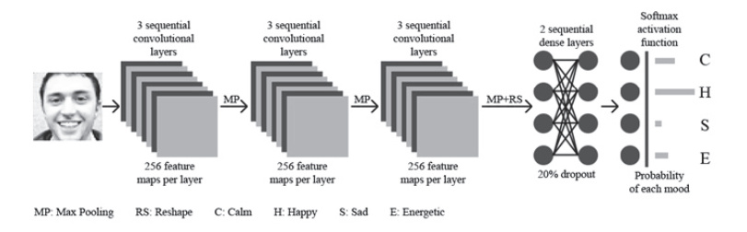
Model
Music Recommendation system-
S. Gilda, H. Zafar, C. Soni and K. Waghurdekar, "Smart music player integrating facial emotion recognition and music mood recommendation," 2017 International Conference on Wireless Communications, Signal Processing and Networking (WiSPNET), Chennai, India, 2017, pp. 154-158, doi: 10.1109/WiSPNET.2017.8299738
Agrahari, P., Tanwar, A. S., Das, B., & Kunekar, P. (2020). Musical Therapy using Facial Expressions. Musical Therapy using Facial Expressions. International Research Journal of Engineering and Technology (IRJET), 7(1).

Slide 12
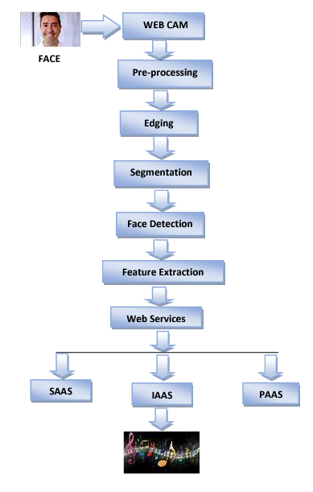
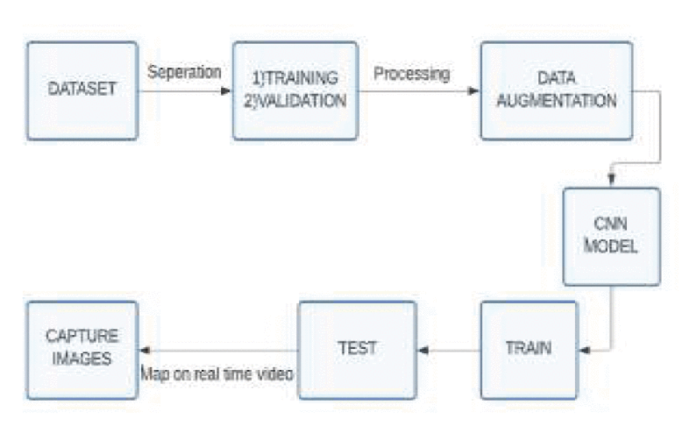
Model
Music Recommendation system-
T. Gorasiya, A. Gore, D. Ingale and M. Trivedi, "Music Recommendation based on Facial Expression using Deep Learning," 2022 7th International Conference on Communication and Electronics Systems (ICCES), Coimbatore, India, 2022, pp. 1159-1165, doi: 10.1109/ICCES54183.2022.9835929
James, H. I., Arnold, J. J. A., Ruban, J. M. M., Tamilarasan, M., & Saranya, R. (2019). Emotion based music recommendation system. Emotion, 6(03).

Slide 13
Some overview paper
Cîrneanu, A.-L.; Popescu, D.; Iordache, D. New Trends in Emotion Recognition Using Image Analysis by Neural Networks, A Systematic Review. Sensors 2023, 23, 7092. https://doi.org/10.3390/s2316709
X. Ben et al., "Video-Based Facial Micro-Expression Analysis: A Survey of Datasets, Features and Algorithms," in IEEE Transactions on Pattern Analysis and Machine Intelligence, vol. 44, no. 9, pp. 5826-5846, 1 Sept. 2022, doi: 10.1109/TPAMI.2021.3067464
S. K. V, R. V. S, R. S, R. Ramalingam, S. M. N and Kiran, "A Comprehensive Overview on Musical Therapy Using Facial Expression Recognition," 2023 International Conference on Distributed Computing and Electrical Circuits and Electronics (ICDCECE), Ballar, India, 2023, pp. 1-5, doi: 10.1109/ICDCECE57866.2023.10151044

