Slide 1
Predicting Wildfires Using Machine Learning
PRESENTATION
Anika Tahsin

Slide 2
CONTENTS
METHODOLOGY
SOFTWARE
RESULTS

Slide 3
PREDICTING WILDFIRES USING MACHINE LEARNING
Wildfires have been a huge natural hazard since 420 million years back
To predict wildfire the dataset was from United States Department of Agriculture Forest Service (USDA)
The Research Objective is:
To test out various machine learning and artificial neural network model
To compare the model performance

Slide 4
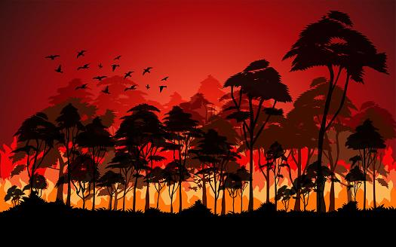
SOFTWARE FOR RESEARCH
01
02
TensorFlow Framework
Keras
03
04
scikit-learn
Anaconda 3

Slide 5

METHODOLOGY
Data Filtering and Handling
NAN, unique values
Target Variable Finding
Correlation matrix, Pearson Test
Application of Regression Models
Linear, Ridge, Lasso, Decision Tree, Random Forest, XGBoost
Application of Neural Network Model
Artificial Neural Network (ANN)
Model Accuracy
R-squared score, Root Mean Squared Error (RMSE)

Slide 6
PREDICTING WILDFIRES USING MACHINE LEARNING
All Model Performance
 | Linear | Ridge | Lasso | Decision Tree | Random Forest | XGBoost | ANN
R-squared | 0.098 | 0.233 | 0.247 | -0.258 | 0.3361 | 0.319 | -0.0005
MSE | 1.178 | 1.049 | 0.99 | 1.677 | 0.869 | 0.897 | 1.334
RMSE | 1.096 | 1.0968 | 1.002 | 1.295 | 0.941 | 0.95 | 1.1554

Slide 7
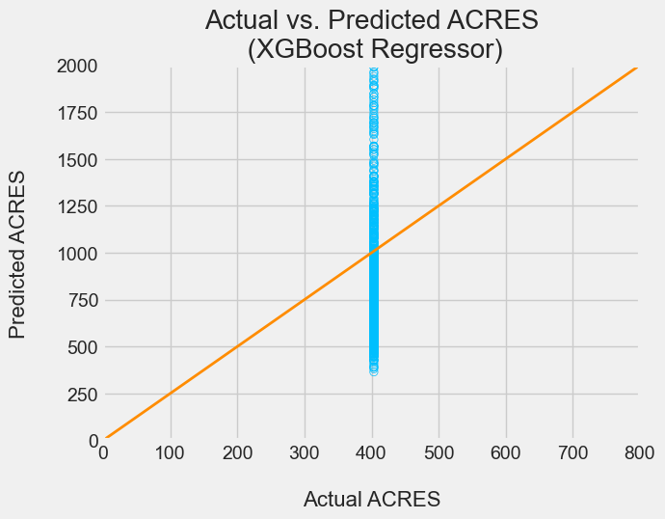
Best Model Results
XGBoost Regressor
The model XGBoost regression gave
A R-squared of 0.319 (3.19%)
a MSE of 0.897 (89.7%)
a RMSE of 0.95 (95%)

Slide 8
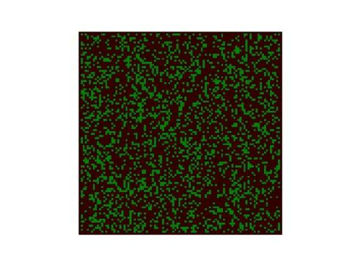
PREDICTING WILDFIRES USING MACHINE LEARNING
WILDFIRE SIMULATION

Slide 9

PREDICTING WILDFIRES USING MACHINE LEARNING
THANK YOU

