Slide 1

Final Presentation Report
Only for Course Teacher
 |  | Needs Improvement | Developing | Sufficient | Above Average | Total Mark
Allocate mark & Percentage |  | 25% | 50% | 75% | 100% | 15
Level of Understanding | 03
Analysis and Design | 04
Demonstration | 03
Delivery | 05
Total obtained mark
Comments

Slide 2
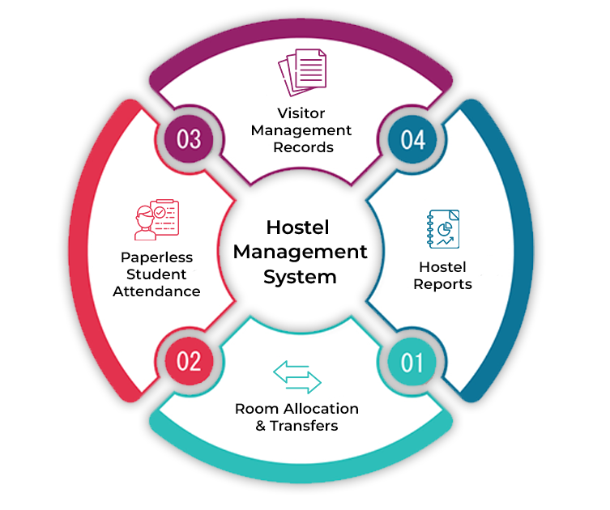
Project Title
Developed By Group No : 07
Semester: Summer 2025
Course Title: Software Development Capstone Project
Course Code: SE 133
Batch: 43
Section : H2

Slide 3
#Group Member’s
Name | Student ID
Mohammad Ali Nayeem | 232-35-022
Emtiaz Hossain | 242-35-744
Arpita Barmon | 242-35-794
Jahid Hossain | 242-35-142

Slide 4
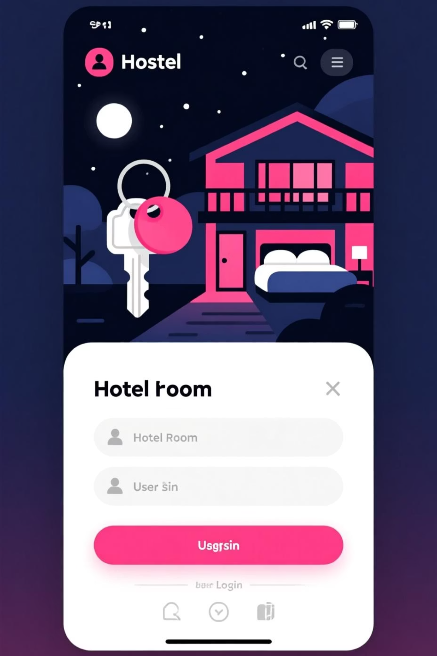
Hostel Management System
A Capstone Project Report

Slide 5
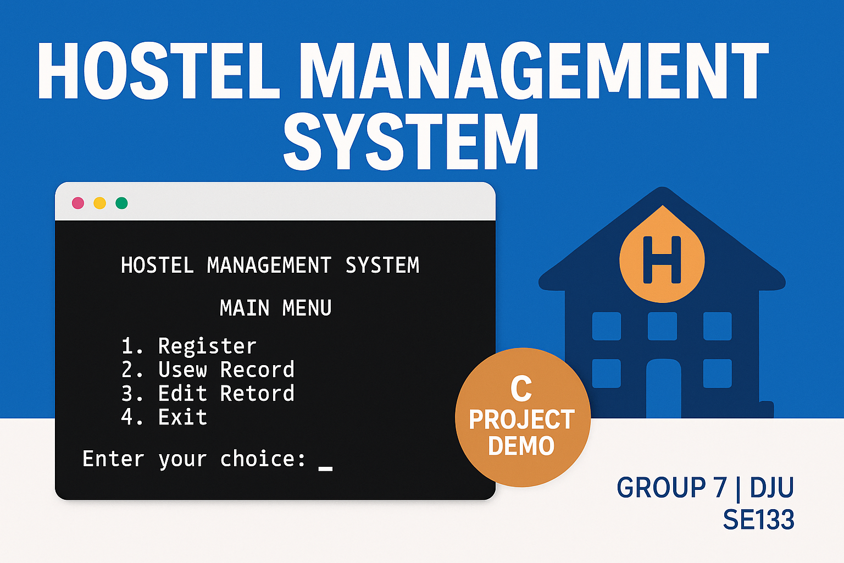

Introduction
Project Team
Supervisor
Members
Sumona Afroz, Lecturer
Mohammad Ali Nayeem (232-35-022)
Emtiaz Hossain (242-35-744)
Arpita Barmon (242-35-794)
Jahid Hossain (242-35-142)

Slide 6
Introduction
Project Overview
Problem Statement
Motivation
Objectives
Manual hostel operations are inefficient and error-prone.
Automate tasks, improve accuracy, enhance user experience.
Develop a reliable, user-friendly management system.

Slide 7

Methodology
System Architecture
Planning
Define requirements, scope, and objectives.
Design
Develop system diagrams and database schema.
Development
Code and implement system features.
Testing
Validate functionality and fix bugs.
Deployment
Launch and monitor system performance.

Slide 8
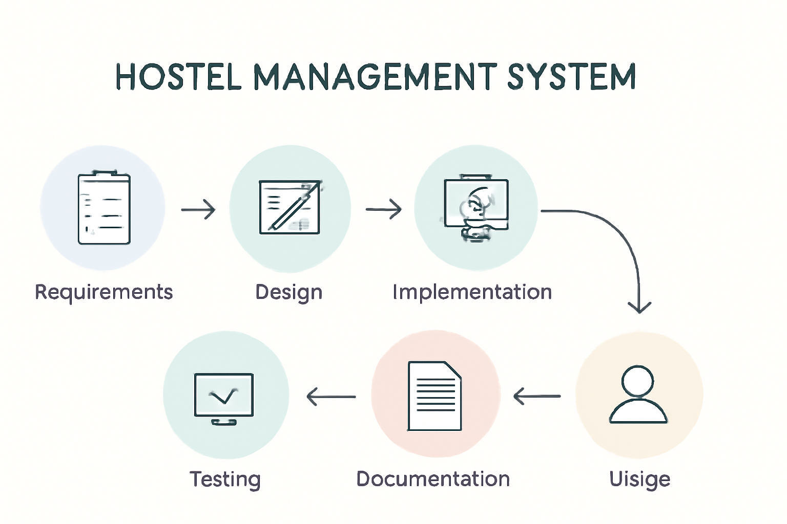
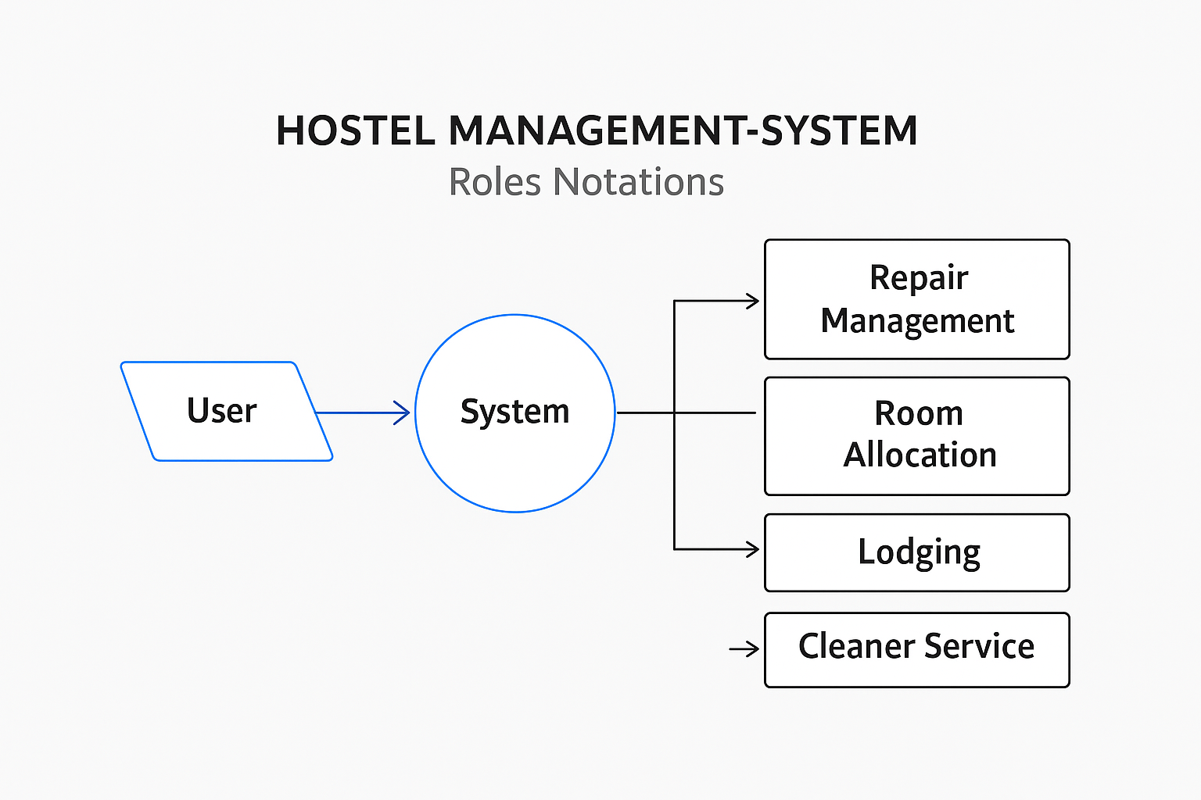
Methodology
Key Diagrams
Workflow Diagram
Data Flow Diagram
Visualizes system flow.
Illustrates data movement.

Slide 9

Methodology
User Interactions
The Use Case Diagram highlights user roles and system functionalities.

Slide 10
Results & Discussion
System Functionality
Smooth Operations: Handles booking, check-in/out, and payments automatically.
Better Efficiency: Cuts down mistakes and saves time.
Better Data Handling: Keeps records safe and in one place.
Easy to Use: Simple design for staff and guests.

Slide 11
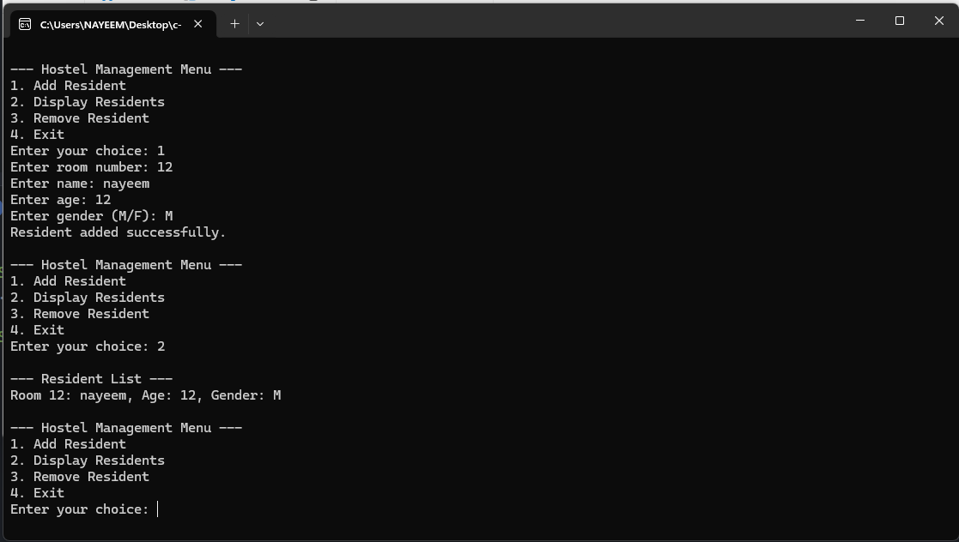
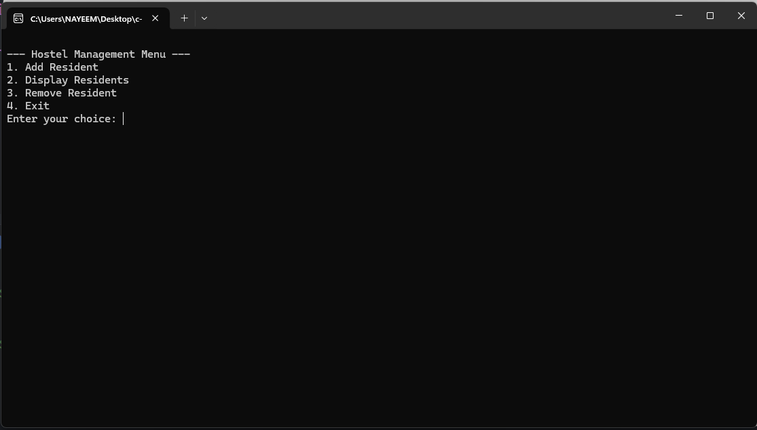
Results & Discussion
System Snapshot
This snapshot displays the clean and intuitive user interface, designed for ease of use in daily operations.

Slide 12
Conclusion
Project Summary
The Hostel Management System successfully addresses key challenges in hostel administration, providing a robust and efficient solution.
Future Work
Mobile application development.
Integration with payment gateways.
Advanced analytics and reporting features.

Slide 13
Conclusion
References
GitHub Repo: https: //github.com/kazinayeem/hostel-management-capstone
W3Schools: https://www.w3schools.com/c/
GeeksforGeeks: https://www.geeksforgeeks.org/c-programming-language/
ResearchGate: https://www.researchgate.net
Presented by the Hostel Management System Team.

Slide 14


