Slide 1
Tour Mate

Slide 2
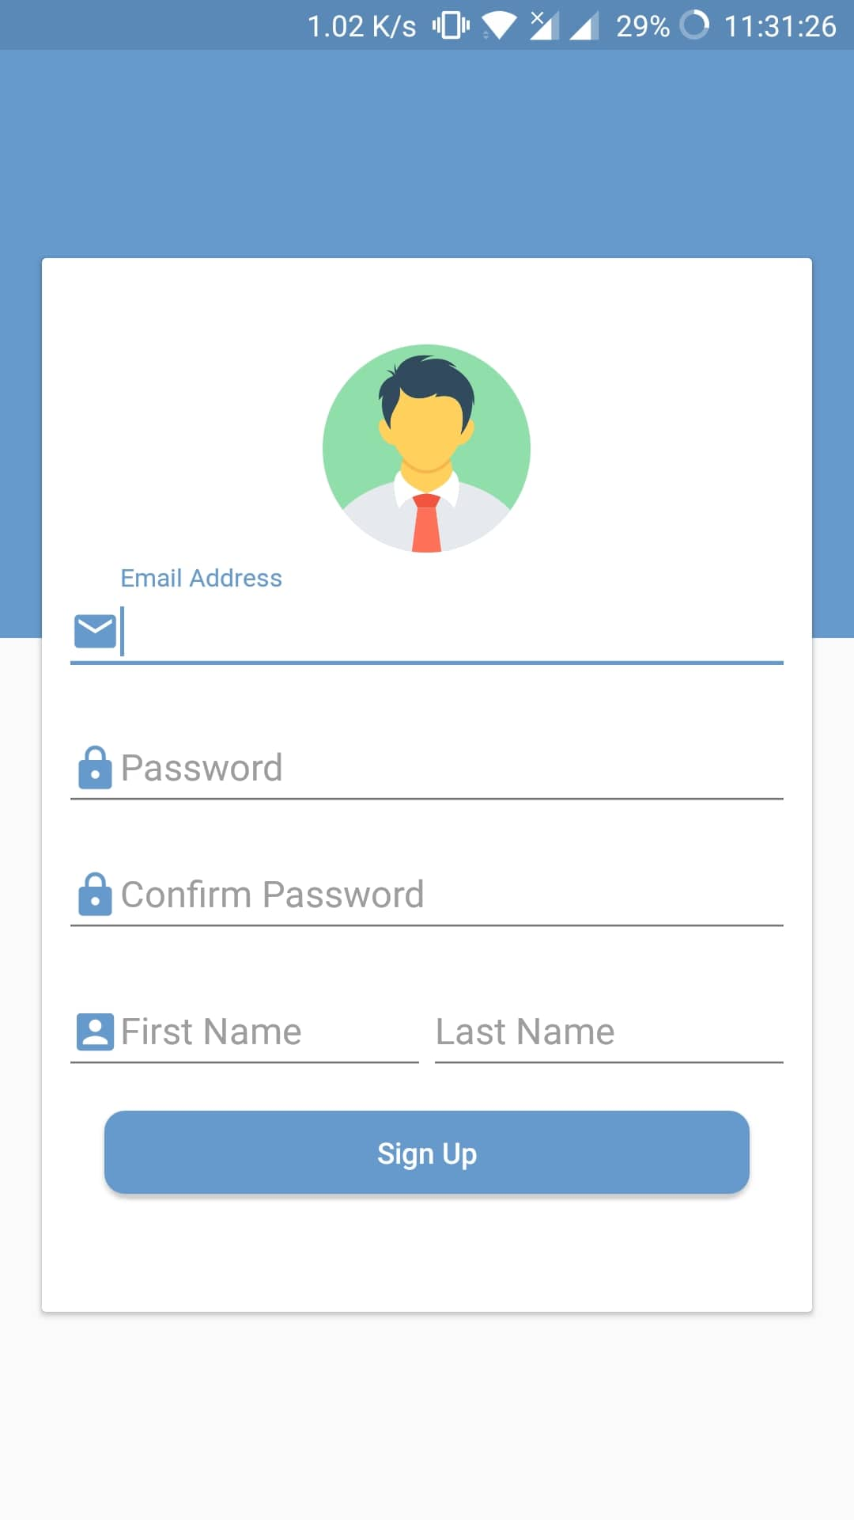
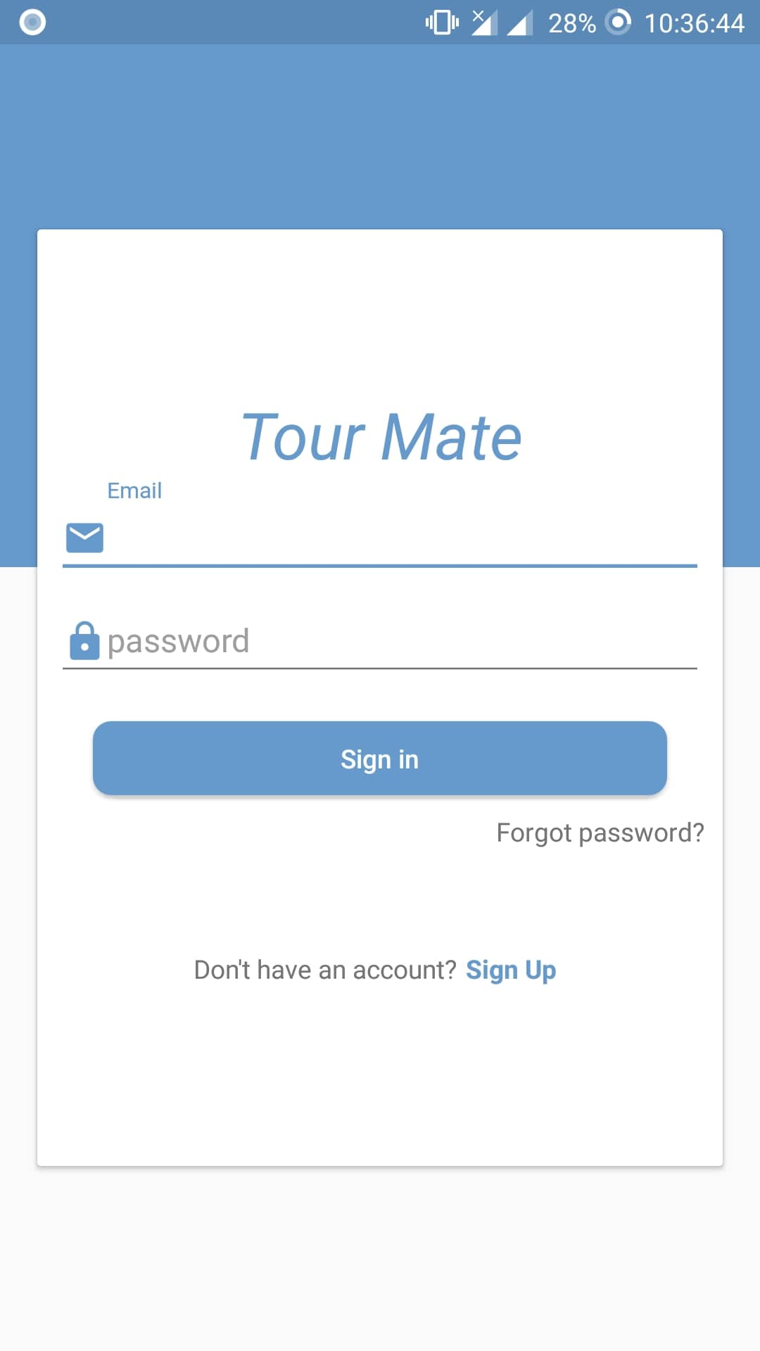
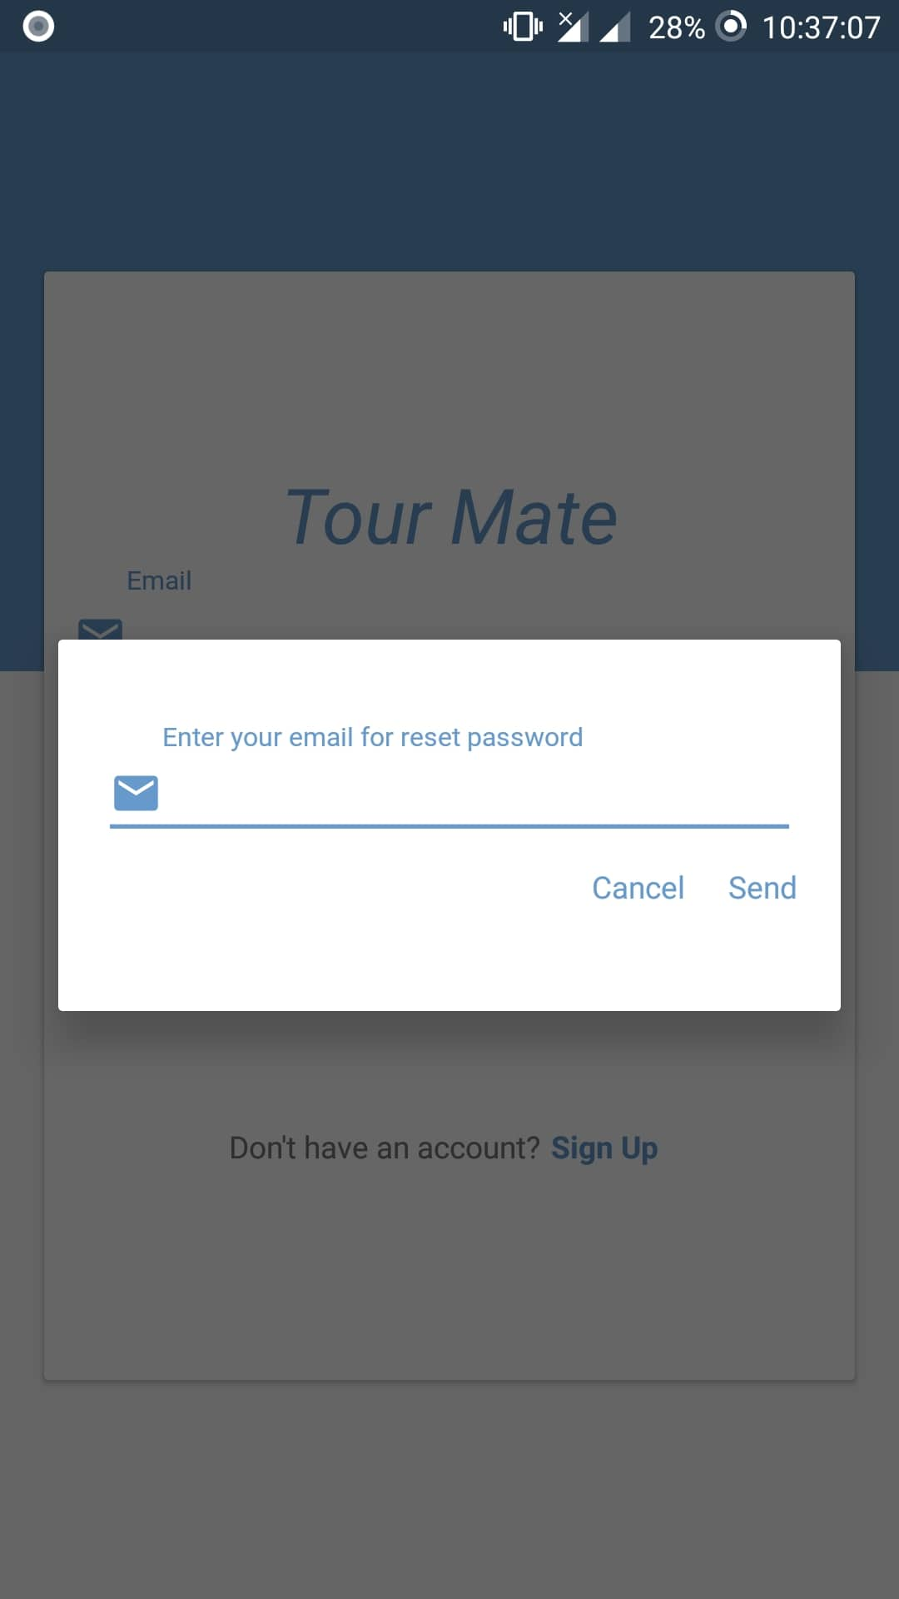
Signup and Signin
1.Signin
2.Signup
3.Forget password

Slide 3
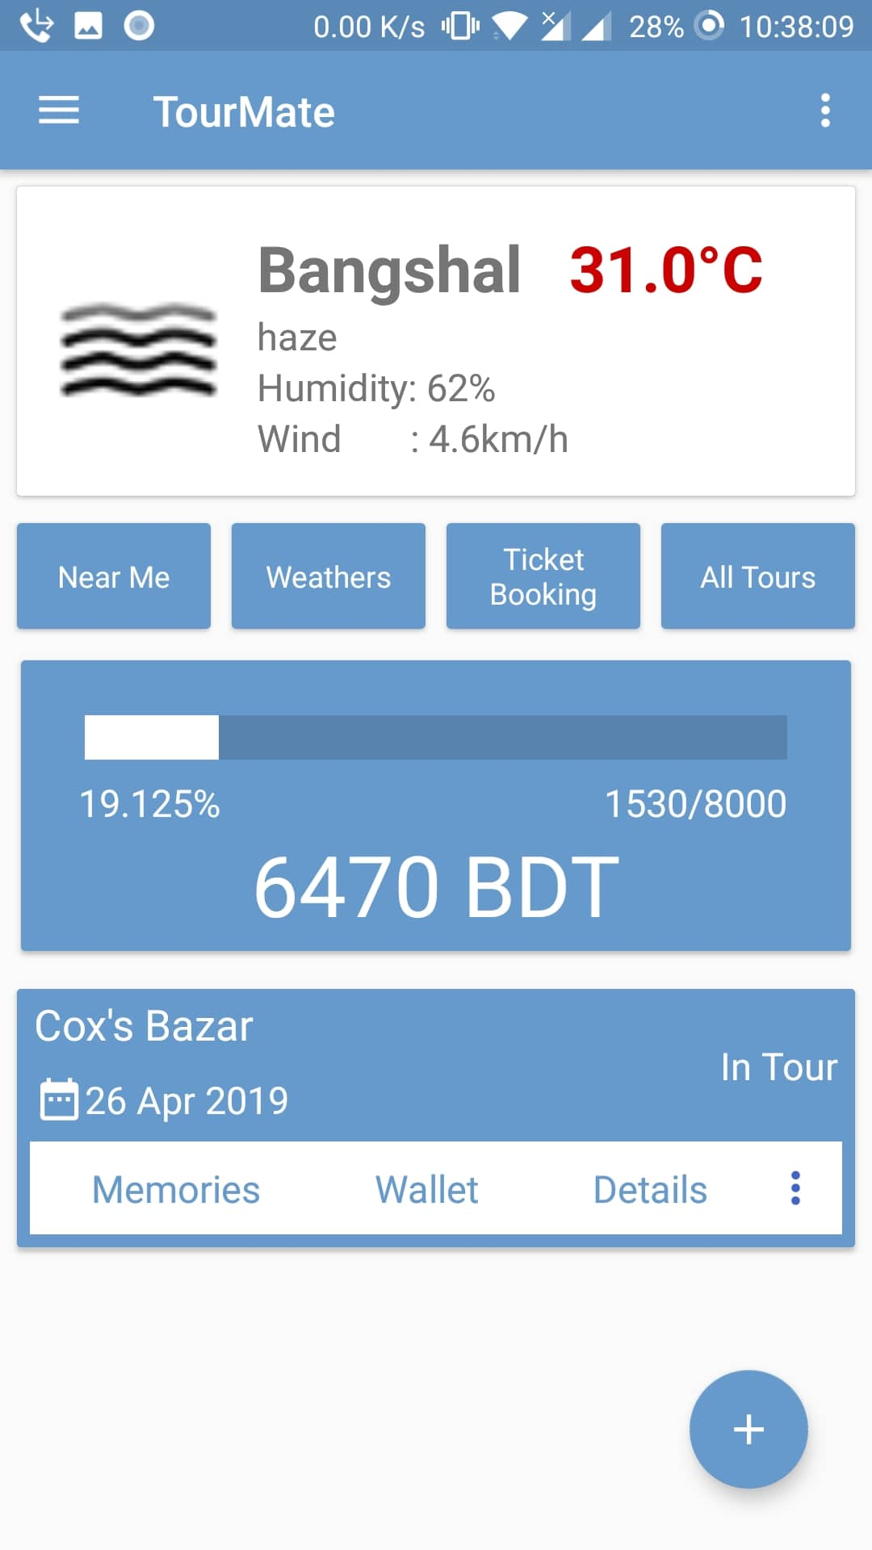
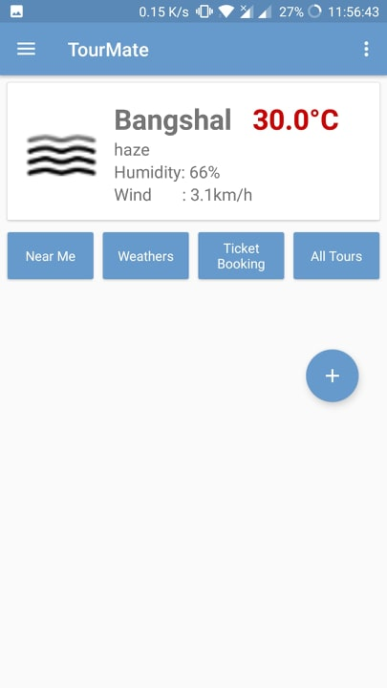
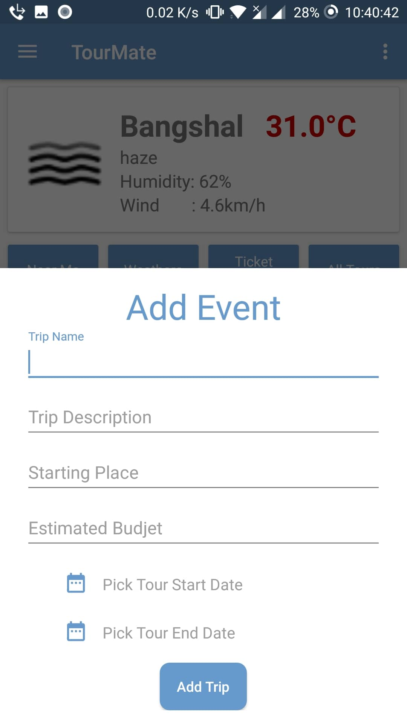
Dashboard
Current Weather
Current Trip
Expense amount

Slide 4
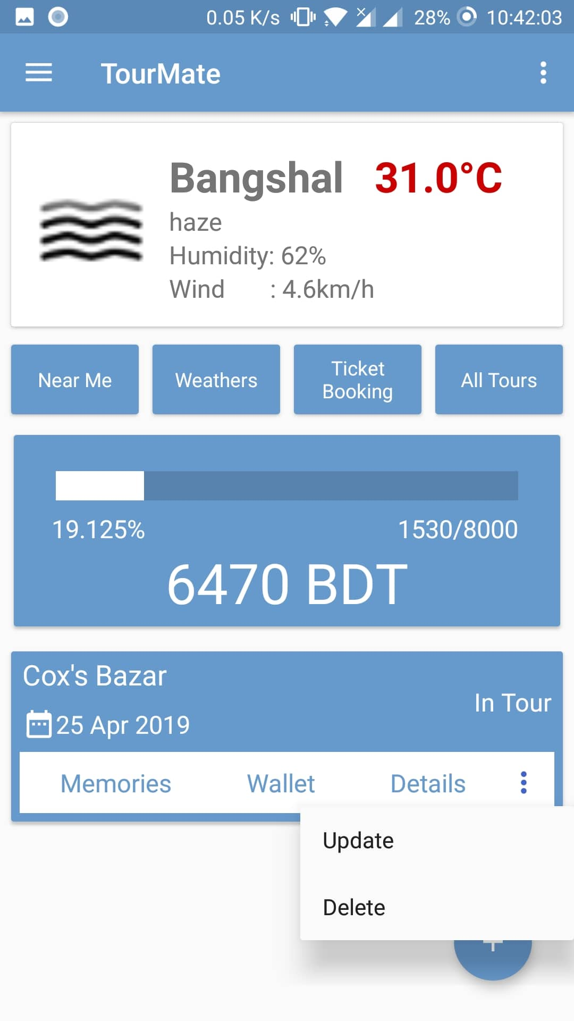
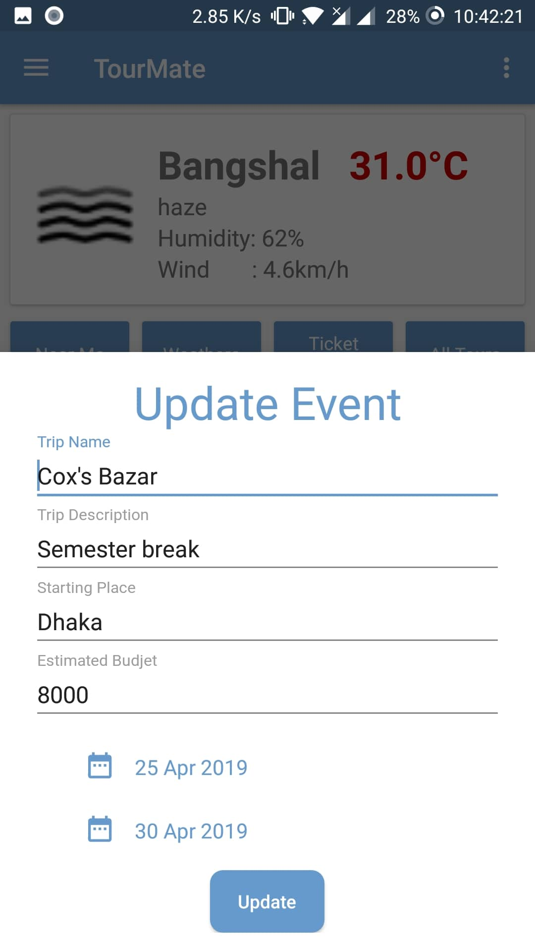
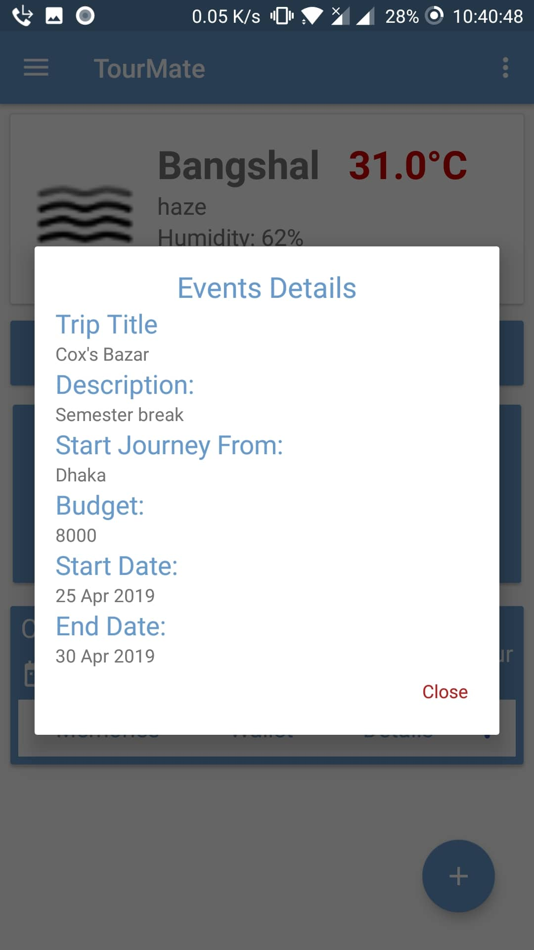
Trips activity
Update
Delete
Details
Add expense
Add memory

Slide 5
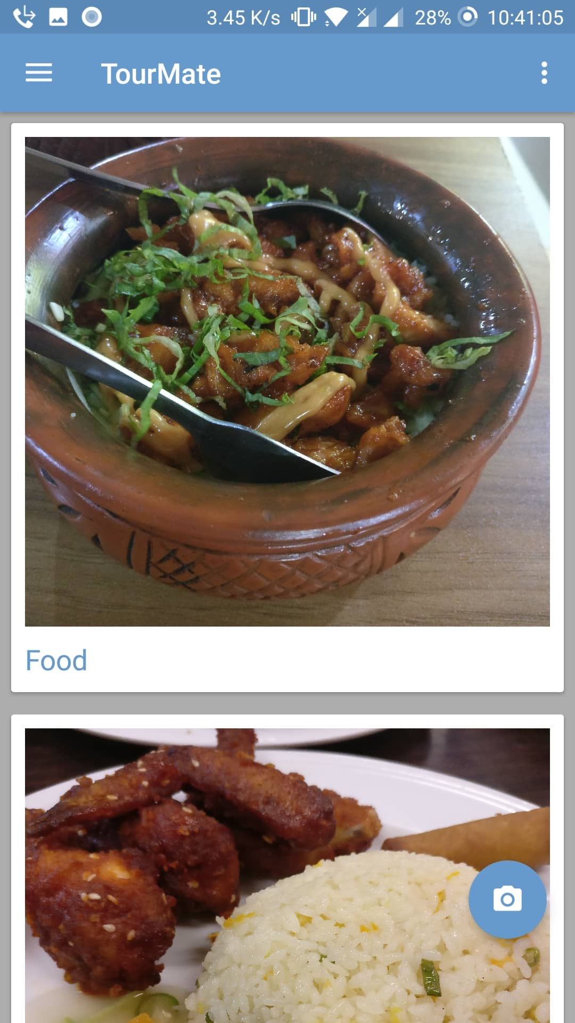
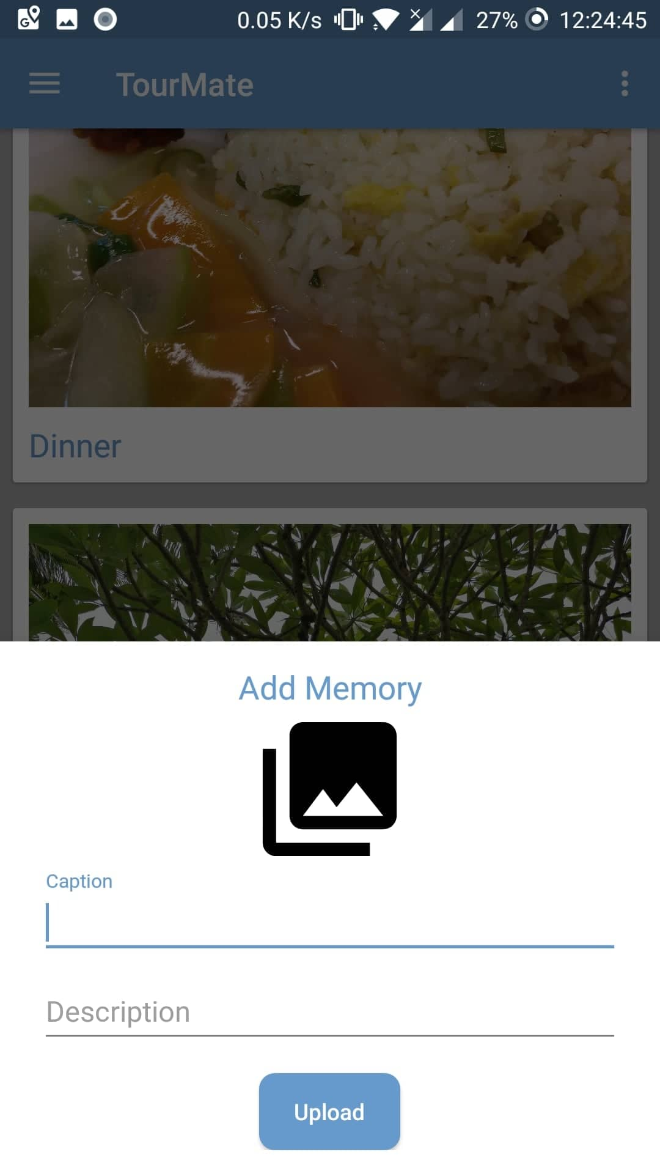
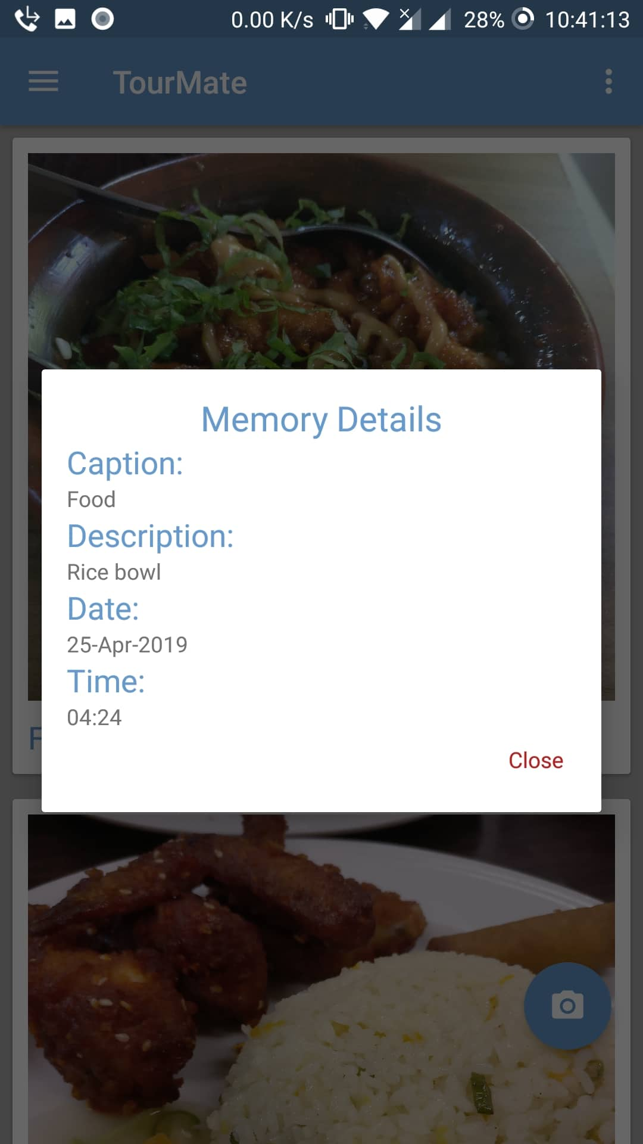
Memories
Add memory
Details memory
Show memory

Slide 6
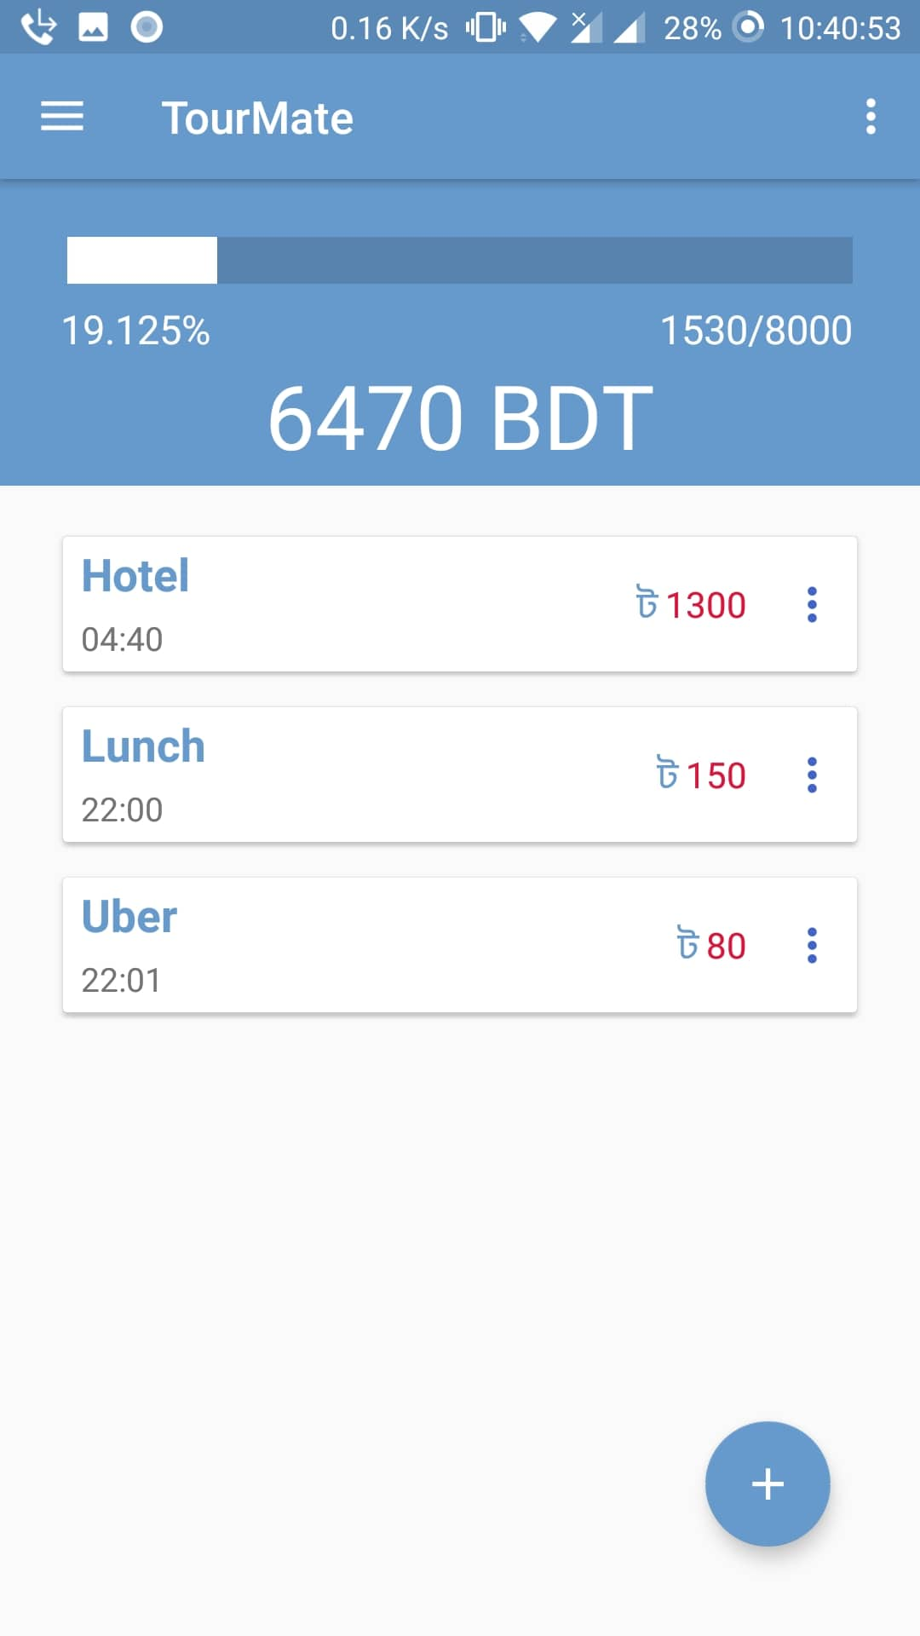
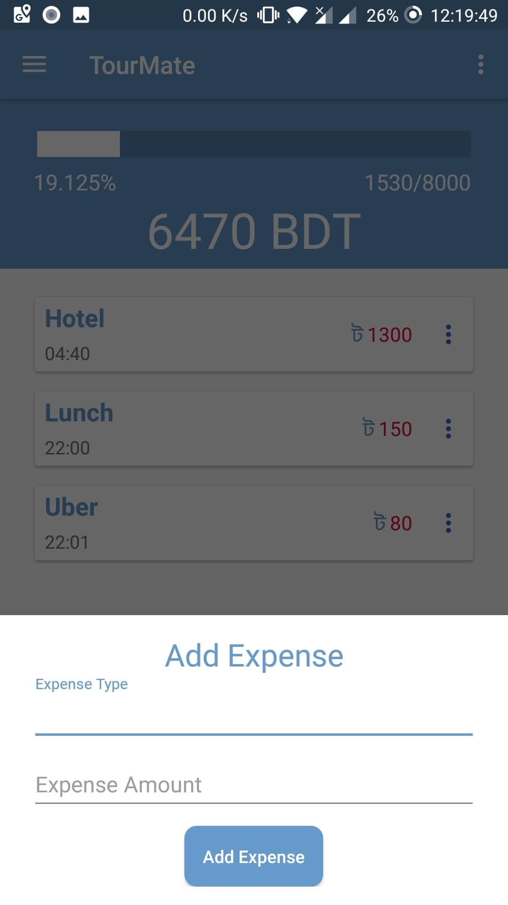
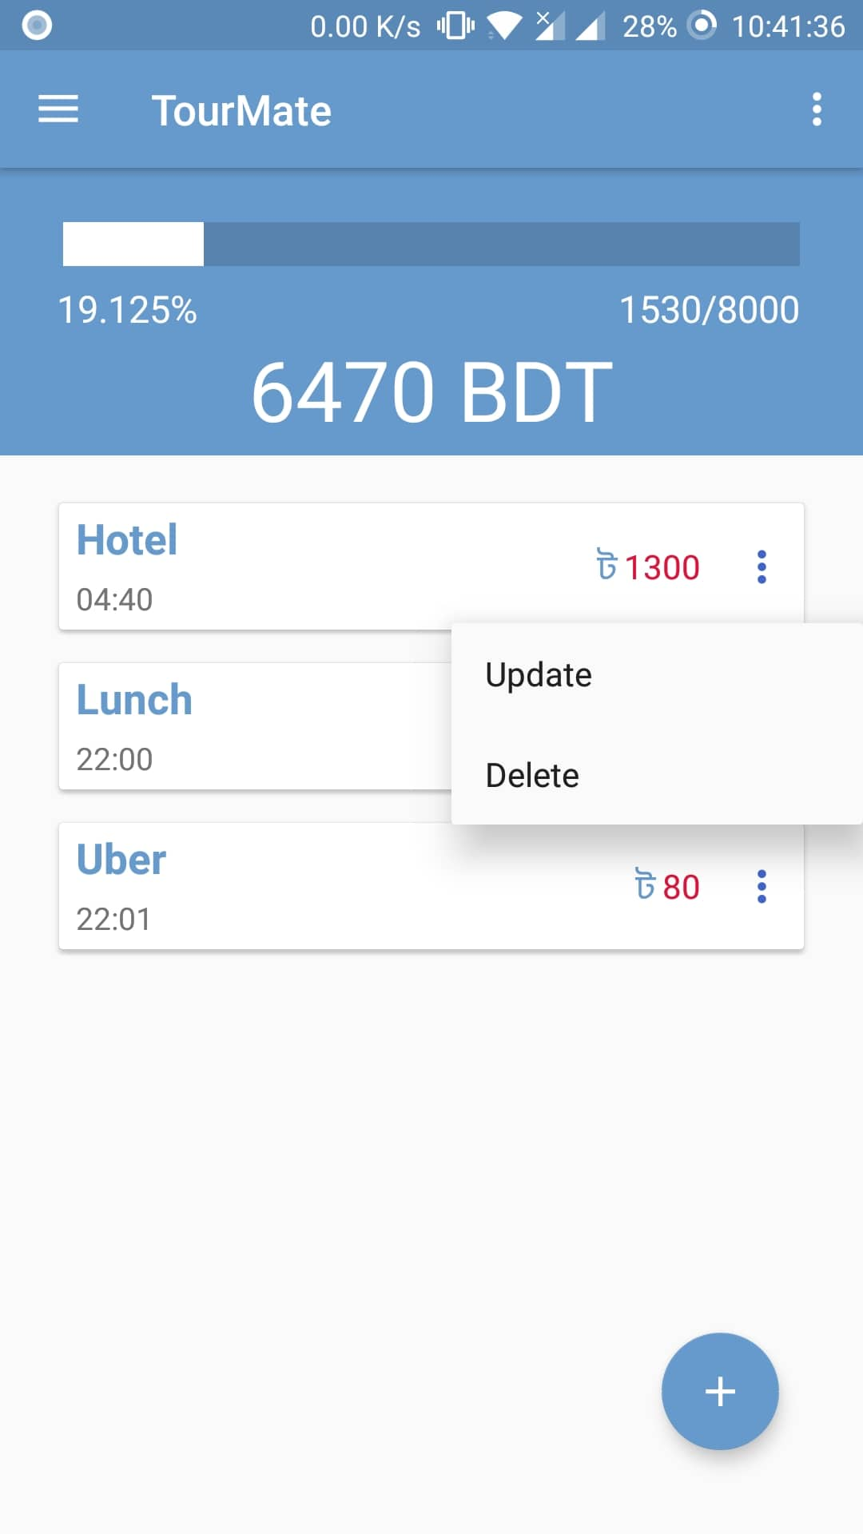
Wallet
Current Balance
Total expense
Graphical view
Total Budget
Add Expense
Update Expense
Delete Expense

Slide 7
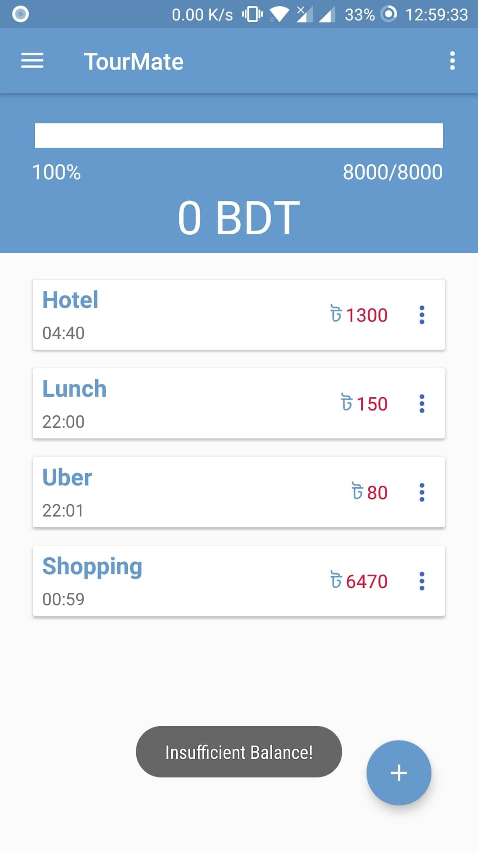
Balance Maintain
Cant add expense when balance zero

Slide 8
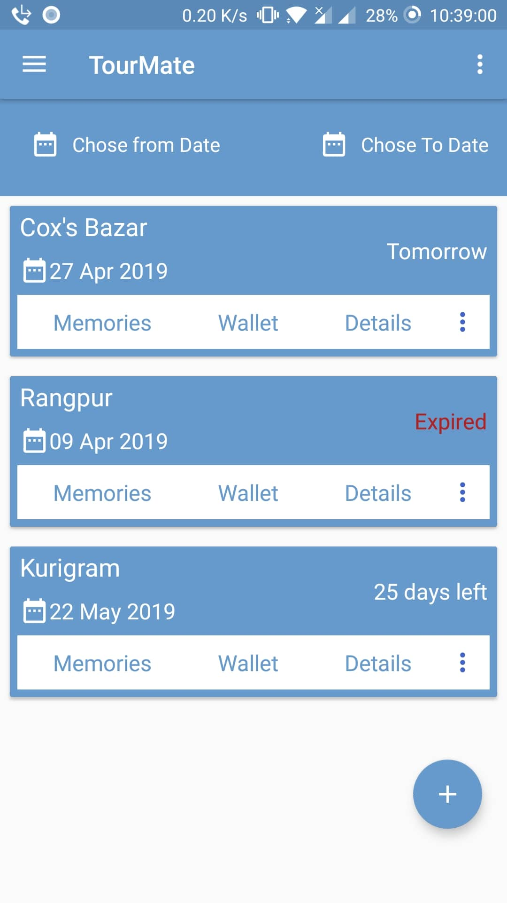
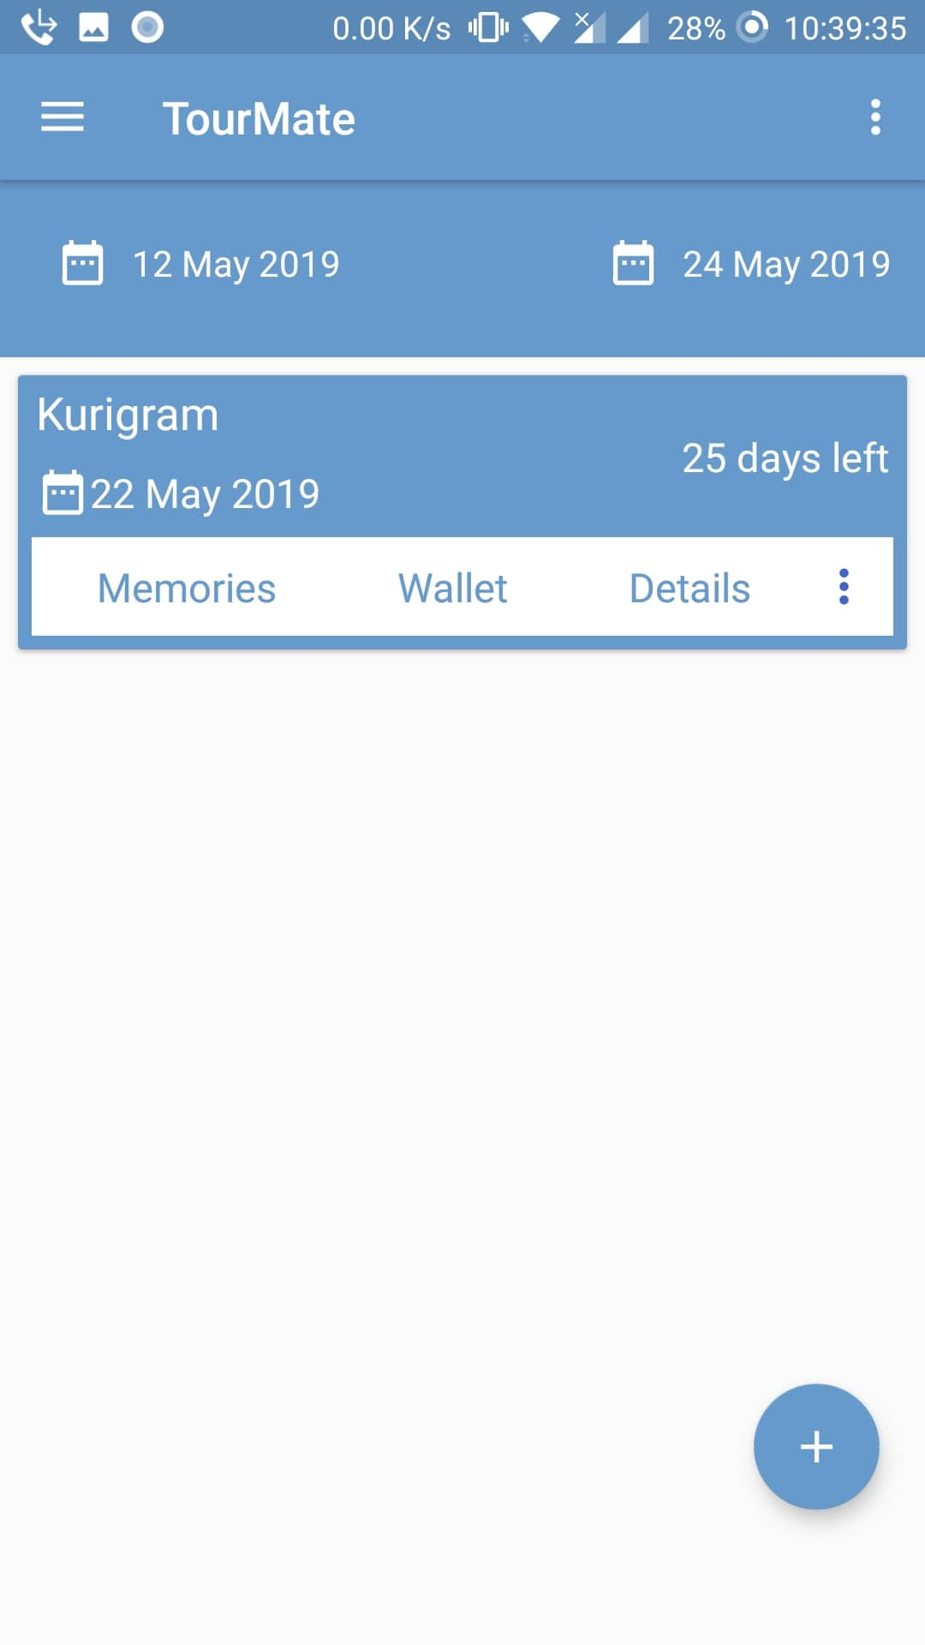
Trips History
Filtering trips
Show the status of the trips
Add Trip

Slide 9
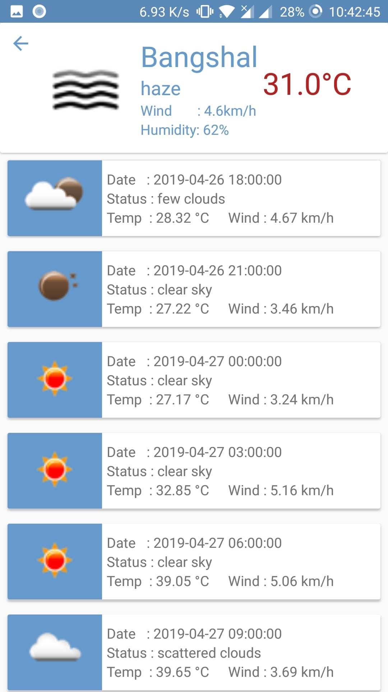
Weather
Current Weather
5 days weather forcast

Slide 10
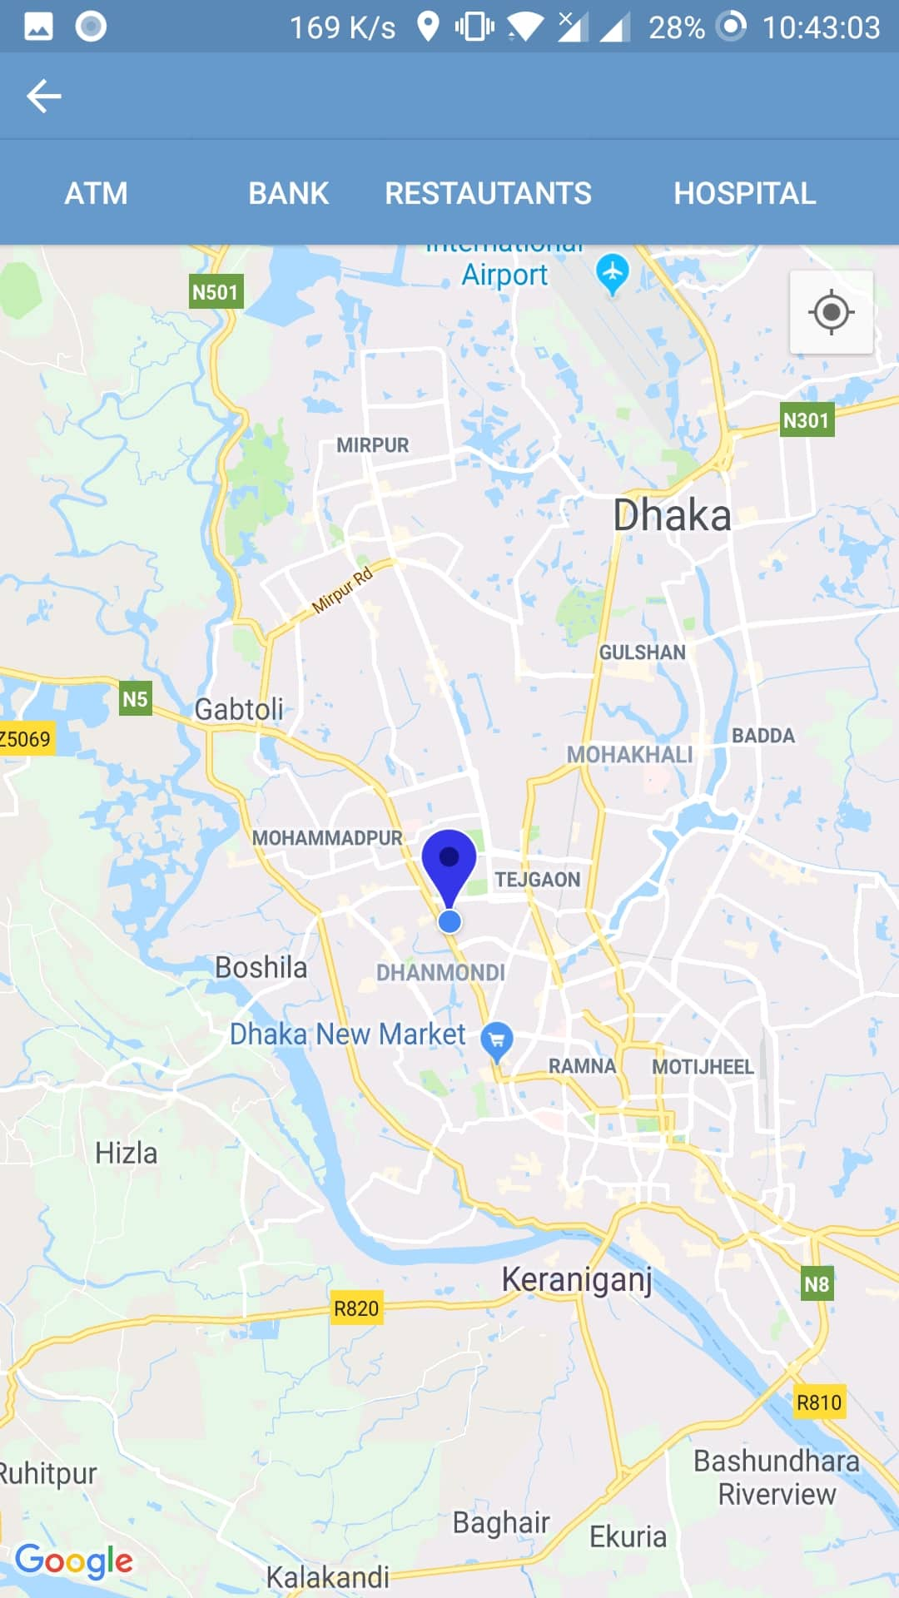
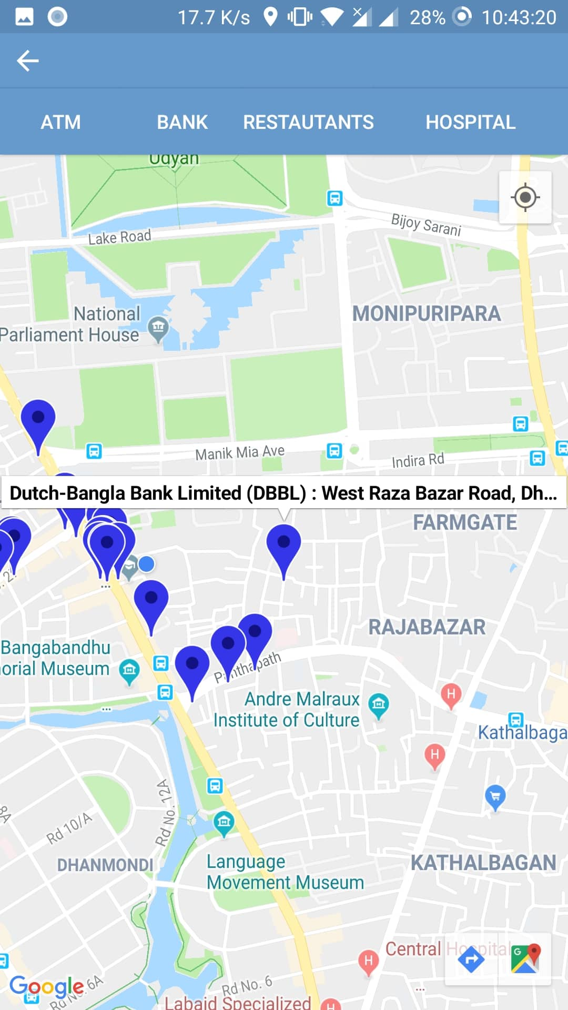
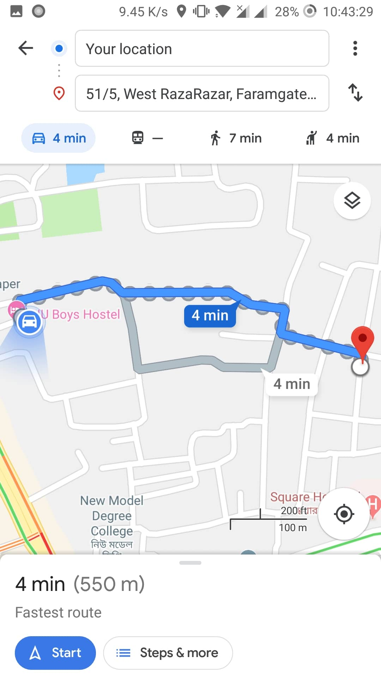
Map
Current Location
Nearby places
Direction
Information

Slide 11
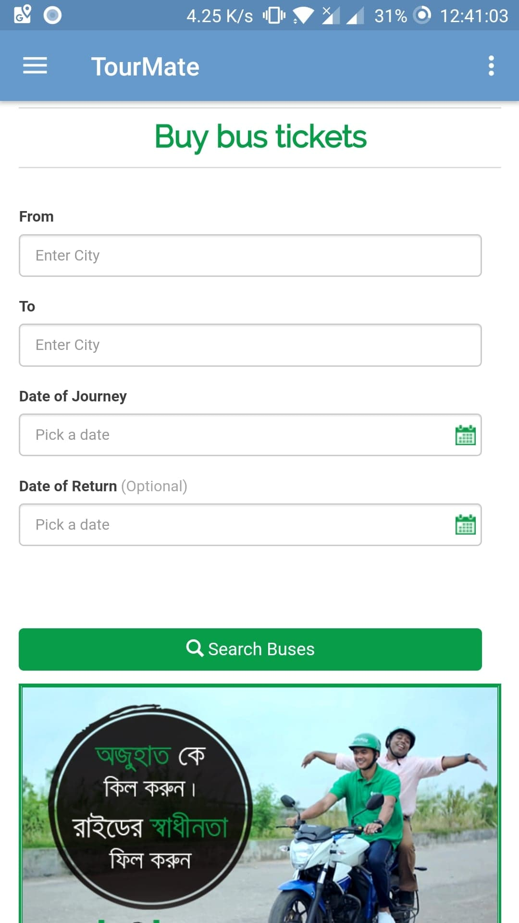
Ticket Booking

Slide 12
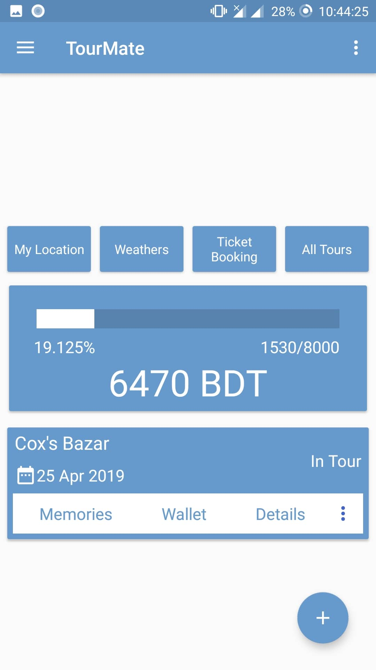
Offline Mode

Slide 13
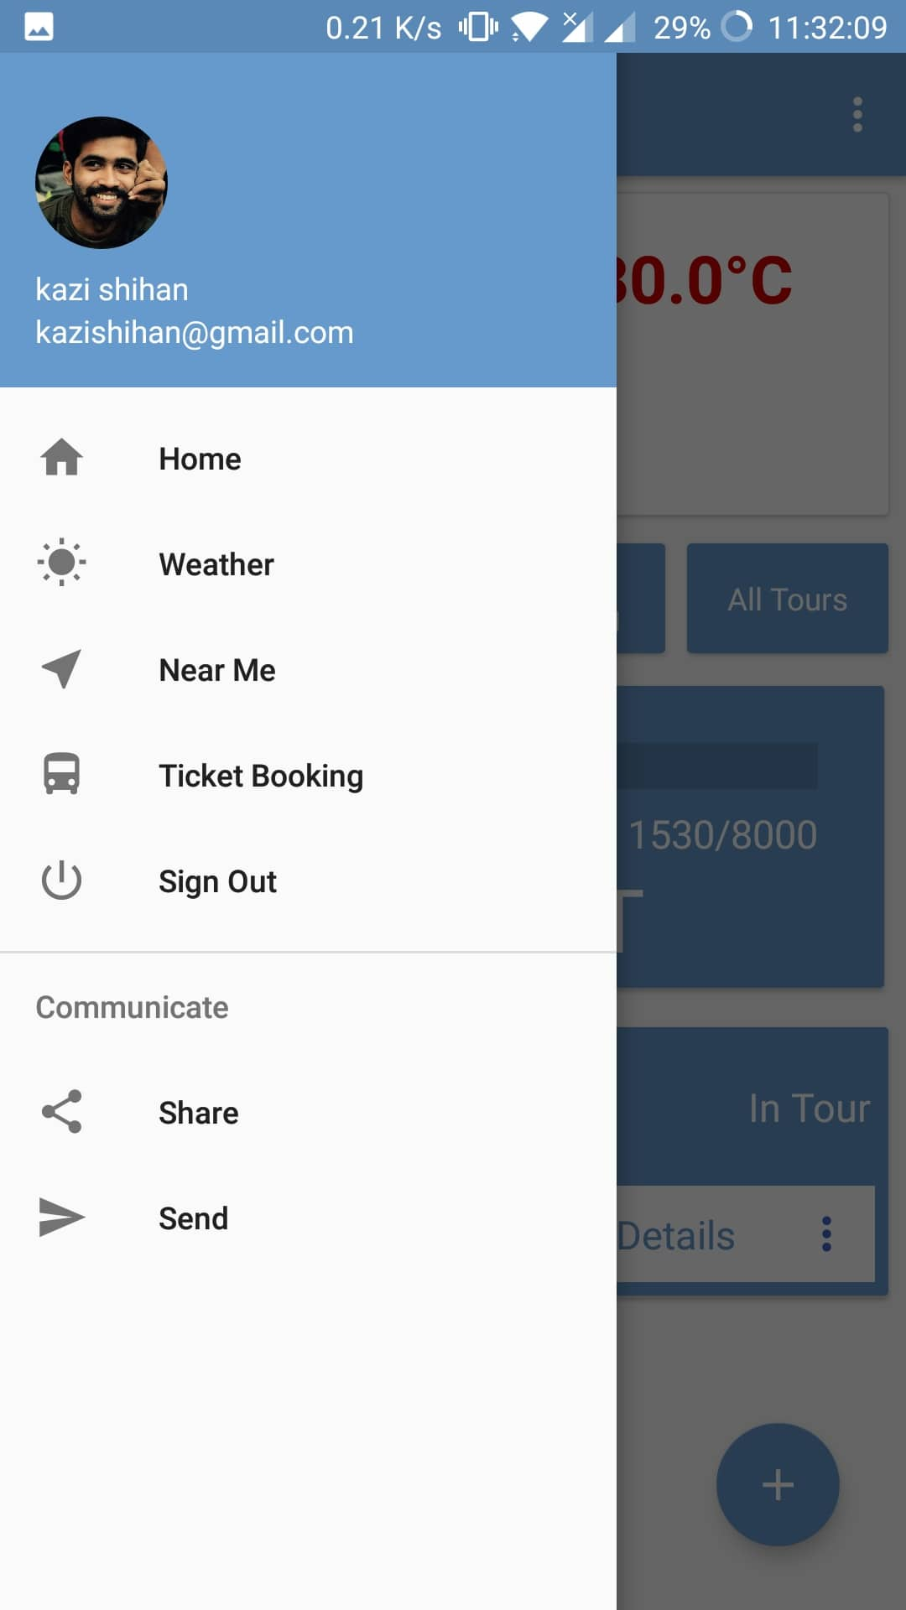
Drawer
User profile photo
User name and email
Weather
Near me
Ticket Booking
Sign Out

Slide 14
Thank You ☺

