Slide 1
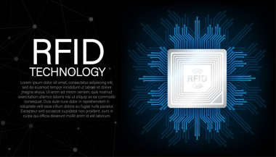

SMART DOOR LOCK
Introduction
Upgrade your security with our innovative Smart Door Lock system, utilizing cutting-edge RFID technology combined with Arduino Uno board.
Key Features
Advanced RFID Authentication: Access your space securely with RFID cards or tags, ensuring only authorized individuals can enter.
Convenient Access Control: Say goodbye to traditional keys and enjoy hassle-free entry with RFID technology.
Compatible with Arduino Uno: Built on the reliable Arduino platform, our system offers flexibility and customization options.
Reliable and Efficient: With a solenoid lock and relay, our system provides robust security for your space.

Slide 2
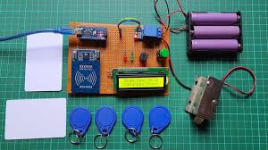
Why Choose Us:
Enhanced Security: Protect your property and loved ones with our state-of-the-art security solution.
Ease of Use: Simple and intuitive operation makes accessing your space effortless.
Customizable: Tailor the system to your specific needs with Arduino Uno's programming capabilities.
24/7 Support: Our team is dedicated to providing excellent customer service and support.
Contact Information
: For inquiries or to learn more about our Smart Door Lock system, contact us at:
Email:chandonroy739@gmail.com
Phone: 01950154809
Website: www.smartdoorlock.com

