Slide 1
Data Visualisation Final Project
Study Group 11: Nereid Kwok, Nisa Ozer, Lauren Wade, Thomas Giannetti-Fakhouri, Kazmer Nagy-Betegh, Chandrime Tolia

Slide 2
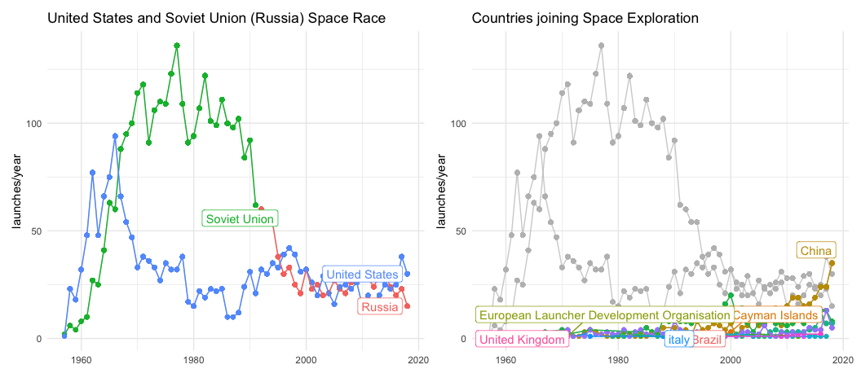
Slide 1

Slide 3
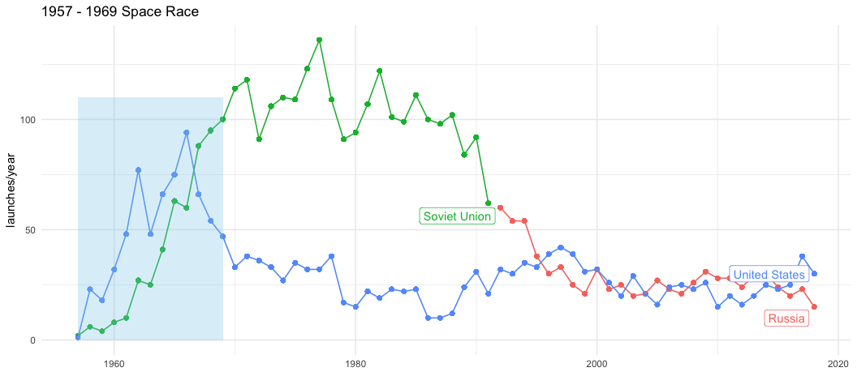
Slide 2

Slide 4
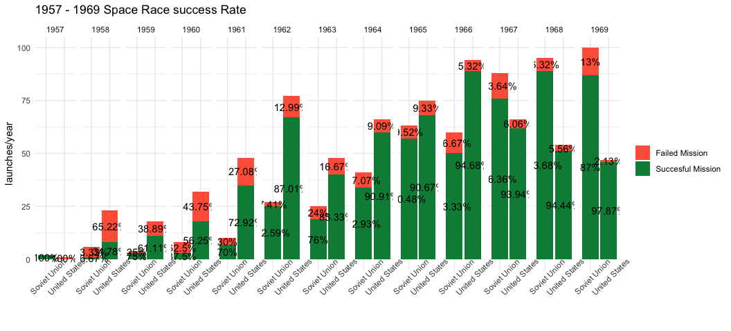
Slide 3

Slide 5
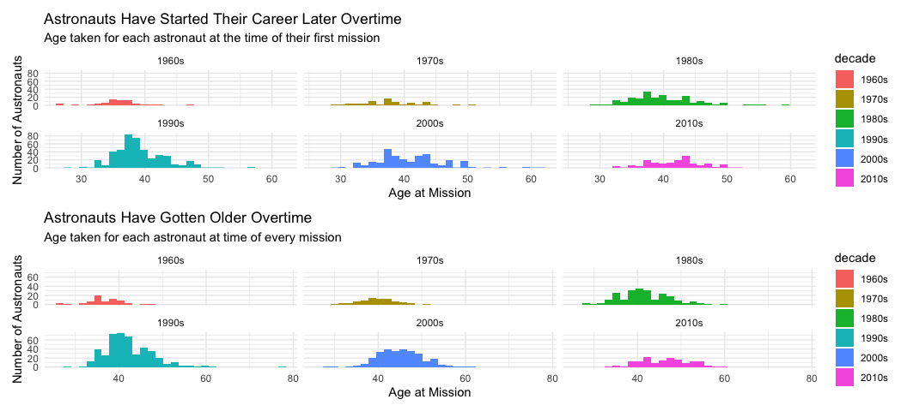
Slide 4

Slide 6
# Slide 5

Slide 7
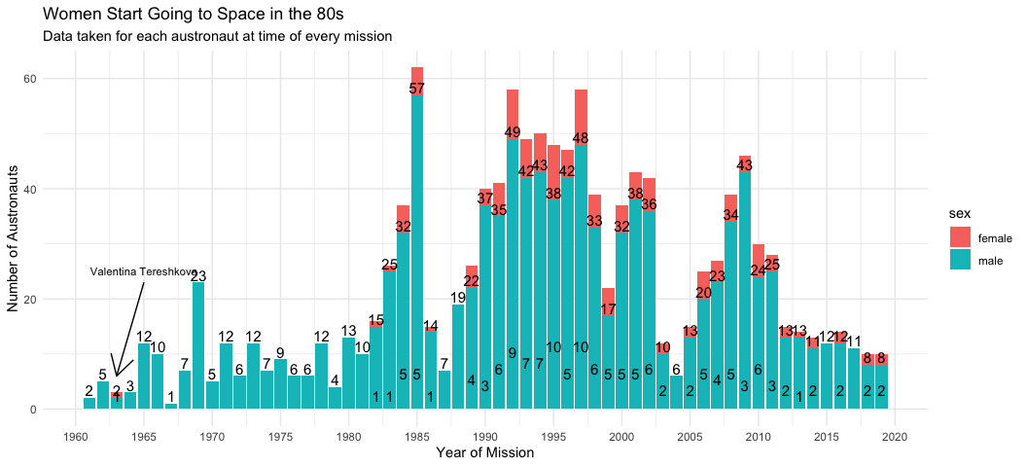

Slide 8
# Slide 5

Slide 9
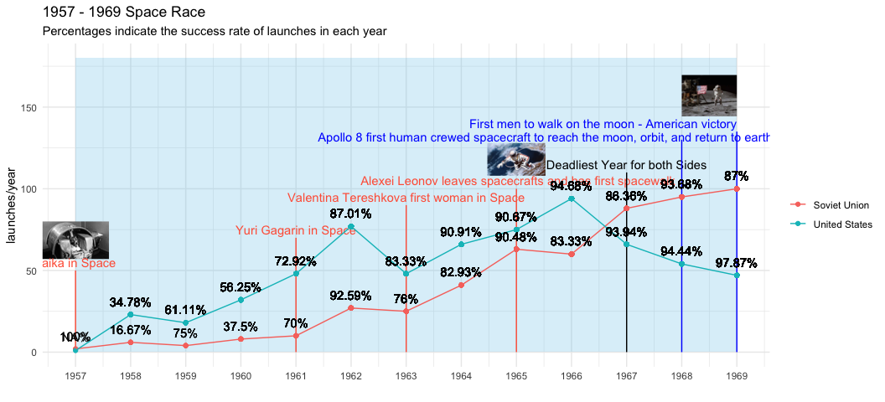

Slide 10
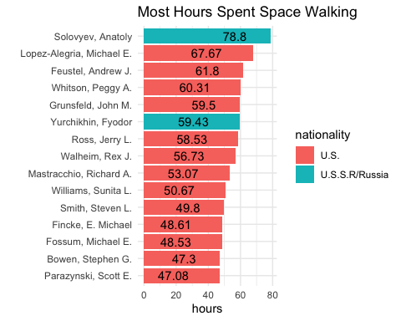
Slide

Slide 11
Slide
US Launches
1966: Peaked state launches 1986: Challenger Explosion 1989: Private commercial Launches starts 2012: Barely any state launches

Slide 12
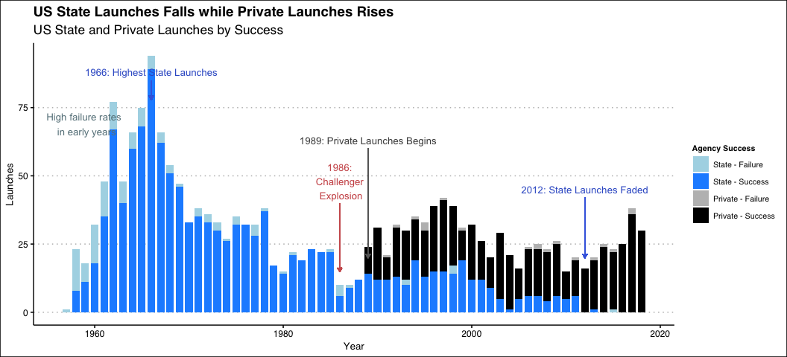

Slide 13
General: High spending/budget during Space Race. Drastic decrease of spending/budget once space is over. US-USSR Space Race: Budget higher than actual spending (underbudget), NASA is too ambitious 2012 paused launches: Budget are increasing, …

Slide 14
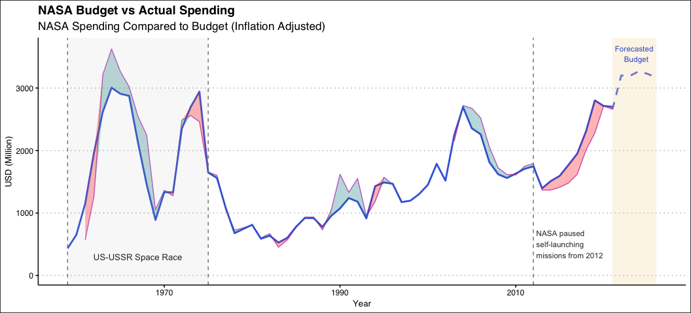
Slide

Slide 15
state and private launches success/failure rate (spaceX) NASA fails, budget cut, blow stuff up cheaper

