Slide 1

10 seconds RPG
A mini RPG game that can be played in just 10 seconds,
The 4th Game Creation Audition
Global sector participation
Meteora Games

Slide 2

Project Overview
Title : 10 seconds RPG
Planning intention:
Simple RPG game with the minimized key mechanism of the RPG for everyone to enjoy.
Target User:
Men aged 36 to 45 who are nostalgic for the Retro game.
Professional women aged 26 to 35 who like simple games and cute characters.
Game Genres : RPG

Slide 3
Human Resources
Personal : Dongeon Byun
Experience :
Meteora Games(Indie Dev Team)
The King of High schools in Tokyo,
The King of High schools in Seoul, Project Director
TNSoft
Granatha Eternal, Client Programmer
Neowiz Games
Wild Gear, Client Programmer
NC Soft
Aion, Senior Game Designer
J-Interactive
Magical School Arpia, Game Designer

Slide 4
Game Concept
A mini RPG game that can be played in just 10 seconds
For Time Killing
Easy and Simple Control
Different result through the Control of play
Special play features in each map
Cute graphics of dot style.

Slide 5
Synopsys
The Mundra continent is where science and magic co-exist.
Once peaceful continent is occupied by the evil wizard Medeia. She exercise her power to stop the forces fighting against her dominance. An intention of rebellion triggers the enchantment and the enchantment starts in 10 seconds.
The way to turn off the enchantment and fight against Medeia is in Shangri-La, hidden somewhere in Mundra continent.
Find in Shangri-La and Take-back the Mundra continent form Medeia!

Slide 6
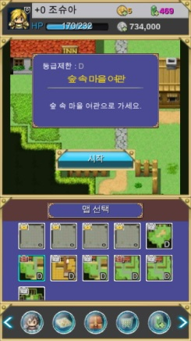
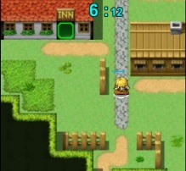
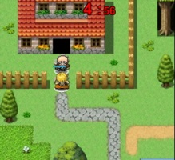
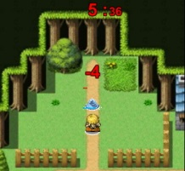
Game Explanation
4
2
3
Select a map to play.
Display the map title and rules of play
Game start button.
Variety of games in each map
Score decided by the time of completion.
Each map has its own open conditions.
1

Slide 7
Game Explanation
Map Type | Description | Note
Moving Type | You have to arrive at a goal point within the time limit. | implementation completion
Dialog Type | You have to talk to NPC within the time limit. | implementation completion
Killing Type | You have to get rid of all the monsters within the time limit. | implementation completion
Boss Type | You have to kill the boss monster within the time limit. | Being implemented
Gimmick Type | You have to operate buttons or levers to complete an action within the time limit. | Being implemented
Trap Type | You have to arrive at a goal point avoiding traps within the time limit. | Being implemented
Reward Type | You have to stay at a certain point for limited time to receive gold. | Being implemented
Puzzle Type | You have to complete a puzzle like pushing box. | Being implemented
Shooting Type | You have to kill all the monsters before they cross a certain point. | Being implemented

Slide 8
BM
Item | Description | Note
Character Gacha | 5 Characters in each grade. Total 20 Characters at launching. | Each Character has 5 ability. Each ability is decided randomly between 0 - 2 when character is generated. When generated, one of 6 random option are given.
Character Enchant | Upgrade Character ability. | 0 or 1 point increase every time a character is enchanted. Max 5 times.
Character Down Grade | Lower Character grade to of the lower graders enter the map. | When excuted, one of 5 ability gets lowered randomly.
Character Slot Addition | Increase the number of characters a user can own. | Max is 99.
Item Slot Addition | Increase the number of items a user can own. | Increase 5 item slots at a time. Max is 99.
Item Enchant | It will increase the performance of item. | Max is 99. When failed, an item disappears.

Slide 9
















BM
Character
Grade D |  | Grade C
Grade B |  | Grade A
Grade S | Undecided | Grade SS | Undecided
Circulation of Currency
Character
Gacha
Character
Enchant
Jewel
(Cash)
Character
Down Grade
Item
Enchant
Gold
Mission
Coin
Character
Slot
Purchasing item
Event
Item Slot
Play

Slide 10
Future Plan
Item | Contents | Note
User Created Map | Add Web Map Editor for users to create their own maps. Add Market System to sell maps with other users. | Map is made using Web Editor. Coins are required to upload maps to the Market System. Users can buy maps in game.
PVP | Users can fight other users using their characters.

