Slide 1
Diffusion LLMs vs Autoregressive LLMs

Slide 2
Što radimo?
Evaluiramo razlike između difuzijskih i AR LLM kada se koriste u LLM-as-a-judge primjenama

Slide 3
LLM-as-a-judge
Prompt + API call
Dovoljno dobro slaganje s ručno anotiranim podatcima
Ako su kriteriji jasni

Slide 4
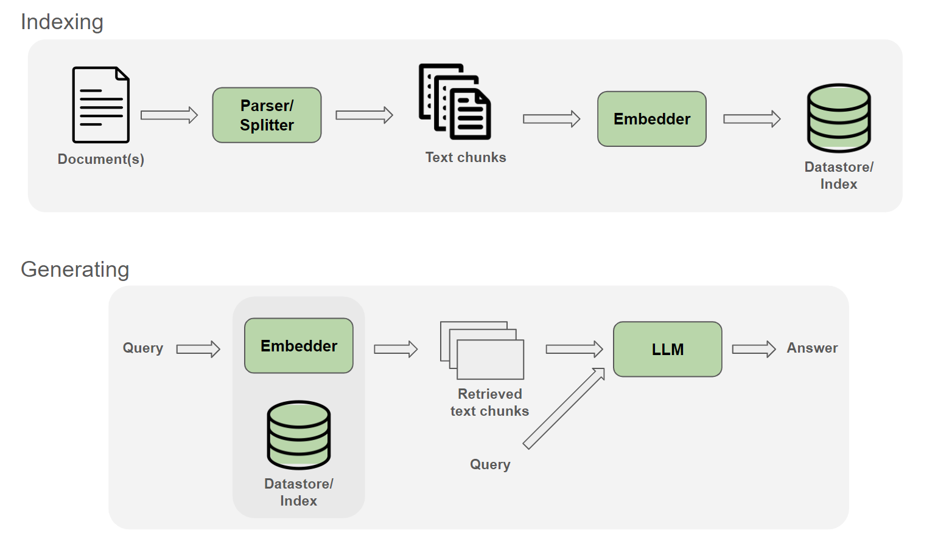
RAG pipeline

Slide 5
Ragas metrike
Open source framework za evaluaciju AI Agenata
5 metrika (ne zahtjevaju referencu)
Answer_relevancy
Context_relevance
Context_utilization
Faithfuless
Response_groundness

Slide 6
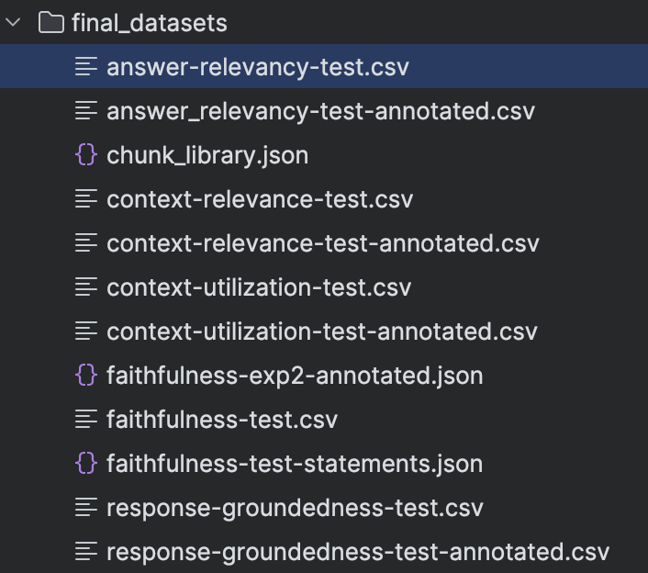
Primjer dataseta

Slide 7
Primjer dataseta

Slide 8
Answer_relevancy
INPUT
Question
Response
OUTPUT
Reverse-engineered question from response
Cosine_similarity(Reverse-engineered question, Question)
Uncommital binary flag
Uncommital odgovori ”ne daju informaciju”
Npr. ” I'm not able to help with that question. Sorry.”

Slide 9
Context relevance
INPUT
Question
Retrieved context
OUTPUT
Oznake 0, 1 ili 2 (diskretna skala)
Judge1 I judge2
Ista semantika, drugciji wording

Slide 10
Response groundness
INPUT
Response
Retreived context
OUTPUT
Oznake 0, 1 ili 2 (diskretna skala)
Judge1 I judge2
Ista semantika, drugciji wording

Slide 11
Context utilization
INPUT
Question
Response
Context (chunk by chunk)
OUTPUT
Binary flag
Utilized vs not utilized

Slide 12
Faithfulness
INPUT
Answer
context
OUTPUT
Factual statements presented in the answer
Binary flag for each
Is faithful to context?

Slide 13
Faithfulness
Atomic claim / statement extraction
NLI-based support checking
faithfulness score

