Slide 1
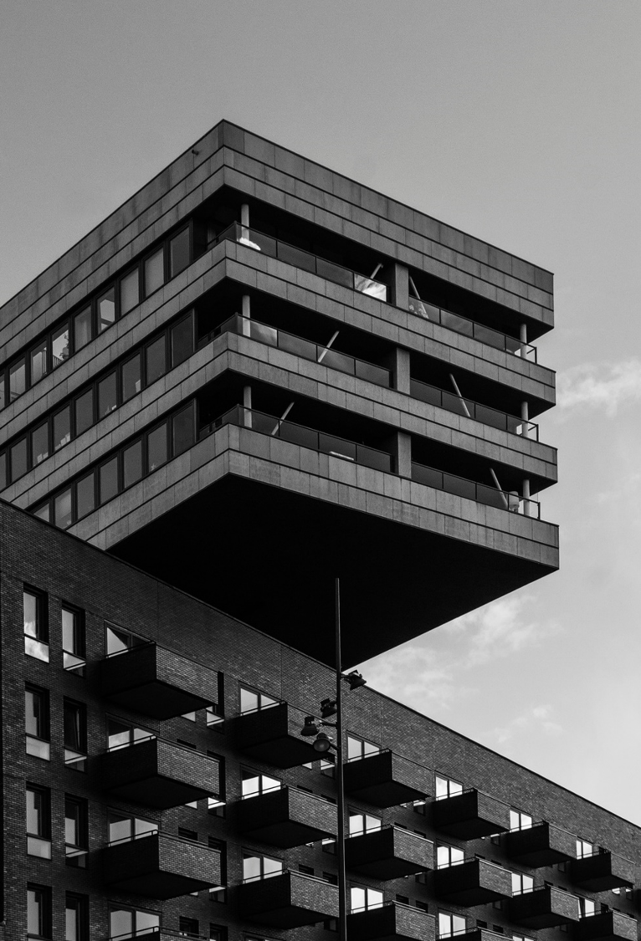
Bike-Share To Success
2019 review of Cyclistic bike-share program
Kelsey Almanzar
4/7/2025

Slide 2
Agenda
Company Current Standing
High Volume Months
Mission and Vision
Long Term Renters
Average Rider Time
Marketing Solutions
Popular Days and Time

Slide 3

Current Standing
A bike-share program that features more than 5,800 bicycles and 600 docking stations. Cyclistic sets itself apart by also offering reclining bikes, hand tricycles, and cargo bikes, making bike-share more inclusive to people with disabilities and riders who can’t use a standard two-wheeled bike. The majority of riders opt for traditional bikes; about 8% of riders use the assistive options. Cyclistic users are more likely to ride for leisure, but about 30% use the bikes to commute to work each day

Slide 4

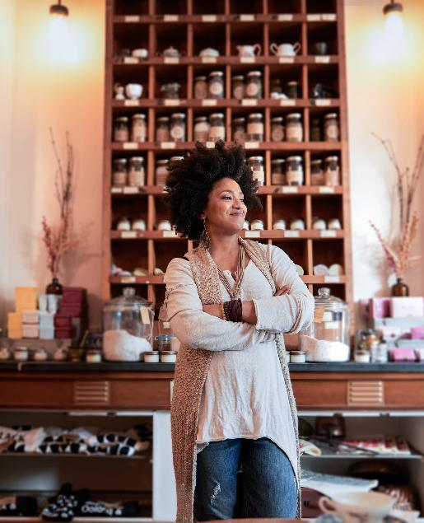

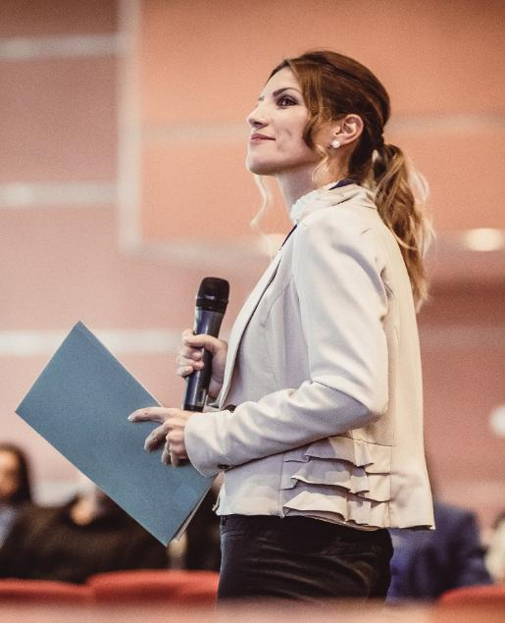
Mission & Vision
Create marketing strategies to convert casual riders into annual members in 2020.
How do members and casual riders use the bikes differently?
Why would a casual rider buy a Cyclistic membership?
How we use digital media to influence casual riders to purchase memberships?

Slide 5
Average Rider
Average Ride Length
Quarter | Time (hh:mm:ss)
 | Customer | Members
Q1 | 1:02:00 | 13:54
Q2 | 48:51 | 14:00
Q3 | 1:04:07 | 16:09
Q4 | 1:01:05 | 12:30
Yearly Average | 0:59:00 | 14:06
Casual riders ~59 minutes
Member riders ~14minutes

Slide 6
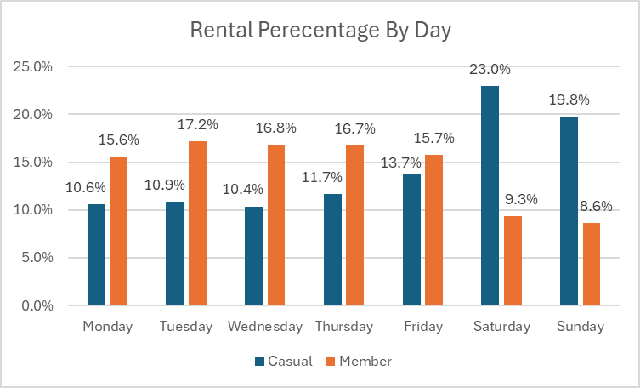
Popular Days
42.8% of casual users ride on weekends
82% of Members rent bikes on the weekdays

Slide 7
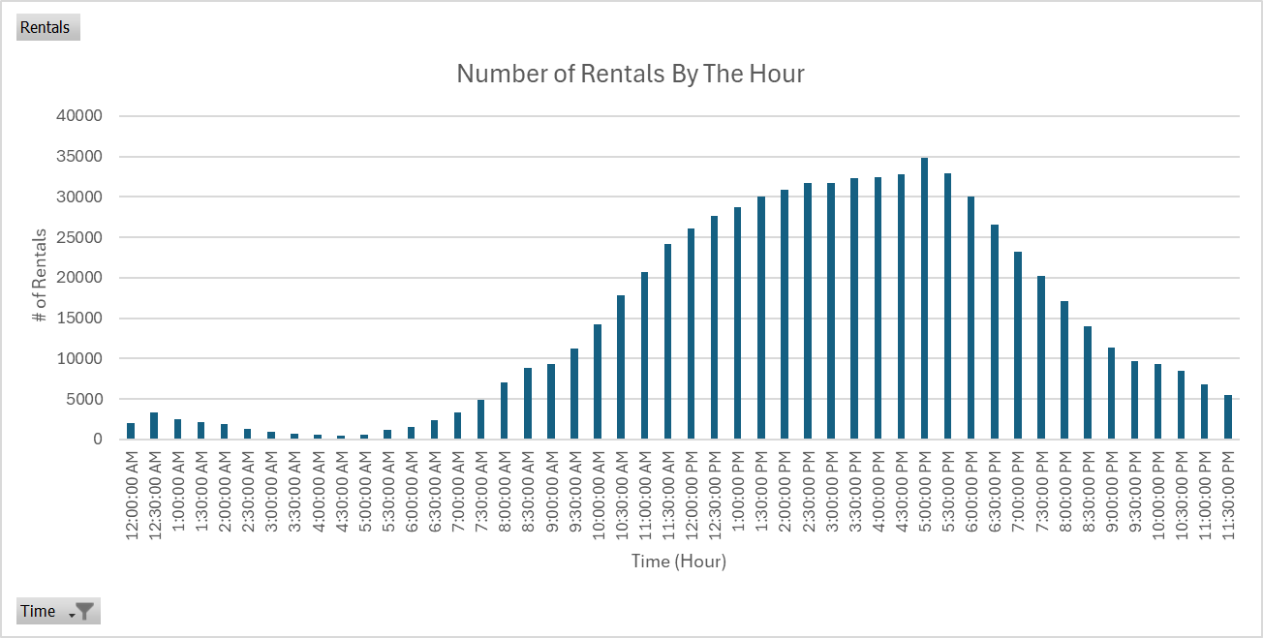
Popular Times
>30,000 renters/hr between 2:00 pm and 6:00pm

Slide 8
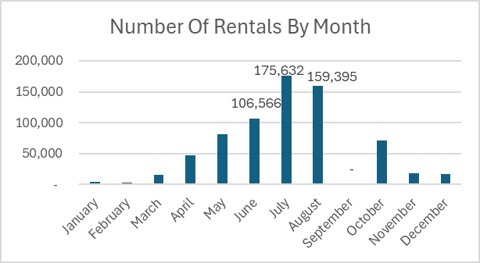
High Volume Months
63% of casual users rent bikes between the months of June, July, & August

Slide 9
Long Term Renters
Percent of Rentals over 24 hours
Quarter | Rentals >24 hours / total rentals
 | Casual | Members
Q1 | 0.29% | 0.04%
Q2 | 0.14% | 0.01%
Q3 | 0.13% | 0.02%
Q4 | 0.27% | 0.02%
Total Yearly | 0.82% | 0.08%
Less than 1% of casual riders rent for more than 24 hours

Slide 10
Marketing Objectives
01
02
03
04
Ride By The Hour
Happy Rider
The Weekender
Long Term
Provide new members discounts on rides longer than an hour
Offer a "Happy Hour" like discount for riders between the time of 2 pm and 6 pm
New members have access to weekend rates for select months or time periods
A higher tier subscription that allows new members to have access to long term rentals.

Slide 11

Thank you

