Slide 1

Data Science: Healthcare
Persistency of a drug
(Group Project)
Dec 2021

Slide 2
Team Members
Team
Name | Email | Country | College/Company | Specialization
Bao Khanh Nguyen | nguyenkhanhbao8695@gmail.com | USA | American Energy Project | Data Science
Seyedeh Marzieh Hosseini | shosseini@uni-potsdam.de | Germany | University of Potsdam | Data Science
Guillermo Leija | leija.guillermo@gmail.com | Mexico | IEBS Business School | Data Science
Zain Ul Haq | zainulhaq904@gmail.com | Germany | University of Rostock | Data Science

Slide 3

Agenda
Executive Summary
Problem Statement
Approach
EDA
Model Development
Model Selection
Model Evaluation
Conclusion

Slide 4
Executive Summary
ABC company also one of pharmaceutical companies, wants to know how long a medicine will last in a patient's system (persistency of a drug). Based on prescription data, the ABC corporation needs to determine whether a patient is persistent or not. ABC pharma would manufacture medicines in that number based on the persistency count so that they could operate their firm effectively and avoid the risks of NTM infections.
ML Problem:
With an objective to gather insights on the factors that are impacting the persistency, build a classification for the given dataset
Target Variable: Persistency_Flag

Slide 5
Problem Description
ABC is a pharmaceutical business that wants to know the persistency of a drug after a physician has prescribed it for a patient. This company has approached an analytics firm to automate the identifying procedure. This analytics firm has entrusted our team with the task of developing a solution to automate the persistence of a medicine for the client ABC.

Slide 6
Business Understanding
One of the long-lasting business issues in the world of pharmaceutical companies is the persistency of drugs which can significantly affect the outcome of medical treatments. One of the important factors that is related to persistency is the adherence of the patient to the prescribed regimens, meaning if the patient is committed to the prescribed regimens or not. There is a lot of information about Non-Tuberculous Mycobacterial (NTM) infections. In fact, related studies show that around 50%-60% of the patients with different illnesses in US miss doses, take the wrong doses, or drop off treatment in the first year. Additionally, the illness, either chronic or acute can be related to the adherence and persistency of drugs.

Slide 7
Project’s Steps
Problem understanding
Data Understanding
Data Cleaning and Feature engineering
Model Development
Model Selection
Model Evaluation
Report the accuracy, precision and recall of both the class of target variable
Report ROC-AUC as well
Deploy the model
Explain the challenges and model selection

Slide 8
Methodologies
Data was taken from github and analysed
Problem understanding
Data Understanding
Data Cleaning and Feature engineering
Model Development
Model Selection
Model Evaluation

Slide 9
Data Intake Report
Name: Healthcare – Data Science Report date: 25th April 2021
Data storage location: https://github.com/Khanhbao8695/HealthCar_DS2021
Total number of files 1
Total number of features 26
Base format of the file .xlsx
Size of the data 898 KB

Slide 10
Data Cleaning
Checking Missing Value/ NAN / Null Data
Checking Outliers
Data Wrangling , Transformation and Standardization

Slide 11
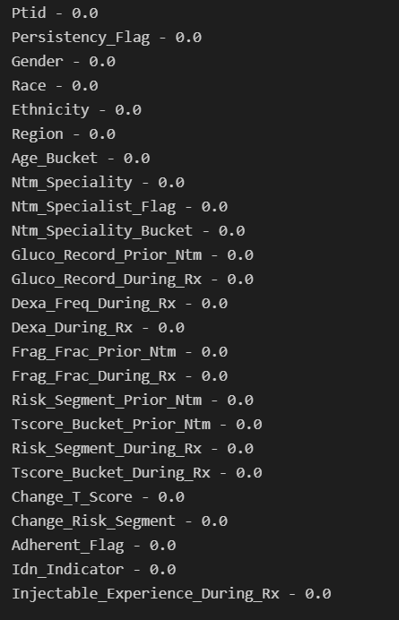
Analyzing dependency of variable (Before Transformation)
Non-Persistent : 62.35 % Persistent : 37.65 %
The analysis showed more non persistence of drugs than persistence
Missing Values
df.isnull().sum()
for col in df.columns:
pct_missing = np.mean(df[col].isnull())
print('{} - {}'.format(col,pct_missing))
No missing values were found

Slide 12
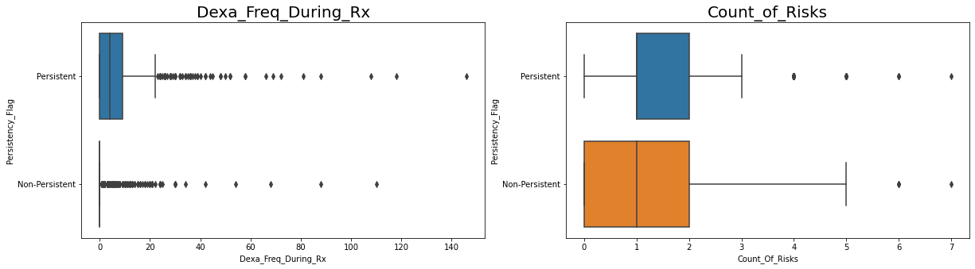
Checking Outliers
As we can see on these graphs, it is clearly to conclude that both Dexa_Freq_During_Rx and Count_of_Risks variables have outliers. Therefore, we will implement solutions to deal with this issue

Slide 13
Data Transformation to resolve outliers
Our approach to deal with the skewness and outliers for these variables is using IQR Score. To remove outliers, this approach uses the IQR values calculated before. Anything outside of the range of (Q1 - 1.5 IQR) and (Q3 + 1.5 IQR) is considered an outlier and should be eliminated.
In this project, for Dexa_Freq_During_Rx and Count_of_Risks, we will remove any data outside of the range of (Q1 - 1.5 IQR) and (Q3 + 1.5 IQR) or two whiskers.
For the Old Shape (3424,69) for both of Count of Risk" and “Dexa Freq During Rx" variable but after removed the outliers with this method, the new shape only (2964,69), which remove 460 data outside of the range of (Q1 - 1.5 IQR) and (Q3 + 1.5 IQR).

Slide 14
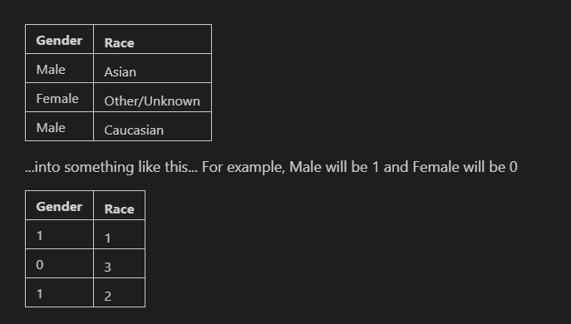
LABEL Encoding for categorical variables
We need to pre-process our categorical data from words to number to make it easier for the computer to understands. To do this we will use LabelEncoder() provided by sklearn. Basically, it will transform a categorical column from this (example to describe this approach):

Slide 15
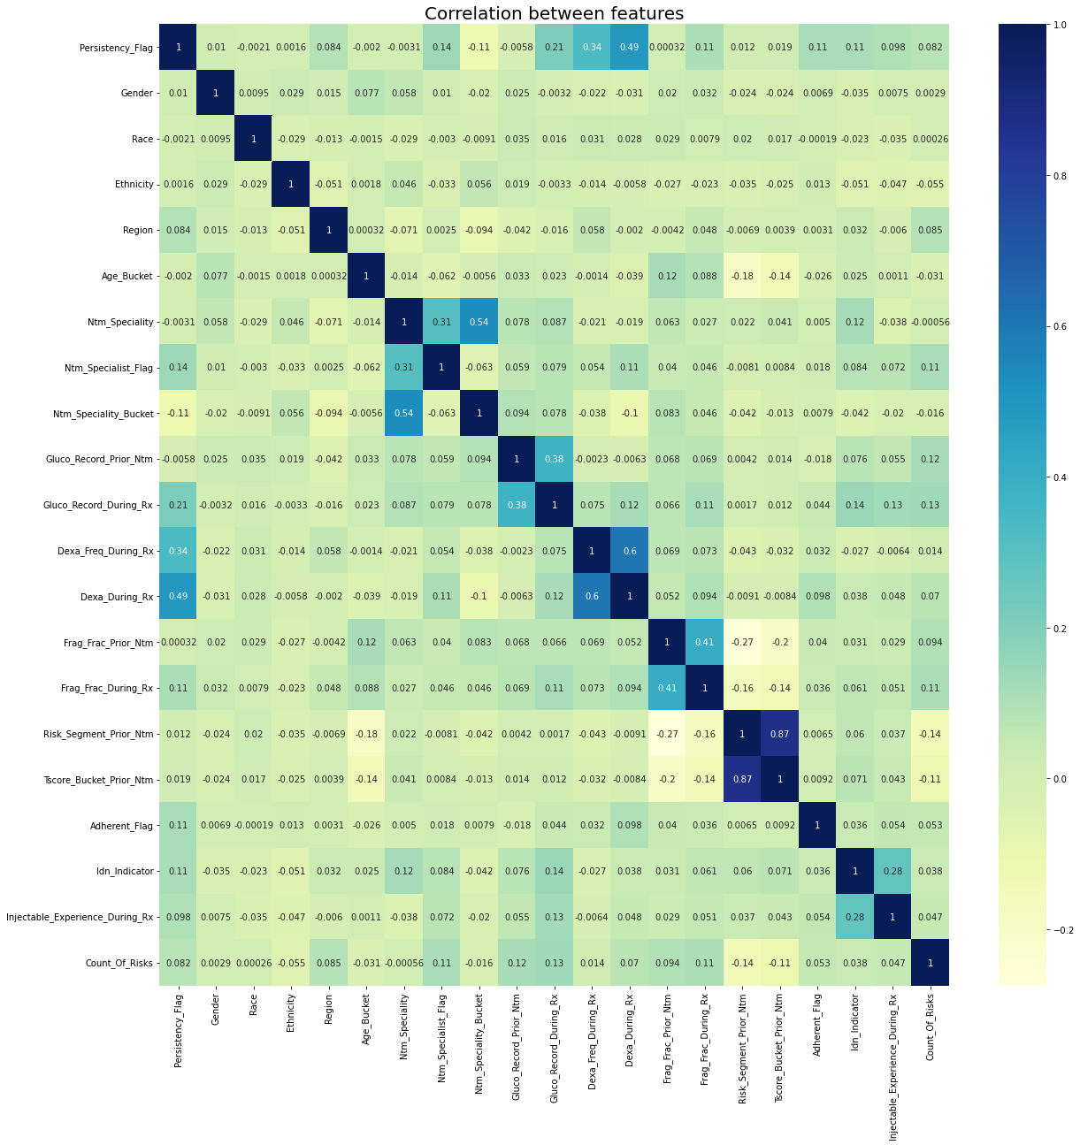
EDA (1): Correlation after transformation

Slide 16
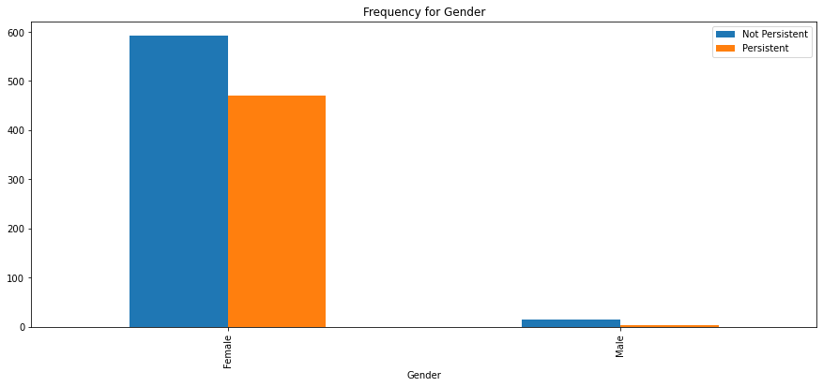
EDA (2): Gender
It shows that females are most persistent with drug compliance

Slide 17
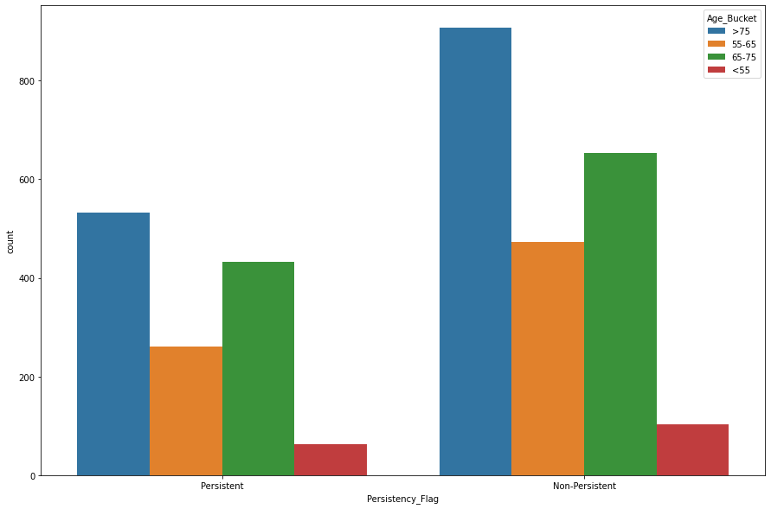
EDA (3): Age
Group of people under 55 years old tend to have higher persistent compared to other groups

Slide 18
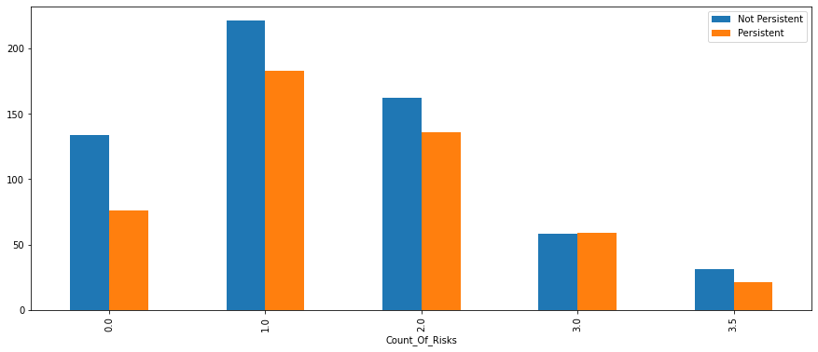
EDA (4): Number of Risks and Persistent with drugs
It shows that the number of risk arises when patients are not persistent with their drugs

Slide 19
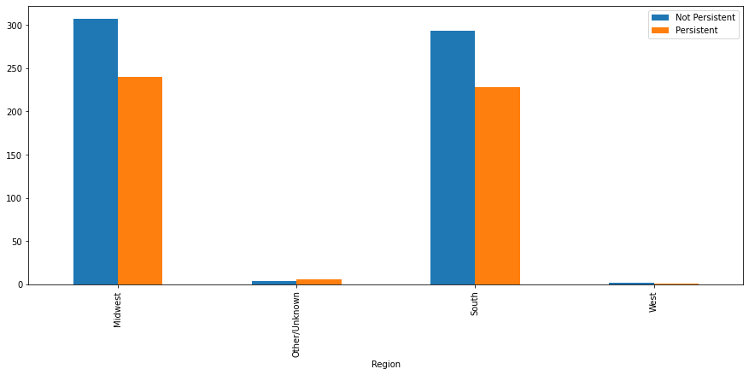
EDA (5): Regions and Persistent with drugs
South and Midwest Regions have both higher Persistent and Non-Persistent Drugs

Slide 20
Model Suggestion
We will develop four different classification models:
Linear Models: Logistic Regression
Model for Ensemble: XGBoost Classifier
Model for Boosting: AdaBoost Classifier
Other models

Slide 21
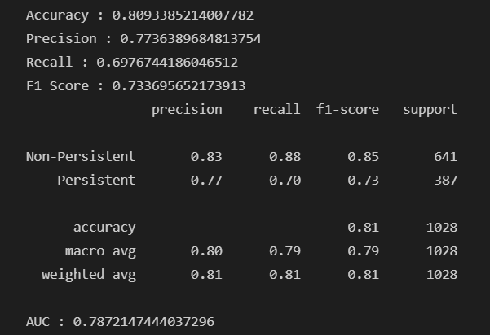
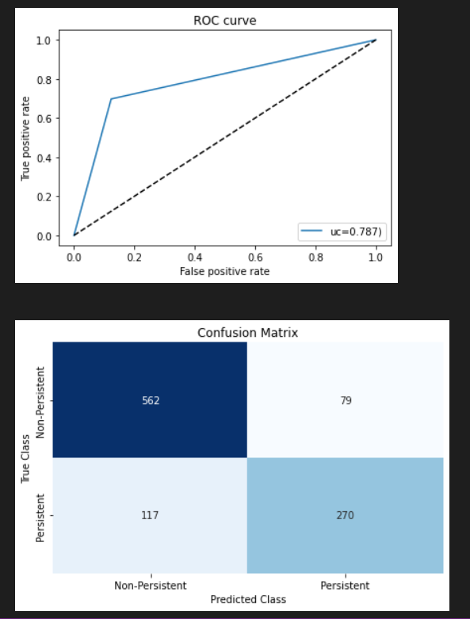
Model Creation-Logistic Regression
Logistic Regression Model shows the Accuracy, Recall, Precision ,f1 score and Support of Non-Persistent and Persistence of drugs.

Slide 22
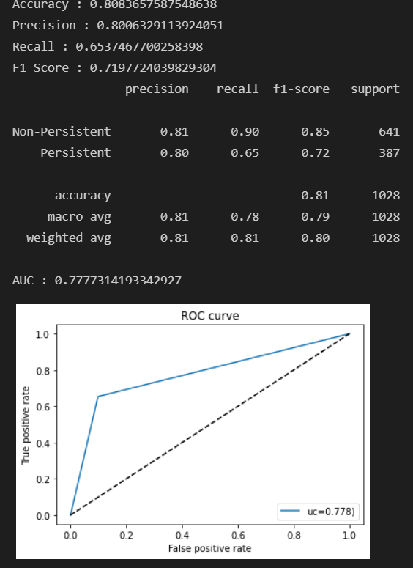
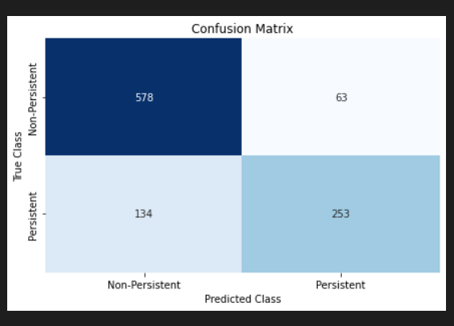
Model Creation- Ridge Classifier
Ridge Classifier Model shows the Accuracy, Recall, Precision ,f1 score and Support of Non-Persistent and Persistence of drugs.

Slide 23
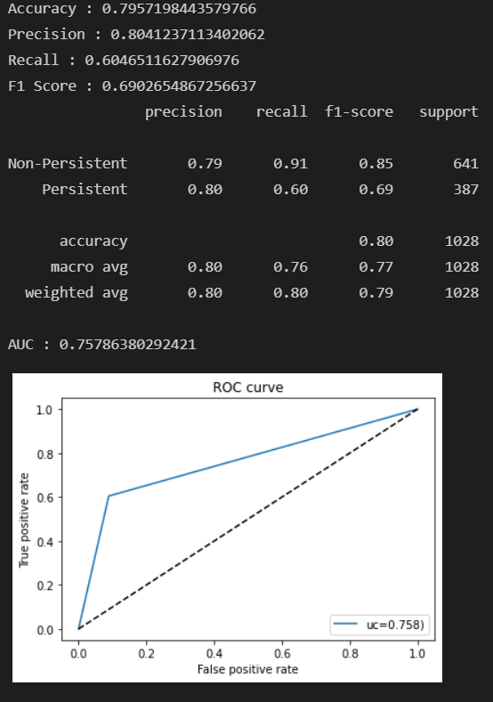
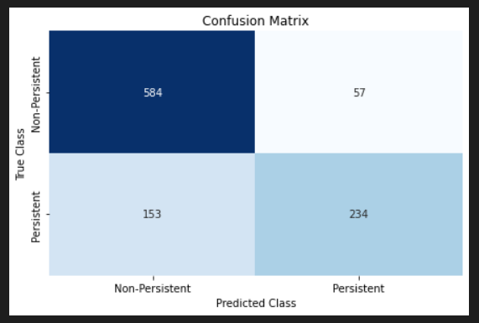
Model Creation-SDG Classifier
SDG Classifier Model shows the Accuracy, Recall, Precision ,f1 score and Support of Non-Persistent and Persistence of drugs.

Slide 24
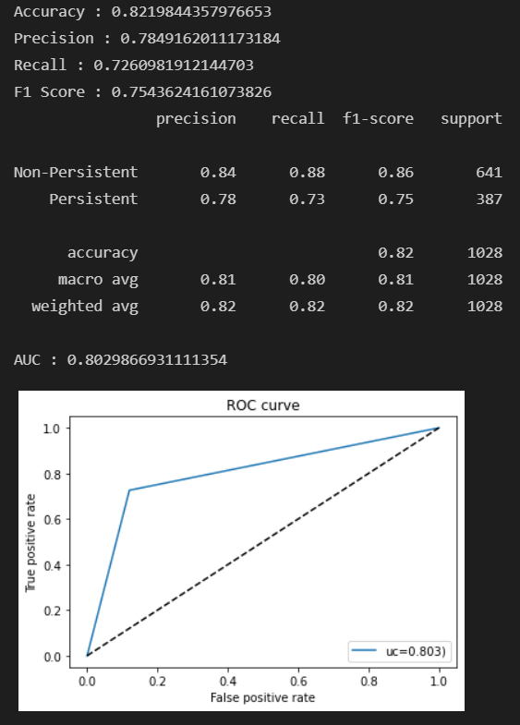
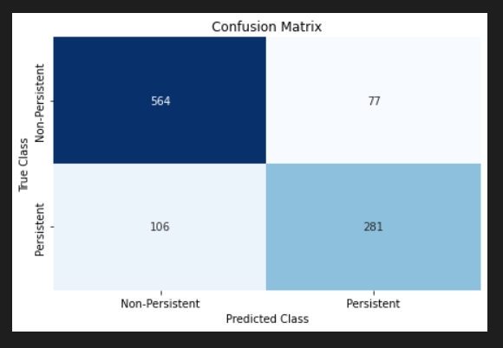
Random Forest Classifier
Random Forest Classifier Model shows the Accuracy, Recall, Precision ,f1 score and Support of Non-Persistent and Persistence of drugs.

Slide 25
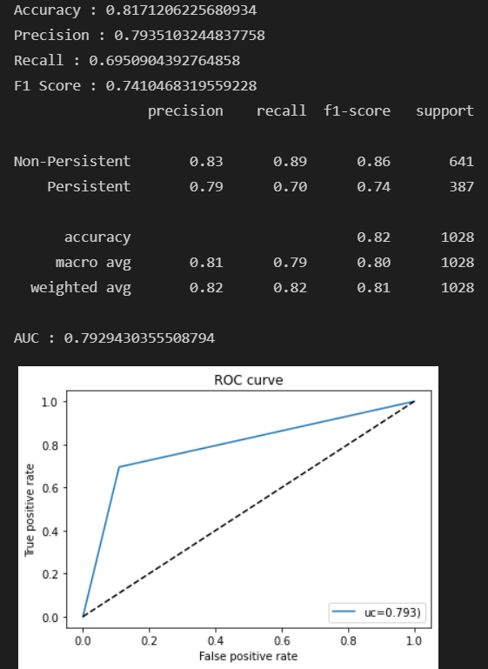
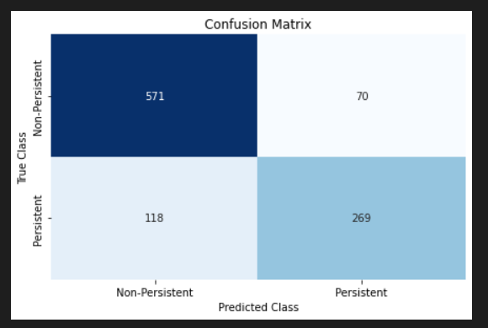
Ada Boost Classifier
Ada boost classifier shows the Accuracy, Recall, Precision ,f1 score and Support of Non-Persistent and Persistence of drugs.

Slide 26
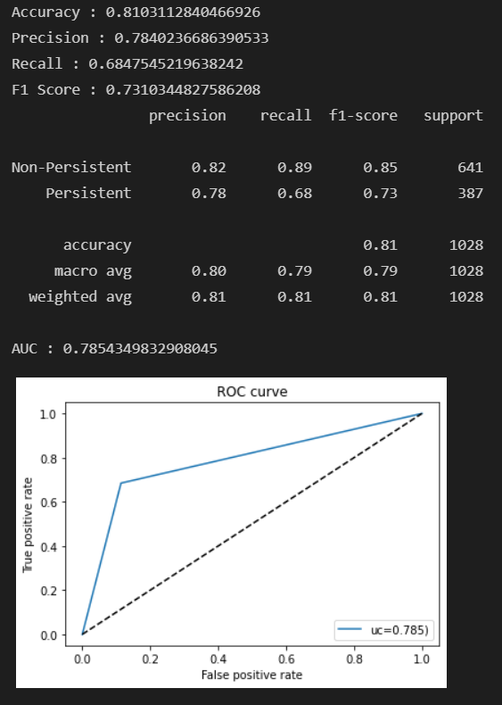
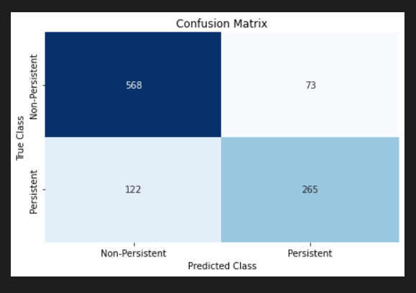
Stacking Classifier
Stacking Classifier Model shows the Accuracy, Recall, Precision ,f1 score and Support of Non-Persistent and Persistence of drugs.

Slide 27
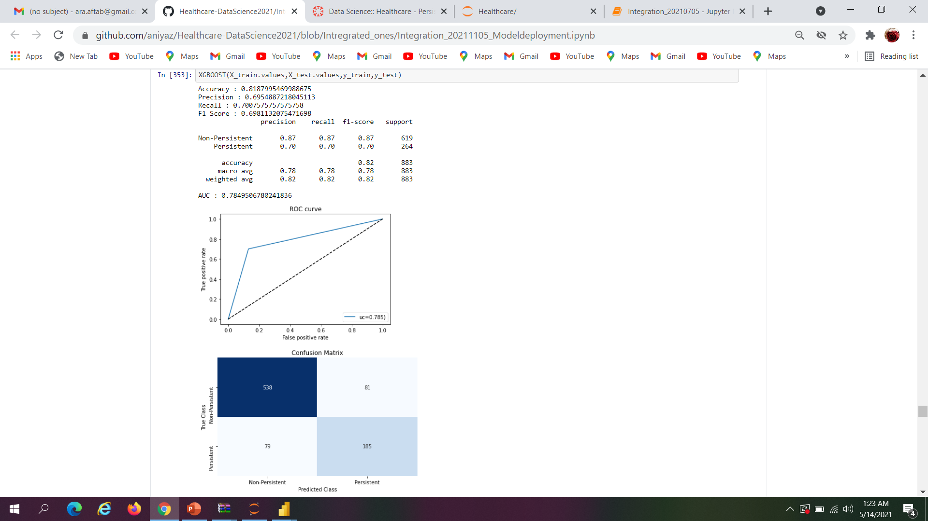
XG Boost Classifier
XG Boost Classifier Model shows the Accuracy, Recall, Precision ,f1 score and Support of Non-Persistent and Persistence of drugs.

Slide 28
Conclusion
Approximately all the classifiers have same result, but three of them are the bests :
Logistic Classifier (Linear) with Accuracy 81%, Recall 70%, 73% F1-Score, and 78% AUC
AdaBoost Classifier (Ensemble/Boosting) with Accuracy 81%, Recall 69%, 74% F1-Score, and 79% AUC
XGBoost Classifier (Ensemble/Boosting) with Accuracy 82%, Recall 73%, 75% F1-Score, and 80% AUC

Slide 29
Thank You

