Slide 1

Progress in First-Principles Phonon Calculations
and
Phonon-Phonon Interactions
Atsushi Togo*¹ and Isao Tanaka^{1,2}
¹Center for Elements Strategy Initiative for Structural Materials (ESISM), Kyoto university
²Department of Materials Science and Engineering, Kyoto University

Slide 2
Outline
Harmonic phonons
(phonopy)
Quasi-harmonic phonons
Anharmonicity
Phonon-phonon interaction
Working with
Laurent Chaput,
Université de Lorraine.
Phonon lifetime
(phono3py)
Thermal conductivity

Slide 3
Phonopy
Phonopy is a post-processing-type phonon code.
Sets of atomic forces wrt atomic displacements are the inputs.
A variety of phonon related properties are the outputs.
Supported (ab-initio) force calculators:
VASP, Wien2k, Abinit, Pwscf, Elk, Siesta, FHI-aims

Slide 4


Harmonic force constants
Force constants are coefficients
of crystal potential energy (V)
expansion.
M
N
P
i, j, k: Cartesian components
: Harmonic force constants
Spring constant between atoms

Slide 5

How to calculate force constants
Finite displacements and supercell approach
1. Displace an atom
M
N
u_{j}(N): Displacement of atom N
2. Measure forces on atoms
F_{i}(M): Force on atom M
P

Slide 6



Phonons
Atomic displacement operator may be described as
Solve eigenvalue problem to obtain phonon frequency & eigenvector:
where dynamical matrix may be defined as

Slide 7
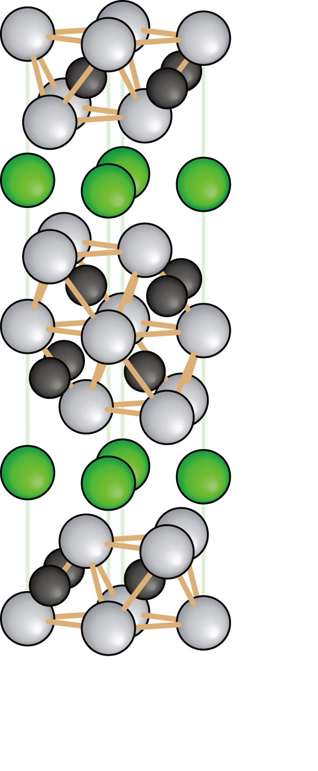
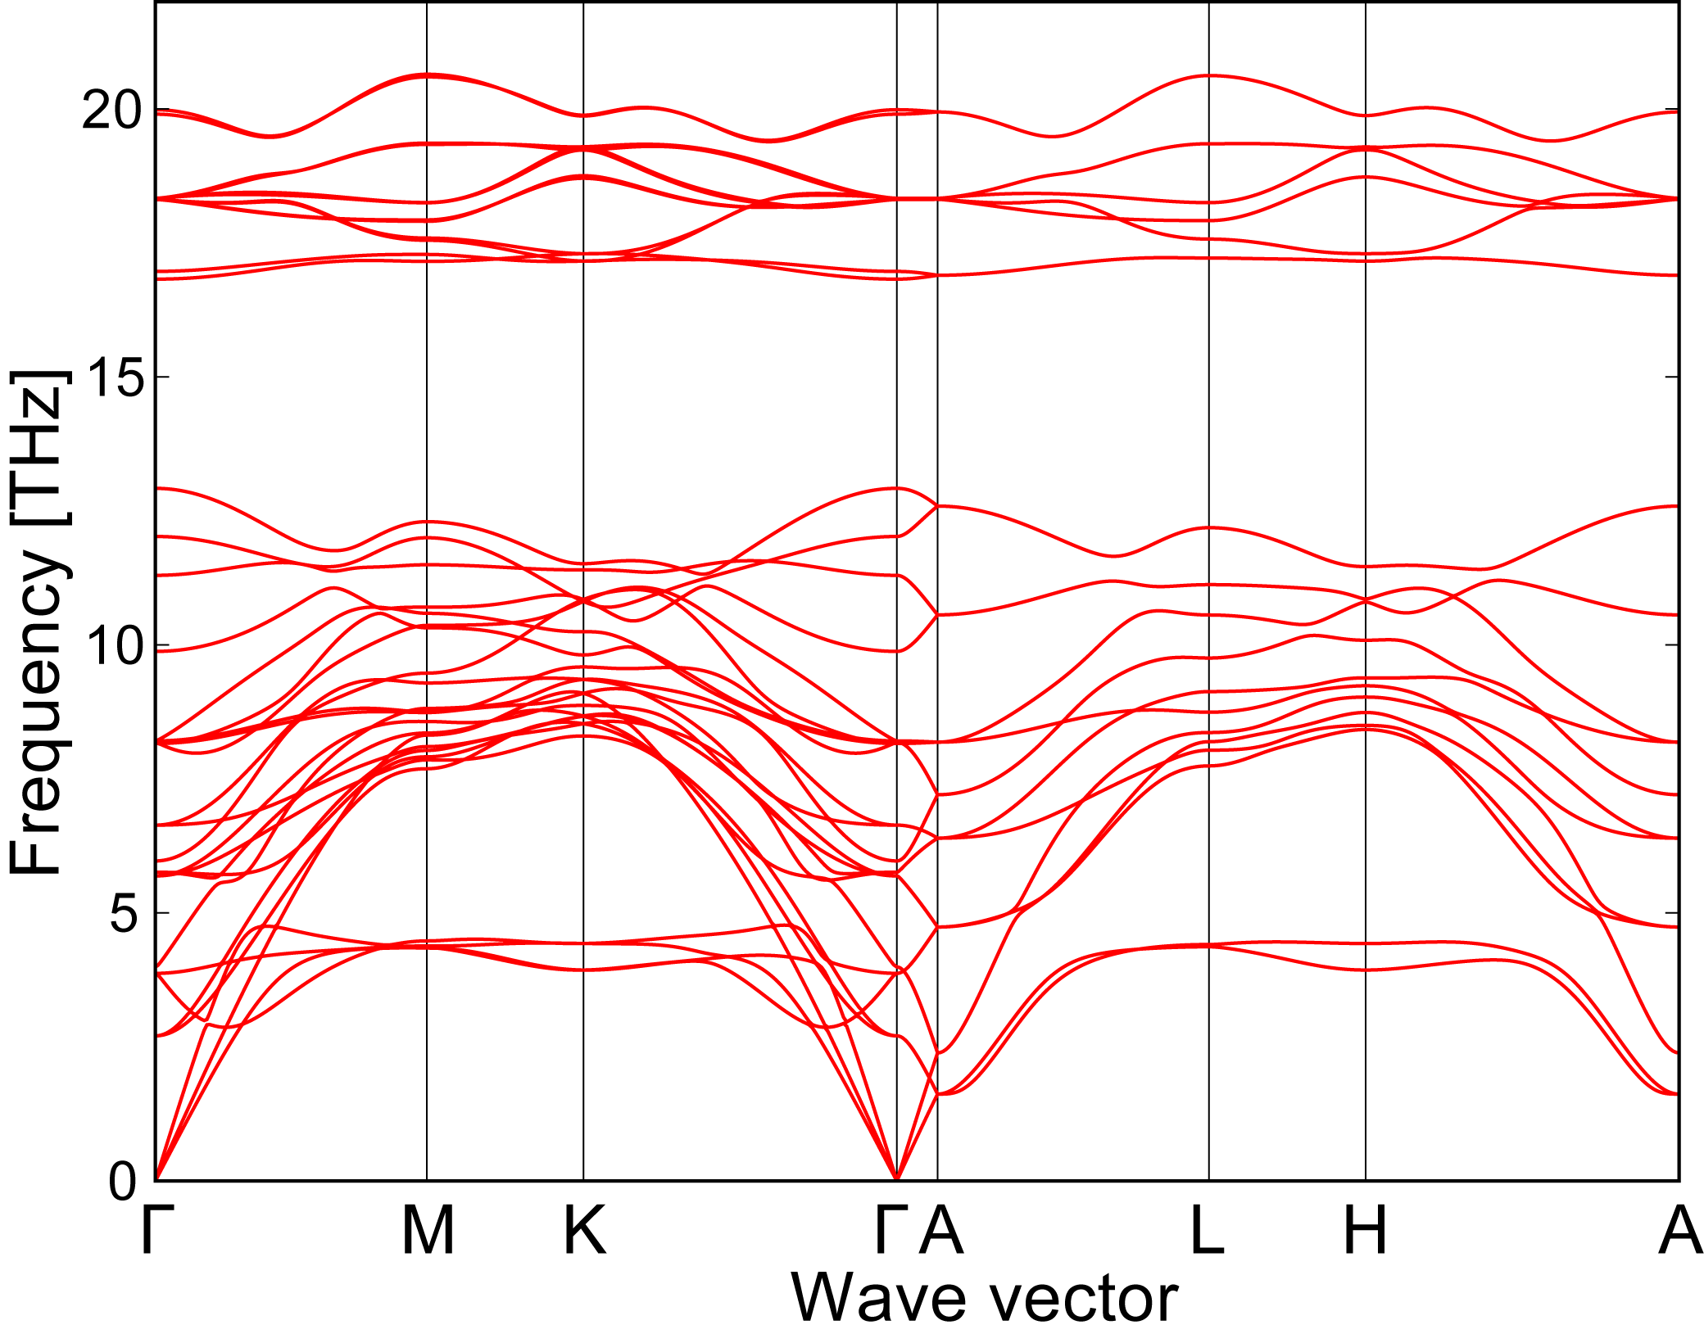
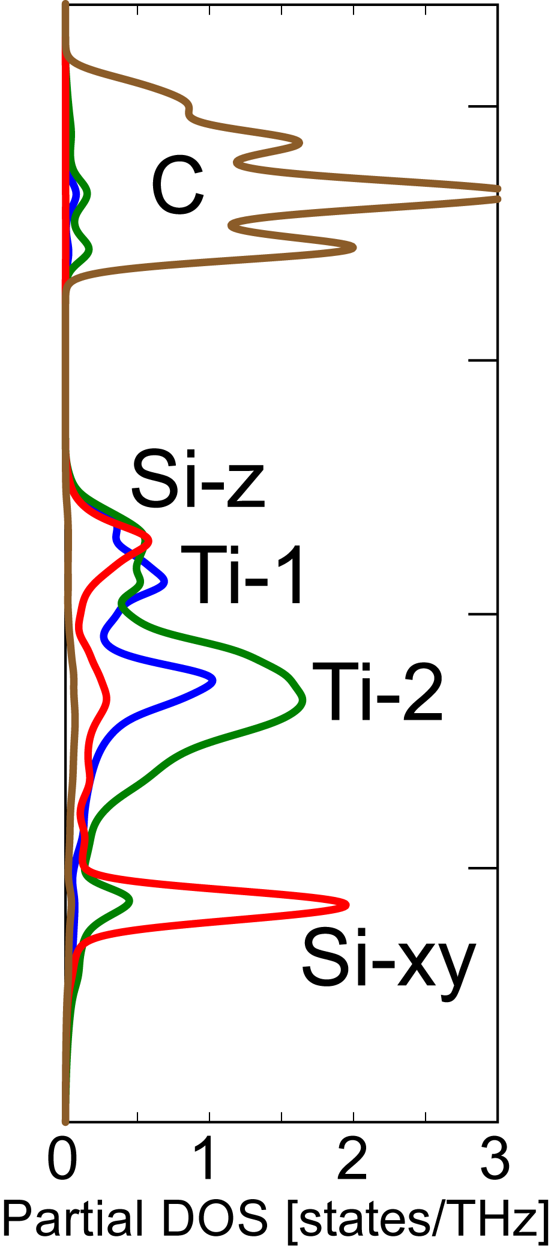
Phonon band structure of Ti3SiC2
Togo et al., Phys. Rev. B 81, 174301 (2010)
Localized bands at ~5 THz:
random motion of Si along basal plane

Slide 8


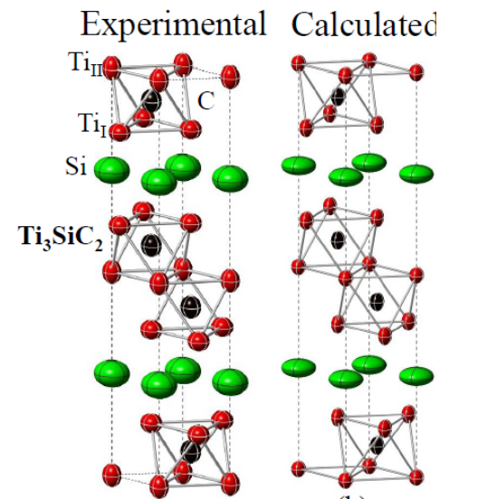
Thermal ellipsoid
How far do atoms move?
N. Lane et al., Phys. Rev. B, 86, 214301-1-9 (2012)

Slide 9


Thermal properties at constant V
Helmholtz free energy
Entropy
Heat capacity at constant volume

Slide 10
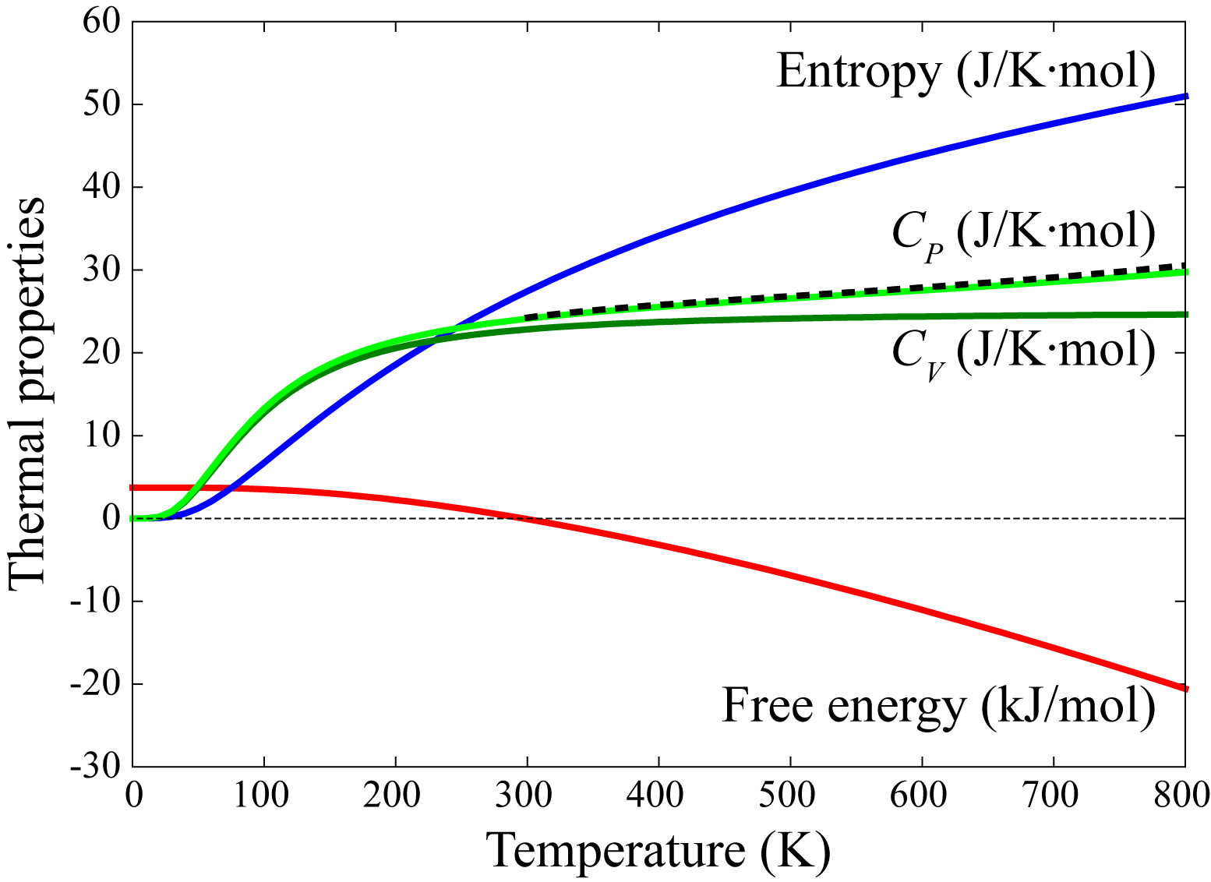
Thermal properties at constant V
Helmholtz free energy
Aluminum
Entropy
Heat capacity at constant volume

Slide 11




Quasi-harmonicity: volume dependence of phonons
LO mode
Si
q=Γ, s=4, 5, 6
Microscopic picture
Mode Grüneisen parameter

Slide 12
Quasi-harmonic Helmholtz free energy
Helmholtz free energy with respect to V and T

Slide 13
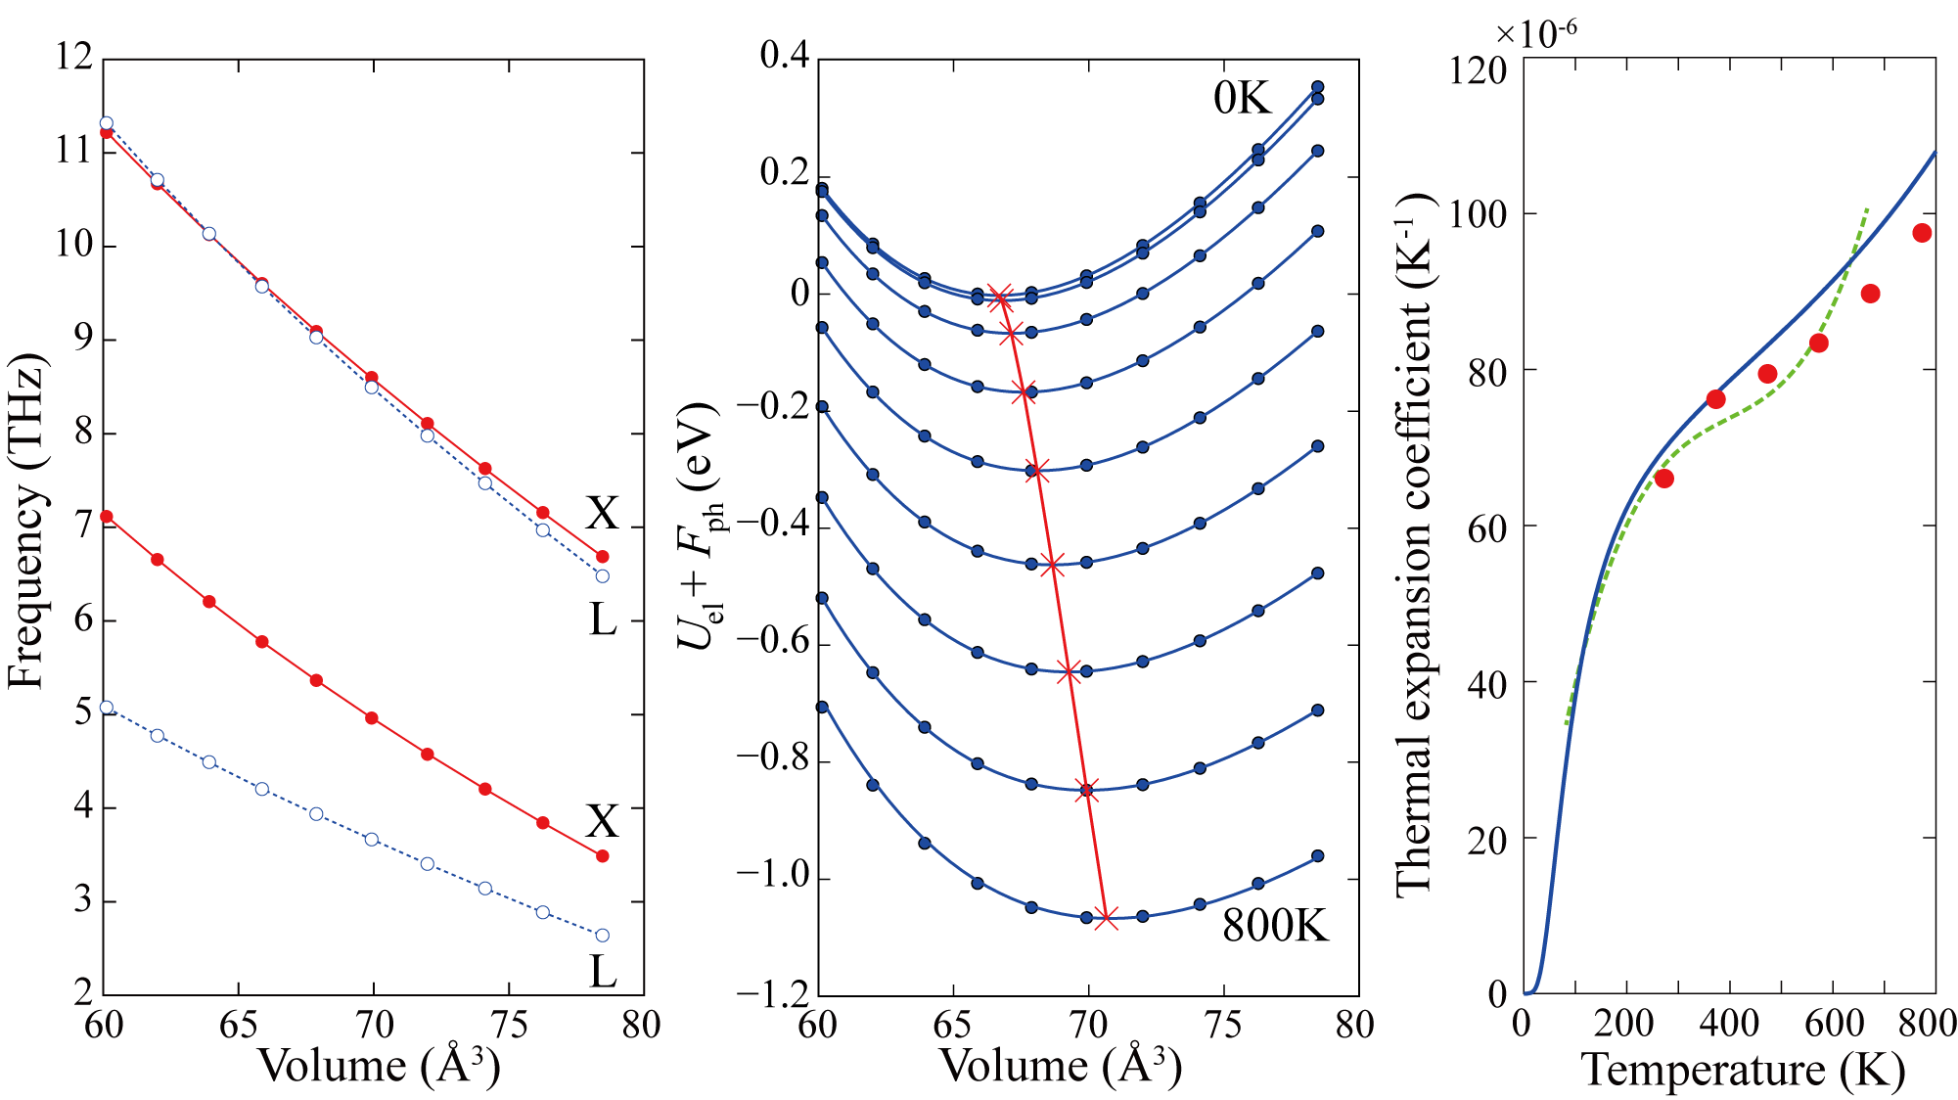
Calculation of thermal expansion in Alminum at p=0

Slide 14
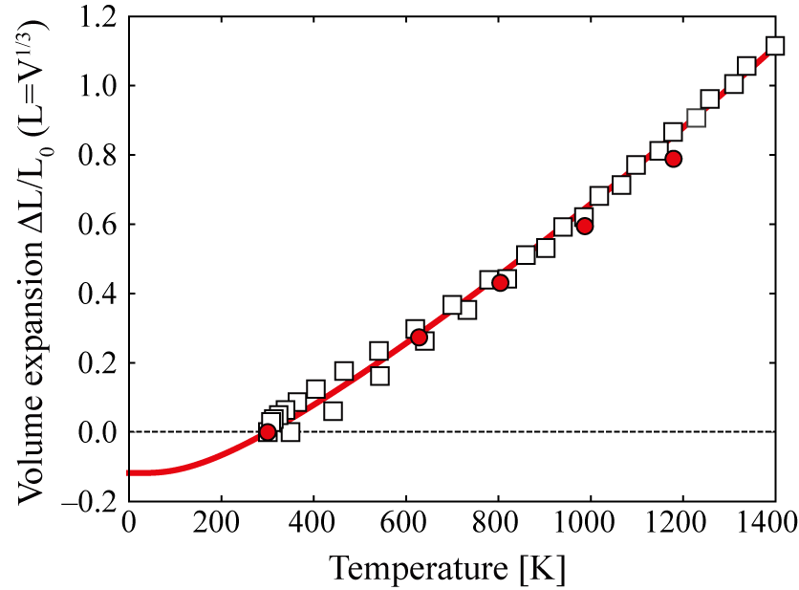
Volume (thermal) expansion of Ti3SiC2
Experiments: Barsoum et al., J. Phys. Chem. Solids 60, 429 (1999)
Scabarozi et al., J. Appl. Phys. 105, 013543 (2009)
Calculation: Togo et al., Phys. Rev. B 81, 174301 (2010)
Quasi-harmonic approximation is often good enough.

Slide 15

Group velocity: grad. of band structure

Slide 16
Anharmonic force constants
Force constants are coefficients
of crystal potential energy (V)
expansion.
M
N
P
i, j, k: Cartesian components
: Anharmonic force constants
Spring constant among atoms

Slide 17
Computing anharmonic force constants
1. Displace a pair of atoms
Δu_{j}(N): Displacement of atom N
M
N
Δu_{k}(P): Displacement of atom P
2. Measure forces on atoms
P
F_{i}(M): Force on atom M

Slide 18



Phonon-phonon interaction
Transformation of anharmonic force constants from real-space
to phonon coordinates, i.e., define anharmonic hamiltonian as
8 types of three phonon collisions:

Slide 19

Phonon-phonon interaction strength

Slide 20



Phonon lifetime
ω
ω''
Imaginary part of self-energy
ω'
Quite rare event due to energy conservation and momentum restriction
Phonon lifetime (reciprocal of linewidth)
Phonon linewidth can be observed by Raman/infrared spectroscopy.

Slide 21
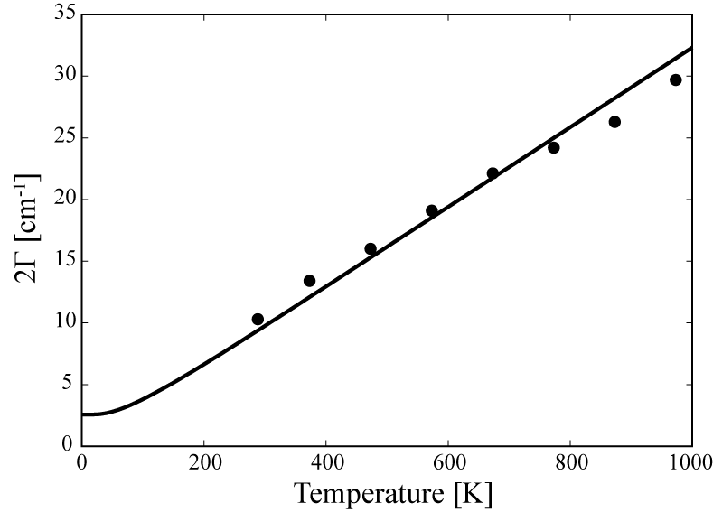
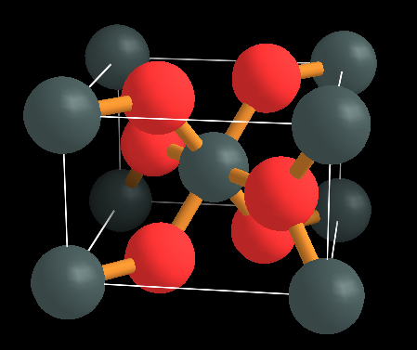
Linewidth: SnO2 (tetragonal)
A1g
Raman linewidths, Sato and Asari, J. Phys. Soc. Japan, 64, 1193 (1995)

Slide 22
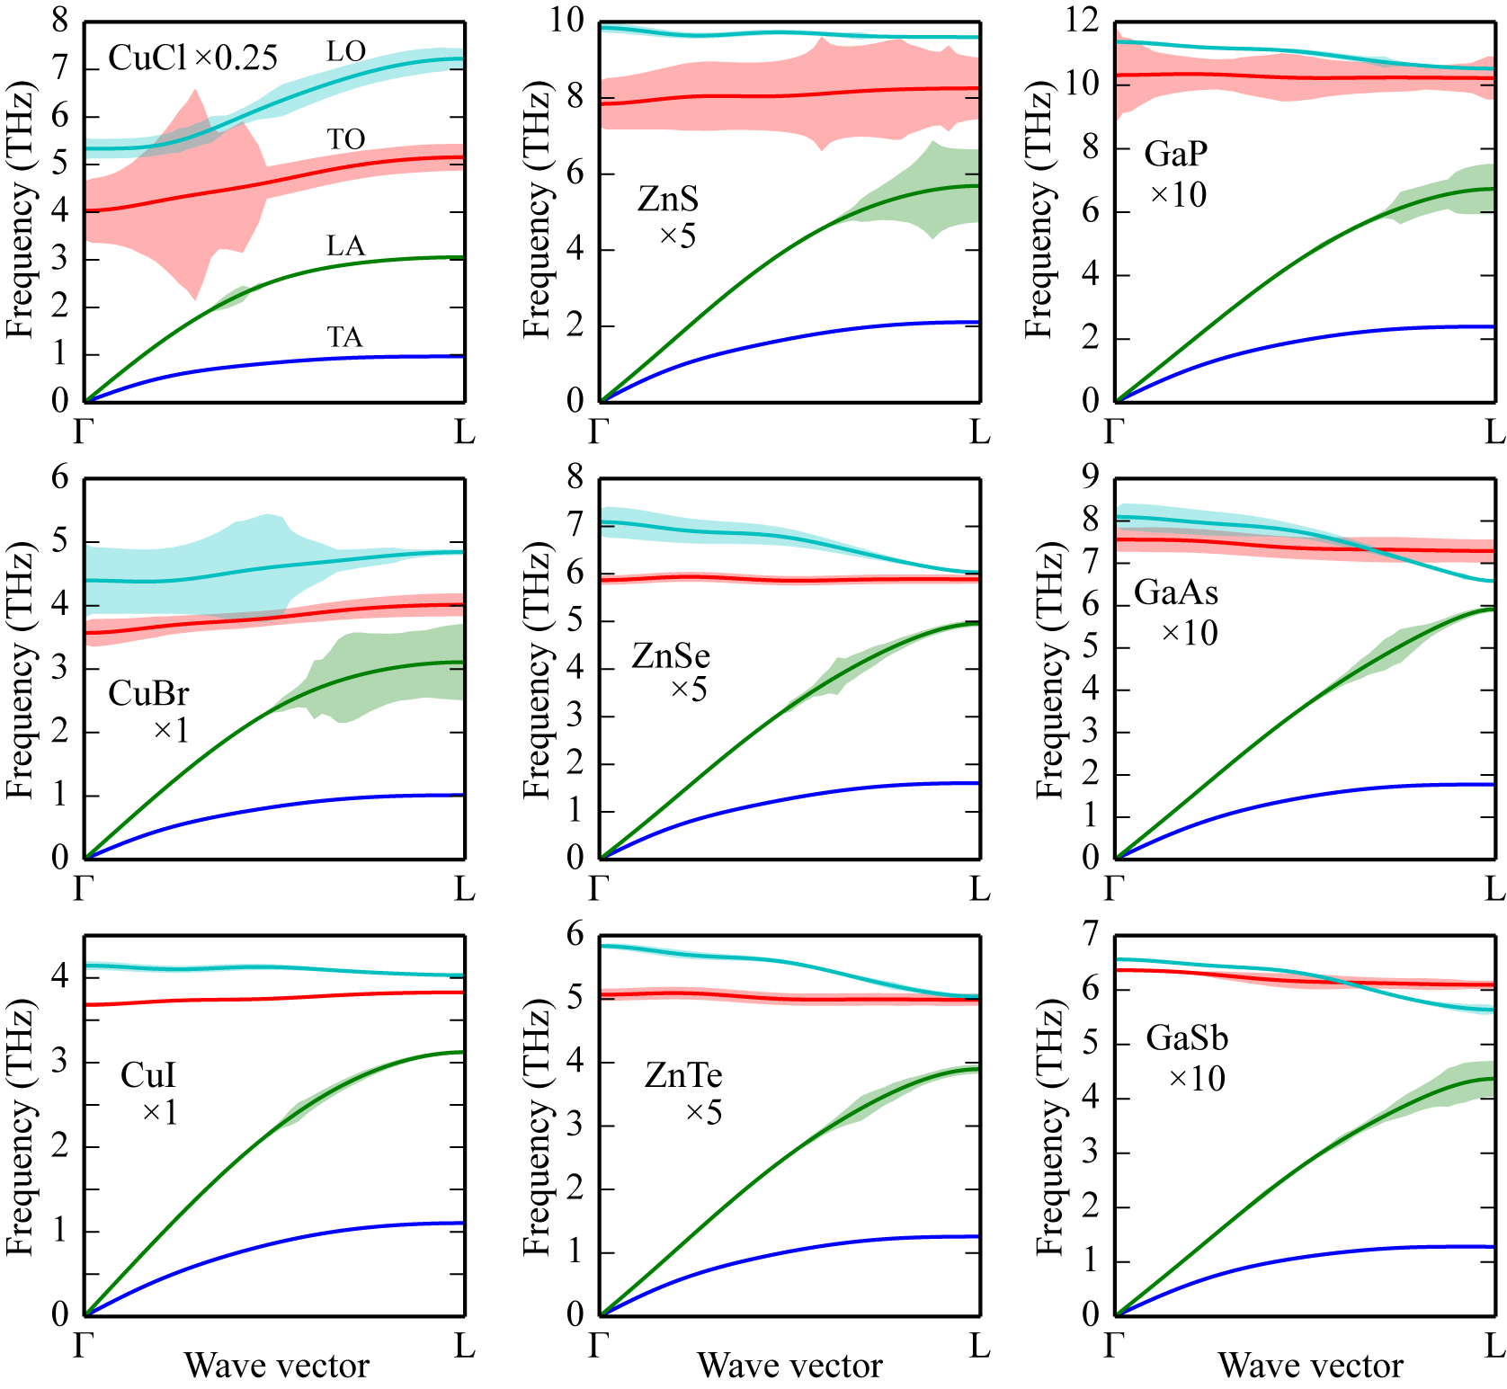
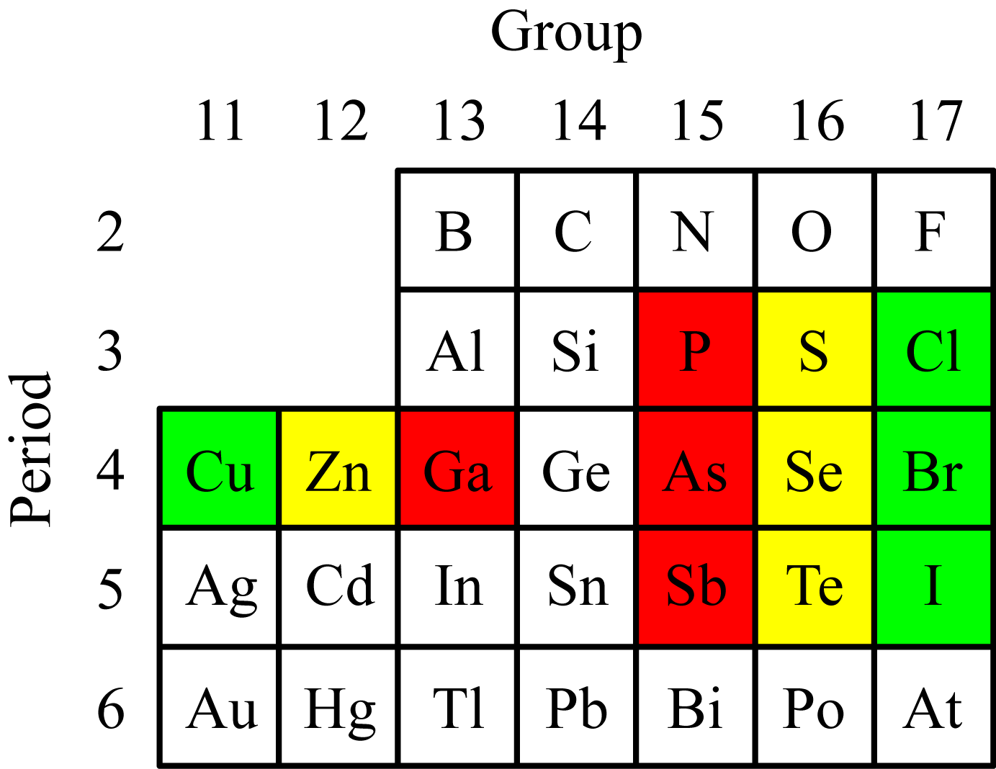
Linewidth distributions: non-smooth
c
CuX
ZnX
GaX
knot
*Togo et al., PRB, 91, 094306 (2015)

Slide 23

Lattice thermal conductivity
T+ΔT
T
Phonon
Fourier's law:
Heat flux
Temperature gradient
Thermal conductivity
(watts per meter kelvin (W·m−1·K−1))

Slide 24




Lattice thermal conductivity with relaxation time approximation (RTA)
Using relaxation time approximation
Heat flux
=
Then
Group velocity
Heat capacity per mode

Slide 25

Linearized Boltzmann equation (LBTE)
Direct solution: L. Chaput, PRL, 110, 265506 (2013)
Pseudo-inversion of a big dense matrix is required to eliminate
null space. Bad scaling on computation and memory usage.

Slide 26
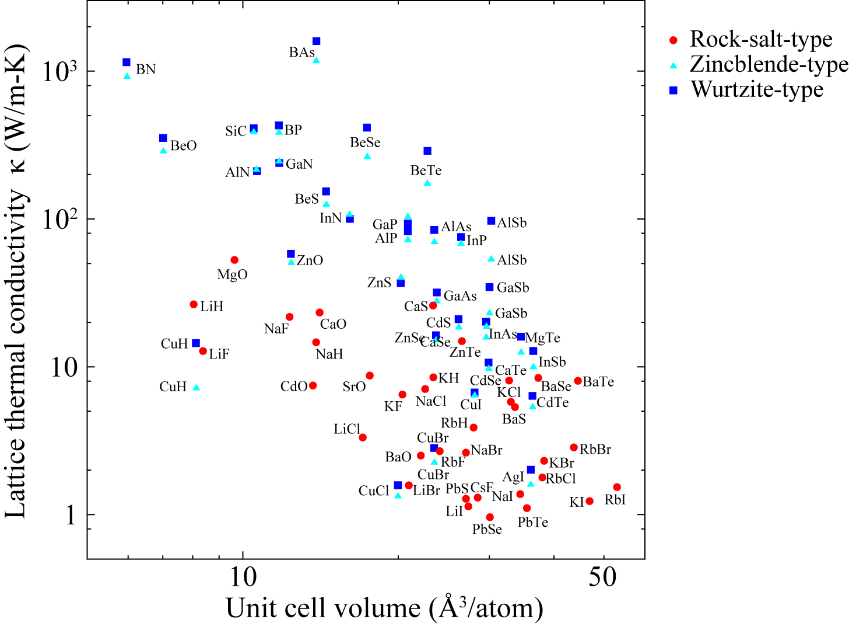
Lattice thermal conductivities (RTA)*
@300 K
*RTA without isotope
GGA-PBE
~300,000 times more expensive in the case of this wurtzite-type lattice thermal
conductivity calculation than the perfect unit-cell calculation.

Slide 27
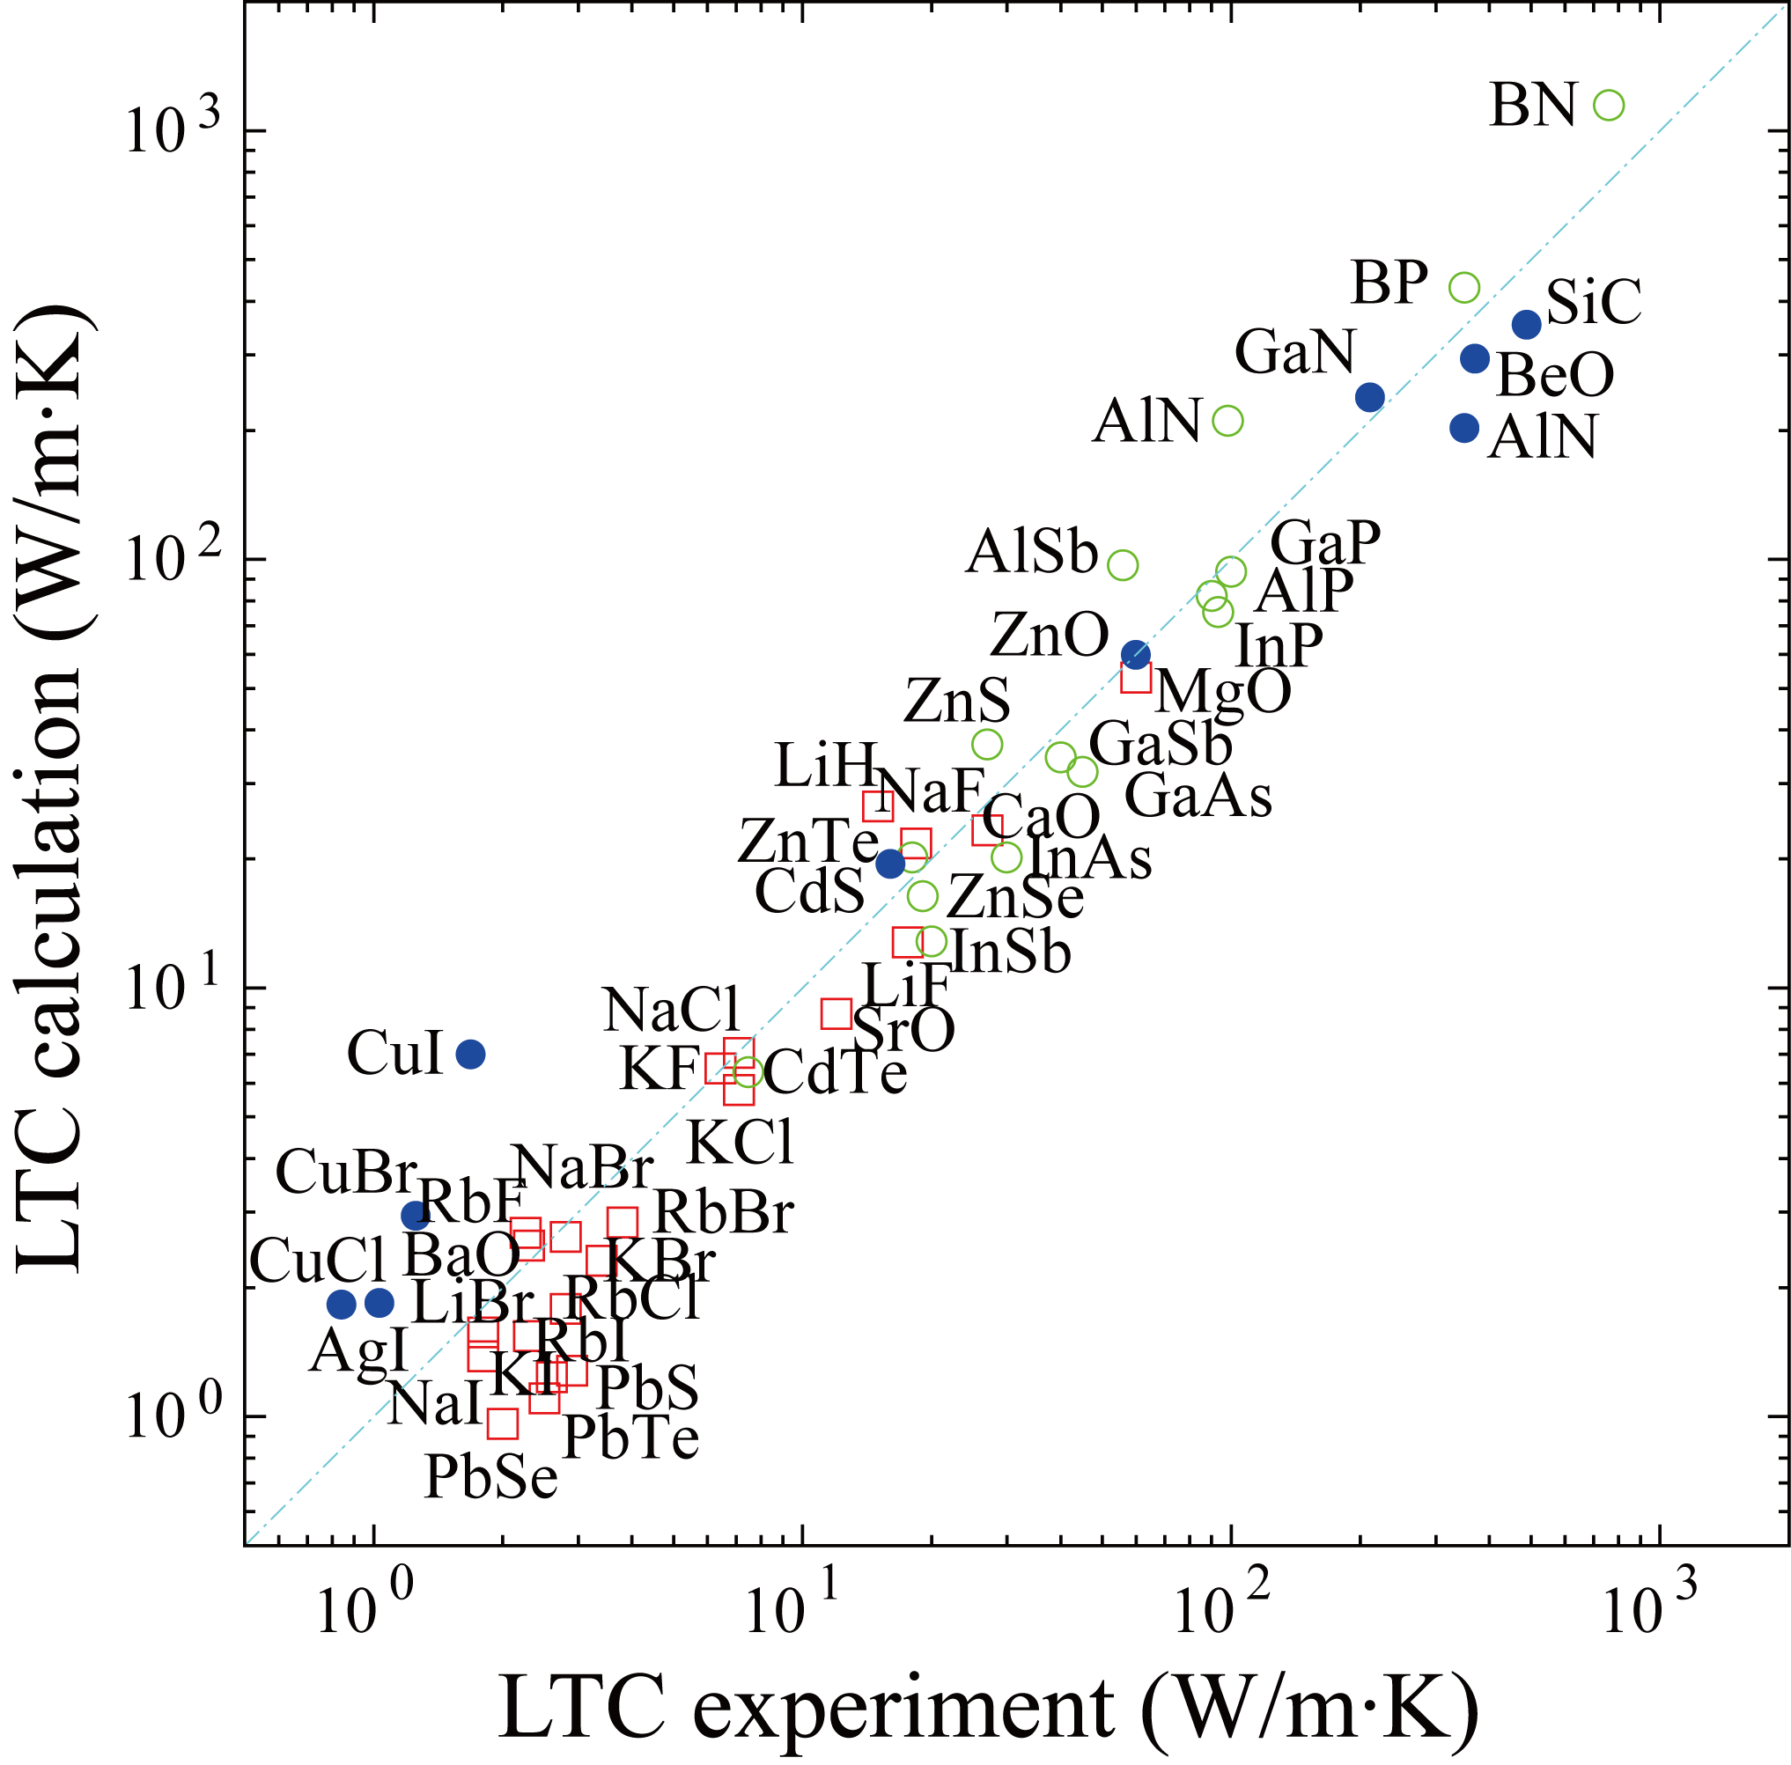
Calculations v.s. experiments (RTA) of rocksalt-, wurtzite- and zincblende-types
@300 K

Slide 28
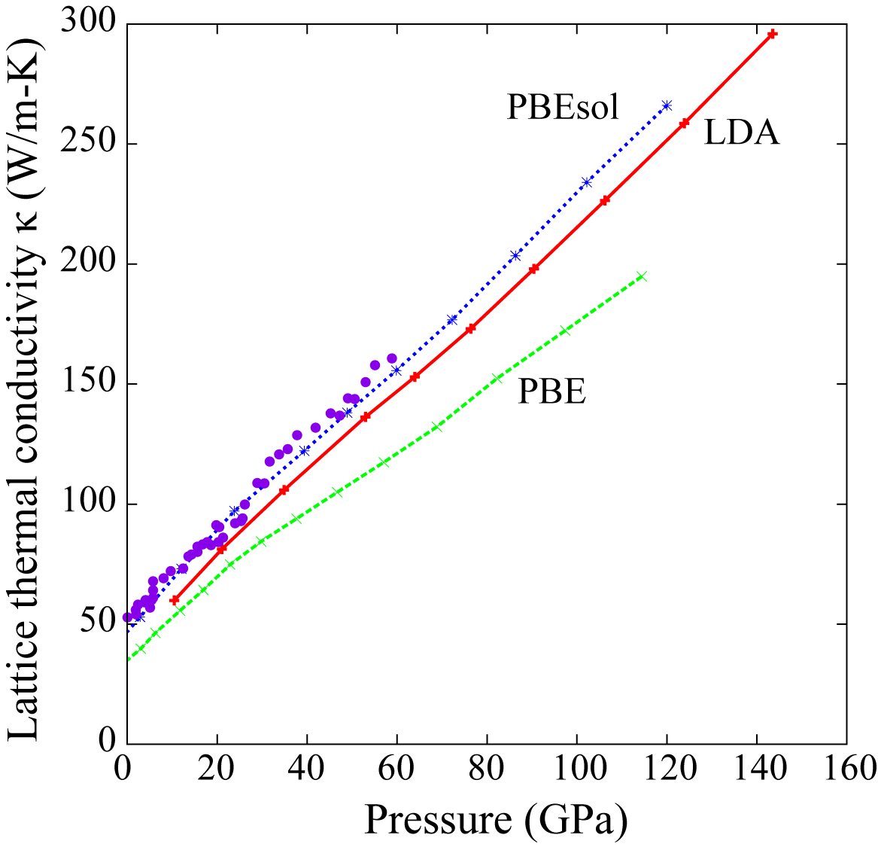

Lattice thermal conductivity of MgO under pressure (LBTE)*
Dalton et at., Scientific reports, 3, 2013
@300 K
Phonon-isotope scattering rate was
calculated using natural abundance of
elements and phonons.
Exp.**
Tamura, PRB, 27, 858 (2015)
*LBTE with QHA (thermal stress), isotope scattering and boundary mean free path of 0.5 μm
** Experiment: Dalton et al., Scientific reports 3, 2400 (2013)

Slide 29
Summary
First-principles phonon calculation is good to try, because
  - Often in good agreement with experiments
  - Computationally not so expensive in harmonic case
  - Software is available.
Finally, I introduce a phonon database.
  http://phonondb.mtl.kyoto-u.ac.jp/

Slide 30
Summary
First-principles phonon calculation is good to try, because
- Often in good agreement with experiments
- Computationally not so expensive in harmonic case
- Software is available.
Finally, I introduce a phonon database.
http://phonondb.mtl.kyoto-u.ac.jp/

Slide 31
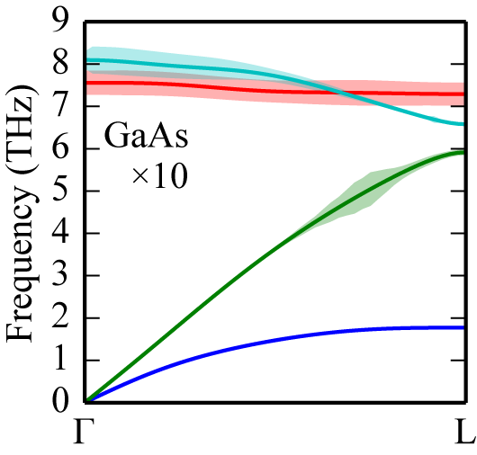
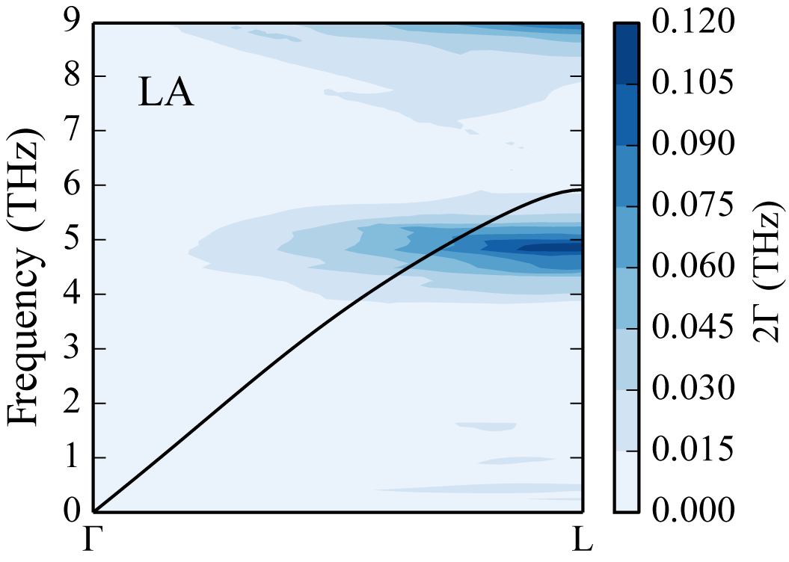
A reason of the non-smoothness
c

Slide 32
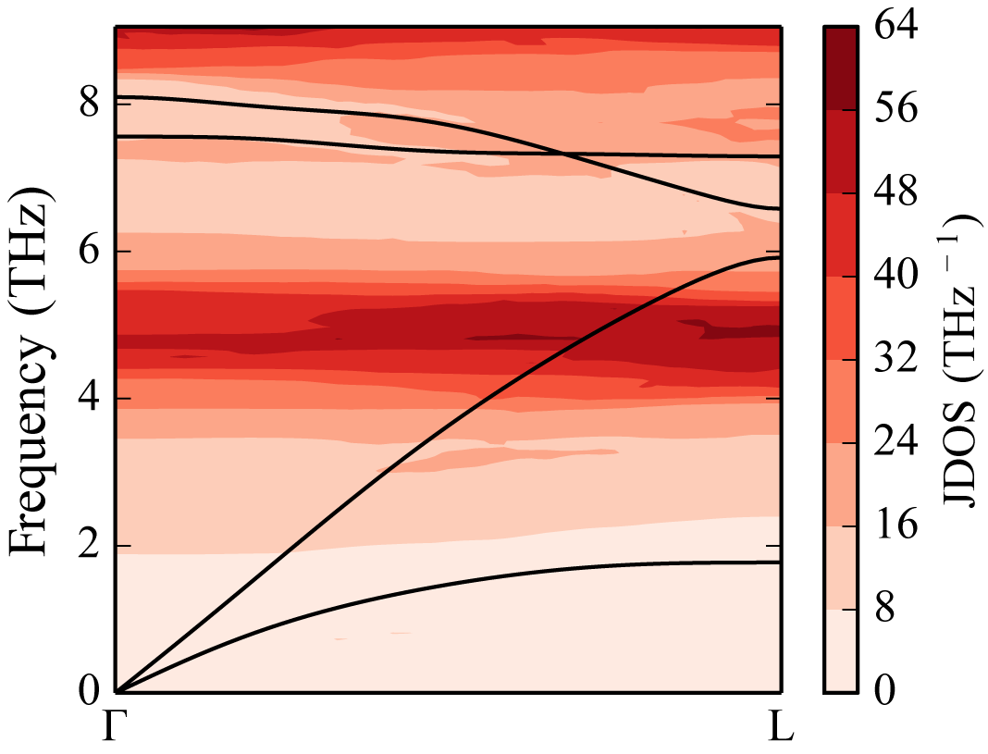

A reason of the non-smoothness
c

Slide 33
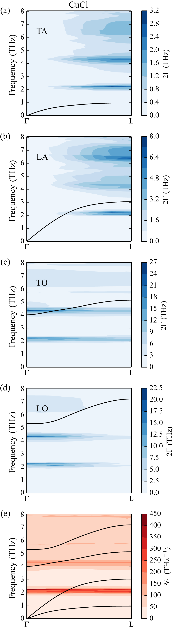
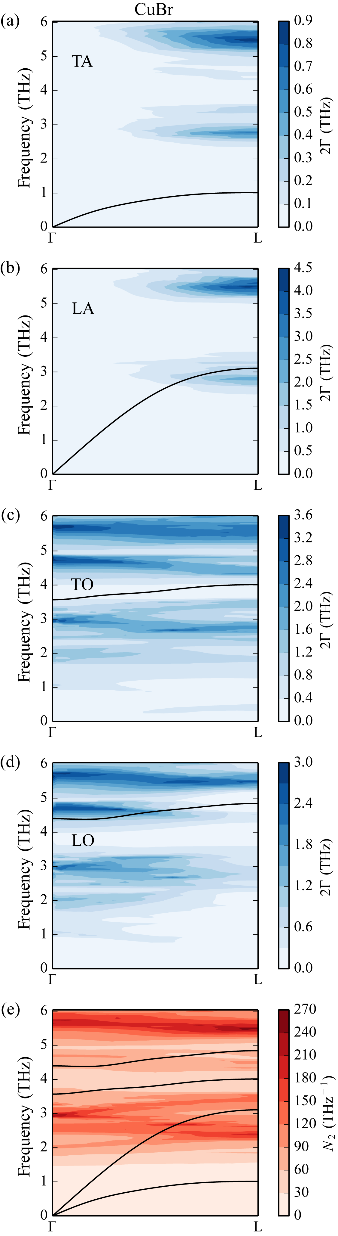
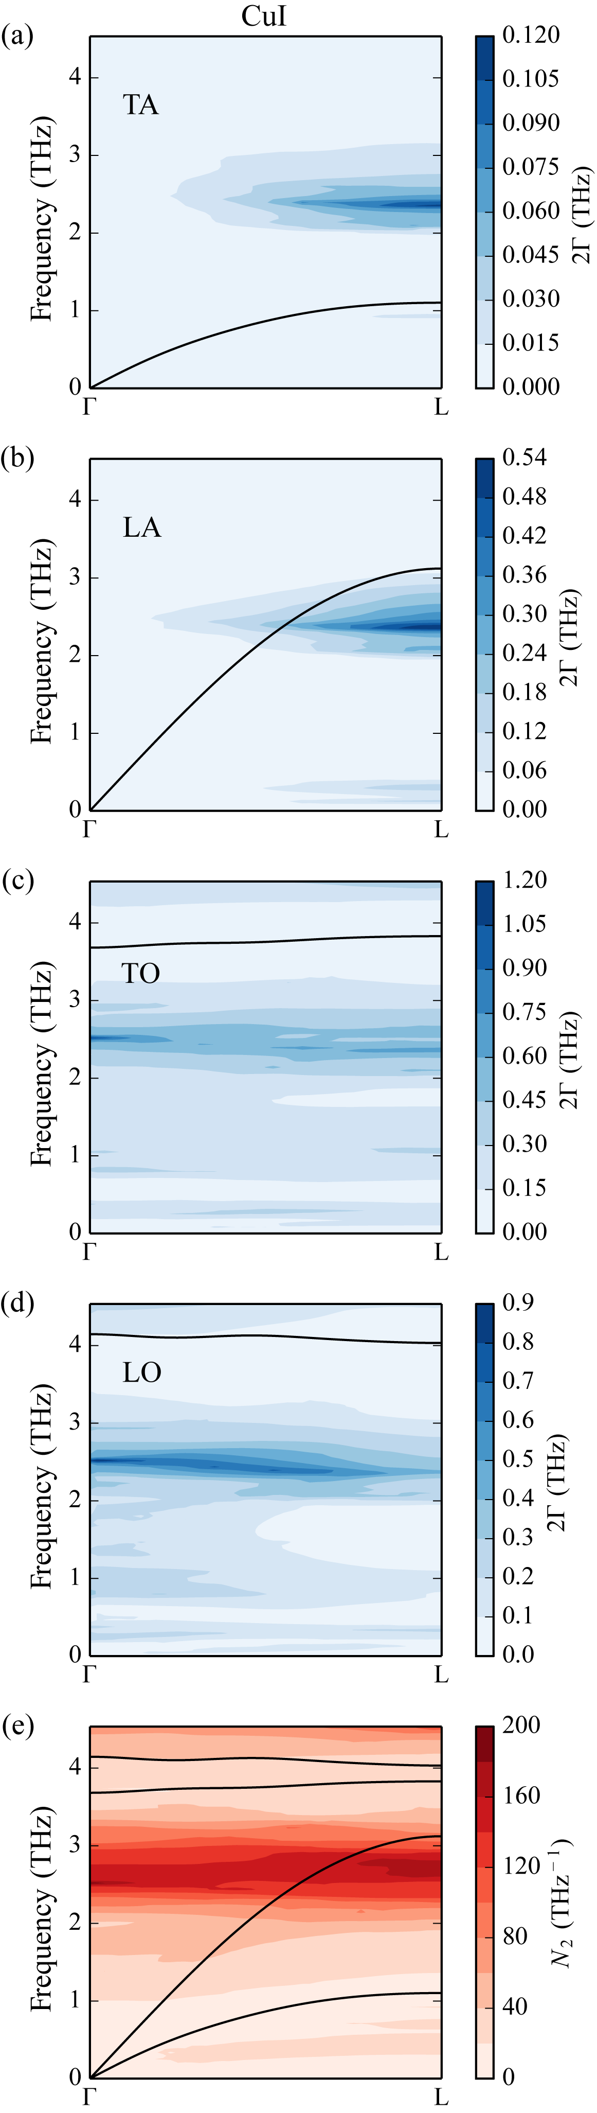
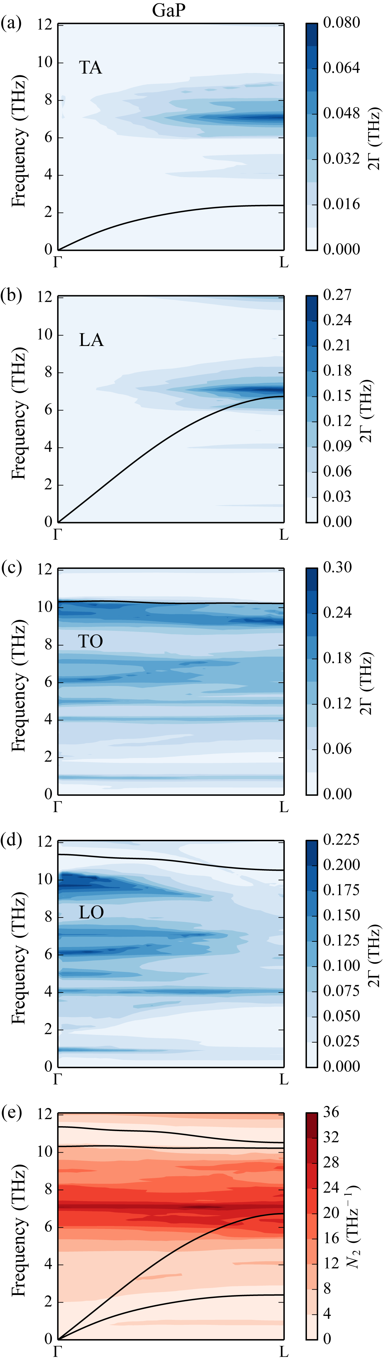
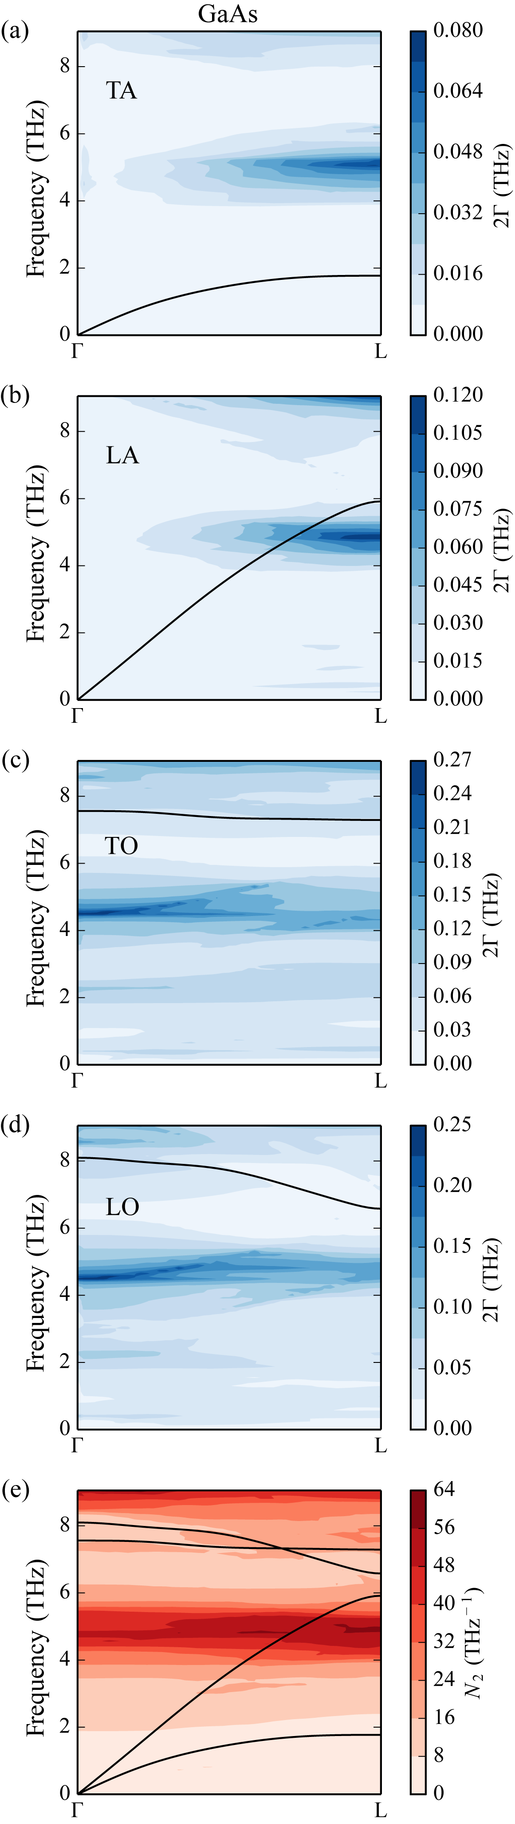
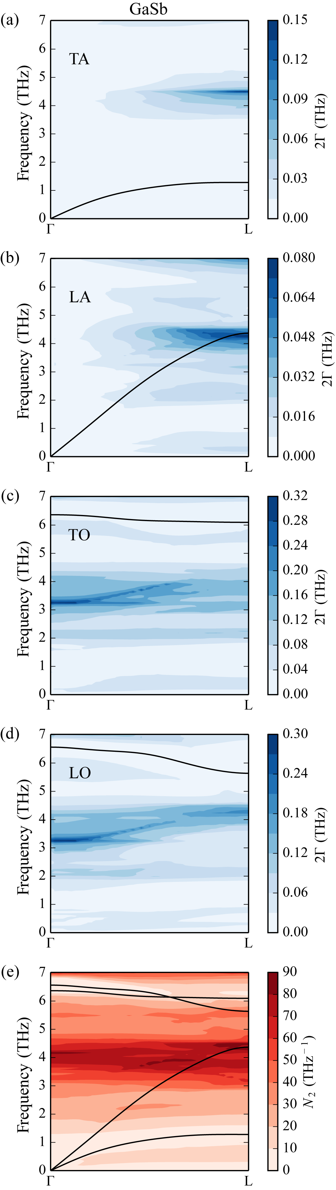
Similarity/non-similarity of Г(q, ω)
c
c
CuCl
CuBr
CuI
GaP
GaAs
GaSb

Slide 34

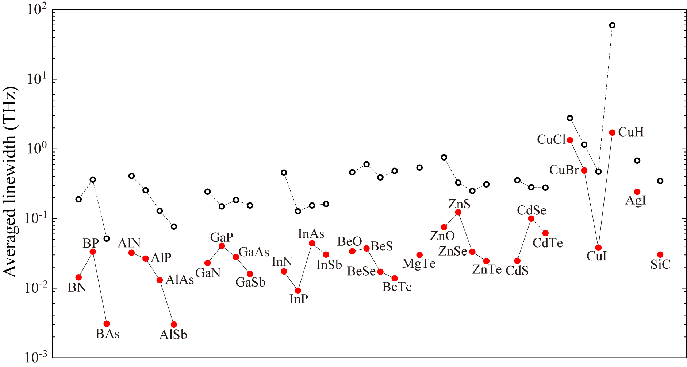
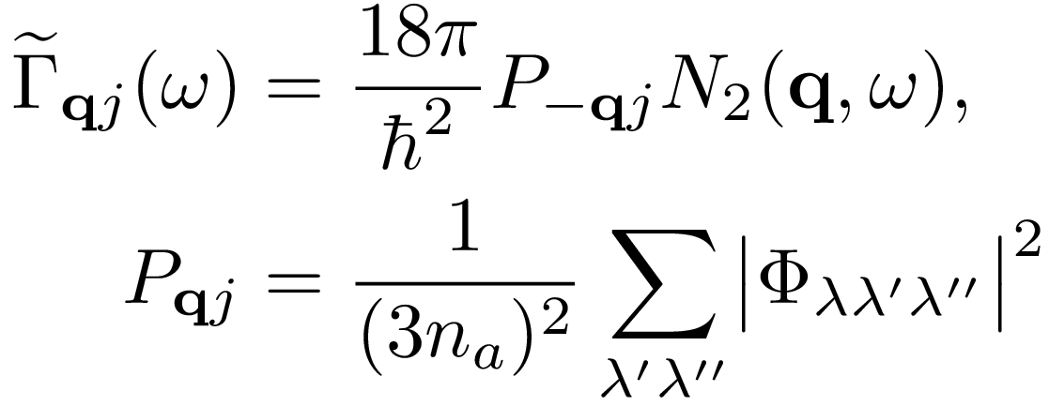
Averaged linewidths
c

Slide 35







Phonon frequency shift
Thermal
expansion

Slide 36
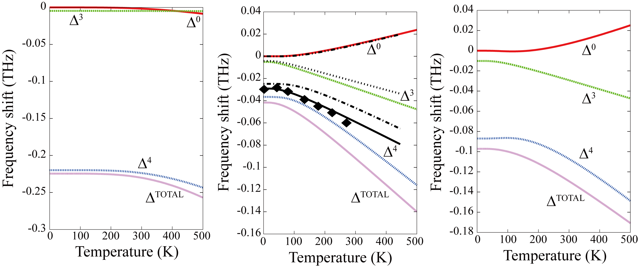
TA-mode at X-point of C, Ge, Si
C
Ge
Si
Germanium black curves (calc.) and diamond symbols (exp.): A. Debernardi et al., arXiv:cond-mat/0212209 (2002)

Slide 37






Stability condition of crystal
Harmonic oscillator case
At equilibrium
u
Stable
Unstable
k > 0
k < 0
Harmonic crystal case
,
(positive definite)
All eigenvalues > 0

Slide 38
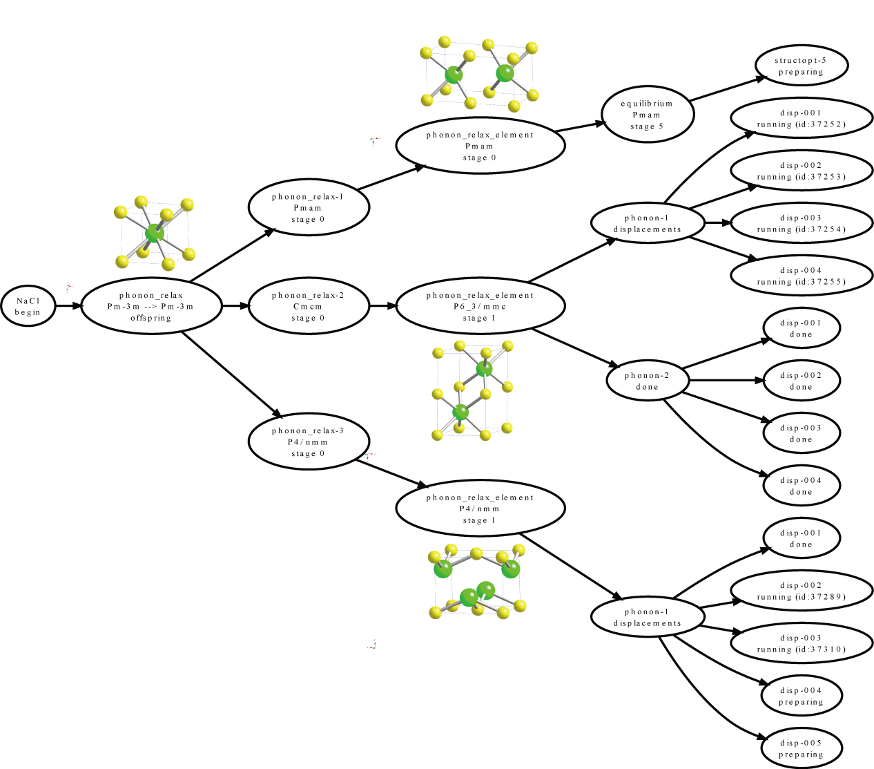
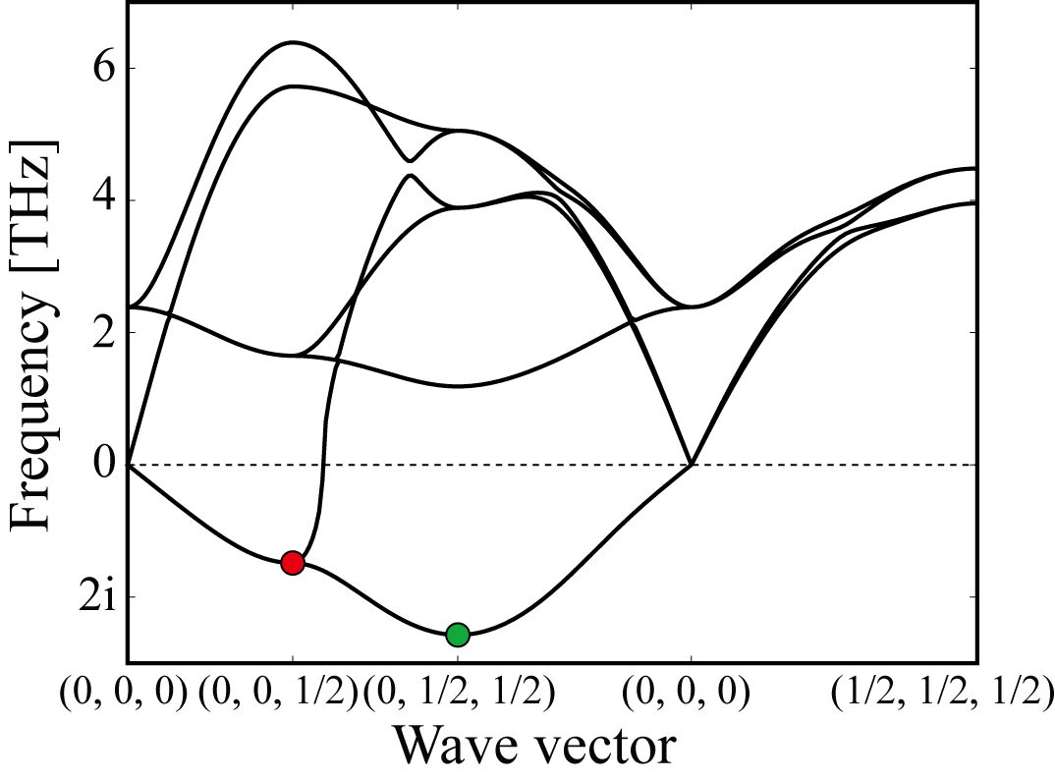
Automatic structure relaxation
CsCl-type NaCl structure is relaxed
following the eigenvectors
of imaginary modes at p = 0.
Calculations are automated.
Concurrent calculation
Series calculation

Slide 39
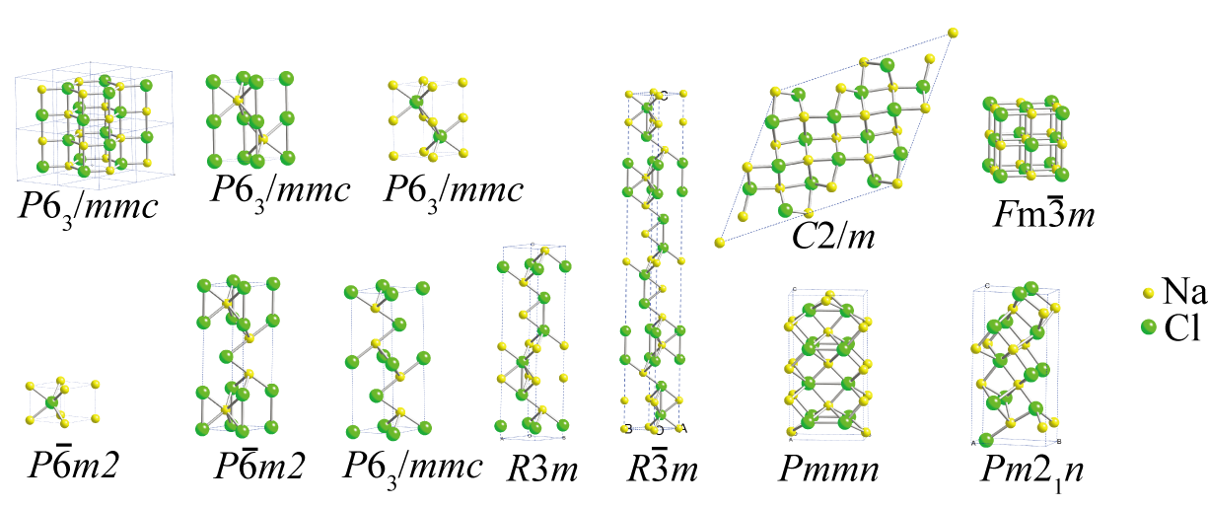
Dynamically stable structures of NaCl
Most of the structures were found as close-packed alternate
stacking of Na and Cl layers.

Slide 40
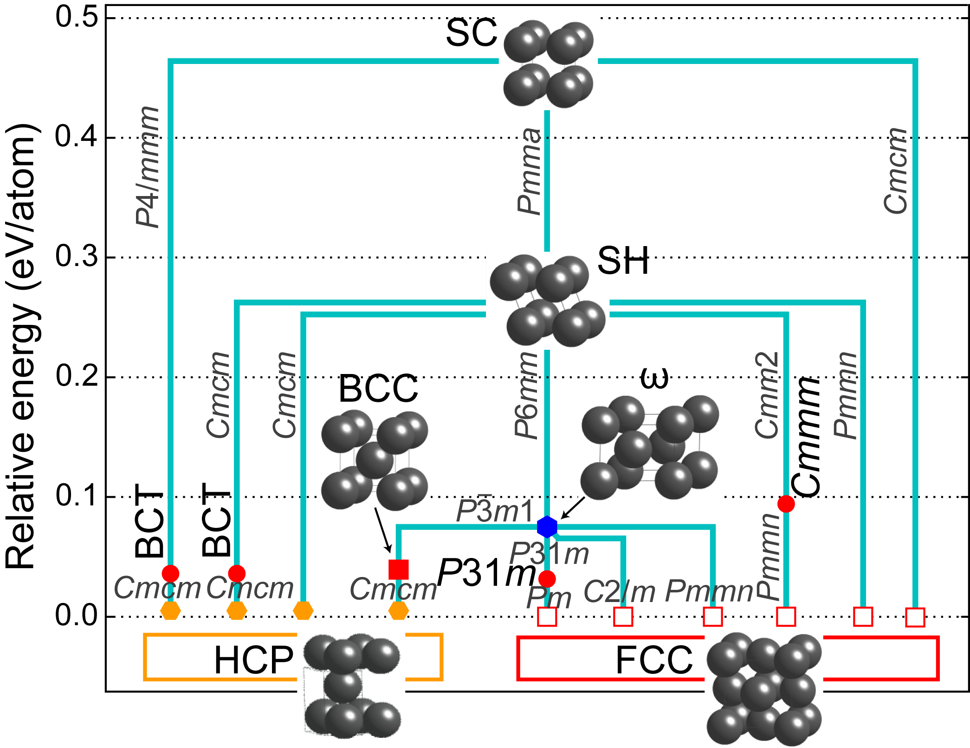
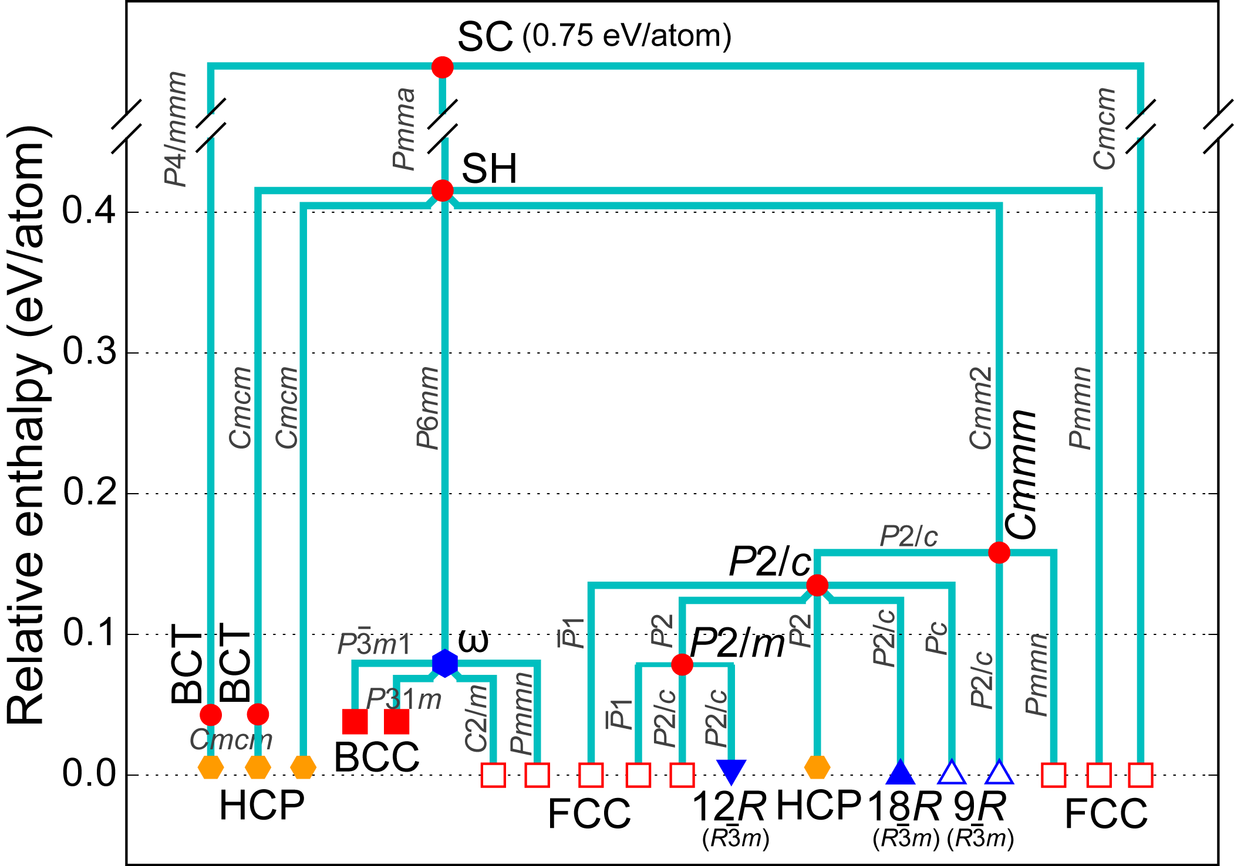
Cu relaxation from simple cubic at 30 GPa
0 GPa
30 GPa
At 0 Gpa,
only FCC and HPC
are found.
Pressure
Togo and Tanaka, Phys. Rev. B, 87, 184104-1-6 (2013)

Slide 41
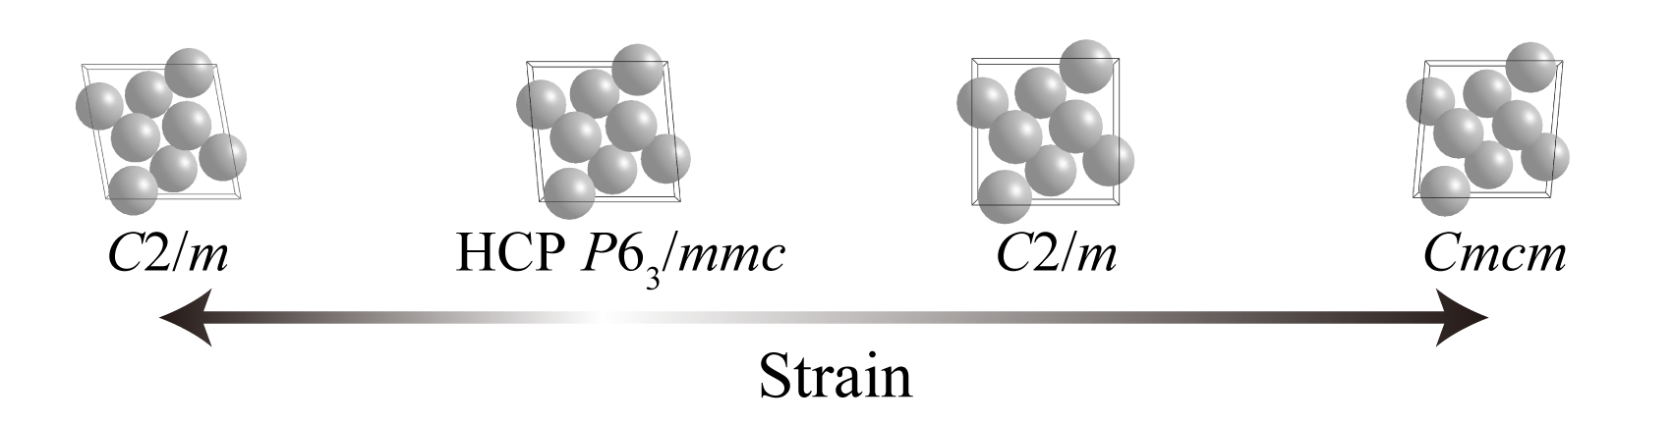
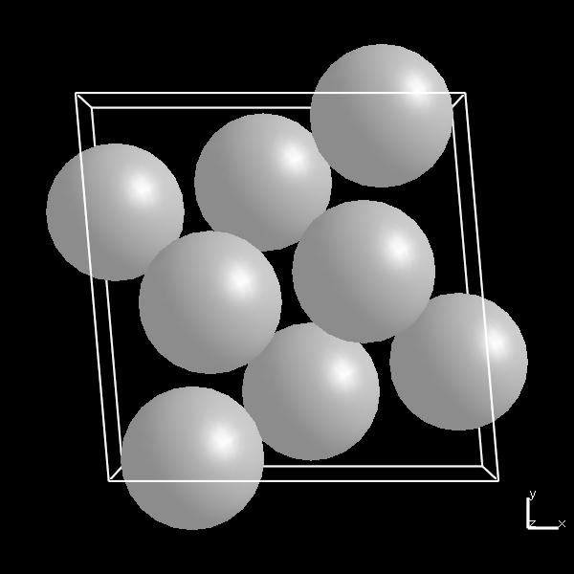
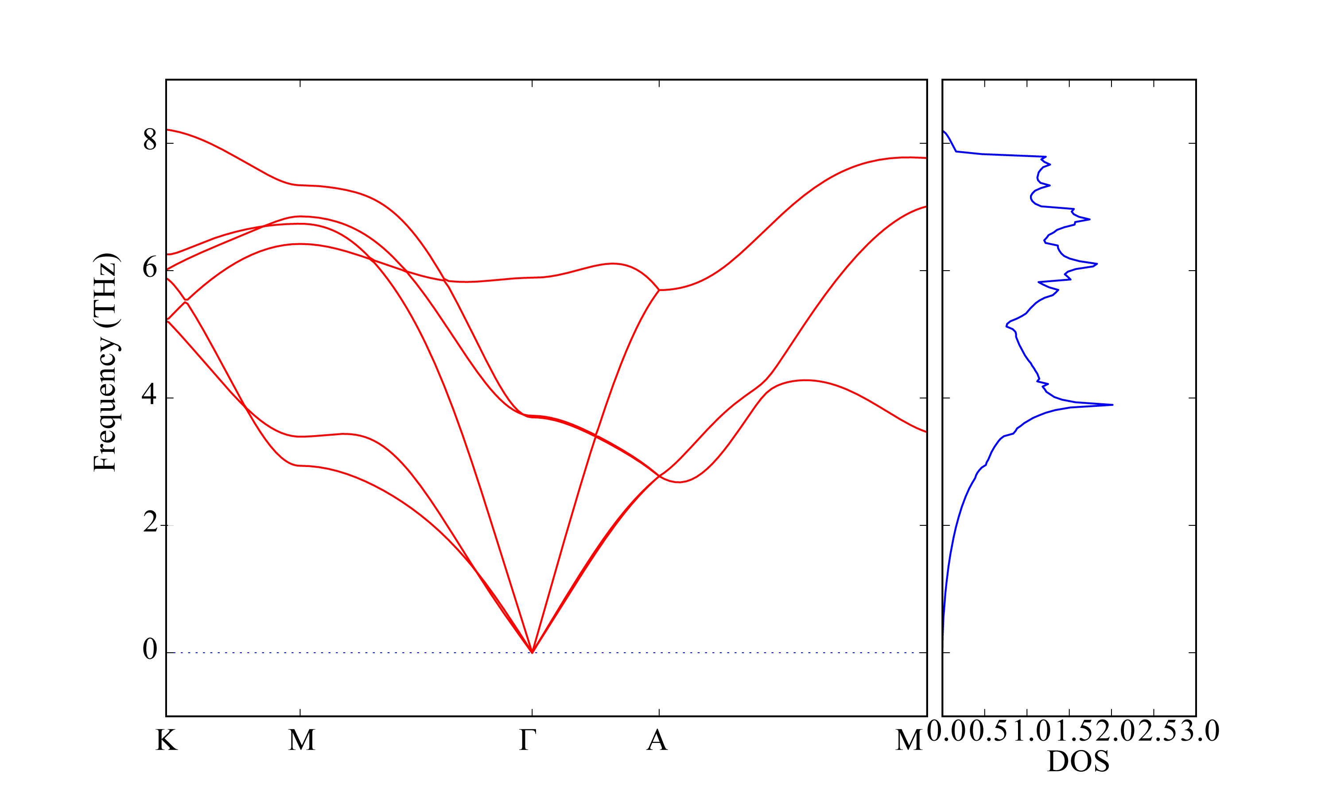
Phonons under shear strain for Ti: research for mechanical twining
η₁=<1011>
K₁ plane{1012}

Slide 42
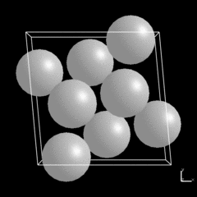
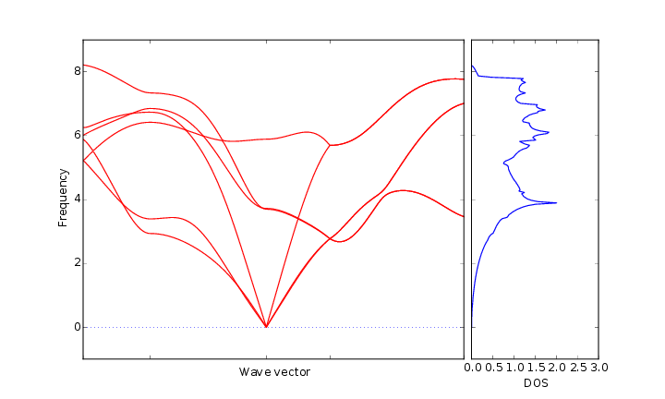
Phonons under shear strain for Ti: research for mechanical twining
η₁=<1011>
K₁ plane{1012}

Slide 43
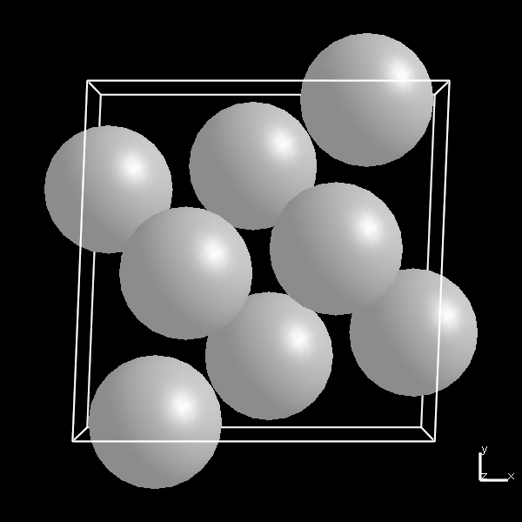
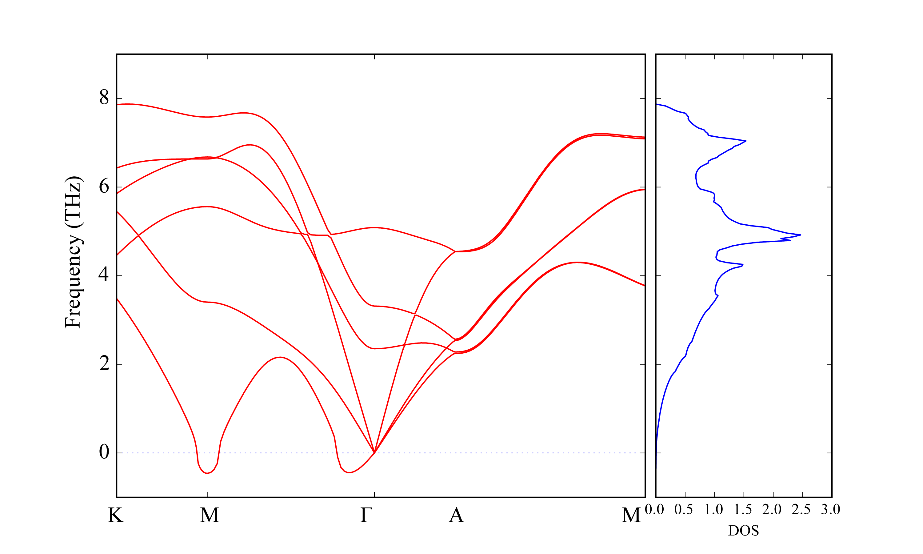
Phonons under shear strain for Ti: research for mechanical twining
η₁=<1011>
K₁ plane{1012}

Slide 44
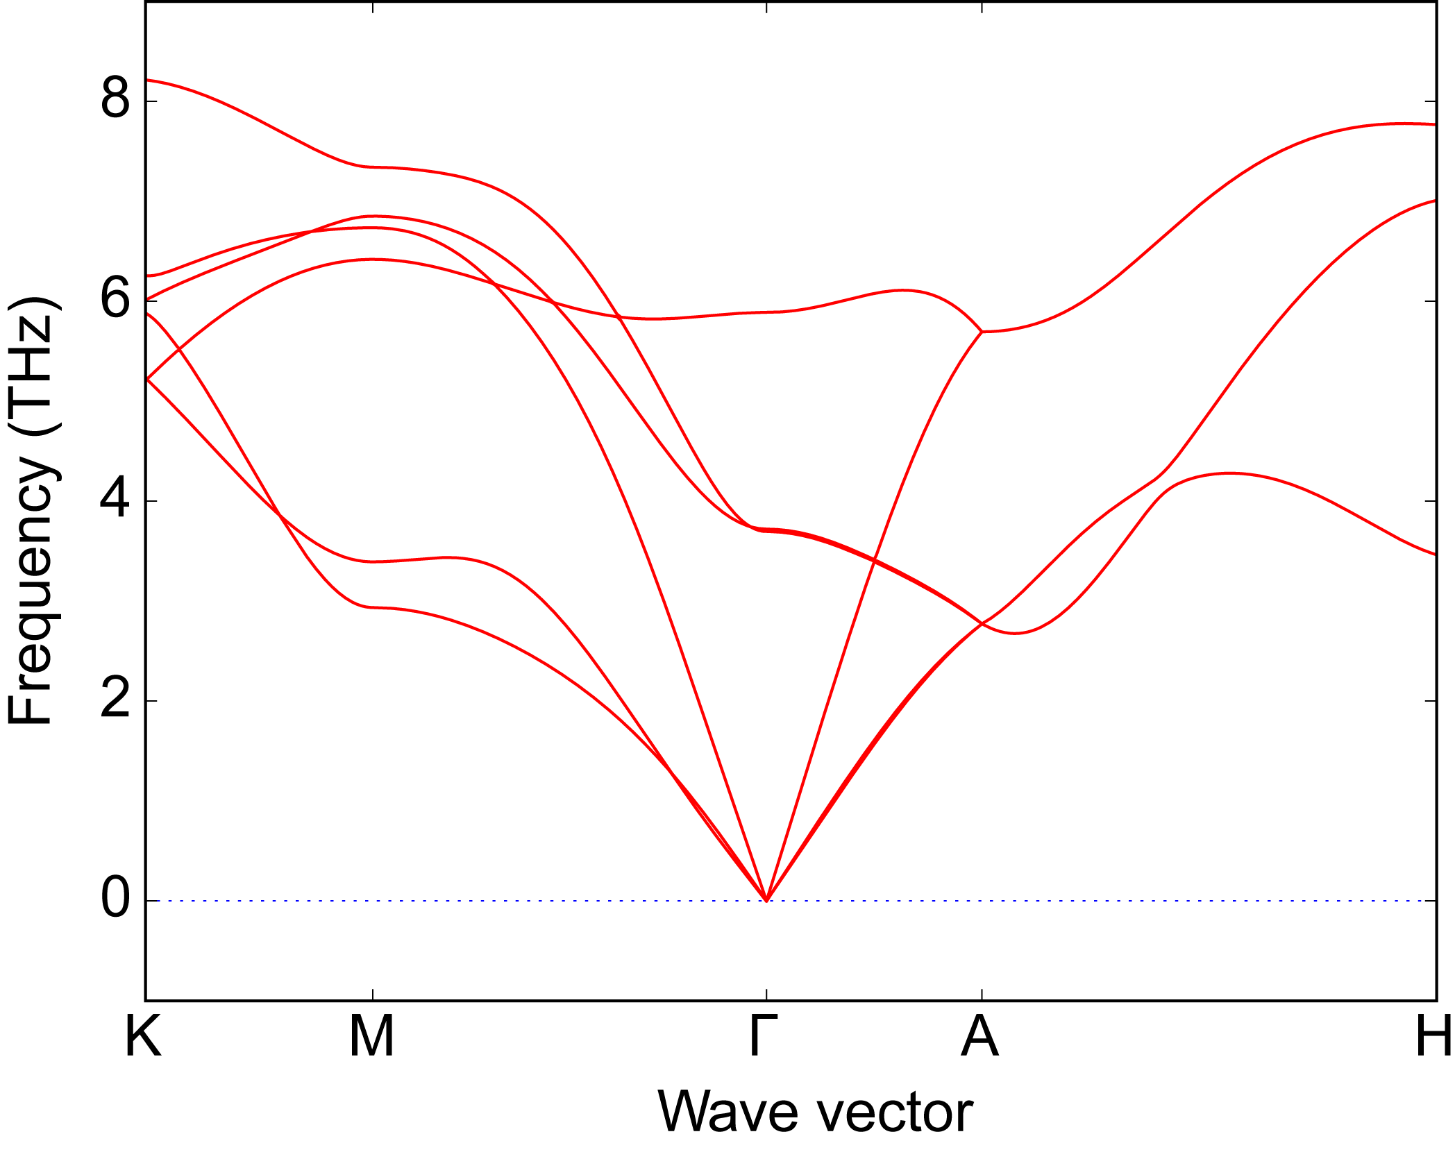
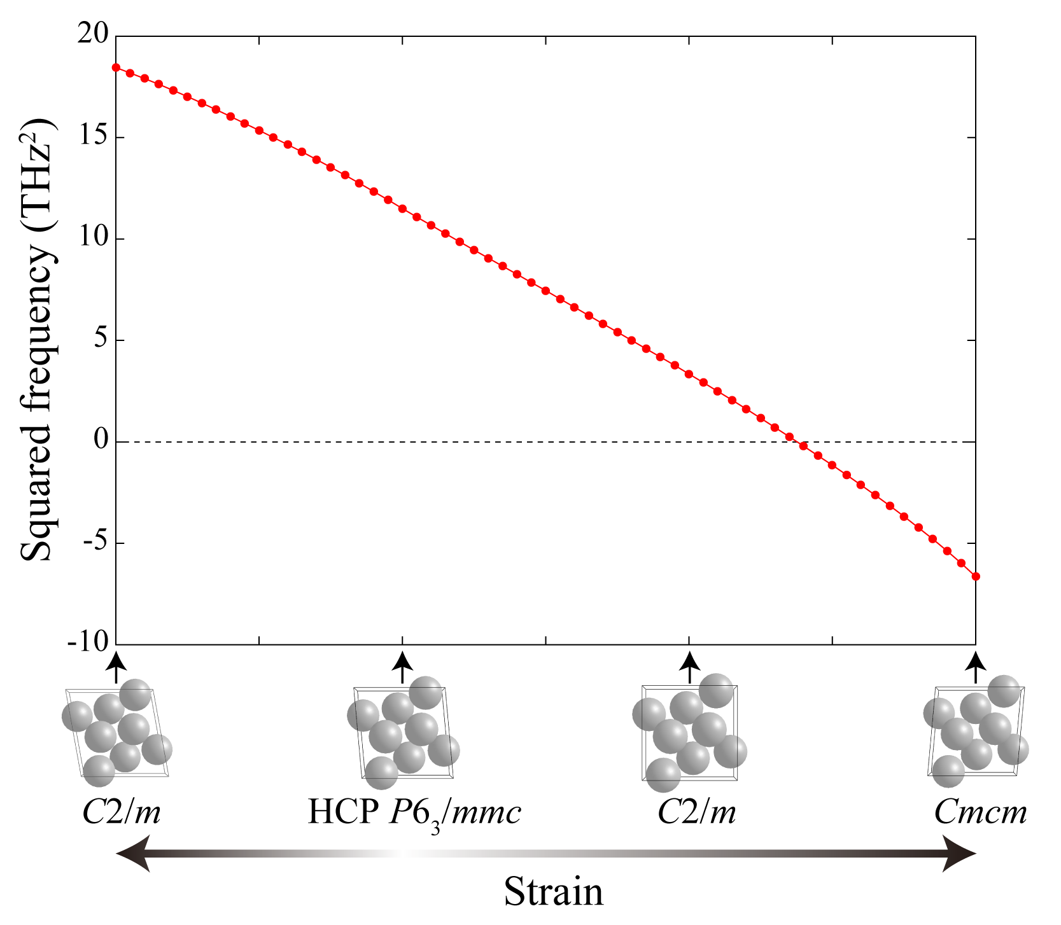
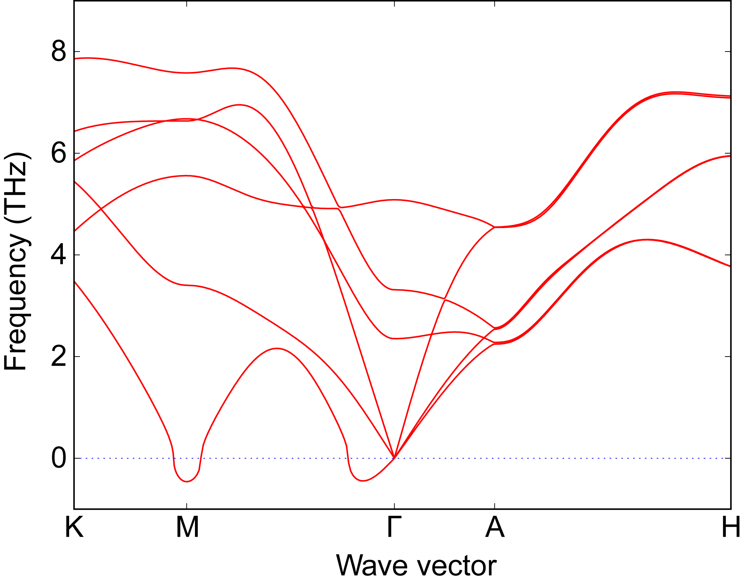
Strain dependence of phonon frequency
Ti

Slide 45
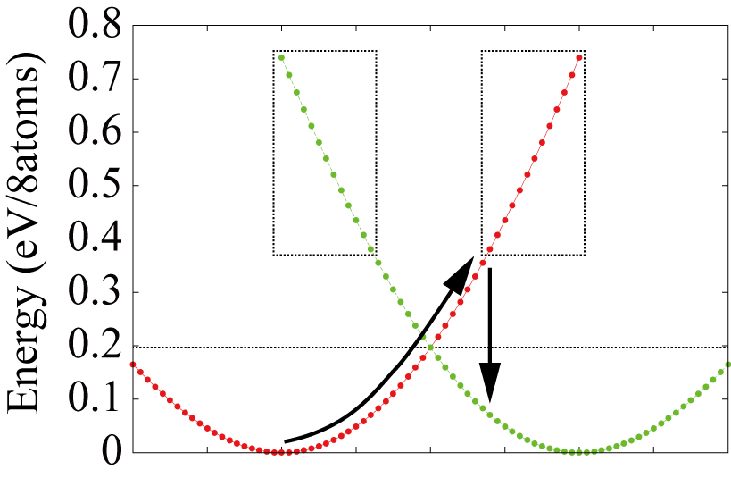

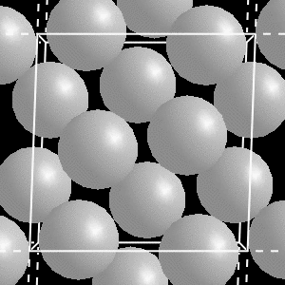
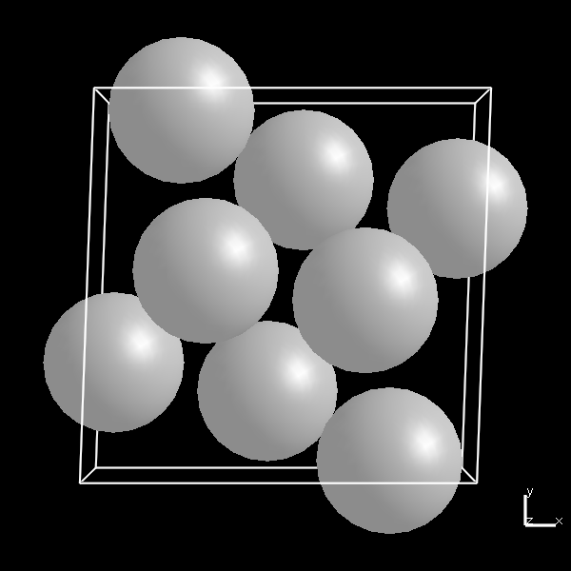
Rearrangement of atoms toward twinning
Symmetry
lowering

