Slide 2
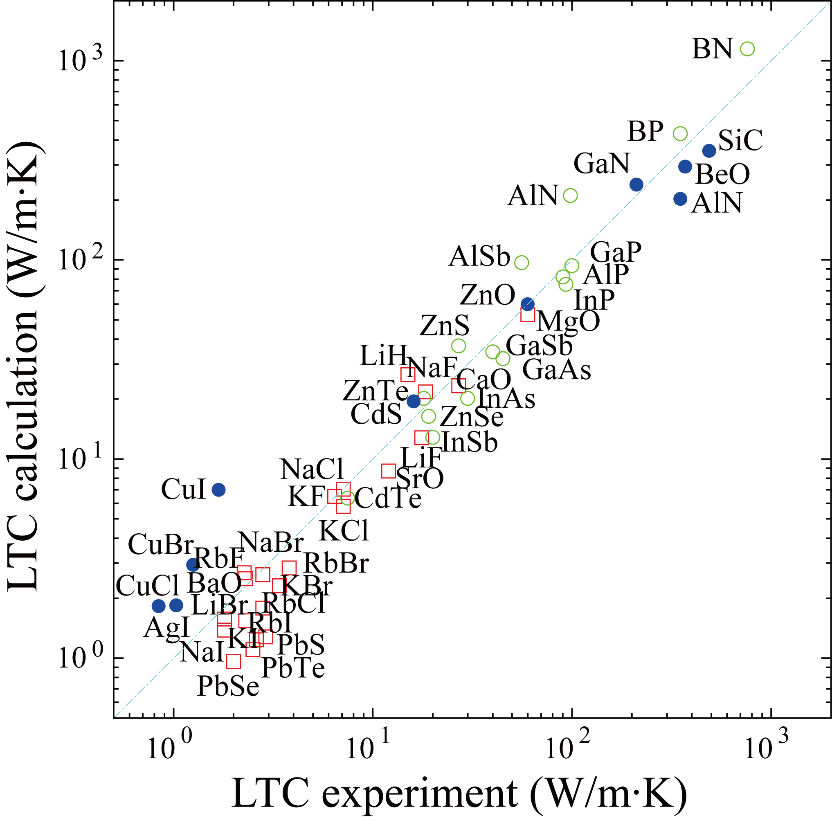
Calculations v.s. experiments (RTA) of rocksalt-, wurtzite- and zincblende-types
@300 K

