Slide 1


(Base Dataset)
(Target Dataset)
ASHRAE
dataset
Experimental
Survey Data
(1)Active Transfer Learning
General base model
Evaluate
entropy
Sorted on its entropy
Personal
customized
models
Active Transfer Learning
on various amount of surveys
(2)Virtual experimental evaluation
Zone
Control
Group
Control
Personal
Control
Result (Comfort, Energy)
N=2
Model
N=4
Model
N=20
Model
Full learning
model
Notes:
From last week, I modified the data arrangement part for transfer learning.
I excluded previous comfort agent part and use experimental data directly.
I read previous paper, zenep included user ID using Xgboost algorithm, not for this transfer learning. Since the base model doesn’t include user ID, adding new parameter on transfer learning is not possible.

Slide 2
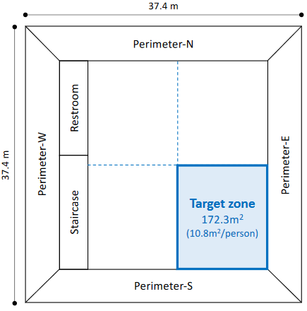
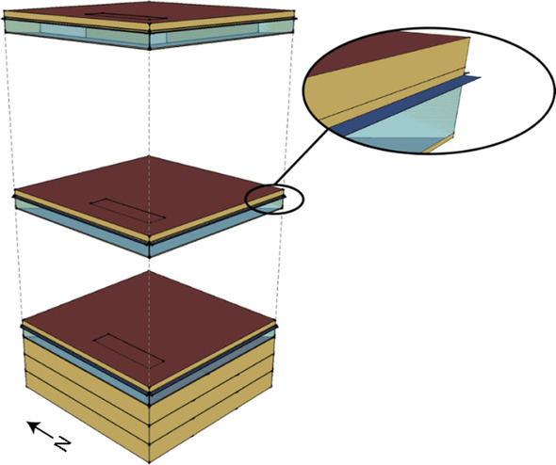
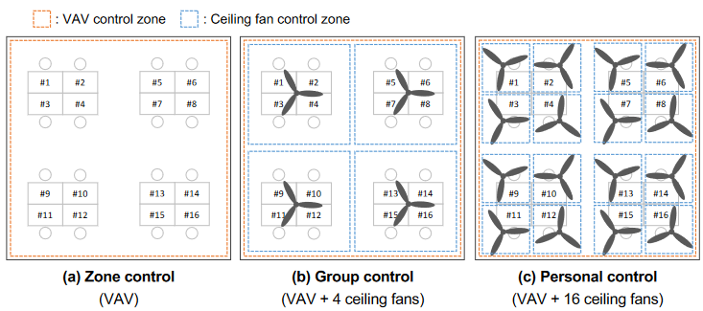
(a)Reference building model
(b) Floor plan of target zone
(c)Office area AC Control type
Notes:
From last week, I modified the data arrangement part for transfer learning.
I excluded previous comfort agent part and use experimental data directly.
I read previous paper, zenep included user ID using Xgboost algorithm, not for this transfer learning. Since the base model doesn’t include user ID, adding new parameter on transfer learning is not possible.

Slide 3


Research Target
Research Background
4. HVAC
Layer
HVAC(Actuator)
Difficulty of adoption in real building
The number of OCC in real building implementation are still less than simulation studies ^{[3]}
While the development of frameworks on simulation is very active, there are still less examples of actual use in real buildings. ^{[4]}
3. Control Layer
Rule Based
MPC
RL
2. Learning Layer
Occupancy
Learning
Used if
enough
resolution
Preference
Learning
1. Sensing Layer
BMS
IoT
Occupied/
Unoccupied
Counting
Location
Sensation
Voting
PID Sensor
Vision
RFID
GPS
Wifi
Voting station
Wearable Device
Feedback via thermostat
Thermal camera
0. Physical Layer
Environment
Occupancy
Comfort
Research Questions
Research Contribution
Integration of Personal Comfort Profiles in Existing HVAC Control Research and OCC Objective Functions Leveraging Differences in Personal Comfort Models
How reducing number of occupant surveys effect comfort and energy usage on different control resolution?
1. Referenceable criteria for data collection on personal comfort survey in actual building control
2. Quantifying the impact of survey reduction on comfort and energy efficiency
[2] Review on occupant centric thermal comfort sensing, predicting, and controlling, Xie et al, 2020
[3] Challenges and opportunities of occupant-centric building controls in real-world implementation: A critical review, Soleimanijavid et al., 2024
Notes:
Last month, I shared my current research questions.
And this month, I’ve been working on the second research question, regarding the number of occupant surveys for comfort modeling
I’m intending to submit the conference paper, for Asim in December
____________________________________________
I set research target here
Occupant centric control with less occupant contribution and maximizing occupant acceptance considering individual personal comfort differences
Current research questions are here
First one is regarding How personal comfort profiles are integrated into HVAC control in existing OCC research,
Second one is the effect of reducing number of survey, the effect to comfort and energy usage varied on control resolution

Slide 4

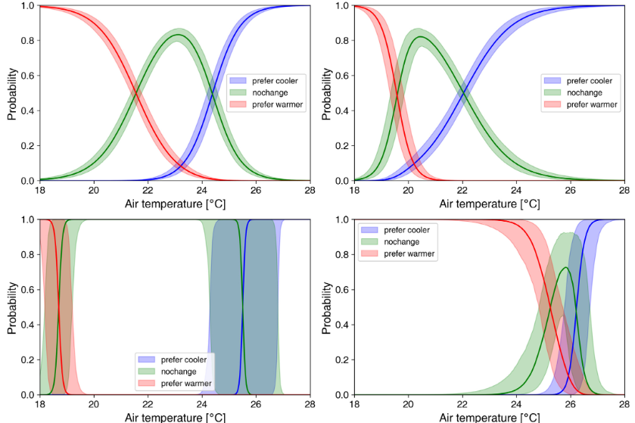

Research Target for Asim2024 paper
Research Questions
How reducing number of occupant surveys effect control and energy usage on different control resolution?
Purpose of research
To evaluate the impact of the number of comfort surveys on model accuracy and its effect to both energy consumption and occupant comfort.
How this relation would differ depending on HVAC resolution and comfort function setting
Personal level control
Zone level control
4. HVAC
Layer
Result with 2 surveys
65% acceptance
10% Energy saving
Effective
Result with 4 surveys
80% acceptance
10% Energy saving
Result with 2 surveys
65% acceptance
5% Energy saving
Less Effective?
Result with 4 surveys
65% acceptance
5% Energy saving
3. Control Layer
2. Learning Layer
Personal
model
…
…
accuracy
60%
accuracy
80%
accuracy
70%
accuracy
85%
accuracy
60%
accuracy
80%
accuracy
80%
accuracy
70%
accuracy
85%
accuracy
85%
1. Sensing Layer
Two surveys per occupant
Four surveys
Two surveys
Four surveys
Notes:
This is the whole image of the experiment, depending on the number of surveys, personal models have variation on its accuracy. Research purpose is to find the effect of amount of survey to model accuracy and building control performance.

Slide 5
Research Method - Overall framework
Previous
1. Developing Personal Thermal Agent Model
(2)Active Transfer Learning
(1)Thermal Agent Model
1-1.Thermal Agent Model Creation:
To simulate various occupant’s thermal sensation, agent model are developed using thermal comfort survey data, using multinomial logistic regression based on survey data.
1-2. Generate Virtual Survey Answers:
Virtual survey answers are generated using the created agent models
ASHRAE
dataset
Agent Model
Development
General base model
Virtual survey answers
2. Active Transfer Learning:
2-1. General base model:
General base model is developed using ASHRAE comfort dataset, using CNN-LSTM model.
2-2. Active Transfer Learning:
For developing personal thermal comfort model, the selected instances from (1-2)Virtual Survey answer are used to re-train (2-1)General base model
Various number of survey instances are used to see the effect of to model accuracy
Personal
customized
models
Active Transfer Learning
on various amount of surveys
(3)MPC control evaluation
Zone
Control
Group
Control
Personal
Control
3. Virtual experimental Evaluation:
Transfer Learned Models are used in various MPC scenarios
Along the number of training survey instances, its effect to comfort(thermal acceptance) and energy consumption are evaluated.
Result
(Comfort, Energy)
Notes:
Here is the framework of this experiment.
1st, I develop personal thermal agent model, based on the survey experimental data. We assume these agents as occupants’ true comfort acceptance expression. And I created virtual survey answers using these agents.
2nd, Active transfer learning was performed to develop various models depending on amounts of survey answers to learn.
Lastly, with these personal customized models, MPC experiment was conducted to see the effect of each models to its performance.

Slide 6
Research Method - Overall framework
(1)Active Transfer Learning
Updated
6
(Base Dataset)
(Target Dataset)
1. Active Transfer Learning:
ASHRAE
dataset
Experimental
Survey Data
1-1. General base model:
General base model is developed using ASHRAE comfort dataset, using CNN-LSTM model.^{[8] [9]}
1-2. Select survey instances for
Evaluate the existing survey dataset for its informative importance
1-3. Active Transfer Learning:
For developing personal thermal comfort model, the selected instances from experimental dataset are used to re-train (2-1)General base model
Various number of survey instances are used to see the effect of to model accuracy, based on thermal acceptability.
General base model
Evaluate
entropy
Sorted on its entropy
Personal
customized
models
Active Transfer Learning
on various amount of surveys
2. Virtual experimental Evaluation:
(2)Virtual experimental evaluation
Transfer Learned Models are used in various rule-based control scenarios
Along the number of training survey instances, its effect to comfort(thermal acceptability) and energy consumption are evaluated.
Zone
Control
Group
Control
Personal
Control
Result (Comfort, Energy)
N=2
Model
N=4
Model
N=20
Model
Full learning
model
[7] Development of the ASHRAE Global Thermal Comfort Database , V. F. Licina, T. Cheung, H. Zhang, R. De Dear, T. Parkinson, E. Arens, C. Chun, S. Schiavon, M. Luo, G. Brager, et al., 2018
[8] A hybrid deep transfer learning strategy for thermal comfort prediction in buildings, Somu et al., 2021
[9] Data-efficient Comfort Modeling: Active Transfer Learning for Predicting Personal Thermal Comfort using Limited Data, Tekler et al., 2024
Notes:
From last week, I modified the data arrangement part for transfer learning.
I excluded previous comfort agent part and use experimental data directly.
I read previous paper, zenep included user ID using Xgboost algorithm, not for this transfer learning. Since the base model doesn’t include user ID, adding new parameter on transfer learning is not possible.

Slide 7
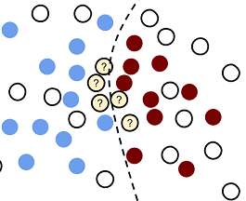
Method – (1)Active Transfer Learning
Developing base model
Transfer Learning
⇒Leverage existing dataset and knowledge
Active Learning
⇒Select most informative survey instances
General base model was developed using ASHRAE global thermal comfort database^{[7]}
CNN-LSTM model ^{[8] [9]} structures was introduced for its high performance in existing research
Base
Dataset
Base model
Knowledge
Input : Air temp, RH, Air velocity, Radiate temp
Output : Thermal Acceptability
Target Dataset
Target model
Focus on most informative instance
Active Transfer Learning
ASHRAE dataset
Base model
Personal surveys
From the survey instances answered by thermal agent, each survey answer’s the uncertainty for general base model were evaluated
Sorted highest uncertainty survey instances are selected.
Different amount of survey instances are used to re-train ASHRAE base model
Fine-tuning
Selected instances
Personalized Re-training
How much should we add?
Minimum learning
Model
N=4
Model
N=6
Model
N=20
Model
Full learning
model
Focus on data with high uncertainty
[7] Development of the ASHRAE Global Thermal Comfort Database , V. F. Licina, T. Cheung, H. Zhang, R. De Dear, T. Parkinson, E. Arens, C. Chun, S. Schiavon, M. Luo, G. Brager, et al., 2018
[8] A hybrid deep transfer learning strategy for thermal comfort prediction in buildings, Somu et al., 2021
[9] Data-efficient Comfort Modeling: Active Transfer Learning for Predicting Personal Thermal Comfort using Limited Data, Tekler et al., 2024
Notes:
For the second part, Active transfer learning, I developed the base model first, using AHRAE thermal comfort dataset. CNN-LSTM model structure was used for its high model performance. Input parameters are air temperature, Relative humidity, Air velocity, Radiate temperature, and the output is thermal acceptance.
For transfer learning part, using active learning method, personal surveys are evaluated on the uncertainty for general base model. These survey instances are sorted based on its uncertainty values. Depending on the amount of surveys, these survey instances are picked up and used for re-training. We gain personal thermal models on various number of surveys.

Slide 8
Result1 – Accuracy of transferred model along the amount of surveys
Ref : Accuracy of full-survey learning
Occupant
Learning Survey Number | 0 | 2 | 4 | 6 | 8 | 10 | 12 | 14 | 16 | 18 | 20 | Ref 100%
Average accuracy along the number of surveys | 56% | 77% | 78% | 83% | 86% | 88% | 88% | 88% | 88% | 88% | 89% | 89%
Average of model accuracy was enhanced along the increase of amount of survey, especially at first 5 steps, N =2~8
Occupant
Focus on data with high uncertainty
Notes:
Here is the updated average accuracy of transfer learning with different amount of survet
Here is the 1st result of active transfer learning, I’m showing the relation of average accuracy and the amount of survey on left upper graph and \each occupant’s relation on the right side graph.
total survey dimension are about one hundred. So we can see the first model with 2% amount of surveys reach 64% accuracy and this accuracy improves as the number of survey increase. Around 30% of adding instances, these model’s average accuracy reached 89%.
As a reference, the model that used all the survey instances reaches 88%.

Slide 9
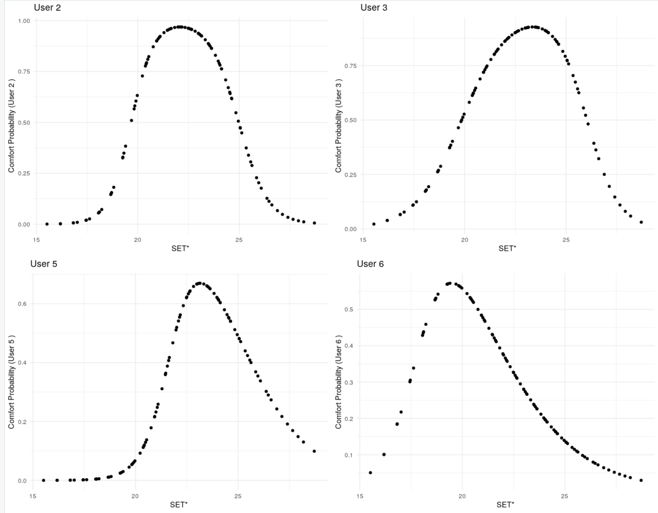
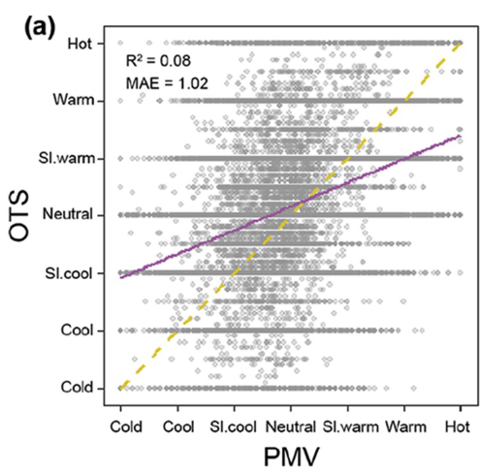
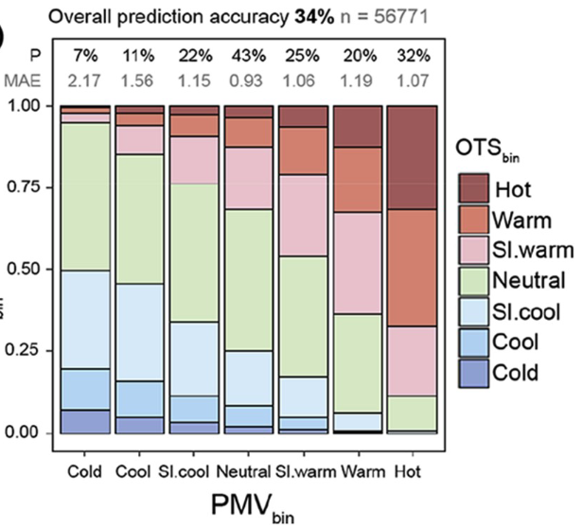
Method – (3) OCC control evaluation
Survey amount for learning
MPC Control Type
N=2
Zone
Control
(VAV)
Difference of thermal comfort
N=4
Group
Control
(VAV+4Fans)
…
…
Personal
Control
(VAV+16Fans)
Difference of energy consumption
Full survey
Addressing discrepancies of PMV with individual thermal comfort
In HVAC control, setpoint control considering PMV is orthodox method.
However, it has been reported that PMV control, which assumes an average comfort level, can result in only about 34% of people being satisfied due to discrepancies with individual thermal comfort. ^{[1]}
Difference between PMV and actual acceptance
Notes:
Using these models, I tried to integrate them into MPC setting to see the effect to thermal comfort and energy consumption

Slide 10
Method – (3) OCC control evaluation
(a)Reference building model
(b) Floor plan of target zone
Virtual experiment setting
Using various models on different number of surveys, its effect to HVAC control performance was evaluated.
For virtual experiment, energy plus model of large office building in Singapore was used^{[9]}.
Target building is conditioned with VAV, equipped with ceiling fans, according to its control methods
3 rule-based control types (Zone, Group, Personal control) are assumed to set temperature setpoint
Calculation was conducted for one-month period in October
Occupancy schedule was created utilizing occupancy simulator ^{[10]}
Office area AC Control type
[9] Development of Whole‐Building Energy Models for Detailed Energy Insights of a Large Office Building with Green Certification Rating in Singapore, Duarte, C., Raftery, P., Schiavon, S., 2018
[10] An agent-based stochastic Occupancy Simulator, Chen et al, 2018
Duarte, C., Raftery, P., Schiavon, S., 2018. Development of whole-building energy models for detailed energy insights of a large office building with green certification rating in Singapore.
Notes:
I used energy plus model of large office building in Singapore, which was conditioned basically VAV and equipped with ceiling fans.
Three control types are assumed, VAV system for zone control and Hybrid system for group and personal control.

Slide 11
Method – (3) Rule-based control
Control rule
Control type | AC System | Num of occupant per control area | To satisfy…
Zone | VAV | 16 | To find temp setpoint which maximize occupant acceptability
Group | Hybrid (VAV+ 4 Ceiling Fan) | 4 | To find temp setpoint which maximize occupant acceptability it with group fan mode
Personal | Hybrid (VAV+ 16Ceiling Fan) | 1 | To find temp setpoint which maximize occupant acceptability it with personal fan mode
Difference between PMV and actual acceptance
Notes:
I set the control like written here. For zone control, maximum temperature setpoint would be selected to make 75% of occupant satisfy.
For group and personal controls, temperature setpoint would be selected to satisfy 75% of occupant with proper fan modes.
I already deploy zone control and personal control, but group personal control part is still undergoing.

Slide 12
Method – Evaluation
(1)Active Transfer Learning
(Base Dataset)
(Target Dataset)
Evaluation method
Developing Personal Thermal Model
ASHRAE
dataset
Experimental
Survey Data
Control performance, controlled by transferred model would be evaluated with full-learned model as a reference
Various models developed by different amount of survey would be evaluated.
General base model
Evaluate
uncertainty
Personal
customized
models
Active Transfer Learning
on various amount of surveys
(2)Virtual experimental evaluation
Zone
Control
Group
Control
Personal
Control
Result (Comfort, Energy)
Reference
N=2
Model
N=4
Model
N=20
Model
Full learning
model
How mush selected control setpoints are actually comfortable?
Notes:
I modified this part, how to evaluate the model performance.
I decided to use the full learning model as reference, and tried to see how the control performance converged.
The result of control would be evaluated in terms of energy and comfort. For comfort evaluation, the thermal agent model’s survey answers are used as a true comfort acceptance.

Slide 13
Result2 – The effect of amount of learning instances to thermal acceptance
Zone Control
Personal Control
Under review
Under review
Mean thermal acceptability on selected environment was improved more quickly, for both zone control and personal control.
Thermal acceptability of personal control get stable more quickly than zone control, because occupant has wider choice of their suggested environment
Ref : Accuracy of full-survey learning
Difference between PMV and actual acceptance
Notes:
Here is the result of comfort performance based on thermal acceptability,
But there seems some errors so I’m reviewing on the code again
Here is the result of thermal acceptability on zone control and personal control. As we set the rule to select temperature to satisfy 75% of occupant, 75% is a basic goal line.
While the model’s accuracy improves in linear, the MPC performance improves quickly, compared to accuracy.
For the case of zone control, the control performance increase quickly at first three models, and reach the target of 75% satisfaction with 12% of data amount.
For the case of personal control, the MPC performance are not stable but after around 16% of survey amount, the control performance get stable.

Slide 14
Current Conclusion
☑ The effect of amount of survey instance for learning, to its accuracy and virtual OCC performance was evaluated.
☑ Accuracy improves along the amount of learning surveys, especially at N=2~8
☑ Surveys with only two instances significantly improve the accuracy, which is enough for AC control strategy.
Next Step before ASim paper submission (Sep 5th)
☑ Calculation on group comfort
☑ Try to enhance the model’s accuracy
☑ Calculation on group comfort
☑ Try to enhance the model’s accuracy
Addressing discrepancies of PMV with individual thermal comfort
In HVAC control, setpoint control considering PMV is orthodox method.
However, it has been reported that PMV control, which assumes an average comfort level, can result in only about 34% of people being satisfied due to discrepancies with individual thermal comfort. ^{[1]}
Difference between PMV and actual acceptance
Notes:
Here is the current result
The effect of amount of learning survey instances, to its accuracy and MPC performance were evaluated.
Accuracy was improved along the amount of survey instances
We can see 10 to 15% amount of comfort survey, from control environmental range works well to control HVAC system properly.
As a next step, I should develop group comfort model and enhance the model accuracy more.

Slide 15
- Active learning with XG-Boost algorithm (one choice of random tree) would include several models in one models, as a brunch of personal model - Active transfer learning using Deep Learning would not include personal ID, since base model won’t include personal detection ID Since gaining complete thermal comfort profiles for various occupant is not feasible, Usual step learning(if not know which environment is informative? ) Active learning(if which environment is informative?) 100% learning(If all the profiles were known? )

Slide 16
EOF

Slide 17
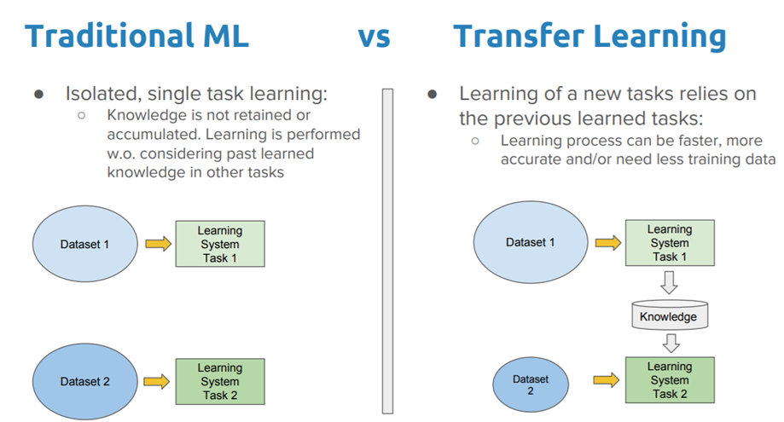
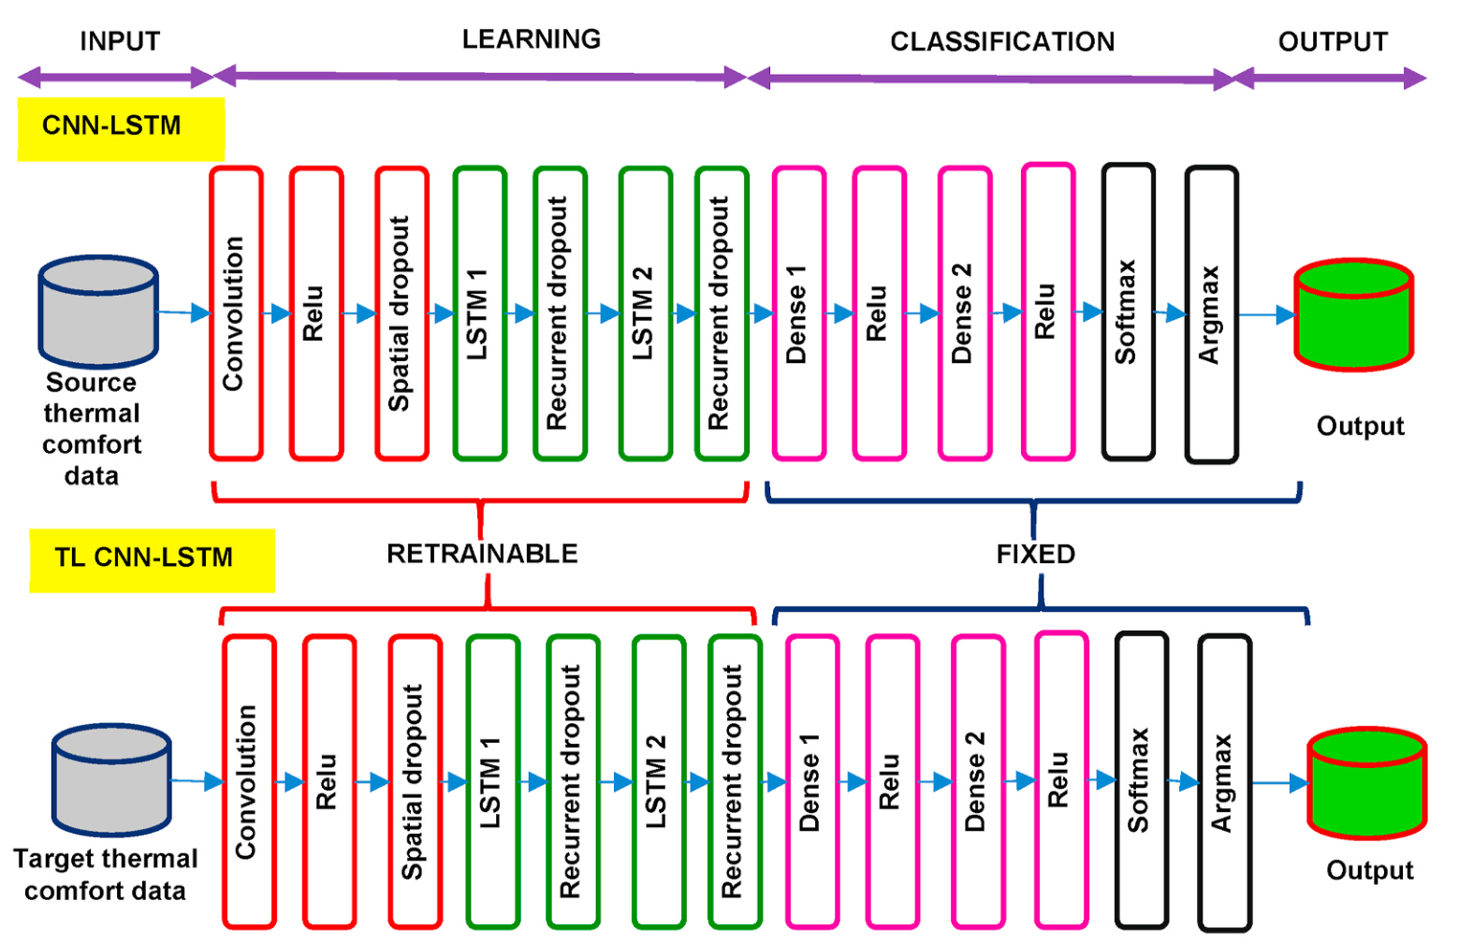
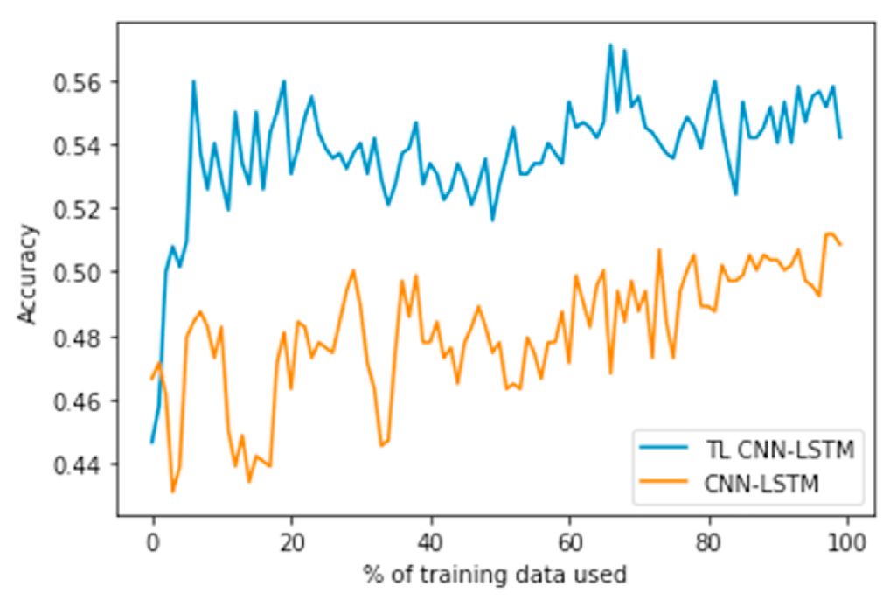
Ref:A hybrid deep transfer learning strategy for thermal comfort prediction in buildings,
Concept of transfer learning
Novel example to leverage existing dataset and to capture the spatio and temporal information
Background
&
Project target
①The significant Thermal Comfort Parameters(TCPs) contributing the model performance
②The significance of the spatial and temporal information
③The effect of the size of the target dataset
Methodology
Proposed TL CNN-LSTM framework
Comfort modeling knowledge is transferred from source domain (ASHRAE dataset) to target domain (Medium US office dataset)
Initial CNN layer (9*1), two LSTM layer will take spatio and temporal information from thermal comfort parameters
Transfer learning
with source dataset (ASHRAE) and target dataset (US office)
Success
Proposed model outperforms Random forest and CNN-LSTM
Shown that 15% of training dataset, the accuracy of TL CNN-LSTM significantly improved
Improving accuracy
along the survey amount
Limitation
Minimum amount of survey data could be explained not in percentage of training dataset
Notes:
our team developped framework to reduce the number of occupant survey using deep learning method like transfer learing and active learningwith transfer learning we can leverage the knowledge of other large data source into our personal model.

Slide 18
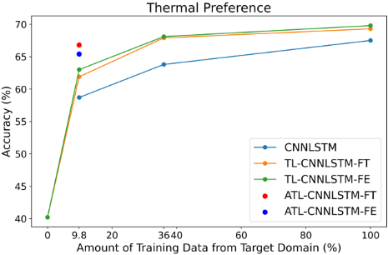
Ref: Data-efficient Comfort Modeling: Active Transfer Learning for Predicting Personal Thermal Comfort using Limited Data
Reduced comfort survey by integrating transfer and active learning
Background
&
Project target
Aim to reduce required amounts of comfort survey and identify minimum number
Combination and transfer learning and active learning
Existing dataset
Foundation model
Personal surveys
Methodology
Proposed ATL-CNNLSTM models, integrating both transfer learning and active learning
Transfer Learning : Retrained by target domain BCA dataset, after trained by ASHRAE source domain dataset
Active Transfer Learning : Select the most informative survey samples by Query-By-Committee learning
Transfer Learning
⇒Leverage existing
dataset and knowledge
Fine-tuning
Selected instances
Active Learning
⇒Select most informative survey instances
Personal Customized Model
Success
Achieve higher accuracy than usual CNNLSTM method
Learning with just two samples achieve almost same accuracy with full-samples learning, higher accuracy than normal CNNLSTM
High prediction accuracy
with only two instances
Limitation
Can be explored how to get the most informative survey in actual building operation
Accuracy evaluation is aggregated, so there can be a variation of accuracy between occupants
Notes:
additionally using active learning we canfocus on the most informative environmental condition regarding the thermal comfort.now we can achieve high prediction accuracy for thermal comfort only with two surveys.

Slide 19
Experiment for Asim paper
Title
Exploring the Impact of Survey Resolution on the Accuracy of Personal Thermal Comfort Models Using Transfer Learning
Purpose
Investigate the relationship of number of thermal comfort survey and its prediction accuracy
Research Flow
1. (☑ done) Develop general thermal comfort model, based on ASHRAE thermal comfort survey, filtered for only tropics country
2. (☑ done) Develop personal comfort model by transfer learning, using BCA experiment survey ← Might replace for better data
3. (☑ done) See the difference of prediction accuracy, varied on the number or survey for re-training
4. (not yet ) Run the RL control with different accuracy comfort model and see the effect of comfort and energy
Research flow
(Might be replaced
to other dataset)
29 subject occupant
35 surveys for each
Comfort model
Test_1
Accuracy
Test_1
BCA survey
On Stable thermal state
ASHRAE Thermal
comfort database
Comfort model
Test_2
Accuracy
Test_2
To be designed
In detail
Not necessary for this conference?
Tropic countries
Survey
General
Thermal
Comfort
Model
Personal
Comfort
Models
Comfort model
Test_3
Accuracy
Test_3
Transfer
Learning
3500 surveys
- Indonesia
- Singapore
- Philippines
- Malaysia
- Thailand
Input
(Air temp, RH,
Air velocity)
Output
(Thermal
sensation)
Input
(Air temp, RH,
Air velocity)
Output
(Thermal
sensation)
…
Comfort model
Test_n
Accuracy
Test_n
1. Develop general thermal comfort model
2. Develop personal comfort model using transfer learning
3. Compare accuracies,
varied by re-learning data
amount
4. Run control with varied comfort models
Research Object
- Investigate the relationship of number of thermal comfort survey and its prediction accuracy
(See the difference of energy and comfort reward on RL control building, varied on model’s prediction accuracy)
Notes:
I started experiment related to second research question.
I created the general thermal comfort model by ASHRAE comfort database in tropics countries, and update personal comfort models using BCA survey data.
It’s still practice but I think I can replace this data
I’m trying to see the difference of accuracy, based on number of learning data

Slide 20
Result2 – The effect of amount of learning instances to energy consumption
Zone Control
Personal Control
With model learned by less amount of surveys, MPC algorithm tend to choose higher setpoint, for its less acceptance prediction accuracy.
As the model’s accuracy improve, the MPC algorithm choose proper temperature setpoint, that contribute to increase of energy consumption.
Ref : Accuracy of full-survey learning
Difference between PMV and actual acceptance
Notes:
This is the result of energy consumption for zone control and personal control.
At early phase, MPC control method would try to set temperature setpoint higher as much as possible.
Along the improvement of personal model accuracy, proper temperature setpoint would be selected, considering occupant schedule and acceptance.

Slide 21
Result1 – Accuracy of transferred model along the amount of surveys
Ref : Accuracy of full-survey learning
Occupant
 | 2.0% | 3.9% | 5.9% | 7.8% | 9.8% | 11.8% | 13.7% | 15.7% | 17.6% | 19.6% | 21.6% | 23.5% | 25.5% | 27.5% | 29.4% | Ref 100%
Average accuracy along the number of surveys | 64% | 68% | 70% | 70% | 69% | 71% | 73% | 75% | 73% | 77% | 75% | 81% | 84% | 87% | 89% | 88%
Average of model accuracy was enhanced along the increase of amount of survey.
With 30% of learning data, the accuracy reached to one of the model, learned by full survey instances.
Occupant
Focus on data with high uncertainty
-> Trying to find the modeling setting, to reach higher accuracy in early amount stage
Notes:
Here is the 1st result of active transfer learning, I’m showing the relation of average accuracy and the amount of survey on left upper graph and \each occupant’s relation on the right side graph.
total survey dimension are about one hundred. So we can see the first model with 2% amount of surveys reach 64% accuracy and this accuracy improves as the number of survey increase. Around 30% of adding instances, these model’s average accuracy reached 89%.
As a reference, the model that used all the survey instances reaches 88%.
Actually, the accuracy was not as high as I expected, so I’m trying to develop the model with higher accuracy in early stage.

Slide 22

Method – (1)Thermal Agent Model
Possibility of
no-change preference
Existing
survey dataset
Thermal Agent models
Thermal agent model, showing true comfort
Thermal comfort dataset collected by the experiment^{[4]} was used to develop thermal comfort agent models
Multinomial logistic regression was used to create the possibility curve of for each agent ^{[5] [6]}, expressed as relation with SET*
18 subject
24-30 °C Indoor Temp
5 fan modes
Generate Virtual Survey Answers
With the developed thermal agent model, possibility of thermal acceptance to each environmental condition was calculated
Then, possibility was converted to 1(accept) 0(not accept) with threshold of 0.5
Indoor Temp
(22~30 °C( Δ 0.5 °C) )
×
Ceiling Fan mode
5 fan modes
Temp | Fan Mode | Object 1 | Object 2
22 | 0 | ○ | ○
22 | … | … | …
22 | 5 | × | ○
22.5 | 0 | ○ | ○
… | … | … | …
30 | 5 | × | ○
102 environmental conditions
[4] Effects of temperature, air movement and initial metabolic rate on thermal sensation during transient state in the tropics., Mihara et al, 2019, Building and Environment
[5] The Impact of Resolution of Occupancy Data on Personal Comfort Model-Based HVAC Control Performance, Ono et al., 2022, BuildSym22
[6] Energy saving potentials of integrating personal thermal comfort models for control of building systems: Comprehensive quantification through combinatorial consideration of influential parameters, Jimg and Jazizadeh, 2020, Applied Energy
5% of noise values were added to introduce randomness
Notes:
I developed thermal agent model that express thermal acceptance in relation with SET*, from the experiment survey data Mihara-san conducted before.
We can calculate the possibility of thermal acceptance on each occupant.
With this possibility curve, I generate the virtual survey answers using the possibility of thermal acceptance, and then convert it to accepted and not accepted with threshold of 0.5

Slide 23
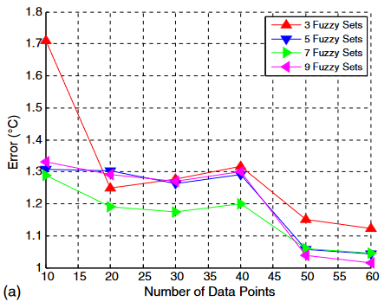

Research Target for Asim2024 paper
Research Objective
The effect of reducing number of occupant surveys to comfort modeling’s accuracy and its effect comfort and energy usage on different control resolution
Relation between prediction accuracy and learning data amount
Purpose of research
Advantage
of OCC
Effort for
OCC
- To evaluate the impact of the number of comfort surveys on model accuracy and its effect to both energy consumption and occupant comfort.
- The investigation is based on data-efficient comfort modeling using the Active Transfer Learning (ACTL-CNNLSTM) model.
[2] Review on occupant centric thermal comfort sensing, predicting, and controlling, Xie et al, 2020
[3] Challenges and opportunities of occupant-centric building controls in real-world implementation: A critical review, Soleimanijavid et al., 2024

Slide 24
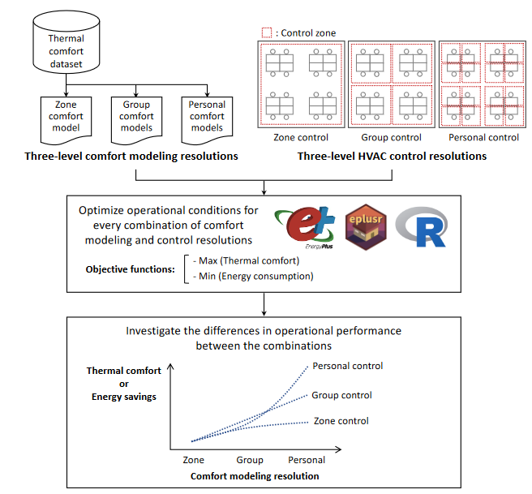
Research for Asim
Research Purpose
Needs to be updated
Comfort Agent Model Creation:
A Comfort Agent Model is developed using Multinomial Logistic Regression based on survey data. This model predicts individual occupant comfort levels in various thermal environments.
Generate Virtual Survey Answers:
Virtual survey answers are generated using the Comfort Agent Model, simulating agent responses to different thermal conditions. A 5% random variation is added to these answers to mimic real-world variability.
Transfer Learning:
The generated Virtual Survey Answers are used to fine-tune a General Model, pre-trained on the ASHRAE dataset, through transfer learning. This process adapts the General Model to the specific comfort preferences of each agent, resulting in a Transfer Learned Model for each agent.
Model Predictive Control (MPC) Evaluation:
The Transfer Learned Models are used in various Model Predictive Control scenarios to manage environmental conditions. The effectiveness of these MPC strategies is then compared against the original Comfort Agent Model to evaluate the improvements achieved through transfer learning.
Notes:
I set research target here
Occupant centric control with less occupant contribution and maximizing occupant acceptance considering individual personal comfort differences
Current research questions are here
First one is regarding How personal comfort profiles are integrated into HVAC control in existing OCC research,
Second one is the effect of reducing number of survey, the effect to comfort and energy usage varied on control resolution

Slide 25
Research Target for Asim2024 paper
Research Objective
The effect of reducing number of occupant surveys to comfort modeling’s accuracy and its effect comfort and energy usage on different control resolution
Relation between prediction accuracy and learning data amount
Purpose of research
- To evaluate the impact of the number of comfort surveys on model accuracy and its effect to both energy consumption and occupant comfort.
- The investigation is based on data-efficient comfort modeling using the Active Transfer Learning (ACTL-CNNLSTM) model.
Advantage
of OCC
Effort for
OCC
[2] Review on occupant centric thermal comfort sensing, predicting, and controlling, Xie et al, 2020
[3] Challenges and opportunities of occupant-centric building controls in real-world implementation: A critical review, Soleimanijavid et al., 2024

Slide 26
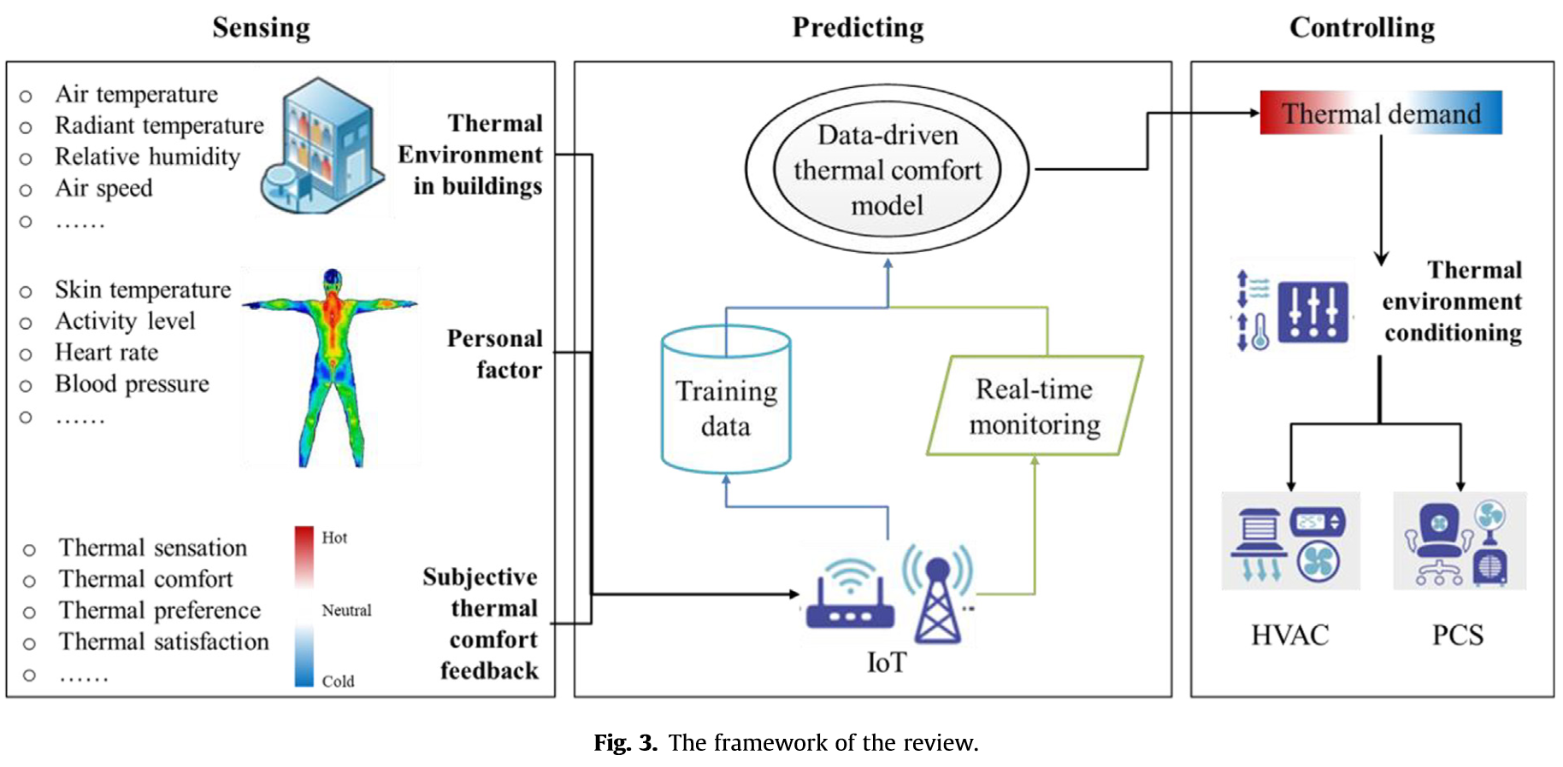
Background of research
Introduction – Purpose of OCC
In building air conditioning industry, Occupant-Centric Control (OCC), has been gaining attentions these years to integrate human element into building control ^{[2]}
OCC aims to optimize air-conditioning system (such as temperature setpoint, ceiling fan mode) automatically to pursue ①Occupant comfort ②Energy saving
4. HVAC
Layer
HVAC(Actuator)
3. Control Layer
Rule Based
MPC
RL
2. Learning Layer
Occupancy
Learning
Used if
enough
resolution
Preference
Learning
Difficulty of adoption in real building
The number of OCC in real building implementation are still less than simulation studies ^{[3]}
While the development of frameworks on simulation is very active, there are still less examples of actual use in real buildings. ^{[4]}
1. Sensing Layer
BMS
IoT
Occupied/
Unoccupied
Counting
Location
Sensation
Voting
PID Sensor
Vision
RFID
GPS
Wifi
Voting station
Wearable Device
Feedback via thermostat
Thermal camera
0. Physical Layer
Environment
Occupancy
Comfort
[1] Analysis of the accuracy on PMV – PPD model using the ASHRAE Global Thermal Comfort Database II
[2]Review on occupant centric thermal comfort sensing, predicting, and controlling, Xie et al, 2020
[3] Challenges and opportunities of occupant-centric building controls in real-world implementation: A critical review, Soleimanijavid et al., 2024
[4] A critical review of field implementations of occupant-centric building controls, Park et al., 2019
Addressing discrepancies of PMV with individual thermal comfort
In HVAC control, setpoint control considering PMV is orthodox method.
However, it has been reported that PMV control, which assumes an average comfort level, can result in only about 34% of people being satisfied due to discrepancies with individual thermal comfort. ^{[1]}
Difference between PMV and actual acceptance
Notes:
in building air conditioning industry, occupant centric control, OCC is gathering attention these years. OCC integrates human perception for the environmental condition, such as feeling cold, cool, neutral, warm, hot the purpose of occ is maximize occupant comfort while minimizing energy consumption
for developing occ, three basic components would be integrated. namely sensing layor for measuring environment or occupant occupancy and preference. developing prediction model to infer like how this person would feel under specic environment. the last part is control layer, deciding how to control temperature or fan speed considering these model

Slide 27
Difficulty of application of OCC
Relation between prediction accuracy and learning data amount
4. HVAC
Layer
HVAC(Actuator)
3. Control Layer
Rule Based
MPC
RL
2. Learning Layer
Occupancy
Learning
Used if
enough
resolution
Preference
Learning
1. Sensing Layer
BMS
IoT
Occupied/
Unoccupied
Counting
Location
Sensation
Voting
PID Sensor
Vision
RFID
GPS
Wifi
Voting station
Wearable Device
Feedback via thermostat
Thermal camera
0. Physical Layer
Environment
Occupancy
Comfort
[2] Review on occupant centric thermal comfort sensing, predicting, and controlling, Xie et al, 2020
[3] Challenges and opportunities of occupant-centric building controls in real-world implementation: A critical review, Soleimanijavid et al., 2024
Notes:
one of the issue for applying occ into real building operation is the difficulty of creating personal comfort model for each occupants. it requires gaining dozenscomfort survey from each ocupant

