Slide 1
Prepared by. Aira Benitez
MAY 2025
Transpacific Trade
Opus Walkthrough

Slide 2
Opus Walkthrough

Slide 3
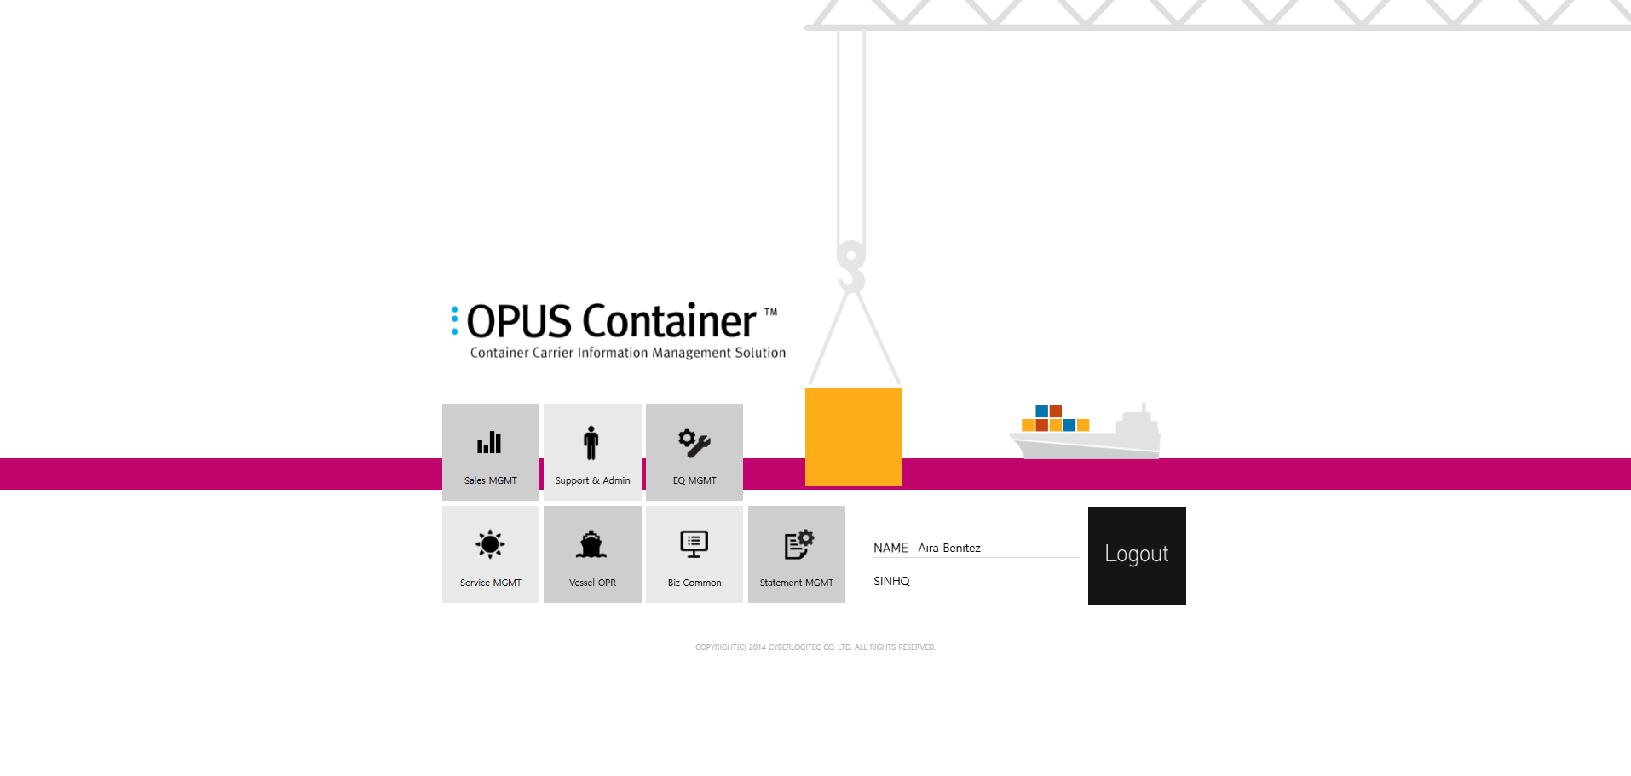
Opus Walkthrough
This is to show how OMMC TP Pricers utilize and use the Opus system’s function in handling daily pricing.

Slide 4
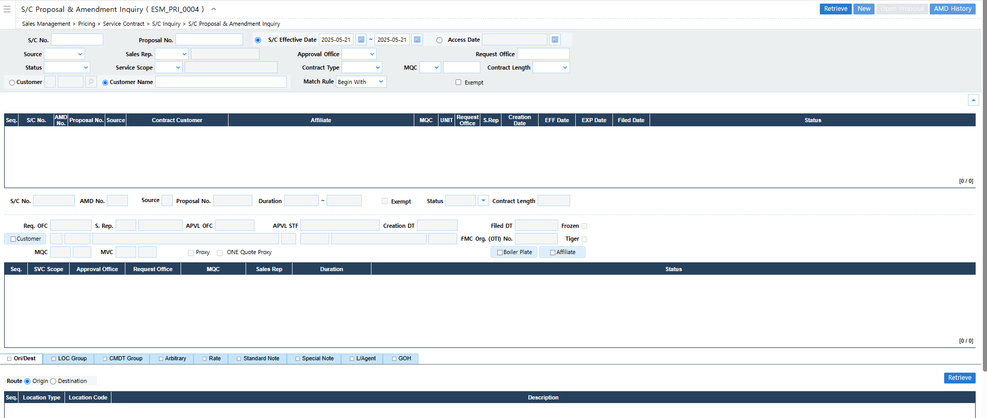
S/C Proposal & Amendment Inquiry
Path: Sales Management > Pricing > Service Contract > S/C Inquiry > S/C Proposal & Amendment Inquiry

Slide 5
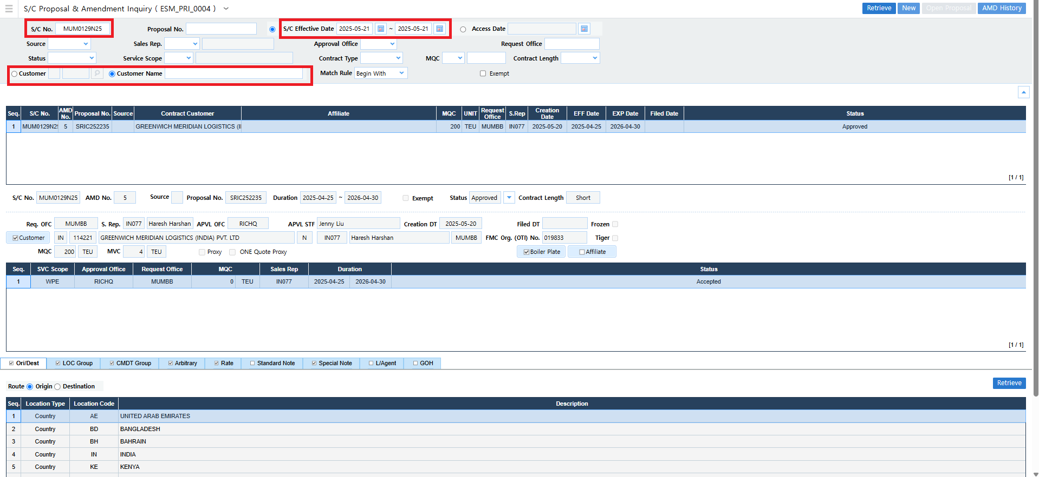
S/C Proposal & Amendment Inquiry
Search by the 10-digit S/C number / Customer Name / Customer Code / S/C Effective Date

Slide 6
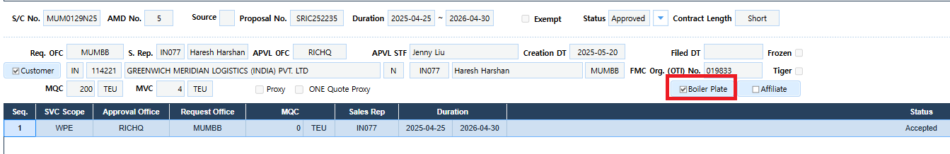
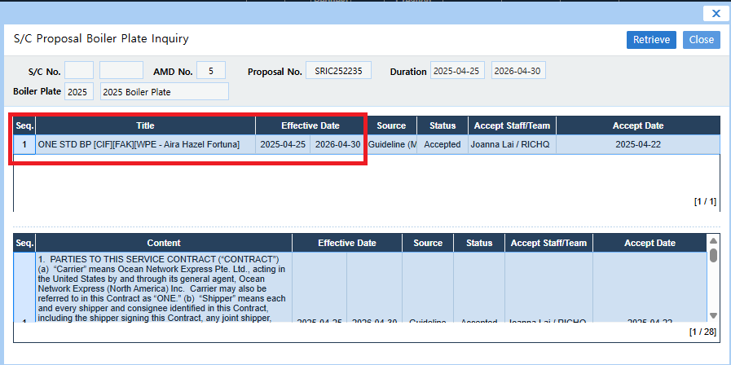
S/C Proposal & Amendment Inquiry
Boiler Plate:
This you can determine if the contract is whether a CIF or FOB contract, along with the pricer’s name and the contract effective duration.

Slide 7
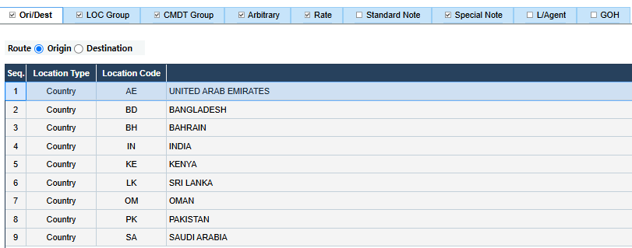
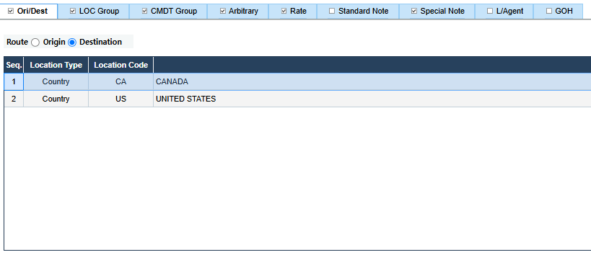
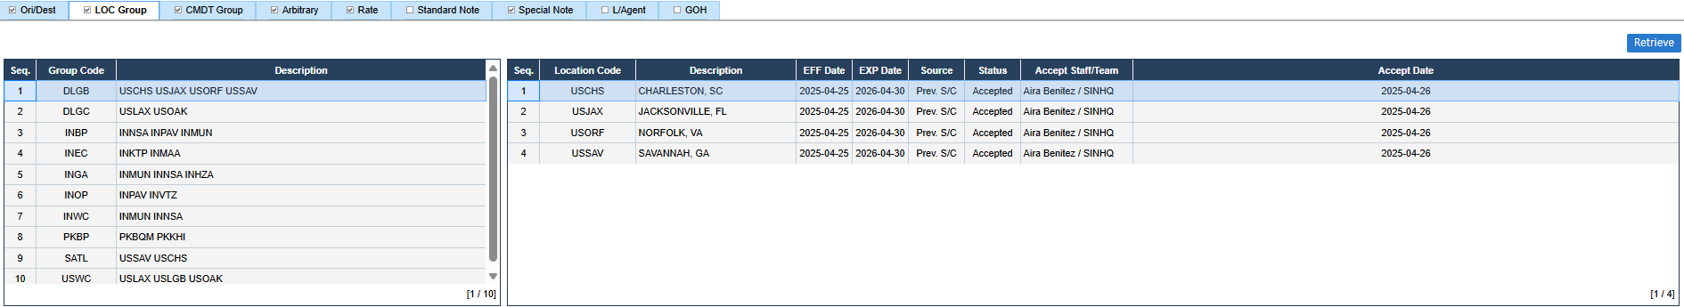
S/C Proposal & Amendment Inquiry
Origin & Destination Route: Countries that shows under WPE scope
Location Group: Tiger location group code is now being utilized also in the Opus system.

Slide 8
S/C Proposal & Amendment Inquiry
WPE Location Group:

Slide 9
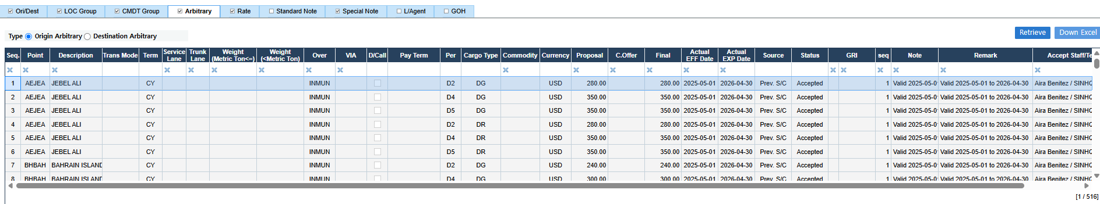
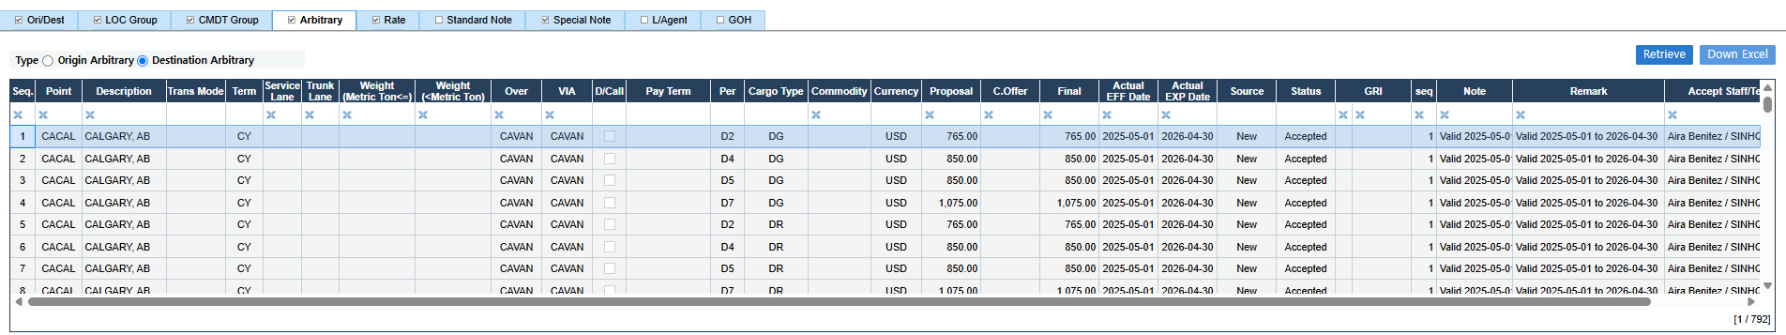
S/C Proposal & Amendment Inquiry
Origin & Destination Arbitrary Rates

Slide 10
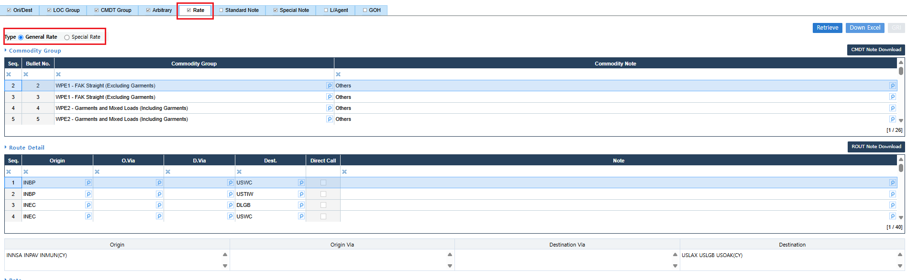
S/C Proposal & Amendment Inquiry
Rate tab
Where all the drafted rates are filed.
General Rate: This is where the FAK rates are being filed
Special Rate: This is where the special NAC / LT NAC rates are being filed with Named Accounts

Slide 11
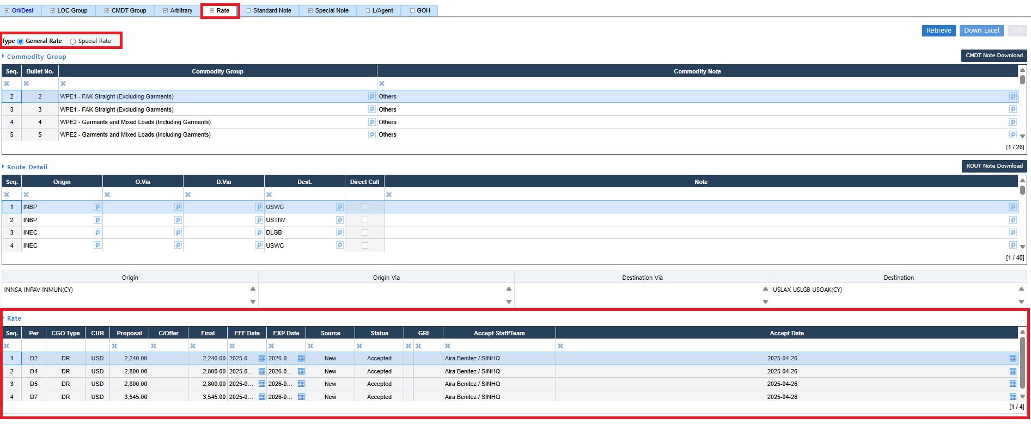
S/C Proposal & Amendment Inquiry
Rate tab
Where all the drafted rates are filed.
General Rate: This is where the FAK rates are being filed
Special Rate: This is where the special NAC / LT NAC rates are being filed with Named Accounts

Slide 12
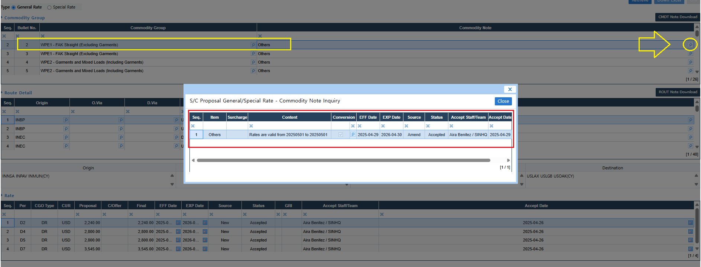
S/C Proposal & Amendment Inquiry
When you click on the spy glass, it will show the rate’s Commodity Note.
The Commodity Notes function is always being used in filing in order to input the rate’s validity, rate structure, specific service/vessel (if applicable), etc.

Slide 13
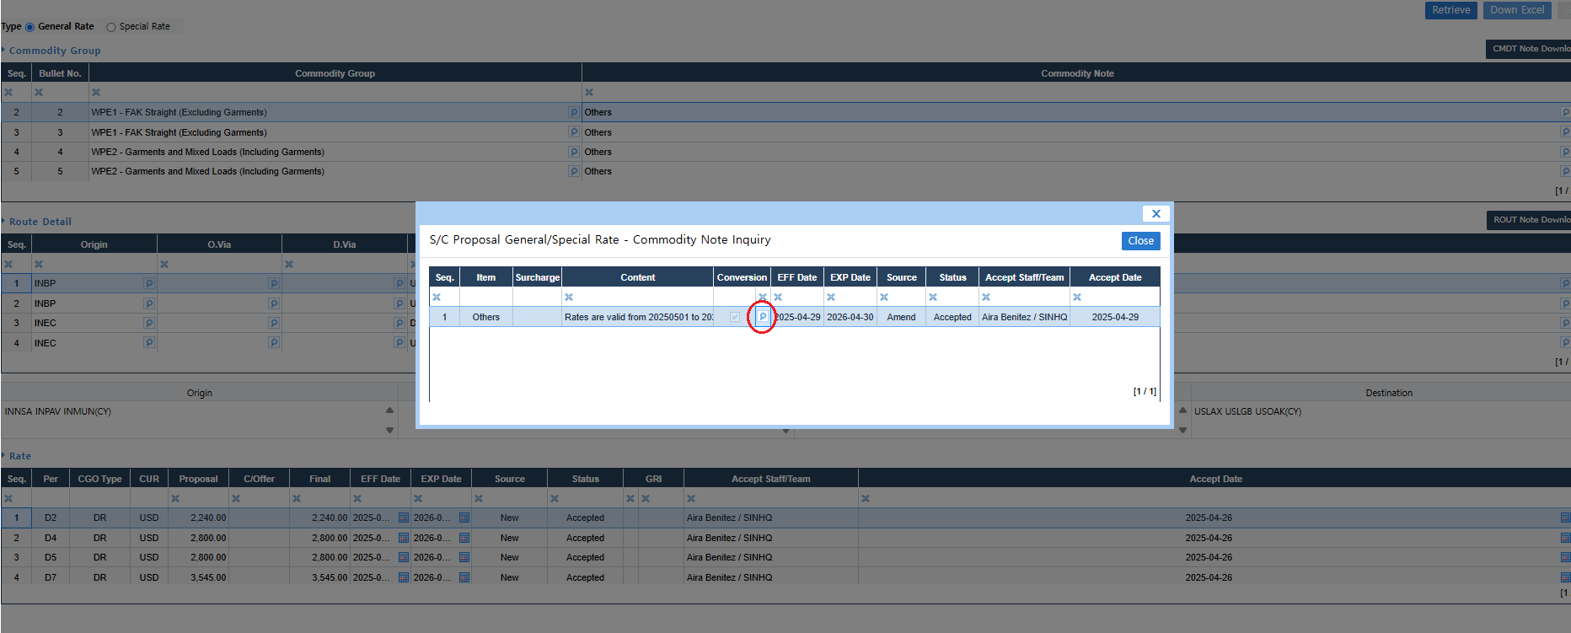
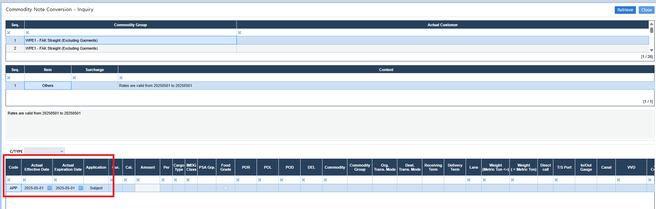
S/C Proposal & Amendment Inquiry
When you click the spy glass under the Conversion column, it will show the APP date and charges (if any).
APP Date – is the actual effective date of the rates. This is the date wherein the customer’s esign was sent to NA CAP and the same time the contract got Filed.
Sample Scenario: There are cases that the rate validity still shows eff 1 May 2025, but if the customer’s sign page was sent late and the contract got filed on 2 May 2025, the APP date will show as 2 May 2025.
Due to this sample scenario, affected bookings that may gate-in on 1 May 2025, will be NROF due to late filing.
That is why OMMC often received requests for delayed (backdate) filing, VID refund, and manual rating in order to rate the NROF booking.

Slide 14
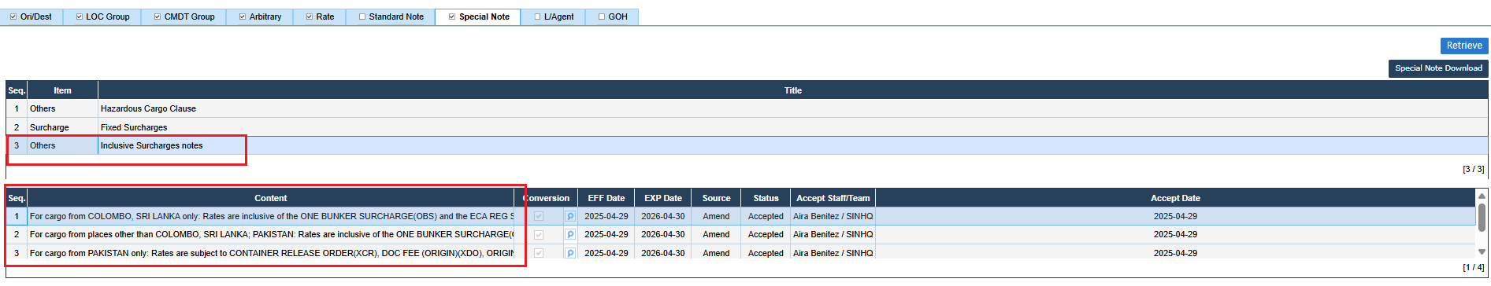
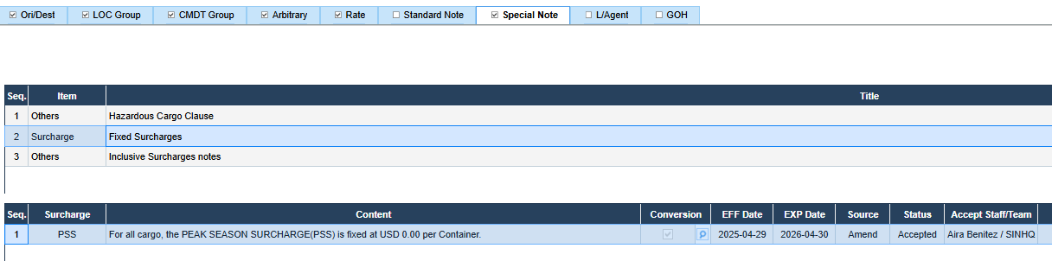
S/C Proposal & Amendment Inquiry
Special Note
Inclusive Surcharges Notes
  This is where the special rate structures are being filed in the contract.
Fixed Surcharges
  This is where the fixed surcharges are being filed in the contract (e.g., the PSS currently fixed at $0)

Slide 15
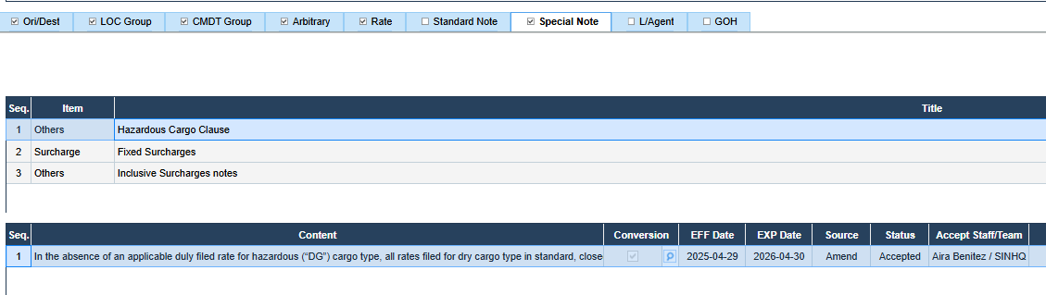
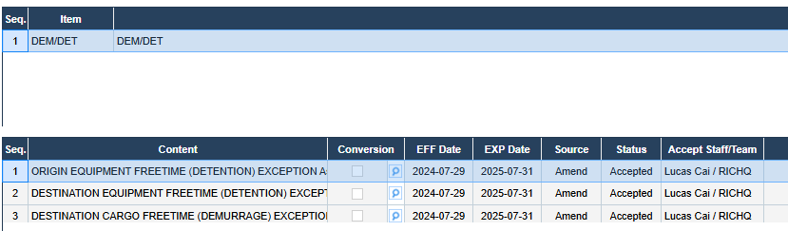
S/C Proposal & Amendment Inquiry
Special Note
Others > Hazardous Cargo Claue
  This is where the HAZ clause is being filed in the contract.
DEM/DET
  This is where the special free time condition is being filed in the contract. This is to minimize the use of ADHOC DAR applications. So long that the account was given approval for the special free time condition.

Slide 16
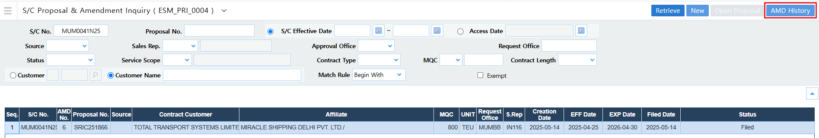
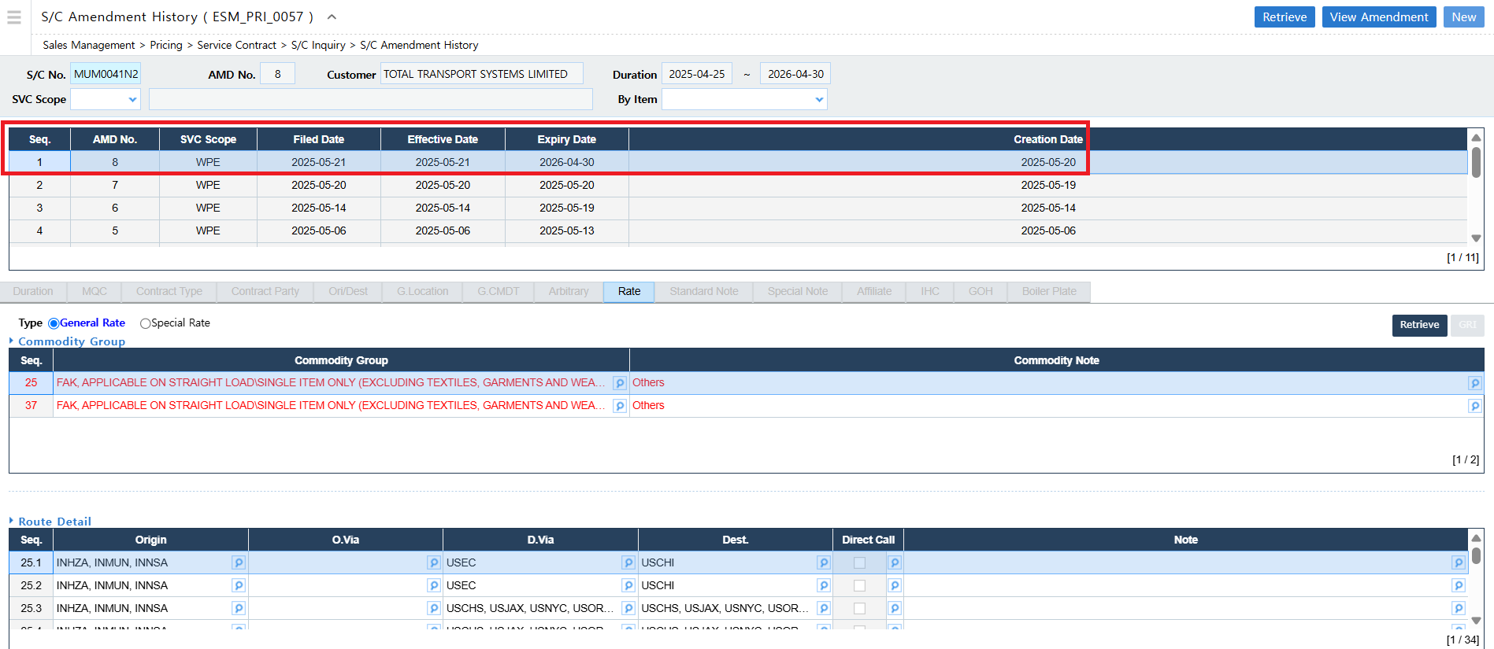
S/C Proposal & Amendment Inquiry
AMD History
If you click on the AMD History, it will redirect you to a new window showing the AMD history of the contract.
This tool is being used to know the filing AMD Date shown under the “Filed Date” column, this is the date when the AMD was filed for signature.

Slide 17
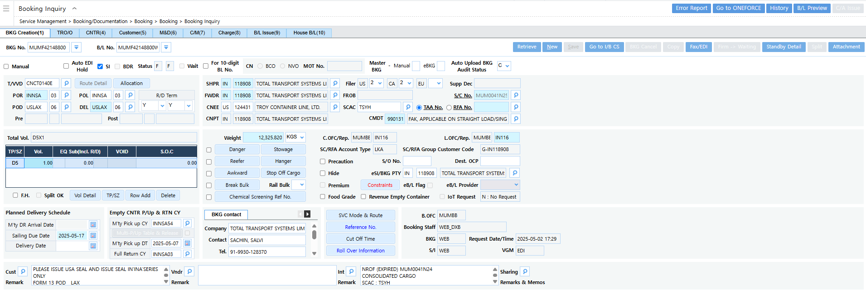
Booking Inquiry
Path: Service Management > Booking/Documentation > Booking > Booking > Booking Inquiry
Sample Booking Number: MUMF42148800

Slide 18
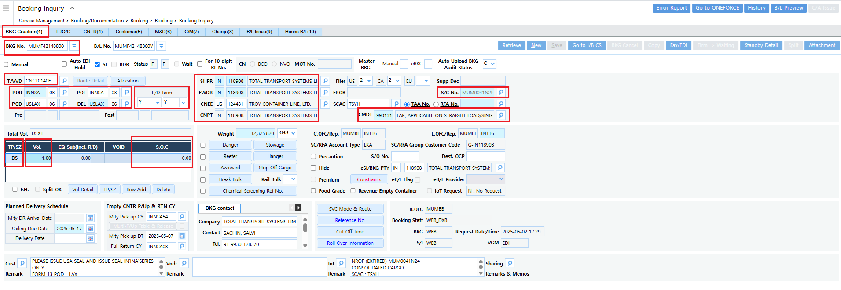
Booking Inquiry
BKG Creation

Slide 19
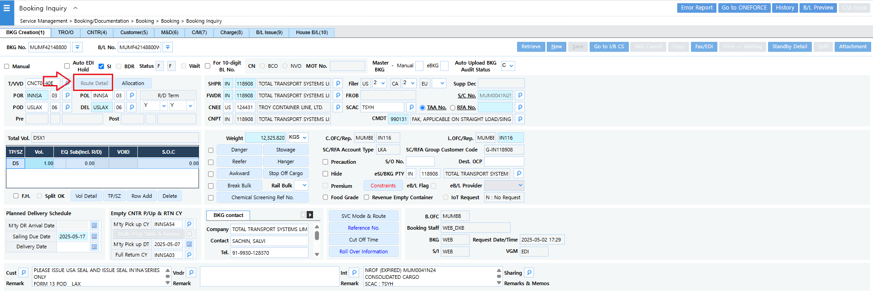
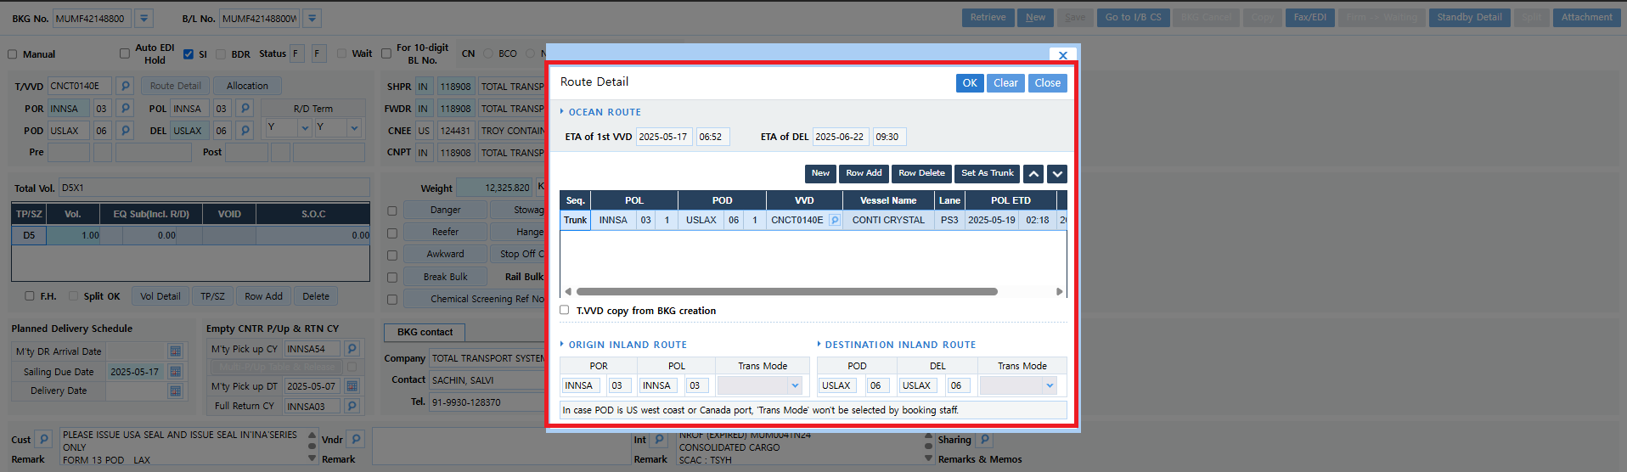
Booking Inquiry
Route Detail
Route information can be viewed in this tab.
This will also be useful in getting the VVD details in reviewing vessel delays.

Slide 20
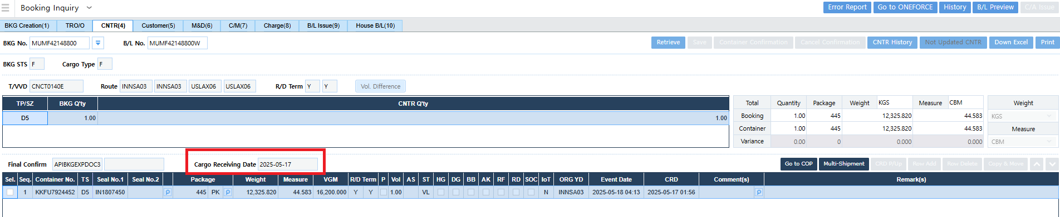
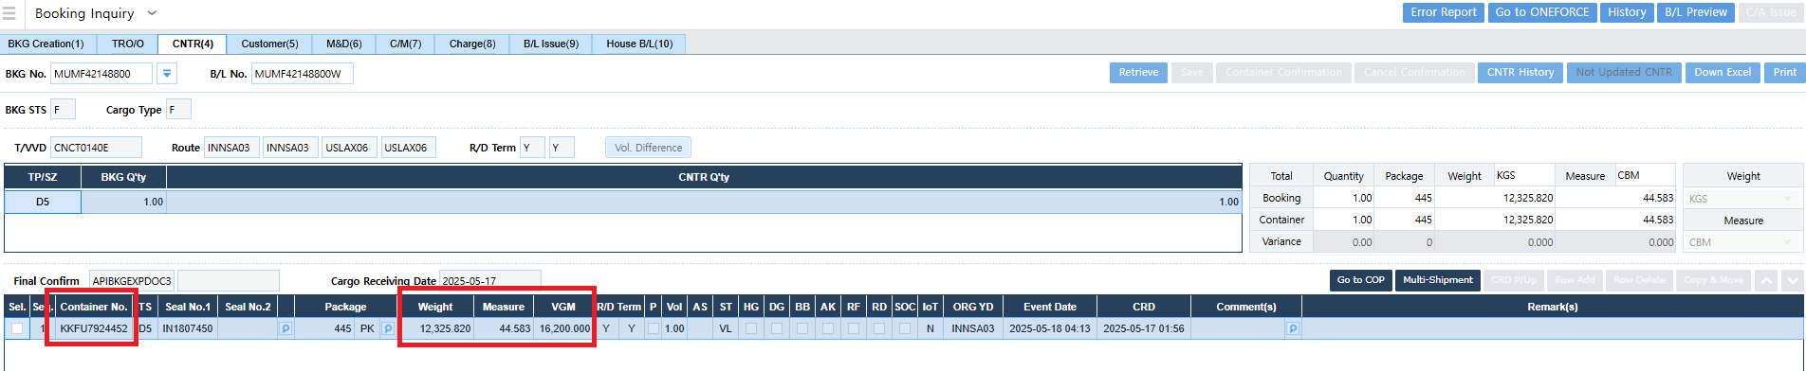
Booking Inquiry
CNTR
Knowing the CRD (Cargo Receiving Date) is essential, especially when reviewing NROF cases.
Can also get the container number, weight, measure and VGM (Verified Gross Mass) of the cargo.

Slide 21
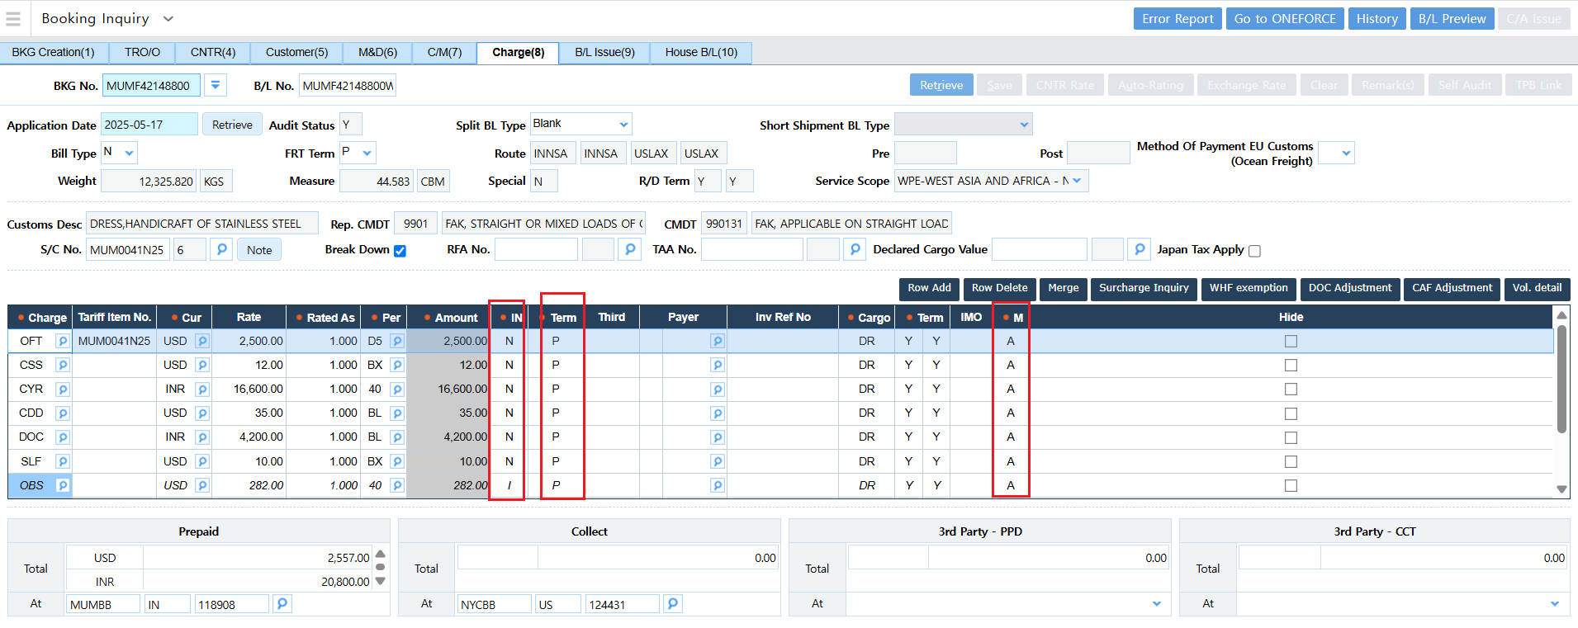
Booking Inquiry
Charge
Charge tab shows the linked rates and charges in the booking.
Application Date : is the applied date of the rate
IN : I – Include / N – Not Include
Term : P – Prepaid / C – Collect
M : M – Manual / A – Automatic

Slide 22
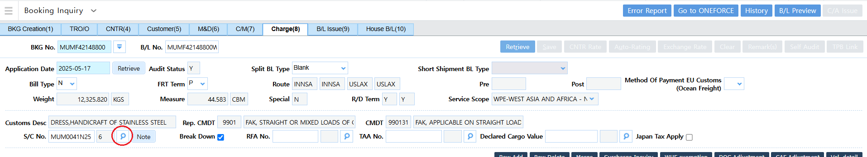
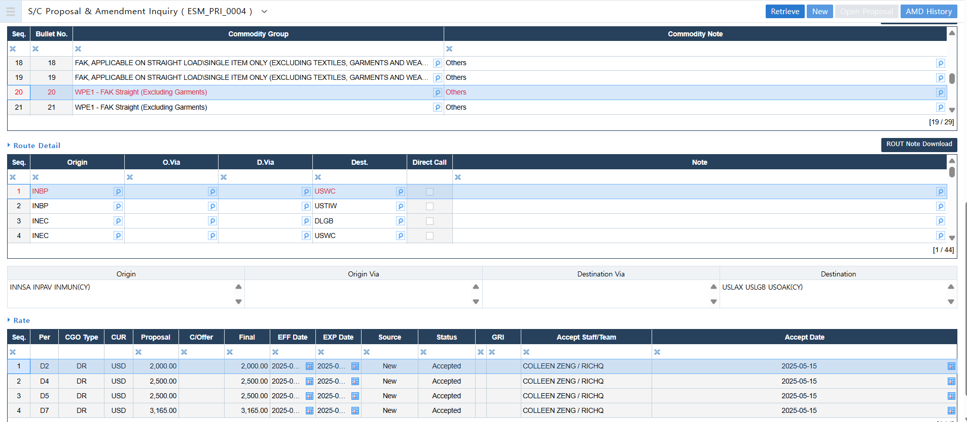
Booking Inquiry
Charge
If you click on the S/C No.’s spyglass it will redirect you to S/C Proposal and Amendment Inquiry.
This is to check what rates are linked in the booking, and if the correct rates are linked accordingly.

Slide 23
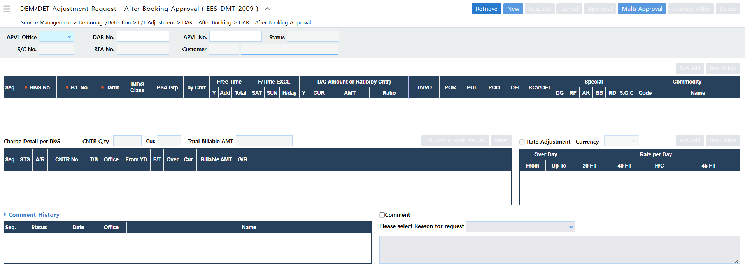
DEM/DET Adjustment Request - After Booking Approval
Path: Service Management > Demurrage/Detention > F/T Adjustment > DAR - After Booking > DAR - After Booking Approval

Slide 24
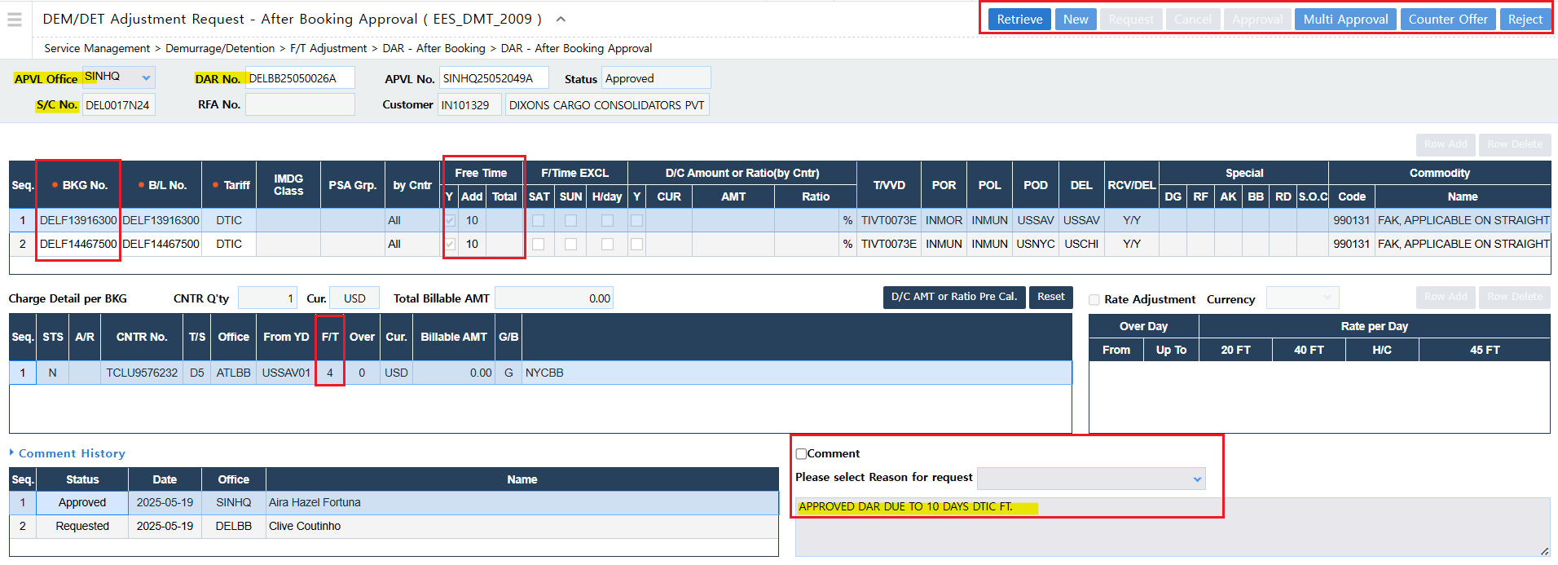
DEM/DET Adjustment Request - After Booking Approval
APVL Office – should indicate the correct APVL Office (for OMMC it is SINHQ)
DAR No. – DAR number to be provided by sales, since sales is the one who prepared the DAR request.
S/C No. – is the 10-digit service contract number of the account.
BKG No. – is the booking linked.
Free Time – for additional free time requests, should be inputted under “Add” column and indicate the number of days.
F/T – column is the number of tariff days
Comment box – is the section you will indicate your remarks.

Slide 25

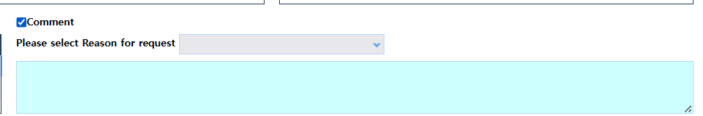
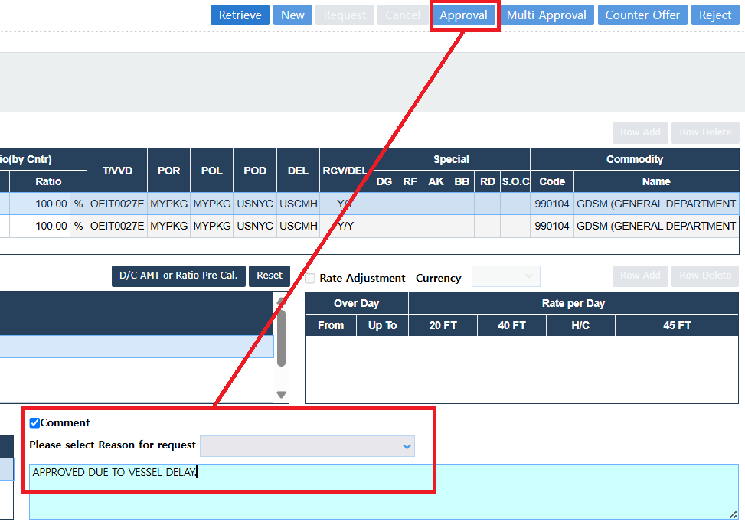
DEM/DET Adjustment Request - After Booking Approval
Input the DAR number and click “Retrieve”.
Check the selected reason for request, it should be accurate with the request.
Click the “Comment” box and input remarks.
Check all details if all are correct, if ok, proceed to Approve the request.

Slide 26
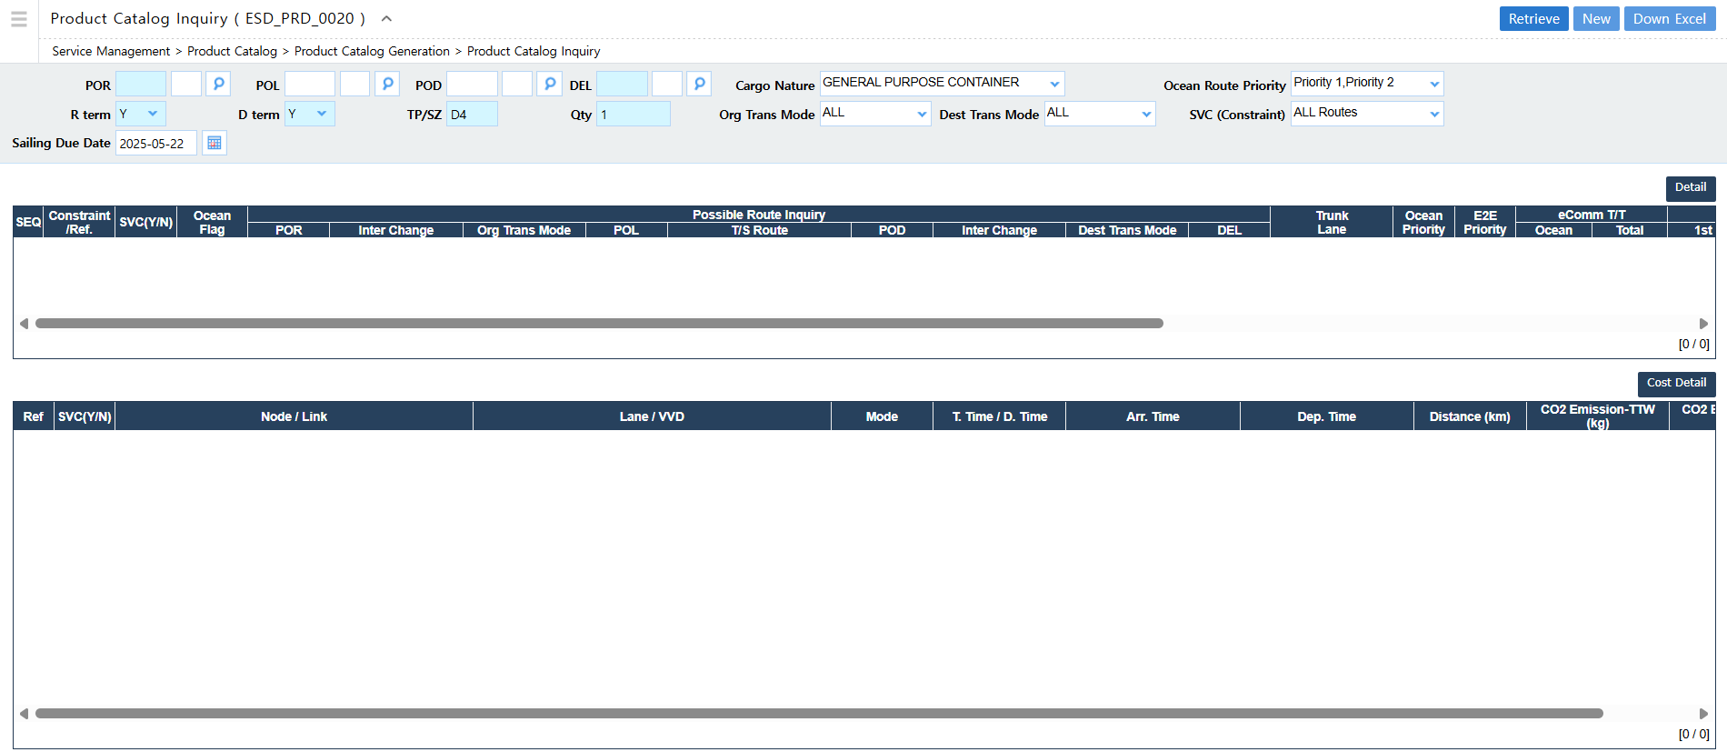
Product Catalog Inquiry
Path: Service Management > Product Catalog > Product Catalog Generation > Product Catalog Inquiry

Slide 27
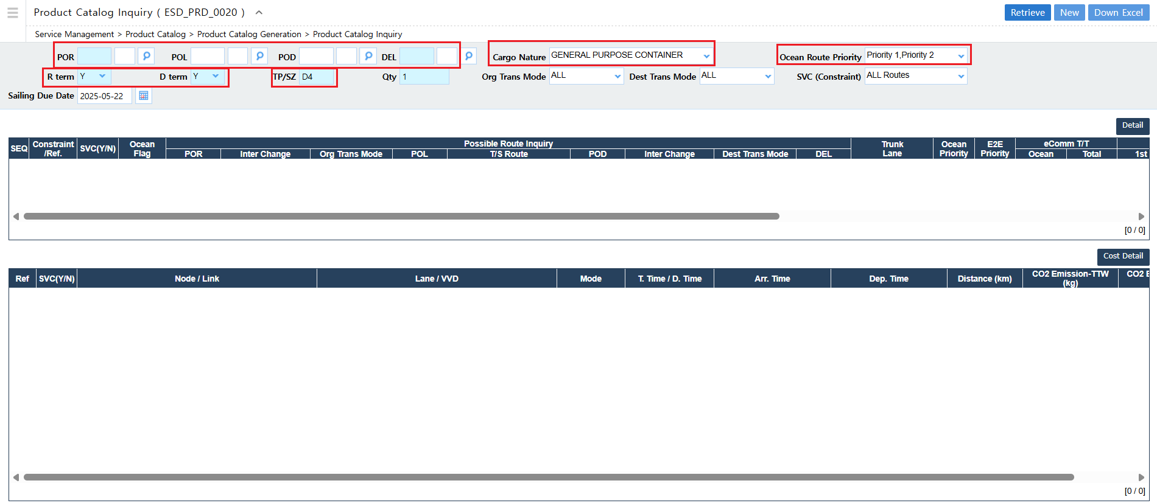
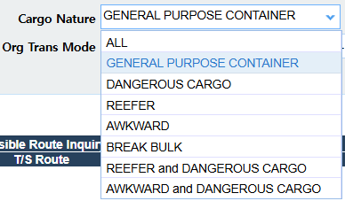
Product Catalog Inquiry
Input the 5-letter location code for the POR / POL / POD / DEL
Select the correct the Cargo Nature
Select the Ocean Route Priority (P1/P2: There are routes that are available in the ONE website, the prioritized routes to be taken) You may select Ocean Route Priority: All so that you can view all the routes available.
R & D Term : C – CY / D – Door
TP/SZ : D2/D4/D5/D7 for Dry or R2/R5 for Reefer

Slide 28

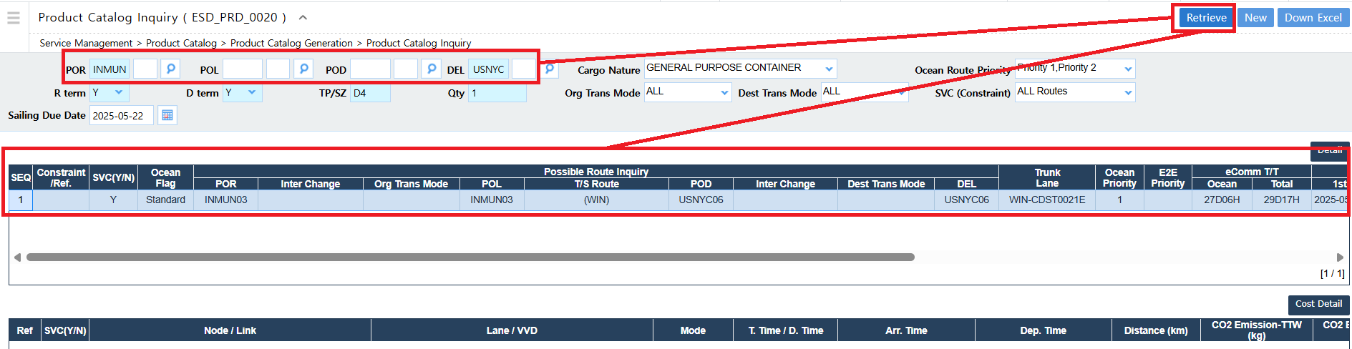


Product Catalog Inquiry
Click “Retrieve” to show the available routes.

Slide 29
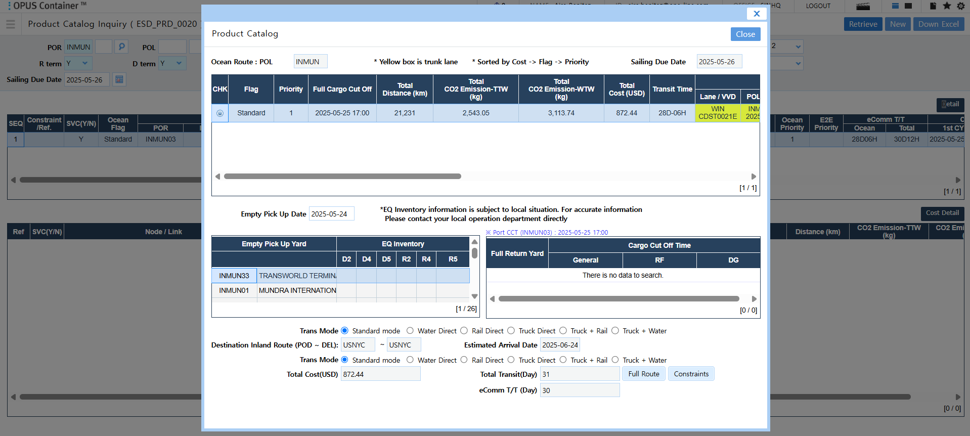
Product Catalog Inquiry
Product Catalog
> Detail

Slide 30
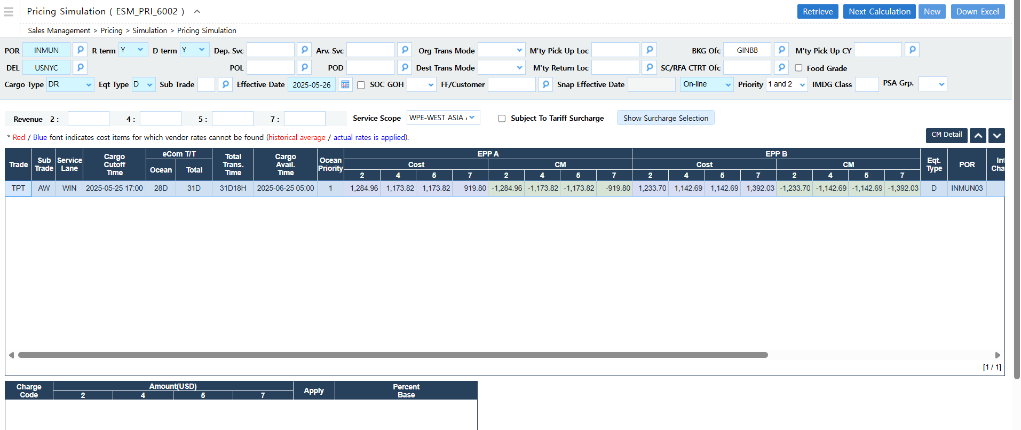
Pricing Simulation
Path: Sales Management > Pricing > Simulation > Pricing Simulation

Slide 31
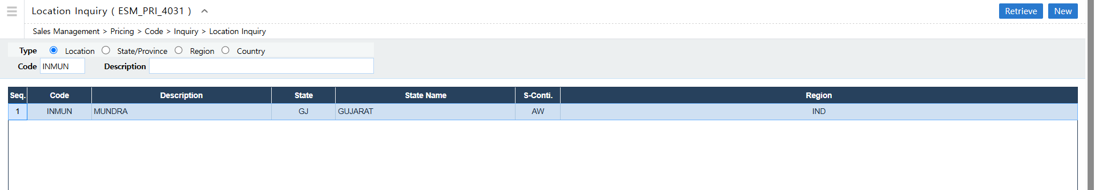
Location Inquiry
Path: Sales Management > Pricing > Code > Inquiry > Location Inquiry

Slide 32
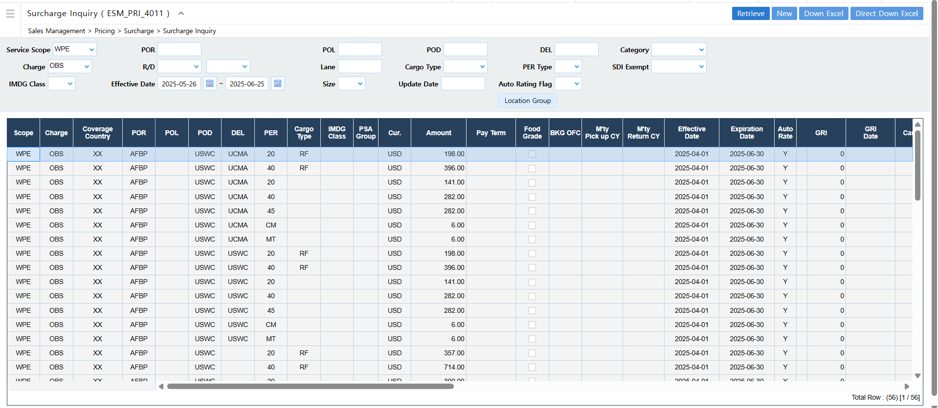
Surcharge Inquiry
Path: Sales Management > Pricing > Surcharge > Surcharge Inquiry

Slide 33
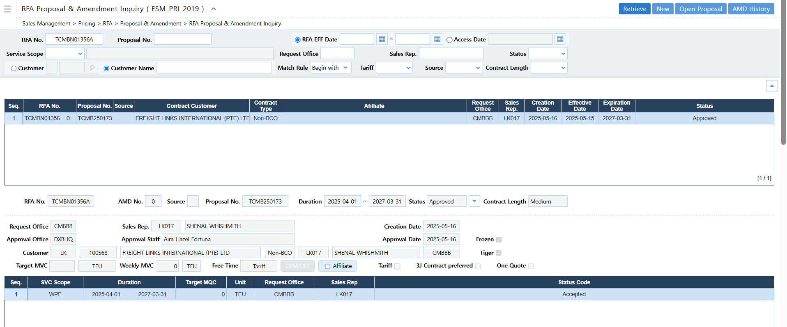
RFA Proposal & Amendment Inquiry
Path: Sales Management > Pricing > RFA > Proposal & Amendment > RFA Proposal & Amendment Inquiry
Sample RFA Used: TCMBN01356A

Slide 34
RFA Proposal & Amendment Inquiry
Path: Sales Management > Pricing > RFA > Proposal & Amendment > RFA Proposal & Amendment Inquiry
Sample RFA Used: TCMBN01356A

Slide 35
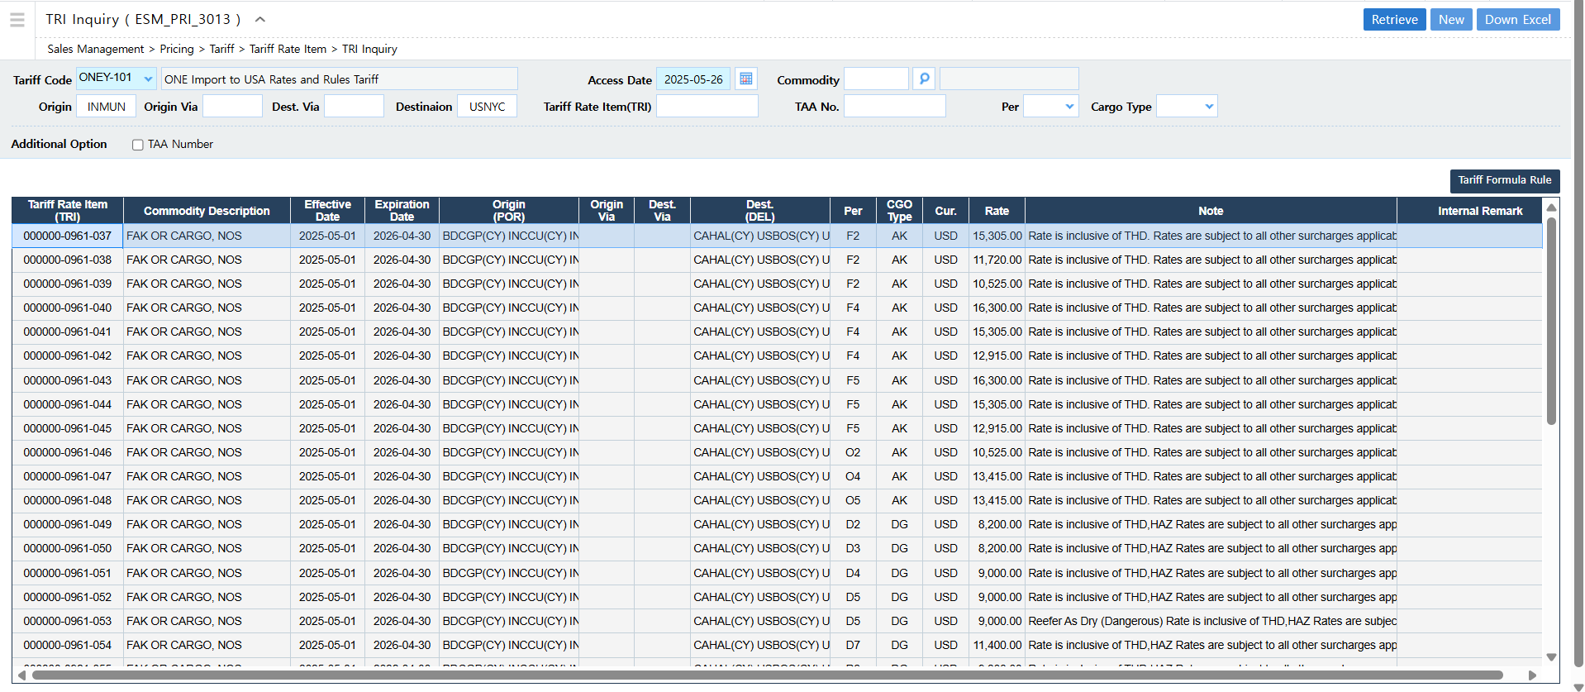
TRI Inquiry
Path: Sales Management > Pricing > Tariff > Tariff Rate Item > TRI Inquiry

Slide 36
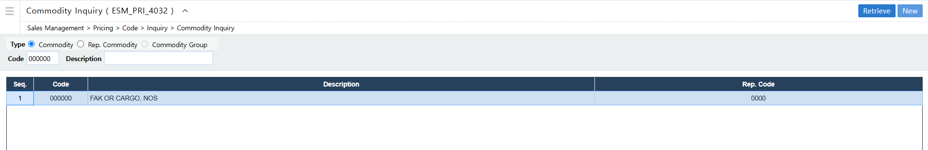
Commodity Inquiry
Path: Sales Management > Pricing > Code > Inquiry > Commodity Inquiry

Slide 37
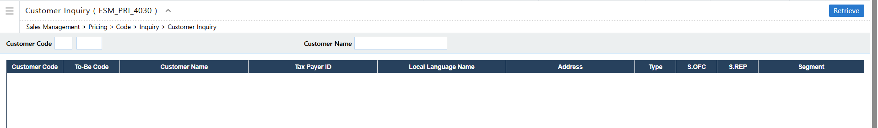
Customer Inquiry
Path: Sales Management > Pricing > Code > Inquiry > Customer Inquiry

Slide 38
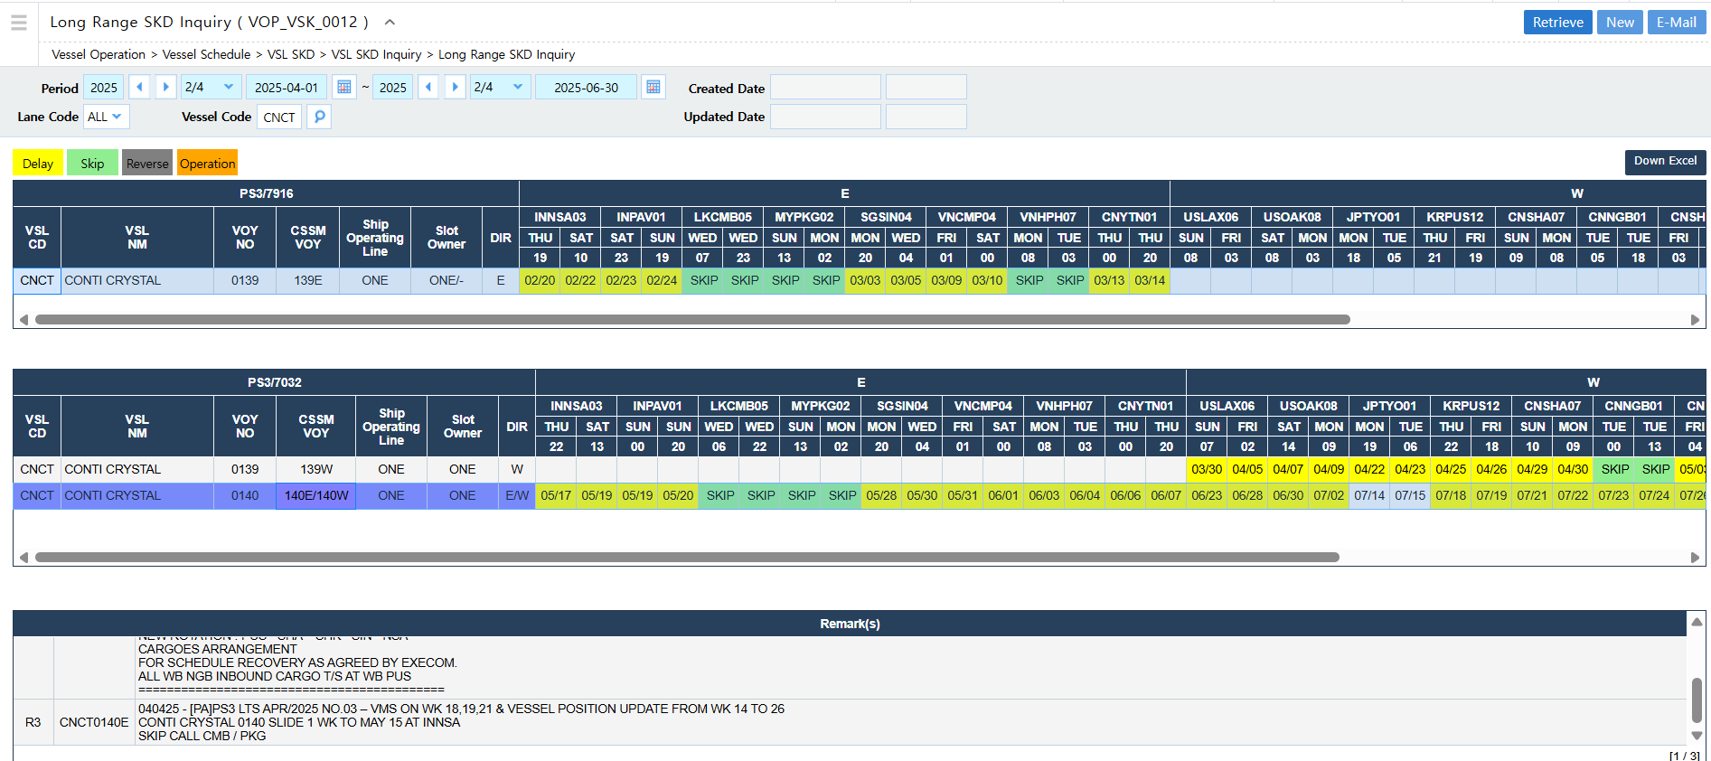
Long Range SKD Inquiry
Path: Vessel Operation > Vessel Schedule > VSL SKD > VSL SKD Inquiry > Long Range SKD Inquiry
Input the Vessel Code that can be retrieved from the Booking Inquiry

