Slide 1
QAGC submission
Team name : qumonkey
Members ：Kazuki Matsumoto
Srijan Srivastava

Slide 2
OUTLINE
・Our algorithm is based on this paper [1]
Contents：
・What is VQE Algorithm
・Motivation for Project
・Ansatz
[1] Stasja Stanisic, Jan Lukas Bosse,Observing ground-state properties of the Fermi-Hubbard model using a scalable algorithm on a quantum computer, 2022,
nature communications

Slide 3

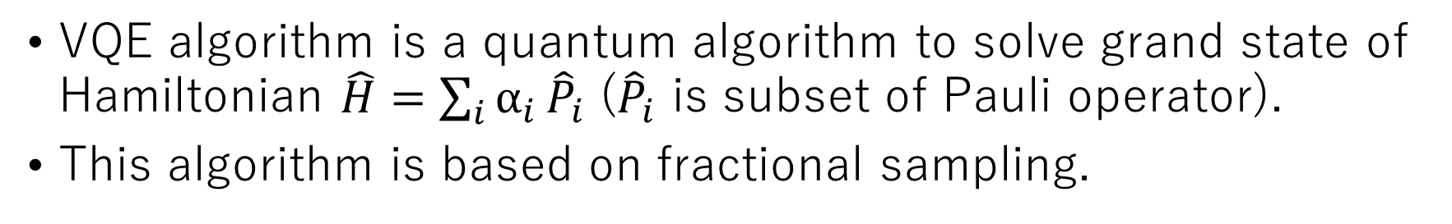
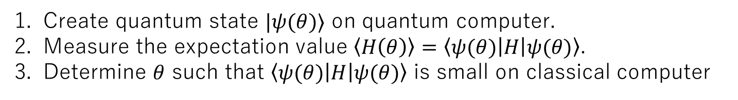
VQE algorithm
VQE algorithm is a quantum algorithm to solve grand state of Hamiltonian $\hat{H}=\sum_{i}{α_{i}}{\hat{P}}_{i}$ (${\hat{P}}_{i}$ is subset of Pauli operator).
This algorithm is based on fractional sampling.
$$\left\langle ψ | H | ψ\right\rangle ≥E_{0}$$
VQE algorithm
Create quantum state $|ψ(θ)⟩$ on quantum computer.
Measure the expectation value $\left\langle H\left(θ\right)\right\rangle =\left\langle ψ(θ) | H | ψ(θ)\right\rangle$.
Determine $θ$ such that $\left\langle ψ(θ) | H | ψ(θ)\right\rangle$ is small on classical computer
Repeat until $\left\langle ψ(θ) | H | ψ(θ)\right\rangle$ converges to get an approximate ground state.

Slide 4
Motivation for project
To search algorithm to solve Fermi-Hubbard model with efficient, low depth and few parameters.
The main motivation is to make ansatz scale down
without loss of accuracy.
We referred paper [1] to meet this requirement.
[1] Stasja Stanisic, Jan Lukas Bosse,Observing ground-state properties of the Fermi-Hubbard model using a scalable algorithm on a quantum computer, 2022,
nature communications

Slide 5
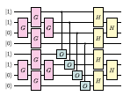
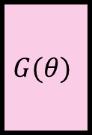

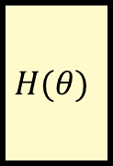
Ansatz
We designed following ansatz :
The gates named G, H and O are
parameterized gats.
$$G(θ)$$
$$H(θ)$$
●
$$O(θ)$$

Slide 6
Thank you !!

