Slide 1

Application Layer (Web Layer)
Domain Layer
Infrastructure
Layer
Bean
XML
<Spring Security>
Spring
Security
Filter
Chain
<H2>
WebServlet
(For H2 Console)
Domain
Objects
config
XML
Bean
XML
MyBatis3
<Spring MVC>
Dispatcher
Servlet
Repositories
Controllers
Mapper
XMLs
Services
DTOs
(Form)
<Java EE>
Bean
Validation
Bean
XML
Bean
XML
TERASOLUNA Global Framework Common Libraries
Bean
XML
<Spring Framework>
Context (DI Container & AOP & Tx ...)
Web
.xml
<Java EE>
Servlet Container

Slide 2

Application Layer (Web Layer)
<SpringSecurity>
Access the protected page
when not authenticate
<SpringMVC>
Add message
that encourage login
into flush scope.
Redirect to /auth/login?encourage
Login
Controller
encourageLogin
Redirect to /auth/login
showLoginForm
Return view name
of login form.

Slide 3
Application Layer (Web Layer)
Domain Layer
Validate login form &
return view name for
authenticate processing.
<SpringSecurity>
<SpringMVC>
POST /auth/login
login
Login
Controller
Load the account.
Forward to /auth/authenticate
Custom
UserDetails
ServiceImpl
loadUserByUsername
Athentication
SuccessEvent
ListenerImpl
onApplicationEvent
Create login history
& reset password
failure count.
Redirect to protected page(/xxxxx)
xxxxx
Xxx
Controller

Slide 4
Application Layer (Web Layer)
Domain Layer
<SpringSecurity>
<SpringMVC>
POST /auth/login
If bad credential are inputted,
create login failure history
& count up password
failure count.
(omit)
Forward to /auth/authenticate
Bad
Credential
EventListener
Impl
Authentication
Error
onApplicationEvent
Forward to /auth/login/error
handleLoginError
Login
Controller
Redirect to /auth/login
Add form object &
AuthenticationException
Into flush scope.
(omit)
View the authentication error &
re-display the input value.

Slide 5
Application Layer (Web Layer)
<SpringSecurity>
<SpringMVC>
Handle the
validation error.
Validation
Error
POST /auth/login
Login
Controller
login
showLoginForm
Return view name
of login form.
View the validation error &
re-display the input value.

Slide 6
Application Layer (Web Layer)
Domain Layer
<SpringSecurity>
Create logout history
& Redirect logout
Success page.
POST /auth/logout
onLogoutSuccess
Custom
LogoutSuccess
HandlerImpl
Authentication
ServiceImpl
createLogoutHistory
<SpringMVC>
Redirect to /auth/logout?success
logoutSuccess
Logout
Controller
Add message that notify
logout was successful
into flush scope.
And return view name for
redirect to top page.
Redirect to /
(omit)

Slide 7
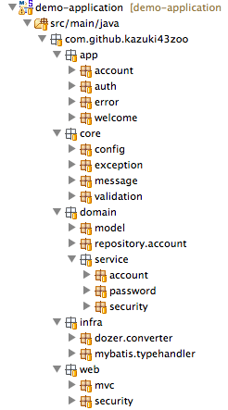
(1) Application layer
(2) Core component
that not depends on layer
(3) Domain layer
(4) Infrastructure layer
(5) Common component
that depends on web layer

Slide 8
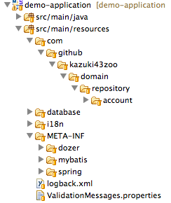
(1) Root
(2) Store Mapper XML of Mybatis 3
(3) Store SQL(DDL & DML)
(4) Store Message properties
(5) Store mapping & global
configuration files for Dozer
(6) Store global configuration
file for Mybatis 3
(7) Store Spring bean files &
properties files
for Spring Framework

Slide 9
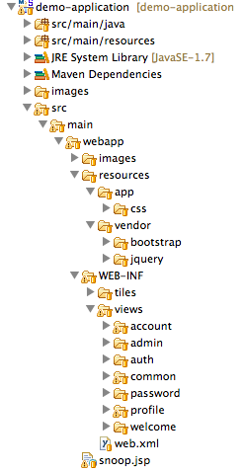
(1) Document root of web application
(2) Store static web resources
(css / js / image / etc...)
(3) Store private resources of web
application.
(JSP / configuration file / etc...)
(4) Store configuration file for Tiles
(5) Store JSP files

Slide 10
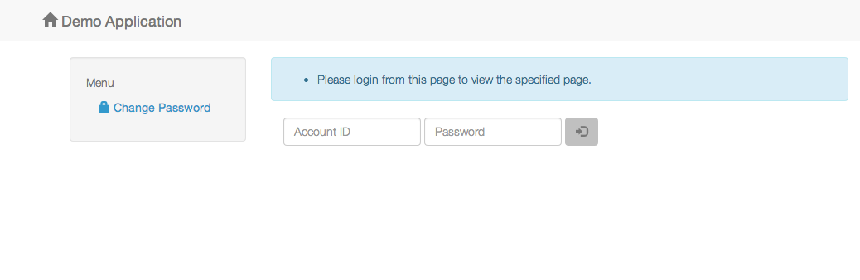

Slide 11
