Slide 1

FOOD, ALIMENT and SUSTENANCE SYSTEM
NEC Food Hackathon
Team : A S I S

Slide 2

Problem Factor
1. Crop Distribution network across India
Farmers sells their yields to the local distributor, who uses his sources to sell the yield instead of focusing on where it needed most or where it would be economically feasible for consumer, they sell with sole main of making profit,helping small farmer on the side.
2. Inadequete Coldchain
Food transporting from one place to another place doesn’t always need cold storage, the path can be broken into the segments where it is needed and places where it is not necessary.
3. Yield Support Price
MSP has been a subject of politics ever since it was introduced. Parties don’t increase MNP on crops per year as per recommend and suddenly increase the MNP before the election season, causing problems in primary production level that is with farmers during off season.

Slide 3

The Solution
Food Network Portal
We are building a network portal which will connect the farmers, logistics and the single point sellers /large scale consumers like Industries with the ease like a single click
Cold chain 2.0
Crop’s Support Price
A better way of transportation of yield from one place to another by using blockchain in the food supply chain, avoiding extra cost and wastage of energy.
Due to enhanced profit because of the elimination of the unnecessary distributors, farmers can be provide with support price in case of adversity

Slide 4
Farm yield distribution network
Data will be collected from farmers about total yields
Data about crops region wise will be collected
We can compare data through out India
Then we will store it in nearest storage centre
From there we will deliver it to the nearest market seller
This will remove network of unnecessary distributors who amplifies the cost
Saving money and gaining profit which will be benefit farmers

Slide 5
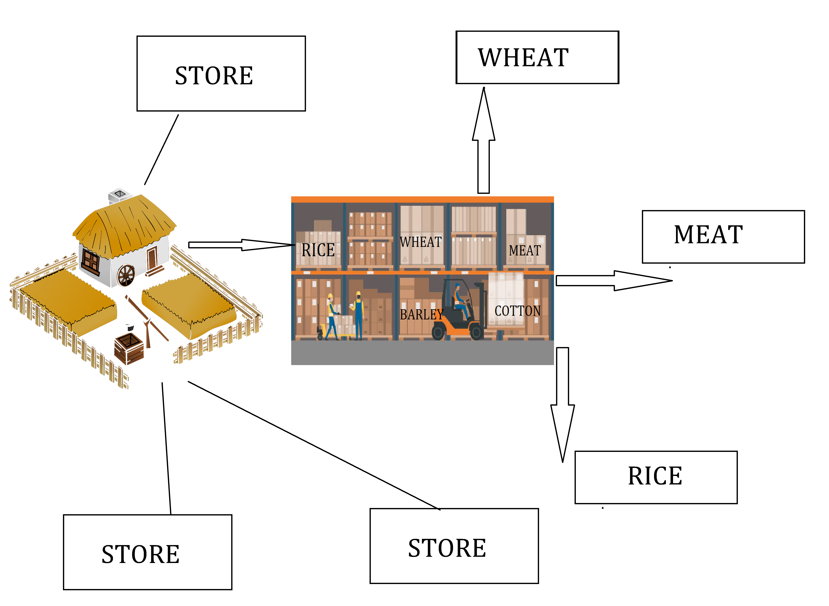
2.1 km
1.8 km
5.1 km
3.1 km

Slide 6
Cold Chain 2.0
Due to uncertain weather condition transferring farm yield can be enhanced by using distributed ledger system
Sensors on sensitive products can record temperature, humidity, vibration, and other environmental conditions.
These sensor readings can then be stored on a blockchain. They are tamper proof and if one block data changes it changes the rest respectively
Blockchain in supply chain cold storage will reduce the unnecessary transaction across the path.

Slide 7
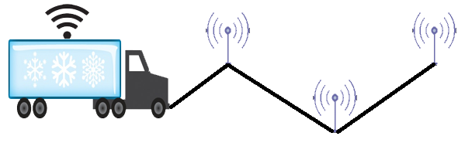
Storage location
Checkpoint 1
Checkpoint 2
Market location
Blockchain
Checkpoint 1
Market location
Checkpoint 2
Storage location

Slide 8
M.S.P Remastered
Removing distributors will enhance profit rate of the our central organization which can be saved for farmers in adverse condition.
Minimum support price will be provided in case of adverse condition and in other cases that money will be used for development of infrastructure of the farmers.

Slide 9
APPROACH
To connect the various aspects of the food sectors of India irrespective of the region or services. So, we are building a portal that will be used by every person involved.
For various type users the interactive menu and options will be different, respectively. For example farmer will have an option to track his yield, contact directly with seller, see the complaints or compliments directly from the consumer.
To make the portal interactive and revenue generating we have given it an social network type of interface were our different types of tenants will have an opportunity to see, understand and connect with the one other leading to better understanding hence better growth rate.

Slide 10
Technology Stack
HTML , CSS and Bootstrap
Java Script for backend
Node JS
SQL for Database management
Block Chain for efficient data Handling
PHP

Slide 11
Benefits of this Portal
When a network is established , processing time for monetary, transportation and selling sorts of task will be less as compared to current system
As our portal works for all farmer,distributer,will connect just by sitting at home and will provide them with more choices and will also Be able to sort out according to use.
Right now, as food distribution is uneven in India, their is chaos in the industry which can only be eliminated by something of this kind.

Slide 12
Business Model
Scalable Model
This business model can be applied to areas as small as a city to areas as big as a country or even it can work between nations
Significant Profit Share
All segments of the deal i.e. farmers, logistics, support funds and the company will get significant amount of profit share, which will rise with time

Slide 13





Funding
Fund Category
Farmer’s Share
Company’s Profit
Farmers will get 20% of the total calculated deal amount for the deal. It will be always above the MSP set and the share ratio will rise by certain ratio every year
The Company will save 20% share for its own expenses and profit
Farmer’s Future Support Fund
Logistics Charges and Development Fund
About 45% of the total calculated deal amount will be saved as support fund . It will be used in future to support the farmers who either got their crops failed or can't produce enough to meet the profit margin
About 15% of the total deal amount will be saved for logistics expenses , its support and its development

