Slide 1
Network Hardening in IoT Networks with Weighted Attack Graphs
Xuanli Lin
April 14, 2023 Arizona State University
Content adopted partially from [6]

Slide 2
Outline
Background
Attack Graph
(Shortest) Attack Trace
Network Hardening w/ SAT

Slide 3

State of IoT
IoT devices are ubiquitous
13.15B¹ online and counting
Smart home, smart city, connected health,…
Image: YottaStor

Slide 4
Cybersecurity in IoT
Unpatched IoT devices remain vulnerable
Mirai botnet (c. 2016)
Smart cameras²
Alexa Echos³
How can we systematically study the exploits in the IoT networks?

Slide 5
Attack Graph
Logical attack graphs⁴ can represent the security conditions in the system and their relationships
A directed graph with four basic ingredients
primitive fact node aka constant 1
rule node aka “AND” node
derived fact node aka “OR” node
“depends on” relationship

Slide 6
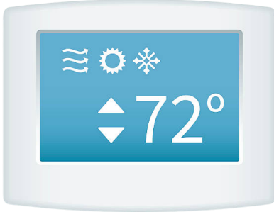




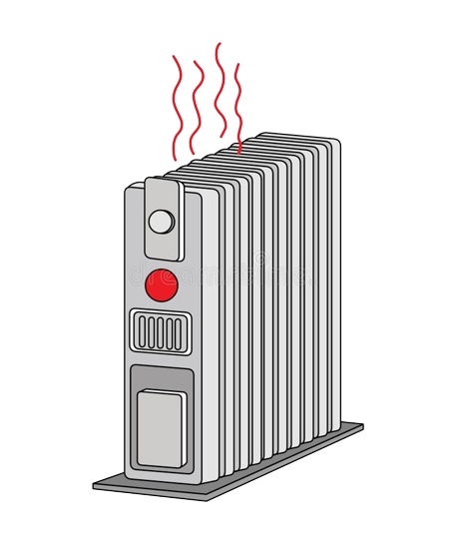
Toy Example
control
exploit
causes
exploit
control
Images: Dreamstime

Slide 7
Attack Graph – Example
Smart Thermostat has vulnerability CVE-2022-10000
Remote attacker
Smart Heater
has vulnerability
CVE-2020-12345
Attacker launches exploit via internet
Attacker launches exploit via internet
Attacker can set therm. temp.
Attacker can turn on heater
Smart Thermostat exists
Smart Heater exists
Attacker sets temp
Attacker turns heater on
Indoor temp 85F
goal node
(other malicious activities)

Slide 8
Attack Trace
In a complex attack graph, there can be many options for attackers
Attack trace⁵ helps us better understand possible routes an attacker can take

Slide 9
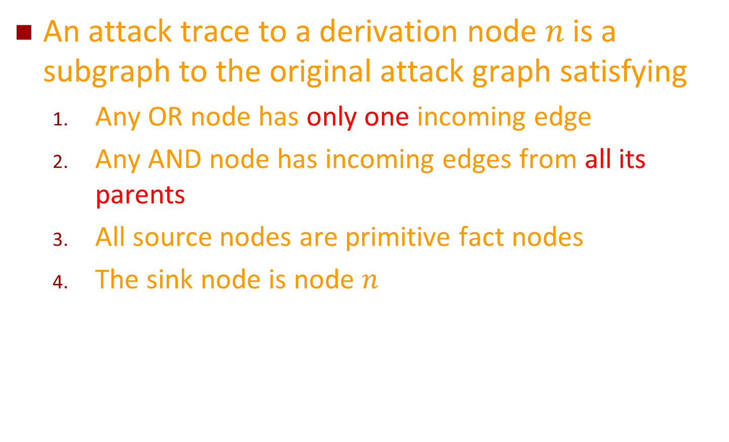
Attack Trace - Definition
An attack trace to a derivation node $n$ is a subgraph to the original attack graph satisfying
Any OR node has only one incoming edge
Any AND node has incoming edges from all its parents
All source nodes are primitive fact nodes
The sink node is node $n$

Slide 10
Attack Trace – Example
Smart Thermostat has vulnerability CVE-2022-10000
Attacker on internet
Smart Heater
has vulnerability
CVE-2020-12345
Attacker launches exploit via internet
Attacker launches exploit via internet
Attacker can set therm. temp.
Attacker can turn on heater
Smart Thermostat exists
Smart Heater exists
Attacker sets temp
Attacker turns heater on
Indoor temp 85F

Slide 11
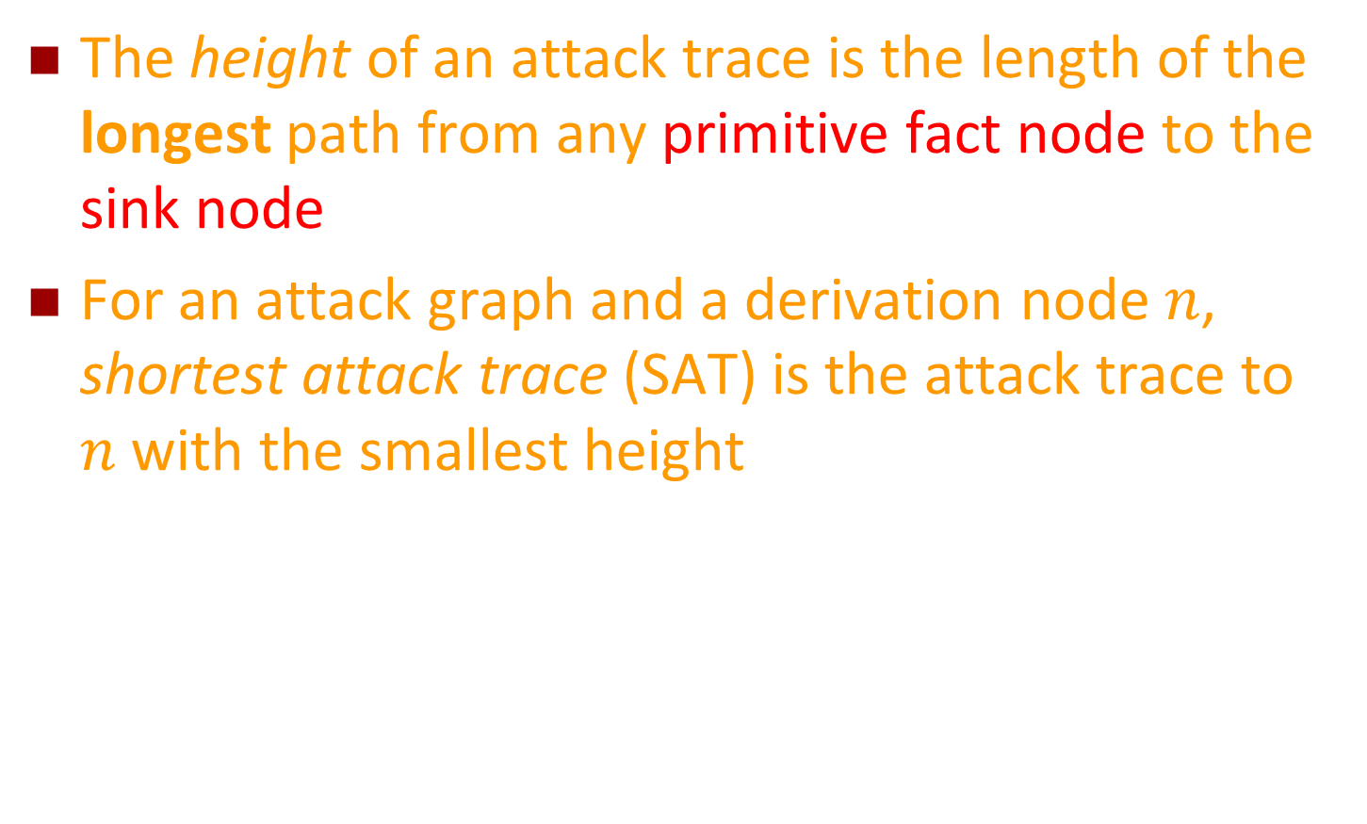
Height of Attack Trace
The height of an attack trace is the length of the longest path from any primitive fact node to the sink node
For an attack graph and a derivation node $n$, shortest attack trace (SAT) is the attack trace to $n$ with the smallest height

Slide 12
Height of Attack Trace – Example
Smart Thermostat has vulnerability CVE-2022-10000
Attacker on internet
Smart Heater
has vulnerability
CVE-2020-12345
Attacker launches exploit via internet
Attacker launches exploit via internet
Attacker can set therm. temp.
Attacker can turn on heater
Smart Thermostat exists
Smart Heater exists
Attacker sets temp
Attacker turns heater on
Indoor temp 85F
Height: 4
Height: 4
Both can be considered SAT

Slide 13
Weighted Attack Graph
We can generalize the attack graph to associate a weight⁶ with each node and/or each edge
The weight can be used to represent attack difficulty, time needed, resource needed, etc.
Attack traces can still be found in the weighted case

Slide 14
SAT in Weighted Attack Graph – Example
Smart Thermostat has vulnerability CVE-2022-10000
Attacker on internet
Smart Heater
has vulnerability
CVE-2020-12345
0
0
0
0
Attacker launches exploit via internet
Attacker launches exploit via internet
5
10
Attacker can set therm. temp.
Attacker can turn on heater
Smart Thermostat exists
Smart Heater exists
1
2
0
0
Attacker sets temp
Attacker turns heater on
1
2
Height: 7
Indoor temp 85F
Height: 14
Left attack trace is the SAT

Slide 15
Network Hardening
SAT can indicate the easiest way an attacker can reach his or her goal
Conversely, when we consider hardening the network, the work would be futile without hardening the nodes/edges in the SAT
We also need to consider the cost of these hardenings

Slide 16
Network Hardening – Example
Smart Thermostat has vulnerability CVE-2022-10000
Attacker on internet
Smart Heater
has vulnerability
CVE-2020-12345
0
0
If we have a lot of budget…
We can just harden them all!
If budget = 20
Bottom two turns out to be better value
If budget = 5
Middle option provides best value
0
0
Attacker launches exploit via internet
Attacker launches exploit via internet
5
10 (cost 20)
10
Attacker can set therm. temp.
Attacker can turn on heater
Smart Thermostat exists
Smart Heater exists
1
5 (cost 5)
2
0
0
Attacker sets temp
Attacker turns heater on
3 (cost 5)
1
2
Indoor temp 85F

Slide 17
Other Considerations
How can we find the SAT efficiently (i.e., in polynomial time) in any attack graph?
How to find the most effective upgrade strategy given any budget amount?
Check out our paper (reference [6]) to find out!

Slide 18
Thank you!
Any questions?
Contact: xlin54@asu.edu

Slide 19
References
[1] Finance Online. Number of Internet of Things (IoT) Connected Devices Worldwide 2022/2023: Breakdowns, Growth & Predictions. https://financesonline.com/number-of-internet-of-things-connected-devices/
[2] Mike Elgan. IoT Security: Thieves Are Targeting Smart Cameras — Here’s How To Stop Them. https://securityintelligence.com/articles/iot-security-smart-camera-thieves/
[3] Dan Goodin. Attackers can force Amazon Echos to hack themselves with self-issued commands. https://arstechnica.com/information-technology/2022/03/attackers-can-force-amazon-echos-to-hack-themselves-with-self-issued-commands/
[4] Xinming Ou, Sudhakar Govindavajhala, Andrew W Appel, et al. 2005. MulVAL: A logic-based network security analyzer. In Proc. of USENIX Security Symposium.
[5] Zheng Fang, Hao Fu, Tianbo Gu, Pengfei Hu, Jinyue Song, Trent Jaeger, and Prasant Mohapatra. 2022. IOTA: A framework for analyzing system-level security of IoTs. In Proc. of ACM/IEEE IoTDI.
[6] Yinxin Wan, Xuanli Lin, Abdulhakim Sabur, Alena Chang, Kuai Xu, Guoliang Xue. 2023. IoT System Vulnerability Analysis and Network Hardening with Shortest Attack Trace in a Weighted Attack Graph. To appear in IEEE/ACM IoTDI 2023. Preprint version available at: https://www.public.asu.edu/~xlin54/publication/iotdi-2023/

