Slide 1
IoT System Vulnerability Analysis and Network Hardening with Shortest Attack Trace in a Weighted Attack Graph
Yinxin Wan, Xuanli Lin, Abdulhakim Sabur, Alena Chang, Kuai Xu, Guoliang Xue
Arizona State University
May 12, 2023

Slide 2
Outline
Introduction
Shortest Attack Trace
Network Hardening Problem
Evaluation
Conclusion

Slide 3
State of IoT
IoT devices are ubiquitous
13.15B^{[1]} online and counting
Smart home, smart city, connected health,…
Unpatched IoT devices remain vulnerable
How can we systematically study the exploits in the IoT networks?
[1] Finance Online

Slide 4
Logical Attack Graph
Logical attack graphs^{[2]} can represent the security conditions in the system and their relationships
A directed graph with four basic ingredients
primitive fact node
rule node aka “AND” node
derived fact node aka “OR” node
“required by” relationship
[2] Xinming Ou, Wayne F Boyer, and Miles A McQueen. 2006. A scalable approach to attack graph generation. In Proc. of ACM CCS.

Slide 5
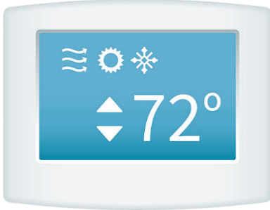




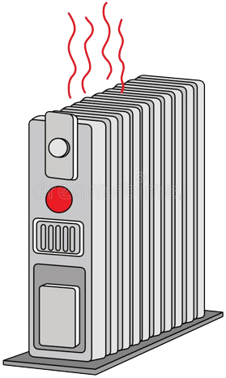
Example
control
exploit
causes
exploit
control
Images: Dreamstime

Slide 6
Attack Graph – Example
Smart Thermostat has vulnerability CVE-2022-10000
Remote attacker
Smart Heater
has vulnerability
CVE-2020-12345
Attacker launches exploit via internet
Attacker launches exploit via internet
Attacker can set therm. temp.
Attacker can turn on heater
Smart Thermostat exists
Smart Heater exists
Attacker sets temp
Attacker turns heater on
Indoor temp 85F
goal node
(other malicious activities)

Slide 7
Attack Trace
In a complex attack graph, there can be many options for attackers
Attack trace^{[3]} helps us better understand possible routes an attacker can take
[3] Zheng Fang, Hao Fu, Tianbo Gu, Pengfei Hu, Jinyue Song, Trent Jaeger, and Prasant Mohapatra. 2022. IOTA: A framework
for analyzing system-level security of IoTs. In Proc. of ACM/IEEE IoTDI.

Slide 8
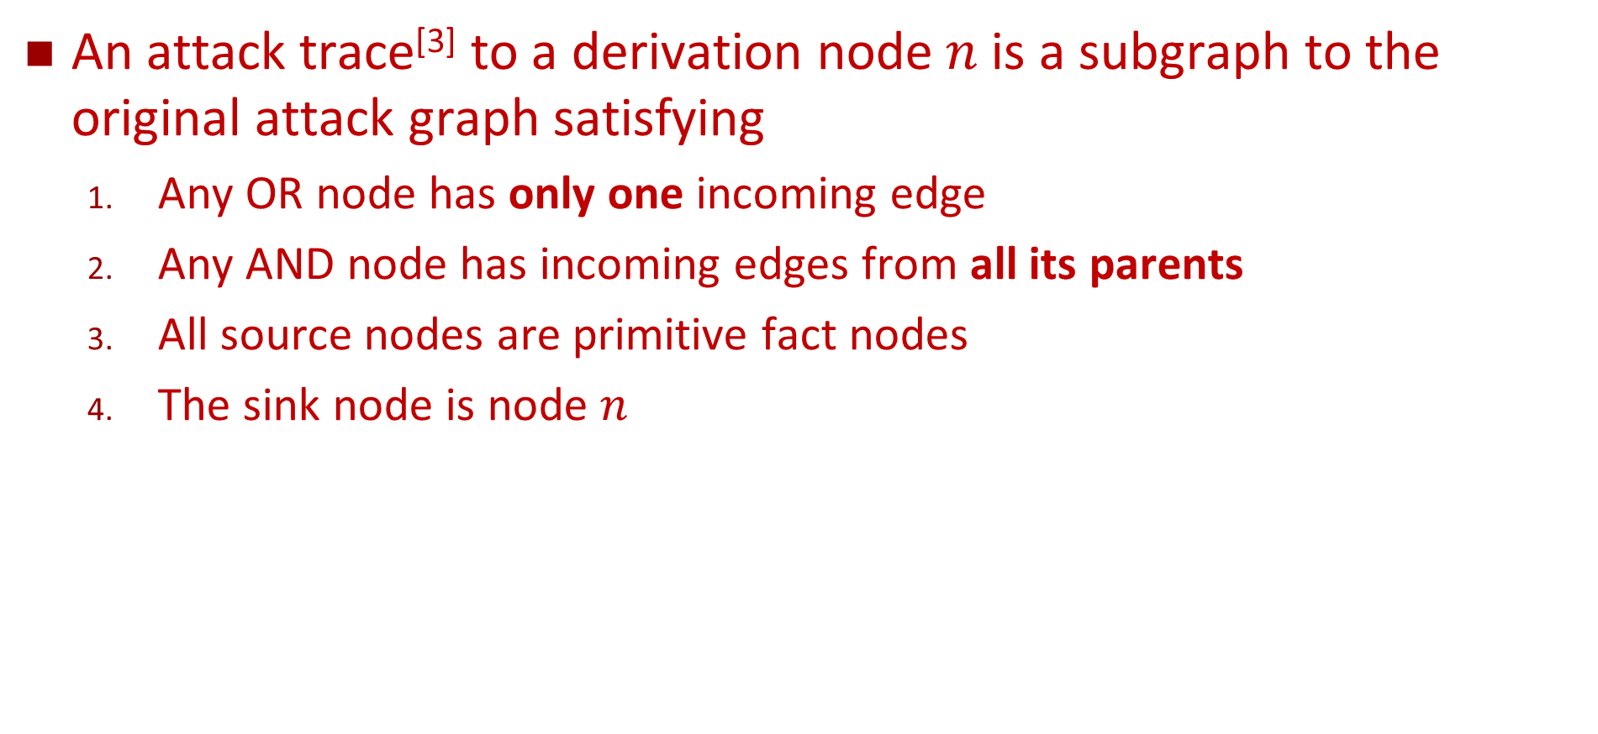
Attack Trace - Definition
An attack trace^{[3]} to a derivation node $n$ is a subgraph to the original attack graph satisfying
Any OR node has only one incoming edge
Any AND node has incoming edges from all its parents
All source nodes are primitive fact nodes
The sink node is node $n$
[3] Zheng Fang, Hao Fu, Tianbo Gu, Pengfei Hu, Jinyue Song, Trent Jaeger, and Prasant Mohapatra. 2022. IOTA: A framework
for analyzing system-level security of IoTs. In Proc. of ACM/IEEE IoTDI.

Slide 9
Attack Trace – Example
Smart Thermostat has vulnerability CVE-2022-10000
Attacker on internet
Smart Heater
has vulnerability
CVE-2020-12345
Attacker launches exploit via internet
Attacker launches exploit via internet
Attacker can set therm. temp.
Attacker can turn on heater
Smart Thermostat exists
Smart Heater exists
Attacker sets temp
Attacker turns heater on
Indoor temp 85F

Slide 10
Weighted Attack Graph
We can generalize the attack graph to associate a weight with each node and/or each edge
The weight can be used to represent attack difficulty, time needed, resource needed, etc.
The height of an attack trace is the length of the longest path from any primitive fact node to the sink node
Shortest attack trace (SAT) is the attack trace to the sink node with the smallest height

Slide 11
SAT in Weighted Attack Graph – Example
p1
p2
p3
Smart Thermostat has vulnerability CVE-2022-10000
Attacker on internet
Smart Heater
has vulnerability
CVE-2020-12345
Priority Queue
0
0
Vertex | Priority
r1
r2
Vertex | Priority
0
0
g 7
p1 0
Attacker launches exploit via internet
Attacker launches exploit via internet
r3 6
d2 10
p2 0
r2 0
d1
d1 5
5
d2
10
Attacker can set therm. temp.
Attacker can turn on heater
p3 0
p5
p4 0
p4
r1 0
Smart Thermostat exists
Smart Heater exists
p5 0
1
2
r3
r4
0
0
Attacker sets temp
Attacker sets temp
Attacker turns heater on
g
1
2
SAT Height: 7
Vertex Heights
Indoor temp 85F
Vertex | p1 | p2 | p3 | p4 | p5 | r1 | r2 | r3 | r4 | d1 | d2 | g
Height
Vertex | p1 | p2 | p3 | p4 | p5 | r1 | r2 | r3 | r4 | d1 | d2 | g
Height |  |  |  |  |  | -∞ | -∞ | -∞ | -∞ | ∞ | ∞ | ∞
0
0
0
0
5
7
0
0
0
0
0
0
6
0
10

Slide 12
Network Hardening
SAT can indicate the easiest way an attacker can reach his or her goal
Conversely, when we consider hardening the network, the work would be futile without hardening the nodes/edges in the SAT
We also need to consider the cost of these hardenings

Slide 13
Network Hardening Problem
Given:
Weighted Attack Graph
Upgrade Costs
Hardenable Elements
Added Weights
NP-hard via a polynomial-time reduction from Knapsack
Budget
Find:
Optimal Hardening Strategy
Where:
The Strategy Does Not Cost More than the Budget

Slide 14
Exact Algorithm
Idea: test out all possible combinations of hardening options and choose the one that gives the most increase in the SAT height (within the budget)
We apply branch and bound to speed up the calculation

Slide 15
Heuristic Algorithm
We can individually test out each hardenable element (within the budget) and pick the one that gives the most value
i.e., the most increase in the SAT height per cost
Repeat until we cannot afford any of the upgrade or no more upgrade is available
Polynomial time with performance close to the exact algorithm

Slide 16
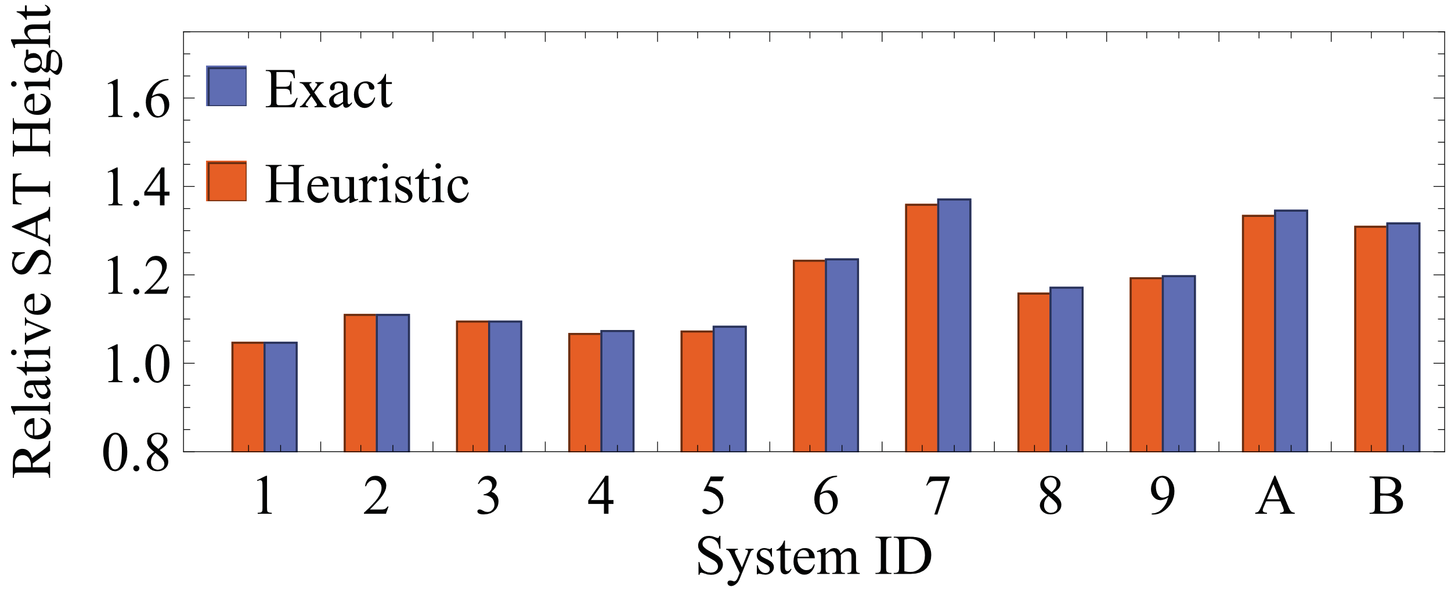
Evaluation (1)
The heuristic algorithm performs very close to the exact algorithm using a fraction of time required for the exact one
Realized ~96.81% increase w.r.t. the optimal solution

Slide 17
Evaluation (2)
Branch is bound is proven to be effective to speed up the exact algorithm
3x~55x speedup depending on the input
We can be smart about patching
Patching a small subset of the vulnerabilities can sometimes produce the same result as patching them all

Slide 18
Conclusions
We studied the SAT in weighted attack graphs and proposed an efficient algorithm to solve it
Using SAT, we studied the problem of network hardening and proposed an exact and a heuristic algorithms
Evaluations showed the effectiveness of our algorithms

Slide 19
Thank you!
Any questions?
Contact: xlin54@asu.edu

Slide 20
Backup Slides

Slide 21
Network Hardening – Example
Smart Thermostat has vulnerability CVE-2022-10000
Attacker on internet
Smart Heater
has vulnerability
CVE-2020-12345
0
0
If we have a lot of budget…
We can just harden them all!
If budget = 20
Bottom two turns out to be better value
If budget = 5
Middle option provides best value
0
0
Attacker launches exploit via internet
Attacker launches exploit via internet
5
10 (cost 20)
10
Attacker can set therm. temp.
Attacker can turn on heater
Smart Thermostat exists
Smart Heater exists
1
5 (cost 5)
2
0
0
Attacker sets temp
Attacker turns heater on
3 (cost 5)
1
2
Indoor temp 85F

Slide 22
Branch and Bound
(root)
H1
H1
H2
H2
H2
H2
H3
H3
H3
H3
H3
H3
H3
H3
H4
H4
H4
H4
H4
H4
H4
H4
H4
H4
H4
H4
H4
H4
H4
H4

