Slide 1
Inferring User Activities from IoT Device Events in Smart Homes: Challenges and Opportunities
Xuanli Lin, Yinxin Wan, Kuai Xu, Feng Wang, Guoliang Xue Arizona State University

Slide 2
Outline
Introduction
Challenges to Existing Solutions
Challenges ➔ Opportunities
Conclusions
Notes:
This is the outline of the talk.

Slide 3
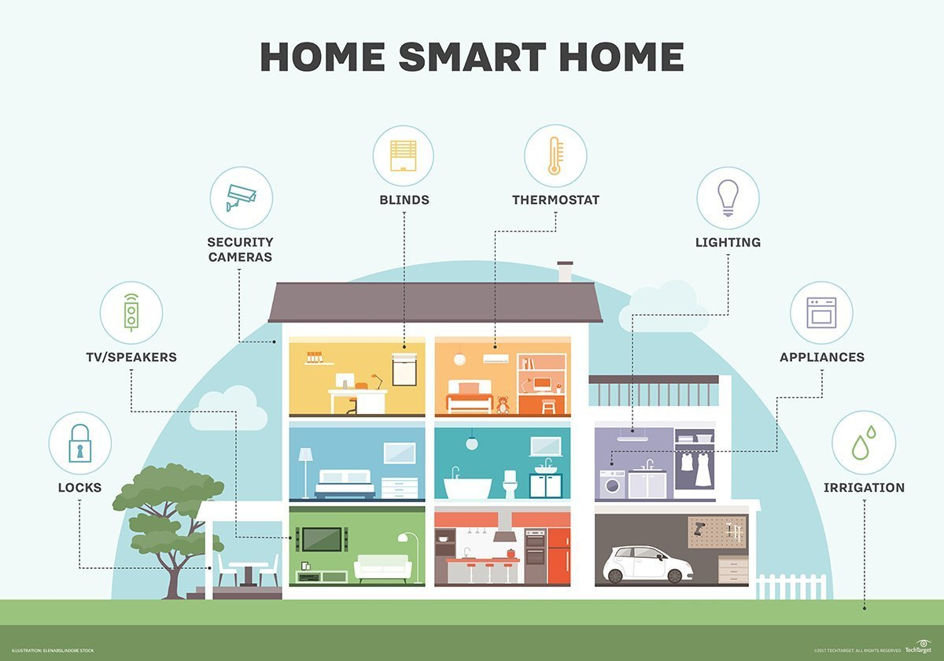
WHY Do We Care about IoT Devices?
10 billion active IoT devices in 2021, projected to surpass 75 billion by 2025
Commonly seen in smart homes
Statistics: Statista, iPropertyManagement / Image: TechTarget
Notes:
IoT devices are becoming a part of our lives.
Ring doorbell, smart lock, mart thermostat, security camera, etc.
It was reported that over10 billion IoT devices are deployed in 2021.
It is projected to have over 75 billion by 2025.
Therefore, there are more and more studies on IoT related issues.

Slide 4
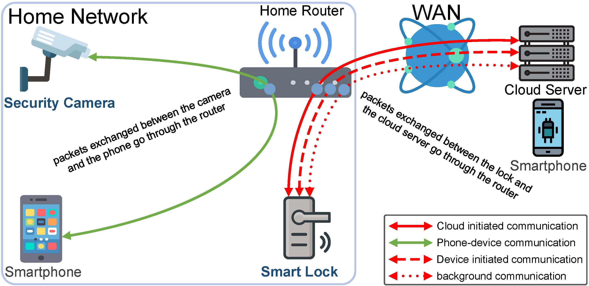
WHAT Do We Have from a Networking Perspective?
Dialogues are going on, many can be captured at the home router
Notes:
Smartphone talking to the cloud server (for August lock) via the app.
The cloud server talks with the lock, going through the home router.
When we use the smartphone to view the security camera, the traffic goes through the home router.

Slide 5
WHAT Do We Have from a Networking Perspective?
22:54:00.750 IP 44.230.166.103.443 > 192.168.1.122.49156: Flags [P.], seq 187180:187593, ack 289324, win 65535, length 413
22:54:00.758 IP 192.168.1.122.49156 > 44.230.166.103.443: Flags [P.], seq 289324:289929, ack 187593, win 12684, length 605
22:54:01.004 IP 44.230.166.103.443 > 192.168.1.122.49156: Flags [P.], seq 187593:188006, ack 289929, win 65535, length 413
22:54:01.012 IP 192.168.1.122.49156 > 44.230.166.103.443: Flags [P.], seq 289929:290534, ack 188006, win 14000, length 605
22:54:02.176 IP 44.230.166.103.443 > 192.168.1.122.49156: Flags [P.], seq 188006:188419, ack 290534, win 65535, length 413
22:54:02.183 IP 192.168.1.122.49156 > 44.230.166.103.443: Flags [P.], seq 290534:291139, ack 188419, win 13643, length 605
22:54:02.420 IP 44.230.166.103.443 > 192.168.1.122.49156: Flags [P.], seq 188419:188832, ack 291139, win 65535, length 413
22:54:02.428 IP 192.168.1.122.49156 > 44.230.166.103.443: Flags [P.], seq 291139:291744, ack 188832, win 13286, length 605
Eight sequenced TCP/IP packets captured during a locking event
Software like tcpdump can capture packets that are sent and received by devices in the local network
Ordered sequences of TCP packets can be observed when an IoT device is in operation
Important information can be obtained from these packets: time, sender, receiver, packet size, etc.
Notes:
(Note: 44.230.166.103 address is the cloud server of August smart lock, and 192.168.1.122 is the August smart lock)
Here we can see a sequence of 8 TCP/IP packets sent and received by a smart lock when someone locks it over internet.
In fact, using software like tcpdump, we can observe similar sequences for many other device events and for different IoT devices.
Looking at this capture, we can find information such as the time the packet was sent, source and destination addresses, and the size of the packets in bytes.
It turns out that this information would be very useful to infer device events.

Slide 6
IoT Device Events and Their Signatures
Each IoT device has a known set of device events
Example 1: Ring Video Doorbell
stream on
stream off
ringing
motion detection
Example 2: August Lock Pro
app opening
WiFi (un)locking
bluetooth (un)locking
manual (un)locking
autolocking
Each device event generates a sequence of network packets, which is called the signature of the corresponding device event (PingPong, IoTAthena)
Notes:
Examples of device events.

Slide 7
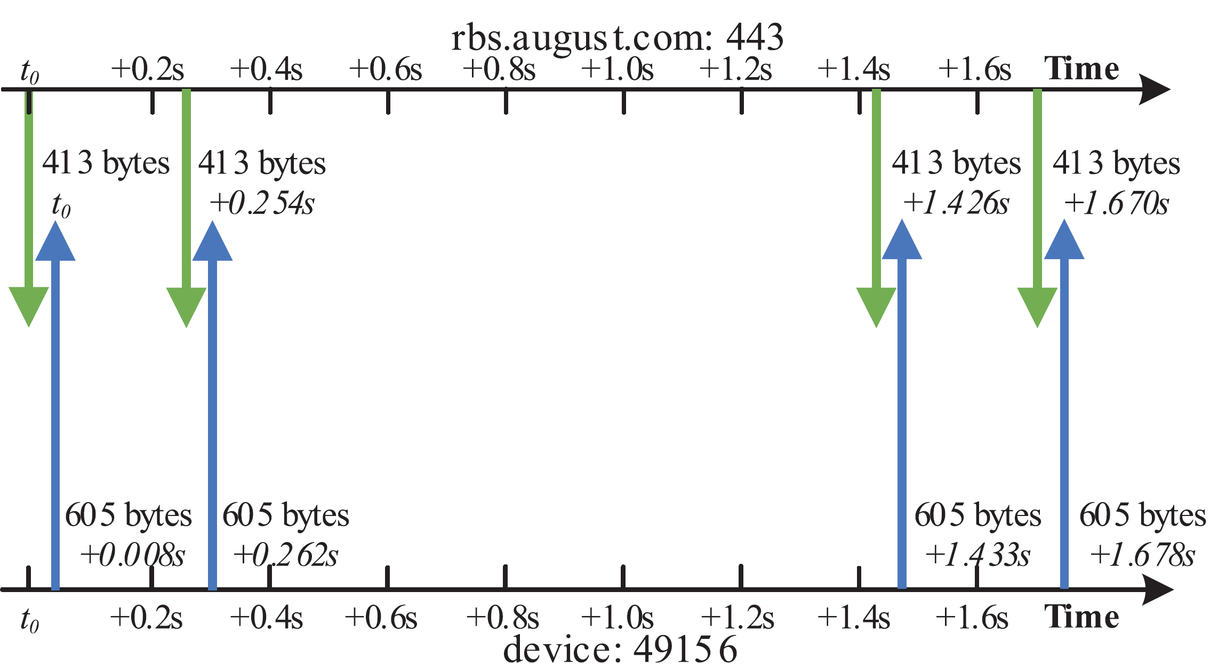
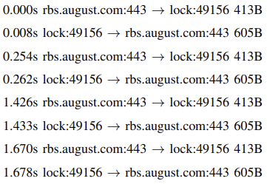
IoT Device Events and Their Signatures
When certain IoT device event occurs, we can observe unique network traffic signature from the IoT device
Network traffic signature when a smart lock (un)locks
Notes:
Signatures of device events.
IoTAthena added “inter-packet intervals” to distinguish more device events.

Slide 8
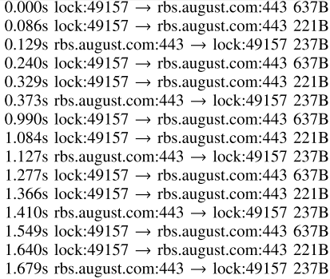
IoT Device Events and Their Signatures
A smart lock (un)locks
A smart lock auto locks
Notes:
More examples of signatures of device events.

Slide 9
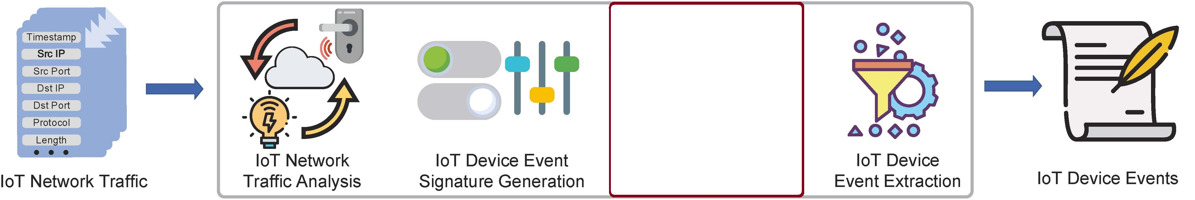
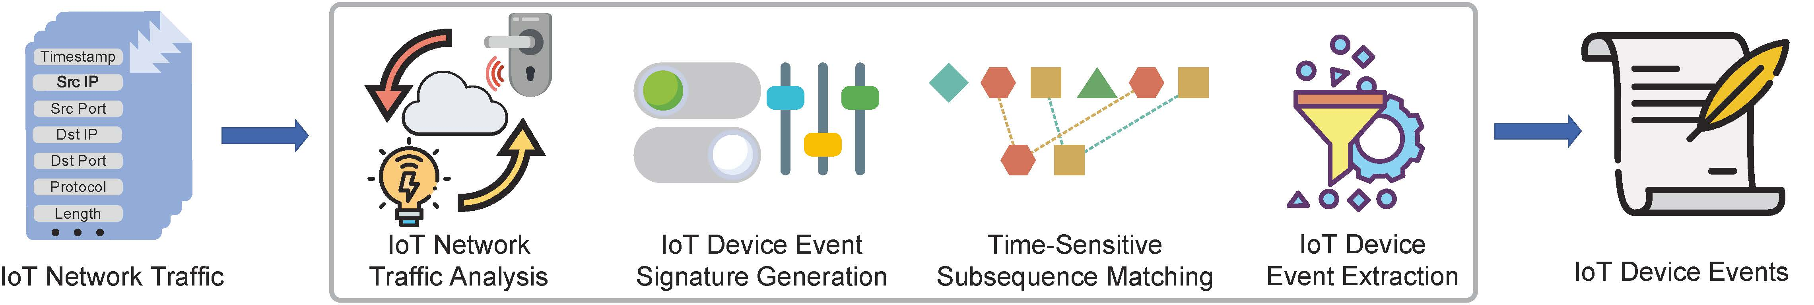
From TCP Packets To Device Events
Ping-Pong (Trimanananda et. al, NDSS’2019)
IoTAthena (Wan et. al, TWC’2022)
Notes:
Using the signatures, we can unveil device events from the sequence of network packets.
First studied by Ping-Pong (Trimananda), then by IoTAthena (Wan, 2022).

Slide 10
User Activities and Their Signatures
Doorbell Motion Detection
Spotlight On
Doorbell Ringing
Spotlight Off
Someone enters the property, rings the doorbell, and leaves (night)
Notes:
Besides device events, we can infer user activities from network traffic.

Slide 11
From Device Events To User Activities
IoTMosaic (Wan et. al, INFOCOM’2022)
E2AP (Xue et. al, JSAC, in press)
Notes:
These were first studied in IoTMosaic, then improved in E2AP.

Slide 12
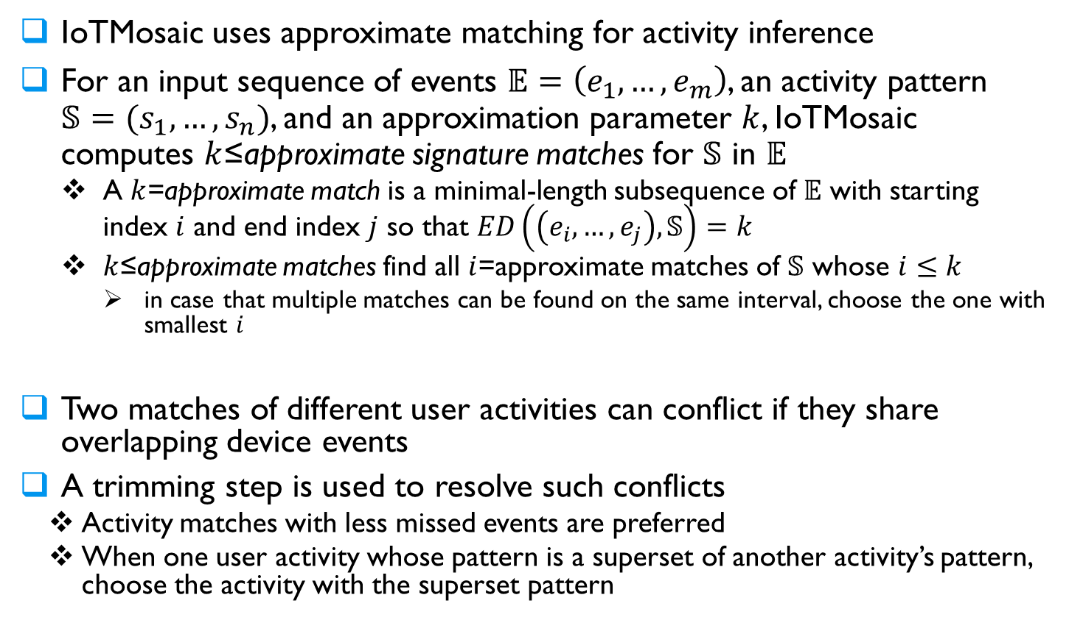
The IoTMosaic Approach
IoTMosaic uses approximate matching for activity inference
For an input sequence of events $𝔼=\left(e_{1},…,e_{m}\right)$, an activity pattern $𝕊=(s_{1},…,s_{n})$, and an approximation parameter $k$, IoTMosaic computes $k$≤approximate signature matches for $𝕊$ in $𝔼$
A $k$=approximate match is a minimal-length subsequence of $𝔼$ with starting index $i$ and end index $j$ so that $ED\left(\left(e_{i},…,e_{j}\right),𝕊\right)=k$
$k$≤approximate matches find all $i$=approximate matches of $𝕊$ whose $i≤k$
in case that multiple matches can be found on the same interval, choose the one with smallest $i$
Two matches of different user activities can conflict if they share overlapping device events
A trimming step is used to resolve such conflicts
Activity matches with less missed events are preferred
When one user activity whose pattern is a superset of another activity’s pattern, choose the activity with the superset pattern

Slide 13
The E2AP Approach
The E2AP framework dynamically assigns a weight for a full/partial match of a signature.
For given weight assignment, it computes a sequence of compatible user activity-patterns that maximizes the total weight.
The loss function of a weight assignment is the edit distance of the network traffic with the concatenation of patterns of the inferred sequence of activity-patterns.
E2AP computes the optimal weight assignment by minimizing the loss function.
Since it learns the optimal weight, rather than giving higher priority for exact matches, E2AP outperforms IoTMosaic, especially when there are missing device events.
Notes:
The E2AP framework uses a different approach for the activity inference.
It is a suite of algorithms that computes the optimal activity sequence Sw given the input event sequence E and the set of all activity patterns S
First, E2AP applies a matching algorithm to compute representative minimal matches for each activity.
(explain representative minimal?)
Please note that in E2AP one activity can correspond to multiple event patterns in S to account for device malfunctions and event timings

Slide 14
Outline
Introduction
Challenges to Existing Solutions
Challenges ➔ Opportunities
Conclusions

Slide 15
Challenges to Existing Solutions
User activity inference depends on the exact identification of device events to infer user activities
Sometimes some events can be missing or out of order
There will be more missing events when devices malfunction
In the face of device malfunction, accuracy of E2AP and IoTMosaic decreases significantly
Can we design more accurate inference algorithms?
Notes:
Now if we have these algorithms the user activity inference should be easy right? In a perfect world, we would have the perfect knowledge of the mapping between the activities and the corresponding device events. On top of that, the events in the network history we have is complete and free of error.
This is unfortunately not the case, and often times we can find some events missing and even out of order in the network history, due to device malfunctions or network issues.
To cope with the issue, IoTMosaic proposed an approximate signature matching algorithm, and E2AP uses an unsupervised learning algorithm
However, as we detail later, several challenges remain, and this is one of the focuses in this paper. Essentially, when certain event sequences exist in the input, the existing solutions can no longer accurately identify their corresponding activities.

Slide 16
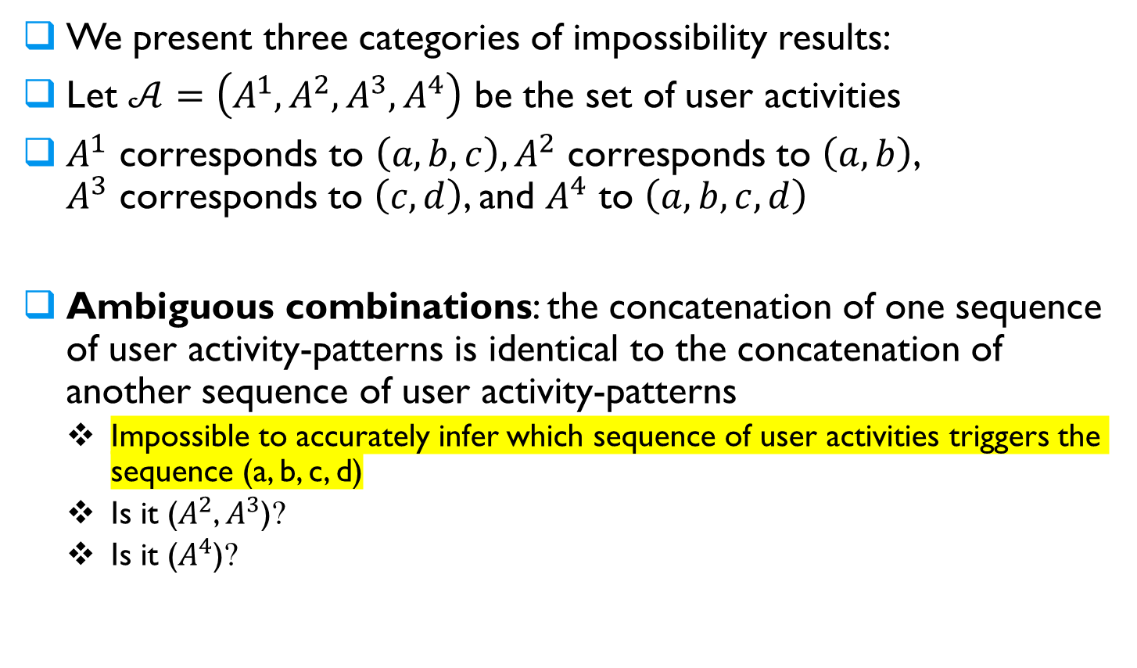
Impossibility Results
We present three categories of impossibility results:
Let $𝒜=\left(A^{1},A^{2},A^{3},A^{4}\right)$ be the set of user activities
$A^{1} \text{corresponds} \text{to} \left(a, b, c\right), A^{2}$ corresponds to $\left(a,b\right)$, $A^{3}$ corresponds to $\left(c,d\right)$, and $A^{4}$ to $\left(a,b,c,d\right)$
Ambiguous combinations: the concatenation of one sequence of user activity-patterns is identical to the concatenation of another sequence of user activity-patterns
Impossible to accurately infer which sequence of user activities triggers the sequence (a, b, c, d)
Is it ($A^{2}$, $A^{3}$)?
Is it ($A^{4}$)?
Notes:
We provide three categories of these inputs.
Suppose we have a set A of user activities A1, A2, A3, and A4.
Another category is called ambiguous combinations, where the concatenation of sequences of events are identical to another event sequence.
For example, suppose we have activity 2 that correspond to (a, b), activity 3 to (c, d), and activity 4 to (a, b, c, d).
If we see the sequence (a, b, c, d), we cannot tell whether it’s activity 2 and 3 happened in sequence, or it is activity 4 that happened instead
Hence the second impossibility result, that one cannot accurately infer which sequence of user activity triggers P if more than one sequence of user activities triggers the same pattern P.
Again, this assumes we use the input sequence E alone.

Slide 17
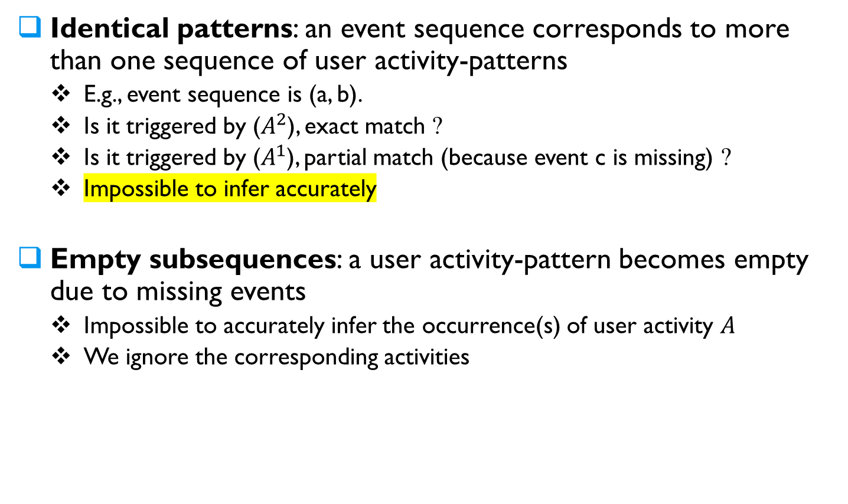
Impossibility Results
Identical patterns: an event sequence corresponds to more than one sequence of user activity-patterns
E.g., event sequence is (a, b).
Is it triggered by ($A^{2}$), exact match ?
Is it triggered by ($A^{1}$), partial match (because event c is missing) ?
Impossible to infer accurately
Empty subsequences: a user activity-pattern becomes empty due to missing events
Impossible to accurately infer the occurrence(s) of user activity 𝐴
We ignore the corresponding activities
Notes:
Another category is what we called identical patterns, in which an event sequence corresponds to more than one activities.
For example, we have activity 1 which corresponds to the event sequence (a, b, c), and activity 2 which corresponds to event sequence (a, b).
If the event c is missing from our sequence due to device malfunction, we end up with both activity 1 and activity 2 sharing the same event sequence, (a, b).
Now if we run into the sequence (a, b) in our event sequence, we cannot know for sure whether activity 1 or activity 2 has occurred.
Here we can derive our first impossibility result, that one cannot pinpoint which activity triggered P if it corresponds to more than one activity using the input sequence E alone.
Finally, there can be empty subsequences, where an activity maps to an empty event sequence due to device malfunctions.
The third impossibility result states that one cannot accurately infer the occurrences of user activities A when it possibly correspond to an empty sequence.
In this case, we adopt the convention and simply ignore the corresponding activities as nothing else can recover the lost information.

Slide 18
Outline
Introduction
Challenges to Existing Solutions
Challenges ➔ Opportunities
Conclusions

Slide 19
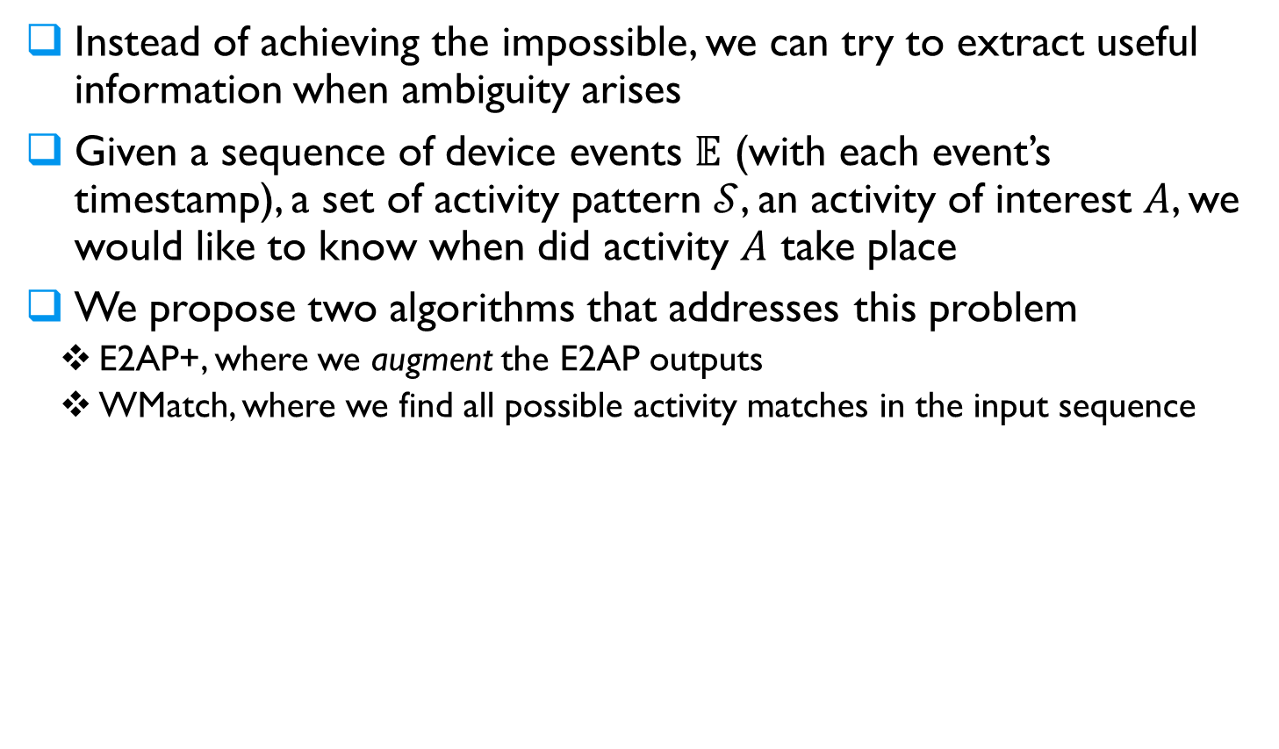
Challenges ➔ Opportunities
Instead of achieving the impossible, we can try to extract useful information when ambiguity arises
Given a sequence of device events $𝔼$ (with each event’s timestamp), a set of activity pattern $𝒮$, an activity of interest $A$, we would like to know when did activity $A$ take place
We propose two algorithms that addresses this problem
E2AP+, where we augment the E2AP outputs
WMatch, where we find all possible activity matches in the input sequence
Notes:
Instead of trying to solve the impossible problem, we will provide more concrete useful information.
We will tell the users that a particular pattern could be a match or a partial match of many user activities.
We will answer the question: When did a particular activity happened?
We propose two separate algorithms that answers this problem.
The first algorithm is called E2AP+, where we augments the outputs from the E2AP framework to uncover previously omitted information.
The second algorithm is called WMatch, where we use the event sequence and attempts to find all possible matches for an activity.

Slide 20
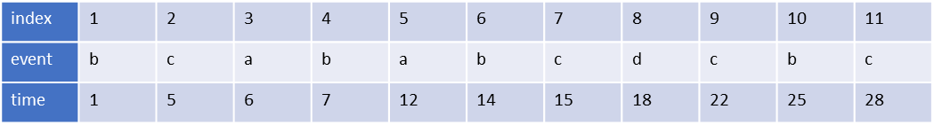
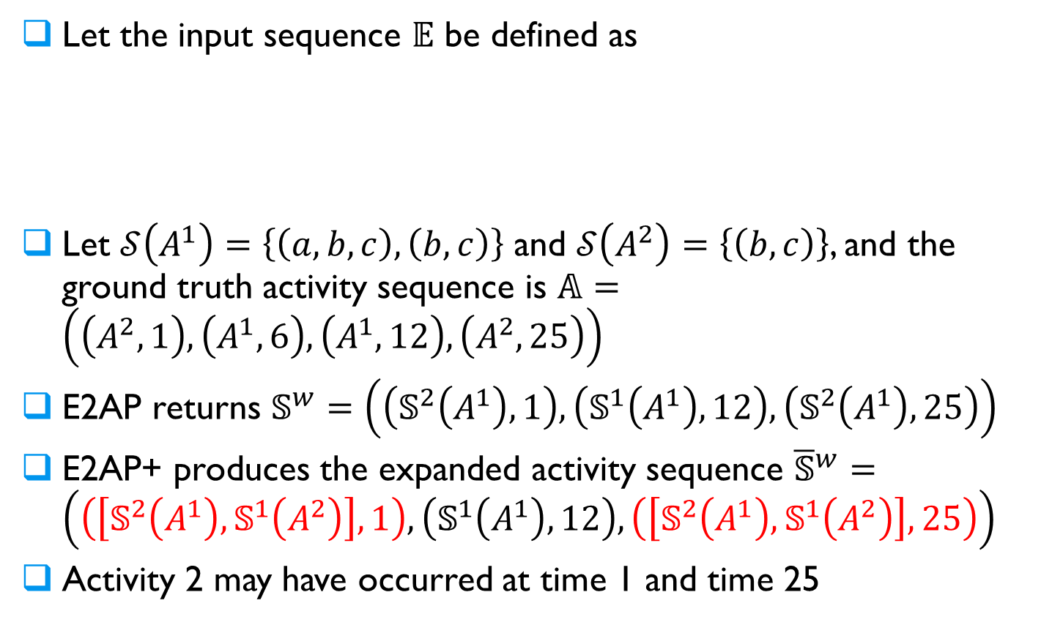
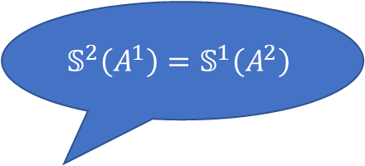
The E2AP+ Approach
Let the input sequence $𝔼$ be defined as
Let $𝒮\left(A^{1}\right)=\left\{\left(a,b,c\right),\left(b,c\right)\right\}$ and $𝒮\left(A^{2}\right)=\left\{\left(b,c\right)\right\}$, and the ground truth activity sequence is $𝔸=\left(\left(A^{2},1\right),\left(A^{1},6\right),\left(A^{1},12\right), \left(A^{2},25\right)\right)$
E2AP returns $𝕊^{w}=\left(\left(𝕊^{2}\left(A^{1}\right),1\right),\left(𝕊^{1}\left(A^{1}\right),12\right), \left(𝕊^{2}\left(A^{1}\right),25\right)\right)$
E2AP+ produces the expanded activity sequence ${\overline{𝕊}}^{w}=\left(\left(\left[𝕊^{2}\left(A^{1}\right),𝕊^{1}\left(A^{2}\right)\right],1\right),\left(𝕊^{1}\left(A^{1}\right),12\right), \left(\left[𝕊^{2}\left(A^{1}\right),𝕊^{1}\left(A^{2}\right)\right],25\right)\right)$
Activity 2 may have occurred at time 1 and time 25
$$𝕊^{2}\left(A^{1}\right)=𝕊^{1}\left(A^{2}\right)$$
Notes:
Along the first direction, we design E2AP+.
Let’s see how E2AP+ can help us with the issue. Because S2A1 is the same as S1A2, we add S1A2 as an alternative to S2A1, and every time we see S2A1 in the sequence Sw, we add S1A2 alongside with it.
S1A1 is untouched because there is no identical pattern to it.
After this operation, we see the expanded activity sequence Sw bar with changes highlighted in red.
You can see that now it is saying activity 2 may have occurred at time 1 and 25, and sometimes we want to make sure that no occurrence of an activity is missed, in which case E2AP+ uncovers this information that would otherwise be omitted.

Slide 21
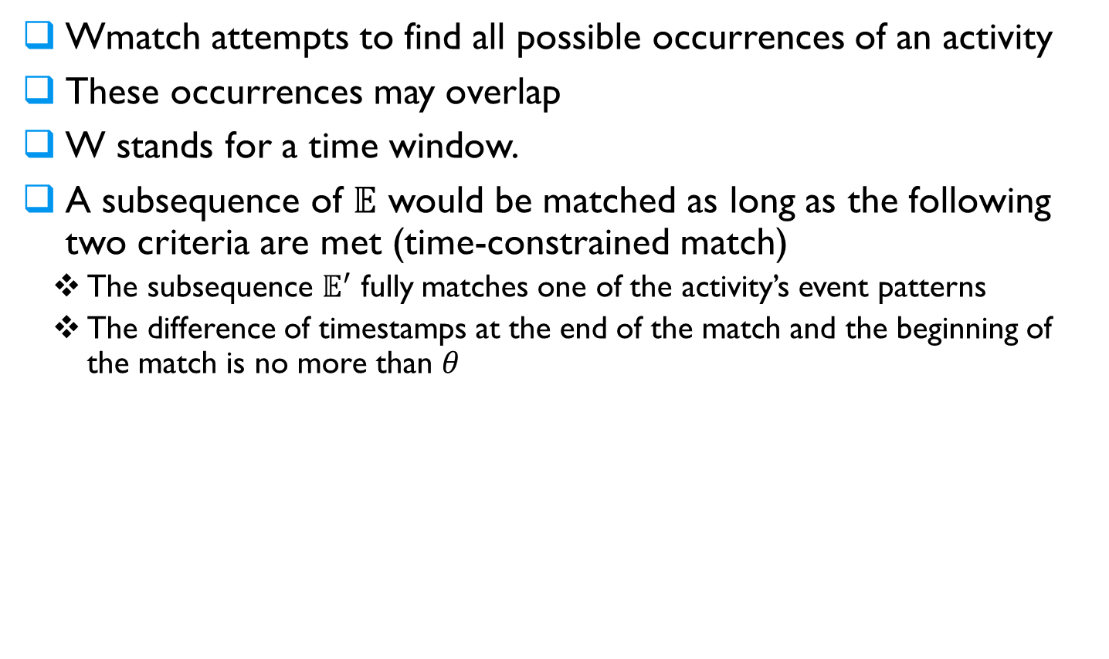
The WMatch Approach
Wmatch attempts to find all possible occurrences of an activity
These occurrences may overlap
W stands for a time window.
A subsequence of $𝔼$ would be matched as long as the following two criteria are met (time-constrained match)
The subsequence $𝔼^{′}$ fully matches one of the activity’s event patterns
The difference of timestamps at the end of the match and the beginning of the match is no more than $θ$
Notes:
Along the second direction, we design Wmatch.
But if you pay close attention to the above example, you may have noticed that the occurrence for activity 1 at time 6 is not found even after we process the output with E2AP+.
This reveals an important shortfall of using E2AP+ along, that is, when E2AP misses an activity altogether, E2AP+ would be unable to recover the lost information.
To tackle this issue, we proposed WMatch algorithm, where it attempts to find all possible occurrences of an activity
To do so, we find all time-constrained matches in the input sequence, which has two criteria
First there needs to be a subsequence, E’, that fully matches the of the activity’s event patterns
Second, the difference of the timestamp at the end of the match is no more than theta of the timestamp at the beginning of the match. Here theta is a user-defined real number
We introduce the second restriction so that it won’t match into event sequences that are obviously too long.
For example, if we want to find the activity “someone enters the property, rings the doorbell, and leaves at night”, we may provide a theta of 30 seconds, as it is unlikely that this activity takes longer than 30 seconds.
The theta information can be conveniently obtained while we profile the mappings between user activities and device events.

Slide 22
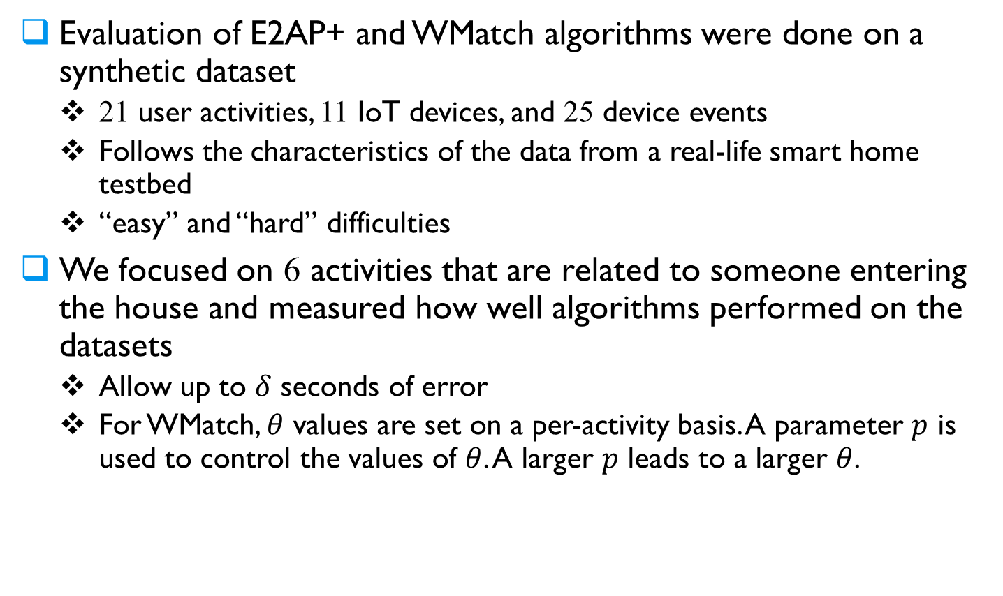
Evaluation Setup
Evaluation of E2AP+ and WMatch algorithms were done on a synthetic dataset
21 user activities, 11 IoT devices, and 25 device events
Follows the characteristics of the data from a real-life smart home testbed
“easy” and “hard” difficulties
We focused on 6 activities that are related to someone entering the house and measured how well algorithms performed on the datasets
Allow up to $δ$ seconds of error
For WMatch, $θ$ values are set on a per-activity basis. A parameter $p$ is used to control the values of $θ$. A larger $p$ leads to a larger $θ$.
Notes:
So how well does these proposed algorithms perform?
To investigate we evaluated the E2AP+ and WMatch algorithms on a synthetic dataset, which contains 21 user activities, 11 IoT devices, and 25 device events.
The dataset follows the characteristics of data from a real-life smart home testbed, such as event timing, activity frequency distribution, etc.
In addition, we introduced two difficulties for the dataset, “easy”, where no ambiguity exists in the activity patterns, and “hard”, where a number of ambiguous activity patterns exist.
We chose 6 out of 21 activities that are related to someone entering the house in different settings, and we ran our algorithms to inquire the timestamps when did these activities take place.
We then compared the output from the algorithm to the ground truth.
Because of time delays in measurement and other random factors, we allow up to delta seconds of difference between the time of an activity occurrence reported by the algorithms and the ground truth.
In addition, for WMatch we set theta values on a per-activity basis because the duration for each activity can be quite different.
A parameter p is used to control the values of theta, where bigger p results in bigger theta values, and vice versa.

Slide 23
Evaluation Results
Two metrics with regards to alternatives in the sequence
We use the relaxed metric for the comparison
Difficulty | Len | Accuracy E2AP | Accuracy E2AP+ (strict) | Accuracy E2AP+ (relaxed)
Easy | 387 | 0.9959 | 0.9959 | 0.9959
 | 1494 | 0.9959 | 0.9959 | 0.9959
 | 2959 | 0.9964 | 0.9964 | 0.9964
 | 10000 | 0.9959 | 0.9959 | 0.9959
Hard | 387 | 0.6849 | 0.4310 | 0.9997
 | 1494 | 0.6848 | 0.4338 | 0.9994
 | 2959 | 0.6814 | 0.4339 | 0.9996
 | 10000 | 0.6857 | 0.4347 | 0.9997
Notes:
First off, I’d like to point out the accuracy of E2AP+ differs depending on the metrics we use.
Here we have two simple metrics, “relaxed” where alternatives would count if it contains the ground truth activity.
To the contrary, “strict” metric accepts exact matches only, and all alternative are counted as incorrect.
As we’d expect, using strict metric results in worse accuracy compared to E2AP for the hard dataset, and the relaxed metric yields better accuracy.
We also note that the accuracy for the easy dataset is the same, as there are no ambiguity in the data, so E2AP+ produces exactly the same activity sequence E2AP does.
We use the relaxed metric for the comparison with other algorithms, as we want to make sure all possible occurrences of an activity is accounted for, thus relaxed metric is more relevant.
(Accuracy: # of correctly inferred activities / # of all activity inferred)

Slide 24
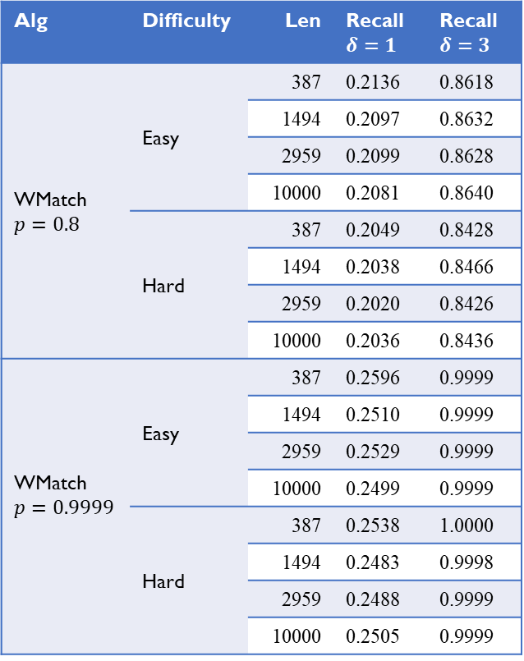
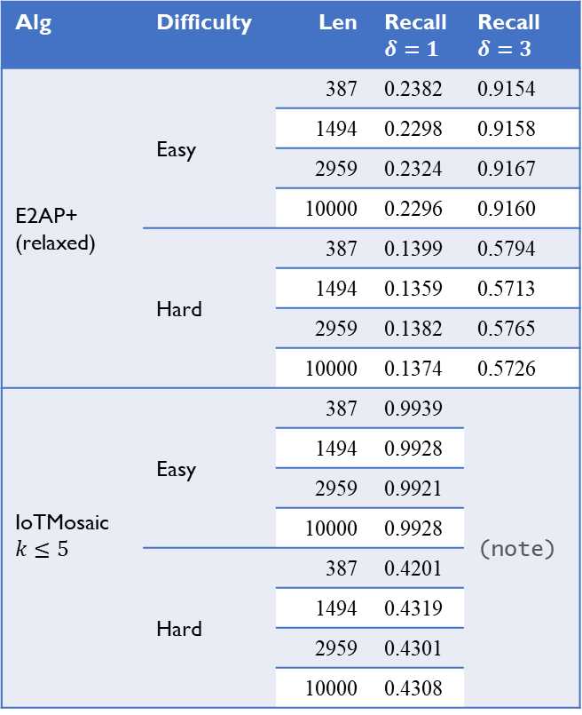

Evaluation Results
Alg | Difficulty | Len | Recall $$δ=1$$ | Recall $$δ=3$$
WMatch $$p=0.8$$ | Easy | 387 | 0.2136 | 0.8618
 |  | 1494 | 0.2097 | 0.8632
 |  | 2959 | 0.2099 | 0.8628
 |  | 10000 | 0.2081 | 0.8640
 | Hard | 387 | 0.2049 | 0.8428
 |  | 1494 | 0.2038 | 0.8466
 |  | 2959 | 0.2020 | 0.8426
 |  | 10000 | 0.2036 | 0.8436
WMatch $$p=0.9999$$ | Easy | 387 | 0.2596 | 0.9999
 |  | 1494 | 0.2510 | 0.9999
 |  | 2959 | 0.2529 | 0.9999
 |  | 10000 | 0.2499 | 0.9999
 | Hard | 387 | 0.2538 | 1.0000
 |  | 1494 | 0.2483 | 0.9998
 |  | 2959 | 0.2488 | 0.9999
 |  | 10000 | 0.2505 | 0.9999
Alg | Difficulty | Len | Recall $$δ=1$$ | Recall $$δ=3$$
E2AP+ (relaxed) | Easy | 387 | 0.2382 | 0.9154
 |  | 1494 | 0.2298 | 0.9158
 |  | 2959 | 0.2324 | 0.9167
 |  | 10000 | 0.2296 | 0.9160
 | Hard | 387 | 0.1399 | 0.5794
 |  | 1494 | 0.1359 | 0.5713
 |  | 2959 | 0.1382 | 0.5765
 |  | 10000 | 0.1374 | 0.5726
IoTMosaic $$k≤5$$ | Easy | 387 | 0.9939 | (note)
 |  | 1494 | 0.9928
 |  | 2959 | 0.9921
 |  | 10000 | 0.9928
 | Hard | 387 | 0.4201
 |  | 1494 | 0.4319
 |  | 2959 | 0.4301
 |  | 10000 | 0.4308
*Note: $δ$ has no effect to IoTMosaic
Notes:
Precision = (# of relevant items retrieved)/(# of items retrieved)
Recall = (# of relevant items retrieved)/(# of relevant items)
A higher p value leads to a larger time window.
A larger delta value allows more relaxed matching (in terms of timestamps).
We observe that E2AP+ has good precision (which is designed for precision), and WMatch has good recall (which is designed for recall).

Slide 25
Outline
Introduction
Challenges to Existing Solutions
Challenges ➔ Opportunities
Conclusions

Slide 26
Conclusions
We can infer user activities from device events
Existing approaches work well when there are no missing events
In the existence of missing events, accuracy of existing algorithms drops
We studied the problem difficulty, identifying impossibility results
We explored opportunities
For the future works, we would like to
Evaluate our proposed algorithms on datasets generated in different smart homes
Explore more approaches to tackle the challenges in user activity inference
Notes:
In summary, we have presented the challenges in inferring user activities from IoT device events faced by existing solutions today.
To tackle these challenges, we proposed two algorithms, E2AP+ and WMatch that finds occurrences of certain activity despite challenges presented by issues in the device event sequences.
(evaluation)
As for the future works, we would like to evaluate the effectiveness of our algorithms on datasets generated in different smart home environments.
We would also like to explore more approaches to tackle the challenges in user activity inference.

Slide 27
References
R. Trimananda, J. Varmarken, A. Markopoulou, and B. Demsky, “Ping-Pong: Packet-level signatures for smart home device events”, NDSS’2019.
Y. Wan, K. Xu, F. Wang, G. Xue, “IoTAthena: Unveiling IoT device activities from network traffic”, TWC, 2022.
Y. Wan, K. Xu, F. Wang, G. Xue, “IoTMosaic: Inferring user activities from IoT network traffic in smart homes”, INFOCOM’2022.
G. Xue, Y. Wan, X. Lin, K. Xu, F. Wang, “An effective machine learning based algorithm for inferring user activities from IoT device events”, JSAC, in press.
https://www.public.asu.edu/~gxue1/

