Slide 1

Hadoop I/o Hadoop Distributed File System

Slide 2

Team Members
Alex Diker 100746284
Thadchayani Kupendiran 100883757
Kazuma Sato 100948212
Robert Gray

Slide 3
What is hdfs
Hadoop Distributed File System (HDFS) is a sub-project of the Apache Hadoop project.
Apache Software Foundation project is designed to provide a fault-tolerant file system designed to run on commodity hardware.

Slide 4
What is HDFS
The primary objective of HDFS is to store data reliably even in the presence of failures including NameNode failures, DataNode failures and network partitions..
The HDFS cluster consists of a single NameNode and a master server manages the file system namespace and regulates access to files.

Slide 5

What does hdfs focus on
Large files stored on HDFS contains usually hundreds of megabytes, gigabytes, or terabytes in size.
Certain Hadoop clusters that are currently running and active today contain petabytes of data.

Slide 6
HDFS – Lets stream
HDFS was developed with the idea in mind that the most efficient data processing algorithm is a write-once, read-many-times pattern.
Datasets are typically generated or cloned from a source destination and then various analyses are performed on that dataset over time.

Slide 7
HDFS – LETs stream
As the data set is analyzed it will involve a large proportion, if not all, of the data set, so the time to read the whole dataset is more important than the latency in reading the first record.

Slide 8
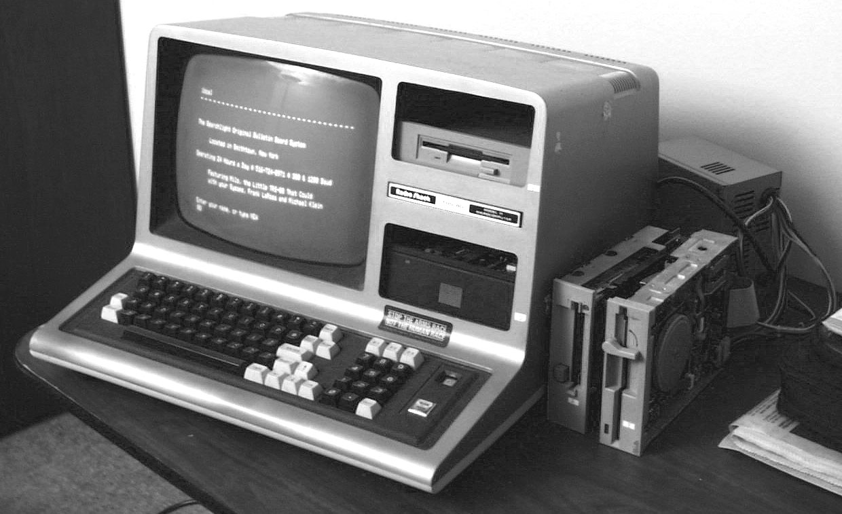
HDFS on commodity hardware
Hadoop is specifically designed and engineered not to require expensive, highly cutting edge hardware
Designed on run on clusters of commodity hardware (generic hardware – commonly available that can be obtained from multiple manufacturers)
HDFS is designed to carry on working without a noticeable interruption to the user in the face of such failure

Slide 9
Avoid using hdfs
Lots of small files: The name node holds filesystem metadata in memory, the limit to the number of files in a filesystem is governed by the amount of the name node. As a rule of thumb, each file directory, and block takes about 150 bytes. So for example: If you had one million files, each taking one block, you would need at least 300 MB of memory. Although storing millions of files is feasible billions is beyond the capability of the current hardware.

Slide 10
Avoid using hdfs
Low-Latency data access: Applications that require low-latency access to data, in the tens of milliseconds range, will not work well with HDFS.

Slide 11
Avoid using hdfs
Multiple writers and arbitrary file modifications:
Files in HDFS may be written to by a single writer. Writes are always made at the end of the file, in append-only fashion. There is no support for multiple writers or for modifications at arbitrary offsets in the file.

Slide 12
Data Integrity
Users of Hadoop rightly expect that no data will be lost or corrupted during storage or processing. However, because every I/O operation on the disk or network carries with it a small chance of introducing errors into the data that it is reading or writing, when the volumes of data flowing through the system are as large as the ones Hadoop is capable of handling, the chance of data corruption occurring is high.

Slide 13
Data integrity
The usual way of detecting corrupted data is by computing a checksum for the data when it first enters the system, and again whenever it is transmitted across a channel that is unreliable and hence capable of corrupting the data. The data is deemed to be corrupt if the newly generated checksum doesn’t exactly match the original

Slide 14
Data Integrity in HDFS
HDFS transparently checksums all data written to it and by default verifies checksums when reading data
Data nodes are responsible for verifying the data they receive before storing the data and its checksum.

Slide 15
Data Integrity in HDFS
When clients read data from data nodes, they verify checksums as well, comparing them with the ones stored at the DataNode.
Each DataNode keeps a persistent log of checksum verifications, so it knows the last time each of its blocks was verified.

Slide 16
Data Integrity in HDFS
Aside from block verification on client reads, each data node runs a DataBlockScanner in a background thread that periodically verifies all the blocks stored on the data node

Slide 17
Data Integrity in HDFS
Because HDFS stores replicas of blocks, it can “heal” corrupted blocks by copying one of the good replicas to produce a new, uncorrupt replica.
If a client detects an error when reading a block, it reports the bad block and the DataNode it was trying to read from to the NameNode before throwing a Checksum Exception

Slide 18
Configuring Hadoop
NameNode (Master):
The centerpiece of an HDFS file system. It keeps the directory tree of all files in the file system, and tracks where across the cluster the file data is kept. It does not store the data of these files itself.

Slide 19
Configuring Hadoop
Data Node (Slave):
A DataNode stores data in the [HadoopFileSystem]. A functional filesystem has more than one DataNode, with data replicated across them. On startup, a DataNode connects to the NameNode; spinning until that service comes up. It then responds to requests from the NameNode for filesystem operations.

Slide 20
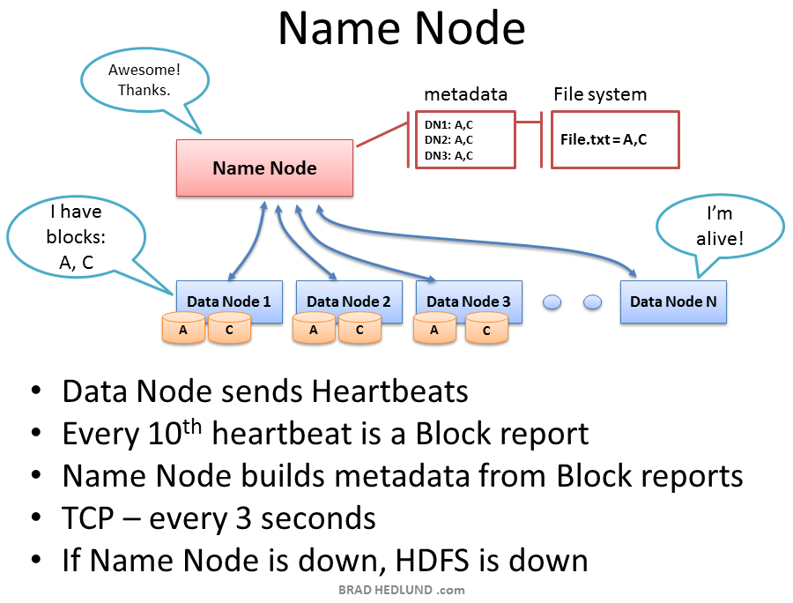
Configuring hadoop

Slide 21
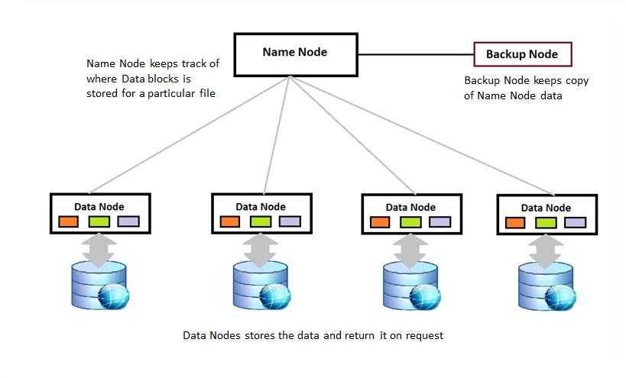
Configuring hadoop

