Slide 1
修論（論文化版） 図表
髙橋正樹研究室 修士2年 林出和之

Slide 2
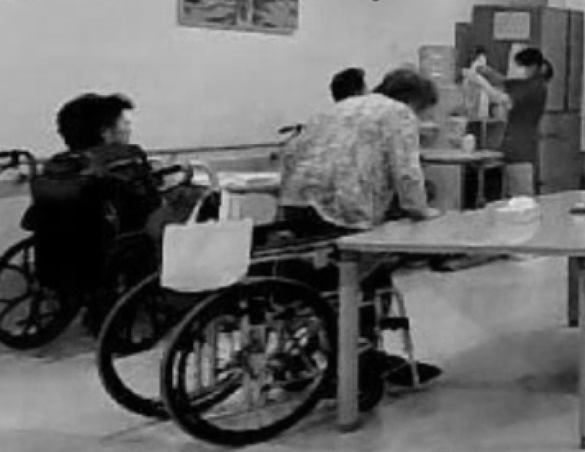
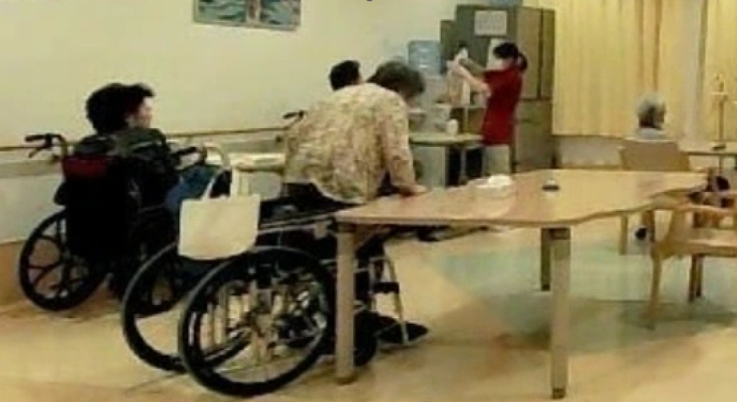
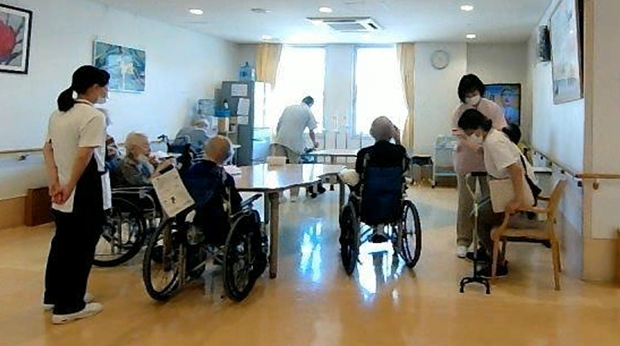
課題を示す図
比較的安全なケース
危ないケース
The nurse supporting the patient
Handrail
The nurse focused on another task
Cane
Chair
The nurse monitoring other patients
Wheelchair
Middle-aged patient
Elderly patient
Standing up with direct support
→ Lower risk / lower monitoring priority
Standing up without nearby support
→ Higher risk / higher monitoring priority

Slide 3
課題を示す図
 | 比較的安全なケース | 危ないケース
患者文脈を重視する場合 | 立ち上がっているため、危険と判断する | 立ち上がっているため、危険と判断する
空間的文脈を重視する場合 | 見守りや支えがあるため、危険度は低いと判断する | 見守りや支えがなく立ち上がっているため、危険と判断する
The nurse supporting the patient
Handrail
The nurse focused on another task
Cane
Chair
The nurse monitoring other patients
Wheelchair
Middle-aged patient
Elderly patient
Standing up with direct support
→ Lower risk / lower monitoring priority
Standing up without nearby support
→ Higher risk / higher monitoring priority

Slide 4

解決アプローチの説明 (患者の文脈を重視するスタッフが、見守りなく立ち上がる患者を見つけた時の階層構造)
Notification Policy:
Q: Which is more dangerous?
A:
Internal <== ==> External
Etc.
Patient
Static
Attribution
Age
Internal
Stand up
Dynamic
…
Action
Action n
Total risk
Far from handrail
Far from staff
Handrail
Static
Stand up
…
Objects
Staff not seeing patient
Wheelchair
External
Distance
Dynamic
Wheelchair
Surrounding staff
: Fuzzy reasoning
: Pairwise comparison
: Others
: Process
: Information
#1 Elderly patient
Direction

Slide 5
解決アプローチの説明 (空間的文脈を重視するスタッフが、見守りなく立ち上がる患者を見つけた時の階層構造)
Notification Policy:
Q: Which is more dangerous?
A:
Internal <== ==> External
Etc.
Patient
Static
Attribution
Age
Internal
Stand up
Dynamic
…
Action
Action n
Total risk
Far from handrail
Far from staff
Handrail
Static
Stand up
…
Objects
Staff not seeing patient
Wheelchair
External
Distance
Dynamic
Wheelchair
Surrounding staff
: Fuzzy reasoning
: Pairwise comparison
: Others
: Process
: Information
#1 Elderly patient
Direction

Slide 6
解決アプローチの説明 (患者の文脈を重視するスタッフが、見守られつつ立ち上がる患者を見つけた時の階層構造)
Notification Policy:
Q: Which is more dangerous?
A:
Internal <== ==> External
Etc.
Patient
Static
Attribution
Age
Internal
Stand up
Dynamic
…
Action
Action n
Total risk
The nurse supporting the patient
Handrail
Static
…
Objects
Handrail
Wheelchair
External
Cane
Chair
Distance
Dynamic
The nurse monitoring other patients
Surrounding staff
: Fuzzy reasoning
: Pairwise comparison
: Others
: Process
: Information
Middle-aged patient
Direction

Slide 7
解決アプローチの説明 (空間的文脈を重視するスタッフが、見守られつつ立ち上がる患者を見つけた時の階層構造)
Notification Policy:
Q: Which is more dangerous?
A:
Internal <== ==> External
Etc.
Patient
Static
Attribution
Age
Internal
Stand up
Dynamic
…
Action
Action n
Total risk
The nurse supporting the patient
Handrail
Static
…
Objects
Handrail
Wheelchair
External
Cane
Chair
Distance
Dynamic
The nurse monitoring other patients
Surrounding staff
: Fuzzy reasoning
: Pairwise comparison
: Others
: Process
: Information
Middle-aged patient
Direction

Slide 8
 | 患者文脈を重視したスタッフの判断知識を反映 | 空間的文脈を重視したスタッフの判断知識を反映
比較的危険な状況
比較的安全な状況
Notification Policy:
Q: Which is more dangerous?
A:
Internal <== ==> External
Etc.
Patient
Static
Notification Policy:
Q: Which is more dangerous?
A:
Internal <== ==> External
Etc.
Patient
Static
Attribution
Attribution
Age
Age
Internal
Internal
Stand up
Dynamic
Stand up
Dynamic
…
Action
…
Action
Action n
Total risk
Action n
Total risk
Far from handrail
Far from staff
Handrail
Static
Far from handrail
Far from staff
Handrail
Static
Stand up
Staff not seeing patient
…
Objects
Stand up
Staff not seeing patient
…
Objects
Wheelchair
External
Wheelchair
External
Distance
Dynamic
: Fuzzy reasoning
: Pairwise comparison
: Others
: Process
: Information
Distance
Dynamic
Wheelchair
Surrounding staff
Wheelchair
Surrounding staff
: Fuzzy reasoning
: Pairwise comparison
: Others
: Process
: Information
#1 Elderly patient
Direction
#1 Elderly patient
Direction
Notification Policy:
Q: Which is more dangerous?
A:
Internal <== ==> External
Etc.
Patient
Static
Notification Policy:
Q: Which is more dangerous?
A:
Internal <== ==> External
Etc.
Patient
Static
Attribution
Attribution
Age
Age
Internal
Internal
Stand up
Dynamic
Stand up
Dynamic
…
Action
…
Action
Action n
Total risk
Action n
Total risk
The nurse supporting the patient
Handrail
Static
The nurse supporting the patient
Handrail
Static
Handrail
…
Objects
Handrail
…
Objects
Wheelchair
Wheelchair
External
External
Cane
Chair
Distance
Dynamic
: Fuzzy reasoning
: Pairwise comparison
: Others
: Process
: Information
Cane
Chair
Distance
Dynamic
: Fuzzy reasoning
: Pairwise comparison
: Others
: Process
: Information
The nurse monitoring other patients
Middle-aged patient
Surrounding staff
The nurse monitoring other patients
Middle-aged patient
Surrounding staff
Direction
Direction

Slide 9
提案システム全体像
Bounding box RGB image
Extracted PointCloud
Input
VQA
Pose similarity evaluator
VQA
Relative position calculator
Features
Patient
Age
Action 1
…
Action n
Object 1
…
Object n
Distance
Direction
Risk factors
Attribution
Action
Objects
Surrounding staff
Questionnaire → AHP weights / Fuzzy rules
: Fuzzy reasoning
: Pairwise comparison
: Others
: Process
: Information
: Static contents
: Dynamic contents
Internal
External
Total risk

Slide 10
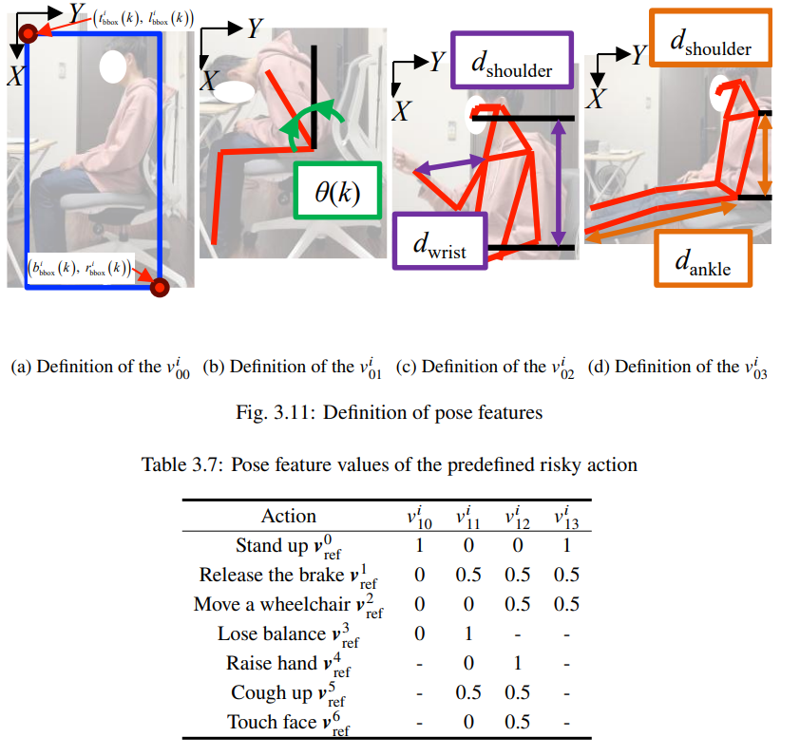

Slide 12


提案手法 危険度評価 人員
1
1
1
×
Degree of membership
Degree of membership
Degree of membership
risk
O
1.0
risk
O
1.0
risk
O
0.5
1.0
1.5
1
1
1
×
Degree of membership
Degree of membership
Degree of membership
risk
O
1.0
risk
O
1.0
risk
O
0.5
1.0
1
1
1
×
Degree of membership
Degree of membership
Degree of membership
risk
O
1.0
risk
O
1.0
risk
O
0.5
1.0
1
1
1
×
Degree of membership
Degree of membership
Degree of membership
risk
O
1.0
risk
O
1.0
risk
O
0.5

Slide 13
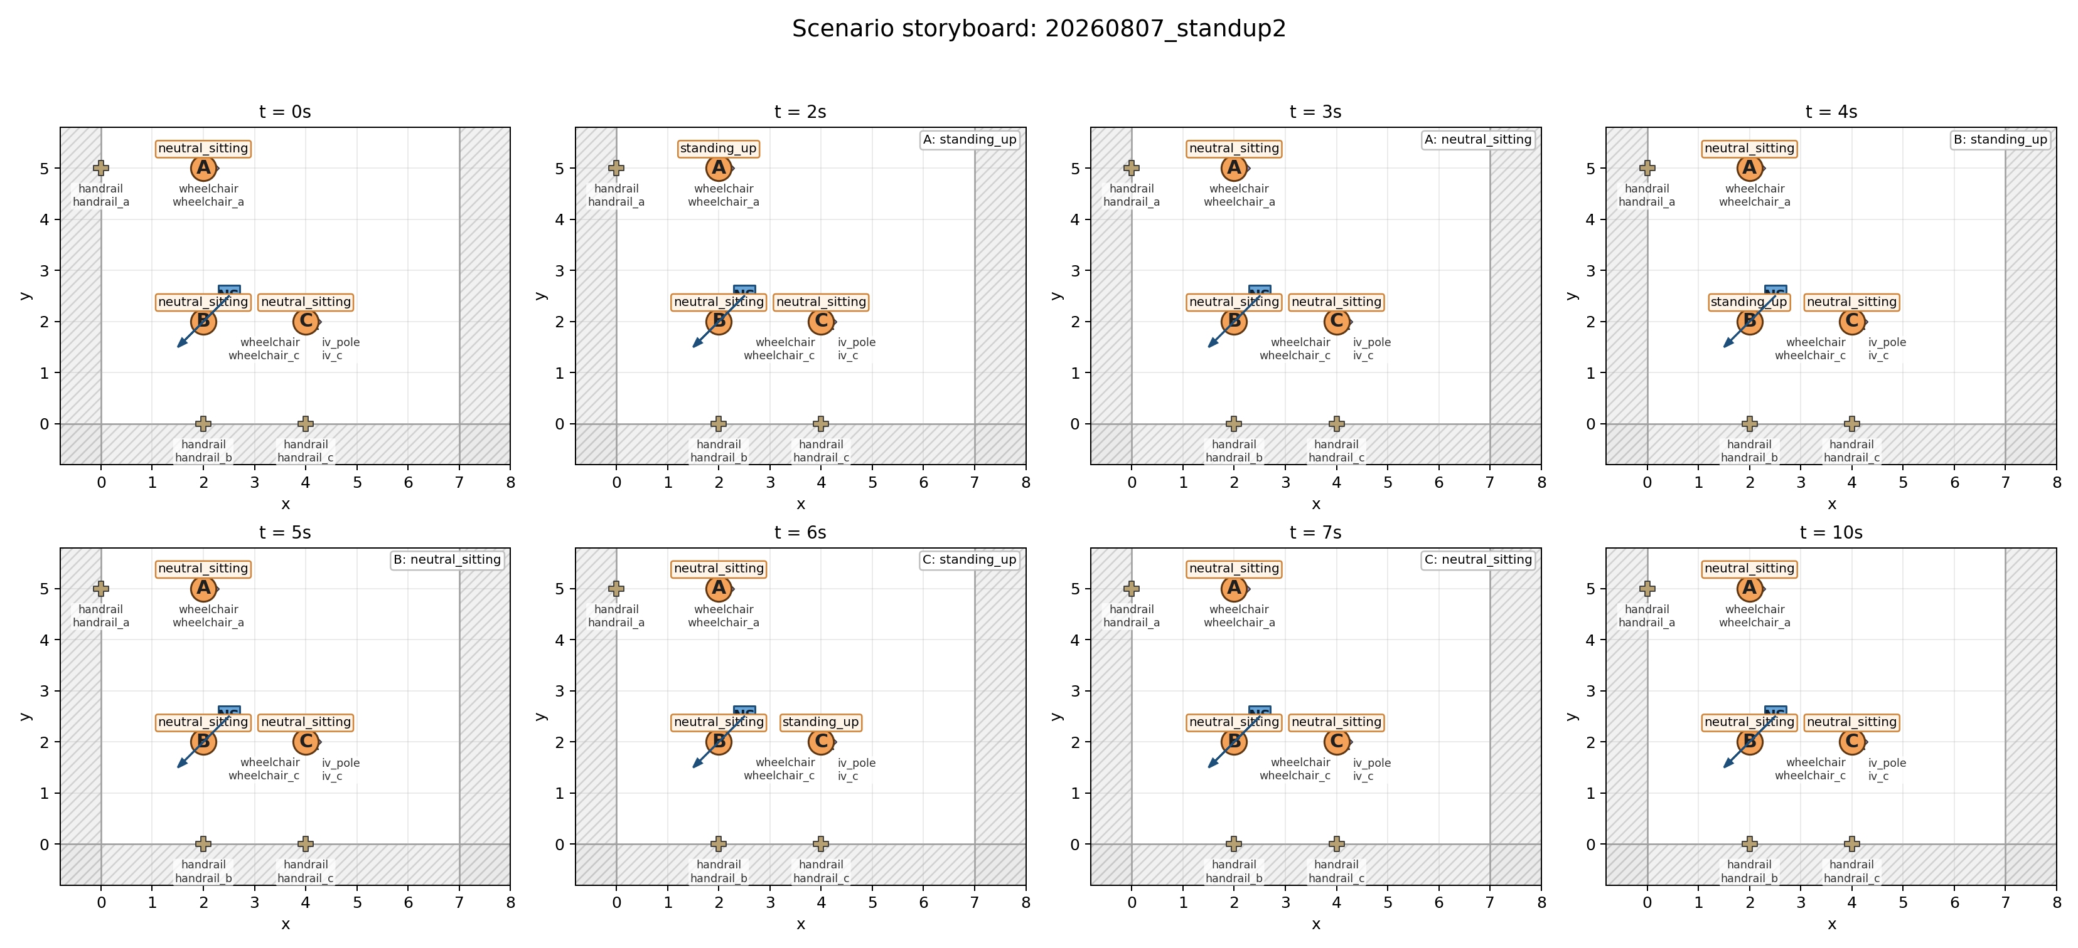
5-1 空間的文脈の考慮の有無で評価が変わることの検証のシナリオ (立ち上がり)

Slide 14
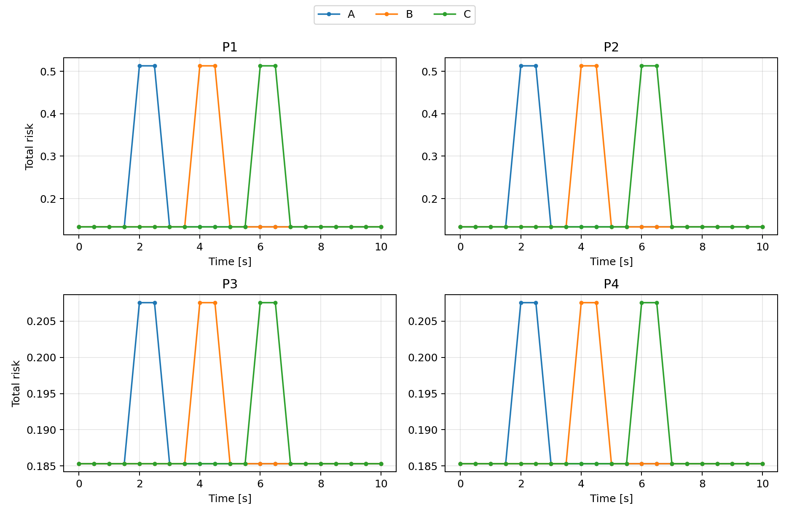
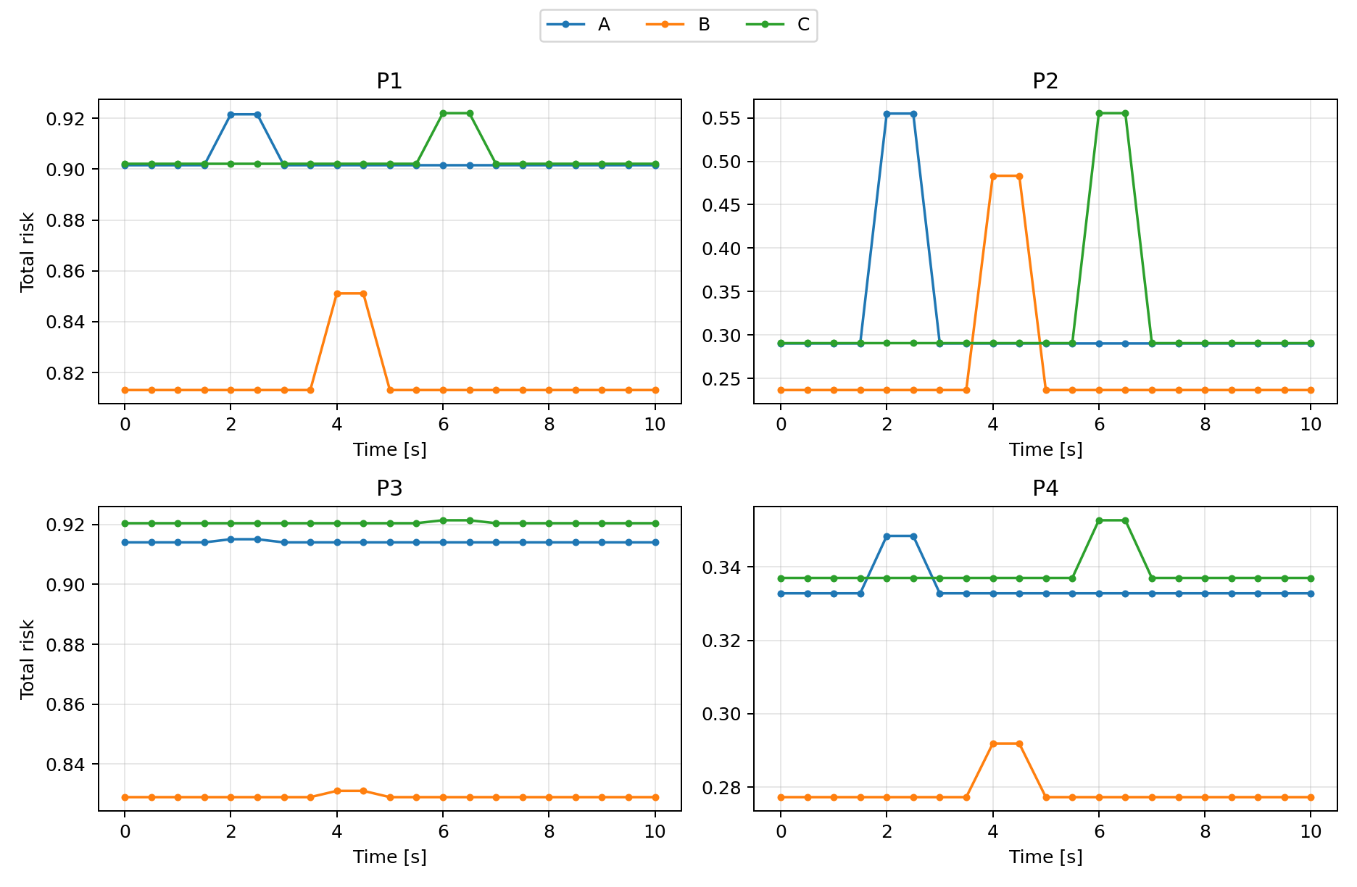
5-1 空間的文脈の考慮の有無で評価が変わることの検証の結果 (立ち上がり)
患者の文脈のみ
空間的文脈も含めた評価
Fuzzy
空間的文脈重視
Fuzzy
患者の文脈重視
Fuzzy
空間的文脈重視
Fuzzy
患者の文脈重視
AHP
立ち上がり重視
AHP
立ち上がり重視
AHP
顔触り重視
AHP
顔触り重視
/home/hayashide/kazu_ws/master_thesis/outputs/20260807_standup_patient2/visualization/profile_total_risk_grid.png
/home/hayashide/kazu_ws/master_thesis/outputs/20260807_standup_spatial2/visualization/profile_total_risk_grid.png

Slide 15
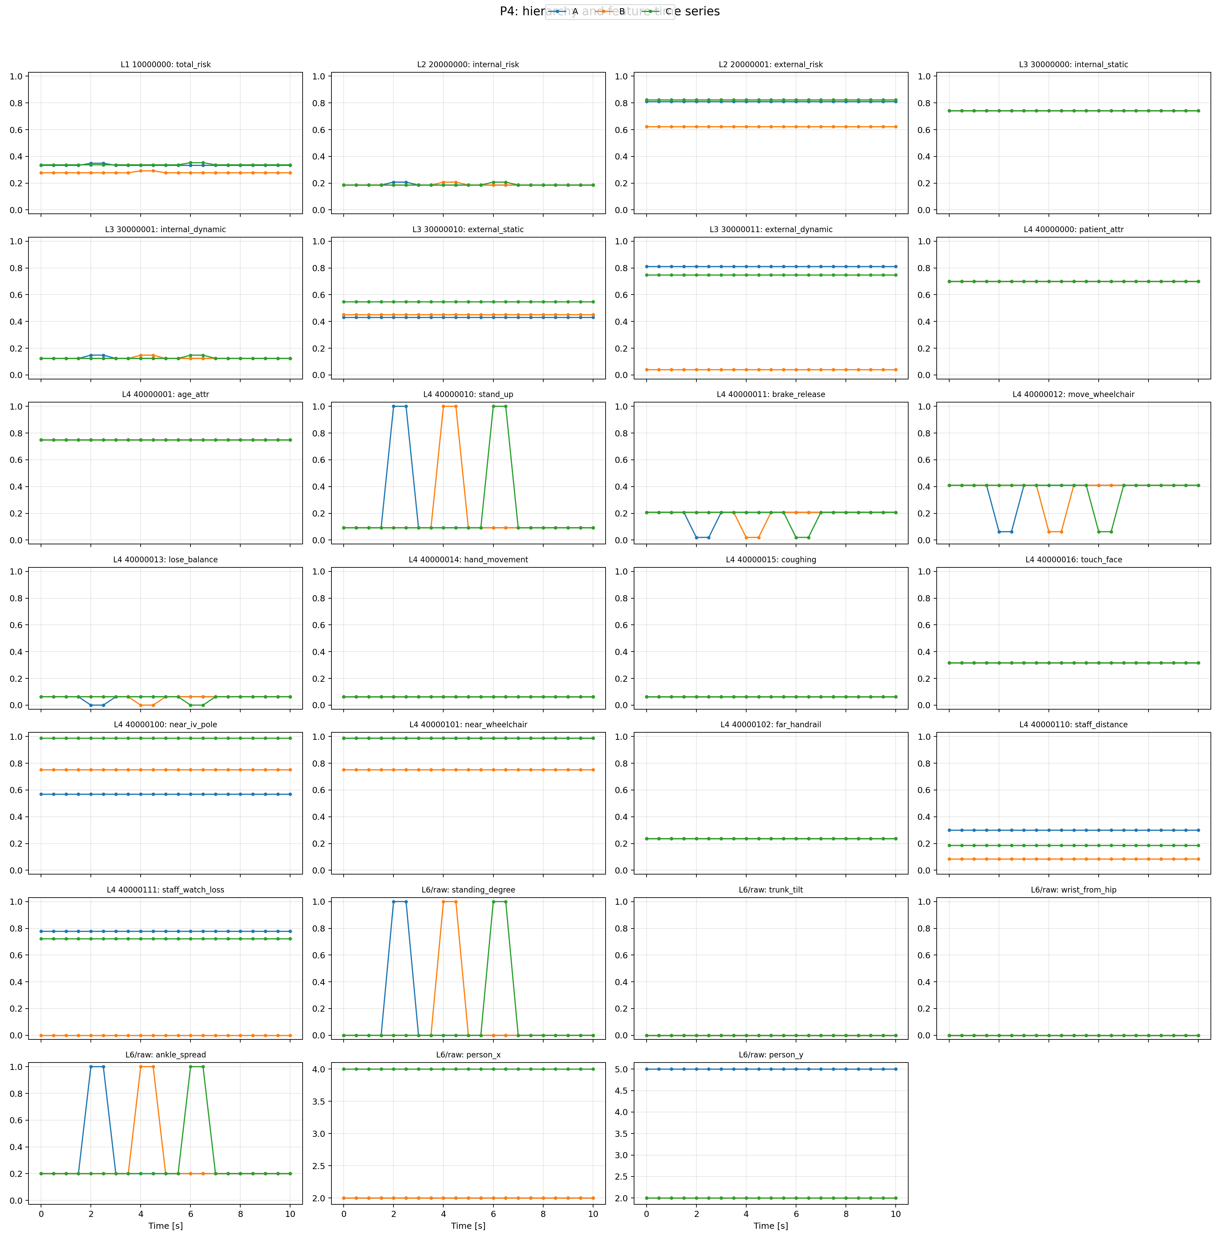
/home/hayashide/kazu_ws/master_thesis/outputs/20260807_standup_spatial2/visualization/P4_hierarchy_timeseries.png

Slide 16
/home/hayashide/kazu_ws/master_thesis/outputs/20260807_standup_spatial2/visualization/P4_hierarchy_timeseries.png

Slide 17
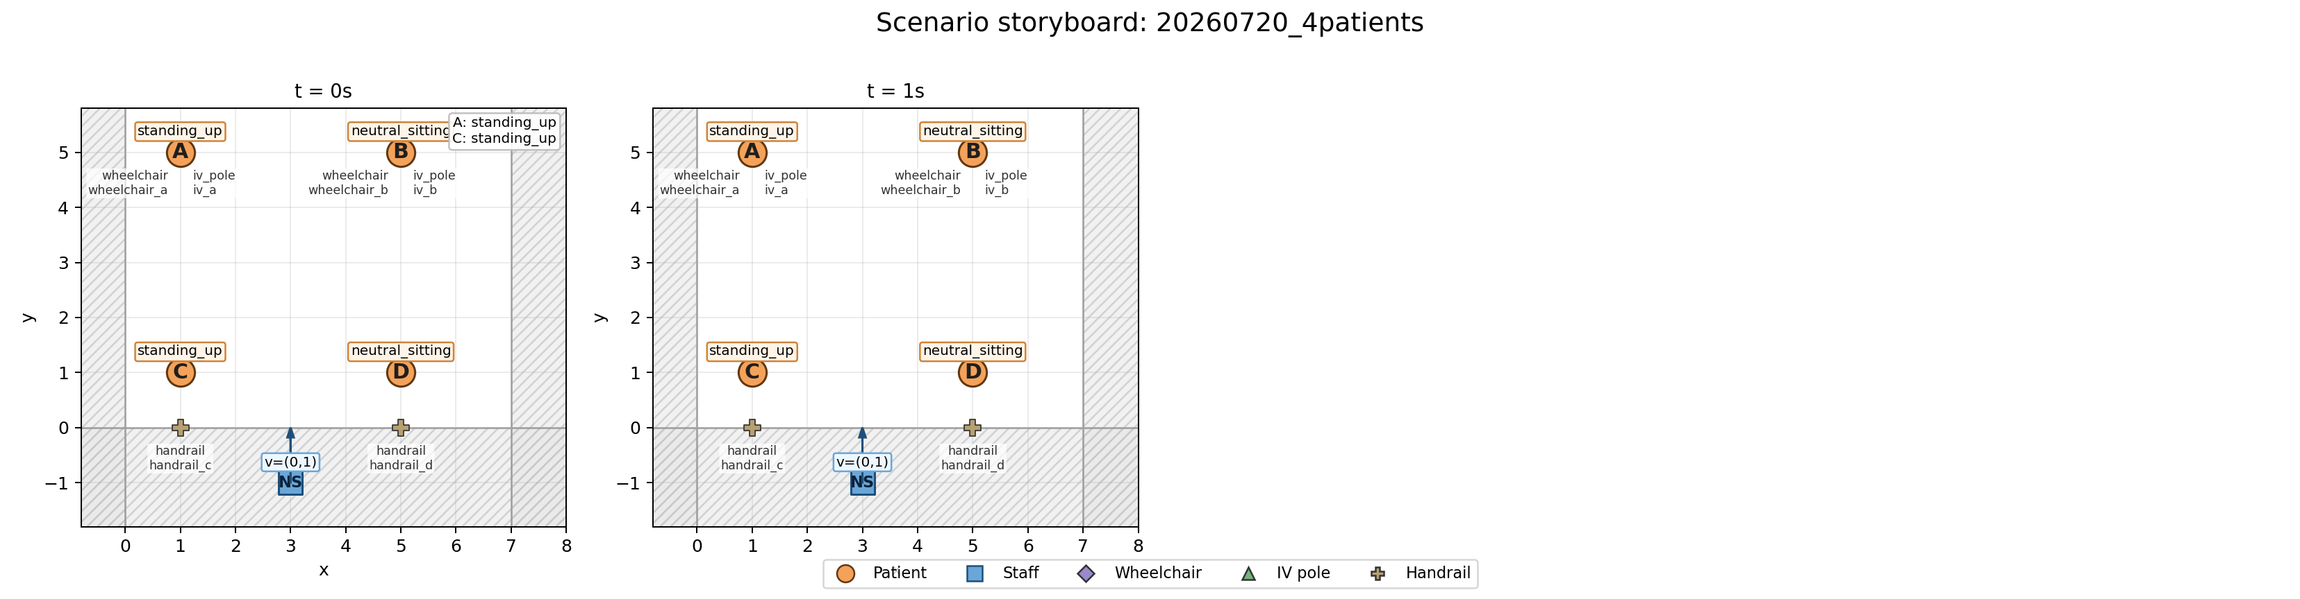
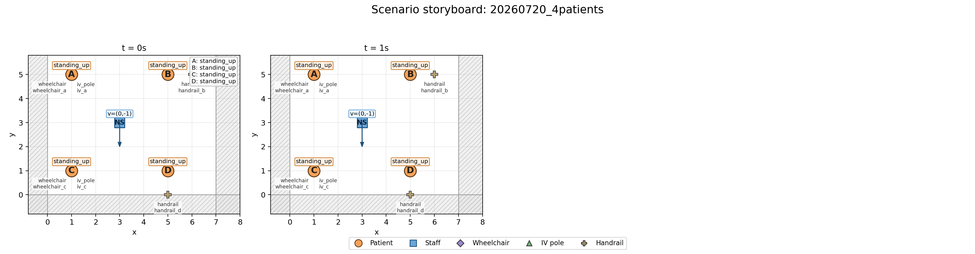
/home/hayashide/kazu_ws/master_thesis/outputs/20260720_4patients/visualization/scenario_storyboard.png
/home/hayashide/kazu_ws/master_thesis/outputs/20260808_4patients2/visualization/scenario_storyboard.png

Slide 18
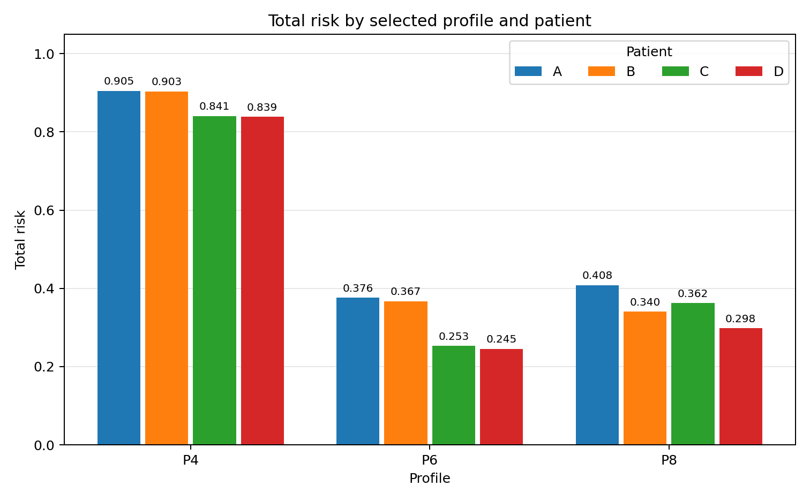
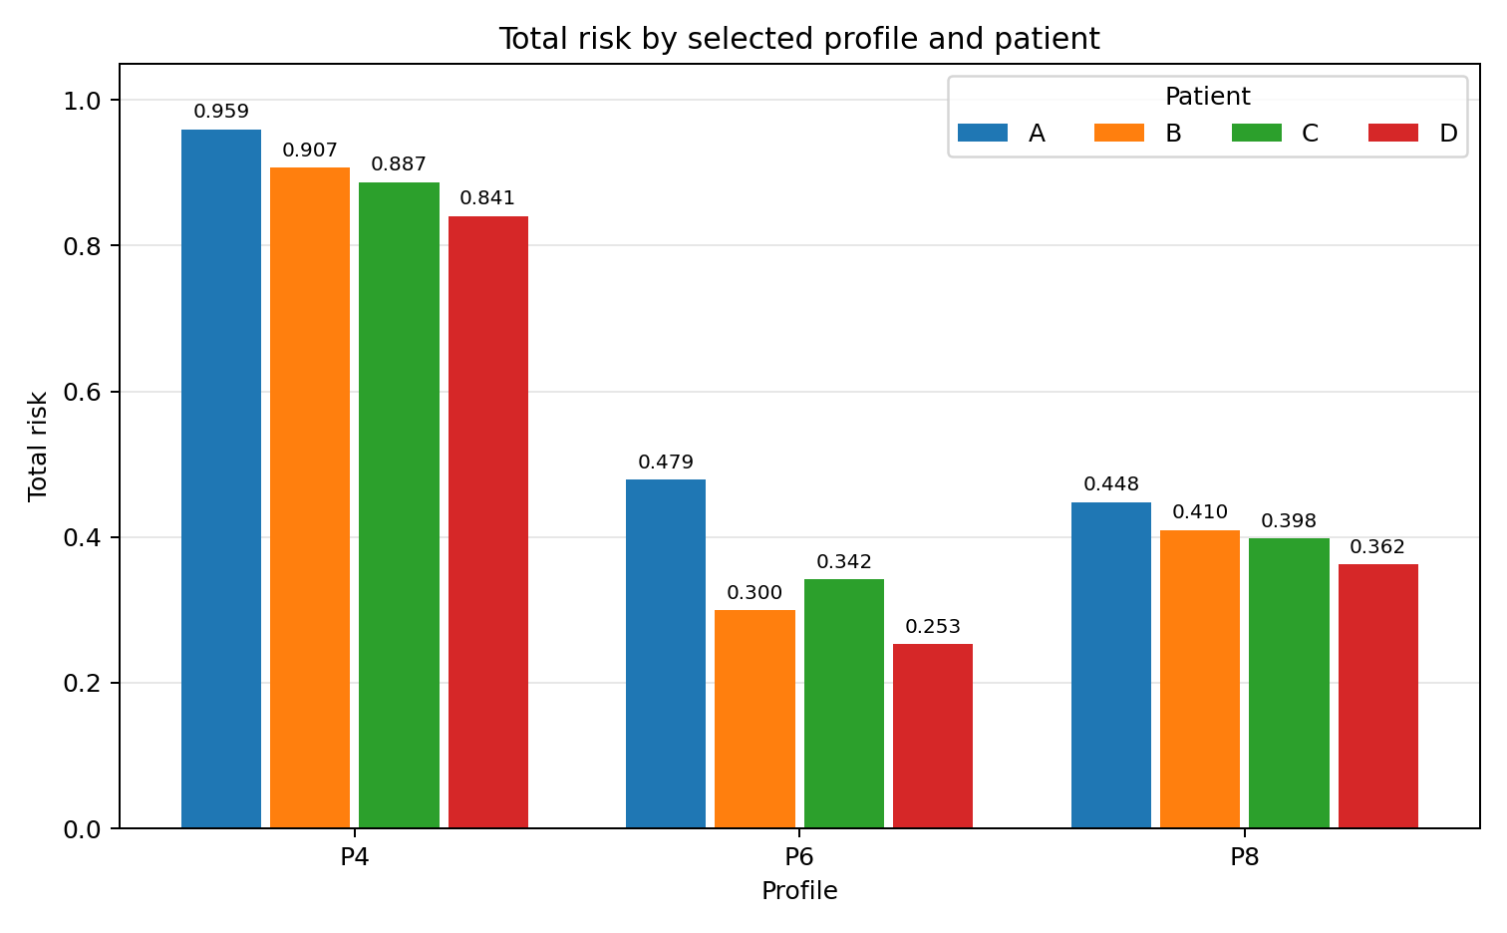
/home/hayashide/kazu_ws/master_thesis/outputs/20260720_4patients/visualization/selected_profile_total_risk_bars.png
/home/hayashide/kazu_ws/master_thesis/outputs/20260808_4patients2/visualization/selected_profile_total_risk_bars.png

Slide 19
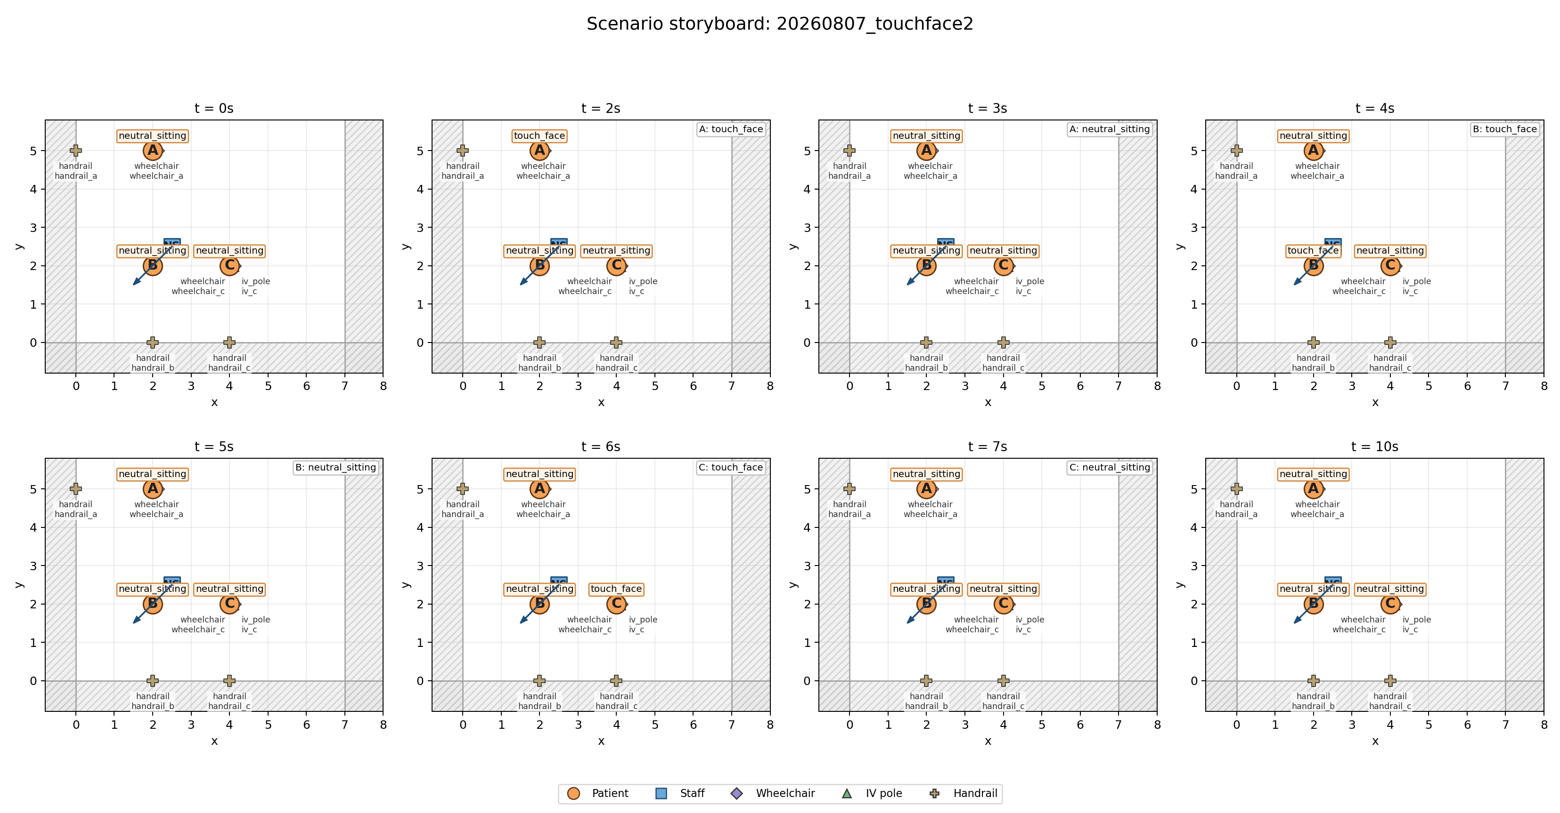
5-1 空間的文脈の考慮の有無で評価が変わることの検証のシナリオ (顔を触る)

Slide 20
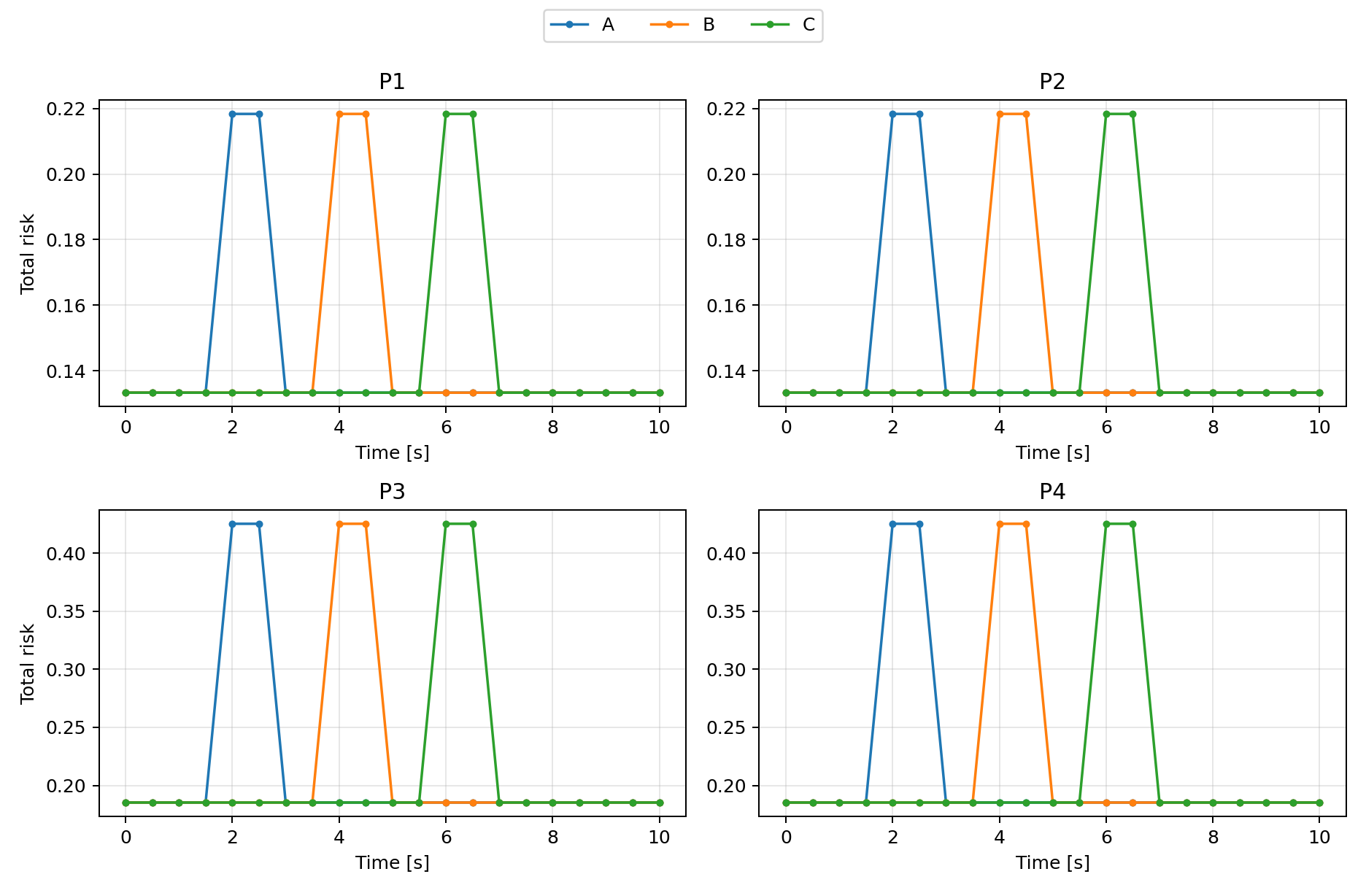
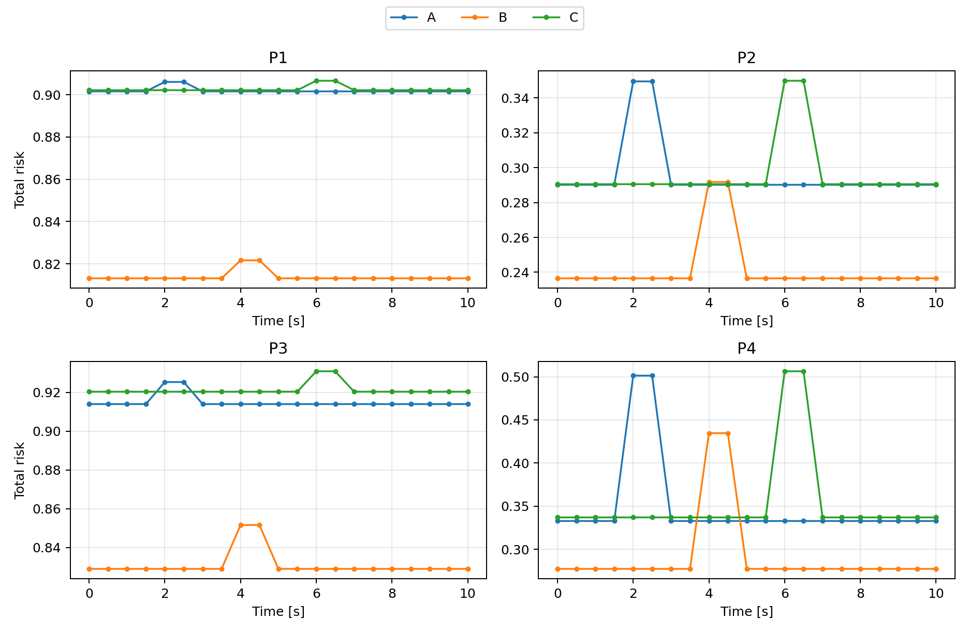
5-1 空間的文脈の考慮の有無で評価が変わることの検証の結果 (顔を触る)
患者の文脈のみ
空間的文脈も含めた評価
Fuzzy
空間的文脈重視
Fuzzy
患者の文脈重視
Fuzzy
空間的文脈重視
Fuzzy
患者の文脈重視
AHP
立ち上がり重視
AHP
立ち上がり重視
AHP
顔触り重視
AHP
顔触り重視
/home/hayashide/kazu_ws/master_thesis/outputs/20260807_touchface_patient2/visualization/profile_total_risk_grid.png
/home/hayashide/kazu_ws/master_thesis/outputs/20260807_touchface_spatial2/visualization/profile_total_risk_grid.png

Slide 21
5-1 空間的文脈の考慮の有無で評価が変わることの検証の結果 (顔を触る)
/home/hayashide/kazu_ws/master_thesis/outputs/20260807_touchface_patient2/visualization/profile_total_risk_grid.png
/home/hayashide/kazu_ws/master_thesis/outputs/20260807_touchface_spatial2/visualization/profile_total_risk_grid.png

Slide 22
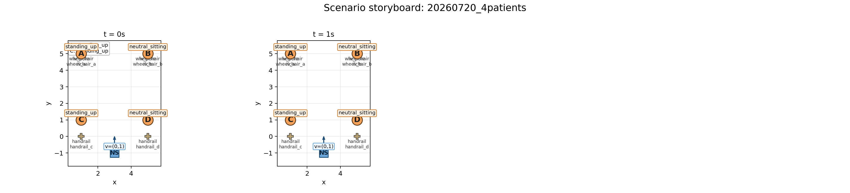
5-2 患者文脈の考慮と順序の関係（4人シナリオその1）

Slide 23
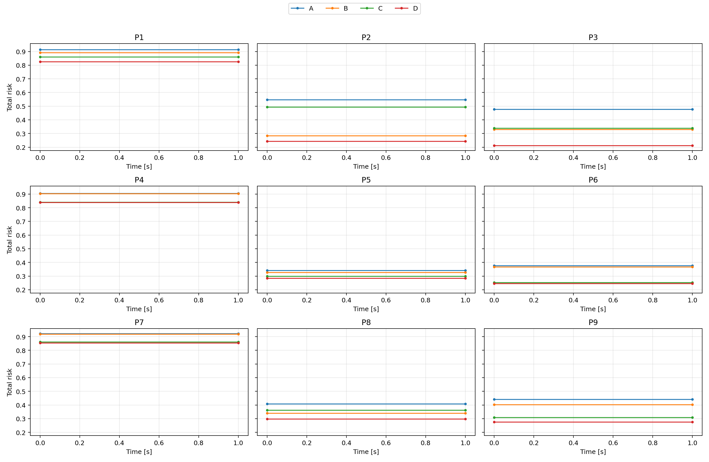
5-2 患者文脈の考慮と順序の関係（4人シナリオその1）
Fuzzy
空間的文脈重視
Fuzzy
やや患者重視
Fuzzy
やや空間重視
AHP
立ち上がり重視
AHP
顔を触る重視
AHP
中間
/home/hayashide/kazu_ws/master_thesis/outputs/20260720_4patients/visualization/profile_total_risk_grid.png

Slide 24
5-2 患者文脈の考慮と順序の関係（4人シナリオその1）

Slide 25
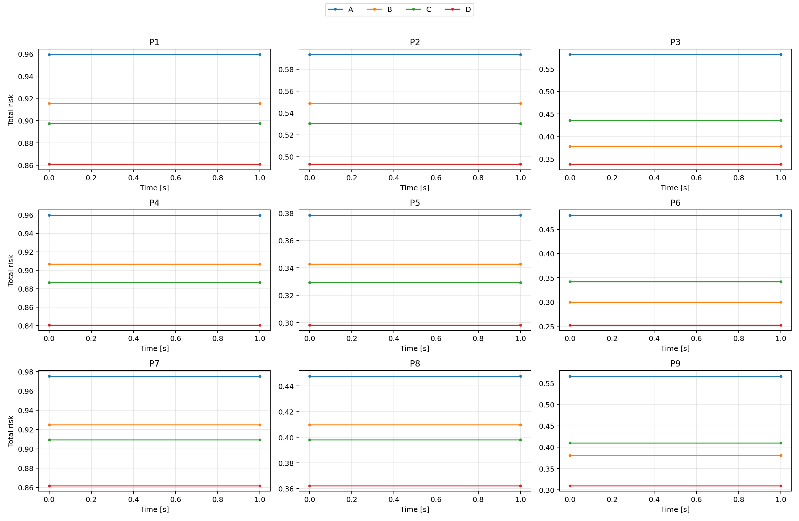
5-2 物体考慮と見守り考慮の傾向（4人シナリオその2）
Fuzzy
空間的文脈重視
Fuzzy
やや患者重視
Fuzzy
やや空間重視
AHP
立ち上がり重視
AHP
顔を触る重視
AHP
中間
/home/hayashide/kazu_ws/master_thesis/outputs/20260808_4patients2/visualization/profile_total_risk_grid.png

Slide 26
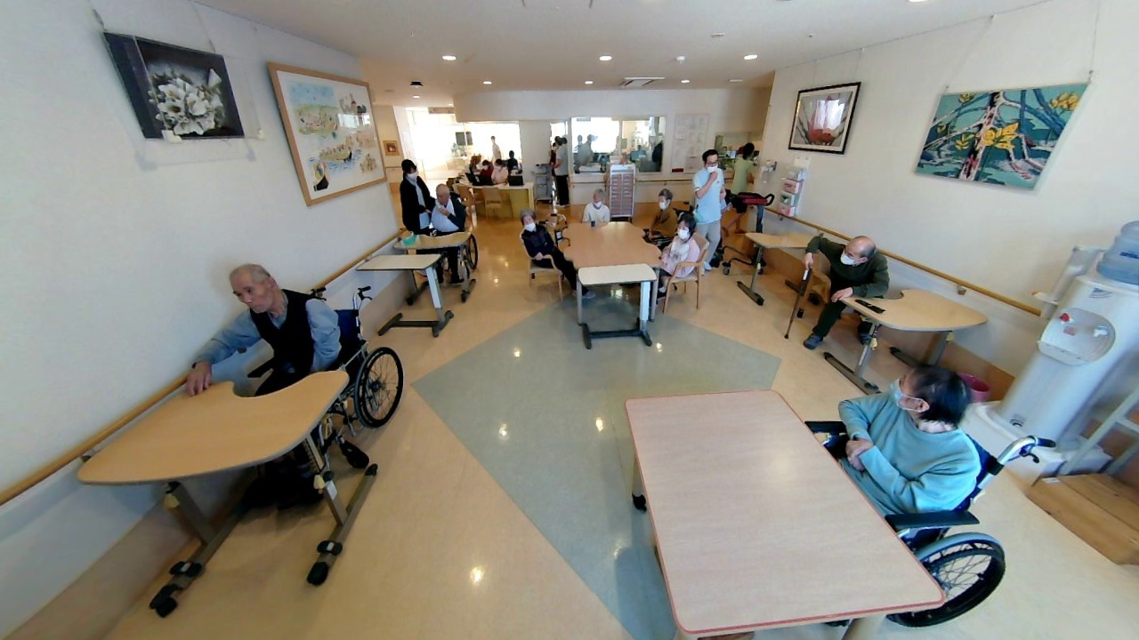
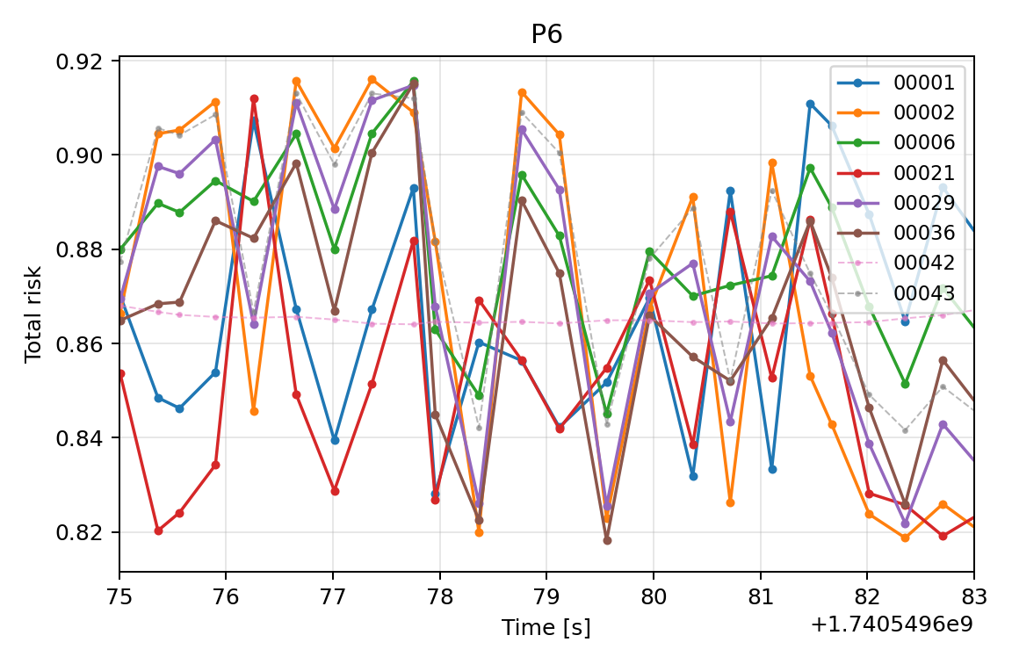
Physical Therapist
00043
00002
Physical Therapist
00042
00021
00006
00001
00029
00036

Slide 27
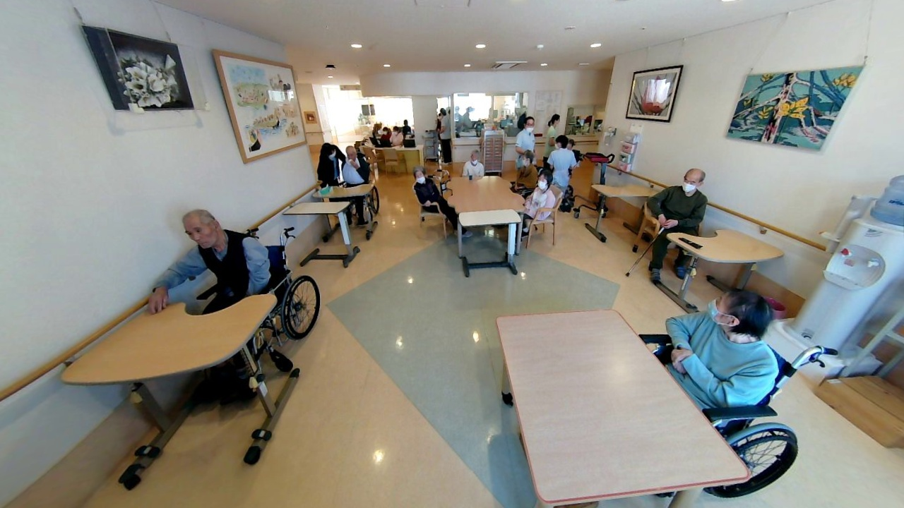

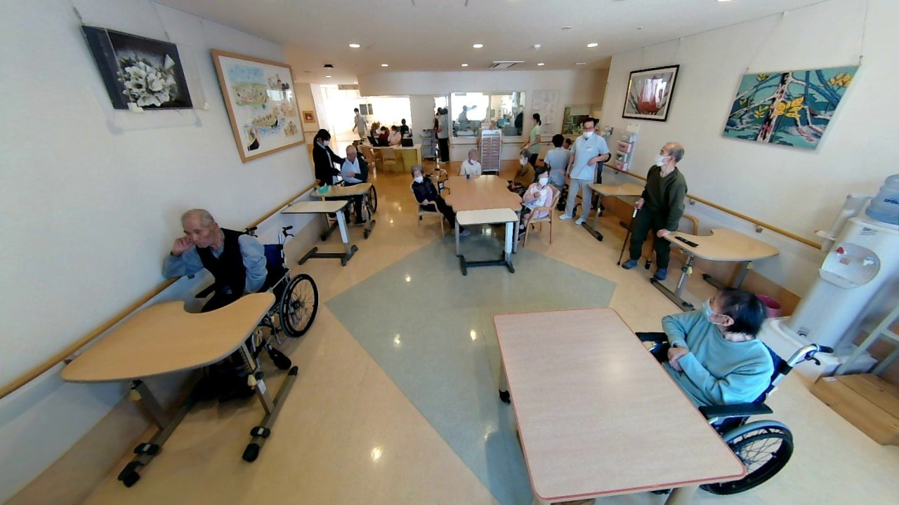


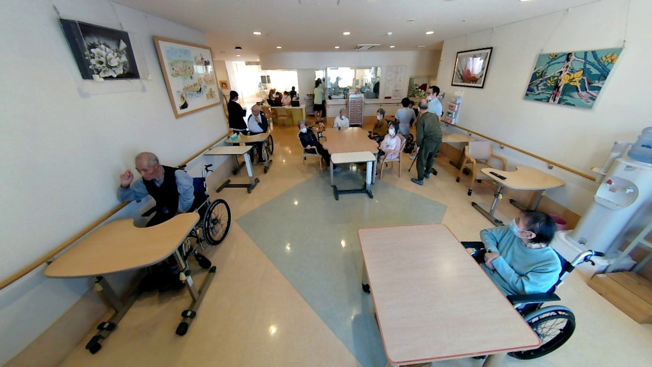

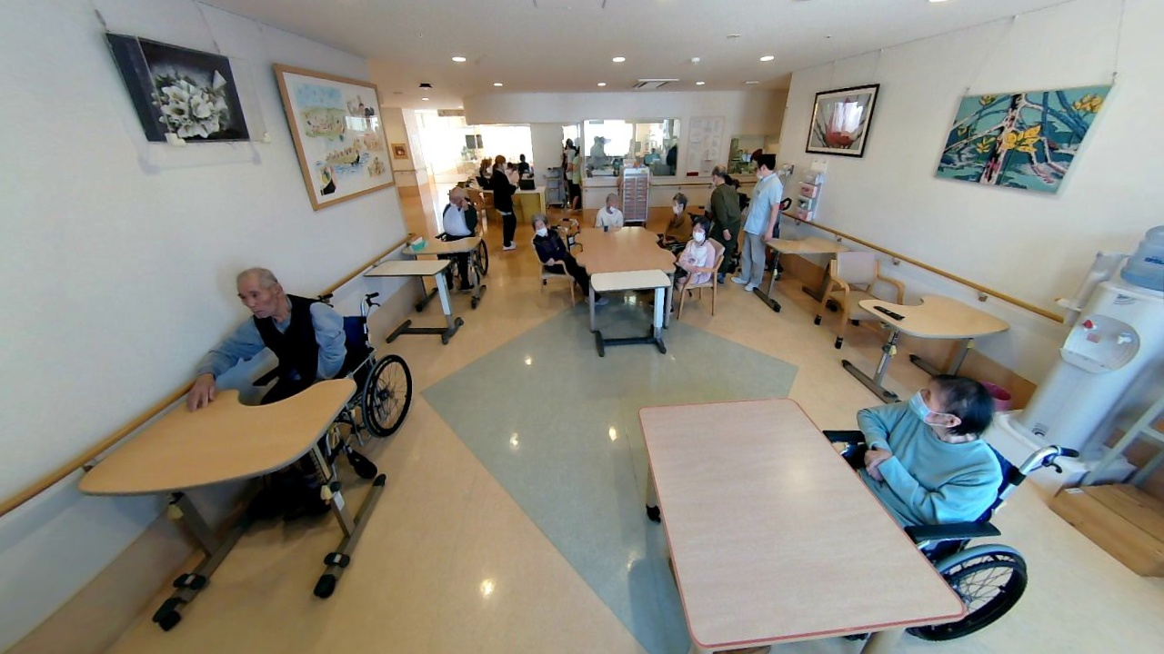
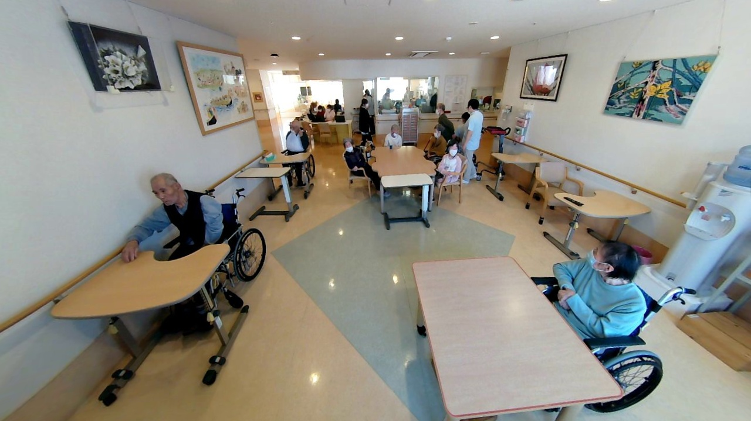

73
75
77
79
81
83

Slide 28
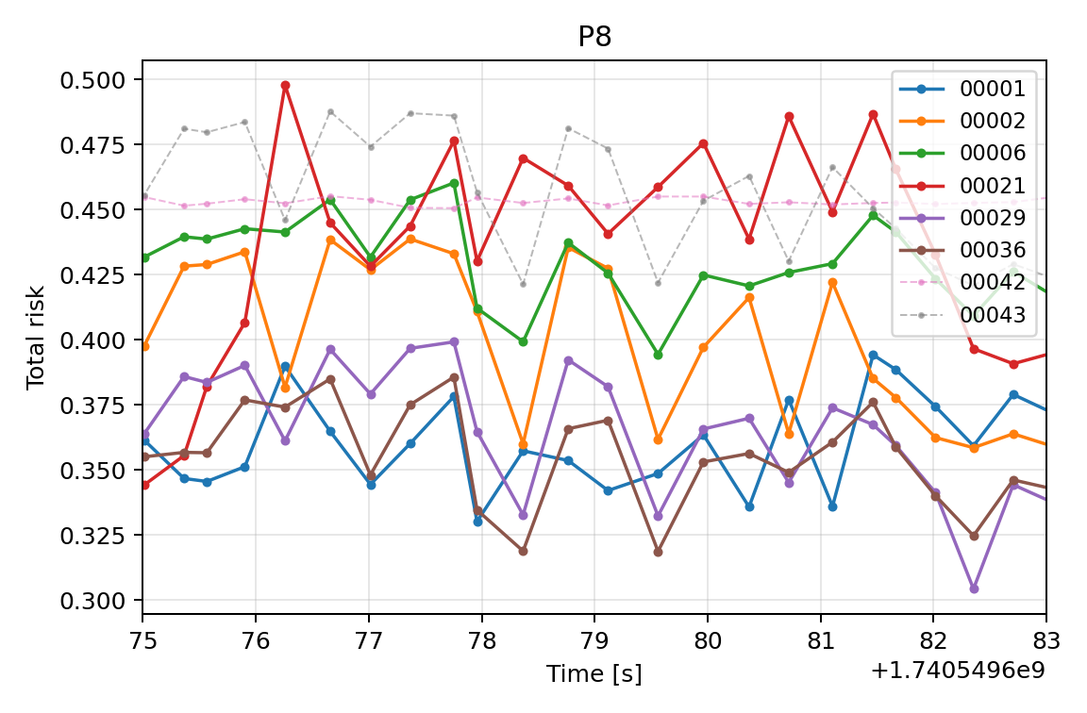
/home/hayashide/kazu_ws/master_thesis/outputs/20260726_realdata/visualization/P6_total_risk_75_83.png
/home/hayashide/kazu_ws/master_thesis/outputs/20260726_realdata/visualization/P8_total_risk_75_83.png

Slide 29
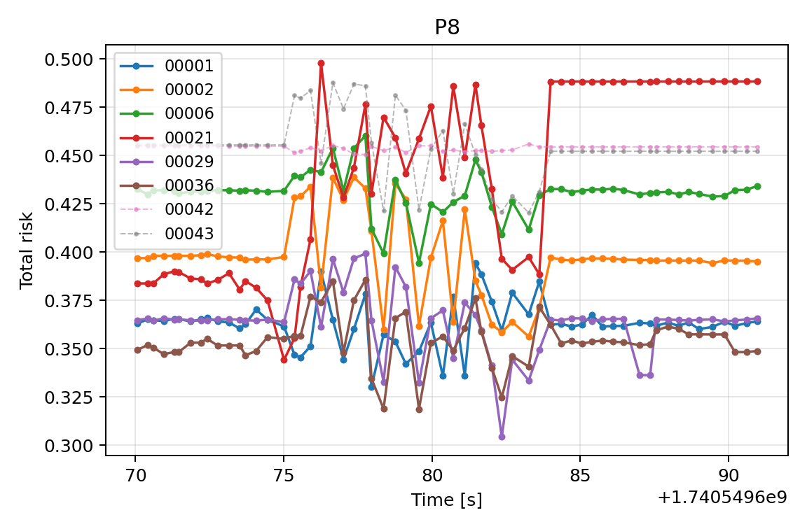
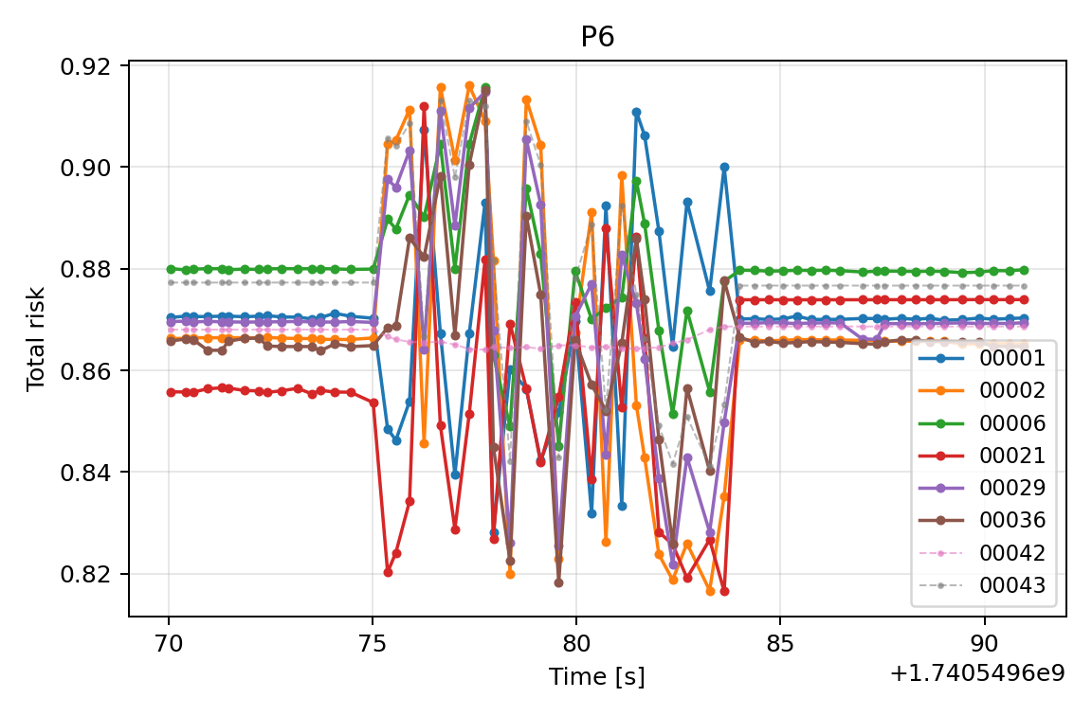
5-3 実データ 対照的な例

Slide 30
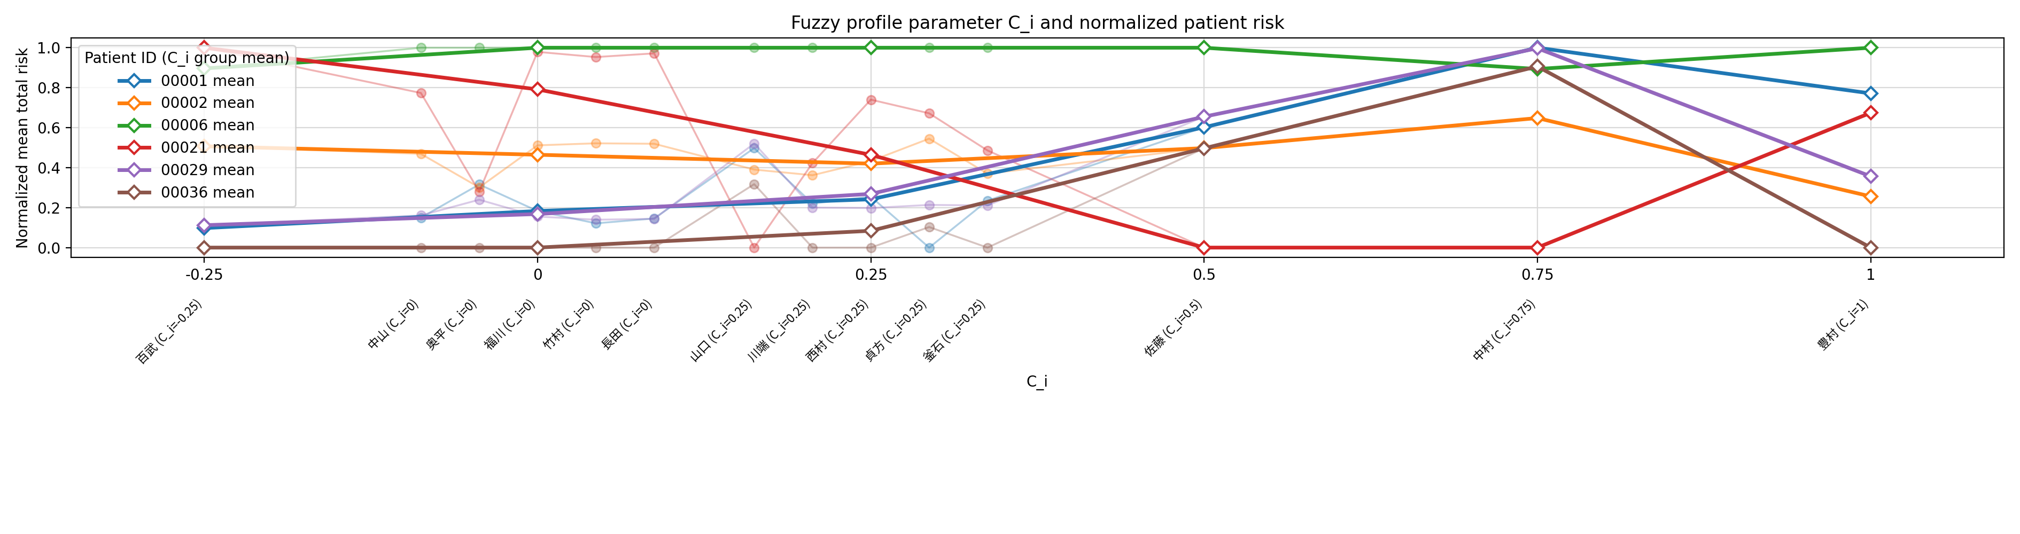
5-3 空間的文脈指向と順位の関係
/home/hayashide/kazu_ws/master_thesis/outputs/20260726_realdata/analysis/fuzzy_profile_ranking.png

Slide 31
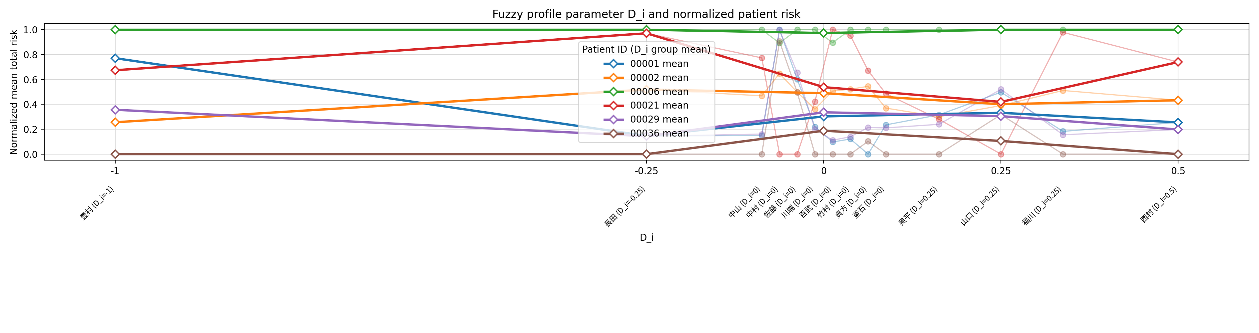
5-3 物体の有無・見守り有無のどちらを重視するかの指標D_iと順位の関係
/home/hayashide/kazu_ws/master_thesis/outputs/20260726_realdata/analysis/fuzzy_profile_di.png

Slide 33
Trigger
BLIP
Patient
Static
Attribution
Bounding box RGB image
Age
Internal
Trigger
Pose similarity evaluator
with YOLO
Action 1
Dynamic
…
…
Action
background differencing
image
Action n
Total risk
Trigger
BLIP
Object 1
Static
…
…
Objects
Object n
External
Extracted PointCloud
Dynamic
Relative position calculator
Distance
Surrounding staff
: Fuzzy reasoning
: Pairwise comparison
: Others
: Process
: Information
Trigger
Direction

Slide 34
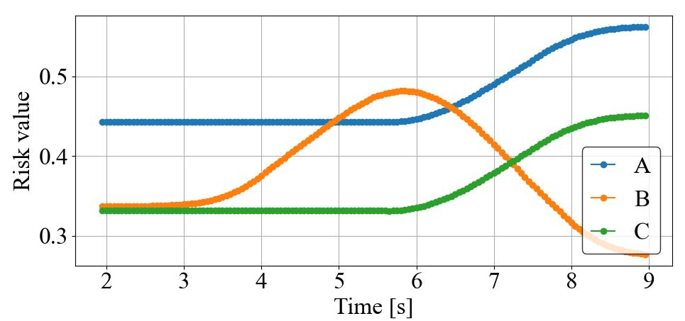
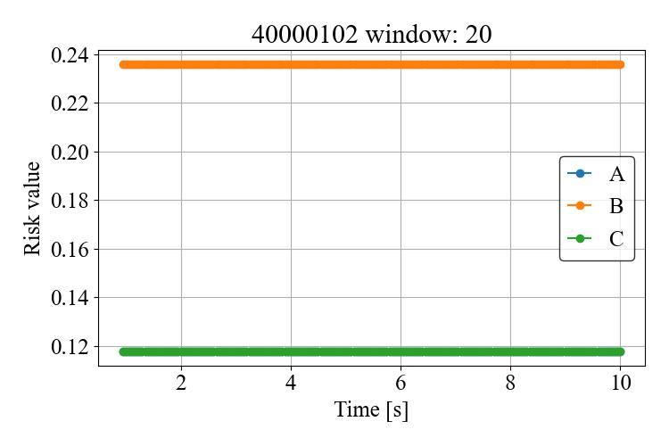
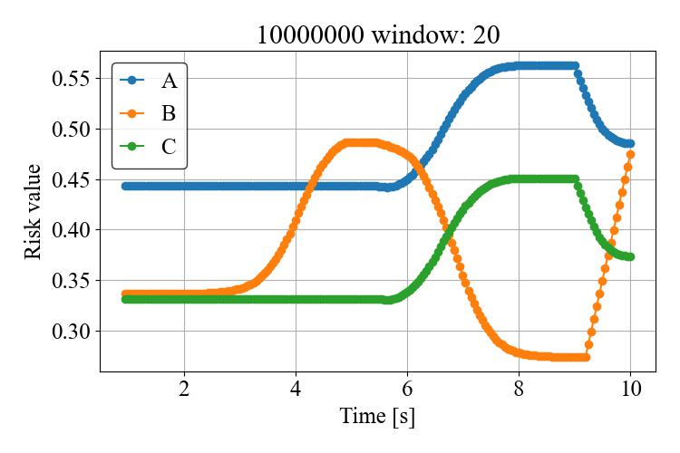
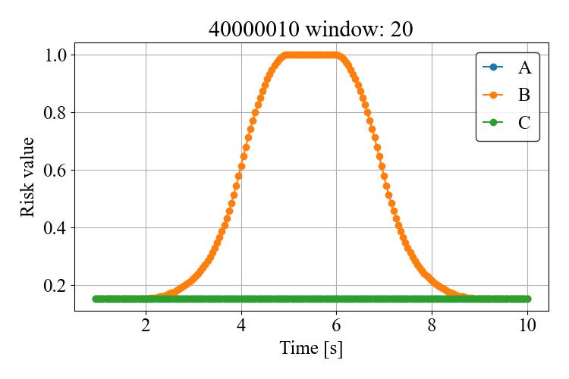
参考：通知
Risk increases & rank changes
Total risk
Stand up
Static Node | Significance
Objects (iv Pole) | 0.12
… | …
Attribution (Patient) | 0.01
Dynamic Node | Correlation
Stand up | 0.99
… | …
Move wheelchair | -0.50
Bさんが車椅子に乗っているのに立ち上がったので危険です！

Slide 35
以下のスライドは作業用

Slide 36
修論 図表
髙橋正樹研究室 修士2年 林出和之

Slide 37
梗概 通知が必要なシーン例
C
B
The nurse concentrating on her task
A
The patient standing up without permission

Slide 38
梗概 手法概要図
Start
Trigger
BLIP
Patient
Static
Observe
Attribution
Bounding box RGB image
Trigger preprocess
Trigger preprocess
Age
Internal
Preprocess
…
Preprocess
Trigger
Pose similarity evaluator
with YOLO
Action 1
Dynamic
Use previous data
Use previous data
…
…
Action
Evaluate risk
Evaluate risk
background differencing
image
Action n
Total risk
Rank patients
Static
Trigger
BLIP
Object 1
…
…
Objects
Need to notify?
Need to ask help?
Object n
External
Send notification to the staff
Send notification to other staff
Extracted PointCloud
Dynamic
Relative position calculator
Distance
Surrounding staff
: Fuzzy reasoning
: Pairwise comparison
: Others
: Process
: Information
Trigger
Direction
End

Slide 39
梗概 手法概要図v2
Start
Bounding box RGB image
Background differencing
image
Extracted PointCloud
Observe
Trigger preprocess
Trigger preprocess
Trigger
Trigger
Trigger
Trigger
Preprocess
…
Preprocess
VQA
Pose similarity evaluator
VQA
Relative position calculator
Use previous data
Use previous data
Evaluate risk
Evaluate risk
Static
Dynamic
Static
Dynamic
Total risk
Total risk
Rank patients
Features
Patient
Age
Action 1
Action n
Object 1
Object n
Distance
Direction
…
…
Need to notify?
3rd risk
Attribution
Action
Objects
Surrounding staff
Send notification to staff
2nd risk
Internal
External
Notification
generator
: Fuzzy reasoning
: Pairwise comparison
: Others
: Process
: Information
Total risk
End
Trigger
BLIP
Patient
Static
Attribution
Bounding box RGB image
Age
Internal
Trigger
Pose similarity evaluator
with YOLO
Action 1
Dynamic
…
…
Action
background differencing
image
Action n
Total risk
Trigger
BLIP
Object 1
Static
…
…
Objects
Object n
External
Extracted PointCloud
Dynamic
Relative position calculator
Distance
Surrounding staff
: Fuzzy reasoning
: Pairwise comparison
: Others
: Process
: Information
Trigger
Direction

Slide 40
梗概 手法概要図v3
Bounding box RGB image
Background differencing
image
Extracted PointCloud
Trigger
Trigger
Trigger
Trigger
Input
VQA
Pose similarity evaluator
VQA
Relative position calculator
Features
Patient
Age
Action 1
…
Action n
Object 1
…
Object n
Distance
Direction
Risk factors
Attribution
Action
Objects
Surrounding staff
Select in advance
: Fuzzy reasoning
: Pairwise comparison
: Others
: Process
: Information
: Static contents
: Dynamic contents
Internal
External
Notification
generator
Total risk

Slide 41
Bounding box RGB image
Background differencing
image
Trigger
Trigger
Trigger
Trigger
VQA
Pose similarity evaluator
VQA
Relative position calculator
Patient
Age
Action 1
…
Action n
Object 1
…
Object n
Distance
Direction
Attribution
Action
Objects
Surrounding staff
Internal
External
Total risk

Slide 42
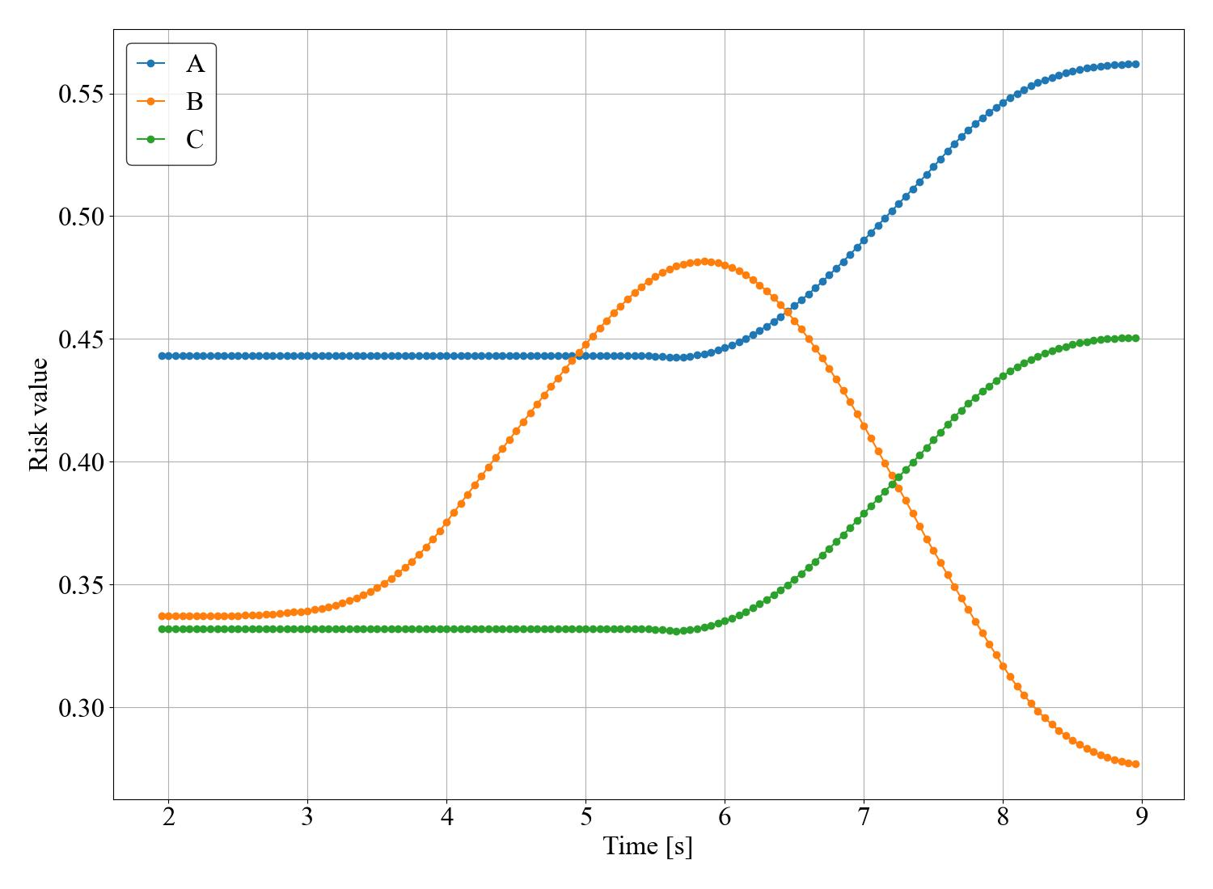
梗概 通知アルゴリズム
Risk increases & rank changes
Total risk
Stand up
Static Node | Significance
Objects (iv Pole) | 0.12
… | …
Attribution (Patient) | 0.01
Dynamic Node | Correlation
Stand up | 0.99
… | …
Move wheelchair | -0.50
Bさんが車椅子に乗っているのに立ち上がったので危険です！

Slide 43
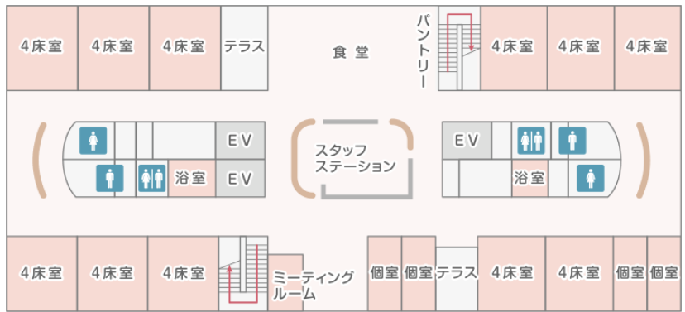
フロアマップ

Slide 44
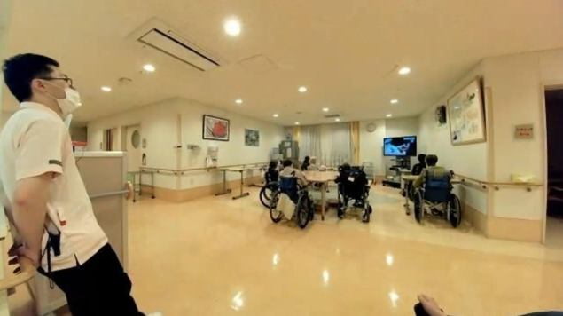
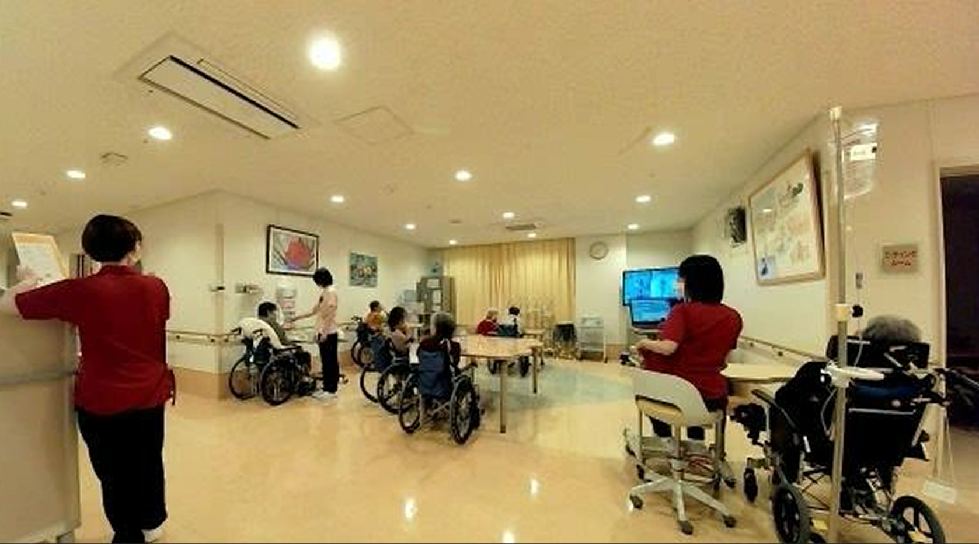
見守りの2形態

Slide 45
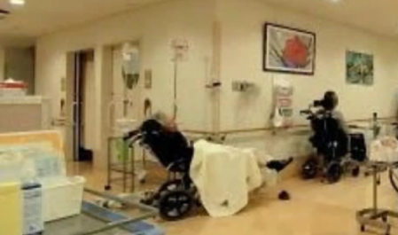
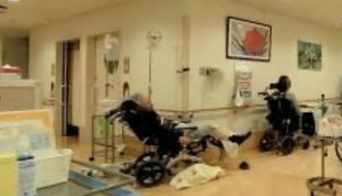
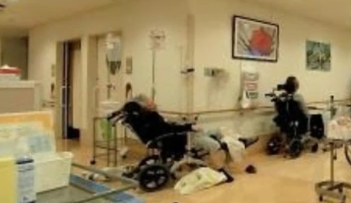
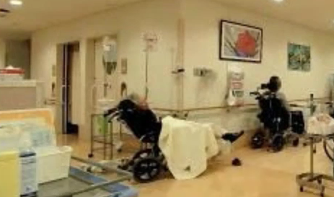
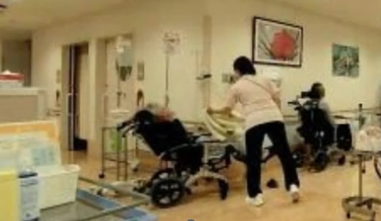
ヒヤリハット集その２

Slide 46
要求分析フロー

Slide 47
ヒアリング結果
高リスク患者の定義
見守り担当者が声をかける例
・動くことが禁じられている患者
・点滴中など，状態起因の危険性がある患者
全員：姿勢の崩れ
何かしたそう
手が動いている
点滴患者：吐く・むせる
顔を触る
管を抜く
※ 経管栄養を含む
見守り業務における「コツ」
危険行動の代表例
・他の業務と並行しているため，見守りミスは不可避
・全スタッフで「死角を埋める」意識で見守る
⇒他スタッフの視線から自分が見るべき患者を決定
・立つ
・車椅子から降りる
・車椅子のブレーキ解除
・テーブルを押し，車椅子を動かす
現場要望のシステム
・スタッフの「第３の目」として補佐するシステム
⇒熟練見守り者が居なくても，夜の病棟を安全に
・担当者の多忙時に，自動で応援を要請するシステム
・患者が動いたことの通知をするシステム
・通知を止める作業が不要なシステム
・通知基準を担当者がカスタマイズできるシステム
特に注意を要する患者
・No.1 :経管栄養中の多動患者
・No.2 : 経管栄養中の通常患者
・No.3 :認知低下患者
※ 動かない・居眠り中患者は様子を見る

Slide 48
ヒアリング⇒機能
ヒアリング内容
要求機能
スタッフの「第３の目」で見ていてくれる
・患者の動作や周囲の状況を「俯瞰的に」見る
情報の取得
・本人の情報と空間的文脈を総合的に取得
危険な状態にある患者を発見してくれる
・状況を総合的に判断して，優先度を考えてくれる
・状況を具体的に説明してくれる
リアルタイムな危険性の判断
・本人の情報と空間的文脈を総合的に判断
・現場知識を反映した判断
・判断基準が調整可能
通知基準を担当者がカスタマイズできるシステム
患者が動いたことの通知をするシステム
危険動作に関する通知
・判断の根拠が言語的に説明可能
・遅延や過剰のない通知
通知を止める作業が不要なシステム
担当者の多忙時に，自動で応援を要請するシステム
担当者増援の自動要請

Slide 49
コンテクスト図
Patient B
Observe
Patient C
Patient A
Observe
Worry
Treat
Talk
(in person or via headset)
Other staff

Slide 50
コンテクスト図
Patient B
Patient A
Observe
Patient C
Observe
Worry
Treat
Notify
Other staff

Slide 51
コンテクスト図
Patient B
Patient A
Observe
Patient C
Observe
Notify
Treat
Notify
Other staff

Slide 52
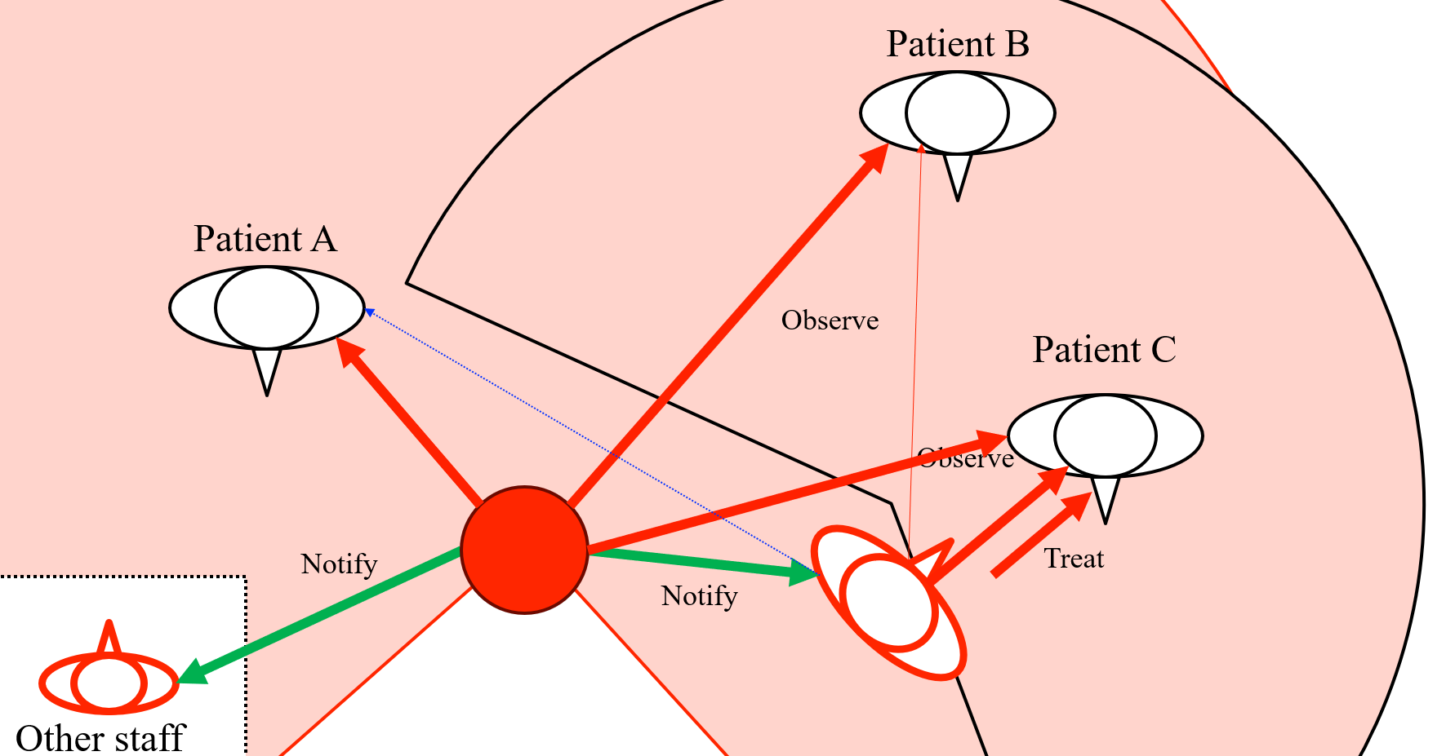
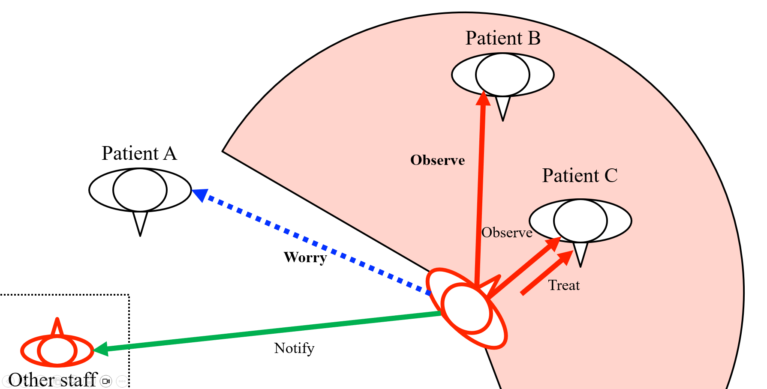

Slide 53
ユースケース図
Patient A
Patient B
Patient C
Observe
Evaluate risk
Ask for help
Other staff

Slide 54
ユースケース図
Patient A
Patient B
Patient C
Observe ,
Observe
Evaluate risk
Evaluate risk
Explain
Ask for help
Other staff

Slide 55
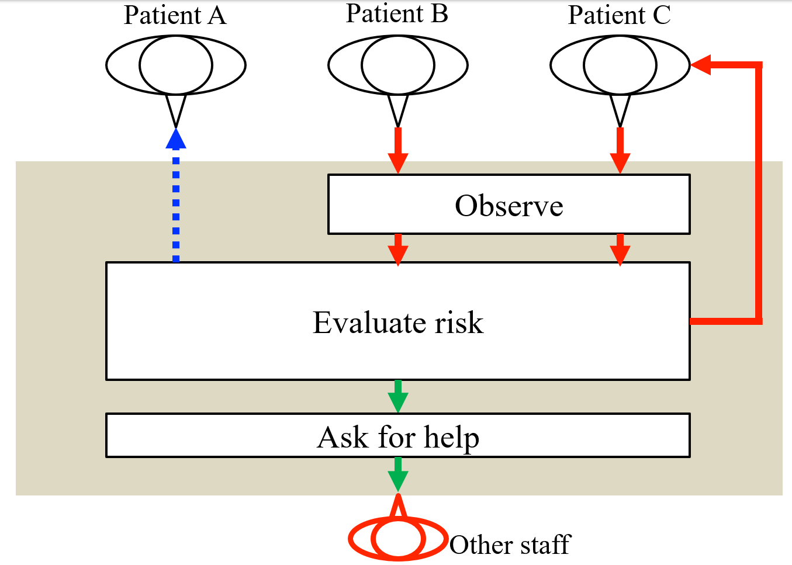
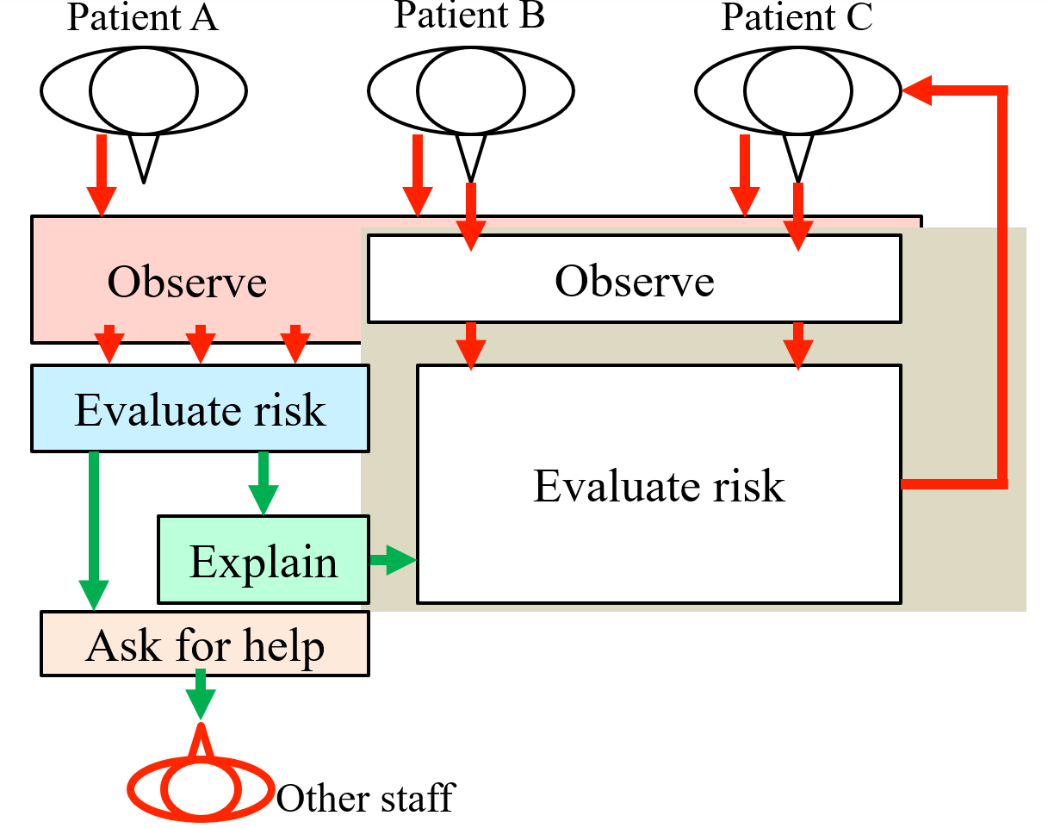

Slide 56
運用コンセプト フローチャート
Patient A
Patient B
Patient C
Patient A
Patient B
Patient C
Patient A
Patient B
Patient C
Patient A
Patient B
Patient C
Patient A
Patient B
Patient C
Patient A
Patient B
Patient C
Observe ,
Observe ,
Observe ,
Observe ,
Observe ,
Observe ,
Observe
Observe
Observe
Observe
Observe
Observe
Evaluate risk
Evaluate risk
Evaluate risk
Evaluate risk
Evaluate risk
Evaluate risk
Evaluate risk
Evaluate risk
Evaluate risk
Evaluate risk
Evaluate risk
Evaluate risk
Explain
Explain
Explain
Explain
Explain
Explain
Ask for help
Ask for help
Ask for help
Ask for help
Ask for help
Ask for help
Other staff
Other staff
Other staff
Other staff
Other staff
Other staff

Slide 57
検証性の確認
Start
Start
Observe
Observe
Trigger preprocess
Trigger preprocess
Preprocess
背景色を使って，各ノードが何章のどこで
検証されるのか明示しておく
（検証の章立てが最終確定してから？）
Preprocess
Use previous data
Use previous data
Evaluate risk
Evaluate risk
Choose notification
Choose notification
Send notification to staff
Ask other staff for help
Send notification to staff
Ask other staff for help
End
End

Slide 58
AHPの理論説明
Final Goal
Criteria 1
Criteria 2
Criteria 3
...
Criteria n
Alternative 1
Alternative 2
Alternative 3

Slide 59
提案手法概要 機能フロー図（横書きだとベスト）
Start
Observe
Trigger preprocess
Trigger preprocess
Preprocess
…
Preprocess
Use previous data
Use previous data
Evaluate risk
Evaluate risk
Rank patients
Need to notify?
Need to ask help?
Send notification to the staff
Send notification to other staff
End

Slide 60
提案手法概要 システム図（変数名入れたい）
Sensing
Segmentation and tracking
Trigger
Preprocess
Evaluate risk
Segmented BD image
Background differencing (BD) image
Segmented RGB image
Feature values
Total risk
Position of the patient
Rank patients
Generate notification to the staff
…
Risks
Ranking
RGB image
Trigger
Preprocess
Evaluate risk
Generate notification to other staff
Segmented BD image
PointCloud
Segmented RGB image
Feature values
Total risk
Position of the patient

Slide 61
提案手法概要 詳細システム図
Trigger
BLIP
Patient
Static
Attribution
Bounding box RGB image
Age
Internal
Trigger
Pose similarity evaluator
with YOLO
Action 1
Dynamic
…
…
Action
Background differencing
RGB image
Action n
Total risk
Trigger
BLIP
Object 1
Static
…
…
Objects
Object n
External
Extracted PointCloud
Dynamic
Relative position calculator
Distance
Surrounding staff
: Fuzzy reasoning
: Pairwise comparison
: Others
: Process
: Information
Trigger
Direction

Slide 62






提案手法 観測 システム図
Bounding box RGB image
Sensing
Generate
background differencing
(BD) image
Image cropping
Person identification and tracking
…
Segmented BD image
BD image M_{k}
Segmented BD image
Segmented RGB image
Position of the patient
RGB image I_{k}
Image cropping
…
…
Environment
YOLO
human detection
Segmented RGB image
Bounding box information
Segmented BD image
PointCloud cropping
Representative point calculation
Segmented RGB image
…
…
PointCloud P_{k}
Position of the patient
Segmented PointCloud
Position of the patient

Slide 63


提案手法 事前処理 属性 システム図
BLIP-2 VQA
fuzzification
Question 1
Answer (Text)
Feature value
(Fuzzy number)
Segmented RGB image
BLIP-2 VQA
fuzzification
Answer (Text)
Feature value
(Fuzzy number)
Question 2

Slide 64
提案手法 事前処理 属性 ファジィ数
No
Yes
Young
Middle
Old
1
1
Degree of membership
Degree of membership
O
0.3
0.4
0.6
0.7
1.0
risk
O
0.3
0.4
0.6
0.7
1.0
risk

Slide 65











提案手法 事前処理 動作特徴量 システム図
Bounding box RGB image
Background differencing
image
Trigger
Trigger
Trigger
Trigger
VQA
Pose similarity evaluator
VQA
Relative position calculator
Patient
Age
Action 1
Action n
Object 1
Object n
Distance
Direction
Attribution
Action
Objects
Surrounding staff
Internal
External
Features of the pre-defined motion
Total risk
f₁₀
Compare features
Bounding box information b^{i} (k)
Feature of the pose
Similarity with pre-defined motion
f₁₁
Compare features
Feature of the pose
Similarity with pre-defined motion
YOLO11-Pose
f₁₂
Feature vector
…
Segmented
RGB image
Joint feature points p^{i} (k)
Feature of the pose
f₁₃
Compare features
Feature of the pose
Similarity with pre-defined motion

Slide 66
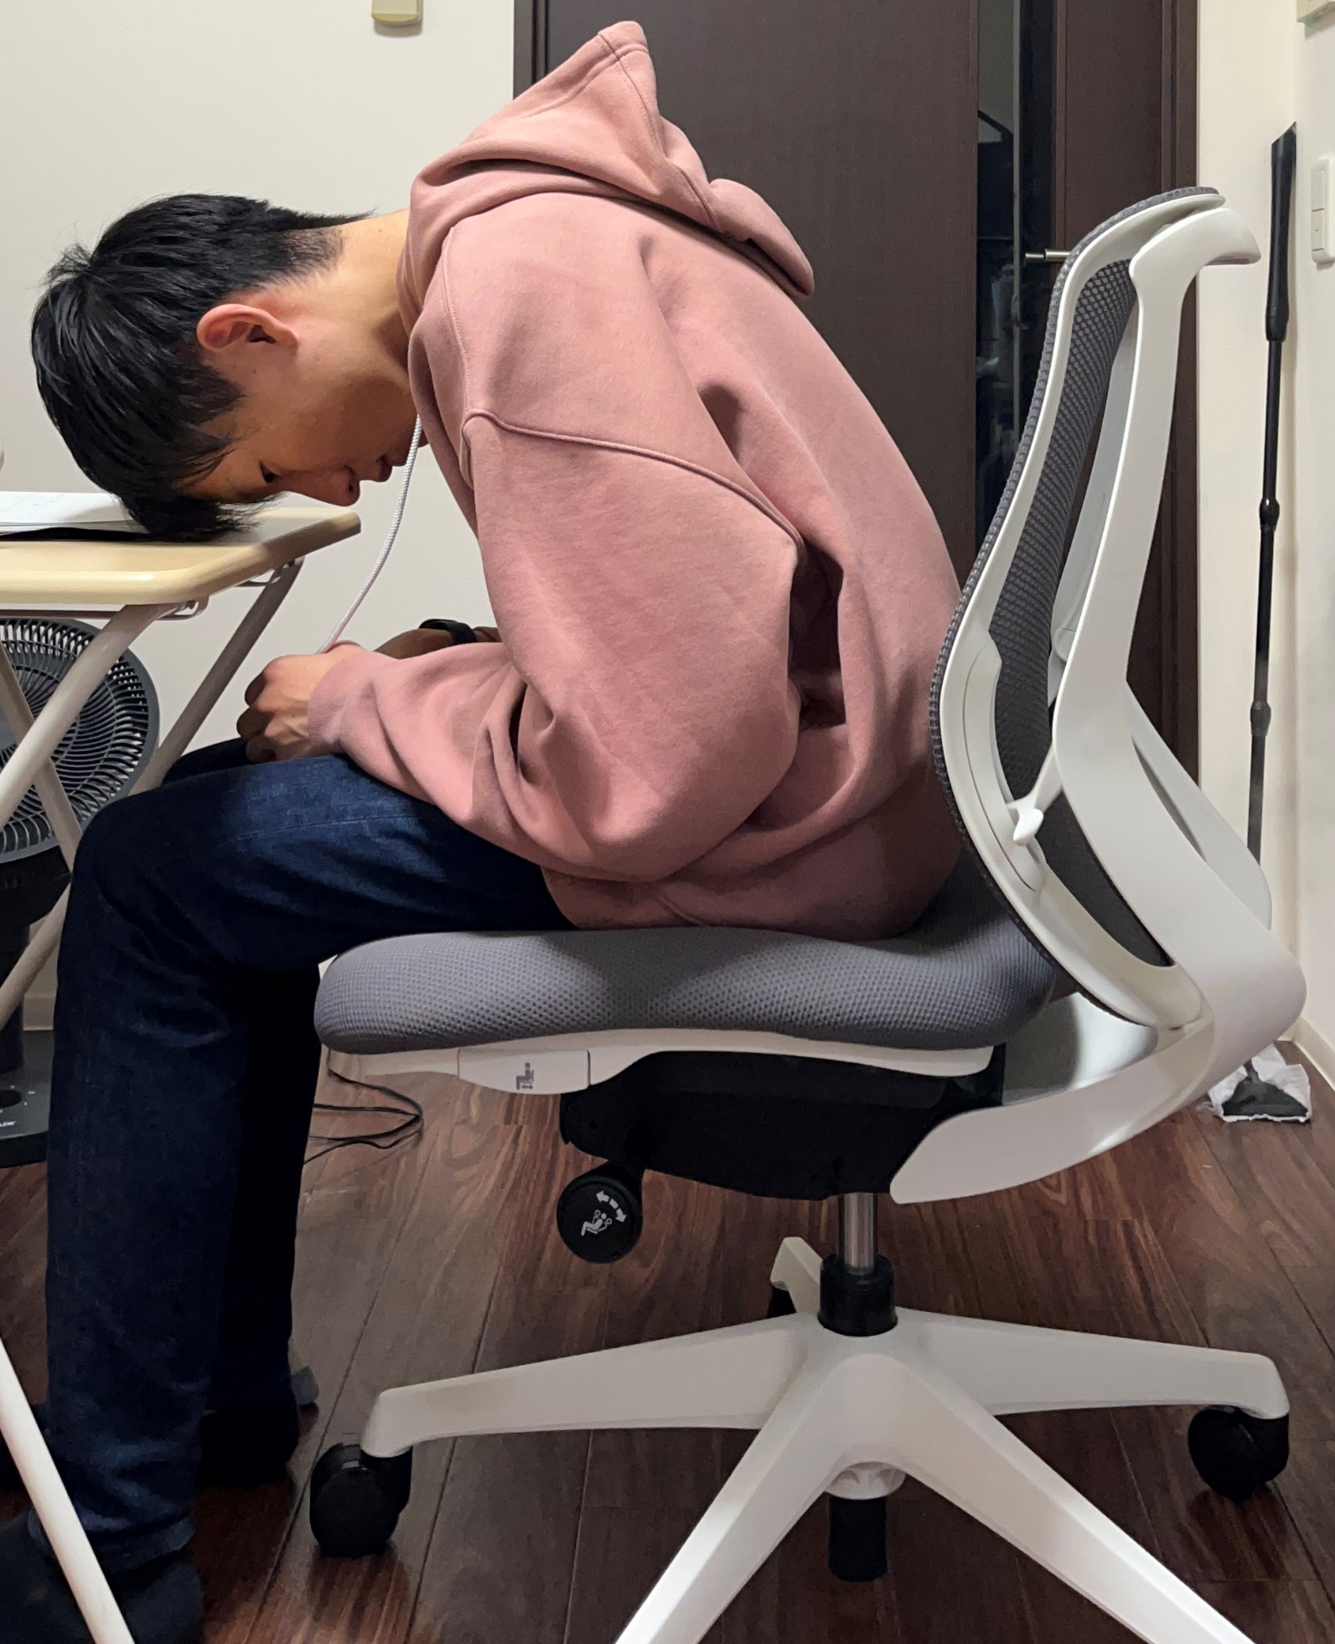
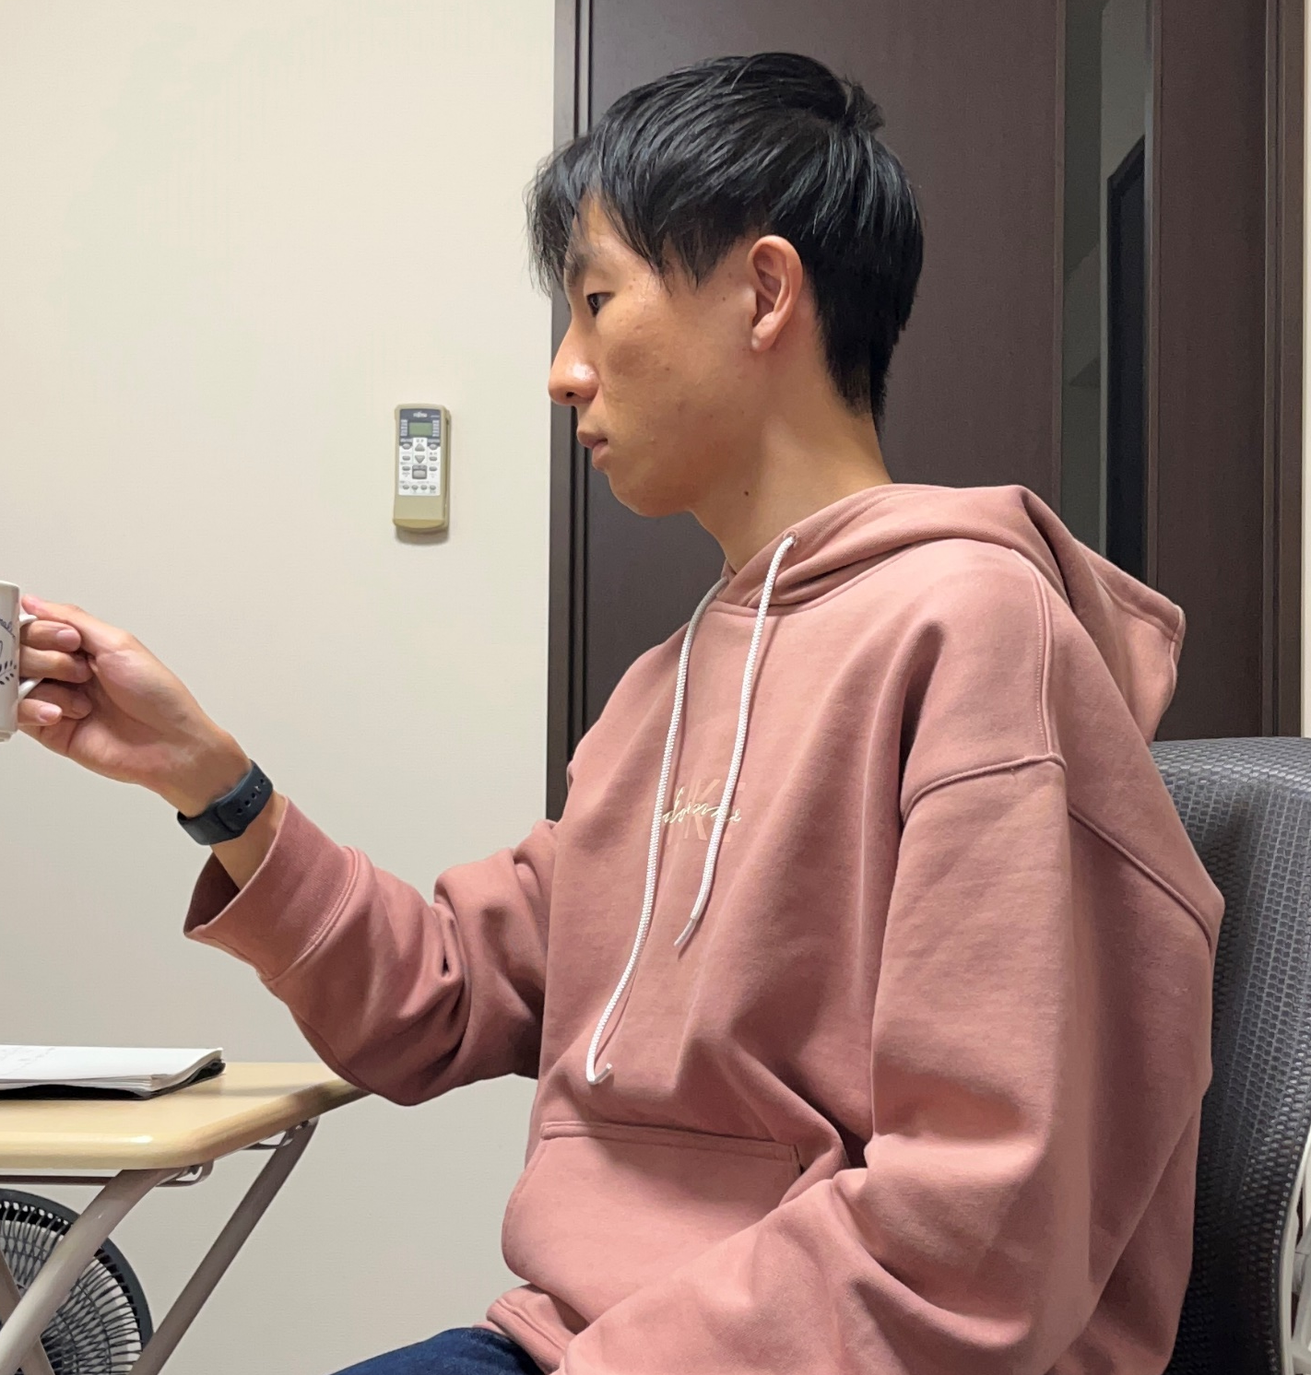
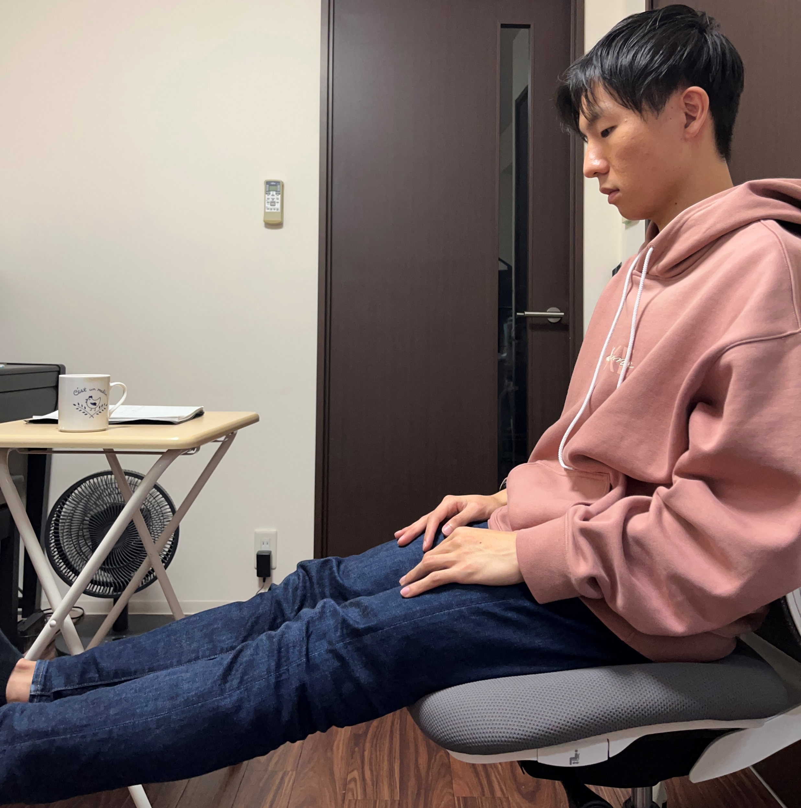






提案手法 事前処理 動作特徴量 姿勢特徴定義
Y
Y
Y
Y
X
X
θ
X
X
b
c
d
d
a
e

Slide 67



提案手法 事前処理 物体特徴量 システム図
BLIP-2 VQA
Binary encoding
Question 3
Answer (Text)
Feature value
(Binary)
Segmented RGB image
BLIP-2 VQA
Binary encoding
Answer (Text)
Feature value
(Binary)
Question 4
Find closest handrail
Position of the patient
Find closest handrail
Feature value (Normalized distance)
Facility map
Position of the closest handrail

Slide 68




提案手法 事前処理 人員特徴量 システム図
Calculate relative position vector
Calculate distance
Position of the patient
Feature value (Normalized distance)
Calculate velocity vector
Calculate relative angle
Position of the nurse
Feature value (Normalized angle)

Slide 69
提案手法 危険度評価 属性
Middle
Yes
Young
Middle
Old
1
1
Degree of membership
Degree of membership
O
0.25
0.4
0.5
0.7
1.0
risk
O
0.3
0.4
0.7
1.0
risk

Slide 70
提案手法 危険度評価 人員
1
1
1
×
Degree of membership
Degree of membership
Degree of membership
risk
O
1.0
risk
O
1.0
risk
O
0.5
1.0
1.5
1
1
1
×
Degree of membership
Degree of membership
Degree of membership
risk
O
1.0
risk
O
1.0
risk
O
0.5
1.0
1
1
1
×
Degree of membership
Degree of membership
Degree of membership
risk
O
1.0
risk
O
1.0
risk
O
0.5
1.0
1
1
1
×
Degree of membership
Degree of membership
Degree of membership
risk
O
1.0
risk
O
1.0
risk
O
0.5

Slide 71
非Fuzzy化
1
1
risk
risk
O
1
O
0.5
1.0
1.5
1
risk
O
0.5
1.0
1
risk
O
0.5
1.0
1
risk
O
1

Slide 72
提案手法 通知アルゴリズム フローチャート
Rank patients
Count patients who meet criteria
No
Ranking changed?
No
Exceed the nurse’s capacity?
No
Risk of 1st patient increased?
Yes
Yes
Yes
Send notification to other staff
Explain the most risky patient

Slide 73
機能フロー図
Start
Trigger observation
Observe
Evaluate risk
Choose notification
Send notification to staff
Ask other staff for help
End

Slide 74
階層構造図
Trigger
BLIP
Patient
Static
Attribution
Bounding box RGB image
Age
Internal
Trigger
Pose similarity evaluator
with YOLO
Action 1
Dynamic
…
…
Action
background differencing
RGB image
Action n
Total risk
Trigger
BLIP
Object 1
Static
…
…
Objects
Object n
External
Extracted PointCloud
Dynamic
Relative position calculator
Distance
Surrounding staff
: Fuzzy reasoning
: Pairwise comparison
: Others
: Process
: Information
Trigger
Direction

Slide 75
機能フロー図と評価システム図
Start
Trigger
BLIP
Patient
Static
Attribution
Observe
Bounding box RGB image
Age
Internal
Trigger preprocess
Trigger
Pose similarity evaluator
with YOLO
Action 1
Dynamic
…
…
Action
Preprocess
background differencing
RGB image
Action n
Total risk
Use previous data
Evaluate risk
Static
Trigger
BLIP
Object 1
…
…
Objects
Choose notification
Object n
External
Extracted PointCloud
Dynamic
Send notification to staff
Ask other staff for help
Relative position calculator
Distance
Surrounding staff
: Fuzzy reasoning
: Pairwise comparison
: Others
: Process
: Information
Trigger
Direction
End

Slide 76
機能フロー図とシミュレーションの対応付け
Start
Trigger observation
Observe
Evaluate risk
Choose notification
Send notification to staff
Ask other staff for help
End

Slide 77
N=1検証のシナリオ図
Handrail
‼
Wheelchair
Nurse
Infusion
pole
A
Out of sight
➡ Danger
Out of sight
➡ Danger
Wheelchair
Stand up
Stand up
B
C
t = 0 [s]
t = 2 [s]
t = 5 [s]
t = 7 [s]
t = 9 [s]

Slide 78
位置ランダム検証
Y
Patient A
with wheelchair and ivPole
5
Patient B
with wheelchair
3
Patient C
with no specific risks
3×₉P₄ trials
1
Nurse
O
1
3
5
X

Slide 79
通知アルゴリズム
Total risk
Stand up
Total risk
Static Node | Difference between patients
Objects (iv Pole) | 0.12
… | …
Attribution (Patient) | 0.01
Dynamic Node | Correlation with total risk
Stand up | 0.99
… | …
Move wheelchair | 0.01
『♬ Bさんが点滴をしているのに立ち上がったので危険です』
Stand up
『♬ Bさんが点滴をしているのに立ち上がったので危険です』
Static Node | Difference between patients
Objects (iv Pole) | 0.12
… | …
Attribution (Patient) | 0.01
Dynamic Node | Correlation with total risk
Stand up | 0.99
… | …
Move wheelchair | 0.01

Slide 80


Slide 81


