Slide 1
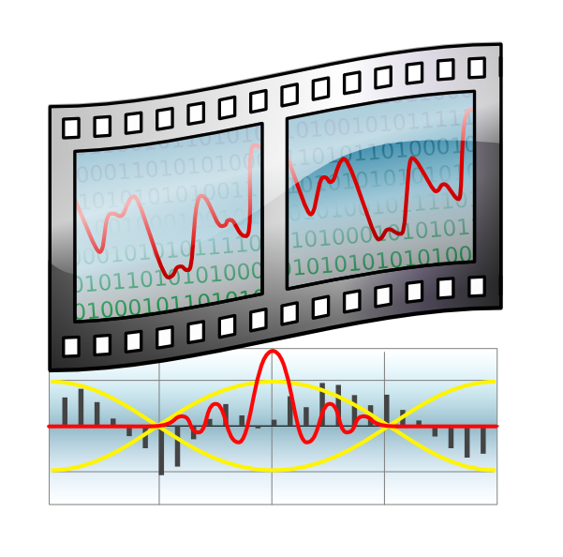
Theora Hardware Decoder
Felipe Portavales Goldstein
portavales@gmail.com

Slide 2

Theora Hardware Decoder
Profile Analisys
Simple Profile Analisys made with gprof :
% cumulative self self total
time seconds seconds calls ms/call ms/call name
14.88 21.08 21.08 3597 5.86 39.33 LoadAndDecode
10.52 35.99 14.91 9847971 0.00 0.00 FilterHoriz
10.51 50.88 14.89 3537252 0.00 0.00 ReconInterHalfPixel2
9.61 64.50 13.62 9861274 0.00 0.00 FilterVert
9.12 77.42 12.92 3597 3.59 29.22 ReconRefFrames
8.74 89.80 12.38 2905949 0.00 0.00 ReconInter
7.67 100.67 10.87 2809557 0.00 0.00 IDct10
5.19 108.03 7.36 845503 0.01 0.01 IDctSlow
4.33 114.16 6.13 21614069 0.00 0.00 ExtractToken
3.33 118.88 4.72 2080037 0.00 0.00 ReconIntra
2.77 122.81 3.93 7889638 0.00 0.01 ExpandBlock
2.15 125.85 3.04 3597 0.85 1.38 QuadDecodeDisplayFragments
2.10 128.83 2.98 4868178 0.00 0.00 IDct1
1.88 131.49 2.66 5361174 0.00 0.00 CopyBlock
1.85 134.11 2.62 18575043 0.00 0.00 ExpandToken
1.40 136.09 1.98 3597 0.55 8.48 LoopFilter

Slide 3
Theora Hardware Decoder
Profile Analisys
Functions that are interesting to be implemented in hardware :
LoopFilter
FilterHoriz
FilterVert
ReconInterHalfPixel2
ReconInter
ReconIntra
IDct10
IDctSlow
IDct1
ExpandBlock
Total cpu-time percentage consumed by these functions: 61 %

Slide 4
Theora Hardware Decoder
Profile Analisys
These functions are interesting to be implemented in hardware
because they are :
  very data-path intensive,
  very cpu-time consumer,
  and are self-contained, isolated from other functions

Slide 5
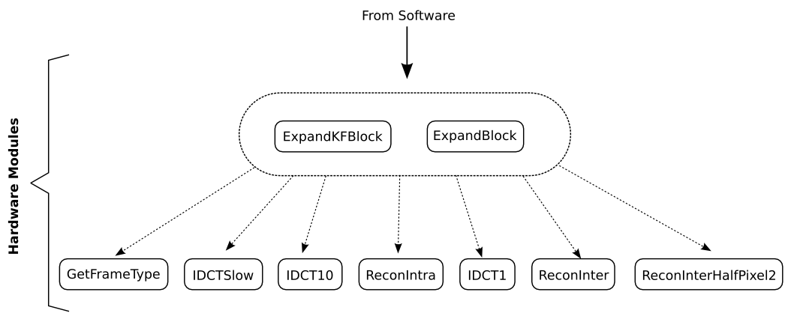
Theora Hardware Decoder
Data-path / pipeline
Piece of the call-graph:

Slide 6
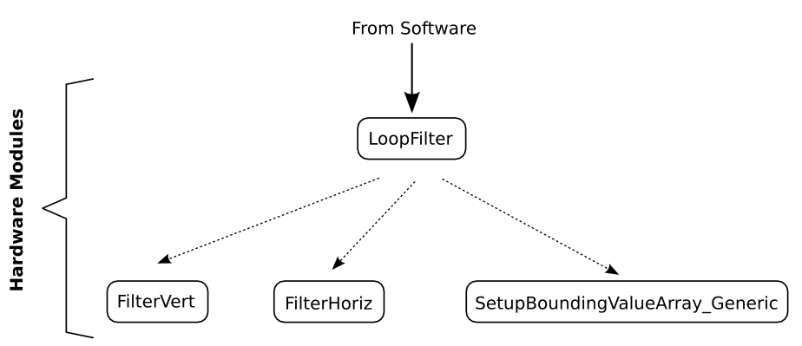
Theora Hardware Decoder
Data-path / pipeline
Piece of the call-graph:

Slide 7
Theora Hardware Decoder
Data-path / pipeline
These two branches of the call-graph are independent
and sugest us the implementation of two independent
acceleration pipelines

Slide 8
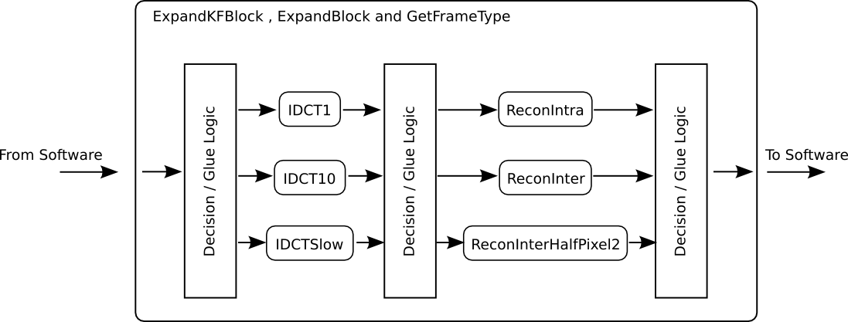
Theora Hardware Decoder
Data-path / pipeline
Pipeline 1
Sub-Modules:
ExpandKFBlock and ExpandBlock will be merged into same pipeline
and a Decision logic will control the pipeline

Slide 9
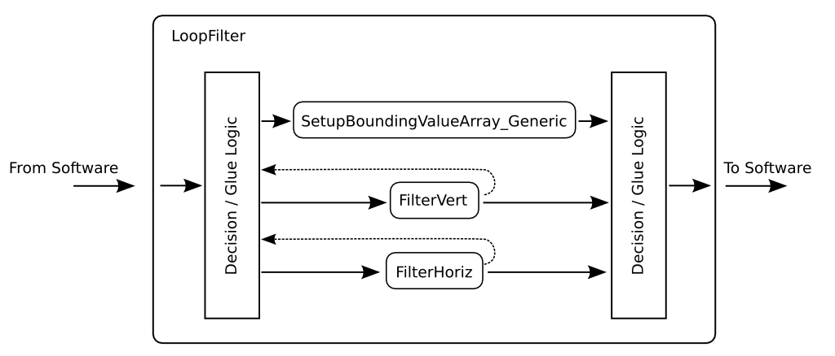
Theora Hardware Decoder
Data-path / pipeline
Pipeline 2
Sub-Modules:

Slide 10
Theora Hardware Decoder
Data-path / pipeline
Each sub-module will be developed independently and
can be tested with a direct bind to the software (even
without the entire pipeline). For example, the IDCTSlow
can be tested without the other sub-modules.
Later, all sub-modules will be integrated as the two
described pipelines.

Slide 11
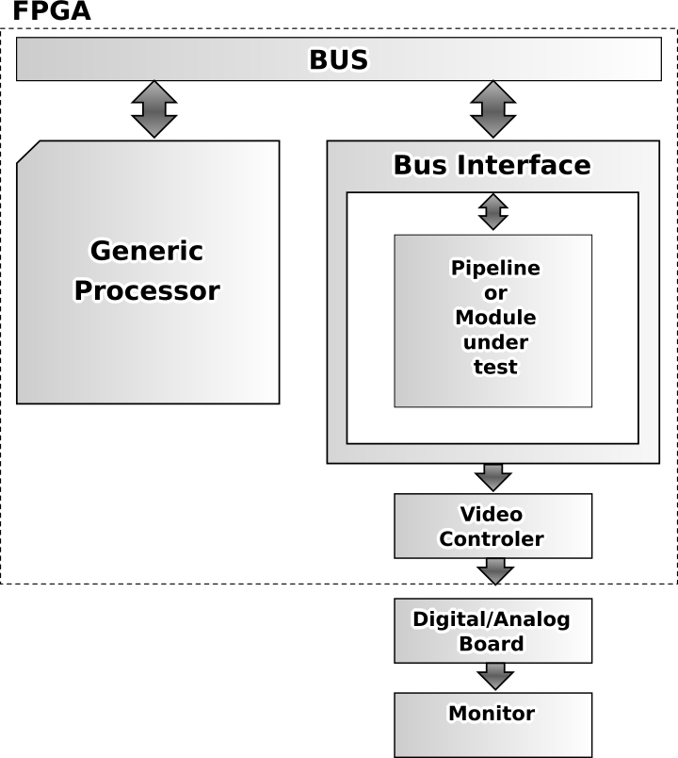
Theora Hardware Decoder
FPGA implementation

Slide 12
Theora Hardware Decoder
Felipe Portavales Goldstein
portavales@gmail.com

