Slide 1
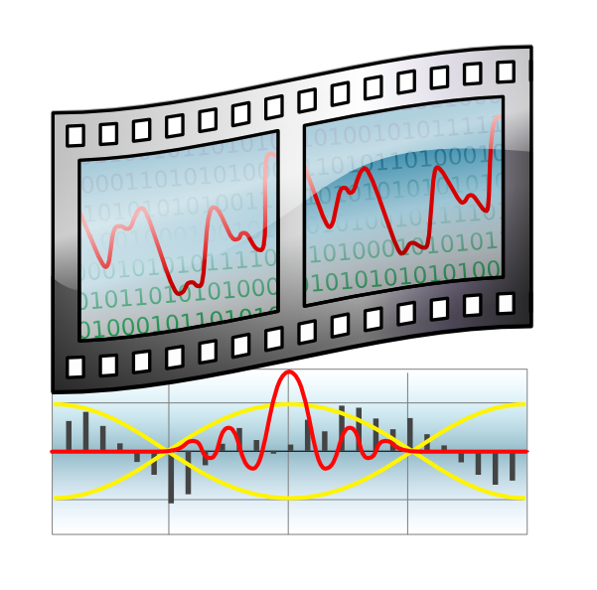
Video encoding: basic principles
Felipe Portavales Goldstein
portavales@gmail.com

Slide 2

Video encoding: basic principles
Color coding

Slide 3
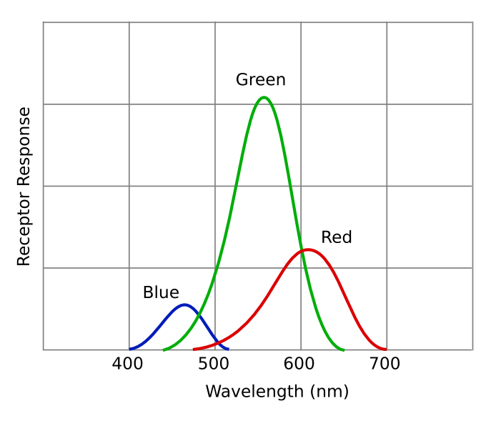
Video encoding: basic principles
Color coding
Human eye color perception

Slide 4
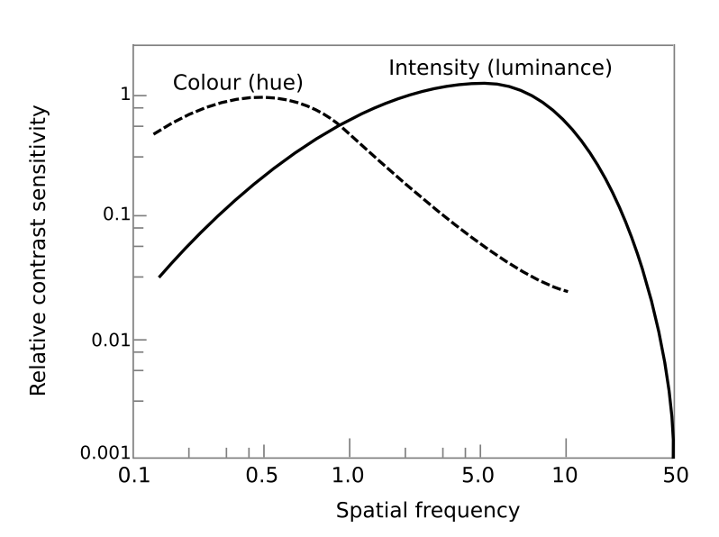
Video encoding: basic principles
Color coding
Human eye Colour x Luminance perception

Slide 5
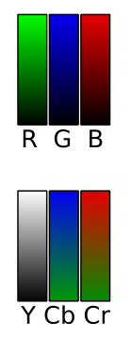
Video encoding: basic principles
Color coding
Human eye Colour x Luminance perception
R (8 bits) G (8 bits) B (8 bits)
Each color is coded separately
Y (8 bits) Cb (4 bits) Cr (4 bits)
Y : Luminance
Cb : Blue color
Cr : Red color
Green color is presense of luminance and absence of Blue and Red color

Slide 6
Video encoding: basic principles
Digital signals / sampling

Slide 7
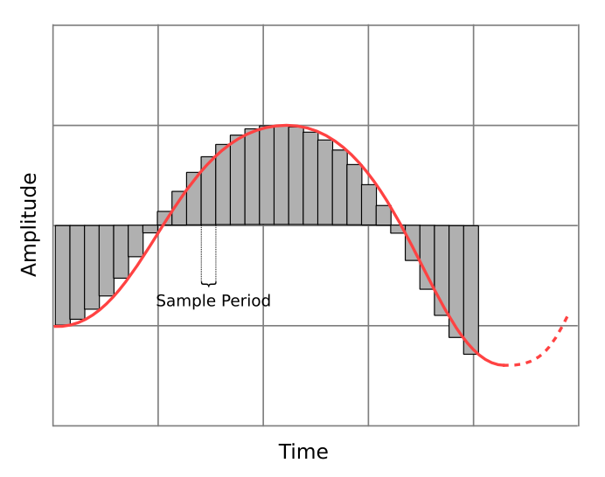
Video encoding: basic principles
Digital signals / sampling

Slide 8
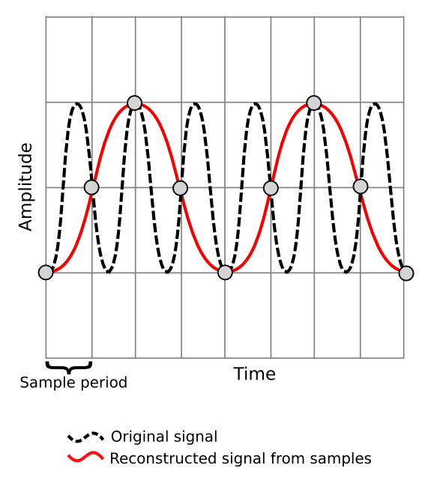
Video encoding: basic principles
Digital signals / sampling
Sampling Aliasing:
Sample rate must be
twice as input bandwidth

Slide 9
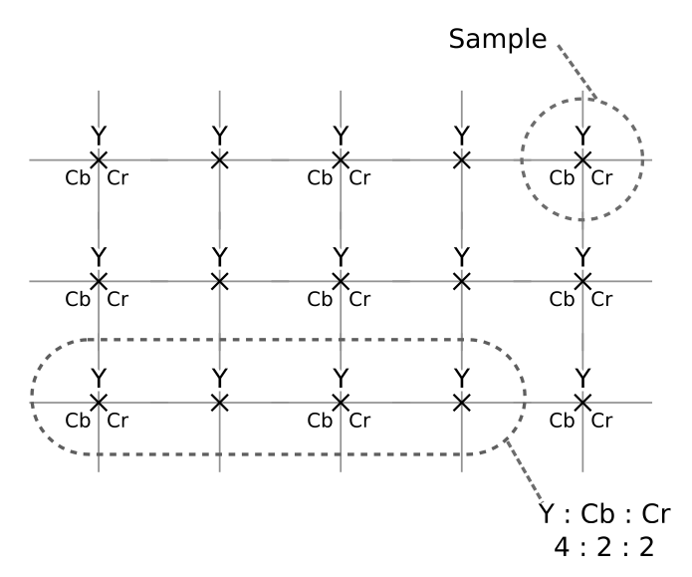
Video encoding: basic principles
Digital signals / sampling
Sampling images

Slide 10
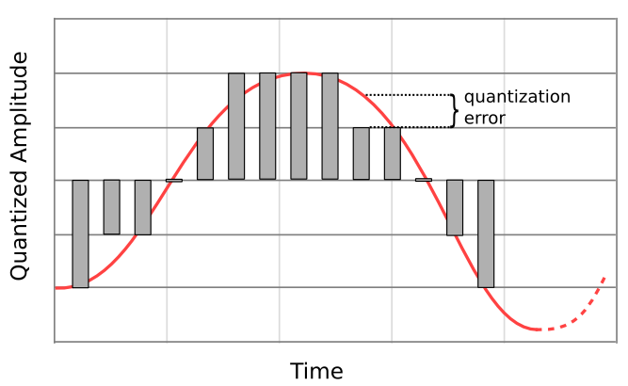
Video encoding: basic principles
Quantizing
7 possible quantized amplitude values:
need 3 bits to represent

Slide 11
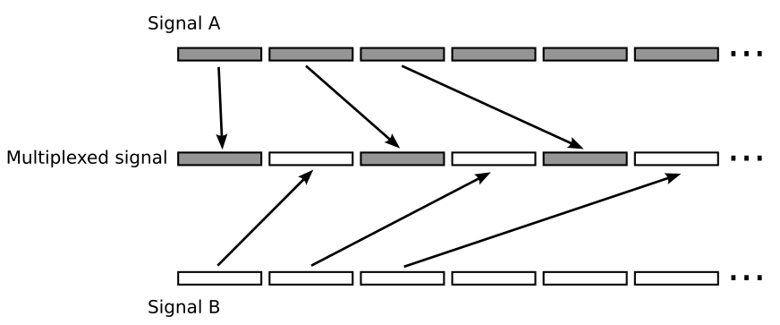
Video encoding: basic principles
Multiplexing

Slide 12
Video encoding: basic principles
Fourrier Transform

Slide 13
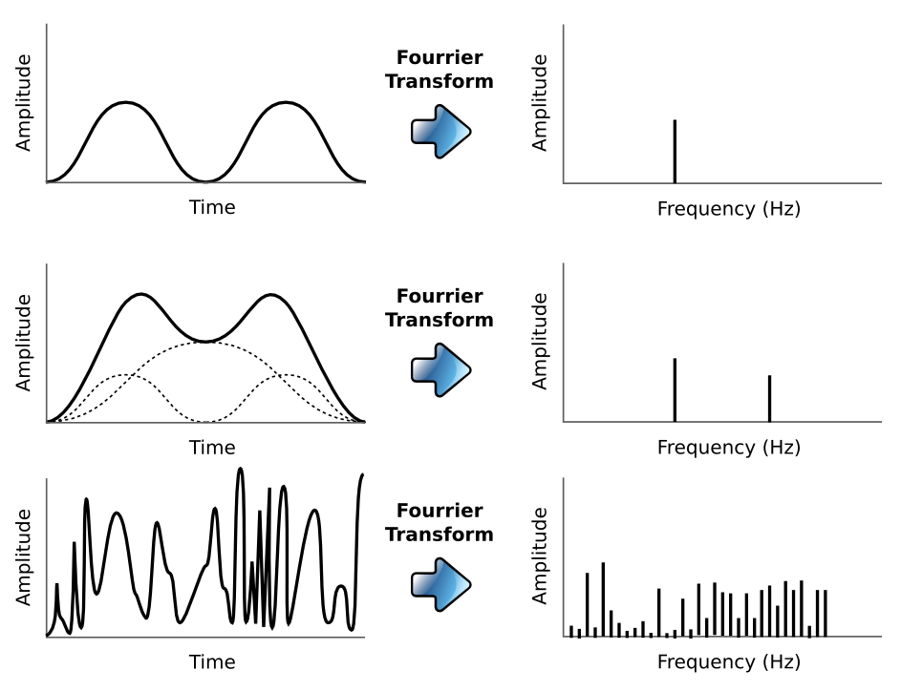
Video encoding: basic principles
Fourrier Transform

Slide 14
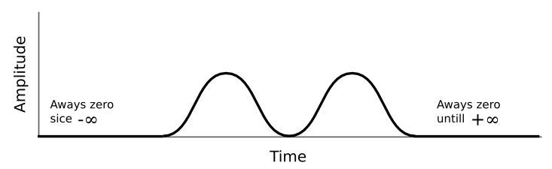
Video encoding: basic principles
Fourrier Transform
The transform must consider the complete signal history
to get the exact frequencies in the signal.
To apply the transform we must known the signal
behavior since -∞ to +∞
Is it possible ?
And, what if the signal behaves like this :

Slide 15
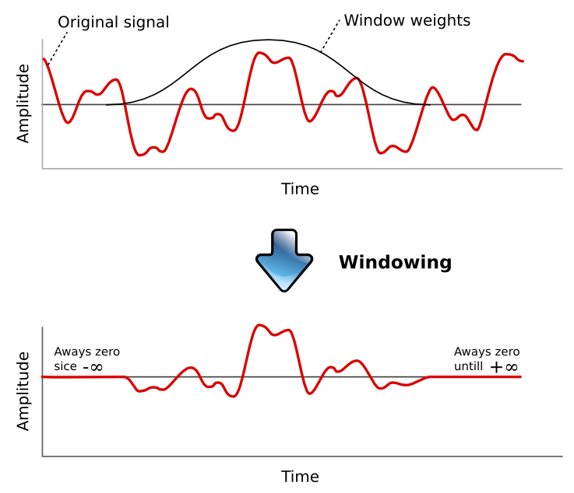
Video encoding: basic principles
Windowing
The windowing must be applied in the signal before
the Fourrier transform, to focalize the analysis

Slide 16
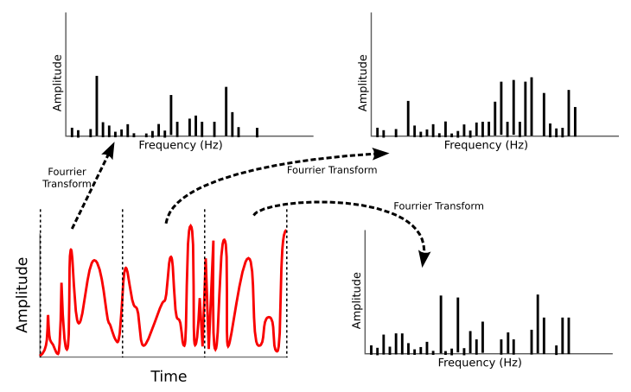
Video encoding: basic principles
Windowing
The windowing can be used to divide the signal
in small pieces, and transform them separately

Slide 17
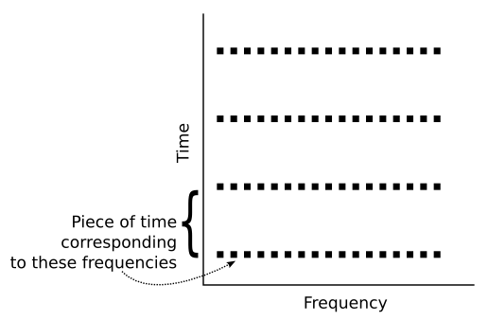
Video encoding: basic principles
Windowing
Another way to view:

Slide 18
Video encoding: basic principles
Windowing
The Heisenberg uncertainty principle states that:
the knowledge of the position of a particle is inversely
proportional to the knowledge of its energy
It is the same to say:
knowledge about time is inversely proportional to
knowledge about frequency
Position knowledge is relative to time
Energy knowledge is related to frequency

Slide 19
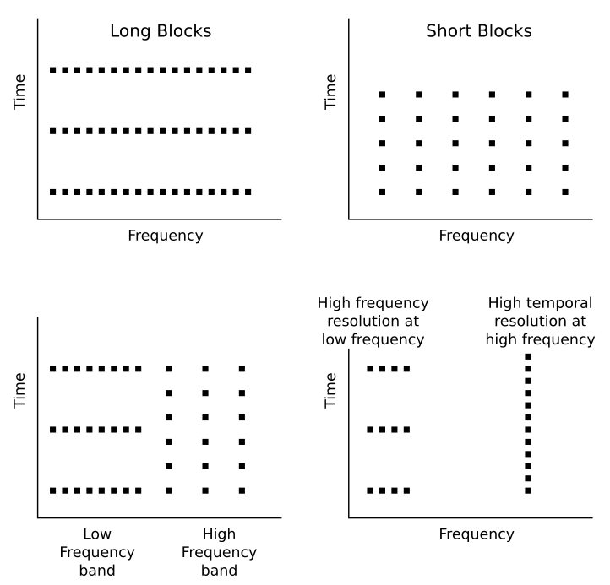
Video encoding: basic principles
Windowing

Slide 20
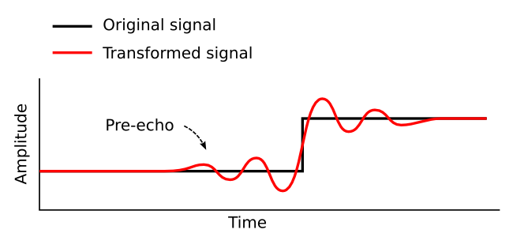
Video encoding: basic principles
Pre-echo

Slide 21


Video encoding: basic principles
Fourrier Transform in a image

Slide 22


Video encoding: basic principles
Fourrier Transform in a image

Slide 23


Video encoding: basic principles
Fourrier Transform in a image

Slide 24


Video encoding: basic principles
Fourrier Transform in a image

Slide 25

Video encoding: basic principles
Fourrier Transform in a image
This picture is the cover of book: MPEG-2 , John Watkinson , Focal Press

Slide 26
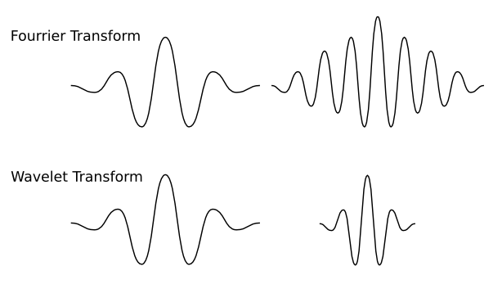
Video encoding: basic principles
Wavelet transform
Wavlet dont use endless sine wave functions as its basis,
but instead, use functions that are finite on time axis.
The window lenght is variable and is inversely proportional
to the frequency.
High frequencies are transformed with short basis functions
and therefore are accurately located. Low frequencies are
transformed with long basis functions which have good frequency
resolution.

Slide 27
Video encoding: basic principles
Frame subdivision

Slide 28
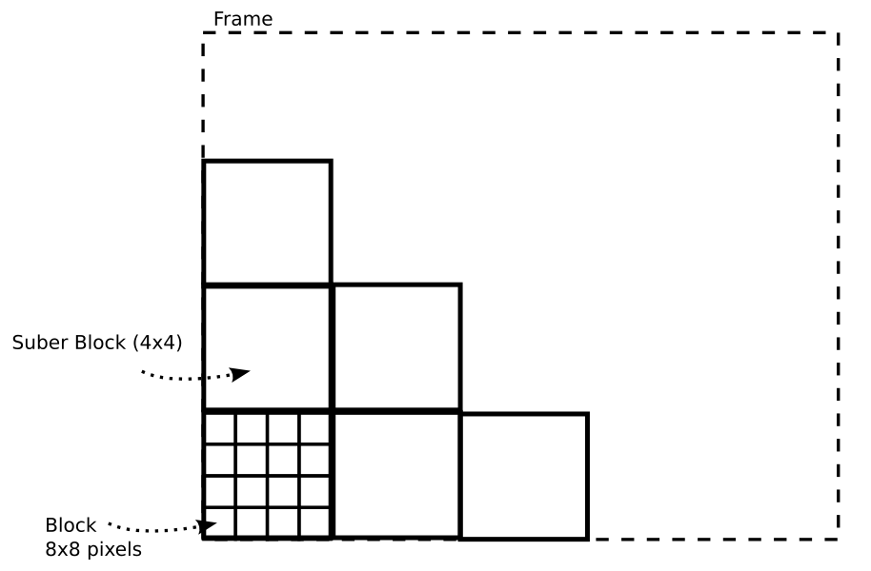
Video encoding: basic principles
Frame subdivision
Subdivision of a Frame into blocks and super blocks
Each color plane has its own set of blocks and super blocks

Slide 29
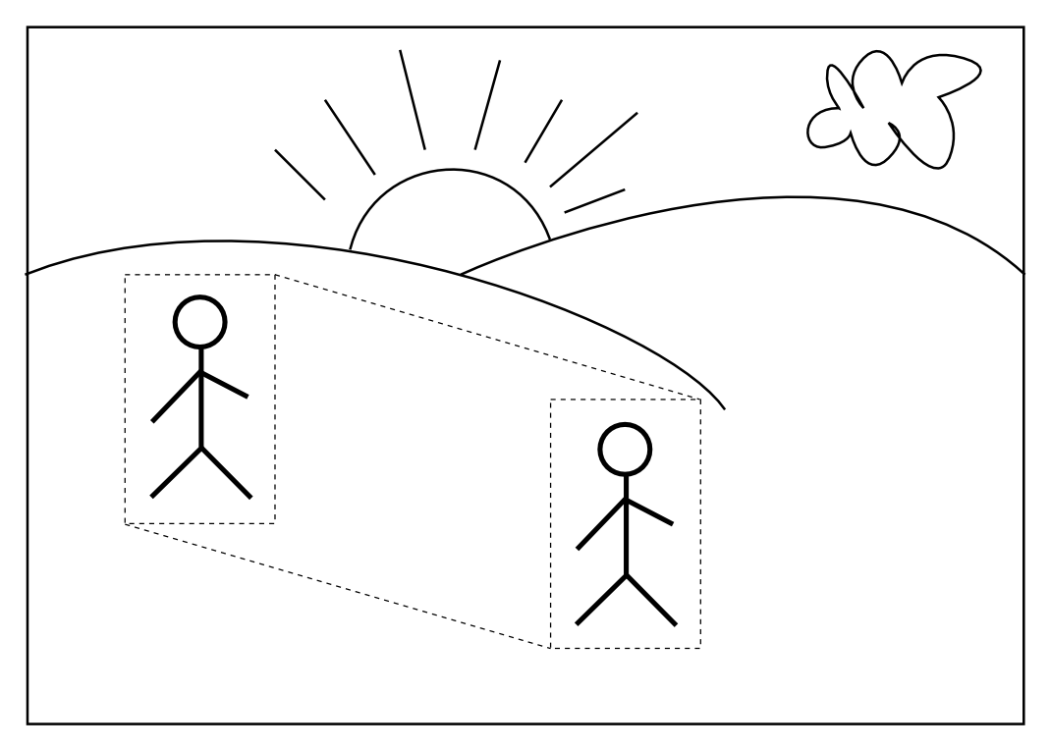
Video encoding: basic principles
Intra Frame
Intra-coding explores redundancy within a picture

Slide 30
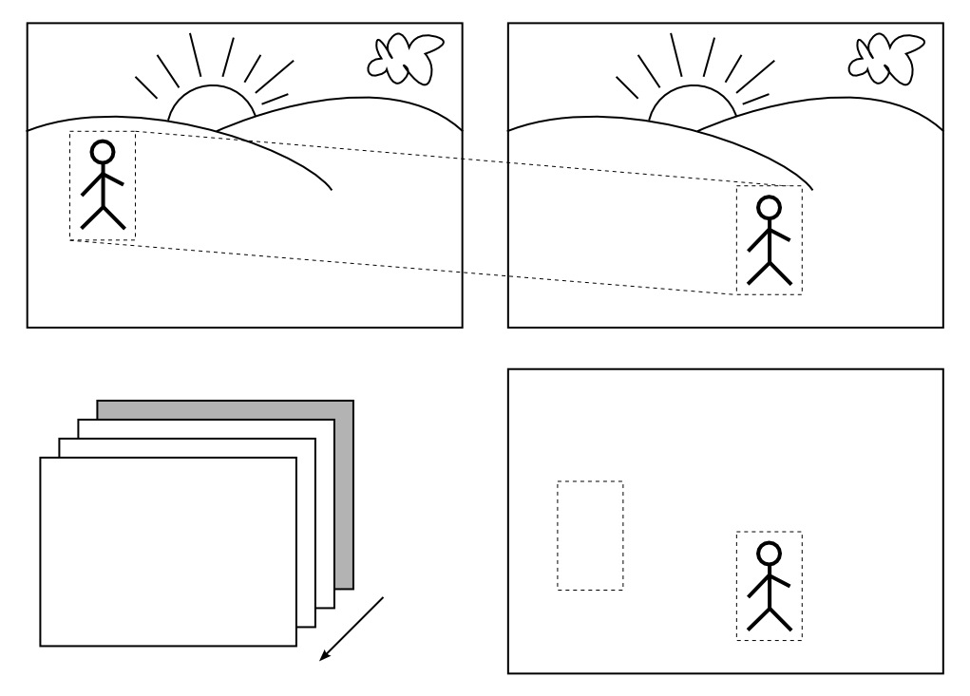
Video encoding: basic principles
Inter Frame
Inter-coding explores redundancy between pictures

Slide 31





Video encoding: basic principles
Inter Frame
Golden Frame (intra)
Inter Frames
Inter Frames
Coded frame

Slide 32
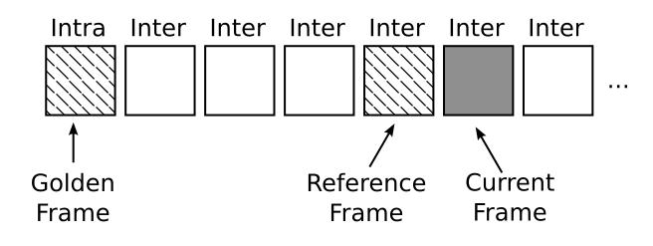
Video encoding: basic principles
Inter Frame

Slide 33
Video encoding: basic principles
References
Theora I Specification; Xiph.org Foundation
John Watkinson; MPEG-2 ; Focal Press
Martin Ruckert; Understanding MP3: Syntax, Semantics, Mathematics, and Algorithms ; Viewg
http://www.animemusicvideos.org/guides/avtech/video3.htm
http://www.complextoreal.com/tutorial.htm
http://cns-alumni.bu.edu/~slehar/fourier/fourier.html

