Slide 1
UNIT – I
Water Technology

Slide 2
Dissolved Oxygen (D.O.)
Dissolved oxygen is defined as the oxygen dissolved in water.Its concentration in water is 8 ppm at room temperature.
The amount of oxygen dissolved in water depends on physical, chemical and biological activities taking place in water.
According to Henry’s Law, the solubility of a gas is directly proportional to the absolute pressure. It means, if pressure is increased, there is increase in dissolved oxygen at given temperature.
Dissolved oxygen causes boiler corrosion.
Dissolved oxygen is determined by Winkler’s method of Iodometric titration.

Slide 3
Determination of Dissolved Oxygen by Winkler’s Method
Dissolved oxygen is usually determined by Winkler’s method.
It is based on the fact that dissolved oxygen oxidized potassium iodide (KI) to iodine.
The liberated iodine is titrated against standard sodium thiosulphate solution using starch indicator.
Dissolved oxygen in water cannot oxidize KI. Hence Manganese Hydroxide is used as an oxygen carrier to bring about the reaction between KI and Oxygen.
Manganese hydroxide, in turn, is obtained by the action of NaOH on MnSO₄.

Slide 4

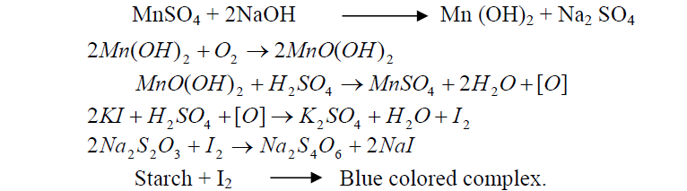
Reactions Involved

Slide 5
For Extra Reading:
Potential Health Impacts of Hard Water
Int J Prev Med. 2013 Aug; 4(8): 866–875.
PMCID: PMC3775162
Pallav Sengupta
A review of permissible limits of drinking water
Indian J Occup Environ Med. 2012 Jan-Apr; 16(1): 40–44.
doi: 10.4103/0019-5278.99696
PMCID: PMC3482709
Manoj Kumar and Avinash Puri¹
PMC - US National Library of Medicine National Institutes of Health

Slide 6
Sewage is the liquid waste which includes domestic wastes, industrial wastes, street washings, ground wastes and storm waters.
It consists of organic and inorganic matters, dissolved, suspended and colloidal substances.
Sewage contains both aerobic and anaerobic bacterias from natural sources or synthetic which is the result of waste water discharge.
These bacterias can bring oxidation of organic compounds present in it.
In the waste water, the dissolved oxygen is rapidly consumed in biological aerobic decay which would affect the quality of water and aquatic lives.

Slide 7
Biochemical Oxygen Demand (BOD)
Biological oxygen demand (BOD) is a quantitative measure of oxygen required for the biological oxidation of the organic matter in a polluted water sample or industrial effluents under aerobic conditions during five days incubation period at 20ºC
The unit of BOD is mg/litre or ppm. An average sewage has BOD of 100 to 150 mg/litre.
BOD value indicates the amount of decomposable organic matter in the sewage.
Larger the concentration of decomposable organic matter, greater the BOD.
It gives information about the extent of pollution and serves as a guideline for environmental protection agencies to check the quality of effluents discharged into such water bodies.

Slide 8
Chemical Oxygen Demand (COD)
Chemical Oxygen Demand (COD) of a sample indicates the measurement of the oxygen equivalent of organic matters in a sample that is susceptible to oxidation by strong chemical oxidants
it is a measure of any kind of oxidisable impurities whether it is biologically oxidisable or biologically inert organic matter present in the sewage sample.
COD values of a sample is generally greater than the BOD values.
The value of COD is important and quickly measured parameter for stream and industrial waste water analysis and waste treatment plants.
Its determination takes about 3h compared to 5 days for BOD determination. (V₁ – V₂) X N₁ X 8 X 1000
COD = -------------------------------------- ppm
V₃

Slide 9
Determination of COD
It is very important parameter in designing and management of the treatment plants. COD test does not differentiate between bio inert and bio degradable materials.
The COD is determined by refluxing the sample in the presence of excess K₂Cr₂O₇, which serves as oxidizing agent.
The solution is acidified with H₂SO₄, and Ag₂SO₄ (catalyst)
Mercuric sulfate, HgSO₄, is added to complex any chloride that is present, thus preventing precipitation of the Ag⁺ catalyst as AgCl.
After refluxing for 30 min, the solution is cooled to room temperature, and the excess Cr₂O₇²⁻ is determined by a back titration, using ferrous ammonium sulphate (FAS) as titrant and ferroin as indicator.
Since it is difficult to completely remove all traces of organic matter from the reagents, a blank titration must be performed. The difference in the amount of FAS needed to titrate the blank and the sample is proportional to COD.

Slide 10
pH
pH of water in the range <6.5 or >8.5 is considered as harmful.
The sources to impart such pH are carbonates, bicarbonates, CO₂, industrial contaminants (pH 3.6-8.4), mineral acids (pH 3.5 or below).
Highly acidic water (pH<6.5) causes corrosion to pipes
Highly basic water (pH >8.5) causes staining.
Highly acidic water is treated using calcite neutralizer and alkaline water is by dealkalyzer.

Slide 11
Total Dissolved Solids (TDS)
The source of dissolved solids is various kinds of minerals present in water.
It can be determined taking a known amount (say 100 mL) of water and by evaporating the contents carefully to dryness.
The residue (W gm) left after evaporation of the filtered sample shows the total dissolved solids present in that particular water sample.
T.D.S. must be less than 500 ppm in potable water.
TDS = (W/100) x 10⁶ mg/L or ppm

Slide 12
Scale / Sludge
As water evaporates continuously in the boilers, the concentration of dissolved salts increase progressively
At its saturation point, thrown out in the form of precipitate
Loose, slimy – Sludge; Hardened adhering coating – Scale
SLUDGE:
Easily scrapped off.
Colder portions of the boilers near bents and joints where the flow of water is slow.
Formed by substances having greater solubilities in hot water than in cold water (MgCO_{3,} MgCl₂, CaCl₂ , MgSO₄ etc.,)

Slide 13
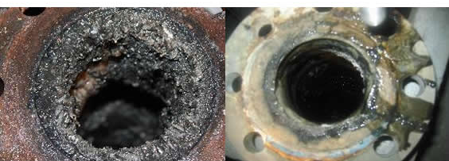
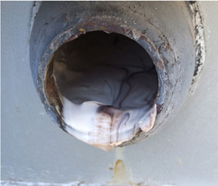
Scale and sludge formation in boilers

Slide 14
Disadvantages / Prevention of Sludge
Wastage of heat generated
Possibility of getting entrapped with the scale and hence very difficult to remove
Affects the working of boiler by getting deposited and causing choking of pipes
Can be prevented by using softened water and by carrying out frequent blow-down operation

Slide 15
Scales
Hard and very firm deposits on the inner surfaces – Difficult to remove.
Chemical constituents contributing for scale formation are CaCO₃, CaSO₄, Mg(OH)_{2,} and silicates of Ca and Mg.
Source of silicates – sand filters
Solubility of calcium sulphate decreases with increase in temperature
Calcium carbonate – problem in low pressure boilers whereas in high pressure boilers becomes soluble
Ca(HCO₃)₂ CaCO₃ + H₂O + CO₂
CaCO₃ + H₂O Ca(OH)₂ (Soluble) + CO₂
MgCl₂ + 2H₂O Mg(OH)₂ + 2HCl

Slide 16
Disadvantages of scale
Wastage of fuel: due to low thermal conductivity – increased fuel consumption to provide steady supply of heat to water.
Lowering of boiler safety – overheating leads to damage to boiler parts.
Decrease in efficiency: Deposits in valves and condensers and create chokes.
Danger of explosion: due to the development of high pressure because of sudden cracks that are formed in cracks
REMOVAL OF SCALES:
Physically removing if it is loosely adhering
Thermal shocks: Heating and immediate cooling
By adding chemicals (CaCO₃ by 10% HCl; CaSO₄ by EDTA
Frequent blow down operations

Slide 17
PREVENTION OF SCALE FORMATION
External treatment - Softening of water
Lime – Soda method
Zeolite or Permutit method
Ion-exchange, deionization and demineralization
Mixed bed deionizer
Internal treatment – chemical treatment
To precipitate scale forming impurities in to sludge and subsequent removal by blow-down operation
To convert into dissolved form by adding complexing agents.

Slide 18
Internal conditioning
Colloidal conditioning
Phosphate conditioning
3CaCl₂ + 2Na₃PO₄ Ca₃(PO4)₂ + 6NaCl
Carbonate conditioning
CaSO₄ + Na₂CO₃ CaCO₃ + Na₂SO₄
Calgon conditioning
Na₂[Na₄(PO₃)₆] 2Na⁺ + [Na₄P₆O₁₈]²⁻
2CaSO₄ + [Na₄P₆O₁₈]²⁻ [Ca₂P₆O₁₈]²⁻+ 2Na₂SO₄
Sodium aluminate treatment
NaAlO₂ + 2H₂O NaOH + Al(OH)₃
MgCl₂+ NaOH Mg(OH)₂ + 2NaCl
Electrical conditioning
Radioactive conditioning
Complexometric method

Slide 19
Caustic embrittlement
Boiler corrosion caused by using highly alkaline water in the boiler.
In high pressure boilers, Na₂CO₃ present in softened water decomposes to give NaOH and CO₂
Na₂CO₃ + H₂O 2NaOH + CO₂
Avoided
Using Na₃PO₄ instead of Na₂CO₃
Tannin and lignin or Na₂SO₄blocks the hair cracks and prevents accumulation of soda.

Slide 20
Priming / Foaming
Wet steam formation – Priming; Along with the steam the particles present in it is carried along with it.
Production of persistent foam or bubbles which do not break easily – Foaming; due to the presence of certain impurities that facilitate foaming. alkalis, oils, fats, greases, certain types of organic matter and suspended solids are particularly conducive to foaming.
Priming is Caused due to
Presence of large amount of dissolved solids
High steam velocities
Sudden boiling
Improper boiler design
Sudden raise in steam production rate

Slide 21
Priming and Foaming
Both occurs together
Causes
Reduces efficiency and damages the machine parts
Avoided by
Priming – steam purifiers; avoiding rapid change of steaming rate; maintaining low water levels and proper softening of water
Foaming – antifoaming agents like castor oil; gallic acid and tannic acid removing oil by adding compounds like sodium aluminate

Slide 22
Boiler corrosion
Decay of boiler material by chemical or electrochemical attack by surrounding environment.
Reasons for boiler corrosion are:
a) Dissolved oxygen
b) Dissolved carbon dioxide
c) Acids from dissolved salts
Dissolved oxygen (DO):
2 Fe + H₂O + O₂ 2 Fe(OH)₂
2 Fe(OH)₂ + O₂ 2 Fe₂O₃.2H₂O
DO can be removed by adding calculated qty. of sodium sulphite or hydrazine or sodium sulphide:
2 Na₂SO₃ + O₂ 2 Na₂SO₄
N₂H₄ + O₂ N₂ + 2H₂O
Na₂S + 2O₂ Na₂SO₄
DO can be removed by mechanical deaeration also.
Rust or corrosion

Slide 23
Boiler corrosion
b) Dissolved CO₂:
Dissolved CO₂ forms carbonic acid which corrodes the boiler
slowly.
CO₂ + H₂O H₂CO₃
CO₂ is removed by adding calculated quantity of ammonia:
2 NH₄OH + CO₂ (NH₄)₂CO₃ + H₂O
It is also removed by mechanical deaeration along with oxygen.
c) Acids from dissolved salts:
Dissolved magnesium salts hydrolyse to form acids:
MgCl₂ + 2 H₂O Mg(OH)₂ + 2 HCl
This acid reacts with boiler and corrodes:
Fe + 2 HCl FeCl₂ + H₂
FeCl₂ + 2 H₂O Fe(OH)₂ + 2 HCl
Small quantity of magnesium salts will large amount of boiler corrosion

Slide 24
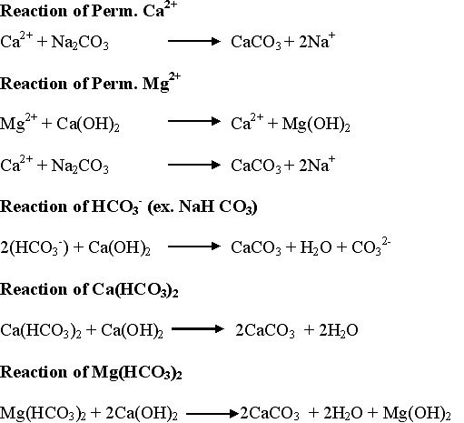
Lime Soda Process - Reactions of Lime and Soda

Slide 25
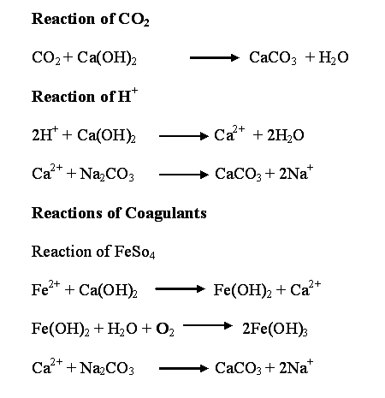

Slide 26
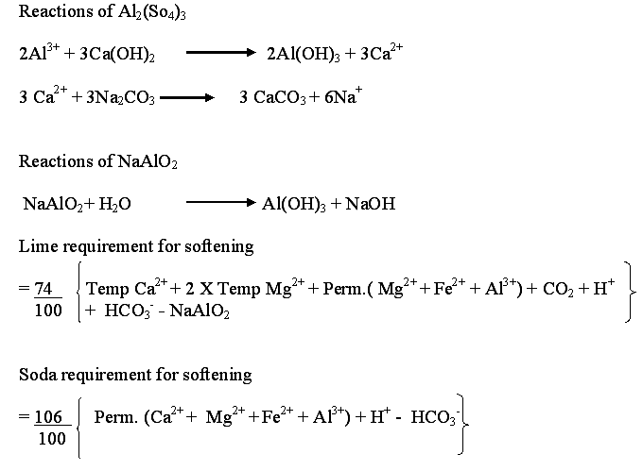

Slide 27
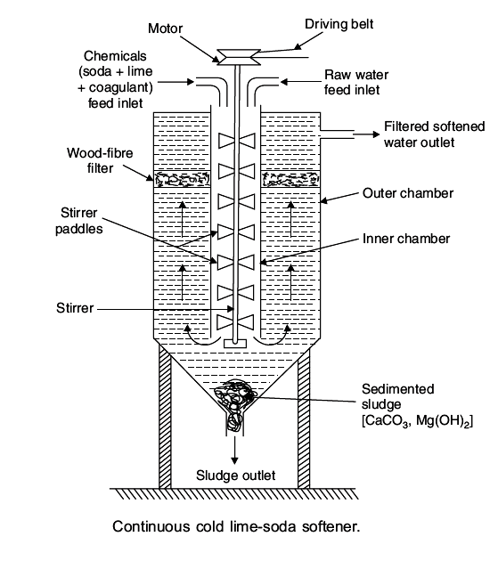

Slide 28
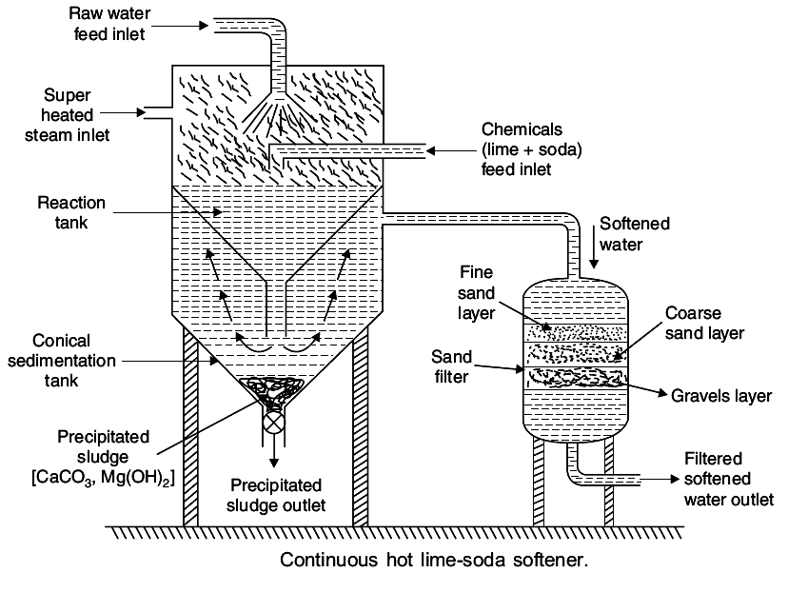

Slide 29
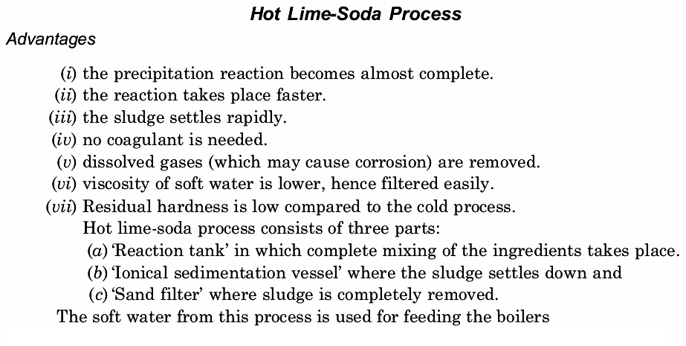

Slide 30
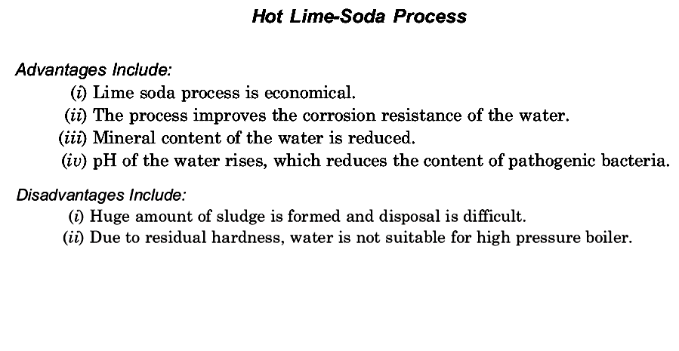

Slide 31
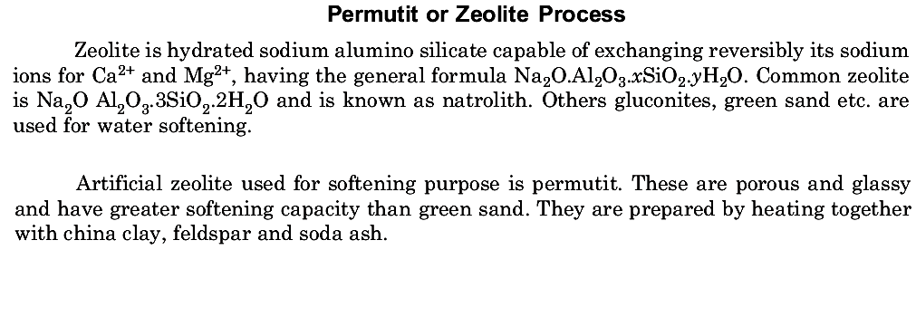
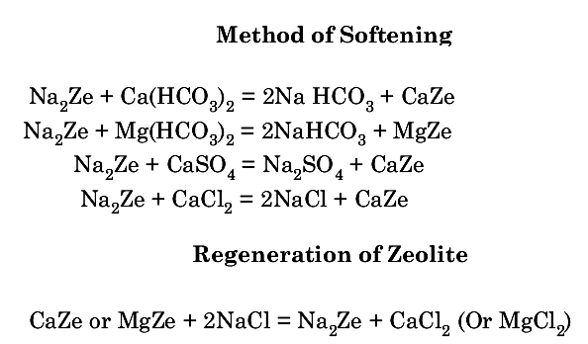

Slide 32
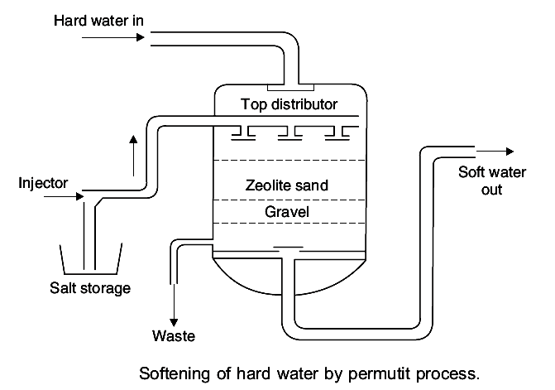

Slide 33
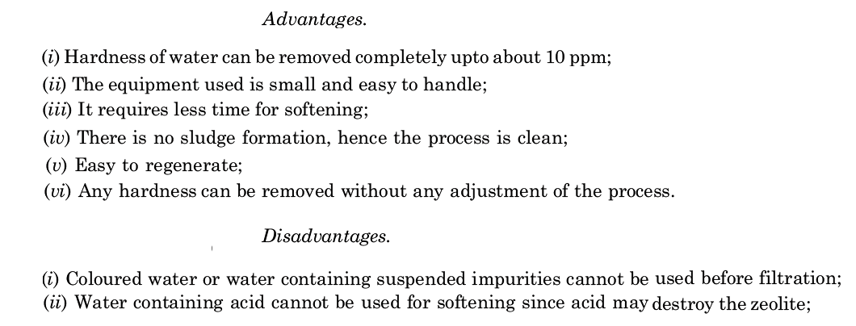

Slide 34
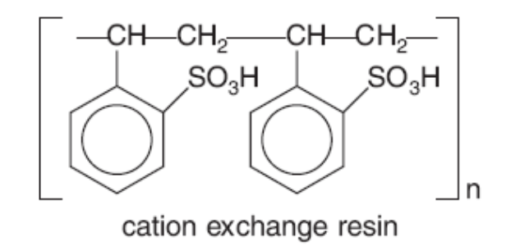
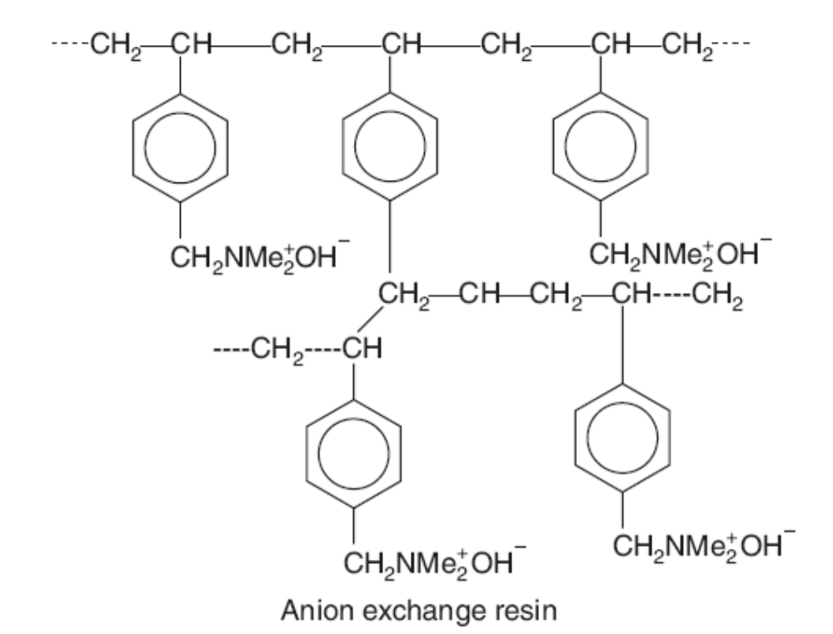
Ion Exchange resin

Slide 35
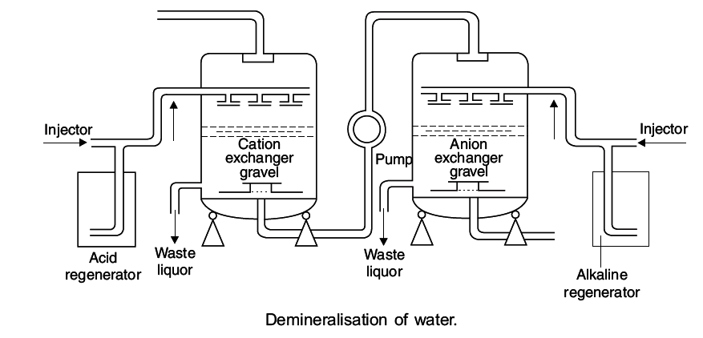

Slide 36
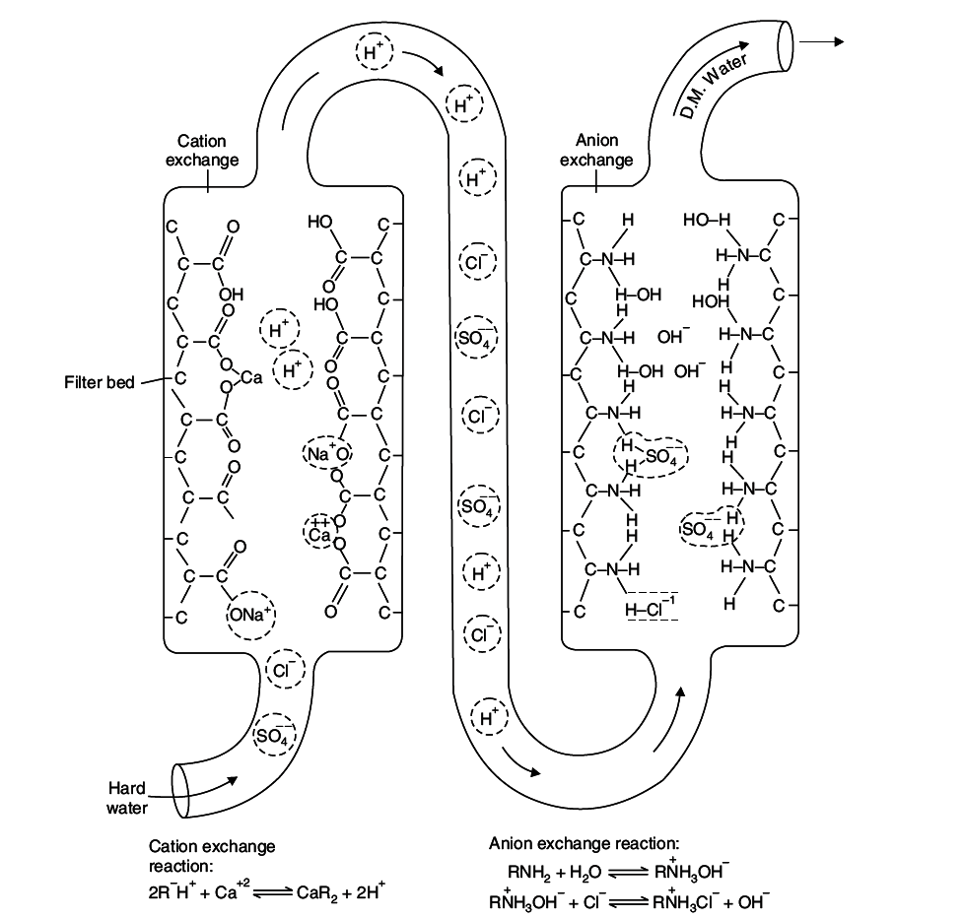


Slide 37
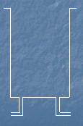
Mixed bed ion-exchanger
Contains intimate mixture of cation and anion exchangers
Water is in contact for a no. of times with the two exchangers alternatively
Raw water
inlet
Anion exchanger
(low density)
NaOH
Mixed ionizer
bed
Mixed
ionizer
bed
Exhausted mixed
ionizer bed
H₂SO₄
Cation exchanger
(higher density)
Backwash
water
Comp.
air
Washings to
sink
Deminaralised
water

Slide 38
Treatment of water for municipal supply
Drinking or potable water should be safe to drink and should satisfy the following requirements:
Sparklingly clean and odourless
Pleasant in taste
Perfectly cool
Turbidity should not exceed 10 ppm.
Free from objectionable minerals like Pb, As, Cr and Mn
Free from dissolved gases like H₂S
Alkalinity should not be too high (pH should be around 8.0)
Should be reasonably soft
TDS should be less than 500 ppm
Free from pathogenic microorganisms

Slide 39
STAGES
Screening
Sedimentation / Coagulation
Al₂(SO₄)₃ + Ca(HCO₃)₂ 2Al(OH)₃ + 3CaSO₄ + 6CO₂
NaAlO₂ + 2H₂O Al(OH)₃ + NaOH
MgSO₄ + 2NaOH Mg(OH)₂ + Na₂SO₄
FeSO₄ + Mg(HCO₃)₂ Fe(OH)₂ + MgSO₄ + CO₂
Filtration
Removal of microorganisms (Disinfection)

Slide 40
Filtration and disinfection
Filtration: Filtration is a process of removing colloidal matter, most f the microorganisms etc.
Filtration is carried out using Sand Filter bed containing coarse and fine sand layers through which water is passed.
Disinfection:
Removal of microorganisms: The process of destroying pathogenic microorganisms etc., from water is called “Disinfection”.
Disinfection can be carried out by:
By boiling: Boiling for 15 minutes to kill all microorganisms.
This cannot prevent growth of microrganisms again.

Slide 41
Disinfection contd…
By adding bleaching powder: 1 kg. of bleaching powder is added per 1000L of water and allowed to stand for several hours.
CaOCl₂ + H₂O Ca(OH)₂ + Cl₂
Cl₂ + H₂O HCl + HOCl (Hypochlorous acid)
Microorganisms + HOCl microorganisms are killed
Drawbacks:
Bleaching powder introduced calcium to water increasing the hardness.
Bleaching powder deteriorates on storage for a long time
Excess beaching powder will gives bad taste and smell to the water.

Slide 42
Disinfection contd..,
3. By Chlorination: Chlorine (gas or concentrated liquid) produces hypochlorous acid which destroys the microorganisms
Cl₂ + H₂O HOCl + HCl
HOCl H⁺ + OCl⁻ (Hypochlorite ion)
This HOCl inactivates the enzymes of microorganisms.
By Liquid chlorine: Liquid chlorine is found to be most effective and most widely used disinfectant throughout the world.
A Chlorinator is used for adding adequate quantity of chlorine so that the residual chlorine is 0.3 to 0.5 ppm. in treated water.
While chlorination,
time of contact (depends on no. of microorganisms)
temperature of water (higher temperature will kill microrganisms faster)
pH of water (lower pH of water, say 5-6.5, needs lower contact time)

Slide 43
Chlorination of water
Advantages of chlorine:
Effective and economical
Needs very little storage space
Chlorine is stable and does not deteriorate
Can be used at low and high temperatures
Does not introduce any salt impurities to water
Disadvantages of chlorine:
Excess of chlorine produces characteristic smell and taste
It also causes irritation to mucus membrane
Residual chlorine should not exceed 0.1-0.2 ppm.
It is most effective below pH 6.5 and not very effective at higher pH.

Slide 44
Diagram of chlorinator
Raw water
inlet
Concentrated
chlorine solution
Baffle plates
High tower
Sterilized water outlet

Slide 45
Break-point chlorination
Oxidn. Of reducing compounds by chlorine
Formation of
chloro-organic
compounds and
chloramines
Destruction
of chloro-
organic
compounds
and
chloramines
Free residual
chlorine
d
Residual chlorine
b
c
a
Applied dosage of chlorine

Slide 46
Advantages of break point chlorination
Oxidises the organic compounds, ammonia and other reducing compounds completely
Removes colour from water
Destroys 100% of the microorganisms
Removes bad smell and taste of water
Dechlorination:
Excess chlorine beyond the break-point produces bad taste and smell.
Excess chlorine can be removed by:
Passing the excess chlorinated water through a bed of carbon
Adding activated carbon and allowing a short reaction time
Adding small quantities of sulphur dioxide or sodium sulphite or sodium thiosulphate:
SO₂ + Cl₂ + 2H₂O H₂SO₄ + 2 HCl
Na₂SO₃ + Cl₂ + 2H₂O Na₂SO₄ + 2 HCl
Na₂S₂O₃ + Cl₂ + H₂O Na₂SO₄ + 2 HCl + S

Slide 47
Disinfection Methods
Disinfection methods used for disinfecting water for drinking purpose are
- Ultrafiltration - Polymeric membrane
- UV treatment - 200-400nm wavelength
- Ozonolysis – Nascent oxygen
- Reverse Osmosis – Semipermeable membrane

Slide 48
Flow diagram of municipal water treatment
Raw
water
Alum
Sand filter
Mixing
tank
Fine sand
Coarse sand
gravel
Liquid
chlorine
To
Supply

Slide 49
Specifications of different materials in drinking water (ICMR and WHO)
S.No. | Parameter/Material | WHO Standards/ppm | ICMR/BIS Standards/ppm
1 | Colour | Clear | Clear
2 | Odour | Pleasant | Pleasant
3 | Turbidity | 2.5 | 2.5
4 | pH | 6.0 – 8.5 | 6.0 – 8.5
5 | TDS | 300 | 500
6 | Total Hardness as CaCO₃ | 200 | 300
7 | Calcium | 75 | 75
8 | Chlorides | 200 | 200
9 | Sulphates | 200 | 200
10 | Fluoride | 0.5 | 1.0
11 | Mercury | 0.006 | 0.001
12 | Cadmium | 0.003 | 0.01
13 | Arsenic | 0.01 | 0.02
14 | Chromium as hexavalent | 0.01 | 0.1
15 | Lead | 0.01 | 0.01
16 | E.Coli | No colony Should be present in 100 mL water | No colony Should be present in 100 mL water

Slide 50
Water treatment for municipal supply
Removes dirt and other particles suspended in water. Alum and other chemicals are added for coagulation through floc
Lakes/Reservoirs/Rivers
Storage tanks
Coagulation
Multilayer filtration using sand, gravel and charcoal
Heavy particles (floc) settle to the bottom and clear water goes for filtration
Filtration
Sedimentation
Flocculation & Clarification
Calculated amount of chlorine is added
Disinfection
Storage in closed containers
Supply through pipelines

Slide 51
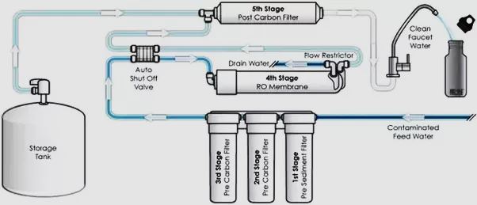
Domestic water purification system

Slide 52
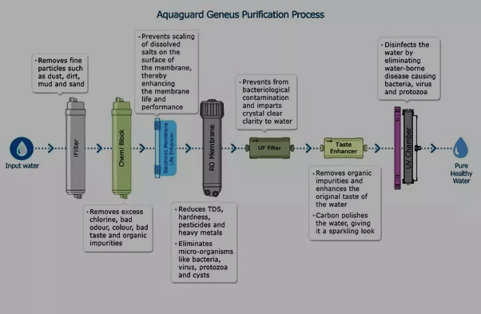
Candles

Slide 53
What is filtration?
Filtration is a process of removing particulate matter from water by forcing the water through a porous media.
This porous media can be natural, like sand, gravel and clay,
or it can be a membrane wall made of various materials.
Sometimes, large particles are settled before filtration; this is called sedimentation
The size of materials that can be removed during filtration depends upon the size of the pores of the filter.

Slide 54

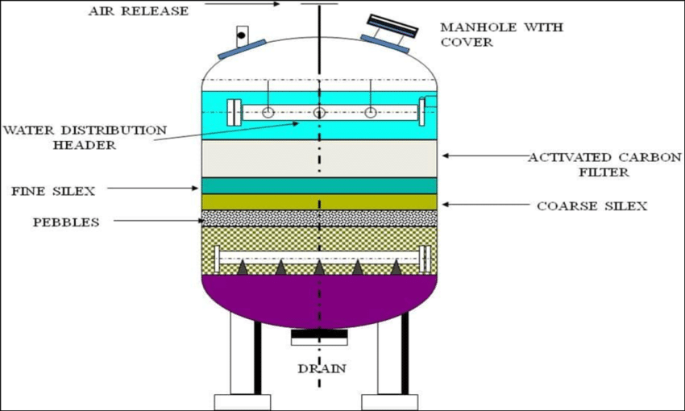
Activated carbon filters are generally used in the process of removing organic compounds and/or extracting free chlorine from water.
Coconut shells and coal (anthracite or bituminous) are both organic sources of activated carbon.
(SiO₂)

Slide 55
Carbon forms when an organic source is burnt in an environment without oxygen. This process leaves only about 30% of the organic mass intact, driving off heavy organic molecules.
Prior to being used for water treatment, the organic mass must then be "activated by either Steam Activation (800°C-1000°C) or Chemical Activation (a powerful dehydrating agent like phosphoric acid (P₂O₅) or zinc chloride (ZnCl₂)."
The process of activation opens up the carbon’s massive number of pores and further drives off unwanted molecules. The open pores are what allow the carbon to capture contaminants, through adsorption.
The rate of adsorption for a surface area of a just one pound (0.45 kg) of Activated Carbon is equal to 60-150 acres!

Slide 56

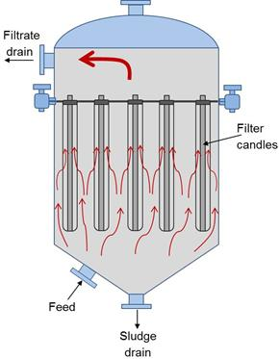
The Candle Filters are, like all pressure filters, operating on a batch cycle and may be seen in process lines handling titanium dioxide, flue gas, brine clarification, red mud, china clay, fine chemicals and many other applications that require efficient low moisture cake filtration or high degree of polishing.
The Candle Filter consists of three major components:
The vessel
The filtering elements
The cake discharge mechanism
Candle Filters are very well suited for handling flammable, toxic and corrosive materials.

Slide 57
Advantages
Excellent cake discharge.
Adapts readily to slurry thickening.
Minimum floor space.
Mechanically simple since there are no complex sealing glands or bearings.
Disadvantages
High headroom is required for dismantling the filtering elements.
The emptying of the vessel in between cake filtration, washing and drying requires close monitoring of the pressure inside the vessel to ensure that the cake holds on to the candles.

Slide 58
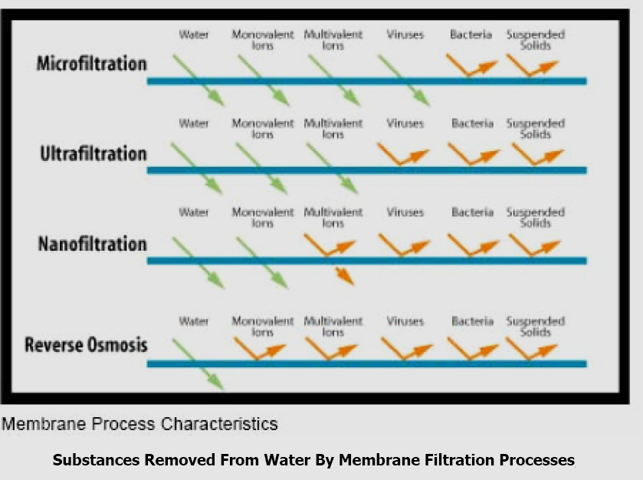
Water purification by Filtration process
The green arrow indicates that the particle is small enough to pass through the filter, whereas the deflected orange arrow indicates that the filter blocks the particle from passing through the filter.

Slide 59
Different filtration processes
Ultrafiltration:
An ultrafiltration filter has a pore size around 0.01 micron.
A microfiltration filter has a pore size around 0.1 micron, so when water undergoes microfiltration, many microorganisms are removed, but viruses remain in the water. Ultrafiltration would remove these larger particles, and may remove some viruses.
Neither microfiltration nor ultrafiltration can remove dissolved substances unless they are first adsorbed (with activated carbon) or coagulated (with alum or iron salts).
Nanofiltration
A nanofiltration filter has a pore size around 0.001 micron.
Nanofiltration removes most organic molecules, nearly all viruses, most of the natural organic matter and a range of salts.
Nanofiltration removes divalent ions, which make water hard, so nanofiltration is often used to soften hard water.
C. Reverse osmosis
Reverse osmosis filters have a pore size around 0.0001 micron.
After water passes through a reverse osmosis filter, it is essentially pure water. In addition to removing all organic molecules and viruses, reverse osmosis also removes most minerals that are present in the water.
Reverse osmosis removes monovalent ions, which means that it desalinates the water.

Slide 60
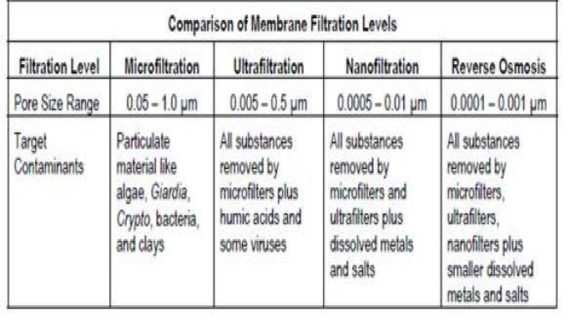

Slide 61
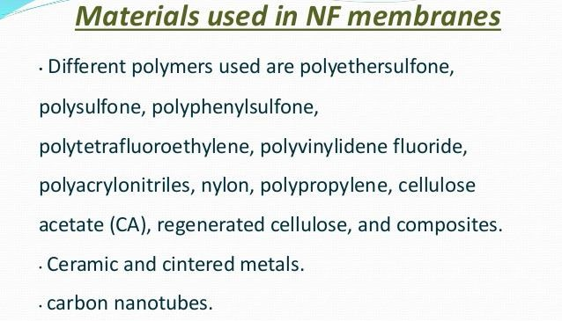
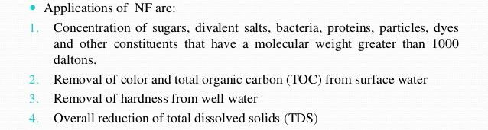
PPrrooff.. DDrr.. FF.. NNaawwaazz KKhhanan,, VVIITT
88//55//22001155 UUNNIVIVEERRSSITITYY 112255

Slide 62
Desalination of brackish water
Water containing dissolved salts with a peculiar salty (brackish)
taste is brackish water
The process of removing common salt from water is desalination
The methods of desalination are:
Electrodialysis
Reverse osmosis
Electrodialysis:
Electrodialysis consists of a large container with two membrane separators, one permeable to positive ions and the other permeable to negative ions.
In the outer compartments anode and cathode are arranged to pass DC Voltage.
When DC voltage/current is passed through the cell, Na⁺ will move towards cathode and Cl⁻ will move towards anode through the membrane.
Hence, the concentration of salt decreases in the middle compartment and increases in the side compartments.
Water from the middle compartment is collected and this water is desalinated water.

Slide 63
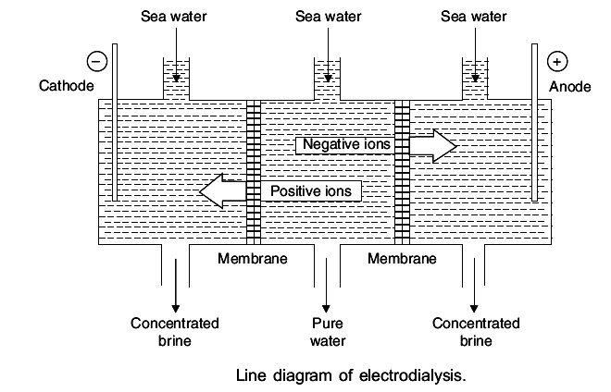
For efficient separation, ion-selective membranes are used which selectively allow cations or anions to pass through them.

Slide 64
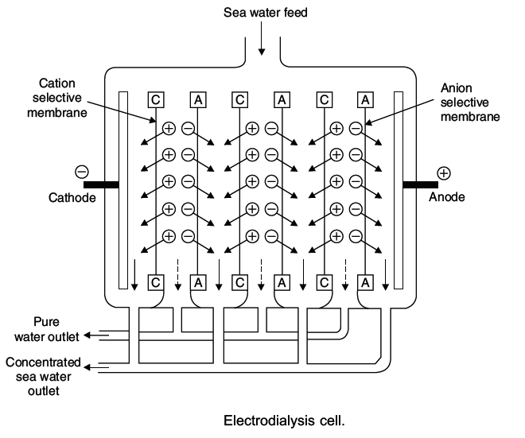

Slide 65
Electrodialysis
Electrodialysis cell consists of Large number of pairs of rigid Plastic membranes.
Saline water at a pressure of 5-6 kg/cm2 is passed through the membrane pairs.
DC current is applied perpendicular to the direction of water flow.

Slide 66
Reverse osmosis
When two solutions of unequal concentrations are separated
by a semipermeable membrane, solvent will flow from lower
conc. to higher conc. - Osmosis
This phenomenon can be reversed (solvent flow reversed) by
applying hydrostatic pressure on the concentrated side
In reverse osmosis, pressure of 15-40 kg/cm² is applied to
sea water.
The water gets forced through the semipermeable membrane
leaving behind the dissolved solids.

Slide 67
