Slide 1
Water
Treatment

Slide 2
Water Softening methods
1. Lime soda
a) Batch process
b) continuous process
- Cold lime-soda
- Hot lime-soda
2. Zeolite (permutit) process
3. Ion-exchange and Mixed bed ion-exchange process

Slide 3
Lime – Soda Process
a. Reaction of permanent calcium:
Ca²⁺ + Na₂CO₃ CaCO₃ + 2Na⁺
b. Reactions of permanent magnesium:
Mg²⁺ + Ca(OH)₂ Ca²⁺ + Mg(OH)₂
Ca²⁺ + Na₂CO₃ CaCO₃ + 2Na⁺
c. Reaction of HCO₃⁻ (ex-Na₂CO₃):
2 HCO³⁻ + Ca(OH)₂ CaCO₃ + H₂O + CO₃²⁻
d. Reaction of Ca(HCO₃)₂ :
Ca(HCO₃)₂ + Ca(OH)₂ 2 CaCO₃ + 2 H₂O
e. Reaction of Mg(HCO₃)₂ :
Mg(HCO₃)₂ + 2 Ca(OH)₂ 2 CaCO₃ + 2 H₂O + Mg(OH)₂

Slide 4
Lime – Soda Process
f. Reaction of CO₂:
CO₂ + Ca(OH)₂ CaCO₃ + H₂O
g. Reaction of H⁺:
2 H⁺ + Ca(OH)₂ Ca²⁺ + 2 H₂O
Ca²⁺ + Na₂CO₃ CaCO₃ + 2 Na⁺
h. Reactions of coagulants:
i) Reaction of FeSO₄:
Fe²⁺ + Ca(OH)₂ Fe(OH)₂ + Ca²⁺
Fe(OH)₂ + H₂O + O₂ 2 Fe(OH)₃
Ca²⁺ + Na₂CO₃ CaCO₃ + 2 Na

Slide 5
ii) Reactions of Aluminium sulphate (Al₂(SO4)₃ :
2 Al³⁺ + 3 Ca(OH)₂ 2 Al(OH)₃ + 3 Ca²⁺
3 Ca²⁺ + 3 Na₂CO₃ 3 CaCO₃ + 6 Na⁺
iii) Reactions of sodium aluminate (NaAlO₂):
NaAlO₂ + H₂O Al(OH)₃ + NaOH
Lime [Ca(OH)₂]requirement :
74 Temp. Ca²⁺ + 2 temp. Mg²⁺ + Perm(Mg²⁺ + Al³⁺ + Fe²⁺) + CO₂ + H⁺ + HCO₃⁻
- NaAlO₂
B. Soda[Na₂CO₃] requirement :
106 Perm. (Ca²⁺ + Mg²⁺ Fe²⁺ + Al³⁺) + H⁺ - HCO₃⁻
{
{
100
{
{
100

Slide 6
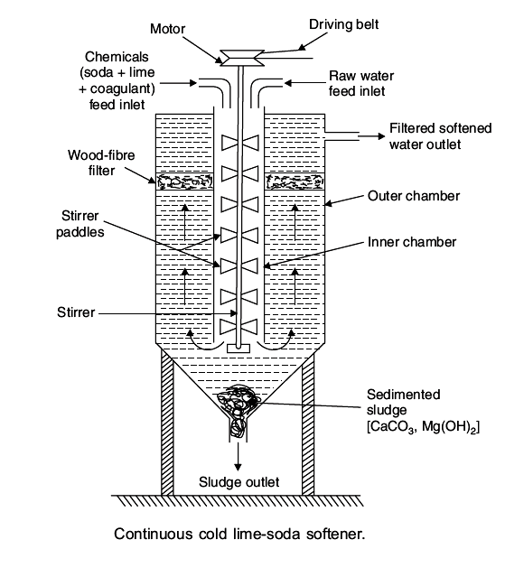
Lime –Soda process equipment

Slide 7
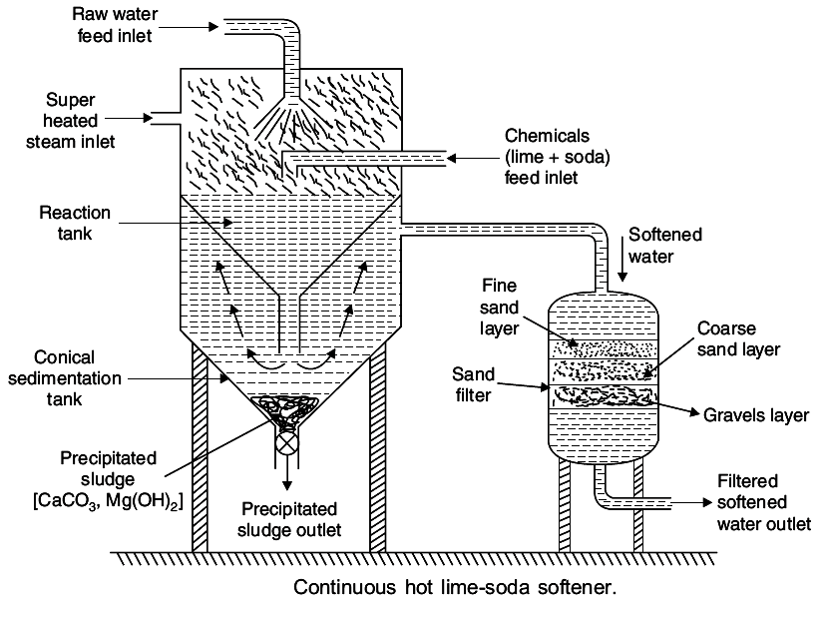
Lime –Soda process equipment
Hot lime-soda process consists of three parts:
Reaction tank to mix all ingredients
b) Conical sedimentation vessel where the sludge settles down
c) Sand filter where sludge is completely removed
Advantages of hot lime-soda process:
The precipitation reactions are almost complete
Reactions takes place faster
Sludge settles down rapidly; No coagulant is needed
Dissolved gases (which may cause corrosion) are removed
Viscosity of soft water is lower, hence filtered easily
Residual hardness is low compared to cold lime-soda process

Slide 8
Advantages & disadvantages of lime-soda process:
Advantages of Lime – soda process:
Economical
Process improves the corrosion resistance of water
Mineral content of water is reduced
pH of water raises thus reducing content of pathogenic bacteria
No skilled labour is required
Disadvantages of Lime – soda process:
Huge amount of sludge is formed and its disposal is difficult
Due to residual hardness, water is not suitable for high pressure boilers

Slide 9
Permutit or Zeolite Process
Zeolite is hydrated sodium aluminium silicate having a general formula, Na₂OAl₂O₃.xSiO₂.yH₂O.
It exchanges Na⁺ ions for Ca²⁺ and Mg²⁺ ions.
Common Zeolite is Na₂OAl₂O₃.3SiO₂.2H₂O known as natrolite.
Artificial zeolite used for water softening is Permutit.
They are prepared by heating china clay, feldspar and soda ash (hydrated aluminium silicate), feldspar (KAlSi₃O₈-NaAlSi₃O₈ – CaAl₂Si₂O₈) are a group of rock-forming tectosilicate minerals which make up as much as 60% of the earth’s crust) and soda ash (Na₂CO₃)

Slide 10
Zeolite process
Method of softening:
Na₂Ze + Ca(HCO₃)₂ 2 NaHCO₃ + CaZe
Na₂Ze + Mg(HCO₃)₂ 2 NaHCO₃ + MgZe
Na₂Ze + CaSO₄ 2 Na₂SO₄ + CaZe
Na₂Ze + CaCl₂ 2 NaCl + CaZe
Regeneration of Zeolite:
CaZe (or) MgZe + 2 NaCl Na₂Ze + CaCl₂ or MgCl₂
Brine solution

Slide 11
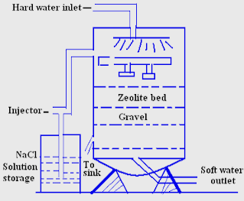
Zeolite process equipment diagram

Slide 12
Zeolite Process
Advantages:
Residual hardness of water is about 10 ppm only
Equipment is small and easy to handle
Time required for softening of water is small
No sludge formation and the process is clean
Zeolite can be regenerated easily using brine solution
Any type of hardness can be removed without any modifications to the process
Disadvantages:
Colored water or water containing suspended impurities cannot be used without filtration
Water containing acidic pH cannot be used for softening since acid will destroy zeolite.

Slide 13
Ion-Exchange Process
Ion-exchange resins are cross linked long chain polymers with
microporous structure.
Cation exchange resins will exchange cations with H⁺.
Anion exchange resins will exchange anions with OH^{-.}
Functional groups present are responsible for ion-exchange
properties.
Acidic functional groups (-COOH, -SO₃H etc.) exchange H⁺ for
cations &
Basic functional groups (-NH₂, =NH etc.) exchange OH⁻ for anions.

Slide 14
Ion-Exchange Process
A. Cation-exchange Resins(RH⁺):
- Styrene divinyl benzene copolymers
- When sulphonated, capable of exchange H⁺

Slide 15
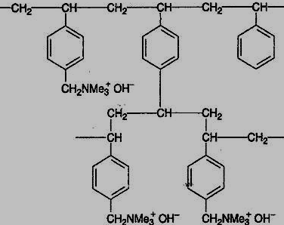
Ion Exchange Process
B. Anion-exchange resins (R’OH):
- Styrene divinyl benzene copolymers or amine formaldehyde copolymers with NH₂,
QN⁺, QP⁺, QS⁺, groups.
- On alkali treatment, capable of exchange of OH⁻
Anion Exchange resin

Slide 16
Ion Exchange Process
The Process of Ion-exchange is:
2 RH⁺ + Ca²⁺/Mg²⁺ R₂Ca²⁺/R₂Mg²⁺ + 2 H⁺ (Cation exchange)
R’OH⁻ + Cl⁻ R’⁺ Cl⁻ + OH⁻ (anion exchange)
2 R’OH- + SO₄²⁻ R’₂ SO₄²⁻ + 2 OH⁻ (anion exchange)
2 R’OH- + CO₃²⁻ R’2 CO₃²⁻ + 2 OH⁻ (anion exchange)
Finally,
H⁺ + OH⁻ H₂O
Regeneration of exhausted resins:
Saturated resins are regenerated by treating with strong mineral acid or alkali respectively
R₂Ca²⁺/R₂Mg²⁺ + 2H⁺ 2 RH⁺ + Ca²⁺/Mg²⁺ (Strong acid)
(washings)
R’₂ SO₄²⁻ + 2 OH⁻ 2 R’OH⁻ + SO₄²⁻ (Strong base)
(washings)

Slide 17
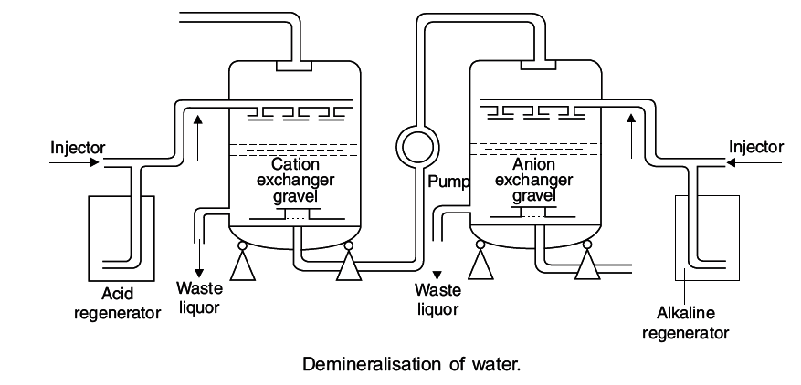
Ion-exchange process
Note: Hard water should be first passed through the cation exchanger and then
Anion exchanger to avoid hydroxides of Ca²⁺ and Mg²⁺ getting formed

Slide 18
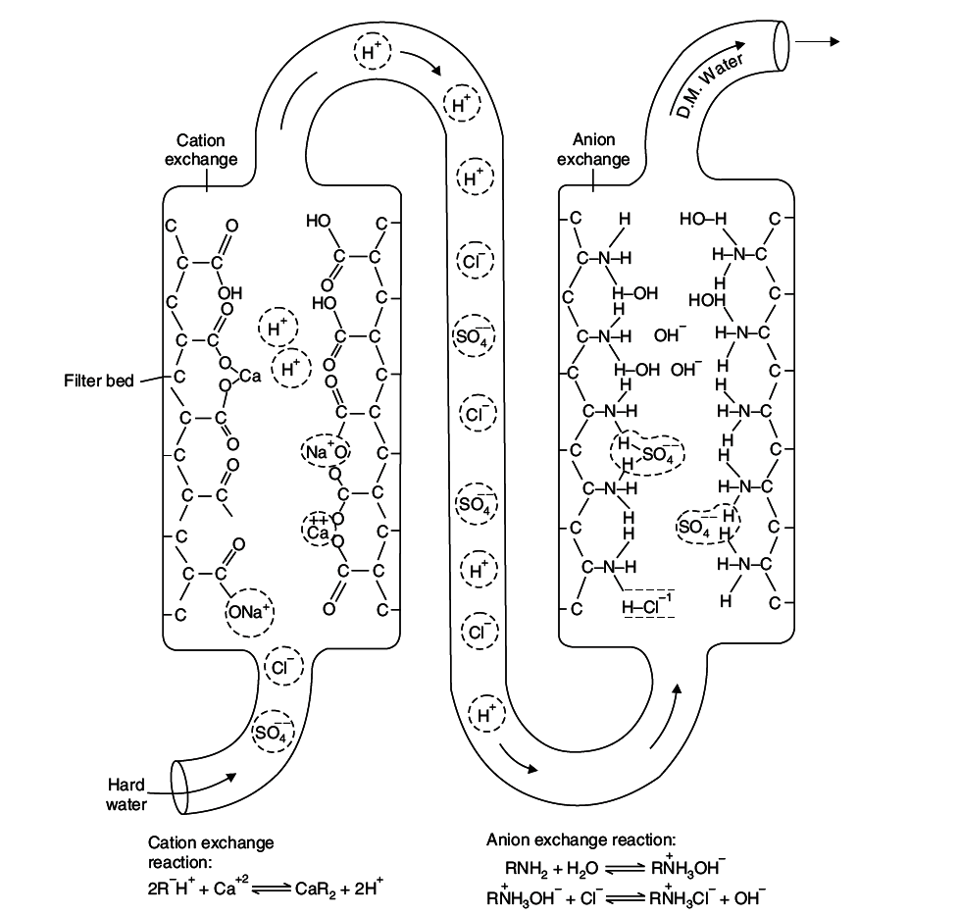

Slide 19
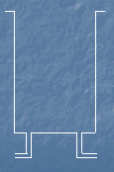
Mixed bed ion-exchanger
Contains intimate mixture of cation and anion exchangers
Water is in contact for a no. of times with the two exchangers alternatively
Anion exchanger
(low density)
NaOH
Mixed ionizer
bed
Mixed
ionizer
bed
Exhausted mixed
ionizer bed
H₂SO₄
Cation exchanger
(higher density)
Backwash
water
Comp.
air
Raw water
inlet
Washings to
sink
Deminaralised
water

Slide 20
Advantages & Disadvantages of ion-exchange process
Advantages:
- Can be used for highly acid and highly alkaline water
- Residual hardness of water is as low as 2 ppm.
- Very good for treating water for high pressure boilers
Disadvantages:
- Expensive equipment and chemicals
- Turbidity of water should be < 10 ppm. Otherwise output will
reduce; turbidity needs to be coagulated before treatment.
- Needs skilled labour

Slide 21
Specifications of different materials in drinking water (ICMR and WHO)
S.No. | Parameter/Material | WHO Standards/ppm | ICMR/BIS Standards/ppm
1 | Colour | Clear | Clear
2 | Odour | Pleasant | Pleasant
3 | Turbidity | 2.5 | 2.5
4 | pH | 6.0 – 8.5 | 6.0 – 8.5
5 | TDS | 300 | 500
6 | Total Hardness as CaCO₃ | 200 | 300
7 | Calcium | 75 | 75
8 | Chlorides | 200 | 200
9 | Sulphates | 200 | 200
10 | Fluoride | 0.5 | 1.0
11 | Mercury | 0.006 | 0.001
12 | Cadmium | 0.003 | 0.01
13 | Arsenic | 0.01 | 0.02
14 | Chromium as hexavalent | 0.01 | 0.1
15 | Lead | 0.01 | 0.01
16 | E.Coli | No colony Should be present in 100 mL water | No colony Should be present in 100 mL water

Slide 22
Water treatment for municipal supply
Removes dirt and other particles suspended in water. Alum and other chemicals are added for coagulation through floc
Lakes/Reservoirs/Rivers
Storage tanks
Coagulation
Multilayer filtration using sand, gravel and charcoal
Heavy particles (floc) settle to the bottom and clear water goes for filtration
Filtration
Sedimentation
Flocculation & Clarification
Calculated amount of chlorine is added
Disinfection
Storage in closed containers
Supply through pipelines

Slide 23
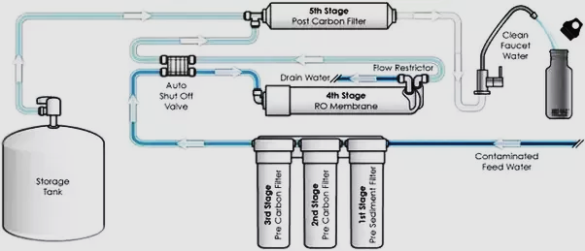
Domestic water purification system

Slide 24
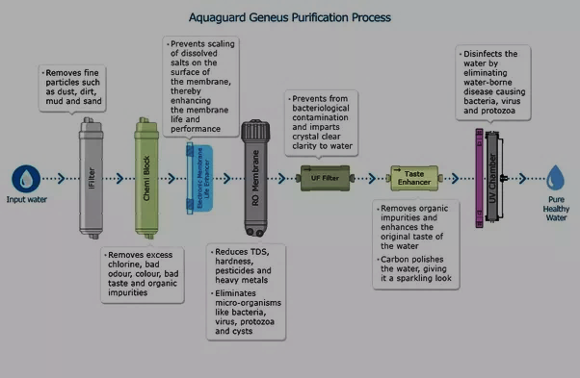
Candles

Slide 25
Disinfection Methods
Disinfection methods used for disinfecting water for drinking purpose are
- Ultrafiltration
- UV treatment
- Ozonolysis
- Reverse Osmosis

Slide 26
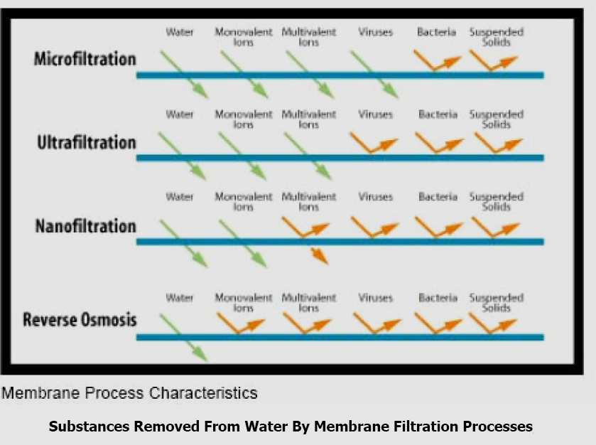
Water purification by Filtration process
The green arrow indicates that the particle is small enough to pass through the filter, whereas the deflected orange arrow indicates that the filter blocks the particle from passing through the filter.

Slide 27
Different filtration processes
Ultrafiltration:
An ultrafiltration filter has a pore size around 0.01 micron.
A microfiltration filter has a pore size around 0.1 micron, so when water undergoes microfiltration, many microorganisms are removed, but viruses remain in the water. Ultrafiltration would remove these larger particles, and may remove some viruses.
Neither microfiltration nor ultrafiltration can remove dissolved substances unless they are first adsorbed (with activated carbon) or coagulated (with alum or iron salts).
Nanofiltration
A nanofiltration filter has a pore size around 0.001 micron.
Nanofiltration removes most organic molecules, nearly all viruses, most of the natural organic matter and a range of salts.
Nanofiltration removes divalent ions, which make water hard, so nanofiltration is often used to
soften hard water.
C. Reverse osmosis
Reverse osmosis filters have a pore size around 0.0001 micron.
After water passes through a reverse osmosis filter, it is essentially pure water. In addition to removing all organic molecules and viruses, reverse osmosis also removes most minerals that are present in the water.
Reverse osmosis removes monovalent ions, which means that it desalinates the water.

Slide 28
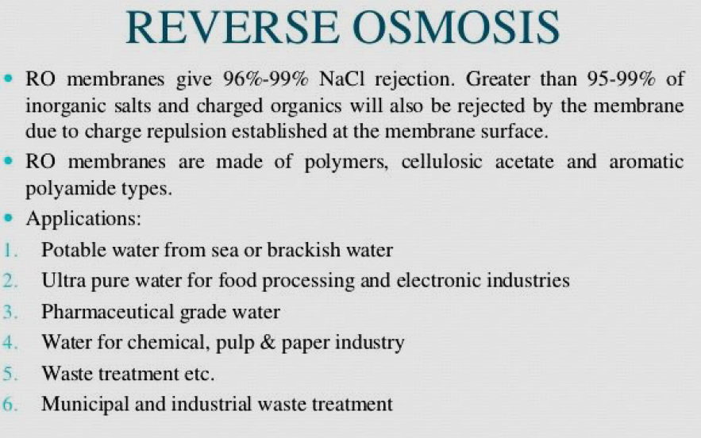

Slide 29
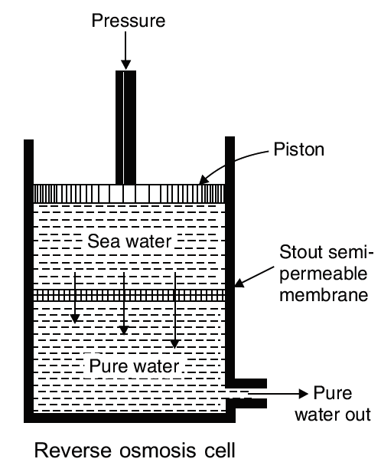
Reverse Osmosis
When two solutions of unequal concentrations are separated by a Semipermeable membrane, solvent will flow from lower conc. to higher conc. due to osmotic pressure
This phenomenon can be reversed by making the solvent to flow in the opposite direction by applying hydrostatic pressure on the concentrated side (Reverse Osmosis)
In reverse osmosis, pressure of 15-40 kg/cm² is applied on the contaminated water compartment.
The water gets forced through the semipermeable membrane leaving behind the dissolved solids.
Thus water is separated from the contaminants rather than removing contaminants from water.
Both ionic and non-ionic impurities as well as colloidal impurities are left behind.
This process is also called as “Super-filtration” or “Hyper-filtration”

Slide 30
Advantages of Reverse Osmosis
Advantage is in removing ionic, non-ionic, colloidal and high molecular wt. organic matter.
It removes colloidal silica (which is not removed during demineralisation)
Cost is only the replacement cost of membranes (life is 2 years)
Membrane replacement is fast and hence uninterrupted water supply can be ensured
Because of the above reasons this process is being adopted for converting sea water into potable water and for high pressure boilers.
It can be used as desalination process for removing salt from sea water.

Slide 31
Desalination of brackish water
Water containing dissolved salts with a peculiar salty (brackish) taste is brackish water
The process of removing common salt from water is desalination
Electrodialysis consists of a large container with two membrane separators, one
permeable to positive ions and the other permeable to negative ions.
In the outer compartments anode and cathode are arranged to pass DC Voltage.
When DC voltage/current is passed through the cell, Na⁺ will move towards cathode
and Cl⁻ will move towards anode through the membrane.
Hence, the concentration of salt decreases in the middle compartment and increases
in the side compartments.
Water from the middle compartment is collected and this water is desalinated water.

Slide 32
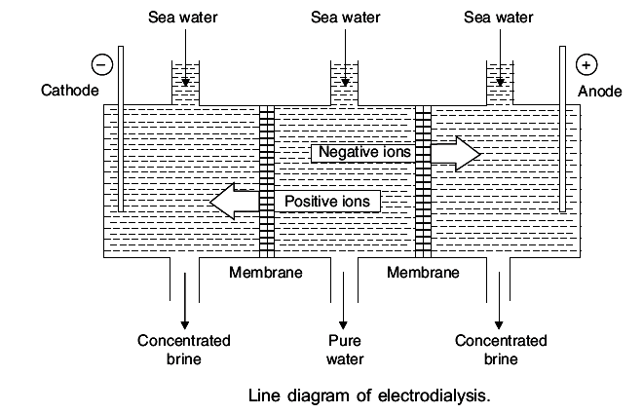
Electrodialysis diagram
For efficient separation, ion-selective membranes are used which selectively allow cations or anions to pass through them.

Slide 33
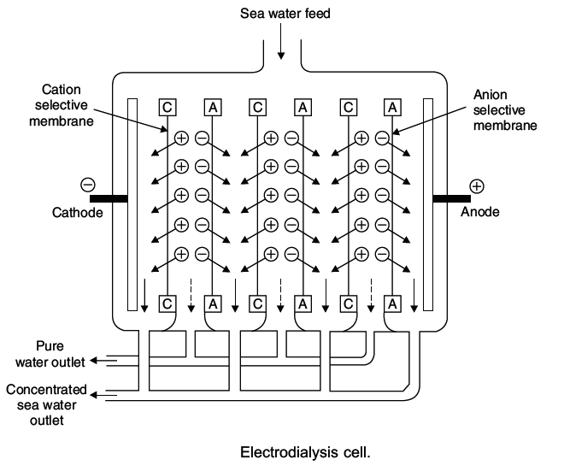
Electrodialysis cell
Electrodialysis cell consists of Large number of pairs of
rigid Plastic membranes.
Saline water at a pressure of 5-6 kg/cm² is passed
through the membrane pairs.
DC current is applied
perpendicular to the direction of water flow.
Advantages are:
Unit is compact and installation is economical
Best suited if electricity is
available.

