Slide 1
Water Technology

Slide 2
Sources of Water
Naturally available water can be classified as:
Surface water : Flowing water - streams, rivers and
Stillwater-ponds, lakes and reservoirs.
Underground water from springs and wells and from coal mining
cuttings.
Sea water and
Rain water
Rainwater : It is the purest form of natural water but contains dissolved toxic gases like CO₂, SO₂, NO₂ etc. and other solids. Also its supply is unpredictable.
Sea water : It is the most impure form of water containing about 3.5% dissolved salts of which about 6% is NaCl. Other salts present include sulphates, bicarbonates, bromides of sodium, potassium, magnesium etc.
It is therefore, necessary to depend on ground and surface water after removing different impurities that are present in them, as required.

Slide 3
Impurities in water
Water has different physical, chemical and biological Impurities which can cause
problems in both domestic and industrial applications.
Physical
- Inorganic such as clay, sand
- Organic such as oil globules, vegetable/animal matter
- Colloidal such as Fe(OH)₃, Complex proteins, amines
Chemical
- Anions such as Cl⁻, SO₄²⁻, CO₃²⁻,HCO₃⁻, NO₃⁻ of Ca & Mg
- Cations such as Ca²⁺, Mg²⁺, Na⁺, K⁺, Fe³⁺, Al³⁺
- Dissolved gases such as O₂, N₂, CO₂, H₂S, NH₃
Biological
- Microorganisms such as algae, fungi, bacteria
(Pathogens causing infectious diseases)

Slide 4
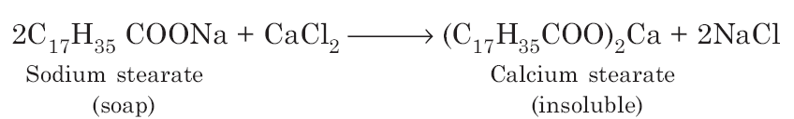
Hardness of water
Hardness of water is the characteristic of preventing lather formation of water with soap. Generally salts like chlorides, bicarbonates and sulfates of Ca²⁺, Mg²⁺ and Fe²⁺ make water hard.
This hard water on treatment with soap which is stearic or palmitic acid salts of sodium or potassium causes white precipitate formation of calcium or magnesium stearate or palmitate.
Thus the cause of hardness is the precipitation of the soap and hence prevents lathering at first. When the hardness causing ions are removed as insoluble soaps, water becomes soft and forms lather.

Slide 5
Types of Hardness
Hardness of water is due to dissolved salts of mainly calcium and magnesium as well as iron and other heavy metals.
Hardness is two types:
a) Temporary :
- Due to dissolved bicarbonates of calcium and magnesium and carbonates of iron and other heavy metals. Hence it is also called as carbonate hardness.
- Can be easily removed by boiling where CO₂ gas gets expelled removing
the hardness.
b) Permanent:
- Due to dissolved chlorides and sulphates of calcium and magnesium. Also called as non-carbonate hardness.
- Can be removed through zeolite, Lime-soda, ion-exchange processes.

Slide 6
Dissolved Oxygen
Dissolved oxygen (DO) is the amount of oxygen dissolved in a given quantity of water at a particular temperature and atmospheric pressure.
DO depends on
• Aeration,
• Photosynthetic activity of the water,
• Respiration of animals and plants
• Speed of water flow
• Roughness of surface over which water flows
• Temperature of the water body
Oxygen Demanding Wastes
- Chemical Oxygen Demand (COD)
Chemicals/Organic wastes present in water consume the DO
- Biological Oxygen Demand (BOD)
Organic wastes reaching water consume oxygen from water bodies for
their decomposition by bacteria through biochemical oxidation
These are useful measures to check water quality

Slide 7
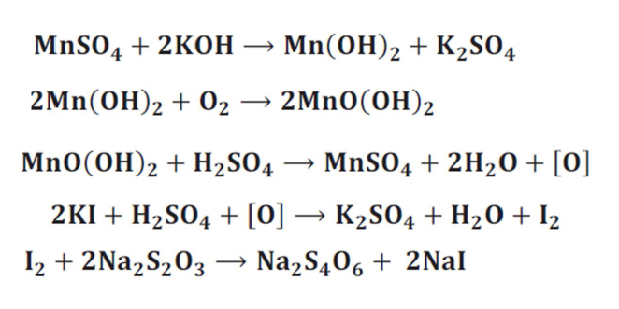
Estimation of DO by Winkler’s method
Theory of Winkler’s Method:
Oxygen in the water sample oxidizes iodide ion (I-) to iodine (I₂) quantitatively.
The amount of iodine generated is then determined by titration with a standard thiosulfate (S₂O₃⁻²) solution.
The endpoint is determined by using starch as a visual indicator.
The amount of oxygen can then be computed from the titre values

Slide 8
Total Dissolved Solids (TDS)
Total Dissolved Solids (TDS) are the total amount of particles (charged ions) dissolved in a given volume of water.
This includes minerals, salts or some metal ions.
It is expressed in units of mg per unit volume of water (mg/L), also referred as parts per
million (ppm).
TDS is a measure of the combined content of all inorganic and small amount of organic matter contained in a liquid in molecular, ionized or micro-granular (colloidal sol) suspended form.
The principal constituents are usually
Cations : Calcium, magnesium, sodium, and potassium and Anions.: Carbonate, Bicarbonate, chloride, sulfate, and nitrate.
If high levels of TDS : toxic ions like lead, arsenic, cadmium, nitrate, and others may also be dissolved in the water.

Slide 9
Total Dissolved Solids (TDS)
Total dissolved solids (TDS) is the amount of particles dissolved in water
They come from
a) Organic sources (leaves)
b) Silt
c) Industrial wastage and sewage as well as runoff from urban sources,
fertilizers and pesticides
d) Inorganic materials such as rocks and air that may contain calcium
bicarbonate, nitrogen, iron, sulphur and other minerals
A constant level of minerals, eg. Phosphorous, nitrogen and sulphur, is necessary for aquatic life.
Concentration of dissolved solids should not be too high or too low which can affect the growth and leads to death of many aquatic organisms.
High concentration of dissolved solids reduces the clarity of water and can decrease the photosynthesis and raises the water temperature.
It can be determined taking a known amount (say 100 mL) of water and by evaporating the contents carefully to dryness.
The residue (W/g) left after evaporation of the filtered sample shows the total dissolved solids present in that articular water sample.

Slide 10
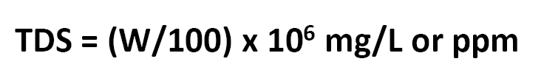
Total Dissolved Solids
Recommended TDS for drinking water is 25-250 mg/L
At any cost drinking water TDS should not exceed 500 mg/L
TDS for distilled water will be 0.5-1.5 mg/L
TDS ranges from 100-20,000 mg/L in river water and will be generally higher in ground water
Sea water will have 3500 mg/L of TDS
Lakes and streams will have a TDS of 20-250 mg/L

Slide 11
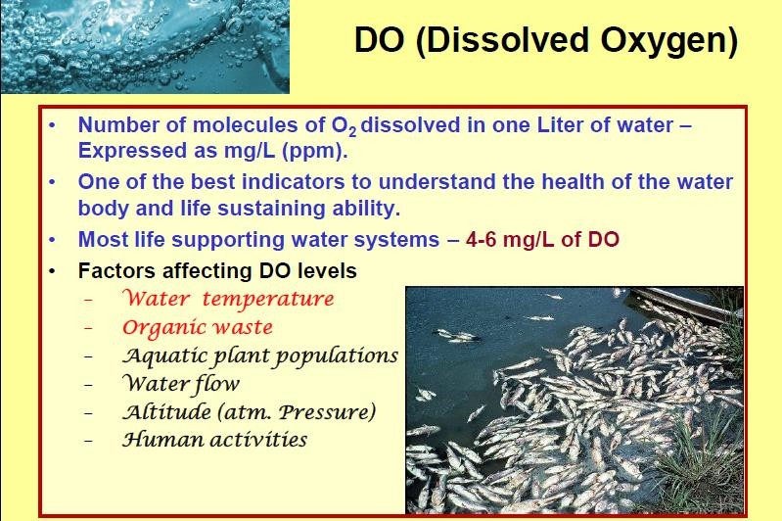

Slide 12
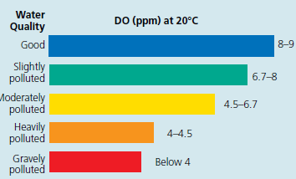

Slide 13
Measurement of hardness of water
Hardness of water is measured in parts per millions (ppm.) as calcium carbonate equivalents.
Reasons for expressing hardness in CaCO₃ equivalents:
- its molecular weight is 100 ; equivalent weight is 50.
- it is the most common insoluble impurity in water.
Units of hardness:
- parts per million in CaCO₃ equivalents (1 mg/L is 1ppm.).
- if 146 mg/L of MgSO₄ is present in water, the hardness of
water is 146 ppm. as MgSO₄.
When expressed in CaCO₃ equivalents, the formula for conversion is:
mass of hardness causing substance
Mol. wt of hardness causing substance
X 100

Slide 14
Estimation of water hardness
EDTA method:
Ethylene diamine tetraacetic acid disodium salt (EDTA disodium salt) is used as a strong complexing agent with Ca²⁺ and Mg²⁺ in hard water.
The structure of EDTA disodium salt is:
N CH₂ CH₂ N
Initially, Ca²⁺ and Mg²⁺ are treated with Eriochrome black T (EBT) indicator using ammonia buffer (to maintain pH between 9-10) to get an unstable complex of Ca²⁺ and Mg²⁺ formed with EBT.
Ca²⁺/Mg²⁺ + EBT Ca²⁺/Mg²⁺ + EBT
(unstable complex – wine red)
NaOOCH₂C
CH₂COOH
HOOCH₂C
CH₂COONa
pH 9-10

Slide 15
Estimation Water Hardness
On addition of EDTA, EBT gets replaced by EDTA since EDTA forms a stronger complex with the metal ions.
This is indicated by the formation of a steel blue coloured complex.
Ca²⁺/Mg²⁺ EBT + EDTA Ca²⁺/Mg²⁺ EDTA + EBT
(Stable complex - Steel blue)
pH 9-10

Slide 16
Procedure
First EDTA Solution is standardized using standard hard water (1 mg/mL of CaCO₃ equivalents is prepared as standard hard water).
For this, first known aliquot of Standard hard water is taken and 10-15 mL of ammonia buffer is added to bring the pH between 9-10.
Then a few drops of EBT solution is added to form the unstable complex giving wine red colour.
This solution is titrated with the EDTA solution till the solution turns to steel blue indicating the formation of stable EDTA-Metal ion complex.
This volume of EDTA is noted as V₁.
The above procedure is repeated with sample hard water of unknown hardness.
Volume of EDTA is noted as V₂.
Then sample hard water of 250 mL is taken and evaporated to a volume of 50mL when the temporary hard salts settle down.
The solution is filtered and washed thoroughly and made up again to 250mL.
From this solution, 50 mL is pipetted out and titrated in similar manner as done with standard hard water.
Volume of EDTA is noted as V₃.

Slide 17
Calculations
a) Total hardness:
V₁mL of EDTA is consumed by 50 mL of std. hard water
V₁mL of EDTA = 50 mg of CaCO₃
1 mL of EDTA = 50/V₁ mg of CaCO₃
EDTA consumed by sample hard water = V₂ mL
So, V₂ mL of EDTA = 50/V₁ x V₂ mg of CaCO₃
Hence, 50 mL of sample hard water contains 50/V₁ x V₂ mg of CaCO₃
Therefore, 1000mL of sample hard water = 50/V₁ x V₂/50 x 1000 mg/L
i.e. Total hardness of sample hard water = V₂/V₁ x 1000 mg of CaCO₃ (ppm.)

Slide 18
Calculations
Permanent hardness:
50 mL of sample hard water after removing temporary hardness consumed V₃ mL of EDTA.
1 mL of EDTA = 50/V₁ mg of CaCO₃ equiv.
Therefore, V₃ mL of EDTA = 50/V₁ x V₃ mg of CaCO₃ equiv.
50 mL of sample hard water after boiling contained 50/V₁ x V₃ mg of CaCO₃ equiv.
Therefore, 1000 mL of sample hard water contains
= 50/V₁ x V₃/50 x 1000 mg/L CaCO₃ equiv.
Permanent hardness = V₃/V₁ x 1000 mg/L CaCO₃ equiv.
Temporary hardness:
Temporary hardness = Total hardness – permanent hardness

Slide 19
Temporary hardness calculation
Temporary hardness:
Temporary hardness = Total hardness – permanent hardness
V₂ V₃
V1 V1
= 1000 X
_
X 1000
X 1000
V₂ – V₃
V₁

Slide 20
Examples of hardness calculations
A sample hard water contains,
8.1 mg/L Ca(HCO₃)₂ ; 7.5 mg/L Mg(HCO₃)₂; 13.6 mg/L CaSO₄;
12.0 mg/L MgSO₄ and 2.0 mg/L MgCl_{2.}
To calculate the hardness and express in CaCO₃ equivalents:
Constituent | Multiplication factor | CaCO₃ equivalents
Ca(HCO₃)₂= 8.1 mg/L | 100/162 | 8.1 x 100/162 = 5.0 mg/L
Mg(HCO₃)₂ = 7.5 mg/L | 100/146 | 7.5 x 100/146 = 5.14 mg/L
CaSO₄= 13.6 mg/L | 100/136 | 13.6 x 100/136 = 5.0 mg/L
MgSO₄= 12.0 mg/L | 100/120 | 12.0 x 100/120 =10.0 mg/L
MgCl₂ = 2.0 mg/L | 100/95 | 2.0 x 100/95 = 2.11 mg/L

Slide 21
Modern methods of water analysis
Importance of Water Analysis
Water analysis is essential to ensure its quality or to detect pollutants that should be removed by water treatment. However, water quality does not mean making the water suitable for human consumption; it depends on its end use. For example, completely different quality standards are applied in case of industrial water compared to those applied to drink water, i.e., drinking water must be fit for human consumption, while industrial water should be free from any contaminants that may corrode or damage equipment.
Limitations of Traditional Methods of Water Analysis
The traditional analysis includes chemical analysis, colorimetry, spectrometry, chromatography, and atomic absorption. Although these techniques differ in sensitivity and accuracy, most of them are highly accurate. Nevertheless, they require sampling, expensive devices, and manpower; besides, they are time-consuming and difficult to conduct onsite.

Slide 22
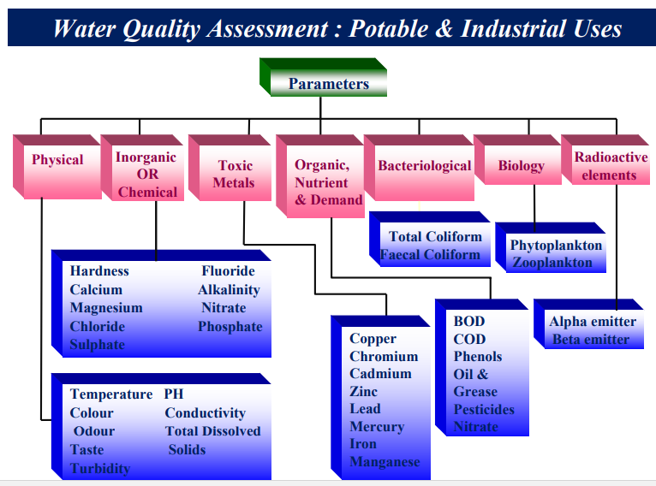

Slide 23
Lab-on-a-chip
A lab-on-a-chip (LOC) is a device that integrates one or several laboratory functions on a single integrated circuit (commonly called a "chip") of only millimeters to a few square centimeters to achieve automation and high-throughput screening
Lab-on-a-chip devices are a subset of microelectromechanical systems (MEMS) devices and sometimes called "micro total analysis systems" (µTAS)
LOCs may provide advantages, which are specific to their application. Typical advantages are:
a) low fluid volumes consumption (less waste, lower reagents costs, and fewer sample volumes)
b) faster analysis and response time due to short diffusion distance & high surface to volume ratio.
c) better process control because of a faster response of the system compactness of the systems due to the integration of much functionality and small volumes
d) lower fabrication costs, allowing cost-effective disposable chips, fabricated in mass production
e) safer platform for chemical, radioactive or biological studies because of integration of functionality, smaller fluid volumes, and stored energies

Slide 24
Lab-on-a-chip
Microfluidics and Lab-On-A-Chip for Water Analysis
Microfluidics and lab-on-a-chip systems are advanced technologies that may replace the traditional methods of water analysis in the near future.
Lab-on-a-chip technology employs microfluidics, which deals with very minute amounts of fluids in microchannels, to perform the analysis.
The lab-on-a-chip device is a chip that resembles electronic chips, but with micro-channels instead of electrical circuits.
It shrinks the lab to the chip size and can perform complete analysis or even series of analysis.
Advantages of using lab-on-a-chip for water analysis:
can reduce time and manpower in the sampling process because this technology can offer immediate, onsite results.
In addition, this technique is much less expensive and offers higher accuracy, because of the small volumes analyzed and the possibility of eliminating the sampling process, which reduces the human error

Slide 25
Components of Lab-on-a-chip systems
The main components of a lab-on-a-chip system for water analysis are; a liquid delivery system (injector and fluidic transporter), mixer, reactor, separator, and power supply.
The Injector is used to deliver precise volumes into the chip. The most common types of the injectors are syringe pumps and robotic pipets.
Transporters control all aspects of the flow. They can be active, which need an energy source, or passive, which are achieved by manipulating the geometries of the channels and do not require any energy source. The choice between the active and passive types is based on the application. There are multiple types of active transporters, but the most preferred is electrochemical pumping systems, such as microsyringe pumps, because they eliminate the design complexity.
Mixers are used to mix different fluids into the channels. Similar to the transporters, the types of mixers are divided into passive, which are achieved by design manipulation, and active, which require power.
The Reactor is where the reaction takes place. There are three types of reactors used in lab-on-a-chip systems: gas phase, liquid phase, and packed-bed reactors.
Controllers are used for controlling all types of activities in the chip as well as data acquisition and signal processing.
Power supplies, such as batteries, are essential to run the lab-on-a-chip systems. Many research studies focus on finding more advanced power supplies because some types of lab-on-a-chip systems require high voltage.

Slide 26
Current Applications in Water Analysis
Lab-on-a-chip technology is rapidly developing and being used in different industrial and research fields.
Most biological lab-on-a-chip devices are commercialized, while those for water analysis are still developing.
However, some lab-on-a-chip applications in water analysis are already established, such as pH testing and detection of various chemicals (e.g., nitrates and nitrites, manganese, phosphates, and silicates).
For example, the microfluidic pH analysis uses sulfonephthalein as the main indicator.
It includes the absorption cell, a static mixer, as well as a syringe pump and four valves attached to the chip to regulate the flow.

Slide 27
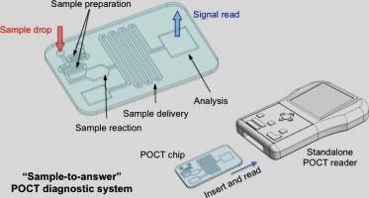
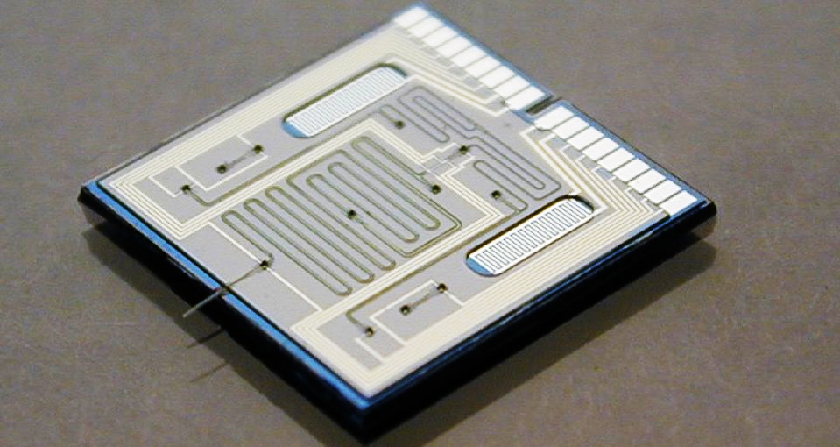
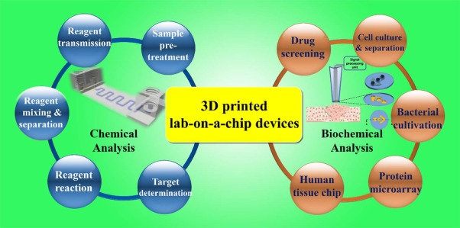
References:
1. J. Cleary, C. Slater, D. Diamond, Analysis of phosphate in wastewater using an autonomous microfluidics-based analyser, World Acad. Sci. Eng. Technol. 52 (2009) 196–199.
2. R. Paul Payel, “Lab on a Chip” Systems for Environmental Analysis, University of Stavanger, 2014.

Slide 28
Problems of hard water for domestic use
Washing:
Hard water, when used for washing purposes, does not lather freely with soap.
It produces sticky precipitates of calcium and magnesium soaps.
Similar problem exists in bathing.
b) Cooking:
Due to the presence of dissolved hardness producing salts the boiling point of water is elevated.
Consequently more fuel is and time are required for cooking.
c) Drinking:
Hard water causes bad effect on our digestive system.
The possibility of forming calcium oxalate crystals in urinary tracks is increased (Kidney stones).

Slide 29
Disadvantages of hard water in industries
Paper Industry:
The presence of calcium and magnesium has impact on the properties and quality of paper and their products
Textile industry :
Hard water cause much of the soap to go as waste.
During dyeing process, calcium and magnesium salts present in water make the quality of the shades very poor.
Sugar industry :
If nitrates, sulphates of calcium and magnesium are present, they cause hindrance to crystallization of sugar
Concrete making :
Water containing chlorides and sulphates, if used for concrete making, affects the hydration of the cement and the final strength of the hardened concrete.
In steam generation in boilers:
If the hard water is fed directly to the boilers, which led to the many problems such as
Formation of scales which corrodes the boiler, wastage of fuel etc.

Slide 30
Disadvantages of hard water
1. Scale and Sludge formation:
a) Sludges:
b) Scales:
Soft, loose, slimy precipitates are sludge
Can be easily scrapped off with a wire brush
Forms in comparatively colder portions of the
boiler such as bends etc.
Formed because of MgCO₃, MgCl₂, CaCl₂, MgSO₄
Mg(OH)_{2,}(more soluble in hot water)
~~~~
~~~~
~~~~
~~~~
~
~
~
~
~~~~
~~
~~
~
~
~~~~
~~~~
~
~
~
~~~~
~
~
~
~
~
~~~~
~~~~
~
~~~~
~
~
~
~
~
~
~
~
~
~~~~
~~~~
~
~~~
~~~~
Heat
Dissolved salts deposit because of continuous
evaporation of water concentration of salts
increases
These are hard and stick strongly to the walls
Difficult to be removed even with a hammer and
chisel.
Formed because of CaCO₃, CaSO₄, CaSiO₃, MgSiO₃
x
x
x
x
x
x
x
x
x
x
x
x
x
x
x
x
x
x
x
x
x
x
x
x
Heat

Slide 31
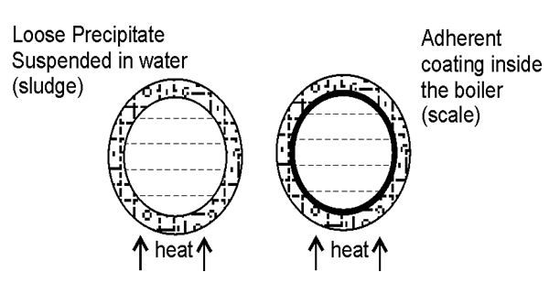
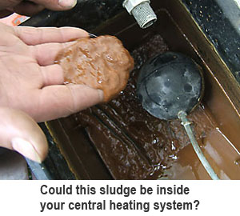
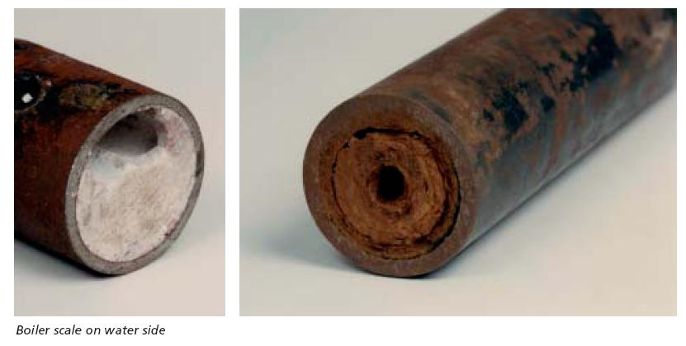
Examples of Sludge and Scale

Slide 32
Scales
Scales are the main source of boiler troubles.
Scale are mainly formed by decomposition of calcium bicarbonate
Ca(HCO₃)₂ CaCO₃ + H₂O +CO₂
Dissolved magnesium salts undergo hydrolysis forming magnesium hydroxide precipitate which forms a soft type of scale
MgCl₂ + 2 H₂O Mg(OH)₂ + 2 HCl
Presence of silica in small quantities deposits as calcium silicate (CaSiO₃) or magnesium silicate (MgSiO₃).
These deposits stick very firmly on the inner side of the boiler surface and
are very difficult to remove.
Scales reduce the thermal conductivity and if there is a crack on the scale, it may lead to differential heating and increases the possibility of boiler explosion.

Slide 33
Disadvantages of hard water
2. Priming and Foaming:
a) Foaming:
Foaming is the production of persistent foam or bubbles in boilers which do not break easily.
This is because of presence of oils which reduce the surface tension of water.
Can be avoided by adding anti-foaming agents like caster oil or removing oil from the boiler feed water by adding sodium aluminate.
b) Priming:
Along with steam, some particles of water are carried (wet steam) which is called priming.
This is because of large amounts of dissolved salts, high steam velocities, sudden boiling, improper boiler design, sudden increase in steam production rate.
Priming can be avoided by maintaining low water level in boilers, avoiding rapid steam generation, efficient softening, installing mechanical steam purifiers.

Slide 34
3. Caustic embrittlement:
Caused by using highly alkaline water in boiler
When water is softened by lime-soda process, free Na₂CO₃ is present in softened water.
In high pressure boilers, this Na₂CO₃ decomposes to NaOH and CO₂
Na₂CO₃ + H₂O 2 NaOH + CO₂
This NaOH makes the water caustic.
This NaOH flows through minute cracks present in the boiler by capillary action.
As water is boiling it evaporates and the conc. of NaOH increases.
This caustic soda attacks the boiler and forms sodium ferroate.
This makes the boiler parts brittle (embrittlement).

Slide 35
Concentration cell representation of caustic embrittlement
Caustic attack on boiler parts can be represented as:
+ _
Iron at Conc. NaOH Dil. NaOH Iron at
rivettes, soln. soln. Plane
bends, surfaces
Joints etc.
The iron in contact with dil. NaOH becomes cathode and the iron in contact with conc. NaOH becomes anode.
The anodic part slowly dissolves and corrodes.
Caustic embrittlement can be avoided by adding:
a) sodium phosphate (Softening agent)
b) tannin or lignin (Blocks hair line cracks)
c) sodium sulphate (Blocks hair line cracks)

Slide 36
4. Boiler corrosion:
Decay of boiler material by chemical or electrochemical attack by surrounding environment.
Reasons for boiler corrosion are:
a) Dissolved oxygen
b) Dissolved carbon dioxide
c) Acids from dissolved salts
a) Dissolved oxygen (DO):
2 Fe + H₂O + O₂ 2 Fe(OH)₂
2 Fe(OH)₂ + O₂ 2 Fe₂O₃.2H₂O (Rust)
DO can be removed by adding calculated qty. of sodium sulphite or hydrazine or sodium sulphide:
2 Na₂SO₃ + O₂ 2 Na₂SO₄
N₂H₄ + O₂ N₂ + 2H₂O
Na₂S + 2O₂ Na₂SO₄
DO can be removed by mechanical aeration also

Slide 37
4. Boiler corrosion:
b) Dissolved CO₂:
Dissolved CO₂ forms carbonic acid which corrodes the boiler slowly.
CO₂ + H₂O H₂CO₃
CO₂ is removed by adding calculated quantity of ammonia:
2 NH₄OH + CO₂ (NH₄)₂CO₃ + H₂O
It is also removed by mechanical aeration along with oxygen.
c) Acids from dissolved salts:
Dissolved magnesium salts hydrolyse to form acids:
MgCl₂ + 2 H₂O Mg(OH)₂ + 2 HCl
This acid reacts with boiler and corrodes:
Fe + 2 HCl FeCl₂ + H₂
FeCl₂ + 2 H₂O Fe(OH)₂ + 2 HCl
Small quantity of magnesium salts will large amount of boiler corrosion

Slide 38
Additional Information on Boiler troubles

Slide 39
Scale & Sludge Formation in Boilers
In boilers
– Concentration of the dissolved salts increases progressively when water evaporates during continuous steam generation. When their concentration reaches saturation point, the salts gets precipitated probably on the inner walls of the boiler.
If the precipitate is
- Soft, Loose, slimy precipitate - Sludge
- Hard, adhering crust/coating on the inner walls of the boiler- Scale

Slide 40
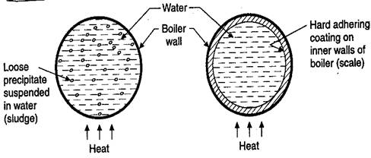

Slide 41
Sludge
Scale
Loose precipitate suspended in water
Boiler wall
scale
water
Heat
Heat

Slide 42
Scales Hard deposits, stick very firmly to the inner surfaces of the boiler Difficult to remove even with the help of hammer Main source for the boiler corrosion
Sludge - Soft, Loose, slimy precipitate
Can be washed easily using brush
Formed at comparatively colder places of the boiler
Collects in a system where the flow rate is slow like bends
Which are formed by the substances which have greater solubilities in hot than cold water (Example – MgCO₃, MgCl₂, CaCl₂, MgSO₄)

Slide 43
Disadvantages
Prevention
Poor conductor of heat – wastage of energy
If sludge formed along with the scale, sludge get entrapped within scale and both gets deposited as scale
Excessive sludge formation disturbs the working condition of the boiler
By using soft water
Frequent blow-down operation

Slide 44
Formation of Scales
Decomposition of calcium bicarbonate
Scales are the main source of boiler troubles. Scale composed chiefly of calcium carbonate is soft and is the main cause of scale formation in low-pressure boilers.
But in high-pressure boilers, CaCO₃ is soluble.
Scale
CaCO₃+ H₂O Ca(OH)₂ (Soluble) + CO₂

Slide 45
Decomposition of calcium sulphate
The solubility of calcium sulphate in water decreases with increase of temperature
The solubility of CaSO₄ is 3,200 ppm at 15°C and it reduces to 55 ppm at 230°C and 27 ppm at 320°C
CaSO₄ gets precipitated as hard scale on the heated portion of the boiler. This is the main cause of scales in high-pressure boilers.

Slide 46
Hydrolysis of magnesium salts
Dissolved magnesium salts undergo hydrolysis forming magnesium hydroxide precipitate which forms a soft type of scale
MgCl₂ + 2H₂O Mg(OH)₂ + 2HCl
Presence of Silica
presence of silica in small quantities deposits as calcium silicate (CaSiO₃) or magnesium silicate (MgSiO₃). These deposits stick very firmly on the inner side of the boiler surface and are very difficult to remove

Slide 47
Disadvantage of scale formation
Low thermal conductivity
Lowering boiler safety
Decrease in efficiency
Danger of explosion
Thickness of scale in (mm) | 0.325 | 0.625 | 1.25 | 2.5 | 12
Wastage of fuel | 10% | 15% | 50% | 80% | 150%

Slide 48
Removal of Scales
By giving thermal Shock if they are brittle (heating the boiler and then suddenly cooling with cold water)
If they are adherent and hard dissolving them with help of chemicals.
Calcium carbonate scales can dissolved by using 5-10% HCl.
Calcium Sulphate scales can be dissolved by adding EDTA (ethylene diamine tetra acetic acid) with which they form soluble complex.
Frequent blow down operation

Slide 49
Prevention of scale formation
Internal Treatment
Colloidal Conditioning
Phosphate conditioning
Carbonate conditioning
Calgon conditioning
Treatment with sodium aluminate
External Treatment
The treatment includes efficient ‘softening of water’
Removing hardness-producing constituents of water

Slide 50
Prevention of scale formation
Internal Treatment
In this process, an ion is prohibited to exhibit its original character by ‘Complexing’ or converting into other more stable salt by adding appropriate reagent.
Colloidal Conditioning:
In low-pressure boilers, scale formation can be avoided by adding substances
Kerosene, tannin, agar-agar : non-sticky and loose deposit
Blow-down operations - removal

Slide 51
Phosphate Conditioning: High-Pressure boilers
Sodium phosphate
Optimum pH – 9.5 to 10.5
NaH₂PO₄
Na₂HPO₄
Na₃PO₄
3CaSO₄+ 2Na₃PO₄ -----------Ca₃ (PO₄)₂ ↓+ 3 Na₂SO₄
3CaCl₂+ 2Na₃PO₄ -----------Ca₃ (PO₄)₂ ↓+ 6NaCl
Carbonate Conditioning: Low-Pressure boilers
Sodium carbonate
CaSO₄+ Na₂CO₃----------- CaCO₃ + Na₂SO₄
Calgon Conditioning:
Sodium hexa meta phosphate
Na₂ [Na₄ (PO₃)₆] ↔2Na⁺ + [Na₄ (PO₃)₆]²⁻
2CaSO₄+ [Na₄ (PO₃)₆]²⁻ →[Ca₂ (PO₃)₆]²⁻ + 2Na₂SO₄
Treatment with sodium meta aluminate:
NaAlO₂ +2H₂O →NaOH+Al[OH]₃↓
MgCl₂ +2NaOH →2NaCl+Mg(OH)₂↓

Slide 52
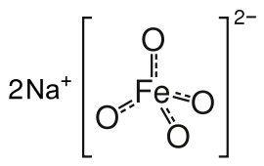
Caustic Embrittlement
Its a kind of boiler corrosion, caused by using highly alkaline water in the boiler
Na₂CO₃ + H₂O 2NaOH +CO₂
Minutes cracks – present in boilers
Water evaporates – dissolved caustic soda concentration increases progressively
This causes embrittlement of boiler parts particularly stressed parts (bends, joints, rivets, etc.)
Sodium Ferrate
+
__
Iron at stressed parts
Conc. NaOH solution
Dil. NaOH solution
Iron at plane surfaces

Slide 53
Caustic embrittlement can be avoided
By using sodium phosphate as softening reagent instead of sodium carbonate
By adding tannin or lignin to the boiler water which block the hair cracks and pits
By adding sodium sulphate to boiler water, which also blocks the hair cracks and pits
1:1 2:1 3:1
10 atm 20 atm >20 atm

Slide 54
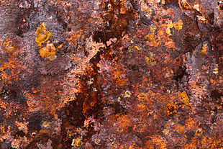
Boiler Corrosion
It’s a decay of boiler material by chemical or electro-chemical attack by its environment
(1) Dissolved oxygen in water at high temperature attack boiler material.
Fe + 2H₂O + O₂ Fe(OH)₂
Fe(OH)₂ + O₂ 2[Fe₂O₃.2H₂O]
(Ferrous hydroxide) (Rust)
Removal of dissolved oxygen
By adding calculated quantity of sodium sulphite or hydrazine or sodium sulphide
Na₂SO₃ + O₂ 2Na₂SO₄
N₂H₄ + O₂ N₂+ 2H₂O
Na₂S + 2O₂ Na₂SO₄

Slide 55
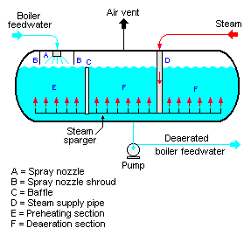
Removal of dissolved oxygen by de-aeration
Water spraying in a perforated plate-fitted tower, heated from sides and connected to Vacuum pump. High temperature, low pressure and large exposed surface reduces dissolved oxygen in water

Slide 56
Dissolved Carbon dioxide
H₂CO₃ is carbonic acid which has corrosive effect on the boiler material
Removal of CO₂
By adding calculated quantity of ammonia
2NH₄OH + CO₂ (NH₄)₂CO₃ + H₂O
Acids from Dissolved Salts
Water containing dissolved magnesium salts liberate acids on hydrolysis
MgCl₂ + 2H₂O Mg(OH)₂ + 2HCl
The liberated acid reacts with iron of the boiler in chain-like reactions producing HCl again and again. As a result presence of even a small amount of MgCl₂ will cause corrosion of iron to a large extent.
Fe + 2HCl FeCl₂ + H₂
FeCl₂ + 2H₂O Fe(OH)₂ + 2HCl

Slide 57
Priming
When a boiler is steaming rapidly some particles of the liquid water are carried along with the steam. Its called priming.
Presence of large amount of dissolved solids
Sudden boiling
Improper boiler design
Foaming
It is the production of persistent foam or bubbles in boilers, which do not break easily. It is due to the presence of oil.
Priming and foaming occur together
Priming can be avoided by
Fitting mechanical steam purifier
avoid rapid change in steaming rate
Foaming can be avoided by
adding anti-foaming agent like castor oil
Removing oil from boiler water by adding compounds like sodium aluminate

