Slide 1
Acrysion with Airbrush
Twitter ：@kazz185
Blog ：https://kazz185.work

Slide 2
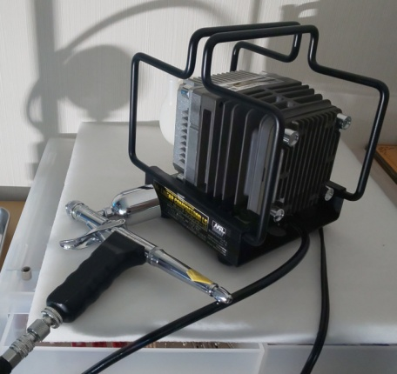
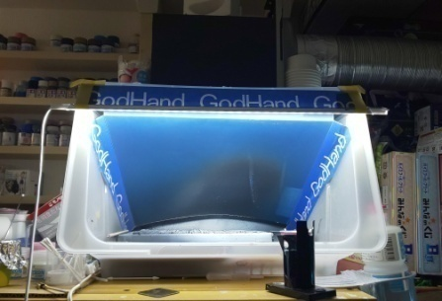
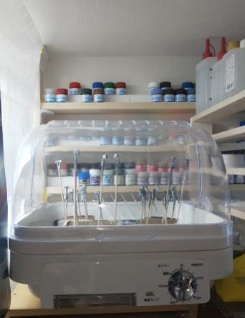
Painting Environment for Acrysion（1/2）
My Working Room
Room in th Attic
It's small and dry
Compressor
MR.LINEAR COMPRESSOR L5/PS289 AIRBRUSH
A full set of Mr.LINEAR COMPRESSOR L5
with airbrush Mr.PROCONBOY WA PLATINUM(0.3MM)
VER.2 and Mr.AIR REGULATOR Mk-Ⅳ.
Airbrush
MR.PROCON BOY LWA TRIGGER TYPE (0.5MM)
+PS-290G
ADDITIONAL GRIP FOR PS290
Painting Booth
D.I.Y
Ventilation fan
FY-24BM6K （Panasonic）
Quiet fan(38.5dB)
https://kazz185.work/post/10/
Drying booth
Tableware dryer (By Yamazen)

Slide 3
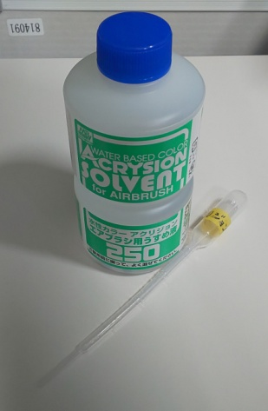
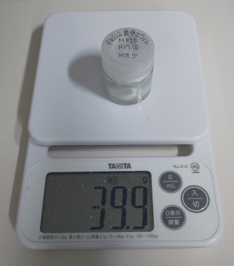
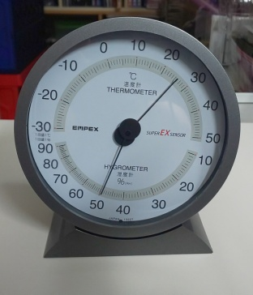
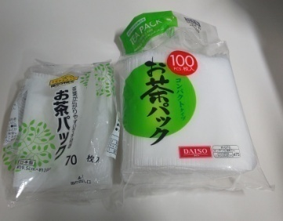
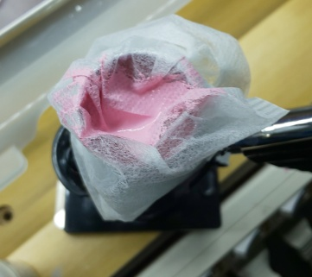
Painting Environment for Acrysion（2/2）
Thermo-Hygrometer
EX-2717（empex）
Kitchen scale
KJ-212（TANITA）
Can measure up to 0.1g
With tare function
Acrysion Thinner
Acrysion thinner for Airbrush
This is recommeneded Not only for airbrush
but also brush painting.
From now on, simply referred to as “Acrysion Thinner”
Green Tee Filter (Tea Bag)
This is the most important item for airbrush painting
with Acrysion
Cover the cup, pour in to filter Acrysion.
Others
Using Paint Stirrer (TAMIYA)

Slide 4
About dilution with an airbrush（1/2）
About dilution
Shake Acrysion thinner WELL
It is normal that it is cloudy in white.
Acrysion Series (N-xx)
Acrysion to Thinner ratio is 1:0.84
However, it is about 0.8-0.9
Ex) Acrysion is 0.5g and Thinner is 0.42g
First, put 0.5g of Acrysion in a paper cup.
Next, add Thinner until it reaches 0.9g.
Acrysion Clear Series（N-20,N-30）
Acrysion to Thinner ratio is 1:2 (and more ?)
During verification (Sorry)

Slide 5
About dilution with an airbrush（2/2）
Acrysion BaseColor Series (BN-xx)
Acrysion to Thinner ratio is 1:1.1
Base White (BN-1) is 1:1.1
Base Gray (BN-2) is 1:1.2
Dilution is changed by color

Slide 6
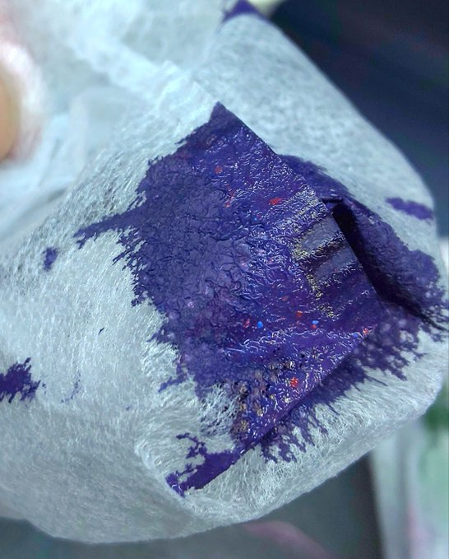
Painting with airbrush and air pressure （1/2）
Filter before blowing with an airbrush
When you open and close the bottle, paint debris that has adhered to the inside of the lid will enter the bottle.
This is one of the causes of clogging.
Another cause is a High Pressure, I think.
It is a mixture of metallic blue and metallic red.
Can you see the red and blue pieces?
Mix well to scoop the bottom of the bottle
Low Pressure（0.03MPa）
High-pressure blowing accelerates drying
This is the cause of clogging
So, You can paint well with L5
Repeat spraying and drying
The amount of paint is adjusted as follows
PS290 Needle Stopper Possion
From the fully occupied state to the one-lap (330°?) loose state
330°
View from behind

Slide 7
Painting with airbrush and air pressure （2/2）
“Gargle” from time to time
The airbrush, not YOU
Loosen the nozzle and let the air flow backwards
Metallic paint easily precipitates
Uploading video to YouTube
My Channel
https://www.youtube.com/channel/UC32cECtyWwPM_kXqcSzQwIA/
Contents
How to Dilution
https://youtu.be/DA5-EkQoN-c
Acrysion BaseColor with AirBrash
https://youtu.be/j-8x_5SbuKo

