Slide 1
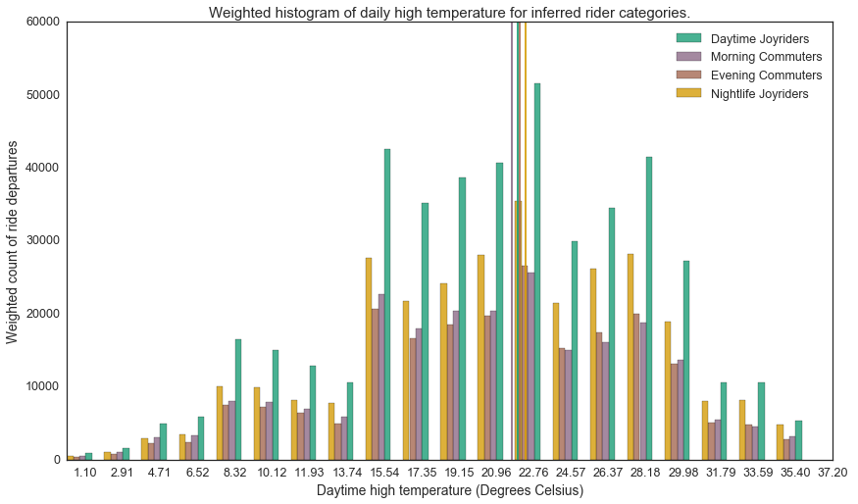
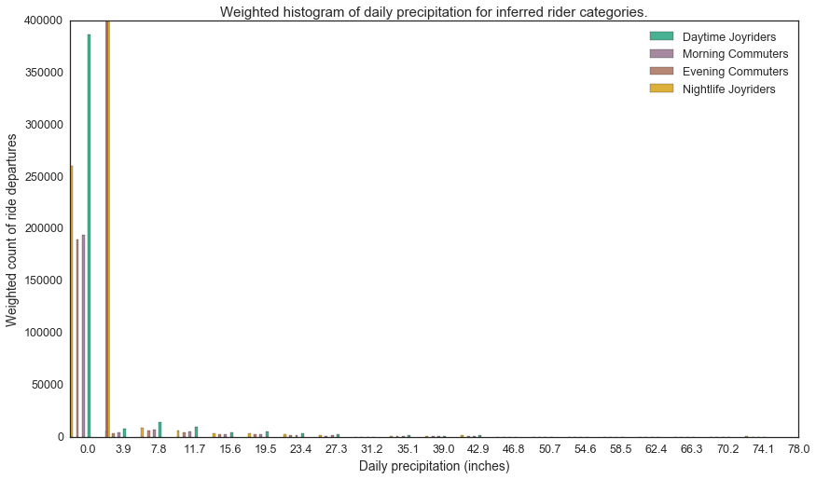
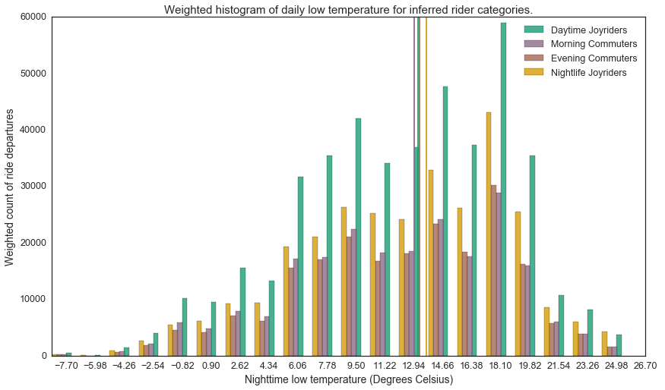
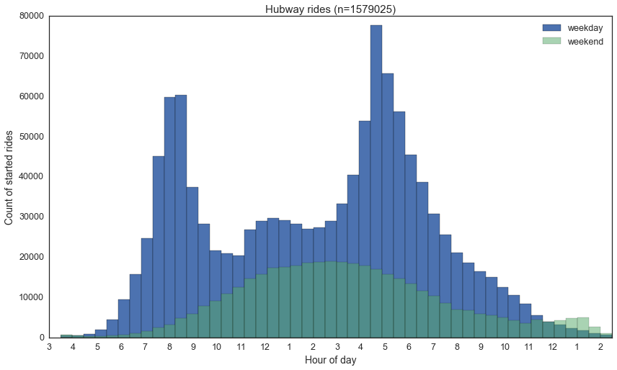
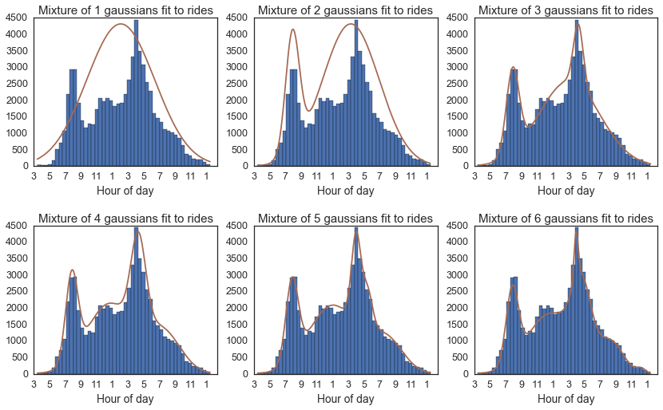
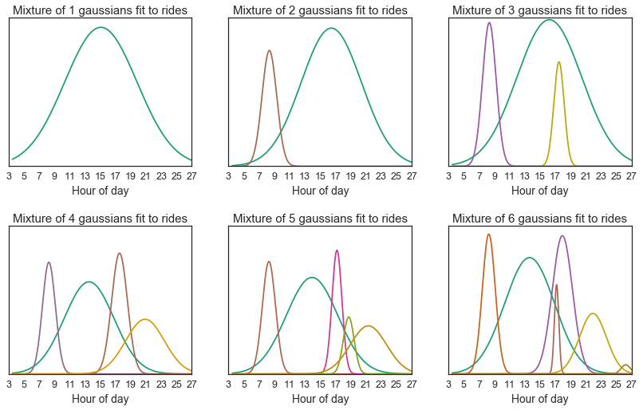

The Effects of Weather on Stratified Hubway Ridership
Kevin Burek and Josh Mclellan
kevin.burek@gmail.com, jvl.mclellan@gmail.com
APMA E-207
Spring 2016
Introduction
This project aims to discover patterns in the habits of bicycle share users. We analyze ridership logs with respect to historical weather data, in order to explore the validity of different modeling hypotheses. In brief, we modeled the possibility that ridership may be composed of two different constituencies, commuters and joyriders, which are affected differently by varying weather conditions. Our analysis did not result in discovery of obvious trends of this variety, but there exist opportunities for the incorporation of additional indicator conditions and prior beliefs.
The HubwayTM bicycle share system serves riders in the urban core and near suburbs of Boston. The system is peculiar if not unique among bicycle shares across the nation in its users’ tendency to exhaust capacity on a daily basis. Active re-balancing of bicycles is necessary to keep the system running smoothly [1]. (Any insight into ridership dynamics could help better serve the citizens of Boston). This project aims to discover patterns in the riding habits of the system’s users with relation to the commitment category of the ride and environmental factors. We analyze ride logs with respect to historical weather data, in order to explore the validity of different modeling hypotheses. We model a belief that ridership may be composed of two different constituencies, which are affected differently by varying weather conditions.
blah blah blah
Data
Morning commuters
Daytime joyriders
Evening commuters
Nighttime joyriders
When we examined the summary statistics for weather data associated with each inferred rider label, we found such small deviations in those numbers as not to merit rigorous testing. (<1°C, < .2 mm) (fig. 4).
Hubway ridership data was published by the service provider for a data visualization competition [2]. The data includes a line for each ride taken in the bike share system from its inception in July 2011 through the end of the 2012 season: 1.5M records. Notably, the data has no direct assignment of commuter status.
For weather data, we turn to NOAA, whose National Centers for Environmental Information provides the service of publishing Climate Data Online. We requested and received a data set including daily observed weather conditions for the relevant time period, for the Boston metropolitan area [3].
Figure 4. Weather by rider category
Approach
Conclusions
We made use of the considerable power that exists in libraries for scientific computing in python. After loading and cleaning the ridership and weather data in a pandas DataFrame, we tagged the ridership data with the daily weather data, and cached the result, using pickle, as the above steps took more than 20 minutes to run. We made a cursory examination of the data by plotting a histogram of departure counts by time of day. (fig. 2). This examination confirmed some hunches we had about the data, and recommended an approach we learned in AM207 this semester: expectation maximization.
By formulating the E and M update steps for the component weights and model curve parameters, respectively, we were able to infer a weighed labelling of individual rides from the ridership log, based solely on the time of departure. (fig. 1)
From this point, we hoped to observe a marked difference in weighted summary statistics inn the weather measures tagged on the rides, across ridership categories.
We must reject our hypothesis that weather impacts commuters and joyriders differently in the Hubway system.
There is more room for analysis of this data. Primary avenues for approach are to add more indicators to the likelihood used in weight-updates of Expectation Maximization, such as ride duration, subscription status, or whether there is a Red Sox game. The model would also benefit from a hierarchy that distinguishes between rental locations, since demand patterns for different parts of the city vary greatly from morning to evening, and our current system-wide model does not capture this.
Figure 2. Time of day for ride departures
Results
Using expectation maximization, we were able to fit a mixture of 4 Gaussians to the ridership histogram. (fig. 3).
Citations and Links
[1] https://www.thehubway.com/news/2016/04/13/rebalancing-act “(Re) balancing Act”. Web Page. Retrieved 3 May 2016
[2] http://files.hubwaydatachallenge.org/hubway_2011_07_through_2013_11.zip "Hubway Data Challenge." hubway_2011_07_through_2013_11. Zip Archive. Retrieved 16 March 2016.
[3] http://www.ncdc.noaa.gov/cdo-web/datasets/GHCND/locations/CITY:US250002/detail "NOAA National Centers for Environmental Information." Daily Summaries Location Details: Boston, MA
[4] http://www.stat.columbia.edu/~gelman/research/unpublished/loo_stan.pdf A. Gelman, A. Vehtari, J. Gabry; "Practical Bayesian model evaluation using leave-one-out cross-validation and WAIC” pdf. Retrieved 27 April 2016.
[5] https://github.com/pymc-devs/pymc3/issues/888 . Github user:aloctavodia. “Implementing WAIC”. Web Page. Retrieved 27 April 2016.
Figure 3. Similarity of Sum of Gaussians to histogram of weekday ridership
Using AIC scores [4,5] for the various models, we chose to proceed with the 4-component model, with the following label interpretations:
Figure 1. EM fitting different numbers of Gaussians
School of Engineering and Applied Sciences • Institute for Applied Computational Science

