Slide 1
MOBILITY PLATFORM / 2026
Smart Parking Finder
Turn every empty space into income and every driver's search into a single tap.
Notes:
Welcome everyone. Smart Parking Finder bridges the urban gap between wasted private spaces and frustrated drivers.

Slide 2
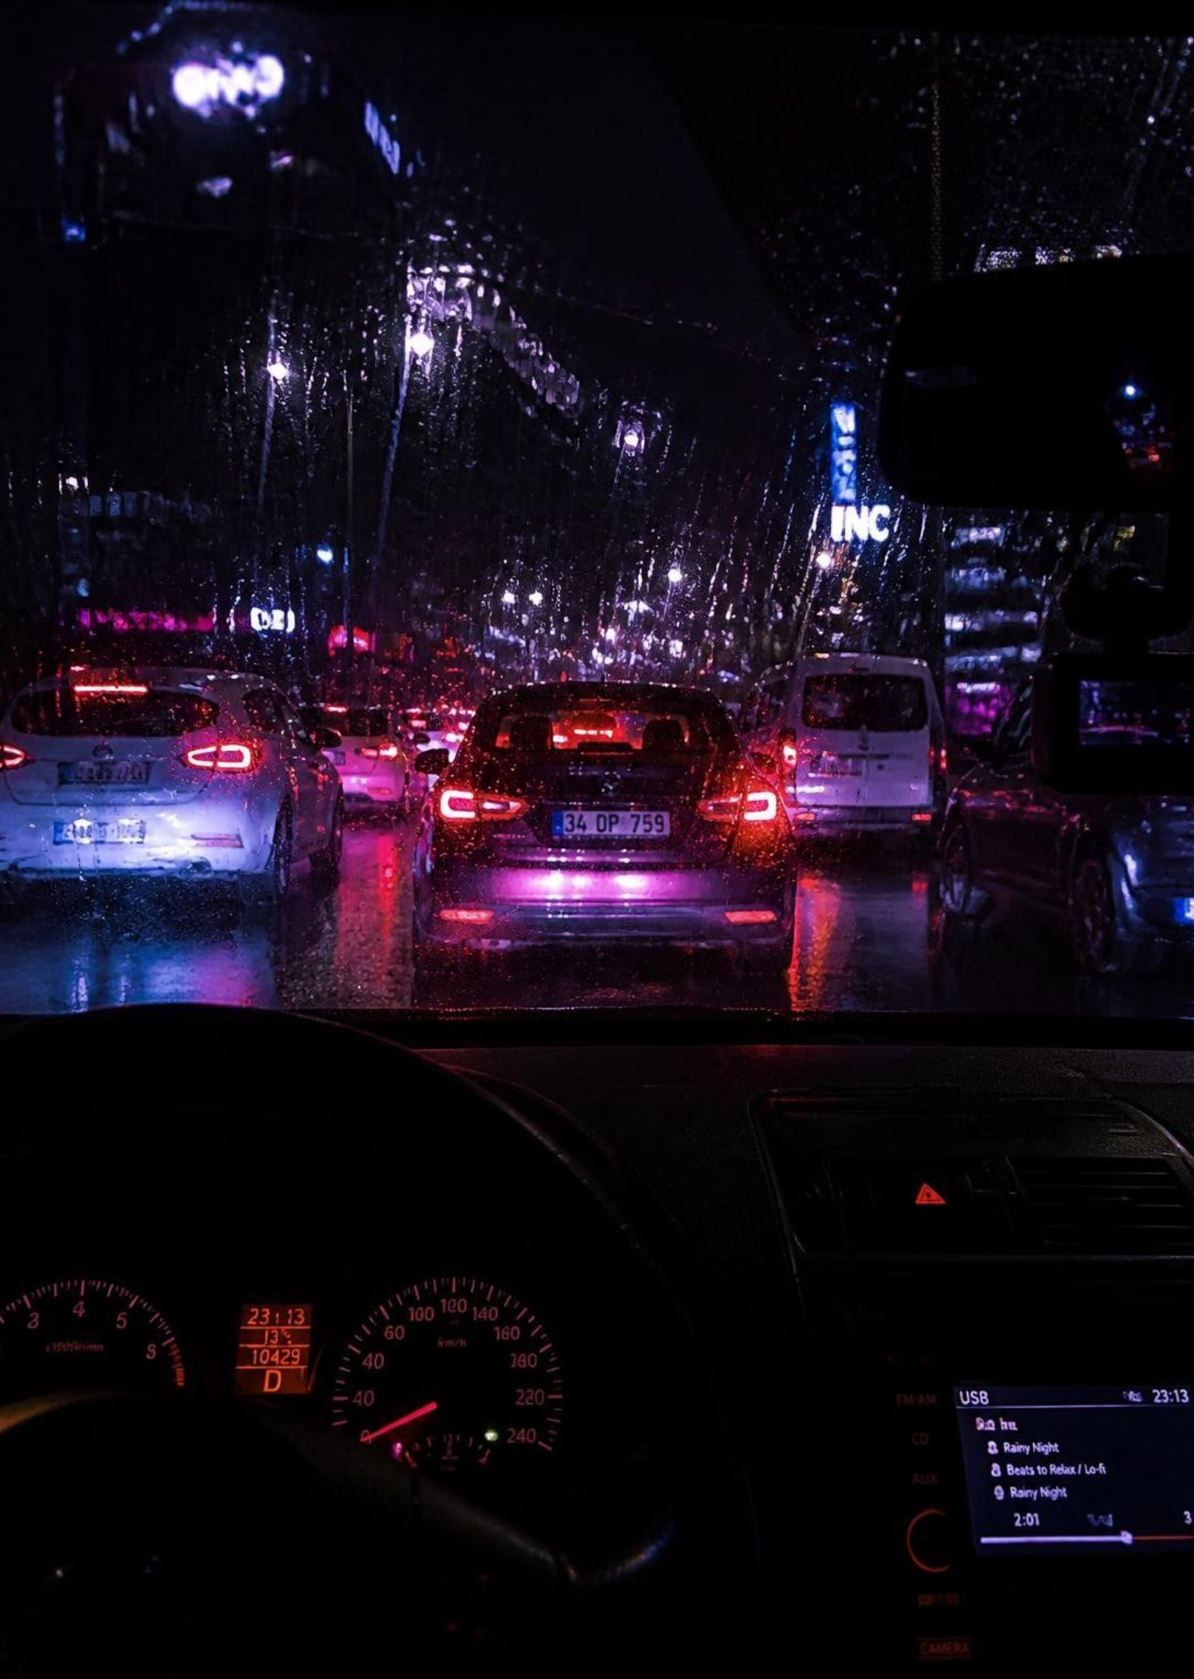
01 — URBAN CHALLENGE
Problem Statement
Drivers spend 10-20 minutes searching for parking, causing traffic, fuel waste, emissions, and stress.
2
Notes:
Cruising for parking accounts for a massive share of downtown traffic congestion and unnecessary carbon emissions.

Slide 3

02 — CORE CONCEPT
Our Solution
A two-sided platform connecting drivers with unused private parking spaces in real time.
3
Notes:
We unlock underutilized inventory: residential driveways, commercial slots, and private garages.

Slide 4






03 — CAPABILITIES
Key Features
Live Availability Map
Instant Booking & Payment
Owner Dashboard
Smart Pricing
Navigation
Ratings & Verification
4
Notes:
Each feature addresses friction points across search, trust, booking, and route guidance.

Slide 5
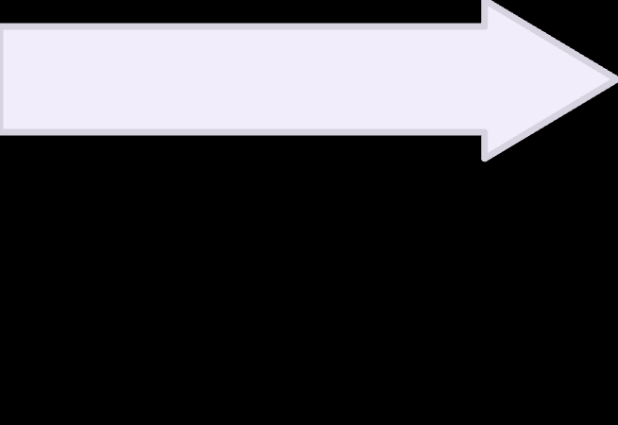




04 — END-TO-END FLOW
How It Works
Owner receives earnings
QR code entry/exit
Driver books & pays
Driver searches destination
Owner lists space
5
Notes:
A seamless frictionless lifecycle from listing through automated payout.

Slide 6
05 — ARCHITECTURE
Technology Stack & Uses
Technology Component | System Role & Application
React Native/Flutter | Mobile App UI
Node.js/FastAPI | Backend APIs & Booking Logic
PostgreSQL | User, booking & payment data
Firebase | Real-time availability updates
Google Maps/OpenStreetMap | Maps & navigation
Razorpay | UPI Payments
QR Codes | Secure access
IoT Sensors |  |  | Future occupancy detection
6
Notes:
Modern, scalable infrastructure designed for low-latency updates and reliable transaction security.

Slide 7
06 — MONETIZATION
Business Model
TRANSACTIONAL
B2B CONTRACTS
PROMOTION
10-15% commission per booking
Commercial subscriptions
Premium parking listings
7
Notes:
Multiple diversified revenue channels spanning marketplace commissions, enterprise recurring plans, and featured listings.

Slide 8




07 — VALUE CREATION
Impact
MOBILITY
ENVIRONMENT
FINANCIAL
PRODUCTIVITY
Less traffic congestion
Lower emissions
Extra income for owners
Time savings for drivers
8
Notes:
Tangible, compounding benefits for both city infrastructure and individual ecosystem participants.

Slide 9
08 — VISION
Future Roadmap
PHASE 1
PHASE 3
IoT-based occupancy detection
Smart city integration
PHASE 2
AI-powered dynamic pricing
9
Notes:
Our growth vector progresses from automated hardware detection toward full integration with metropolitan traffic grids.

Slide 10
Thank You
Questions?
Notes:
Thank you for your time. Let's open the floor to questions and discussion.

