Slide 1
Hit Level Data Processing

Slide 2
Problem Statement
Architecture
Analysis
Complexity
Consideration
Scalability
Recommendations
Results
Deployment/Execution

Slide 3
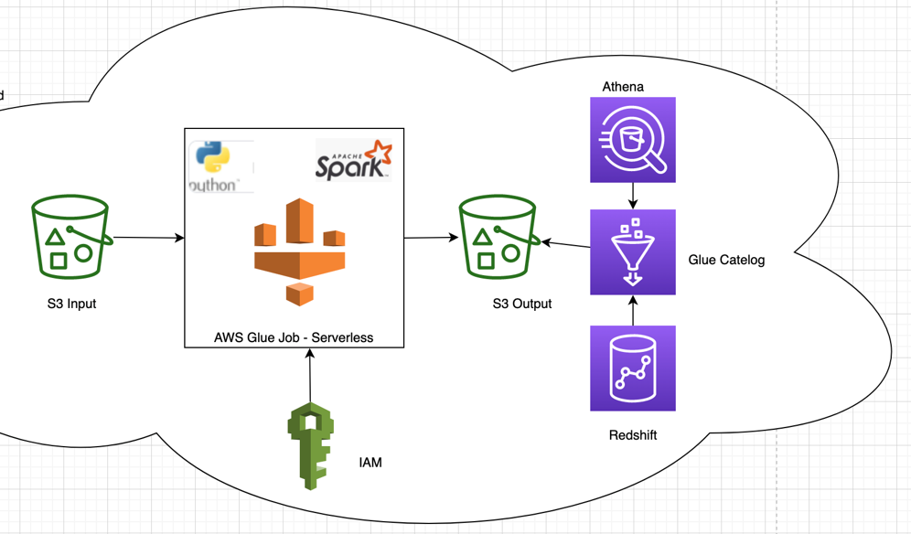
Architecture
AWS Services Used in the development
S3 - Data storage (input and output)
Glue – ETL processing Serverless
Spark API and Python Programming
IAM – Access management S3 and Glue Service
AWS Services for customer(optional)
Glue Catalog – Hive Metastore
Athena – output query processing
Redshift – optional database to access output data for SQL engine

Slide 4
Problem Statement
How much revenue is the client getting from external Search Engines, such as Google, Yahoo and MSN, and which keywords are performing the best based on revenue?
Tab delimited Output file name as [Date](yyyy-mmdd)_SearchKeywordPerformance.tab with below listed fields. Output data should be in Revenue amount sorted order
•Search Engine Domain (i.e. google.com)
•Search Keyword (i.e. "Laffy Taffy")
•Revenue (i.e. 12.95)
Development Requirements
Python programming
At least one python class
Input file as an argument

Slide 5
Analysis
Understand and Analyze Business Requirements
Sample Data Analysis is the key starting point to solve this business problem
Analyze complex data type fields event list and product list
Analysis helped filter data. In this case Purchase event which is event =1 data only needed to determine actual Revenue
Data Size – it can go up to 10 GB,so large volume of unstructured data
Required fields needed to address the business problem
Product list
Event list
Referrer

Slide 6
Complexity
Easy to read Input file which is tab delimeted data with field names in header row
Event List – Complex field required to split into python list and transpose the data into rows so that we can easily filter purchase event data
Product List – complex field required to split into python list and transpose the data into rows. Also need to parse list into additional fields
[Category];{Product Name];[Number of Items];[Total Revenue];[Custom Event]|[Custom Event];[Merchandizing eVar],.
Referrer – Medium complex .. Take out the search engine domain from this field which is required in the final output

Slide 7
Considerations
Given the nature of the data and volume of the data to be processed, code is developed in python programming language with Spark API framework and embedded within AWS Glue job.
Recommendation is to load Customer data in S3 input location. We can set up life cycle policy implementation to keep it for days/weeks or we can delete as soon as the input file is processed.
AWS Glue job will initiate Glue Context along with Spark Session
Glue 3.0, Spark 3.1 and Python 3 versions are used
Sample data executed with 2 workers used
IAM role attached for read and write data to S3
Spark with Glue ETL is the appropriate ETL solution for this case and we can increase worker capacity in Glue job when the input volume is high.

Slide 8
Scalability
AWS Glue ETL implementation is serverless implementation. We can increase worker capacity and worker type when the input data size is high during peak times. We can reduce the same when we have to process low volume dataset.
Serverless option is cost effective for customer as they pay only for job execution time
AWS Glue now coming with 3.0 version which supports latest spark version 3.1 and Python 3 version, this is good to leverage inbuilt libraries for complex data processing
Code is developed with fault tolerance. The job can rerun with no data issues.
Developed Code is portable and we can execute the same in other AWS services like Lambda and EMR with minimal changes to the code.

Slide 9
Recommendations
(Optional)
Create Glue Catalog table with S3 output data
Glue Catalog table can be queried in AWS Athena for quick analysis
Glue Catalog database/table can be used as an external database/table in AWS Redshift database for further Analysis and Reporting

Slide 10
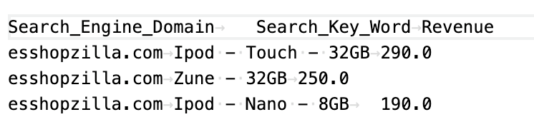
Results
AWS Glue job ran successful with 2 worker capacity on G1.X type.
Sample Results provided above
We can filter customer website search records if customer don’t want it in output file

Slide 11
Deployment/Execution
AWS Console:
IAM role with one inline policy with get, put and delete object on specific S3 bucket/location. Attach Glue Service Role managed policy to allow permissions to Glue service
Go to AWS Glue -> Glue Studio -> Create job by editing script by uploading or copy Programming_Exercise.py code and save the job
3. In Glue job advanced options add these parameters with values
--file_name data.tsv
--s3_bucket s3-example
--input_path input
--output_path output
4. Attach IAM policy created in step 1, Choose 2 worker capacity and type G1.x to Run the job
. CI/CD:
We can checkin code in git repository and deploy the code through CI/CD.
I haven’t implemented this for this exercise
Set up airflow job with required parameters and run at specific schedule date/time

