Slide 1
Classifying text data - dowker complex
Researcher: Jaehee Lee
Advisor: Dr. Robinson

Slide 2
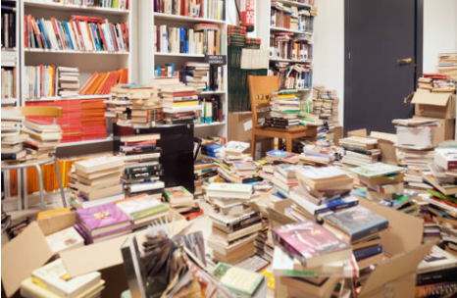
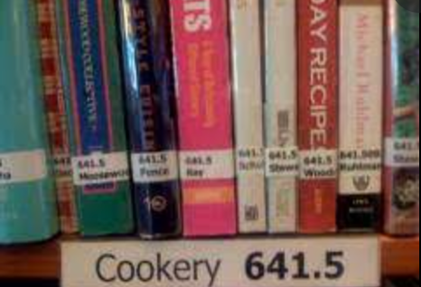
Introduction
Dewey Decimal Classification (DDC)
Term Frequency-Inverse Document Frequency (TF-IDF): Calculate the importance of a word in a document
In some cases, TF-IDF is not effective
The Dowker Complex -> Explore how relevant the terms are between the documents.

Slide 3
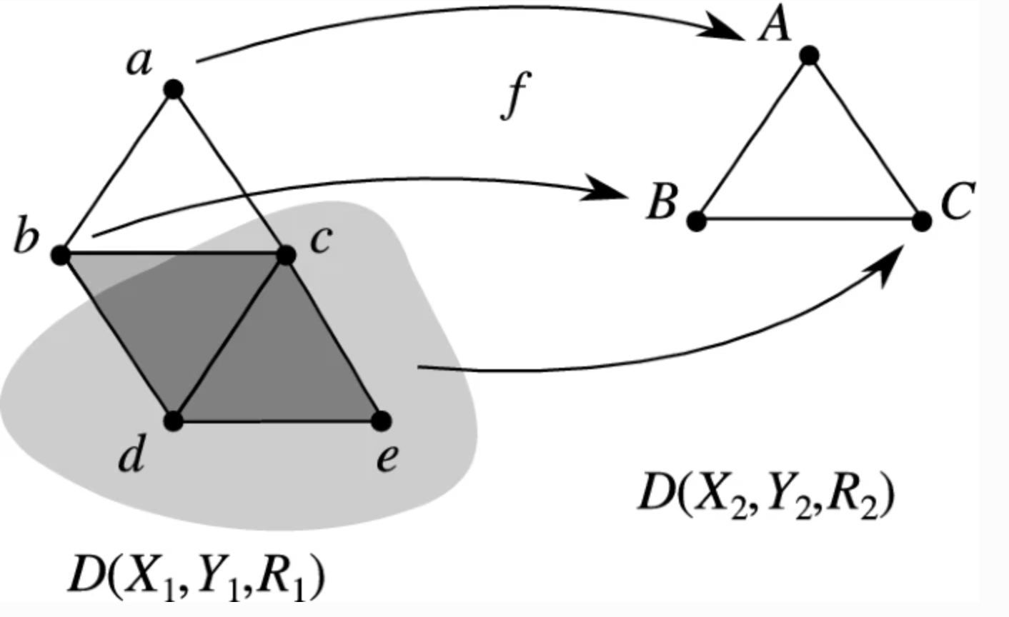
Dowker complex
In 1951, Dowker introduced
The structure of an abstract simplicial complex
Potentially used in many areas such as Mathematics and Data Science (Ghrist, 2014)
Used the Dowker Complex based on word usage among documents
In a matrix format to represent the relationship between terms and documents
[Cosheaf representations of relations and Dowker complexes, Dr. Robinson, 2022]

Slide 4
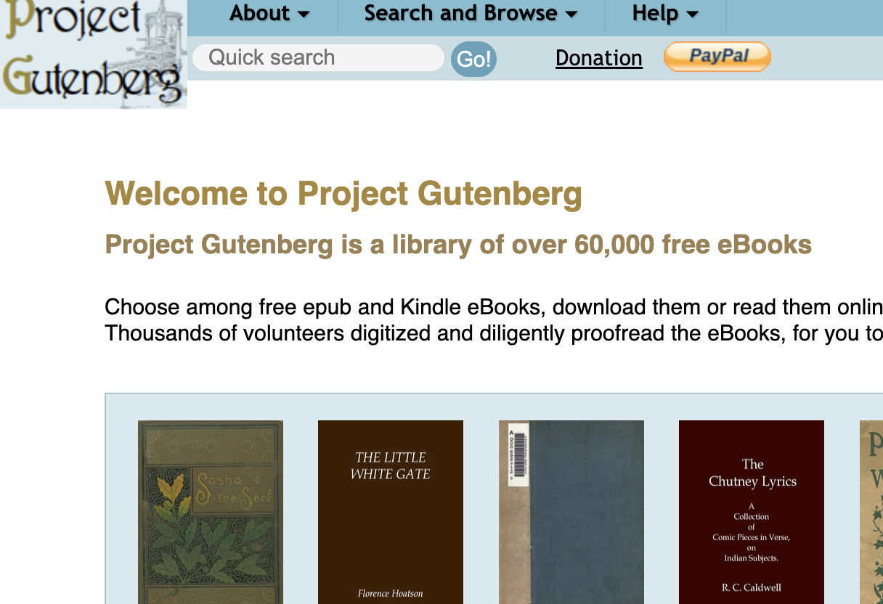
Research materials
Research Goal: Classify documents into specific topic categories based on relevant/common terms
Tool: R
Method: Dowker Complex
Data: gutenbergr library
Sample Size: 100 books
Topics: Politics, Art, Biology, Cookery, Travel

Slide 5
procedures
Gutenberg library download 100 books (politics 20 , art 20, biology 20, cookery 20, travel 20)
Convert text to a corpus
Clean corpus
Apply TDM (Terms Document Matrix)
Identify non-zero values
Apply Dowker Complex Function designed by Dr. Robinson

Slide 6
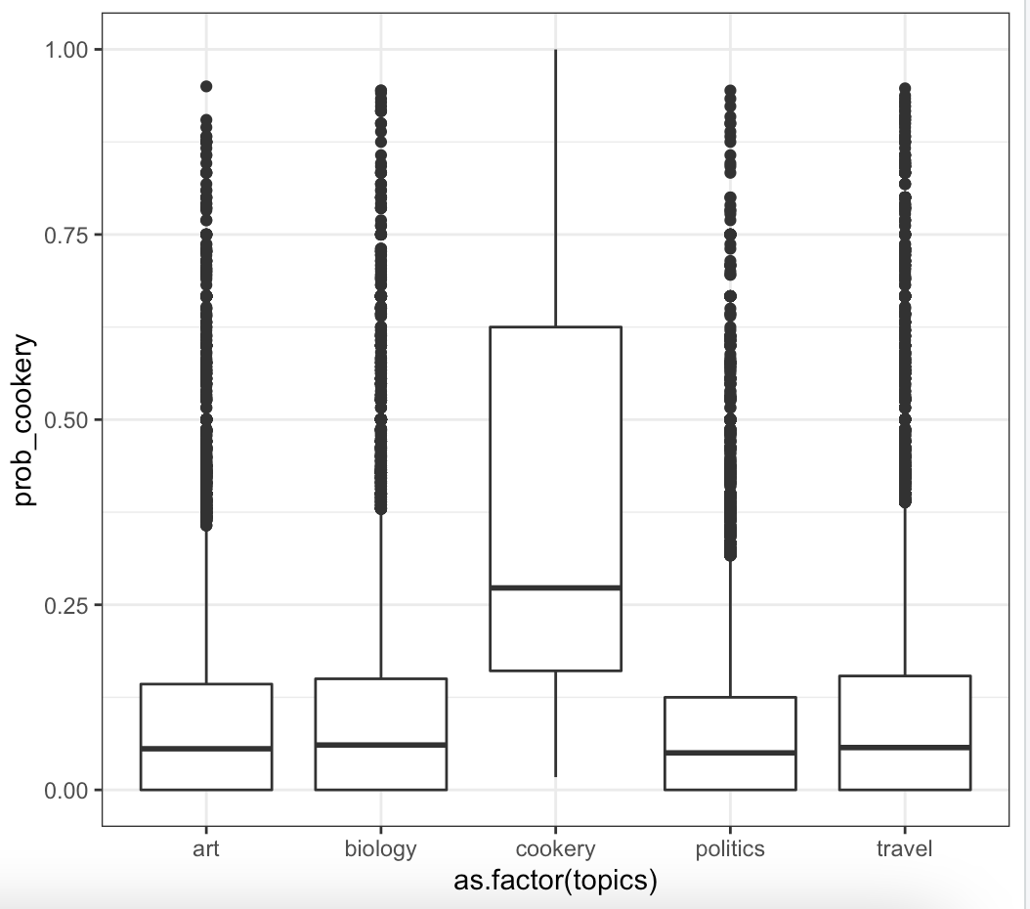
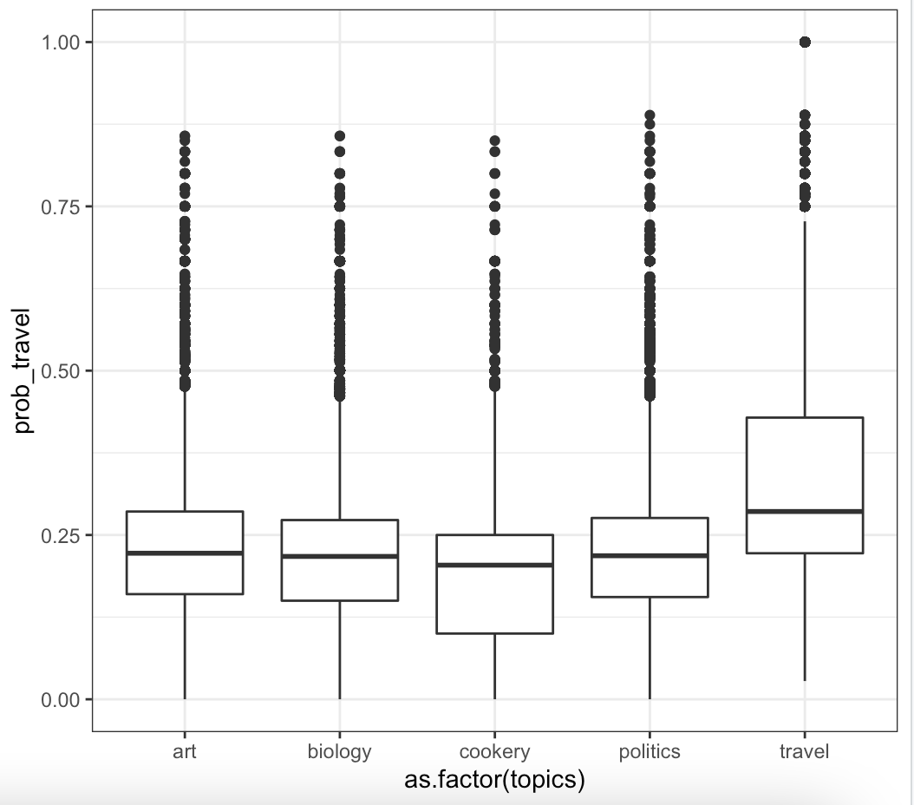
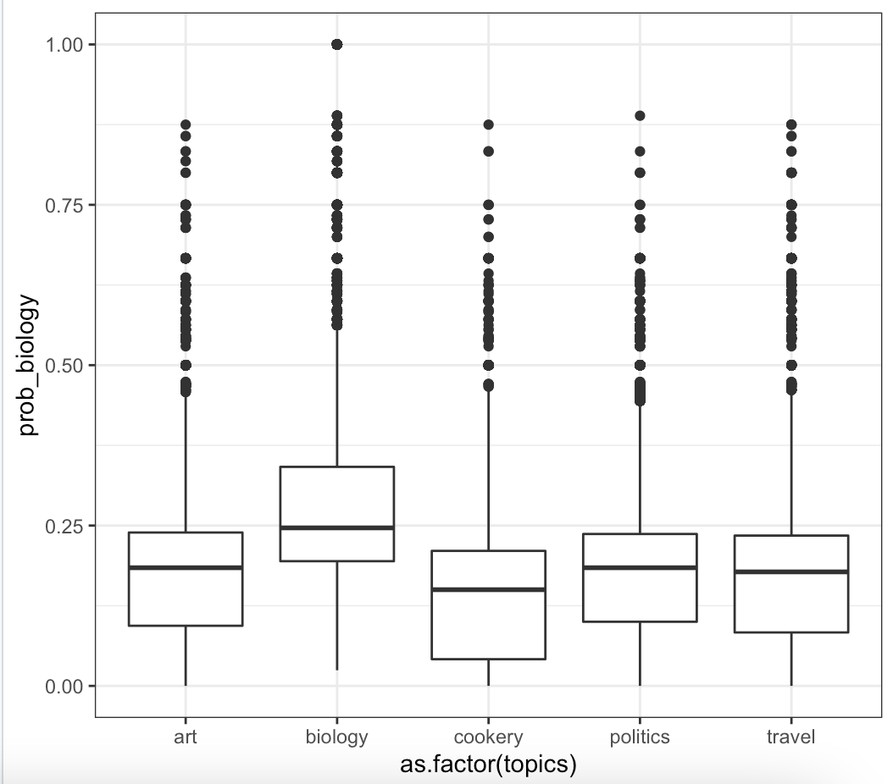
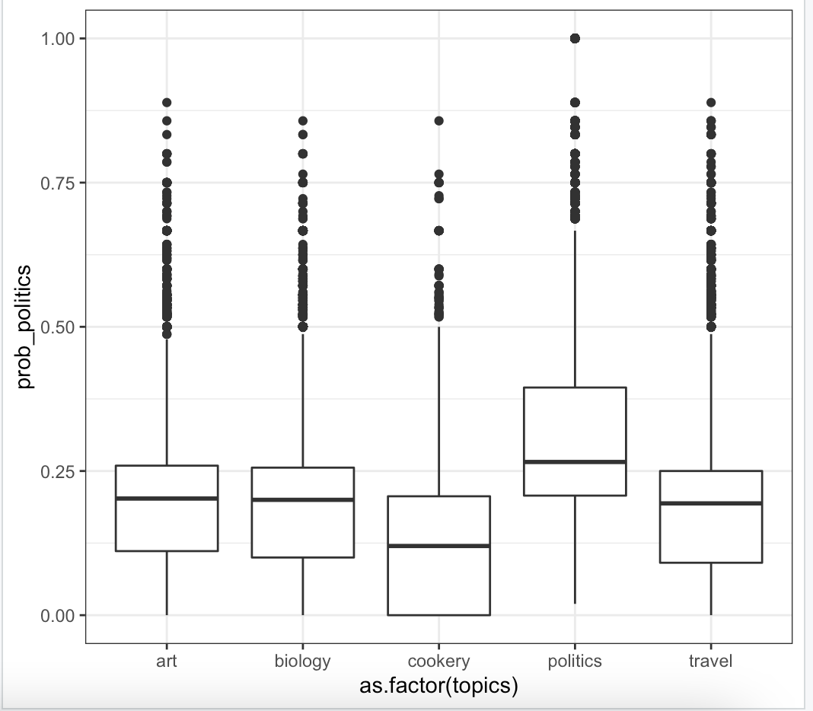
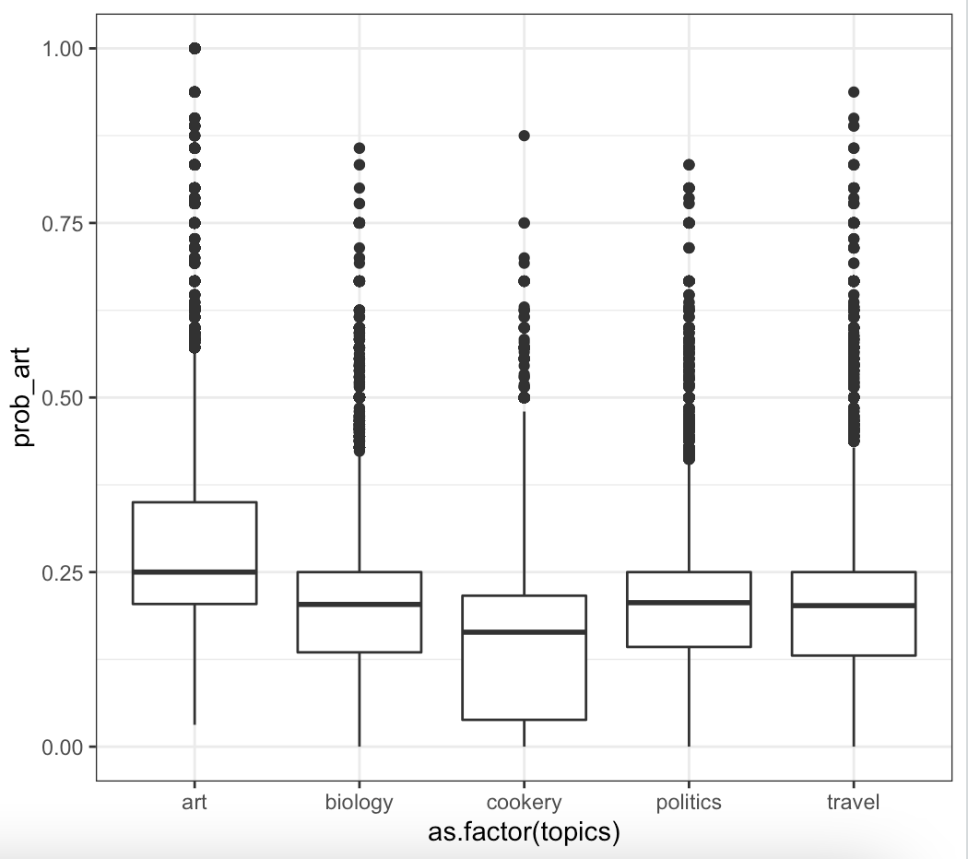
RESULTS
The current results show that the Dowker Complex separates the documents by their topics, as measured by the topic's probability, more efficiently than TF-IDF.

Slide 7

future direction!
This research can be applied to help search engines rank documents by relevant terms.

Slide 8
references
Robinson, M. Cosheaf Representations of Relations and Dowker Complexes.
https://www.istockphoto.com/photos/messy-library-book-stack

Slide 9
Q & A
THANK YOU

