Slide 1

Daria – Deloitte Advanced Research & Interview Assistant
Transforming User Research with Generative AI
April 2025

Slide 2

AGENDA
Problem Statement & Industry/ Market Evidence
Solution Overview & Benefits to Users
How will you scale? What’s Next?
Team & Process followed

Slide 3
Problem Statement
INDUSTRY FOCUS
DARIA is a UX Research tool focusing on user interviews, journey mapping, and persona creation. It's ideal for UX researchers, product designers, and service designers in technology companies, consulting firms, and digital transformation projects. DARIA supports application evaluation and exploratory research, making it valuable in software development, digital service design, and customer experience optimization, especially in industries like healthcare, finance, retail, and enterprise software.
PROBLEM BEING SOLVED?
UX researchers face significant challenges in conducting, documenting, and analyzing user interviews at scale. The manual process of interviewing, transcribing, and creating research artifacts like personas and journey maps is time-consuming, often leading to bottlenecks in the design process and limiting the amount of user research that can be conducted.
DARIA solves this by automating the interview process with AI-driven conversation, real-time transcription, and intelligent analysis. It maintains consistency in research methodology while automatically generating key UX artifacts, allowing researchers to focus on strategic insights rather than administrative tasks. This enables organizations to conduct more comprehensive user research.

Slide 4
Market evidence
HOW BIG IS THE PROBLEM?
BIG!
Manual UX research is highly time-consuming and resource-intensive, with typical studies requiring 20–50 hours of analysis and transcription costs ranging from $60–$300 per hour, significantly straining research budgets
EVIDENCE OF THIS PROBLEM?
77%
of UX researchers admit that "the full extent of insights were not mined and translated" due to time constraints, leading to shallow analysis¹.
36.3%
of UX researchers reported that recruitment and operational hurdles caused project delays, making it the biggest source of delay in their research process².
Appendices and Data Sources
[1] Time Pressure & Missed Insights: In a survey of 300 UX researchers, over half said they only had “just enough time” for their last project, while 22.4% had “not enough time” (How Long Does UX Research Take? 300 UXRs Surveyed On Project Timelines). Critically, 51.6% wished for more time in the analysis phase than they had (How Long Does UX Research Take? 300 UXRs Surveyed On Project Timelines) – indicating analysis is the biggest crunch. When research is rushed, nearly 77% of researchers admit “the full extent of insights were not mined and translated”, meaning valuable findings get left behind (How Long Does UX Research Take? 300 UXRs Surveyed On Project Timelines). This shows how manual processes can lead to shallow analysis simply due to time constraints.
[2] Resource and Recruiting Bottlenecks: Recruiting the right participants and scheduling interviews is another well-known bottleneck. It often “takes weeks” to find and schedule qualified users (Outset - AI Research Assistants Are Making UX Research More Iterative), delaying projects. Indeed, a large portion of researchers reported that recruitment and operational hurdles caused project delays (36.3% identified this as the biggest source of delay) (How Long Does UX Research Take? 300 UXRs Surveyed On Project Timelines). With few researchers available per team and ad-hoc recruiting, it’s hard to scale studies quickly.

Slide 5
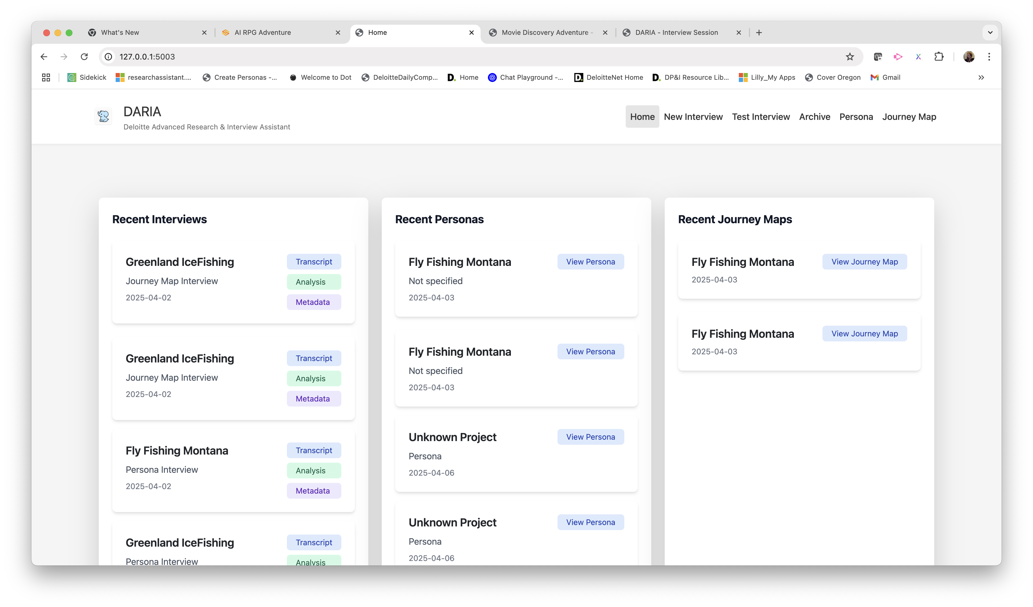
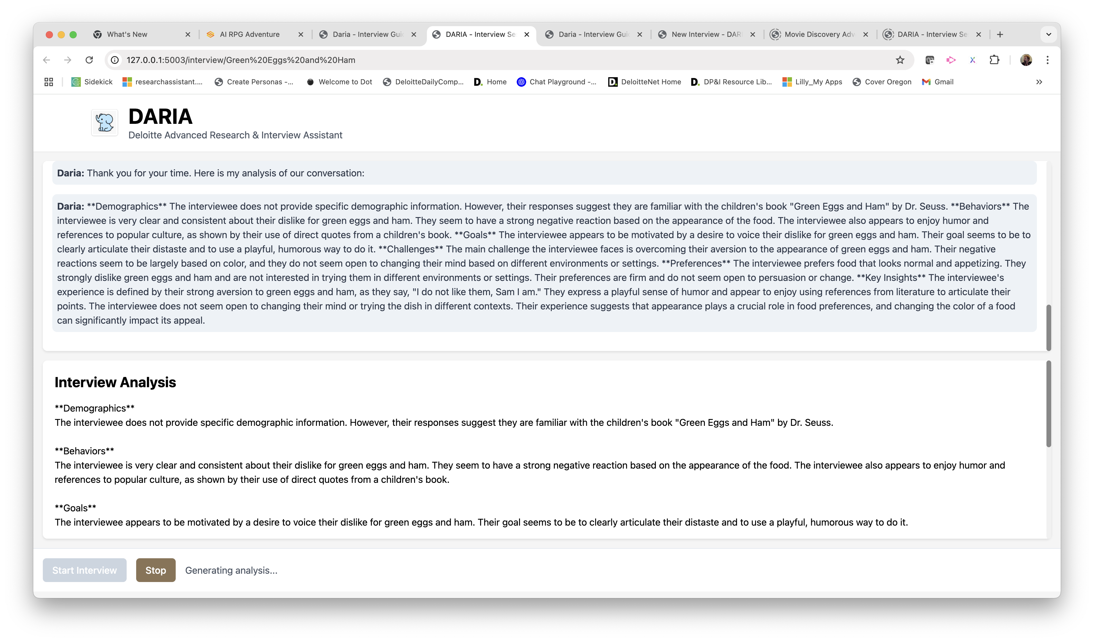
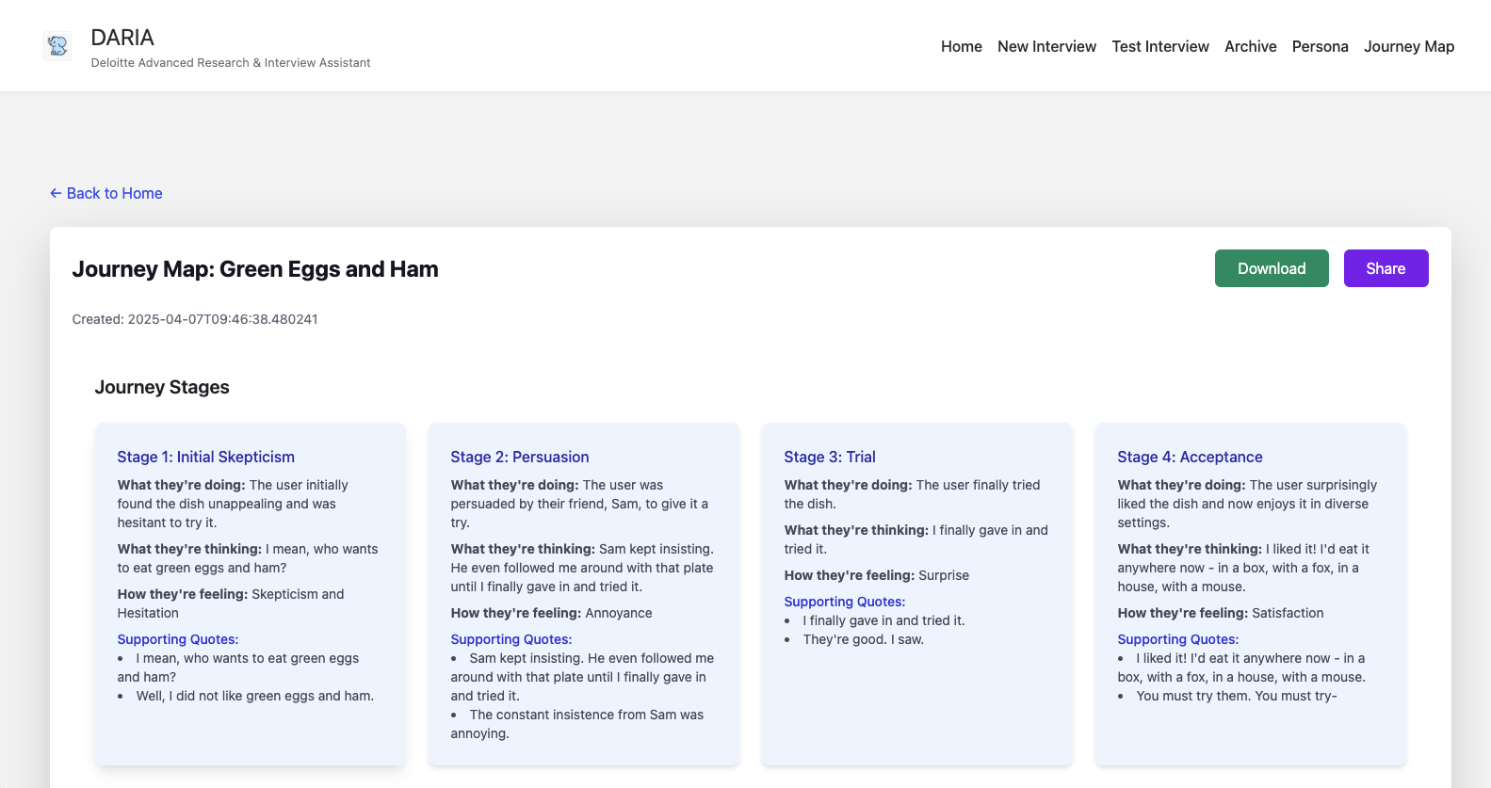
Solution Overview
DARIA offers an AI-powered research assistant with dynamic interview capabilities, real-time transcription, and automated UX artifact generation. The system combines natural conversation flow with structured research methodology, providing instant persona creation and journey mapping while maintaining research integrity. The interface seamlessly integrates voice interaction and text analysis, ensuring comprehensive data collection and insights generation. Additionally, it provides automated analysis and visualization tools for tracking research patterns and findings, enhancing the efficiency and scalability of UX research processes.

Slide 6
Solution Overview
DARIA represents a new category of research tools that combine:
Automation - Handling routine research tasks
Augmentation - Enhancing researcher capabilities
Intelligence - Providing smart analysis and insights
Standardization - Maintaining research rigor
Scalability - Enabling larger research efforts
KEY FEATURES / CAPABILITIES OF DARIA
AI-powered interview assistant with natural conversation flow and voice interaction
Real-time transcription with automated note-taking and key point extraction
Instant persona generation from interview insights and patterns
Dynamic journey map creation with emotional touchpoint tracking
Research consistency through structured methodology and prompts
Automated sentiment analysis and theme identification
Seamless integration of qualitative and quantitative data
Time-saving automation of research documentation and analysis
Scalable research capabilities without additional resource investment
Professional research standards maintained through AI guardrails
Enhanced data visualization for insight presentation
Reduced administrative burden through automated artifact generation

Slide 7
SCALE & WHAT’S NEXT
Scaling Strategy:
Phase 1: Beta launch with select UX research teams in tech companies
Phase 2: Expand to design consultancies and enterprise UX departments
Phase 3: Develop industry-specific versions (Healthcare, Finance, Retail)
Build strategic partnerships with design tools (Figma, Miro) and research platforms
HOW WOULD YOU SCALE THIS PRODUCT?
WHAT DOES YOUR MARKET LAUNCH PLAN LOOK LIKE?
WHAT’S NEXT FOR THIS PRODUCT & PRODUCT TEAM?
Market Launch Plan:
We'll follow a controlled rollout starting with a 3-month beta program featuring 5-10 partner organizations. This provides valuable feedback while building case studies and testimonials. Marketing will focus on thought leadership content, conference presentations, and direct outreach to UX research leaders. Pricing will follow a tiered SaaS model with enterprise customization options.
Product Roadmap:
Multi-language support for global research teams
Advanced analytics dashboard for cross-project insights
Custom template builder for specialized research methodologies
Integration with popular design and research tools
AI-powered research pattern recognition across multiple studies
Collaborative features for distributed research teams

Slide 8
TEAM & PROCESS Highlights
MEET THE TEAM
Next Steps for Team:
We focus on building a robust feedback loop with early adopters while maintaining agile development cycles. Prioritize features that demonstrate clear ROI for enterprise clients. Continue refining AI models with real-world usage data while expanding the engineering and customer success teams to support growth.
Our collaboration thrived through an iterative development process, starting with a basic application structure. We progressively evolved the concept in stages: from a simple survey form to a visually engaging choice-based interface, ultimately culminating in a fully interactive user research assistant. Key milestones included building a modern UI with smooth transitions, implementing AI-powered interview analysis, and integrating a comprehensive user journey mapping tool. Each step was achieved through collaborative problem-solving, where we tackled technical challenges, refined features based on user testing, and infused our creativity into the design. This agile approach ensured that Daria not only met user needs but also provided an efficient and engaging user research experience.

