Slide 1
ETL Project
Krys Doyle
Gabriel Franco
Jessica Hatcher
Gil Tungol
Stephanie Villegas

Slide 2
Motivation
Is alcohol consumption somehow related to happiness?

Slide 3
Data sources
Suicide data for 1980 to 2016 (2015).
Country data for 2017
Happiness indicators and alcohol consumption for 2017

Slide 4
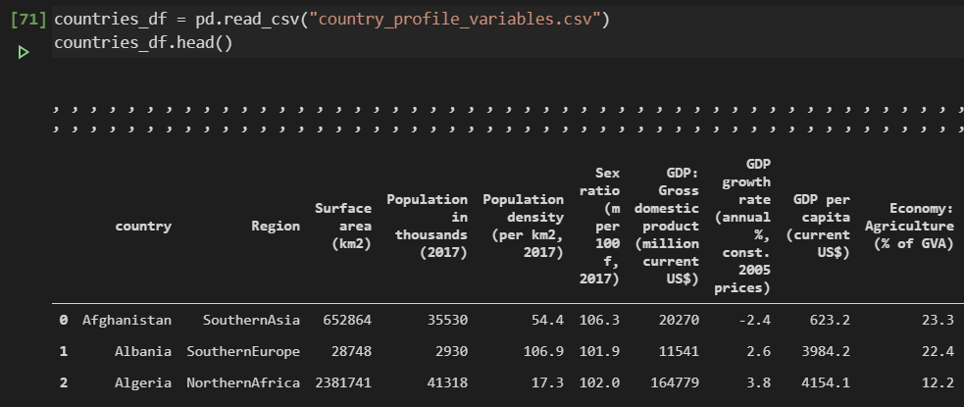
Data cleansing with pandas
Importing data
Dropping columns that were not applicable to our analyses

Slide 5
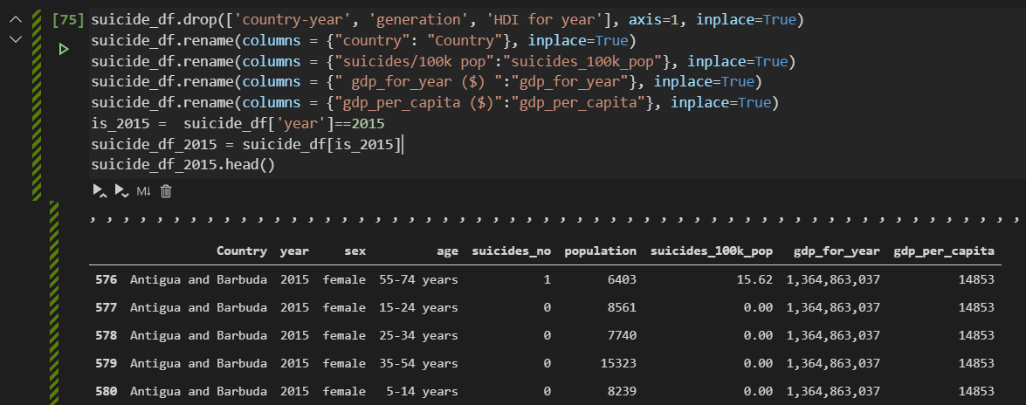
Data cleansing with pandas
Filtering suicide data for only 2015
Renaming columns

Slide 6
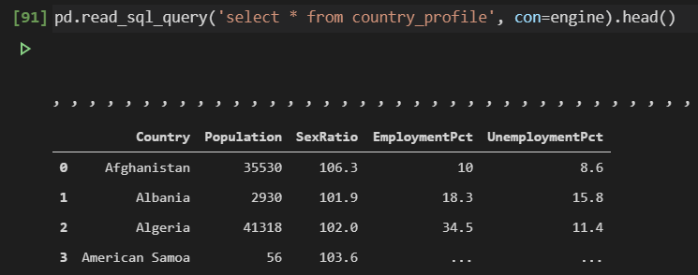
Data cleansing with pandas
Connecting the engine to export the data

Slide 7
SQL
INSERT INTO "alcohol_suicide"
select
h."Country",
"HappinessScore",
"Beer_PerCapita",
"Spirit_PerCapita",
"Wine_PerCapita",
"Population",
"SexRatio",
"EmploymentPct",
"UnemploymentPct",
"gdp_for_year",
"suicides_no"
from
(select "Country",
"HappinessScore",
"Beer_PerCapita",
"Spirit_PerCapita",
"Wine_PerCapita"
from happiness) h
JOIN (select "Country",
"Population",
"SexRatio",
"EmploymentPct",
"UnemploymentPct"
from country_profile) cp on cp."Country" = h."Country"
JOIN (select "Country",
"gdp_for_year",
sum("suicides_no") as "suicides_no"
from suicide
group by "Country", "gdp_for_year"
order by "Country") s on s."Country" = h."Country"
​
CREATE TABLE "happiness" (
"Country" varchar NOT NULL,
"HappinessScore" FLOAT NOT NULL,
"HDI" INTEGER NOT NULL,
"GDP_PerCapita" FLOAT NOT NULL,
"Beer_PerCapita" INTEGER NOT NULL,
"Spirit_PerCapita" INTEGER NOT NULL,
"Wine_PerCapita" INTEGER NOT NULL,
CONSTRAINT "pk_happiness" PRIMARY KEY (
"Country"
)
);

