Slide 1

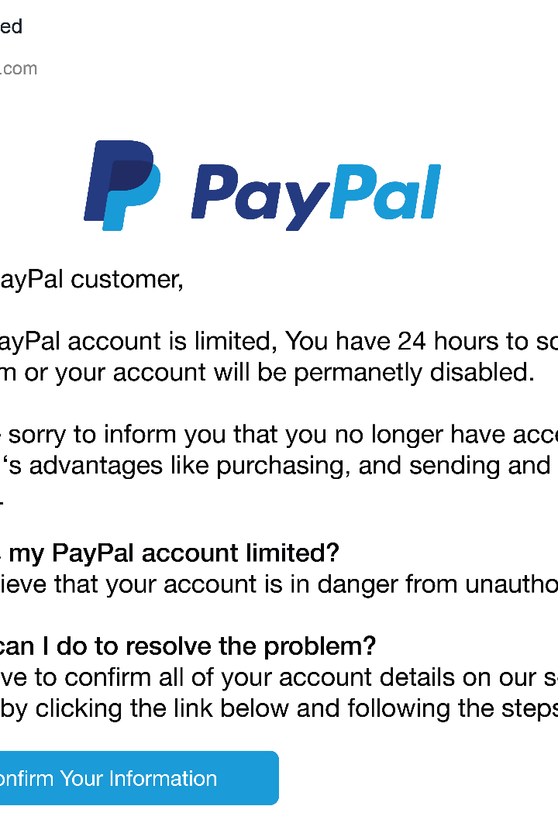
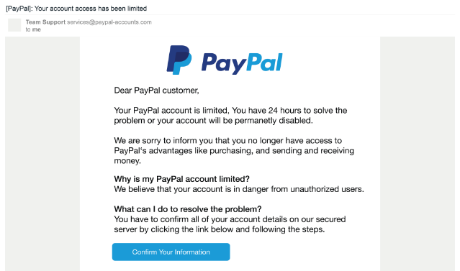

Introduction to Phishing
Phishing is a type of cybercrime where attackers try to trick individuals into revealing sensitive information, like login credentials or financial information, through deceptive emails, messages, or websites. This presentation will provide an in-depth look at phishing tactics, how to identify phishing attempts, and best practices for protecting against these threats. Understanding phishing is crucial for maintaining cybersecurity and safeguarding your personal and professional data.
by Kunal Bhagat

Slide 2

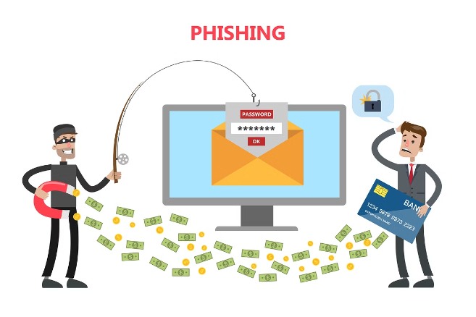
What is Phishing?
1
Definition
Phishing is a social engineering attack where cybercriminals attempt to lure victims into revealing sensitive information or performing an action that compromises their security, such as clicking on a malicious link or downloading an infected file.
2
Motivations
Phishers are driven by financial gain, seeking to steal login credentials, credit card numbers, and other valuable data that can be used for identity theft or fraud. They may also aim to infect systems with malware to further their criminal activities.
3
Targets
Phishing attacks can target individuals, businesses, and organizations of all sizes. Cybercriminals often cast a wide net, hoping to ensnare as many victims as possible.

Slide 3
Common Phishing Tactics
Deceptive Emails
Fake Websites
Impersonation
Phishers often send fake emails that appear to be from legitimate companies, organizations, or individuals. These emails may contain malicious links or attachments, or ask the recipient to provide sensitive information.
Cybercriminals create convincing-looking websites that mimic legitimate ones, like online banking portals or e-commerce platforms, in an attempt to steal login credentials or financial information.
Phishers may impersonate authority figures, like government officials or IT support staff, to trick victims into providing sensitive information or performing actions that compromise security.

Slide 4

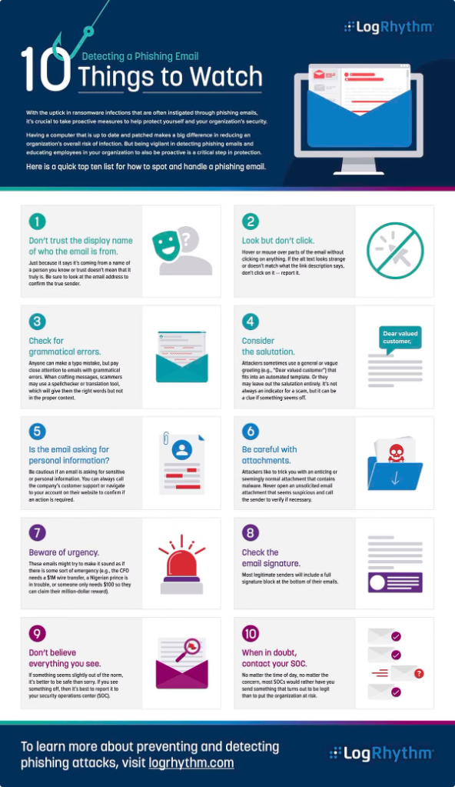
Identifying Phishing Emails
Sender Email Address
Phishing emails often use email addresses that are similar to, but not exactly the same as, the legitimate sender's address. Look for small differences in the domain name or subtle spelling errors.
Urgent or Threatening Language
Phishing emails often try to create a sense of urgency or fear to pressure the recipient into taking immediate action, such as clicking on a link or providing sensitive information.
Generic Greetings
Legitimate emails from companies or organizations you have a relationship with will typically address you by name. Phishing emails often use generic greetings like "Dear Customer" or "Dear User".
Suspicious Links and Attachments
Hover over any links in the email to see the actual URL, and be wary of attachments, which may contain malware. If anything looks suspicious, do not click or open it.

Slide 5





Recognizing Phishing Websites
Secure Connection
Address Bar
Trust Seals
Visual Design
Verify that the website uses HTTPS, which indicates a secure connection. Phishing sites often use HTTP, which is not secure.
Closely examine the website's address in the browser's address bar. Phishing sites often use similar-looking domain names to trick users.
Legitimate websites often display trust seals from reputable security providers. Phishing sites may try to mimic these seals, so verify their authenticity.
Phishing sites may have poor design, low-quality images, or inconsistent branding compared to the legitimate website they're impersonating.

Slide 6

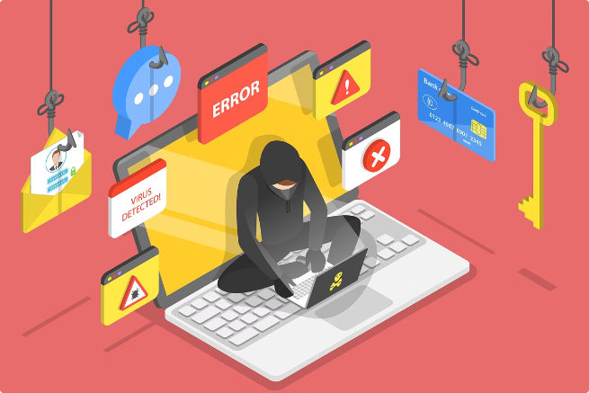



Protecting Against Social Engineering
Recognize the Tactics
Be aware of common social engineering tactics, such as phishing, pretexting, and impersonation, and how they are used to manipulate victims.
Verify Requests
If you receive a request for sensitive information or to perform a task, verify the legitimacy of the request through additional channels before taking action.
Maintain Skepticism
Cultivate a healthy skepticism towards unsolicited requests, and don't be afraid to question or challenge something that seems suspicious.

Slide 7

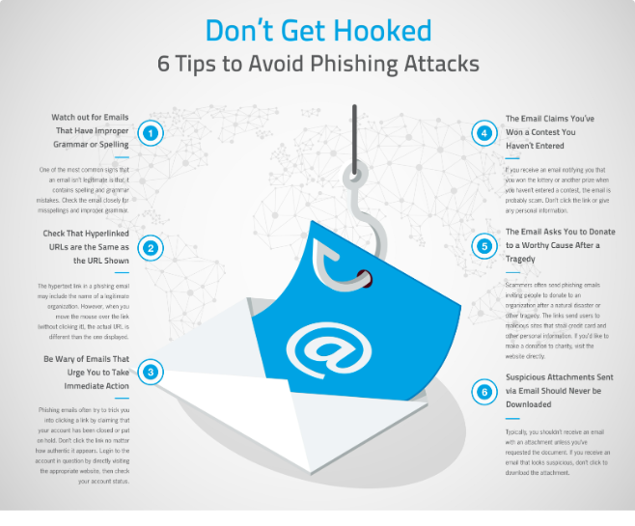
Best Practices for Phishing Prevention
1
Employee Training
Provide comprehensive training to employees on how to identify and respond to phishing attempts, emphasizing the importance of caution and verification.
2
Technological Defenses
Implement robust security measures, such as spam filters, antivirus software, and web content filtering, to detect and block phishing threats.
3
Incident Response
Develop a clear incident response plan to quickly and effectively address any phishing incidents, minimizing the potential for damage or data loss.

Slide 8

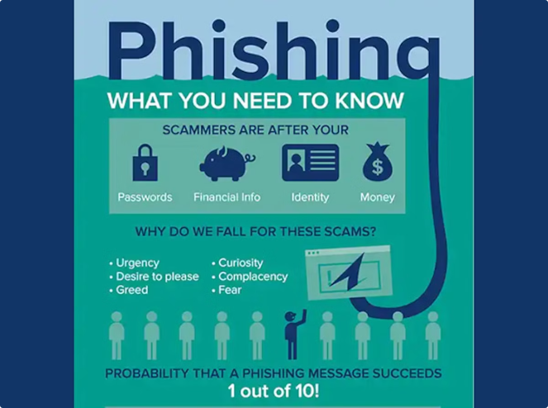
Conclusion and Resources
Phishing Awareness Training
Comprehensive training program to educate employees on phishing threats and prevention strategies.
Phishing Reporting and Response
Guidance on how to report phishing attempts and implement effective incident response procedures.
Phishing Prevention Tools
Information on technological solutions, such as email filtering and web content blocking, to protect against phishing attacks.
Phishing Resources and Articles
Additional resources, including industry reports, research, and expert insights, to further your understanding of phishing threats.

Slide 9


Thank You
Thank you for your attention and participation in this phishing awareness training. Remember, staying vigilant and following best practices is key to protecting yourself, your organization, and your data from the growing threat of phishing attacks. If you have any further questions or concerns, please don't hesitate to reach out.

