Slide 1

Linux Kernel Configuration Tool
Kacper Bak & Karim Ali
CS 889 – Spring 2010

Slide 2
Agenda
Background
Motivation
User Studies
  Why does our tool have its current design?
Conclusion
Future Work

Slide 3
Linux Kernel
Core of any GNU/Linux based distribution
Very modular
Highly customizable
  > 5500 features, 89% are user-selectable
Linux Kernel Configurator (LKC) engine
  KConfig to define variability and dependencies
menuconfig, xconfig, gconfig

Slide 4
Motivation
Huge variation space
Lack of Linux auto configuration tools
  Improved by adding localmodconfig target
Bloated Linux
  Torvalds @ Linuxcon, 2009
Current Linux configurators target advanced users
  No progressive disclosure for less experienced users
  Inconsistent .config files can be generated

Slide 5
User Study 1 – Current Tools
Are the current GUI tools useful to less experienced users?

Slide 6
User Study 1 – Feedback
Tree view (default) has too many entries
Confusing selection modes
Less cryptic feature names and description
Search needs to be enhanced
Hardware discovery/configuration is frustrating
Notes:
Tree view (default) has too many entries
Almost all users started the process by collapsing all tree entries
Confusing selection modes
Y/N/M
Selecting the root of a sub-tree vs. selecting its children
Less cryptic feature names and description
Search needs to be enhanced
Currently, only feature names can be searched
Google
Hardware discovery/configuration is painful
Some participants thought the interviewer is being deceptive as they couldn't find the required hardware
Auto configuration

Slide 7
User Study 2 – Suggested Designs
Comments/feedback on design mockups

Slide 8
User Study 2 – Feedback
Hardware Detection Dialog
  I would like to know what's going on
  Without it getting in the way
  Report crashes

Slide 9
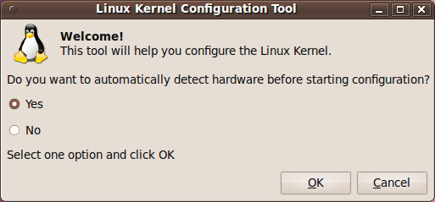
Hardware Detection Dialog

Slide 10
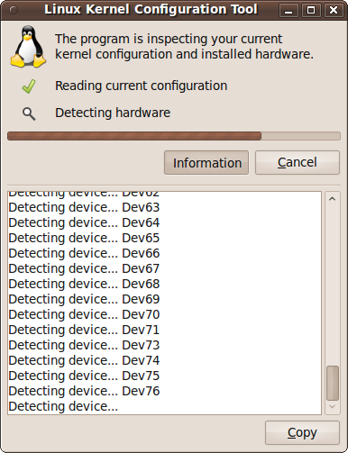
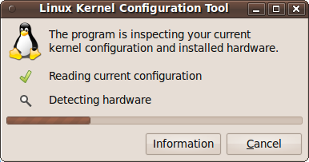
Hardware Detection Dialog

Slide 11
User Study 2 – Feedback
LKC Tool
  Help text
  Easy navigation through different categories of features
  Few categories
  Wizard if quick navigation and search is provided
  Review the final .config file
  Question format
    Better understanding of the effect of selecting a feature

Slide 12
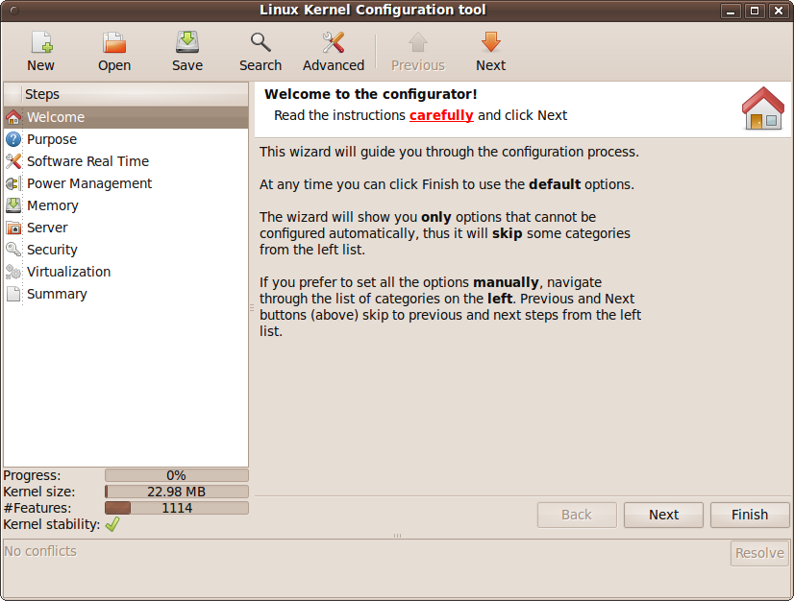
lkc Tool

Slide 13
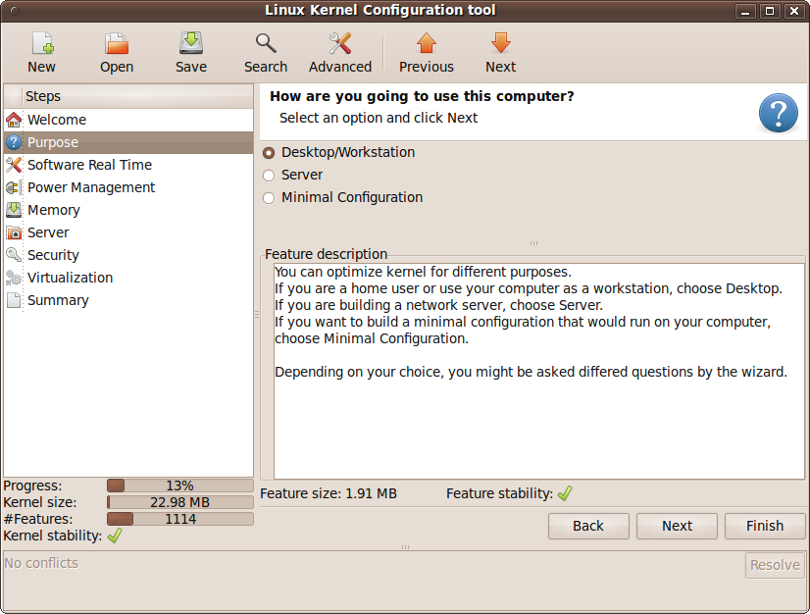
lkc Tool

Slide 14
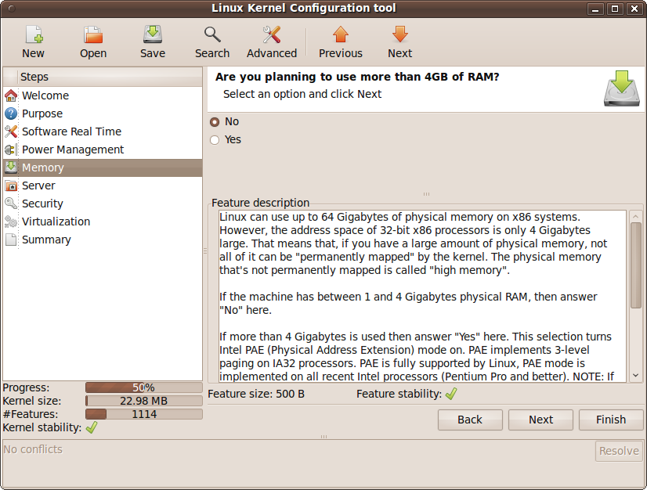
lkc Tool

Slide 15
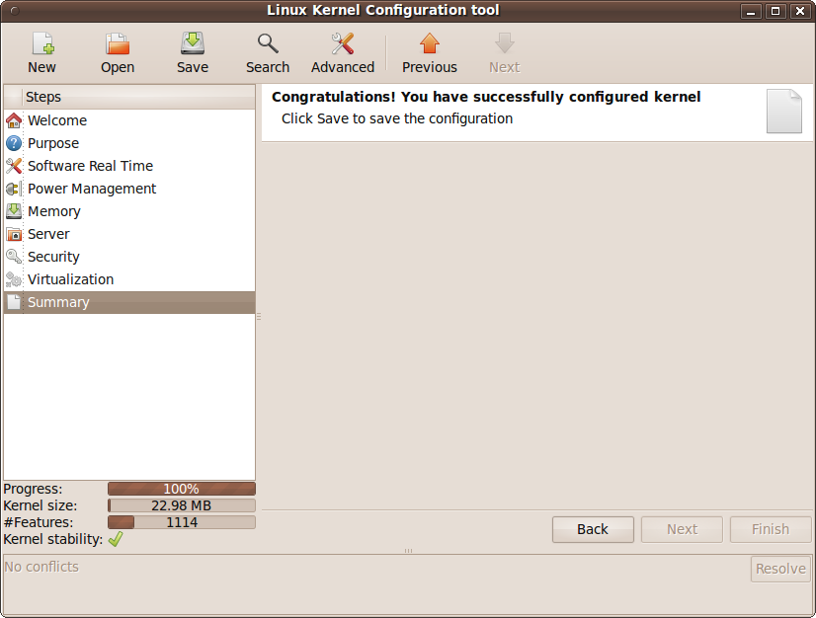
lkc Tool

Slide 16
Final User Study
Provided users with a scenario where the user is Tiësto
  Configure Linux according to:
    Machine usage
    Installed hardware
Compare xconfig and lkc tool

Slide 17
Findings

Slide 18
xconfig
General problems
  Too many options
  Confusing categories
Search
  Useless
  Some users used Google instead
    Adam's tool might be useful to offer help here
Hardware configuration
  Hard to find drivers
  Difficult to match hardware with modules

Slide 19
lkc Tool – pros
Improvement compared to xconfig
  Simple, intuitive
  Statistics
  Two-mode navigation: wizard, free navigation
  Hiding unnecessary details

Slide 20
lkc Tool – cons
One user didn't know what "feature" means in statistics
Two users didn't know what stability means in our app
"Minimal Configuration" was confusing for one user
The study seemed biased, because the asked questions can be easily answered using this tool

Slide 21
lkc Tool – suggestions
Progressive disclosure: hackers and less experienced users
Hardware detection
  Have the ability to re-detect hardware
  Provide info about detected hardware
Change position of Save button
Finish button should always be enabled
  Show a save/save&quit/cancel dialog when clicked
Previous/Next buttons should be closer to the left panel, another user suggested removing them

Slide 22
Conclusion
Current LKC tools are not suitable for less experienced users
Compared to xconfig, lkc tool
    is simple, intuitive
    provides better navigation
    hides unnecessary details
However
    More understandable description is needed
    Modify some design aspects based on suggestions

Slide 23
Future Work
Implement some of the design suggestions
  Re-detecting hardware
  Provide more info about detected hardware
  Finish button related suggestions
Resolve conflicts
Keep history
Perform more user studies

