Slide 1

EXCHANGE RATE DETERMINATION
ZAMBIA ZMW/USD — STRATEGIC POLICY ANALYSIS
A comprehensive analysis of exchange rate policy, purchasing power parity, currency depreciation trends, and macroeconomic inflation dynamics.
20.89
+21.3%
9.4 pp
ZMW/USD — Latest Avg Rate
YoY Currency Depreciation
Inflation Differential
PREPARED FOR
ANALYSIS PERIOD
CLASSIFICATION
DATE
FSi Outsourcing — Executive Leadership
2015 – 2023
Internal | Confidential
May 2026

Slide 2
AGENDA
Exchange Rate Determination — Zambia Analysis
01
Exchange Rate Policy
02
Depreciation & Bid-Ask Analysis
Trend analysis, policy bounds, PPP target, and selling rate KPIs
Year-on-year currency depreciation and foreign exchange spread dynamics
03
Inflation Analysis
04
Policy Verdict & Recommendations
US vs Zambia inflation comparison and differential impact assessment
Conclusion on exchange rate alignment and strategic policy direction
EXCHANGE RATE DETERMINATION | ZAMBIA | 2015–2023

Slide 3
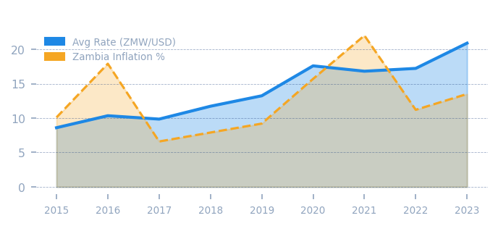
EXECUTIVE SUMMARY
Key findings across exchange rate, depreciation, inflation, and policy alignment — 2015 to 2023
AVG SELLING RATE (ZMW/USD)
YOY DEPRECIATION
BID-ASK SPREAD
INFLATION DIFF.
POLICY VERDICT
20.89
+21.3%
3.1%
9.4 pp
! Pressure
2023
2023
ZM–US
KEY FINDINGS
1
Exchange Rate Depreciation
The ZMW/USD rate surged from 8.60 in 2015 to 20.89 in 2023 — a cumulative depreciation of ~143%, exceeding the PPP-implied target rate of 19.50.
2
Policy Bound Breach
The 2023 rate of 20.89 ZMW/USD sits ~7.2% below the upper policy bound (22.98), indicating limited but narrowing headroom.
3
Inflation Differential
Zambia's average inflation (13.5%) significantly outpaces US inflation (4.1%), sustaining persistent depreciation pressure through PPP dynamics.
4
Bid-Ask Spread Widening
The bid-ask spread widened from 1.8% (2015) to 3.1% (2023), signalling reduced FX market liquidity and elevated transaction costs.
EXCHANGE RATE DETERMINATION | EXECUTIVE SUMMARY | CONFIDENTIAL

Slide 4
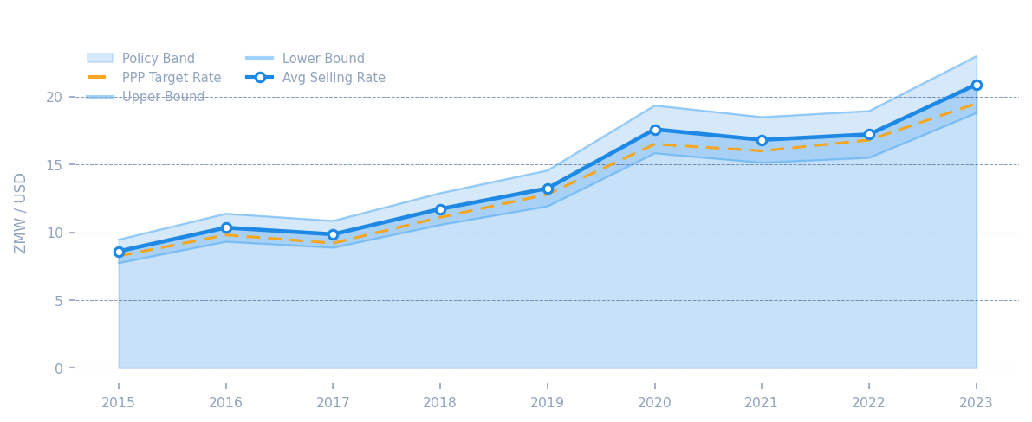
01
EXCHANGE RATE POLICY
EXCHANGE RATE DETERMINATION | ZAMBIA
Trend Analysis · Policy Bounds · PPP Target Rate · 2015–2023
AVG SELLING RATE
PPP TARGET RATE
POLICY VARIANCE
KEY INSIGHT
UPPER BOUND
20.89
19.50
-9.1%
The 2023 selling rate (20.89) has surpassed the PPP target (19.50) and is approaching the upper policy bound (22.98). Continued depreciation pressure warrants policy review.
22.98
ZMW/USD
ZMW/USD
vs Upper Bound
ZMW/USD
SECTION 01 | EXCHANGE RATE POLICY | PAGE 1 OF 4

Slide 5
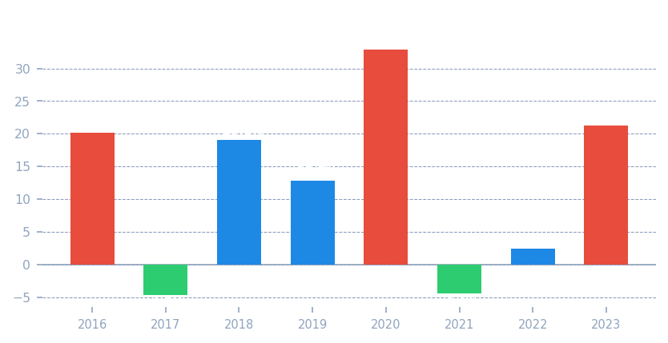
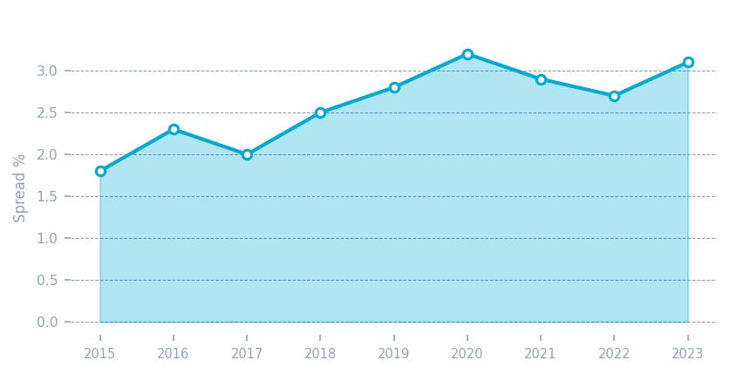
02
DEPRECIATION & BID-ASK RATE ANALYSIS
EXCHANGE RATE DETERMINATION | ZAMBIA
Currency Depreciation · FX Spread Trends · 2015–2023
YOY DEPRECIATION
BID-ASK SPREAD
CUMULATIVE DEPR.
+21.3%
3.1%
+142.9%
2023
2023 Latest
2015→2023
2020 saw the sharpest depreciation (+32.9%) driven by COVID-19 economic shock
Spread widening post-2019 reflects reduced FX liquidity and elevated hedging costs
SECTION 02 | DEPRECIATION & BID-ASK ANALYSIS | PAGE 2 OF 4

Slide 6
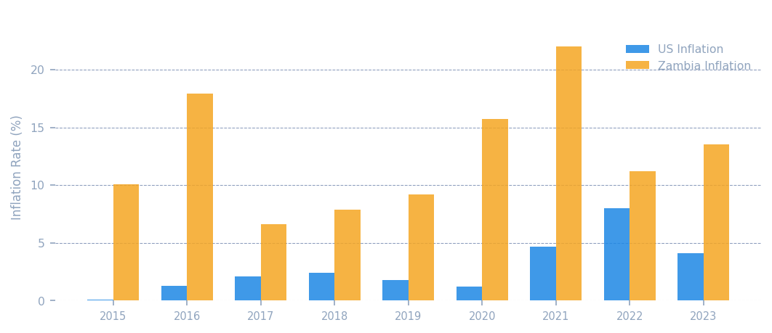
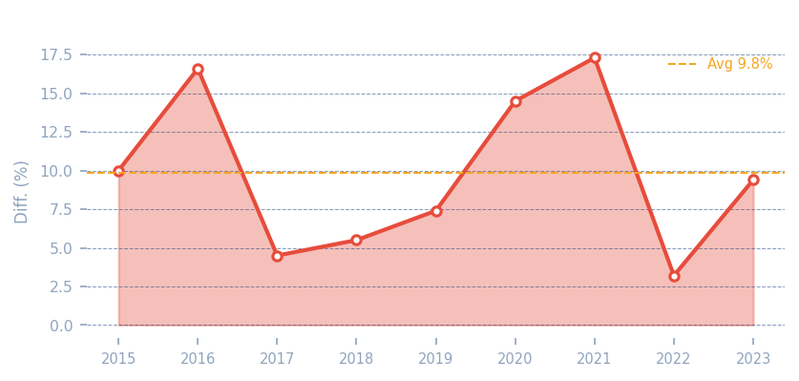
03
INFLATION ANALYSIS
EXCHANGE RATE DETERMINATION | ZAMBIA
US vs Zambia Inflation · Differential Impact · PPP Implications · 2015–2023
US AVG INFLATION
ZAMBIA AVG INFLATION
INFLATION DIFFERENTIAL
AVG DIFF. (2015–2023)
4.1%
13.5%
9.4 pp
10.8 pp
2023
2023
ZM − US
9-yr avg
PPP IMPLICATION
Purchasing Power Parity theory dictates that sustained inflation differentials drive proportional exchange rate depreciation. Zambia's persistent 9–11 pp differential above US CPI continues to exert structural downward pressure on the ZMW.
SECTION 03 | INFLATION ANALYSIS | PAGE 3 OF 4

Slide 7
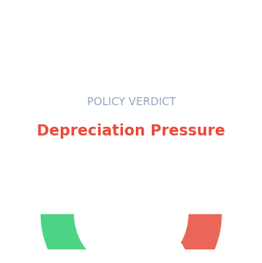
04
POLICY VERDICT & RECOMMENDATIONS
EXCHANGE RATE DETERMINATION | ZAMBIA
Exchange Rate Alignment Assessment · Strategic Guidance · 2023
VERDICT
DEPRECIATION PRESSURE — APPROACHING POLICY BOUNDS
The ZMW/USD rate of 20.89 (2023) exceeds the PPP target (19.50) and is tracking toward the upper bound (22.98). The 9.4 pp inflation differential reinforces continued depreciation risk.
01
Monetary Policy Tightening
02
FX Market Intervention
The Reserve Bank of Zambia should consider targeted rate adjustments to moderate inflation and slow the depreciation trajectory.
Strategic FX reserves deployment at key technical levels (21.50–22.00 ZMW/USD) can dampen excessive volatility.
03
Inflation Anchor Framework
04
PPP Monitoring Dashboard
Implement an explicit inflation targeting band of 6–8% to close the inflation differential gap with the US over a 3-year horizon.
Establish a quarterly PPP equilibrium review against the Optimal Target Rate to provide early-warning signals for policy intervention.
SECTION 04 | POLICY VERDICT & RECOMMENDATIONS | PAGE 4 OF 4

Slide 8
ANALYSIS SUMMARY
143%
THANK YOU
Cumulative ZMW Depreciation 2015–2023
20.89
This analysis provides a data-driven foundation for exchange rate policy review and strategic decision-making for Zambia. The findings highlight the urgency of addressing inflation differentials and FX market depth to sustain ZMW stability.
ZMW/USD Avg Rate (2023)
9.4 pp
Inflation Differential (Zambia vs US, 2023)
QUESTIONS & DISCUSSION
3.1%
PREPARED BY
Bid-Ask Spread (2023)
FSi Outsourcing — Analytics & Advisory
k.banda@fsioutsourcing.com | May 2026 | CONFIDENTIAL
Data sourced from Power BI model: Analysis.pbix Analysis Period: 2015–2023 | All rates in ZMW/USD

