Slide 1
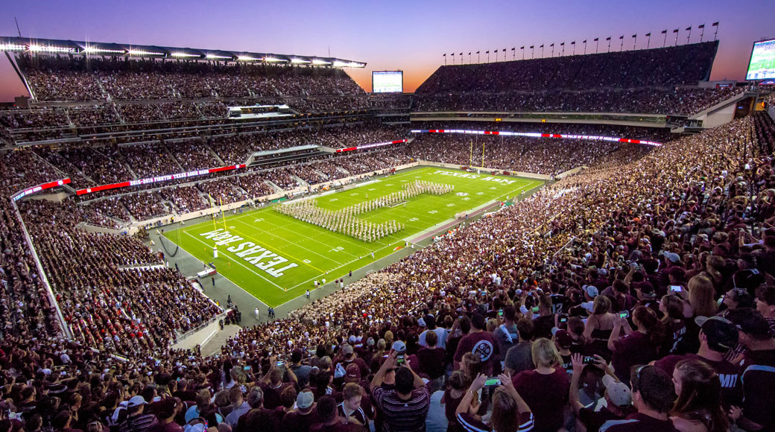
TV Deep-Dives
Dayparts

Slide 2
The B daypart’s 2016 performance was the most balanced overall
TV Daypart Deep-Dive
(Higher is Better; 100 is average)
(Lower is Better; 100 is average)
% Share of Activity | 12% | 68% | 10% | 10%
% Share of Spend | 27% | 43% | 9% | 21%

