Slide 1
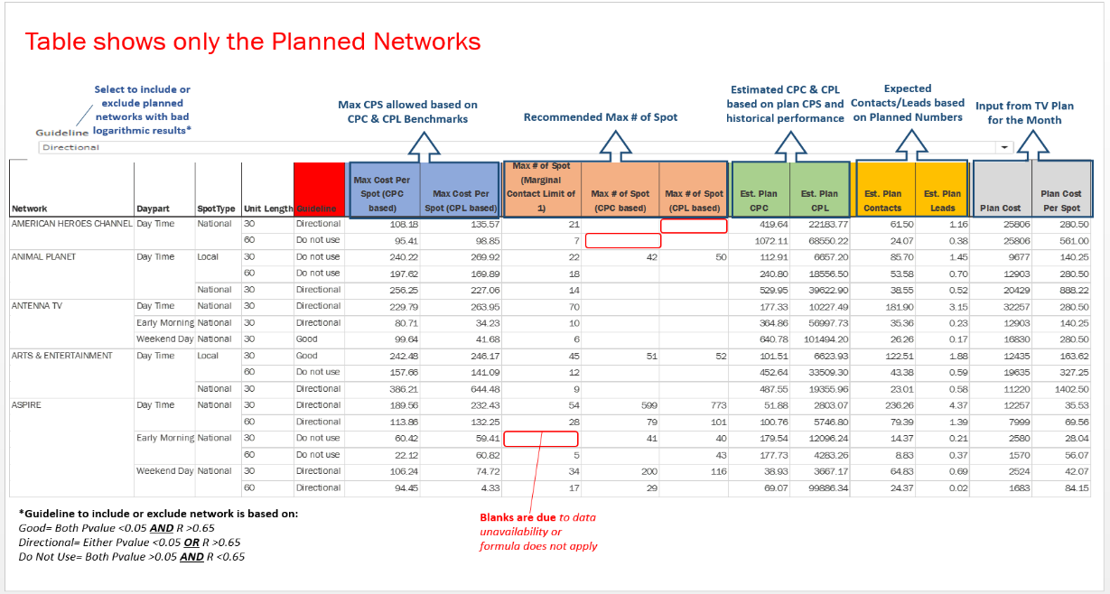
User guideline for TV Tool output

Slide 2
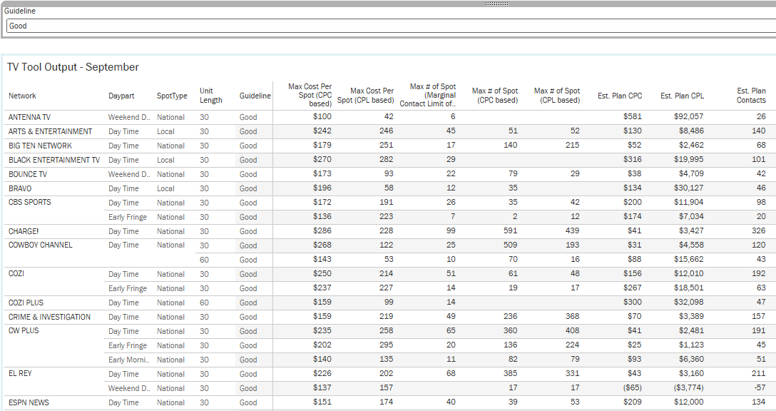
Holistic view of all the networks in Tableau dashboard showing metrics like Max Cost per Spot, CPC, Max no. of Spots etc.

