Slide 1
Gaze
Aksa Zehra
1406813012
Manan Gupta
1406813037
Marvi Khan
1406813040
IT (4th Year)
See world digitally

Slide 2
Contents
Introduction
What is AR?
Relative work
Storyboard
Objective
DFD
Lab Requirement
References
Notes:
Let me give you a quick overview of what you are going to hear.

Slide 3
Introduction
Gaze is a location-based augmented reality app.
Brings Google Maps to life.
Find useful places around you - such as restaurants, ATMs etc.
Hold up your phone and the streets in front of you will be transformed with information about nearby facilities.
Digitally generated signposts.
Overlays of virtual signboards onto the camera view in that direction.
Notes:
Gaze is a location-based augmented reality app that brings Google Maps to life, so all you need to do is hold up your phone and the streets in front of you will be transformed with information about nearby facilities.
To use the app you simply select one of the pre-defined categories, hold up your smartphone and watch as the world around you populates with digitally generated signposts.
If you want more information, you simply click on the signpost to get full contact details, user reviews and directions.
Augmented Reality is thus used to enhance the view of your surroundings.

Slide 4
What is AR?
A live direct or indirect view of a physical, real-world environment.
Elements are "augmented" by computer-generated or extracted real-world sensory input such as sound, video, graphics, haptics or GPS data.
A view of reality is modified by a computer.
Enhances one’s current perception of reality.
The information about the surrounding real world of the user becomes interactive and digitally manipulable.
Integration of digital information with the user's environment in real time.
Notes:
It is related to a more general concept called computer-mediated reality, in which a view of reality is modified (possibly even diminished rather than augmented) by a computer
in contrast, virtual reality replaces the real world with a simulated one.
Augmentation techniques are typically performed in real time and in semantic context with environmental elements, such as overlaying supplemental information like scores over a live video feed of a sporting event.
Today, Google glass and heads-up displays in car windshields are perhaps the most well-known consumer AR products, but the technology is used in many industries including healthcare, public safety, gas and oil, tourism and marketing.

Slide 5
Relative Work
Applications like Zomato and Google Places let you find nearby places.
Gaze combines geo-tagging with Augmented Reality.
Easy to learn about the nearby restaurants just by clicking on the digital signboards.
Information from Google Places makes it comprehensive.
Choose between camera, list and map views to navigate.
Notes:
Applications like Zomato and Google Places let you find nearby places, browse through restaurant menus, photos, user reviews and ratings to decide where you want to eat, and use the map feature to guide you there.
But Gaze lets you see the world digitally and explore it using the augmented reality feature which makes it easy to learn about the nearby restaurants just by clicking on the digital signboards rather than searching for every single place.

Slide 6
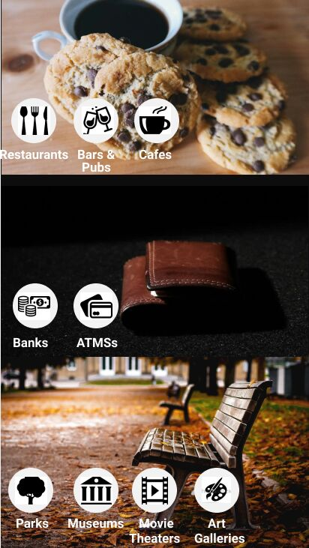
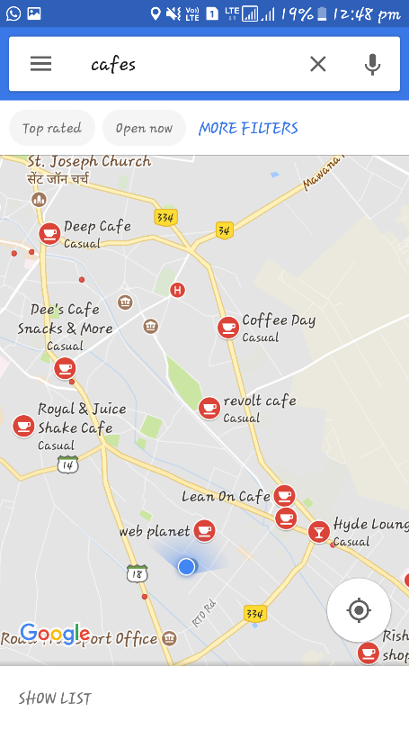
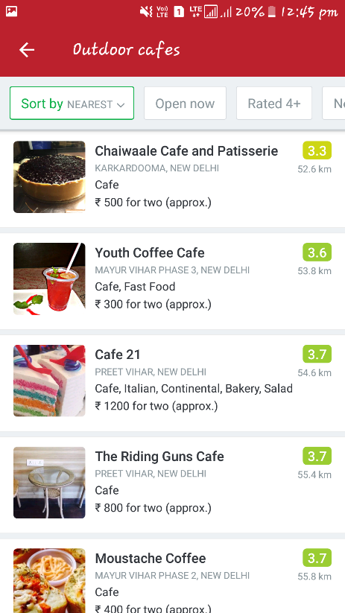
Storyboard

Slide 7
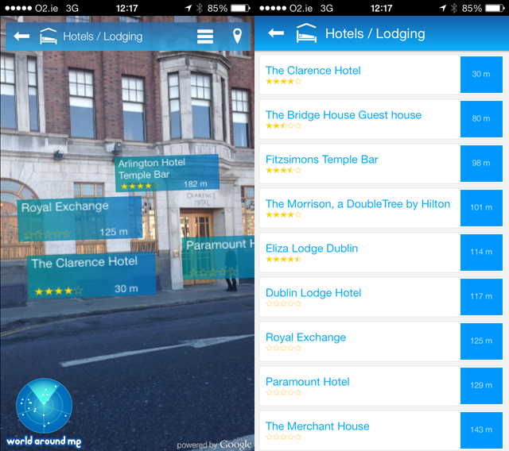
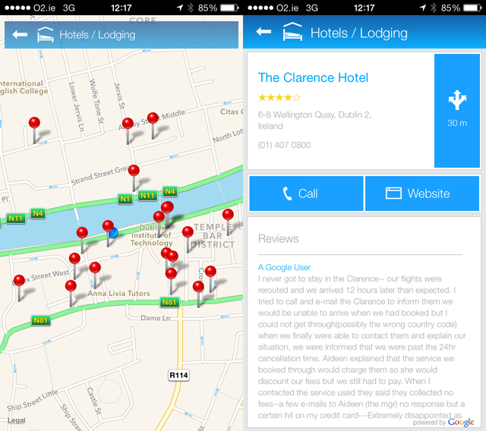

Slide 8
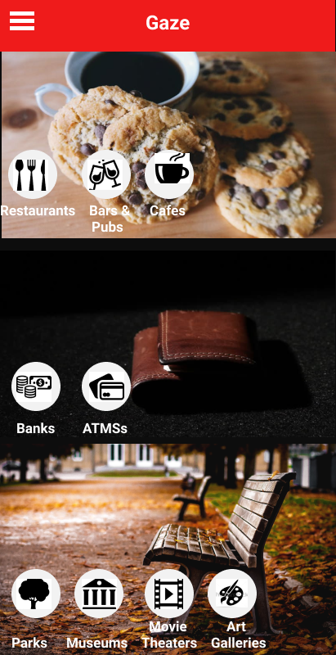
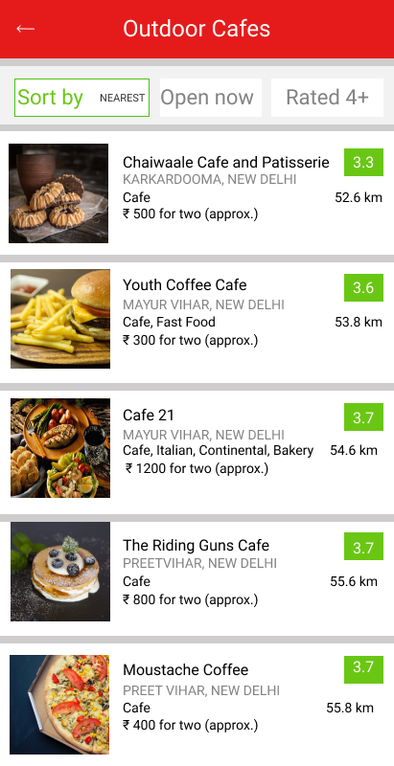
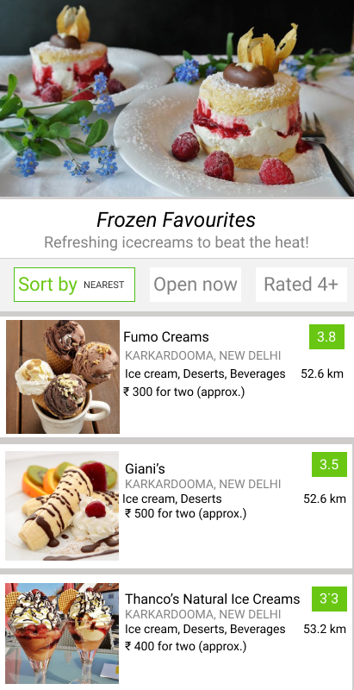
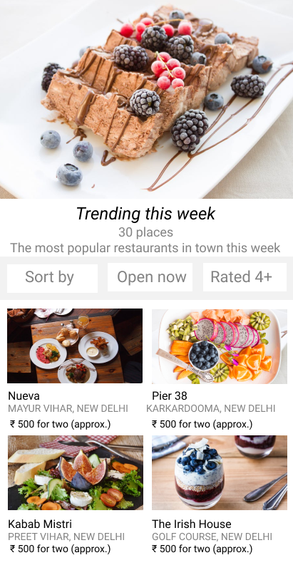
App Design

Slide 9
Objective
Difficult to match the maps with what we see.
Gaze lets you find places in the way most suitable to you.
It can be in the form of lists, maps or augmented reality.
Quickly access information about the facilities around you.
AR feature makes it easy to learn about the nearby places
Notes:
When visiting a place, nearby locations can be found but it can be difficult to match the maps with what we see.
Gaze lets you find places in the way most suitable to you. It can be in the form of lists, maps or augmented reality.
The augmented reality feature combined with geo-tagging makes it easy to know which direction you should be going and the app makes it easy to quickly access information about the facilities around you.
Gaze lets you see the world digitally and explore it using the augmented reality feature which makes it easy to learn about the nearby restaurants just by clicking on the digital signboards rather than searching for every single place.

Slide 10
DFD
Eat
List
Banks
Money
Map
Atms
Camera
Enjoy

Slide 11
Lab Requirement
Windows PC
Android SDK
JDK
Android Studio IDE
Adobe Photoshop
Adobe After Effect

Slide 12
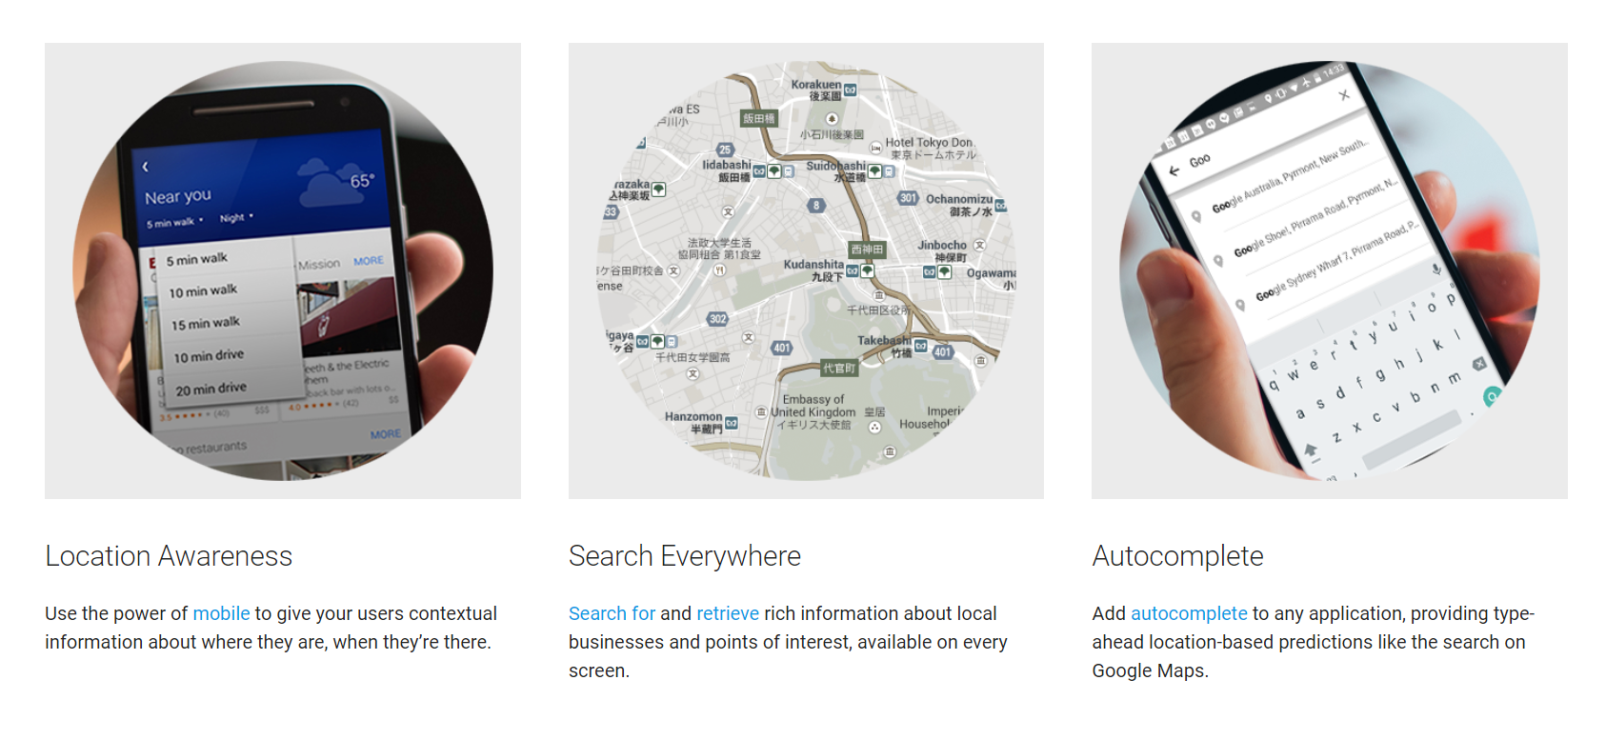
Google Places API

Slide 13
ARcore
ARCore provides SDKs for many of the most popular development environments. These SDKs provide native APIs for all of the essential AR features like motion tracking, environmental understanding, and light estimation. With these capabilities you can build entirely new AR experiences or enhance existing apps with AR features.

Slide 14
Conclusion
This is only a step forward in what this app and concept can do. We can expect more such developments in the future. Augmented reality can be used in many more applications to make the user’s life easier.

Slide 15
References
developers.google.com/ar/
developer.android.com/learn
www.stackoverflow.com
www.youtube.com
https://play.google.com/store/apps/details?id=com.application.zomato&hl=en

Slide 16
Thank You. If anyone has any questions, we would love to answer them.

