Slide 1


DEPARTMENT OF ELECTRICAL AND ELECTRONICS ENGINEERING 18EEP201L - MINOR PROJECT I SECOND REVIEW TEACHING BOARD WIPER BATCH NO:10
PRESENTED BY:
ANCHANA B [ 21BEE006]
BARATH SRINIVASAN K [21BEE012]
BHARATHI S [21BEE015]
GUIDED BY:
Mr.M.YUVARAJ

Slide 2
LIST OF CONTENT
Abstract
Introduction
Problem identified
Block diagram
Block diagram description
Circuit diagram
Circuit diagram description
List of components
Cost of estimation
Outcome

Slide 3


ABSTRACT
In teaching field - board , duster, chalk makes crucial element .
To erase the writing from large size board consume lots of time.
It may breaks the concentration between both lectures and listeners.
This paper represents the design and construction of automatic board wiper
It consists of dc motor , wiper blade , wiper arms.
The automatic teaching board wiper reduce the time and effort required

Slide 4
INTRODUCTION
The Automatic board wiper is a spectacular replacement of “duster”.
Our main aim of our project is to save time and energy .
Around 80 – 70% of educational institution use teaching board .
In an technology world it is impossible to spend time on cleaning of board .
Instead of this we can use board wiper .

Slide 5
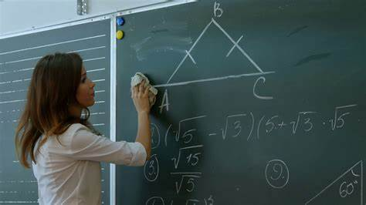
PROBLEM IDENTIFICTION
The teaching boards used 70-80% educational institute around the world uses board as writing medium.
Here teachers are getting affected by the dust produced from calcium chalks while erasing the dust actually cause many lung related diseases and affect the eyes which is may eye gets defect.
8-10% time become waste because of cleaning the board using duster .

Slide 6
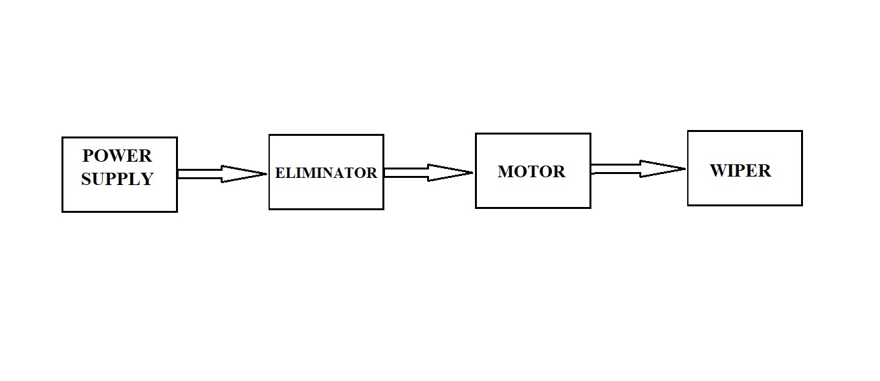
BLOCK DIAGRAM

Slide 7


BLOCK DIAGRAM DESCRIPTION
When power is provided -AC is converts into DC by eliminator, then the small electric motor rotates (back to forth).
Wiper generally consist of a metal arm ,one end pivots the other end has line cotton blade attached to it .
When the arms move the actual wiper blades clears the board

Slide 8
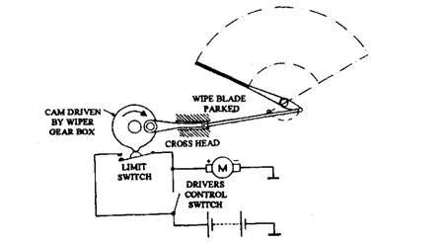
CIRCUIT DIAGRAM

Slide 9
CIRCUIT DIAGRAM DESCRIPTION
Board wipers are operated by an electric motor (back to forth) .
The electric motor is attached to a worm gear, which transmits the necessary force to a long rod that sets the wiper arms in motion.
The worm gear is able to generate the force required to move the wipers as fast as they need to move.
The arms move the actual wiper blades. The blades are made of cotton cloths and must apply enough pressure to the board in order to remove the dust.
The arms attach to the middle of each wiper blade, and each wiper blade has several arms that distribute the pressure onto the board evenly.

Slide 10
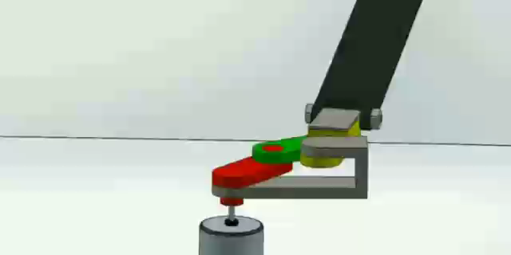

Slide 11
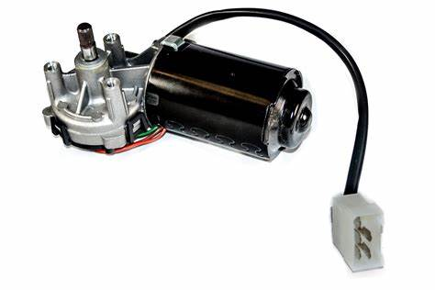
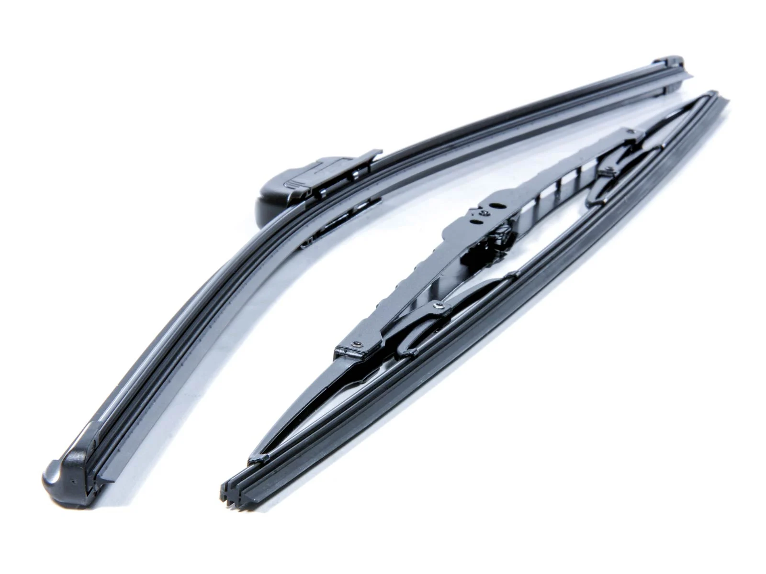
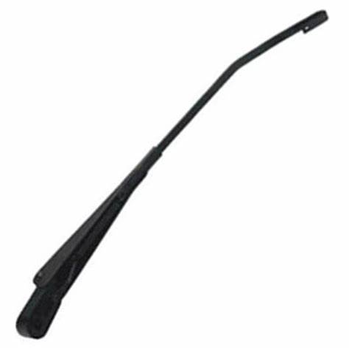

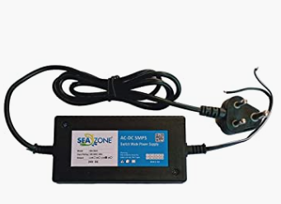

LIST OF COMPONENTS
MOTOR
WIPER BLAD
WIPER ARMS
ELIMINATOR

Slide 12

COST OF ESTIMATION
S.NO | COMPONENTS | SPECIFICATIONS | RATE
01 | MOTOR (DC) | 12V | Rs.1200/-
02 | WIPER ARM | L=40cm | Rs.200/-
03 | WIPER BLADE | L=27cm | Rs.150/-
04 | ELIMINATOR | 150-300VAC | Rs.500/-

Slide 13

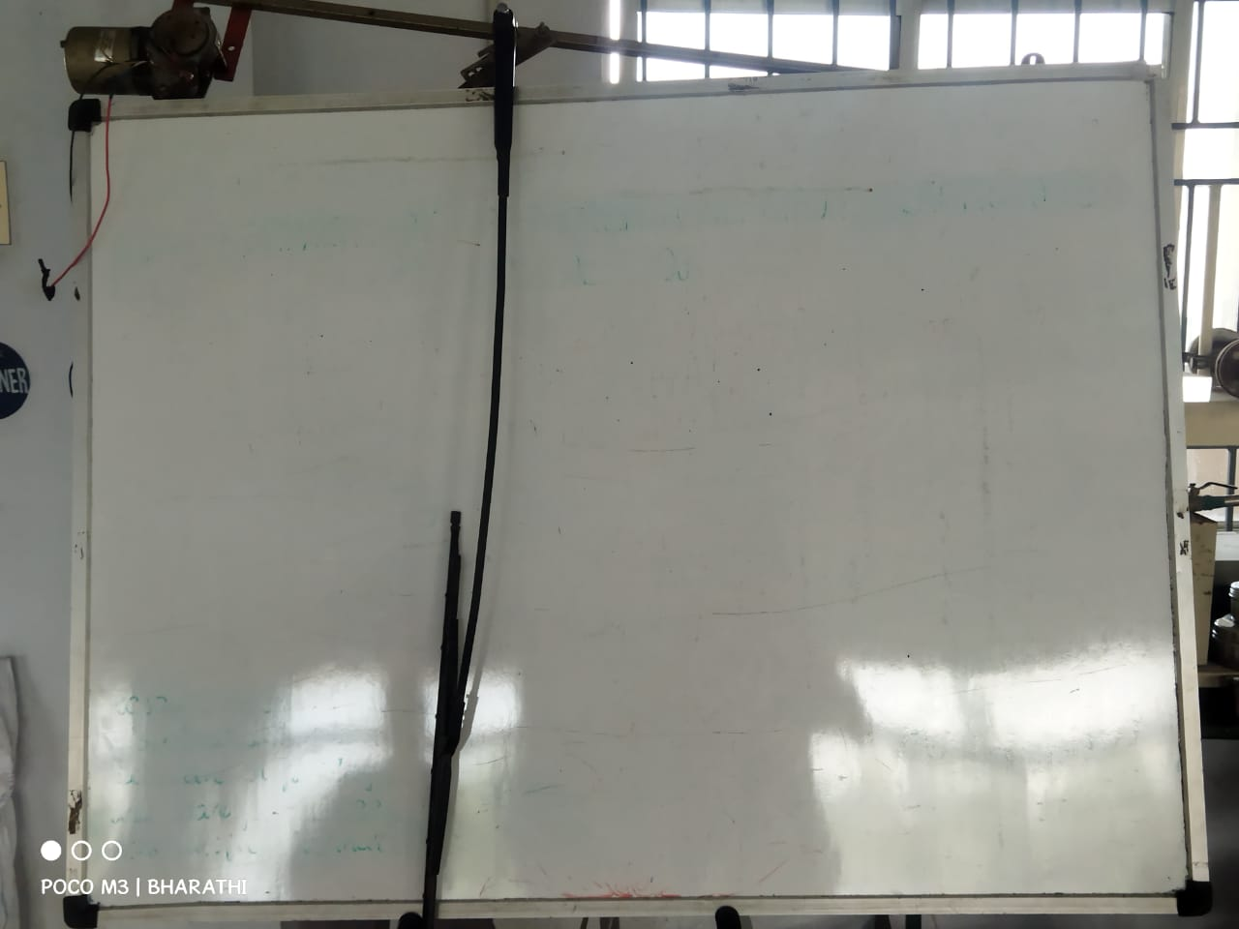
HARWARE

Slide 14

OUTCOME
As an automatic board wiper machine was designed and fabricated using low cost material and with user friendly interface.
This machine can potentially be used in class rooms to assist the teacher in keeping the board clean .

Slide 15

THANK YOU

