Slide 1

“Do I really have to learn yet another language?”
Kyle Barbary
Large parts of this talk “borrowed” from Steven G Johnson's EuroSciPy 2014 Keynote. http://julialang.org/learning/

Slide 2
The “two language” problem
High-level dynamic language for rapid development
(e.g., Python, R, Matlab, ...)
Interface code
Compiled language
for performance-sensitive code
(e.g., C, C++, Fortran)
In contrast, most of Julia's standard library is written in Julia. “Users are developers.”

Slide 3
“Just vectorize your code”?
= rely on mature external libraries
operating on large blocks of data
for performance-critical code
Good Advice! But...
Someone has to write those libraries
Eventually that person might be you
(some problems impossible to vectorize or just very awkward)

Slide 4
dynamic ≠ slow
We want a language that’s open source, with a liberal license. We want the speed of C with the dynamism of Ruby. We want a language that’s homoiconic, with true macros like Lisp, but with obvious, familiar mathematical notation like Matlab. We want something as usable for general programming as Python, as easy for statistics as R, as natural for string processing as Perl, as powerful for linear algebra as Matlab, as good at gluing programs together as the shell. Something that is dirt simple to learn, yet keeps the most serious hackers happy. We want it interactive and we want it compiled.
(Did we mention it should be as fast as C?)
– http://julialang.org/blog/2012/02/why-we-created-julia/

Slide 5
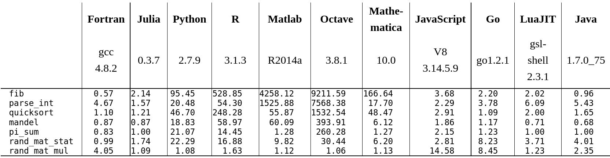
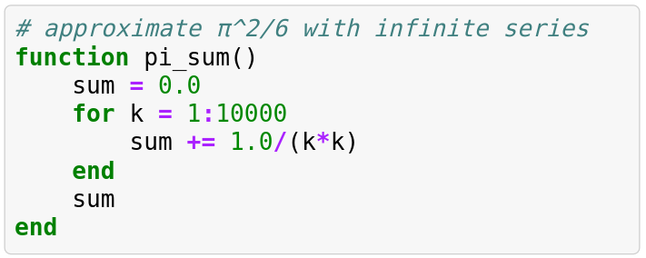
Is it fast?
times relative to C (lower is better)

Slide 6
Using Julia
Command-line REPL (Read-Eval-Print Loop):
julia
Running scripts:
julia filename.jl
Ipython/Jupyter notebook:
ipython notebook --profile julia

Slide 7
Can Python/R/etc be fast?
Maybe, but it's difficult.
goto Steven G Johnson's slides...

Slide 8
Is it for you?
Do you hate hate hate backwards compatibility issues?
The language is evolving.
Do you rely on tons of domain-specific libraries in other languages?
Native Julia package ecosystem is still young
Is speed never ever an issue for you?
There's other cool stuff, but main selling point is speed

