Slide 1
Can a quantum computer tell molecules apart?
QISKIT FALL FEST BW 2026
We gave it three molecules and three fingerprints. It matched every one, in simulation and on real IBM hardware.
Molecule A
Molecule B
Molecule C
Fingerprint 3
Fingerprint 2
Fingerprint 1
Team 23: Sevim Davul, Enes Özver, Moritz Dallinger, Yusuf Abdul Aziz, Alexander Gernert
Notes:
Here is our answer first: molecule A has fingerprint 3, B has 2 and C has 1. In the next five minutes I will show what a molecular fingerprint is, how a quantum computer can produce one, and what happened when we tried it on a real IBM machine.

Slide 2
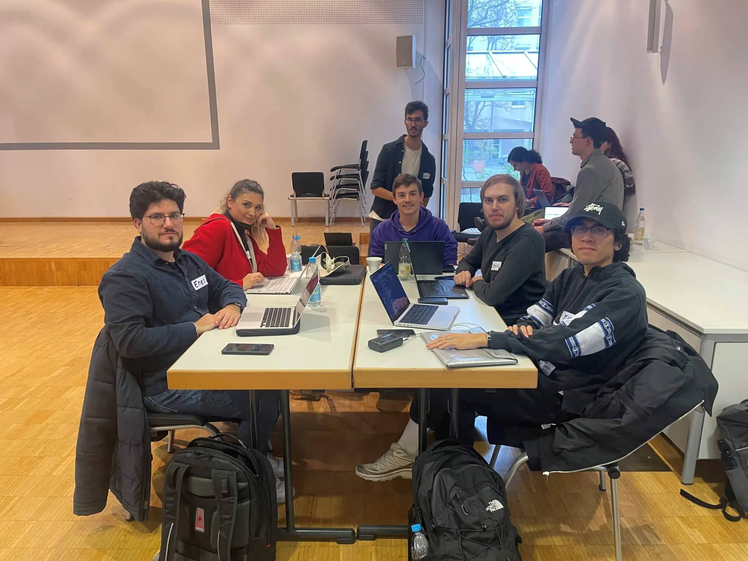
us after Leon told an unfunny joke

Slide 3
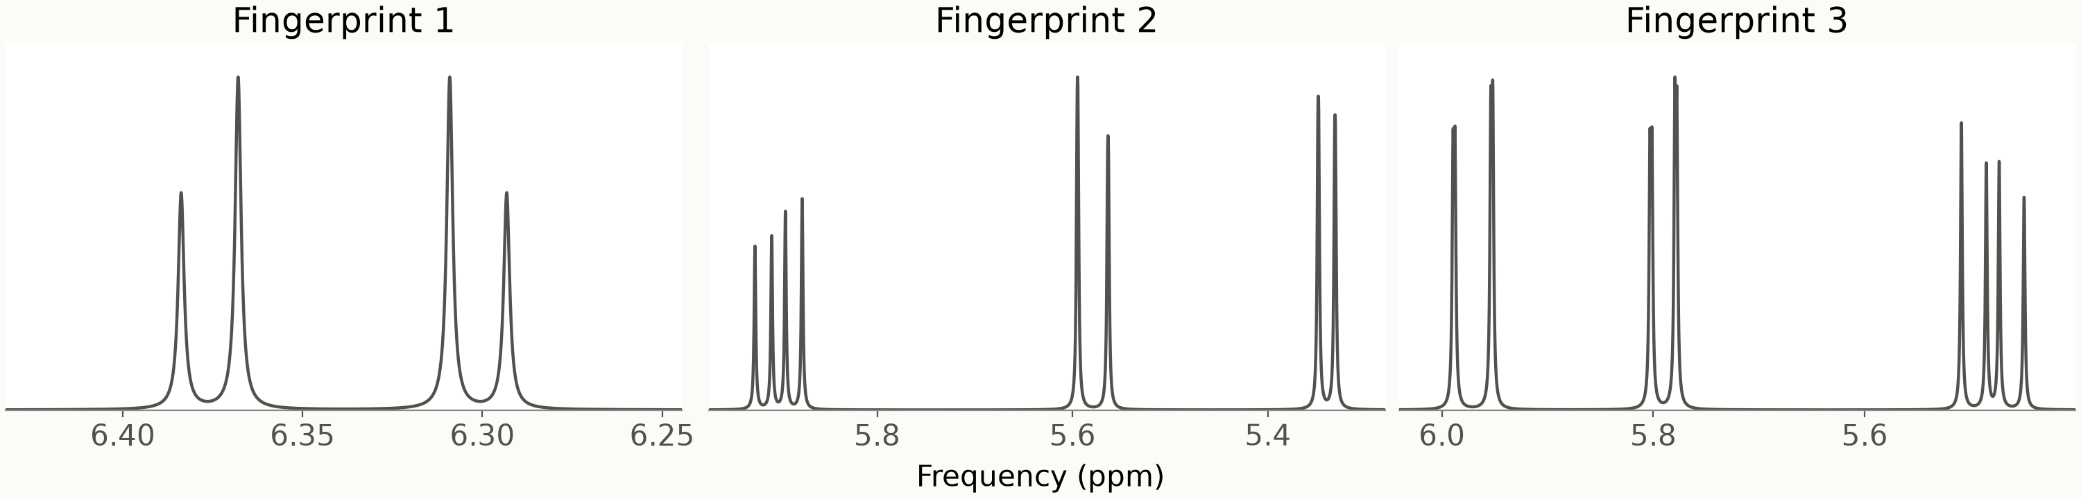
Every molecule has a fingerprint
Our task: three molecules and these three fingerprints. Which fingerprint belongs to which molecule?
Notes:
Chemists identify molecules with NMR. You place the sample in a strong magnet, and the hydrogen atoms start to spin like tiny tops. Each one rings at its own frequency, and neighbouring atoms nudge each other, which splits the peaks into small groups. The result is a pattern that is unique to the molecule, like a fingerprint. We got three molecules described as rules, and these three fingerprints, and had to match them.

Slide 4
We let qubits play the atoms
Atoms become qubits
Rules become gates
Signal becomes peaks
One qubit represents a hydrogen atom
Atomic interactions visualized as a quantum circuit
Oscillations are calculated into peaks
Notes:
Here is the idea in four steps. Each hydrogen atom becomes one qubit. The rules of how the atoms push on each other become gates in a quantum circuit. Then we let time run forward in small steps, a bit like the frames of a film, and after every step we record a signal. Finally, a Fourier transform turns that recording into peaks, the same way an app turns a sound into its notes.

Slide 5
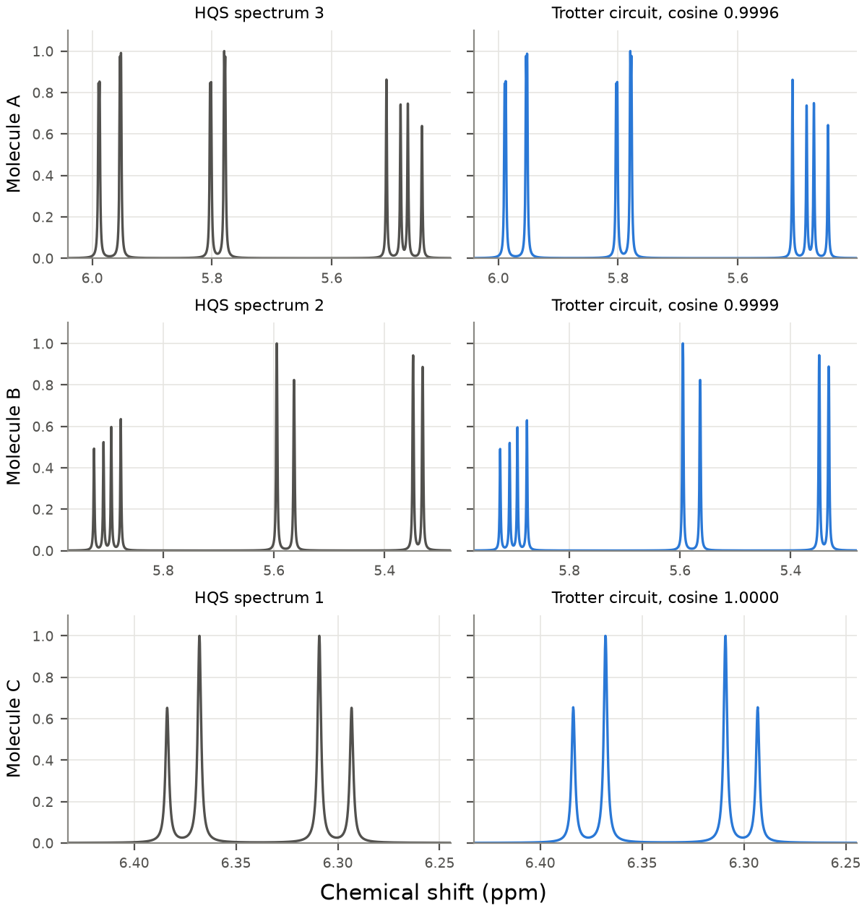
Our fingerprints match the answer key
Reference
NMR spectrum
Simulated
Quantum Computer
Notes:
Left is the fingerprint we were given, right is the one our circuit produced. They look the same, and the numbers agree: the right pairs match by 99.9 percent, while the wrong pairs score almost zero, so there is no doubt about the answer. One small piece of detective work helped: the answer key had been blurred by exactly one hertz. Once we used the same blur and recorded longer, the match went from good to almost perfect.

Slide 6
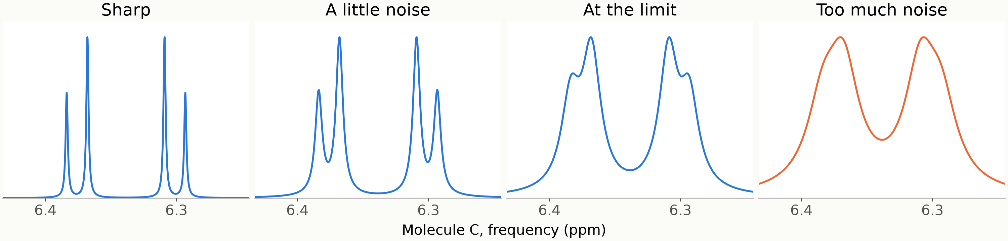
Noise blurs the fingerprint
Notes:
The challenge asked how much noise a fingerprint can take. Noise acts like blur. Here is molecule C with more and more of it: first sharp, then softer, then at the limit, and finally the small side peaks have melted away. The rule is simple: peaks merge once the blur is wider than the gap between them, and those gaps come from how strongly neighbouring atoms pull on each other. All three molecules stay readable up to about eight to nine times the blur of the answer key. A sharpening trick that chemists use buys about 1.8 times more.

Slide 7
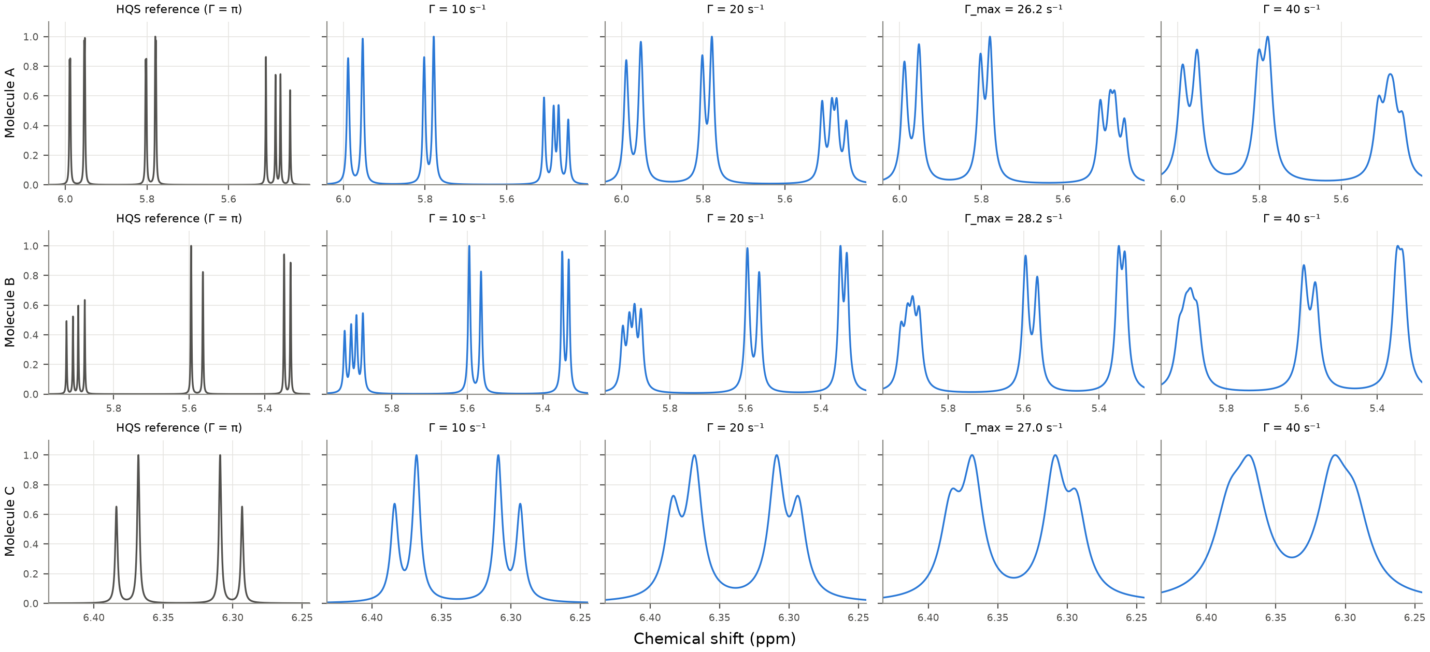
All three molecules, from sharp to blurred
Γ is the amount of blur, per second. Left: the answer key (Γ = π). Right: more noise. The fourth column is each molecule’s limit.
Notes:
Here is the same test for all three molecules. Each row is one molecule. On the left is the answer key, and to the right we add more and more blur. You can watch the small peak groups soften and finally melt together. The fourth column is the limit for each molecule, at about 26 to 28 units of blur. Beyond that, at 40, the fine structure is gone.

Slide 8
Making it fit a real quantum computer
Every gate on real hardware adds a small error. Goal is to minimize gates and errors.
72 → 18
gates per time step. We group the pieces that do not get in each other’s way, with the same accuracy.
8 → 4
experiments per time step. A mirror symmetry means half of them are copies we can skip.
Fewer steps
win on noisy hardware. Finer steps are more precise on paper, but each one adds more errors.
Notes:
A real quantum computer makes a small mistake with every gate, a bit like photocopying a photocopy. So we made the circuit lean. First, we grouped the parts of the problem that do not interfere with each other, which cut the gates per time step from 72 to 18 without losing accuracy. Second, a mirror symmetry in the problem means half of the experiments are copies, so we skip them. And third, we found that on noisy hardware, fewer and coarser steps actually give the better result.

Slide 9
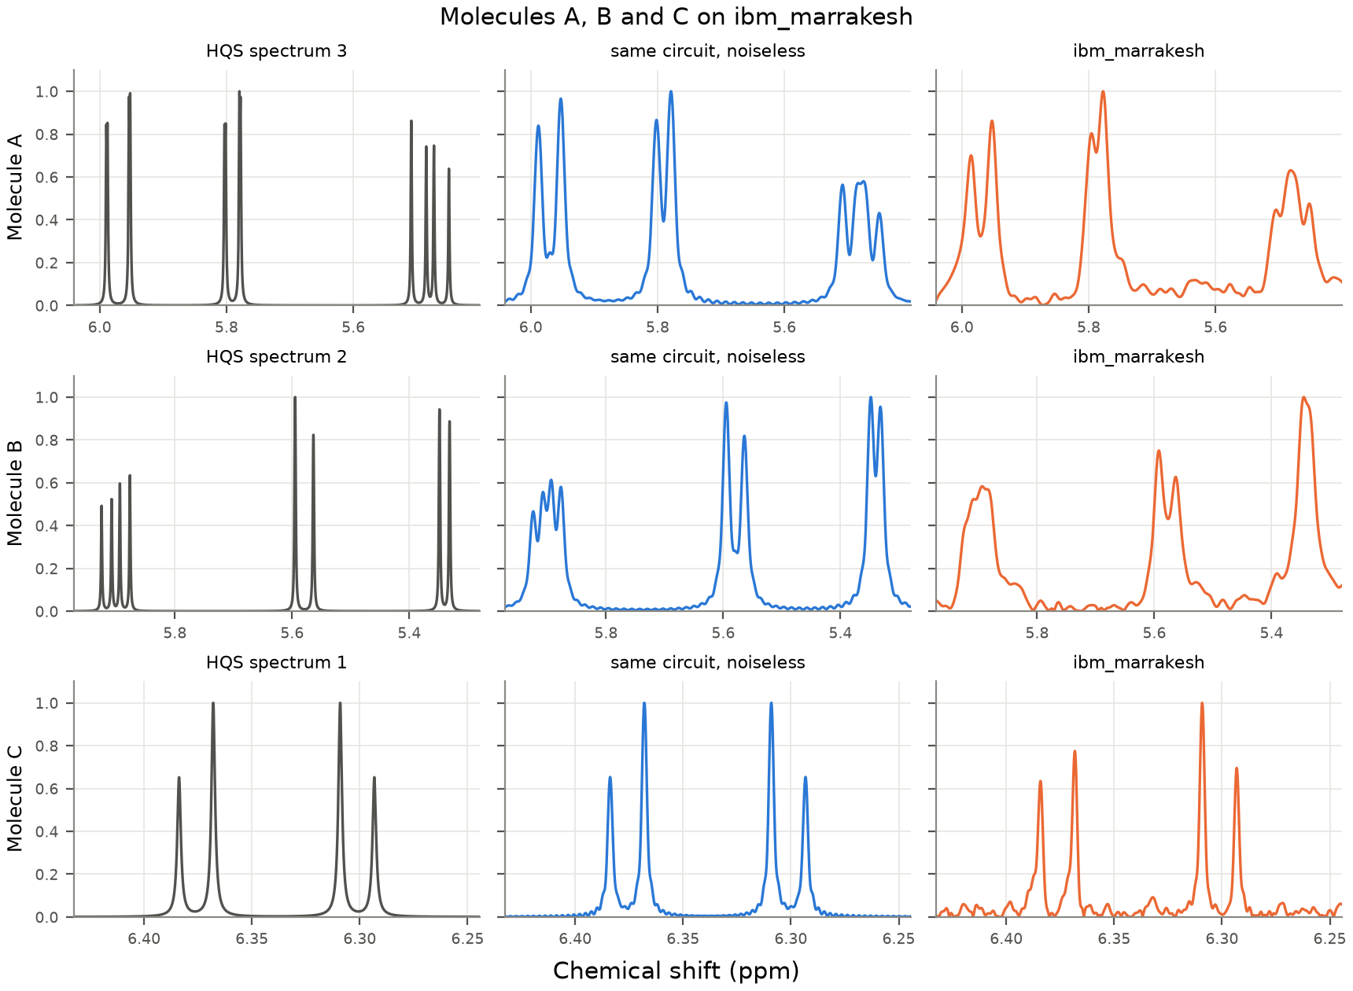
It works on a real IBM quantum computer
Notes:
Then we ran it on a real IBM quantum computer called ibm_marrakesh. Each row shows the given fingerprint, our circuit without errors, and what the machine measured. All three molecules picked the right fingerprint, with a clear gap to the wrong ones. The small molecule C came out almost perfect. A and B need much longer circuits, up to about 800 two-qubit gates, so we recorded a shorter signal. That is enough to recognise each molecule, but not to see every small detail.

Slide 10
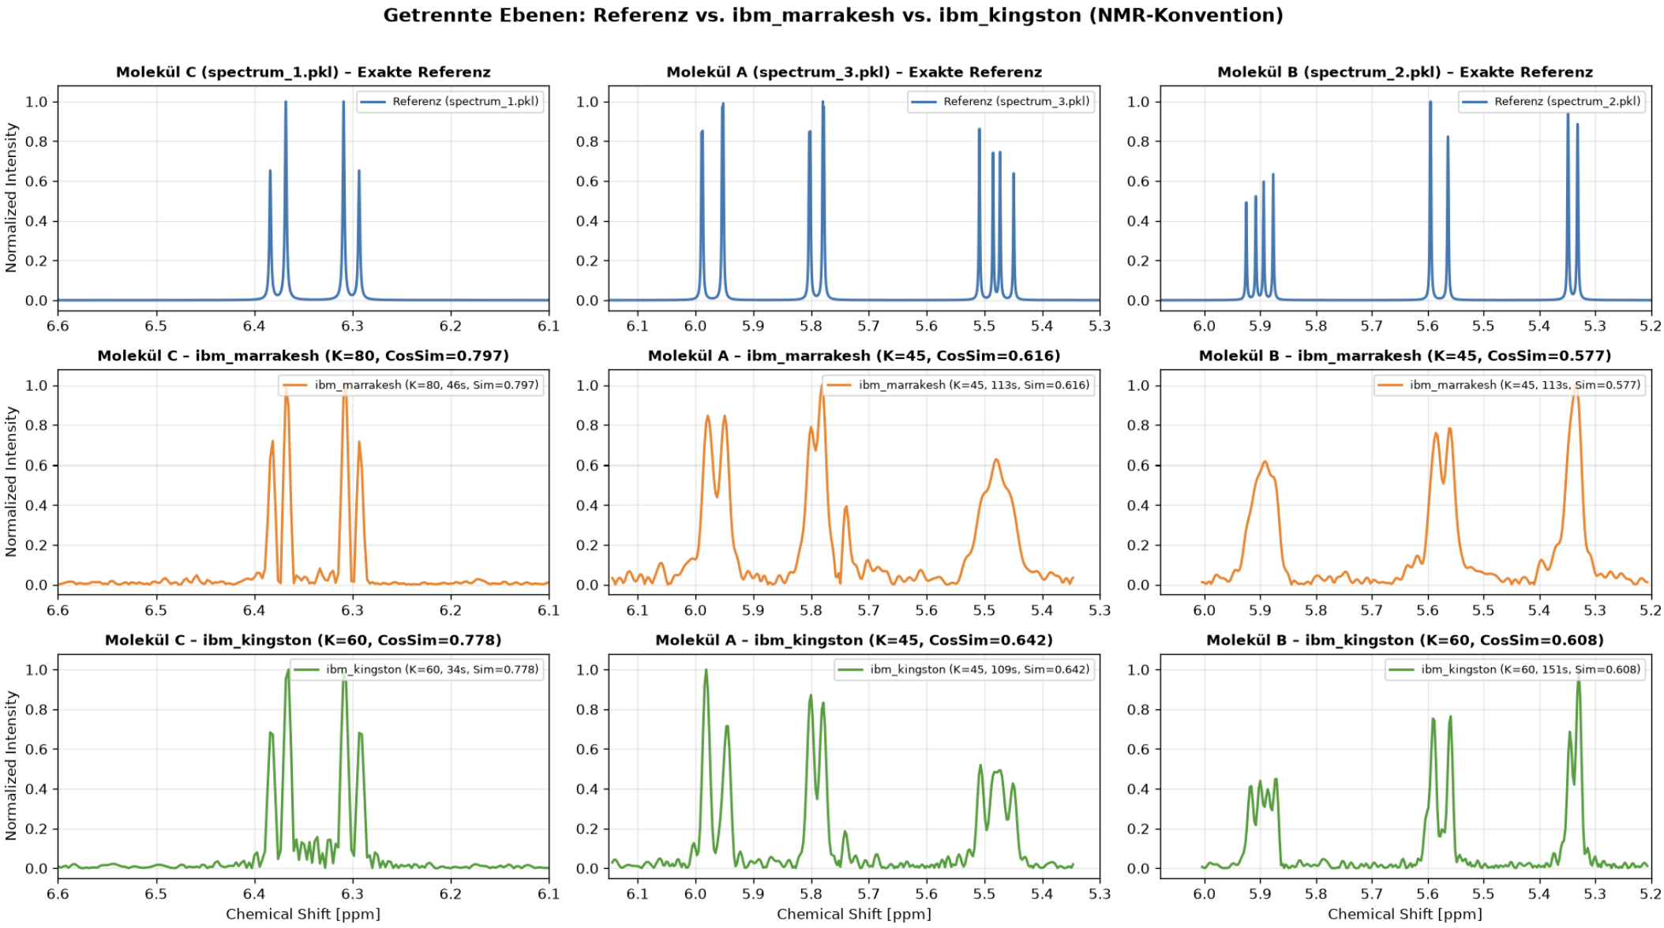

Slide 11
What we learned
A quantum computer can already recognize small molecules by their fingerprint.
Noise sets the limit and the closest peaks decide how much noise is too much.
Error mitigation makes quite a difference.
Notes:
To sum up. A quantum computer can already recognise small molecules by their fingerprint, and we showed it on real hardware. Noise is the limit, and how much noise a molecule can take depends on its closest peaks. Bigger molecules need longer circuits than today’s machines run cleanly, and that is exactly where leaner circuits like ours help. Everything is in our notebook, which runs in under a minute. Thank you.

