Slide 1
⌇
Resonance
A contemplative listening room. Generative audiovisual, music-led, slow time.
INSTALLATION BRIEF | KAREL BARNOSKI | MAY 2026

Slide 2
WHAT IT IS
A generative audiovisual instrument. Music-led. Slow time.
A composed piece of music drives real-time audio-reactive shaders and AI-curated imagery, producing a 20–40 minute slow-moving visual landscape that never repeats verbatim.
Originally built for personal listening. Scales naturally to a shared room: same engine, same patience, just larger and quieter.

Slide 3
THE ROOM
Planetarium vibes. A dark space, audience reclining, eyes up.
SPACE
12×12 ft to 30×40 ft. Dome geometry welcome.
FLOOR
Mats and pillows. No chairs.
DISPLAY
Single overhead projection, dome, or large wall display.
AUDIO
4-corner speaker array. Stereo as a baseline.
FLOW
Visitors enter and leave on their own time. No timed entry. No headphones. No narration.

Slide 4
THE PIECE
A single ~30 minute Path.
Three to five composed tracks, threaded into one continuous arc.
01
02
03
04
Threshold
Expansion
Apex
Return
Open in near-silence. Single tone. Near-black field.
Imagery surfaces. Music builds. Caustics, mandalas, figures.
Full motion and color. The room is loud and alive.
Settle back toward stillness. Cycle resolves and begins again.

Slide 5
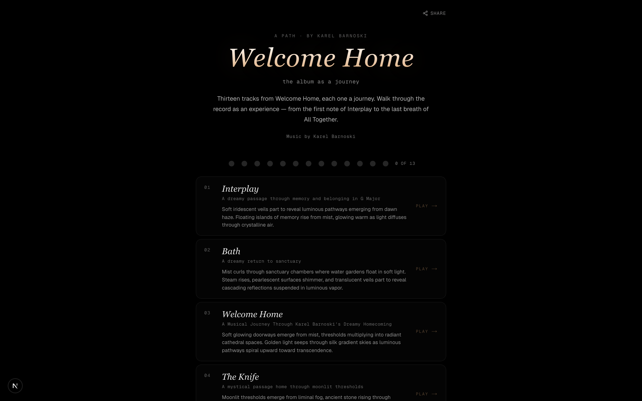
SHAPE OF THE WORK
Welcome Home — thirteen tracks, one ~30-minute path through the album

Slide 6
WHAT A VISITOR EXPERIENCES
Enters a dark room. Lies back. The first phase opens with a single low tone and a near-black field — slow caustics, the faint hint of a mandalic form. Imagery surfaces gradually as the music builds: water, light, figures that resolve and dissolve. Around the apex the room is full of motion and color; then everything settles back toward stillness. The visitor leaves when ready.

Slide 7
REFERENCES
A small canon.
Brian Eno
James Turrell
Ryoji Ikeda
77 Million Paintings
Skyspaces (1974— )
test pattern · data.matrix
Generative visual companion to ambient music. Proof that slow time finds an audience.
The dark contemplative room as primary form. No narrative scaffolding. Pure perception.
Sound and light as total sensorium. Room-scale, durational, austere.

Slide 8
WHERE IT DIFFERS
Composed first. AI second.
The AI-image installation has become a genre — Anadol-flavored generative spectacle, large-format, often impressive, often hollow.
Resonance is the inverse. Each track is a written piece of music with intent. The visuals serve the music, not the other way around. AI sits inside the journey as a tool. It is not the headline.

Slide 9
WHY NOW
Slow attention is having a moment.
Hiroshi Yoshimura's Music for Nine Post Cards hit the Billboard charts in 2024 — fifty years after release. Ambient music is mainstream again.
Planetariums are reclaiming a cultural foothold. Hayden, Adler, and Morrison have all renovated and reopened their domes for contemporary programming.
Sleep No More-era audiences trained themselves on long-form, low-direction experiences. The patience is back.

Slide 10
WHO
Karel Barnoski
Pianist · Composer · Designer
Pianist and composer. Released Welcome Home, a solo piano album self-produced during quarantine — the source material for many of the journeys in Resonance.
Design Director at Workday. 15+ years leading UX for enterprise products at Workday, GE, and Kodak. BFA Illustration and MFA Computer Graphics from RIT, with classical training from Barnstone Studios.
Founder of 2octave, an audio design studio specializing in product sonification. Award-winning sounds for products from digital cameras to kitchen appliances. Published in UX Magazine on the science of sound in product design.
Resonance is the current shape of a multi-year practice translating composed music into shared visual experience. The installation is the natural next room.

Slide 11
THE ASK
Let's talk.
A one-night event. A multi-week run. A residency. A slot in an existing program. A conversation. Whatever shape the fit takes.
Happy to ship a working prototype, or install in person.
kbarnoski@gmail.com
getresonance.vercel.app

